Slide 1
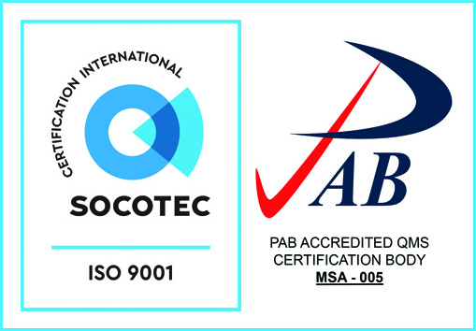
AquaPick: A Mobile Application for Water Stations in Calbayog City
Sales, John Errol M.
‎Villamor, Jay Vincent P.
‎Panugaling, Heizel D.
‎Rodriguez, John Cedrick N.
‎Isanan, Margaux S.
‎
Rueda Street, Calbayog City, Samar, Philippines | +63 (055) 533 9857 | main@nwssu.edu.ph | www.nwssu.edu.ph

Slide 2
Project Context
The beneficiary of this is the water stations in Calbayog City
It helps customers find water stations near them
Users can order water, see prices, and pay using the app or cash on delivery

Slide 3
Statement of the Problem
Difficulty in finding nearby water stations in Calbayog City
Manual ordering process causes delays and miscommunication
Limited access to information on prices and available products
No centralized system for easy ordering and payment
Water station owners struggle to manage orders and track sales

Slide 4
Proposed Solution
Develop Aquapick mobile application
Provide list of nearby water stations
Enable easy ordering of water products
Offer multiple payment options (online or cash on delivery)
Help water station owners manage orders and sales

Slide 5
Objectives
To design a user-friendly UI/UX
To allow users to register accounts & locate water stations
To provide payment options to users such as online payment or cash on delivery
To manage ordering or sales for water stations
To provide water station owners with tools to manage orders and monitor sales

Slide 6
System Functions
Users registration and login system
Can search nearby water refilling stations
View available water products and prices
Place orders through the mobile application
Select payment method (online payment or cash on delivery)
Order management system for water station owners
Sales tracking and monitoring

Slide 7
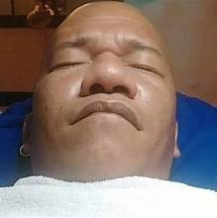
THANKYOU FOR LISTENING<3

