Slide 1
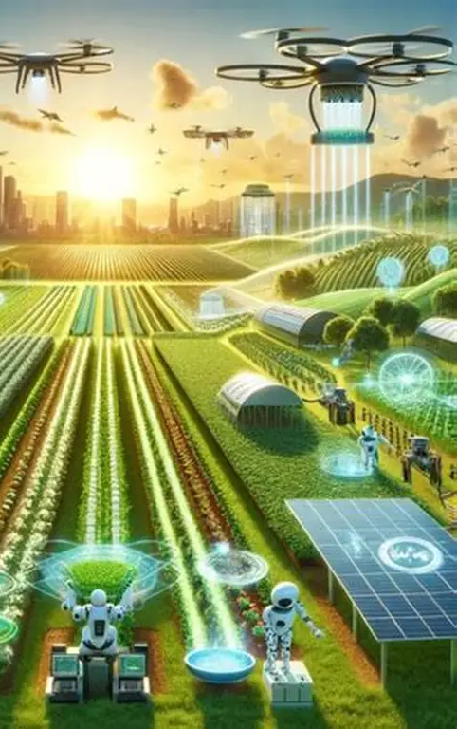

BY TEAM SVD SYNAPSE · FOR IDEALIZE 2026 MINI COMPETITION
SaruNena AI
Smart Multi-Agent Farming Assistant
An AI-powered agricultural decision system built to empower Sri Lankan farmers with real-time intelligence, disease detection, and actionable insights.
Notes:
Good morning judges. We present SaruNena AI, a multi-agent intelligent farming assistant designed to help Sri Lankan farmers make better agricultural decisions.

Slide 2
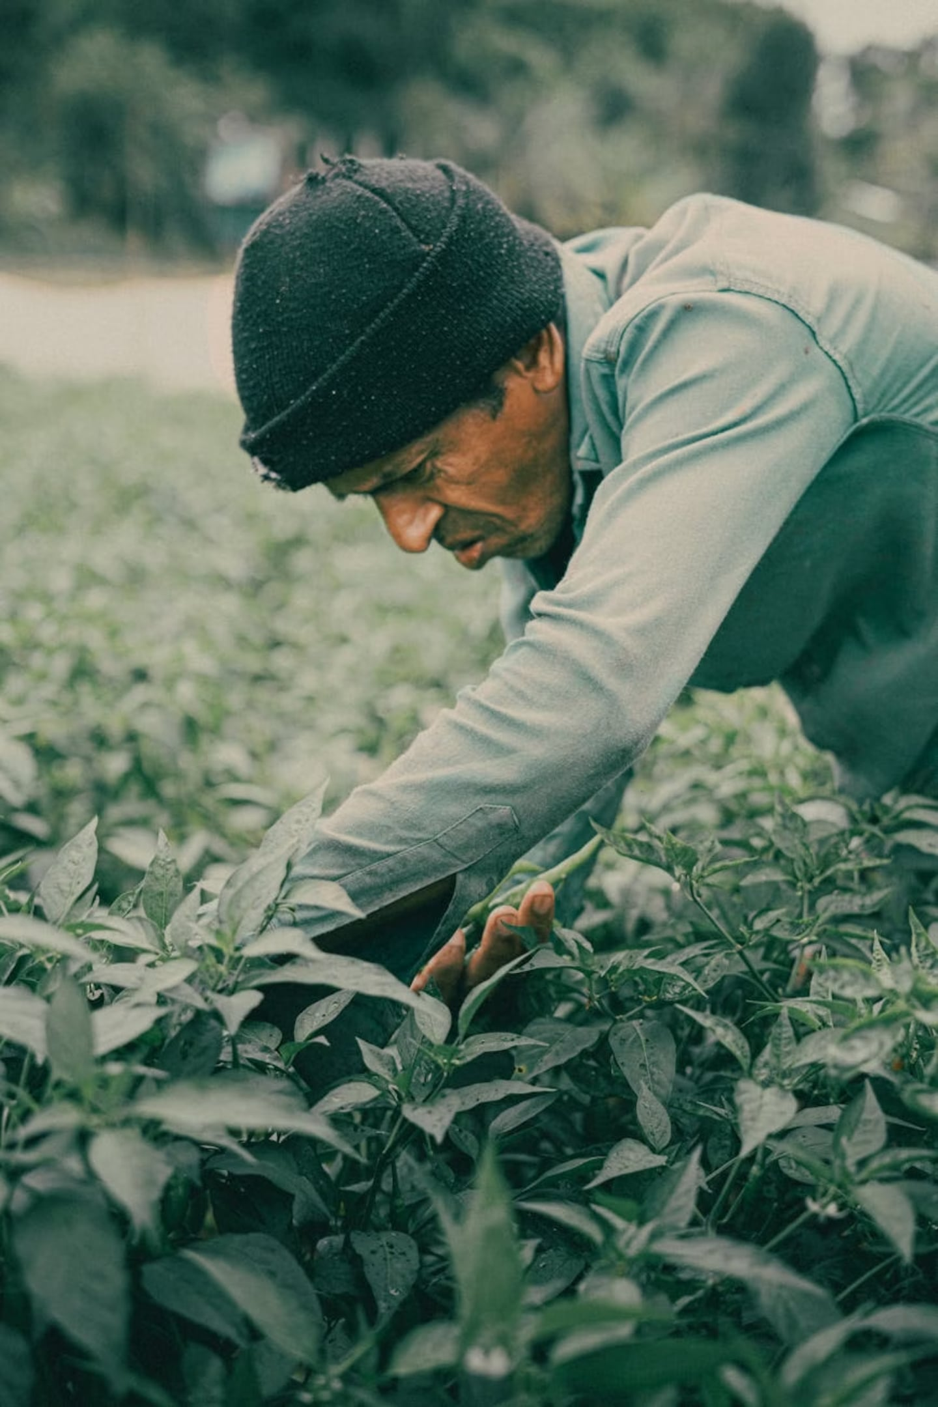
Challenges Faced by Farmers
Sri Lankan farmers operate with limited information — making critical decisions based on guesswork rather than data.
Unpredictable Weather
No localized forecasts to plan planting or harvesting cycles.
Late Disease Detection
Crop diseases identified too late, causing preventable yield loss.
No Market Intelligence
Farmers lack real-time price data to negotiate fair sales.
Manual Dependency
Decisions rely solely on experience — no digital decision support.
Notes:
Farmers currently rely on experience and delayed information, which leads to poor decisions and reduced productivity.

Slide 3
Introducing SaruNena AI
A multi-agent AI system that transforms raw agricultural data into clear, actionable farming intelligence — all in one platform.
Live Weather Analysis
Disease Detection
Real-time API data for location-specific climate insights.
Logic-based crop disease risk analysis before damage spreads.
Market Insights
Farm Risk Scoring
Current price data to help farmers maximize returns.
Consolidated risk index combining weather, disease, and market factors.
Smart Recommendations
Location Intelligence
Personalized, context-aware farming guidance generated on demand.
Geo-aware processing tailored to each farmer's region.
Notes:
Our system combines multiple AI agents that work together to provide real-time farming guidance.

Slide 4
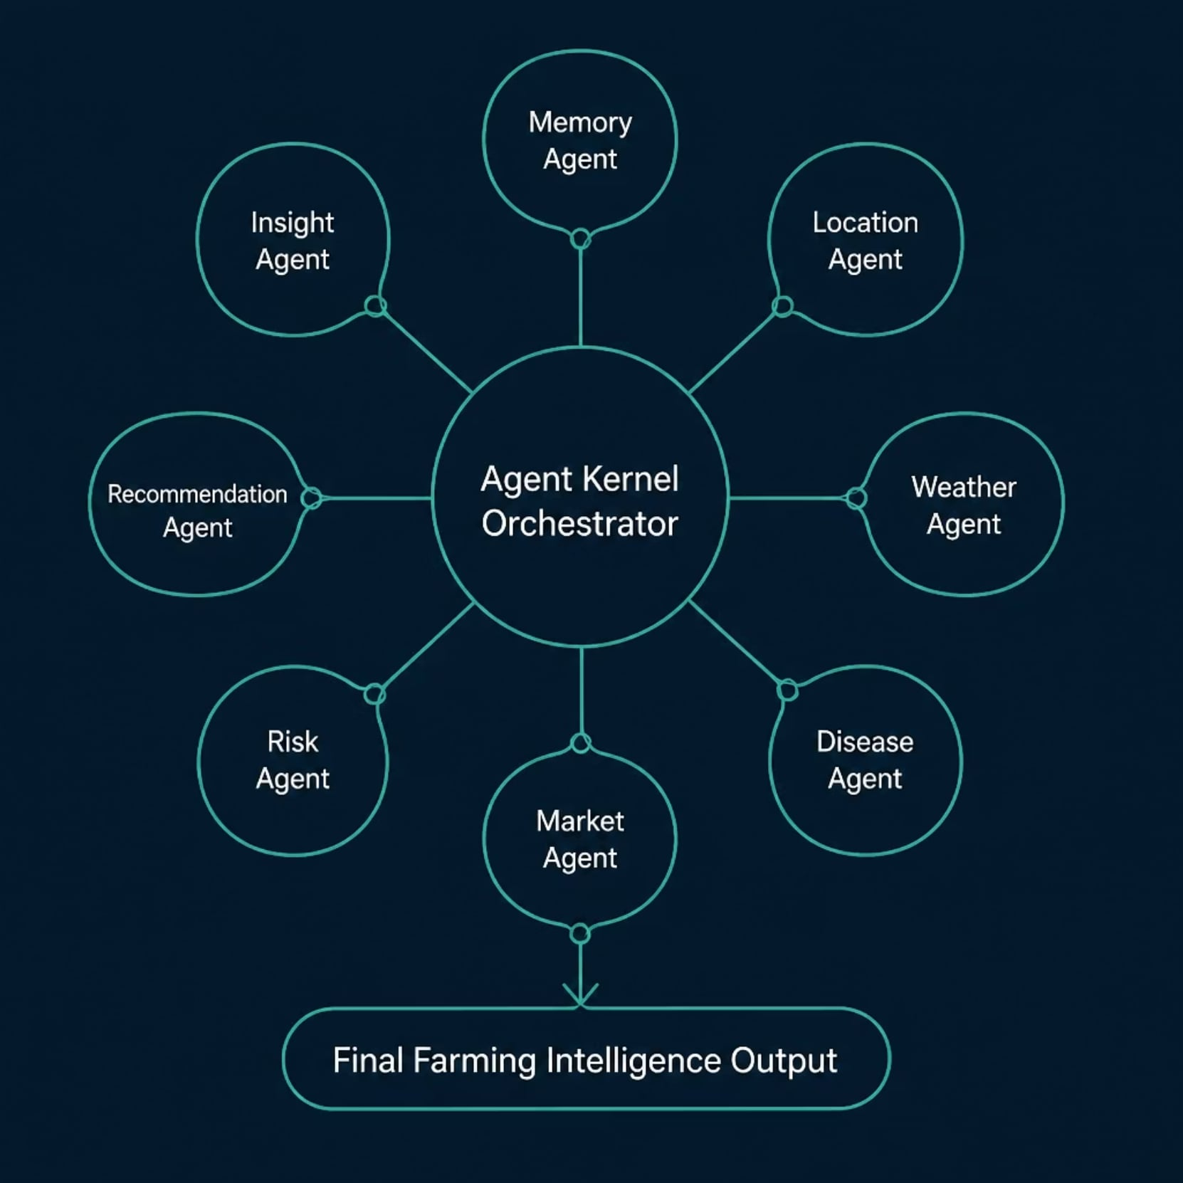
Multi-Agent System Architecture
SaruNena AI uses a modular agent kernel — each agent specializes in one domain, and the orchestrator synthesizes their outputs into unified farming intelligence.
Memory Agent
Location Agent
Weather Agent
Disease Agent
Stores and retrieves farmer context
Geo-processes input regions
Fetches live climate data
Analyzes crop health risks
Market Agent
Risk Agent
Recommendation Agent
Insight Agent
Delivers price intelligence
Calculates composite risk scores
Generates actionable guidance
Provides AI-powered summaries
Notes:
Each agent handles a specific task, and all agents work together through a central orchestrator to generate intelligent farming advice.

Slide 5
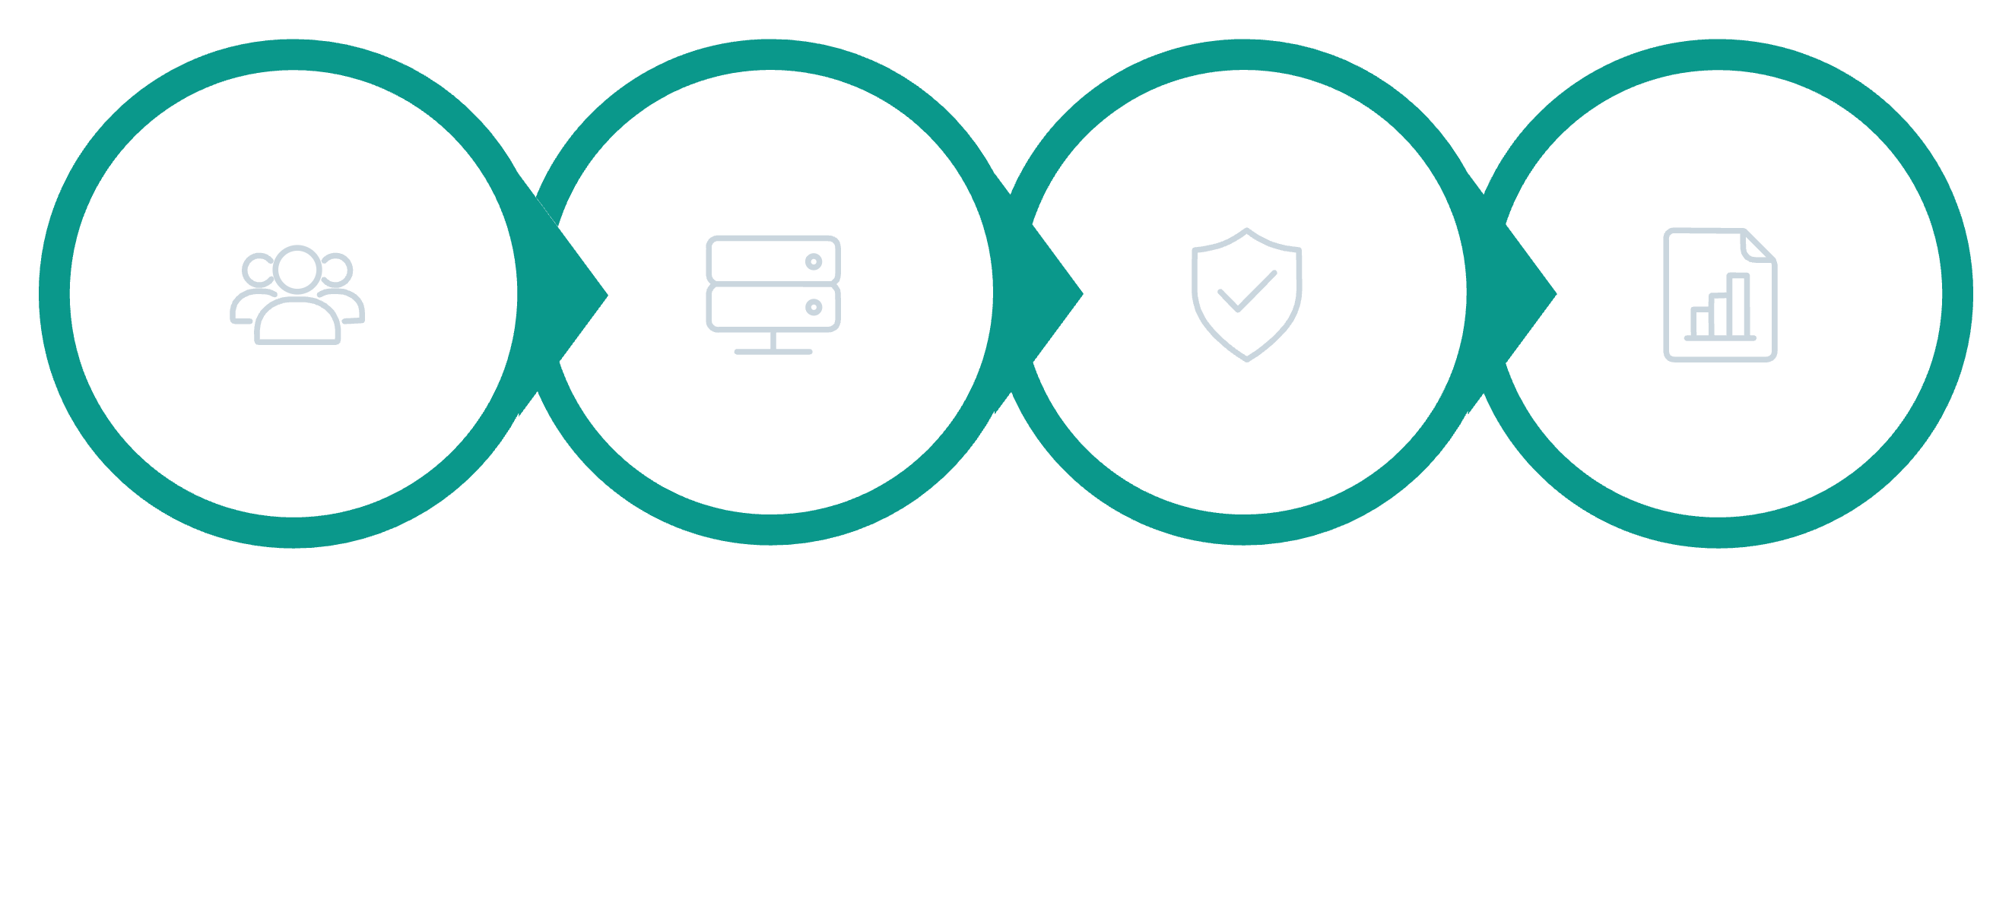

Live System Workflow
A farmer enters a simple query — SaruNena AI handles the rest, delivering a complete intelligence report in seconds.
Risk & Recommend
Farmer Input
Agent Kernel
Final Output
Example Output: Location detected · Live weather fetched · Disease risk analyzed · Market price displayed · Risk score: 72/100 · Recommendation generated · AI insight provided
Notes:
When a farmer enters a crop and location, the system processes multiple AI agents to generate a full farming report.

Slide 6
Technologies Used
SaruNena AI is built on a lean, modern stack designed for reliability, speed, and scalability in low-resource environments.
Python
Flask
Core language for all agent logic and data processing.
Lightweight web framework powering the UI and API layer.
Open-Meteo API
JSON Memory
Free, accurate weather data for any location worldwide.
Lightweight structured storage for farmer context and history.
HTML + CSS
Agent Architecture
Clean, responsive interface accessible on basic devices.
Modular, extensible design enabling independent agent scaling.
Notes:
We used lightweight but powerful tools to ensure fast and scalable AI processing.

Slide 7
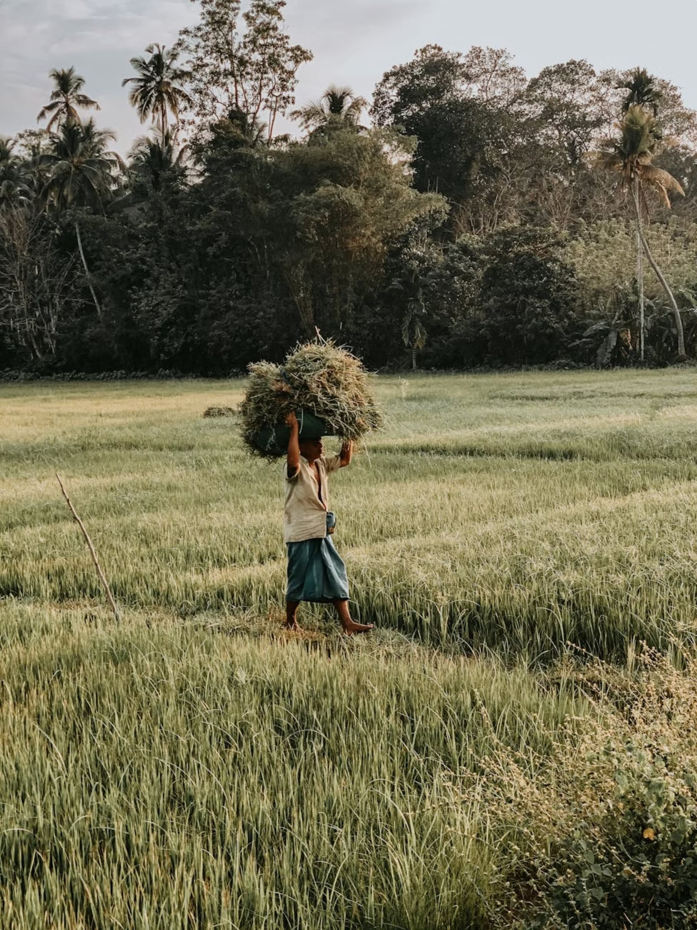
Real-World Impact
SaruNena AI bridges the gap between traditional farming and modern technology — putting data-driven decisions directly in farmers' hands.
1. Smarter Decisions
Farmers act on live data rather than intuition
alone.
2. Reduced Crop Loss
Early disease and weather warnings prevent
preventable losses.
3. Real-Time Insights
Market and climate data delivered instantly, not
days later.
4. Data-Driven Farming
Builds a culture of evidence-based agricultural
practice.
Smarter Decisions
Reduced Crop Loss
Farmers act on live data rather than intuition alone.
Early disease and weather warnings prevent preventable losses.
Real-Time Insights
Data-Driven Farming
Market and climate data delivered instantly, not days later.
Builds a culture of evidence-based agricultural practice.
Notes:
Our solution directly contributes to global sustainability goals by improving agricultural productivity.

Slide 8
Future Enhancements
SaruNena AI is designed to grow. Our roadmap focuses on accessibility, language inclusion, and deeper AI capabilities.
WhatsApp Integration
1
Deliver alerts and recommendations directly via WhatsApp for maximum reach.
2
Voice Assistant
Voice-based AI interaction for farmers with limited literacy or smartphone access.
Image Disease Detection
3
Upload crop photos for AI-powered visual disease identification.
4
Market Prediction
Predictive analytics to forecast price trends and optimize harvest timing.
Local Language Support
5
Full Sinhala and Tamil language interfaces for nationwide accessibility.
Notes:
In the future, we aim to make the system more accessible through mobile and multilingual support.

Slide 9
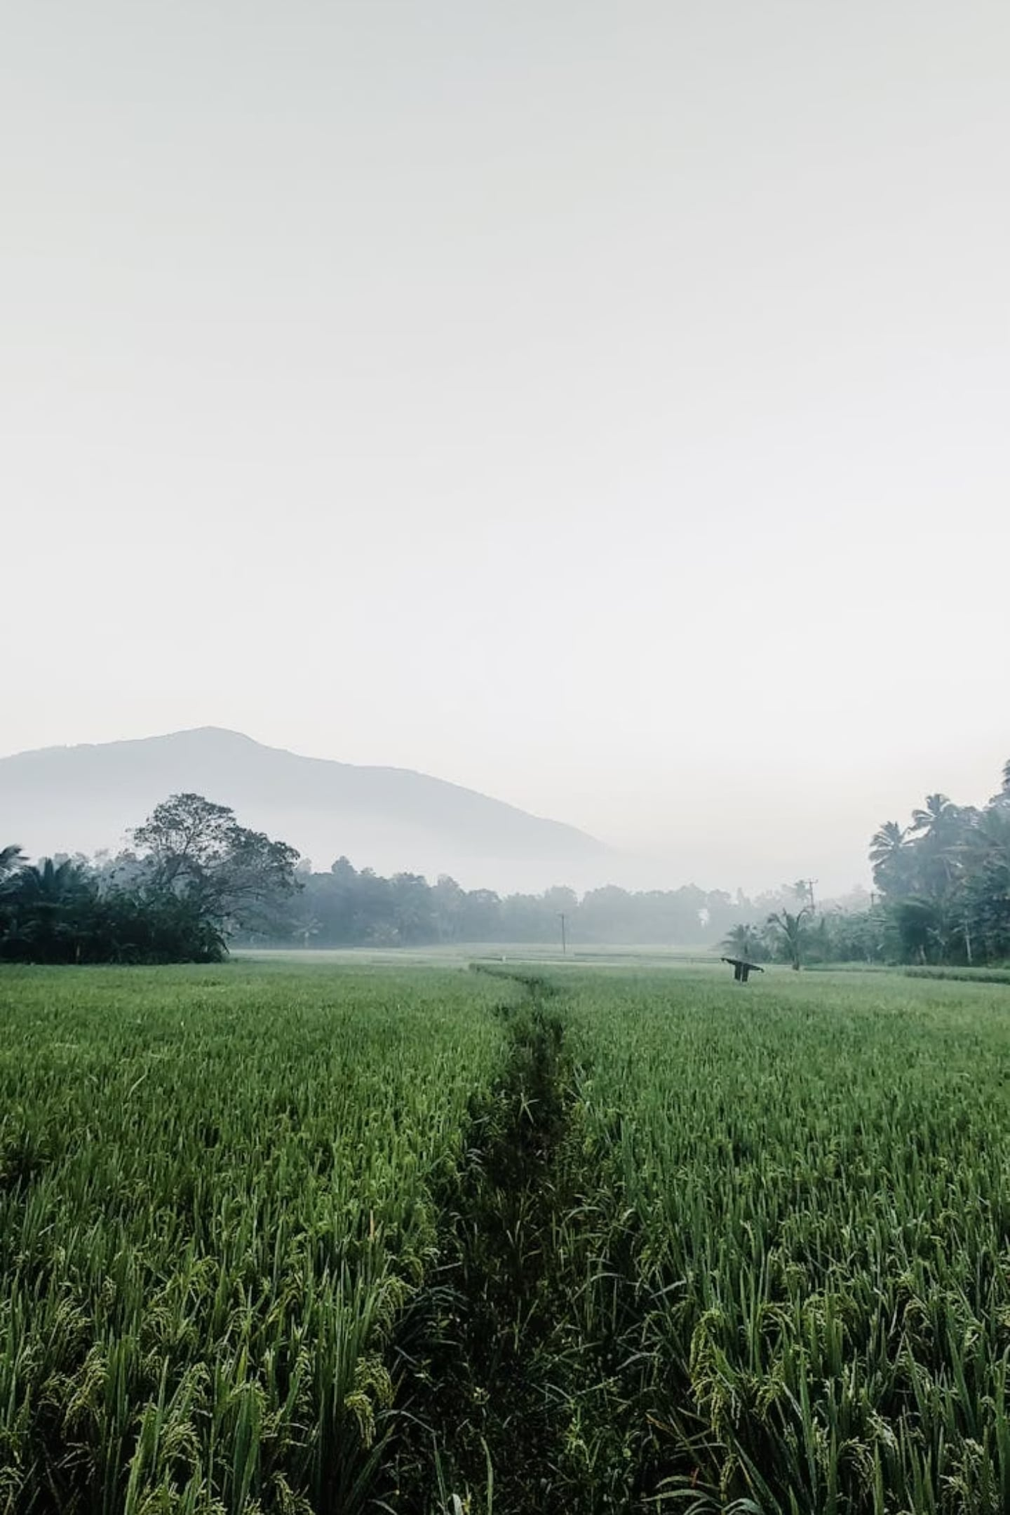
CREATED BY,
SINURA PERERA
VIHAS KODITHUWAKKU
TEAM SVD SYNAPSE · IDEALIZE 2026
Smart Farming for a Smarter Future
SaruNena AI
Empowering every Sri Lankan farmer with the intelligence to grow more, lose less, and earn better — one field at a time.
🌾 Multi-Agent AI
⚡ Real-Time Data
8 specialized agents working in harmony
Live weather, market, and risk intelligence
🇱🇰 Built for Sri Lanka
Designed with local farmers in mind
Notes:
Thank you for your time. We are ready for your questions.

