Slide 1

Opinion Mining
Presented by: Sinya
Notes:
Good evening
I am Sinya

Slide 2
Outline
Survey of Opinion Mining
Clustering Product Features for Opinion Mining
Introduction
Related Work
Algorithm
Evaluation
Conclusions
Comments
2
Notes:
First I am going to introduce my current research topic and then I will introduce a related paper.

Slide 3
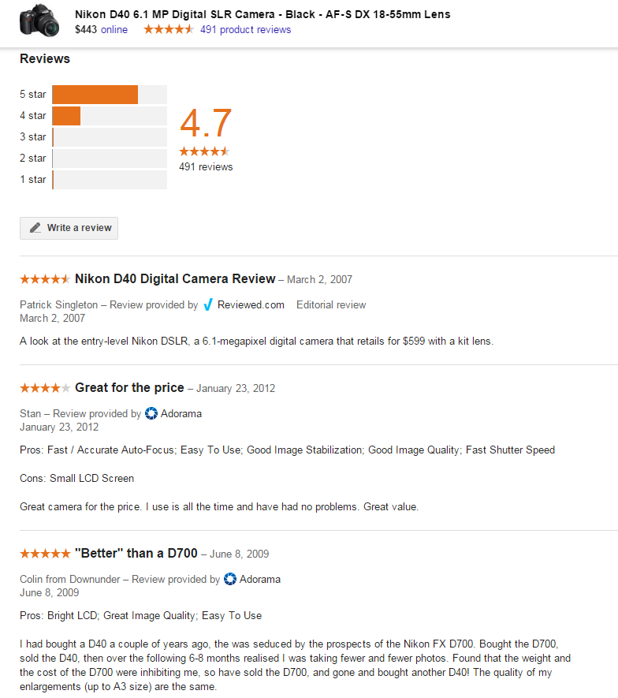
https://www.google.com/shopping/
Notes:
My topic is opinion mining
This is a screenshot from a Google Shopping website.
It is convenient for us to fast refer to those opinions on certain object.

Slide 4

Review Model
This camera has good auto-focus, and the picture quality of this camera is awesome …
but it is bad in shape.
object
This camera has good auto-focus, and the picture quality of this camera is awesome, but it is bad in shape.
review
sentence
sentence
segment
sentence
sentence
sentence
segment
customer
Score
(opt.)
Feature/Aspect
(word or phase)
Opinion word
(word or phase)
Not Equal
Sentiment Orientation Evaluation
Notes:
We take a deep look into a piece of opinion, “This camera has good auto-focus, and the picture quality of this camera is awesome …”
Not all opinion gives customer score, customer score usually given in product opinion
But opinion can also be field of political debate which we don’t give score, so this part is optional
Let’s look into this review, it can split into sentences and the sentence is grouped by many words and phases, the information we want is in these segments, which we called Feature and Opinion word.
Having opinion word we can mining the Sentiment Orientation Evaluation
Some research involved in these part.

Slide 5
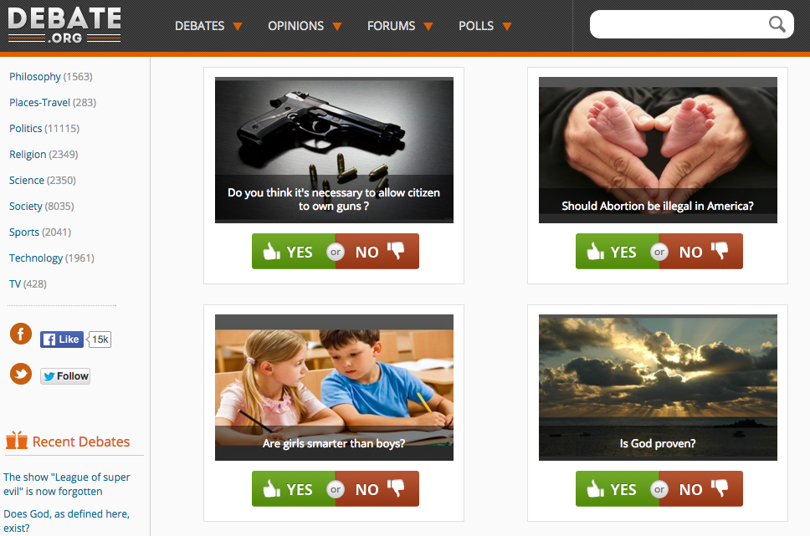
http://www.debate.org/opinions/

Slide 6
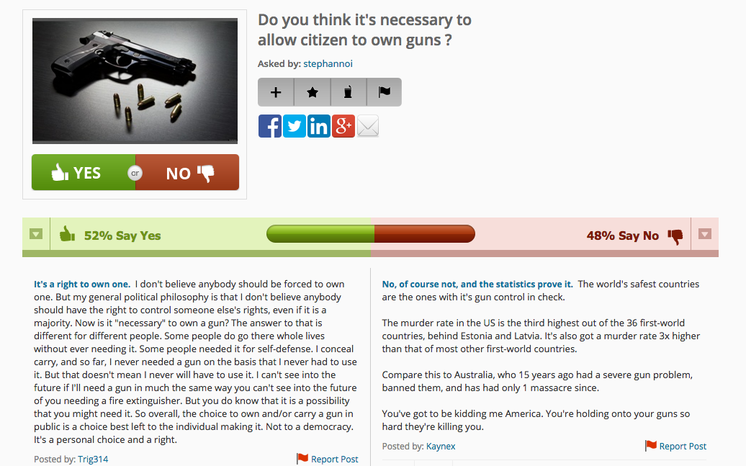
http://www.debate.org/opinions/
Notes:
These are opinions on Nikon camera,
http://www.debate.org/opinions/
Beyond expressing our opinions in isolation, we also like to comment, argue, discuss and debate.
These are opinions too but of a slightly different type

Slide 7
Roadmap
Sentiment Analysis and Opinion Mining
Document sentiment classification
Sentence subjectivity & sentiment classification
Aspect-based sentiment analysis
Mining comparative opinions
Opinion spam detection
Beyond Sentiments
Notes:
Here is the roadmap of recent research
Sentiment analysis and opinion mining
Computational study of opinions, sentiments, and emotions expressed in text
A popular research topic in Neuro-linguistic programming(NLP), text and Web mining

Slide 8
Aspect-based Sentiment Analysis
Review 1
“I bought an iPhone a few days ago. It is such a nice phone,…”
Review 2
“ The touch screen is really cool. The voice quality is clear too. It is much better than my old Blackberry,…”
Review 3
“ However, my mother was mad with me as I did not tell her before I bought the phone. She also thought the phone was too expensive, …”
….
Feature Based Summary of iPhone:
Feature1: touch screen
Positive: 212
The touch screen was really cool.
The touch screen was so easy to use and can do amazing things.
…
Negative: 6
The screen is easily scratched.
I have a lot of difficulty in removing finger marks from the touch screen.
…
Feature2: voice quality
…
Note: We omit opinion holders
8
Notes:
Find a structure from the unstructured text.
The input is...
The opuput is...

Slide 9
Aspect-based Sentiment Analysis
+
Summary of reviews of Cell Phone
_
Voice
Screen
Battery
Size
Weight
Extracting Features/Aspect
A frequency-based approach
Supervised learning
Double propagation E.g., “The rooms are spacious”
Rules from grammar dependency
Topic models(document generative model)
9
Notes:
Visualization
In the early work,
A frequency-based approach (Hu and Liu, 2004): nouns (NN) that are frequently talked about are likely to be true aspects (called frequent aspects) .
Supervised learning, e.g., HMM and CRF (conditional random fields) (Jin and Ho, 2009; Jakob and Gurevych, 2010).
A double propagation (DP) approach proposed 2010
Use dependency of opinions & features to extract both features & opinion words.
Knowing one helps find the other.
E.g., “The rooms are spacious”
The opinion word is used to describe feature it must be describable
This direction of research is mainly based on topic models:
pLSA: Probabilistic Latent Semantic Analysis (Hofmann 1999)
LDA: Latent Dirichlet allocation (Blei, Ng & Jordan, 2003; Griffiths & Steyvers, 2003; 2004)
The idea of using Topic models:
A review are mix of aspect
a aspect is a probability distribution over words.
A topic model is a document generative model

Slide 10
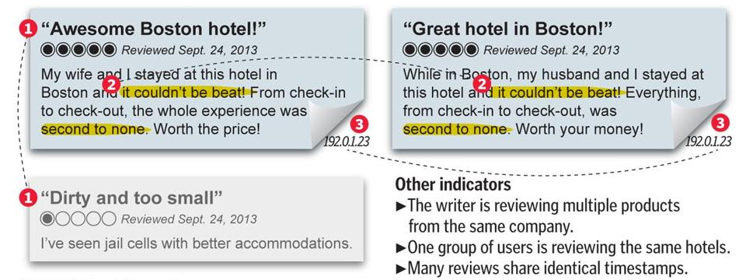
Opinion Spam Detection
finding unexpected rules and rule groups
10
Notes:
Opinion spam is hard to detect because it is very difficult to recognize fake reviews by even manually reading them.
indicator
one reviews gives great opinion on a company and give bad score to the competitors
mutiple reviews share many of the same phrases and typos
the ip address and the timestamp is the same
most of the research use rule based in Opinion Spam Detection

Slide 11
Clustering Product Features for Opinion Mining
Zhongwu Zhai, Bing Liu, Hua Xu, Peifa Jia
WSDM’11, February 9–12, 2011
Notes:
This paper is from WSDM 2011

Slide 12
Introduction
In sentiment analysis of product reviews, one important problem is to produce a summary of opinions based on product features/aspects.
However, for the same feature, people can express it with many different words or phrases.
The picture quality is great.
The image looks vivid.
12
Notes:
The goal is to...
it's very time consuming for human users to group them into feature cluster

Slide 13
Roadmap
Sentiment Analysis and Opinion Mining
Document sentiment classification
Sentence subjectivity & sentiment classification
Aspect-based sentiment analysis
Mining comparative opinions
Opinion spam detection
Beyond Sentiments
13
Notes:
It is in the area of
Aspect-based sentiment analysis

Slide 14
Related Work
similarity measure
pre-existing knowledge resources (e.g., WordNet, and semantic networks)
Carenini G, Ng R, and Zwart E. Extracting knowledge from evaluative text. ICKC. 2005 (lexical similarity)
Liu B, Hu M, and Cheng J. Opinion Observer: Analyzing and Comparing Opinions on the Web. WWW. 2005
appearance
design
14
Notes:
Refer to clustering
The main dominate clustering property is the similarity measure
In the category that relies on pre-existing knowledge sources, the work of Carenini et al. [9] is most related to this paper.
The authors proposed a method called lexical similarity which will be introduce later in the slide
Frist, many words and phrases that are not synonyms in a dictionary may refer to the same feature in an application domain. For example, “appearance” and “design” are not synonymous, but they can indicate the same feature, design.
Which is their main weakness because many expressions of the same feature are not synonyms or even similar in WordNet because they are domain dependent. Dictionaries do not contain domain specific knowledge, for which a domain corpus is needed.

Slide 15
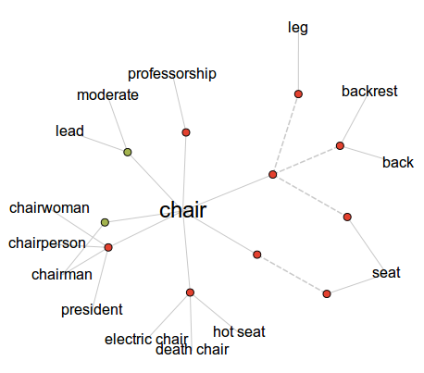
WordNet
Notes:
Wordnet group of similar word

Slide 16
Related Work
distributional properties of words in corpora
Bollegala D, Matsuo Y, and Ishizuka M. Measuring semantic similarity between words using web search engines. WWW. 2007
Pedersen T. Information Content Measures of Semantic Similarity Perform Better Without Sense-Tagged Text. NAACL HLT. 2010
16
Notes:
Distributional similarity is based on the hypothesis that words with similar meaning tend to appear in similar contexts
This paper will show that these methods do not perform well in the experiment section.

Slide 17
Related Work
topic modeling
Branavan S R K, Chen H, Eisenstein J, and Barzilay R. Learning document-level semantic properties from free-text annotations. ACL. 2008
Andrzejewski D, Zhu X, and Craven M. Incorporating domain knowledge into topic modeling via Dirichlet forest priors. ICML. 2009
17
Notes:
As mentioned above, topic model is a method to extract features.
These methods will be compared in the empiriment part.

Slide 18
Contributions of Paper
The problem solved in this paper is semi-supervised learning task but without asking the user to label any training examples.
They propose two soft constraints to help label some examples and one piece of pre-existing natural language knowledge to extract more discriminative distributional context for the augmented EM.
An EM algorithm based on naïve Bayesian classification is adapted to solve the problem, which allows EM to re-assign classes of the labeled examples to different classes.
18
Notes:
This paper Contributions is semi-supervised learning task but without asking the user to label any training examples. The labeled data is generate by the proposed method.
two soft constraints to help labeled data before semi-supervised learning
we called soft because
Use EM algorithm based on naïve Bayesian classification to do clustering.

Slide 19
Architecture
Input
Data
Clustering
Output
Preprocessing
Context Extraction
Feature Clusters
Sharing Words
Feature Expression Document
Lexical Similarity
Expectation Maximization
Clustering
Labeled Data
19
Notes:
The circle ones represent the data and the rounded rectangle stands for some methods
Input Data: a set of reviews R, and a set of discovered feature expressions F from R.
Labeled and unlabeled

Slide 20
Algorithm
Input: a set of reviews R, and a set of discovered feature expressions F from R
Generating Labeled Data L
Connect feature expressions using sharing words
Merge components using lexical similarity
Select the leader components as labeled data
Semi-Supervised Learning using EM
20
Notes:
step 1 2

Slide 21
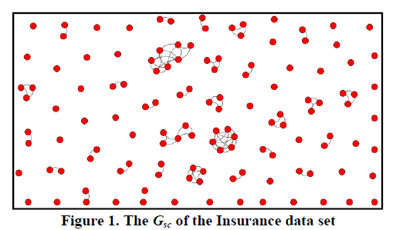
Generating Labeled Data L - Step 1
sharing words: feature expressions(red node) sharing some words are likely to belong to the same group or cluster.
customer service
customer support
service
photo quality
food
quality
21
Notes:
The vertex is a feature
Although the sharing-word constraint is useful,
the number of such pairs is small and does not help us that much.
For example, in our five experimental real-world data sets,
their corresponding graphs Gsc are very sparse,
which means that there are too many disconnected components or sub-graphs.

Slide 22
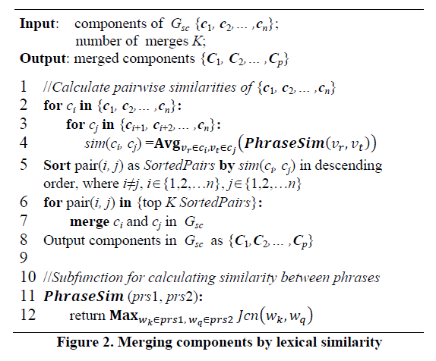
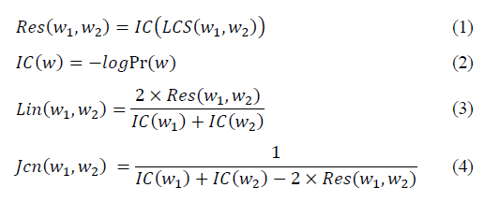
Generating Labeled Data L - Step 2
calculate components similarities
sort and merge top k pairs
22
Notes:
so we have to take the next step,
we only perform the top k merges
why k: We believe that the main reason is that only those components with very high similarities are reliably
calculate components similarities:

Slide 23
Generating Labeled Data L - Step 2
Object
Vehicle
Boat
Automobile
Car
Least Common Subsumer(LCS) of two concepts A and B is the most specific concept which is an ancestor of both A and B, where the concept tree is defined by the is-a relation.
23
Notes:
For example: 歸類
A car is an automobile, and an automobile is a vehicle
A boat is a vehicle.
Vehicle belongs to an object.
In this case, "automobile" is the parent (and also ancestor) of "car",
Vehicle is the first

Slide 24
Generating Labeled Data L - Step 2
Pr(w) is the probability of the concept word w, based on the observed frequency counts in the WordNet corpus
two formula which calculate similarity between two words
24
Notes:
WordNet Synonymous clusters
if a word appear in many different topic, it has the low probability to have the same meaning

Slide 25
Generating Labeled Data L - Step 3
This step selects k leader components from the all components to form the labeled data with k classes or clusters.
25
Notes:
only those components with very high similarities are reliably
so we just selects k leader

Slide 26
Architecture
Input
Data
Clustering
Output
Preprocessing
Context Extraction
Feature Clusters
Sharing Words
Feature Expression Document
Lexical Similarity
Expectation Maximization
Clustering
Labeled Data
26
Notes:
we are now in the clustering model

Slide 27
Content Extraction - Example
“The picture quality is great, the battery life is also long, but the zoom is not good.”
27
Notes:
From either of the sentences, we can infer that “picture quality”, “battery life”, and “zoom” are probably not synonyms because people are unlikely to repeat the same thing in the same sentence

Slide 28
Content Extraction
Labeled Example L
Unlabeled Example U
For example, a feature expression from L (or U) is
v_{i} =“screen”
s_{i1} = “The LCD screen gives clear picture”.
s_{i2} = “The screen is too small”.
D_{i} = {<LCD, screen, gives, clear>, <screen, small>}
28
Notes:
two sentences that contain the feature expression “screen"

Slide 29
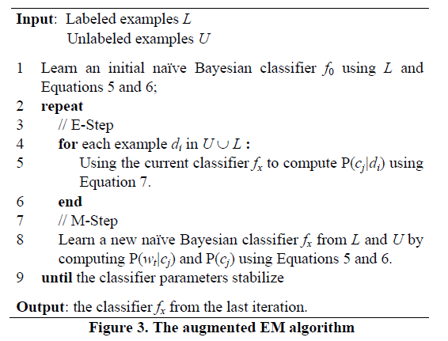
Semi-Supervised Learning using EM
29
Notes:
In the intial, this paper learn naive bayesian classifier using Labeled data
Given document, it will compute the probability of each component
And in the M step it will learn new classifier using Labeled and Unlabeled data to find the parameters of maximum a posteriori

Slide 30
Semi-Supervised Learning using EM
Distributional information is critical for finding domain synonyms because it gives the domain context.
The approach is able to explore both domain independent (pre-existing knowledge) and domain dependent (distributional information).
appearance
design
30
Notes:
This paper thinks that using pre-exist knowledge improve the performance on domain independent information

Slide 31
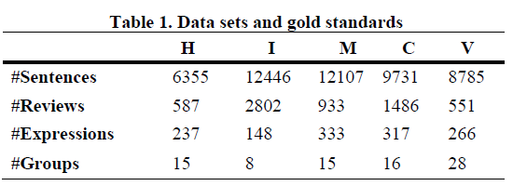
Evaluation – Dataset
Data Sets: Home theater(H), Insurance (I), Mattress (M), Car (C) and Vacuum (V).
31
Notes:
The data are in five domain

Slide 32
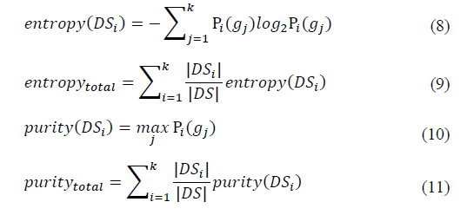
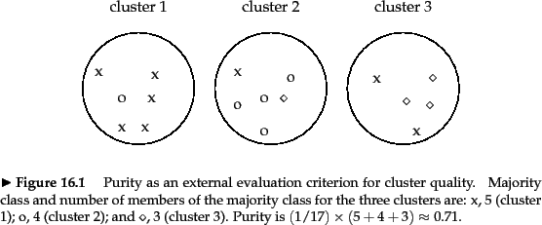
Evaluation – Evaluation Measures
32
Notes:
Entropy: Entropy is commonly understood as a measure of disorder.
purity in the cluster, we have most x, so we count
Low Entropy High Purity

Slide 33
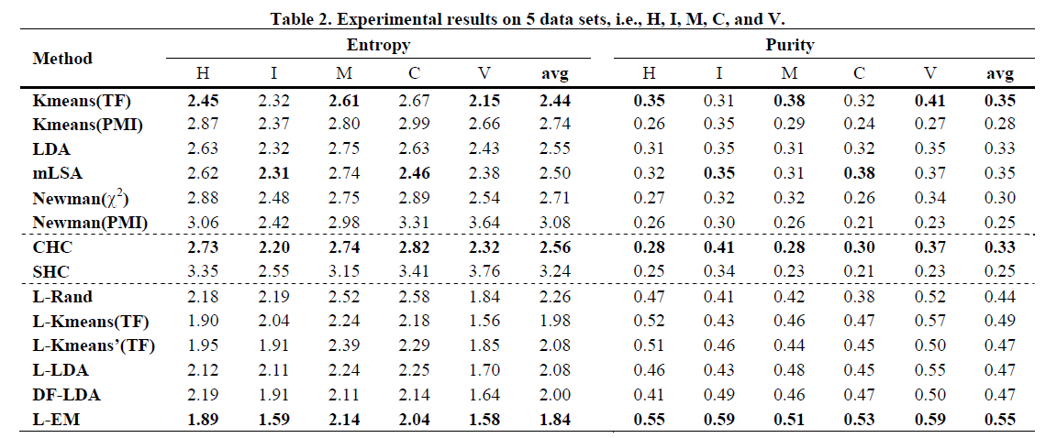
Evaluation – Methods
33
Notes:
L is the labeled data generated by this algorithm
Single link complete link hierarchical clustering

Slide 34
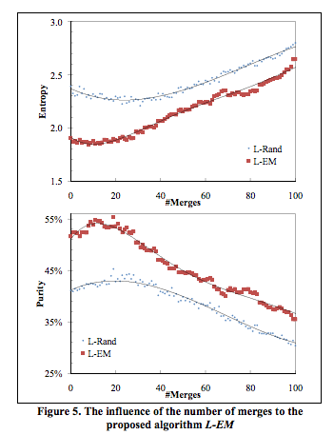
Evaluation – Number of Merges (k)
34
Notes:
how do we choose the k, this paper make experiment and found k 20/100 has the best perform.
the lexical similarity knowledge helps our task, but only the strong similarities are reliable. Weak similarities can harm the overall performance.

Slide 35
Conclusions
The problem solved in this paper is semi-supervised learning task but without asking the user to label any training examples.
An EM algorithm based on naïve Bayesian classification is adapted to solve the problem, which allows EM to re-assign classes of the labeled examples to different classes.
They propose two soft constraints to help label some examples and one piece of pre-existing natural language knowledge to extract more discriminative distributional context for the augmented EM.
35
Notes:
The problem solved in this paper is an unsupervised task. However, due to the poor performances of existing unsupervised methods we formulate it as a semi-supervised learning task but without asking the user to label any training examples. To our knowledge, this is first such attempt. An EM algorithm based on naïve Bayesian classification is adapted to solve the problem, which allows EM to re-assign classes of the labeled examples to different classes.
2. Since there are no labeled examples for learning, we propose to use two soft constraints to help label some examples and one piece of pre-existing natural language knowledge to extract more discriminative distributional context for the augmented EM.
3. It is shown experimentally that the new method outperforms the main existing state-of-the-art methods based on clustering and other techniques that can be applied to the task.

Slide 36
Comments - pros
Without asking the user to label
36

Slide 37
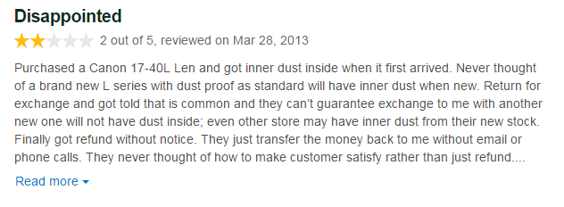
Comments
There are some domain constraint when doing opinion mining.
Not only features extract, when doing positive or negative opinion classify. We can do with semi-supervised learning.
The iPhone 6 Plus can also be an infuriating device which polarizes opinion. Apple may be widely held up as a master of modern industrial design, but for me it has got the iPhone 6 Plus completely wrong. The biggest issue is ergonomics. The iPhone 6 is a flat, big phone that doesn’t feel particularly good in-hand, but just about gets away with it because it is relatively compact.
37

