Slide 1
Milestone 3
Please Refrigerator

Slide 2
Outline
Quick recap & Key Tasks
Method
Personas
Scenarios

Slide 3
Quick recap & Key Tasks
Our Product: Intelligent Refrigerator
Key tasks:
The refrigerator can tell us what we can cook via these ingredients inside!
"Remind" us or send the message to our phones about the expiry date, it would reducing wasted food at home.
Let us know the food position in the refrigerator so that we will not find it in a long time.

Slide 4
Method
We create our personas ans scenarios from our interviewing data and product’s key tasks.

Slide 5
Personas
Japanese food restaurant owner - Mr. YAMATA
Housewife - Cindy
Student who rent a house outside the school - Hackman

Slide 6
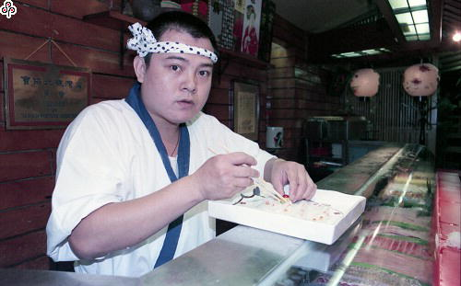
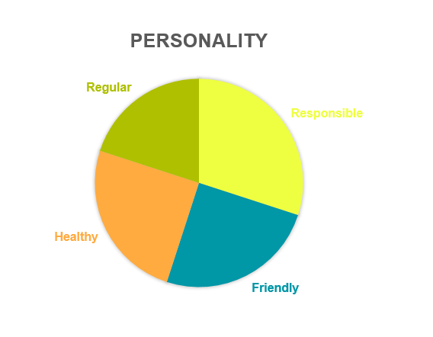
“I want to provide the most delicious, and the freshest food to my customer. That is my responsibility.”
Name: Yamata
Age: 38
Occupation: Japanese food restaurant owner
Marital status: Single
Goals Let the food ingredients always stay fresh.
Easily to find the expired food and throw it away.
His refrigerator always has enough food.

Slide 7
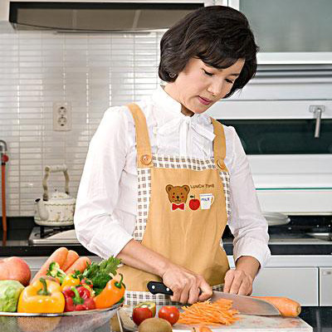
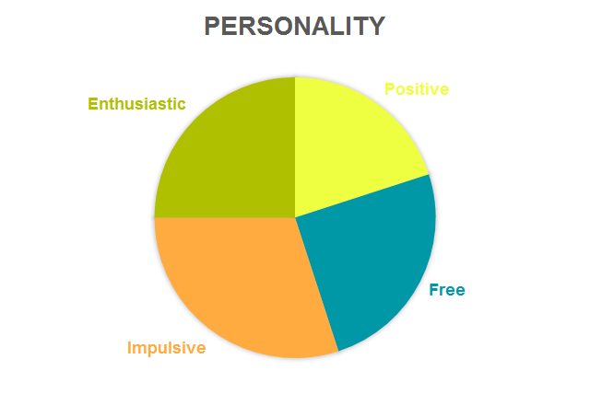
“I love my husband and child, but discount is my Achilles’ heel. I usually buy too many things”
Name: Cindy
Age: 40
Occupation: Housewife
Marital status: Married
Goals Cook delicious and various meals for her family.
Put the vegetables and fruits in order in short time.
Have more time to spend with her child.

Slide 8
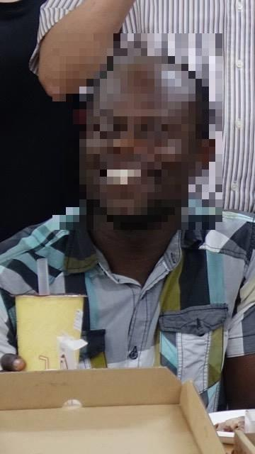
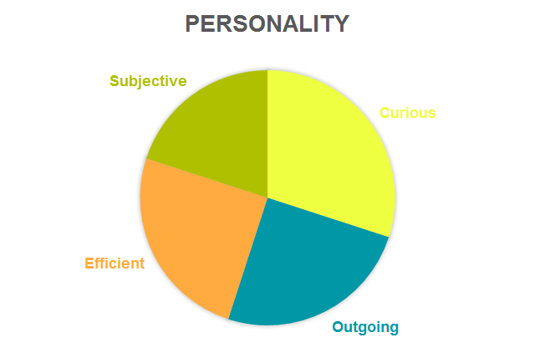
“I rent a house outside the school, but I am not familiar with here. Even though I want to cook, I don’t know where to buy and how to choose.”
Name: Hackman
Age: 23
Occupation: Student
Marital status: Single
Goals
Someone can help him to buy food ingredients before he goes home.
Someone can tell him some cooking tips to cook more delicious food.
Have spare time to do the things he likes.
.

Slide 9
Scenarios

Slide 10
Scenarios 1
Japanese food restaurant owner
One day in the morning, the sky is still dark, Mr. YAMATA wakes up at 4 am. He notices that there is a message sent from the refrigerator to his cellphone. It says that there is some food will be expired in next few days, and some is running out. He then drives his van to the market near the harbor. After he arrived the market, he chats with the fishmonger like old friends, and the fishmonger will provide him some fresh fish to buy. Mr. YAMATA choose fresh fish strictly in order to let his customer enjoy the meal and also buy some food that the refrigerator told him that are going to run out. After his shopping, he then drives back to his Japanese food restaurant. He checks the expired food from the monitor on the refrigerator door, and take it out, and put the fresh fish and new food into the refrigerator and input the expiry date to the refrigerator in order to let the refrigerator remind him next time. And he prepares to open his Japanese food restaurant, such as setting the tables and chairs, and waiting for his customers to come.

Slide 11



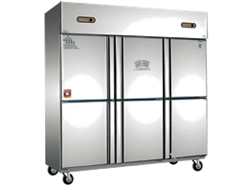

Slide 12
Scenarios 2
Housewife
In a very sunny day, Cindy went out strolling around the food market. As usual, Cindy shopped vegetables and fruit causally. When she finished shopping and was about to going home, she noticed that there was a group of people gathering together. She went over to see what was going on. She found that there were many vegetables and the prices were very cheap. Therefore, she began buying vegetables again. After coming home, Cindy opened the door of refrigerator and put all the food in it. And she went to pick up her child. After that, Cindy began to prepare cooking dinner. She wanted to cook a fish cooking. However, when she opened the refrigerator, she found that all food was in a mess. She decided to use refrigerator monitor to search the position of fish, and the monitor showed the position of fish. Cindy got the fish out and began to cook.

Slide 13
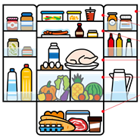
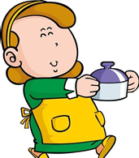
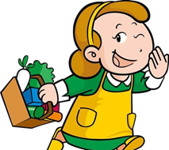

Slide 14
Scenarios 3
Student
Hackman is in the middle of UI/UX class. He find himself is dying for having curry for dinner. Therefore, he start the application on his cell phone and login in. The application has a "recommand recipe" page. He select this page and type in "curry". The application return several results. He click on one recipe most attracting him. The application shows the ingredients of this recipe. And there is a notification beside to let Hackman knows what is the recipe needed ingredients but not in his refrigerator. And there is a button beside named "put it in the cart". He find there is no potatoes in his refrigerator. He click the "put it in the cart" and buy this item. He goes home at 18:00 and the ordering item is arrive on time. Now, Hackman has all the ingredients needed to cook curry. He start to cook and use the application showing him the steps. Finally, Hackman make a wonderful curry and have a great time.

Slide 15



