Slide 1
Milestone 2

Slide 2
Outline
Method
Target population
How you recruited interviewees
Themes of the questions
Analysis
What models did you create and use
Affinity wall (you must have photos of the wall)

Slide 3
Method
Target Population
The people who often use refrigerators
How you recruited interviewees
Our mother’s
5 females

Slide 4
Themes of the questions
User background
Refrigerator Types
User hobbit for refrigerator
About expired food
How you use refrigerator
Unforgettable memory
Imagine the future refrigerator

Slide 5
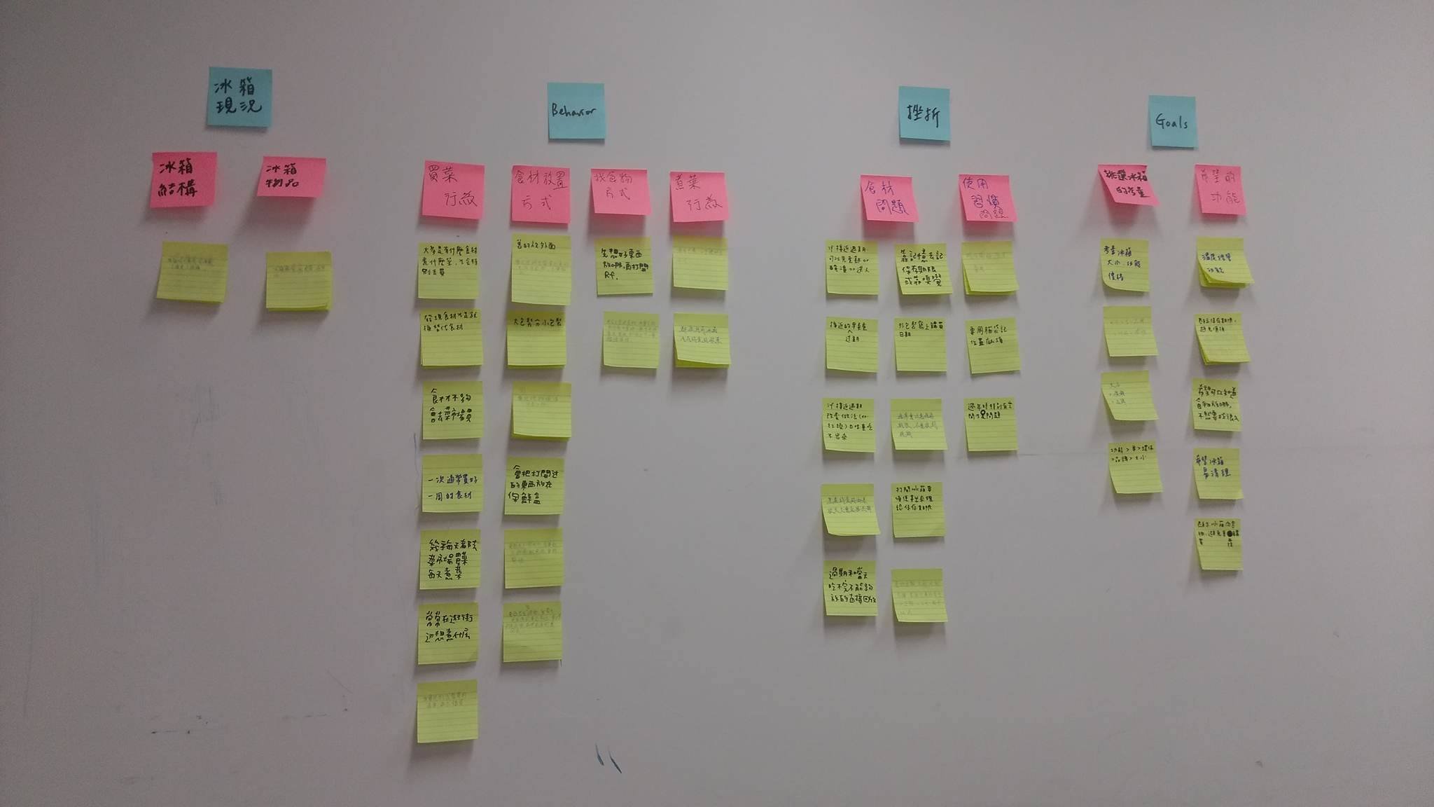
Affinity Diagram (wall)

