Slide 1
The golf blueprint
Software Development Project
UFCFFF-30-3
University of the West of England
19011230

Slide 2

Problem statement
What is The Golf Blueprint aiming to solve?
Course Management is extremely important, but often overlooked by golfers
80% of surveyed amateur golfers report having ‘Average’ or worse course management skills
Amateur golfers lack detailed resources to help them improve their course management
The Golf Blueprint aims to solve this problem through visually represented data-driven analytics – specific to The Kendleshire

Slide 3
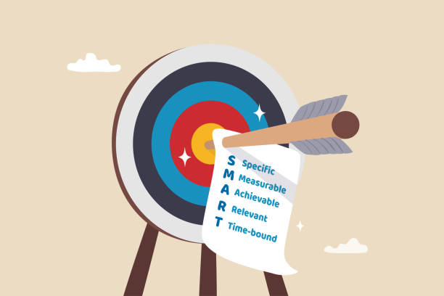
Project aims and objectives
Create detailed top-down recreations of each hole at The Kendleshire
Design and Implement a simple system to collect and analyse golf shot data
Create a secure database to store collected golf shot data and user account information
Design an intuitive and good-looking website, to be the main point of interaction with the users
Ensure that the system satisfies the needs of the users, by conducting comprehensive system testing

Slide 4

Research methodology
Primary Research conducted through a survey – with 86 respondents of Kendleshire members
Try to gain an understanding of current course management knowledge, and interest levels in The Golf Blueprint
Gain valuable insight into desired features and design
Secondary Research exploring existing golf analytic technology – understanding the difference between availability to amateurs compared to professionals

Slide 5
Research findings
Primary Research
80% of respondents have ‘Average’ or worse understanding of course management
85% either ‘Very Interested’ or ‘Interested’ in the concept
88% would be willing to contribute data to the resource
Respondents want the resource to be easy to use
Secondary Research
Data Analysis is an extremely important feature of the modern game of golf
Professional golfers utilise data analysis to improve their game, amateur golfers lack such analysis
Course Management is essential for success, with amateurs neglecting its importance

Slide 6
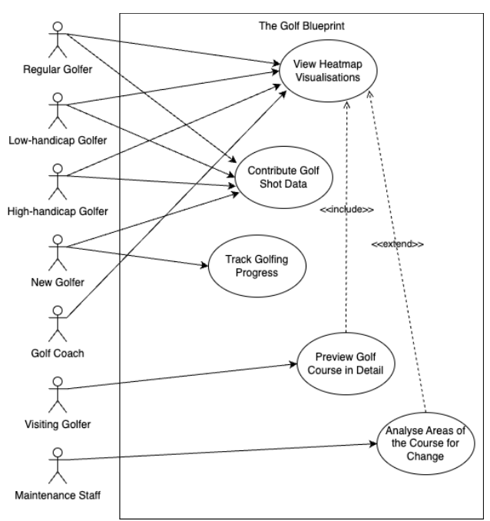
User stories and use cases
User Stories
- 1 developed 8 detailed user stories capturing diverse perspectives
- Important to understand the wishes of the users
- Utilised when designing the core functionality of the system
Use Cases
- Derived from User Stories
- Showcase how users interact with the system
- Ensure requirements meet the real needs of the users

Slide 7
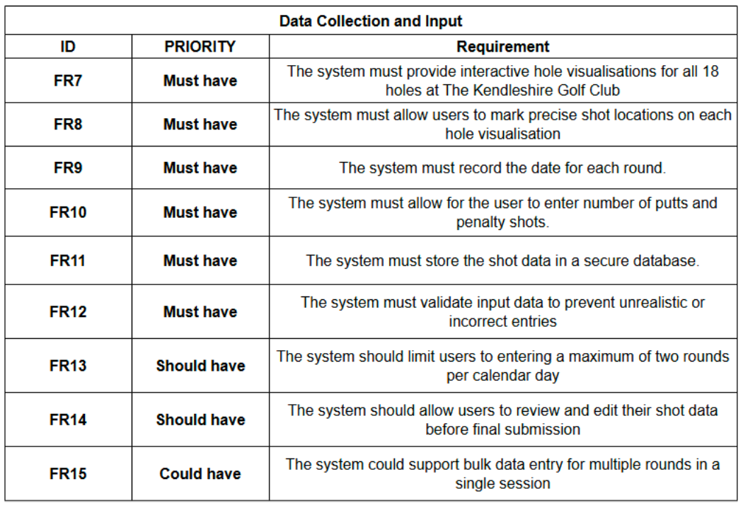
Requirements
Created using the MoSCoW Method
User Account Management
Data Collection and Input
Visualisation and Analytics
Round History
Administration
Won’t Have
Ensuring user’s needs are met while maintaining traceability to research findings

Slide 8
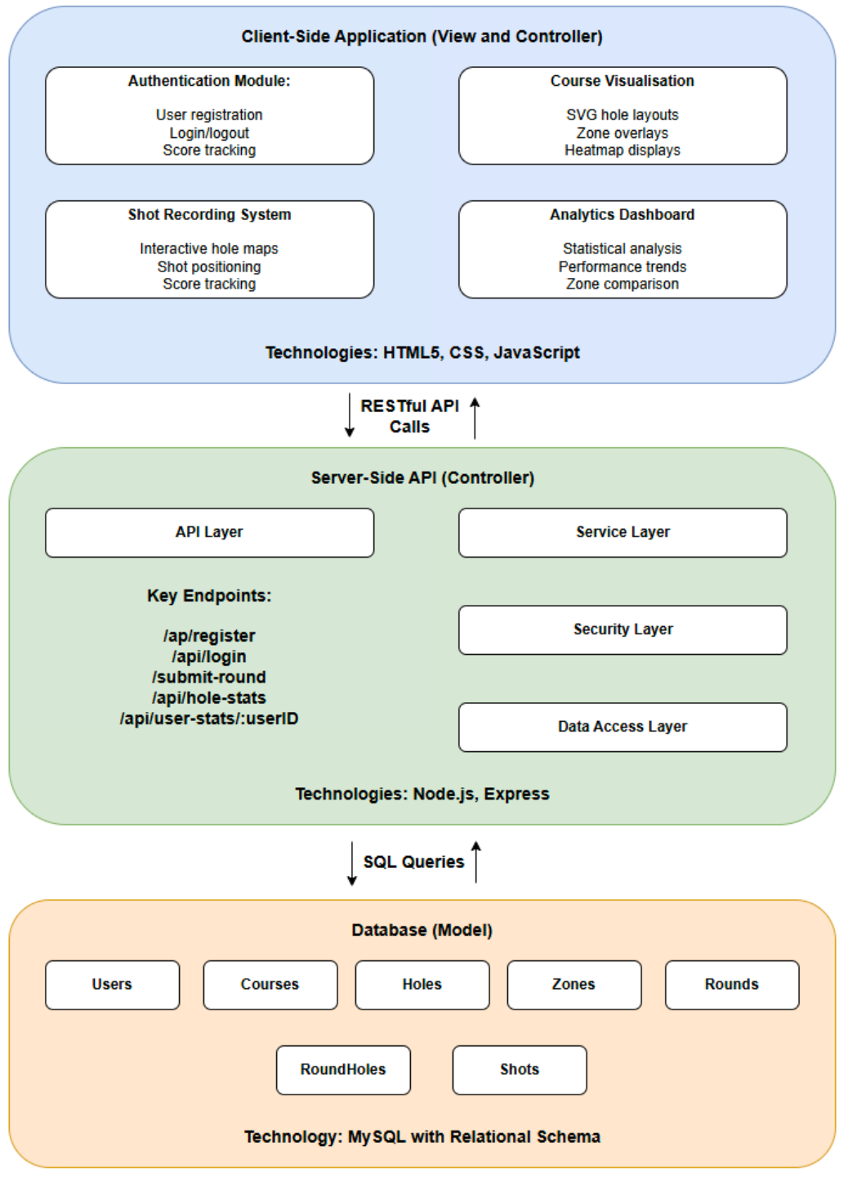
Software architecture
Client-Server Architecture using
Model-View-Controller pattern
Client-side application handles user interface and interactions
Server-side API processes requests
Persistent data stored through MySQL database

Slide 9
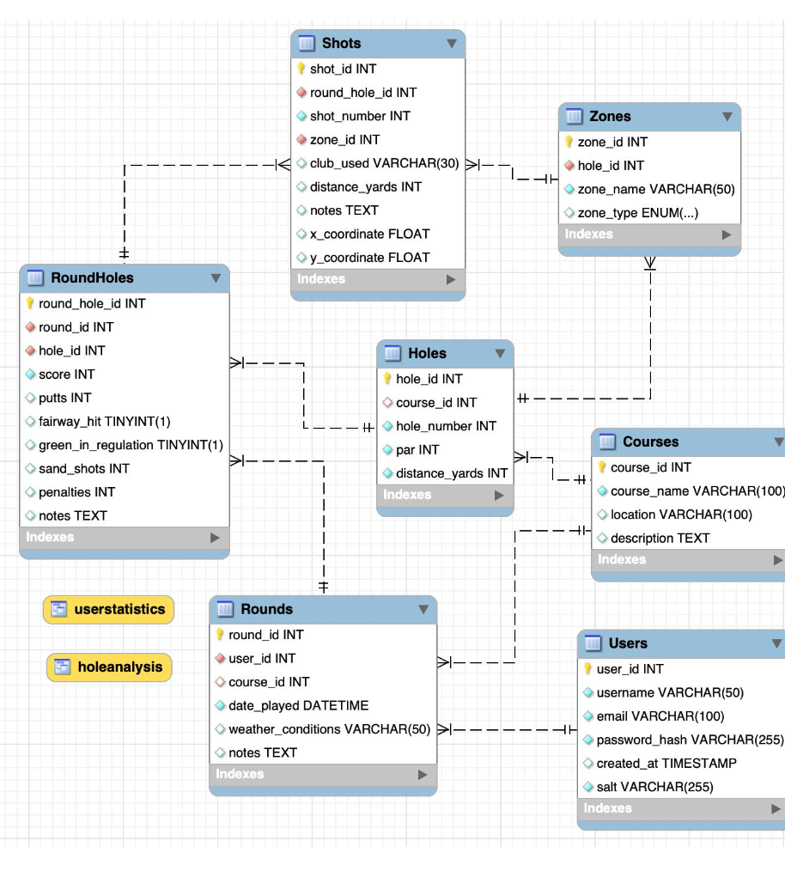
Database design
Designed to efficiently store and reproduce shot data as useful analytics
- Users Table: Stores account information
- Rounds Table: Each round of golf played by users
- Holes Table: Each of the 18 different holes
- RoundHoles Table: Join table
- Shots Table: Detailed information about individual golf shots
- Zones Table: Defines the areas of each hole
- Courses Table: List of available courses

Slide 10
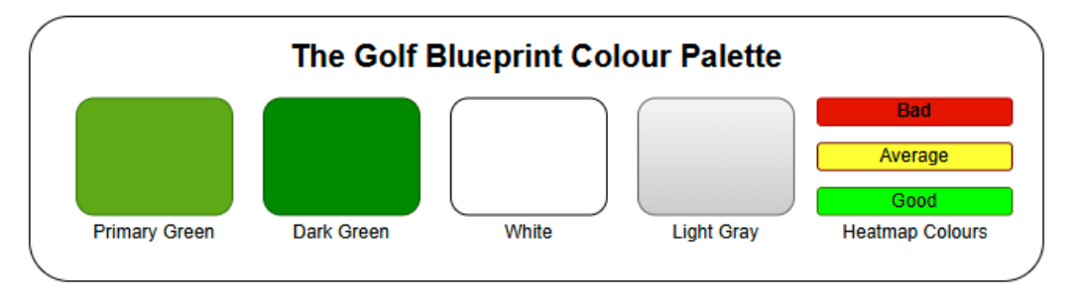
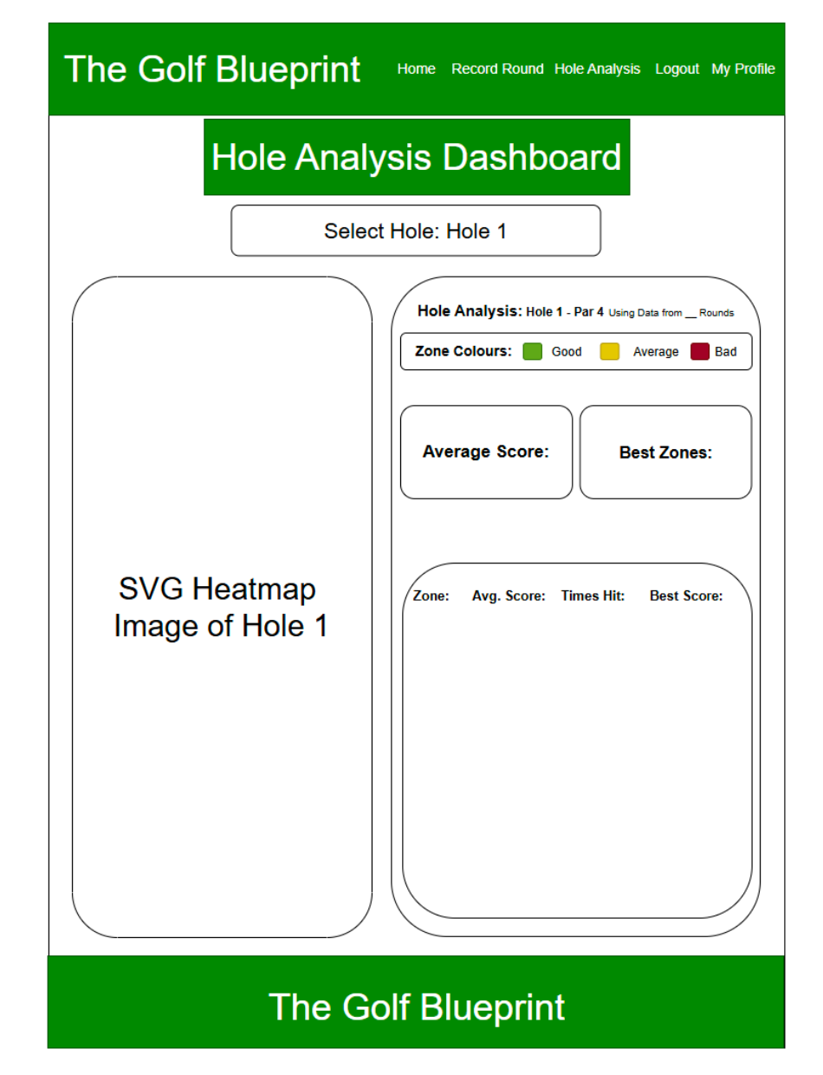
User interface design
Colour Palette
- Professional aesthetics
- Familiar golf-related colours
Wireframes
- Created for all website pages
- Provided a blueprint for the website before creation
- Allowed focus on usability and looks
- Implementation through CSS followed wireframes closely

Slide 11
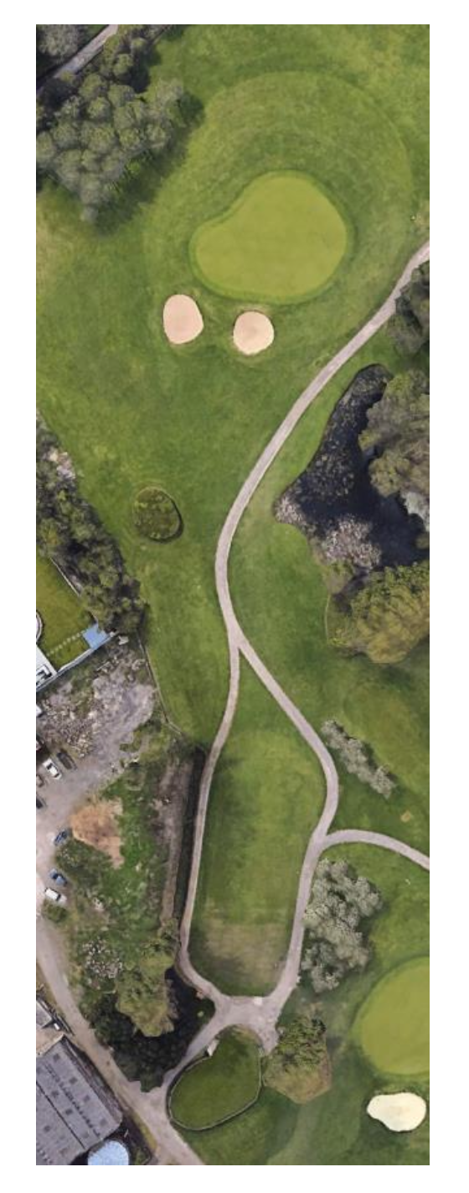
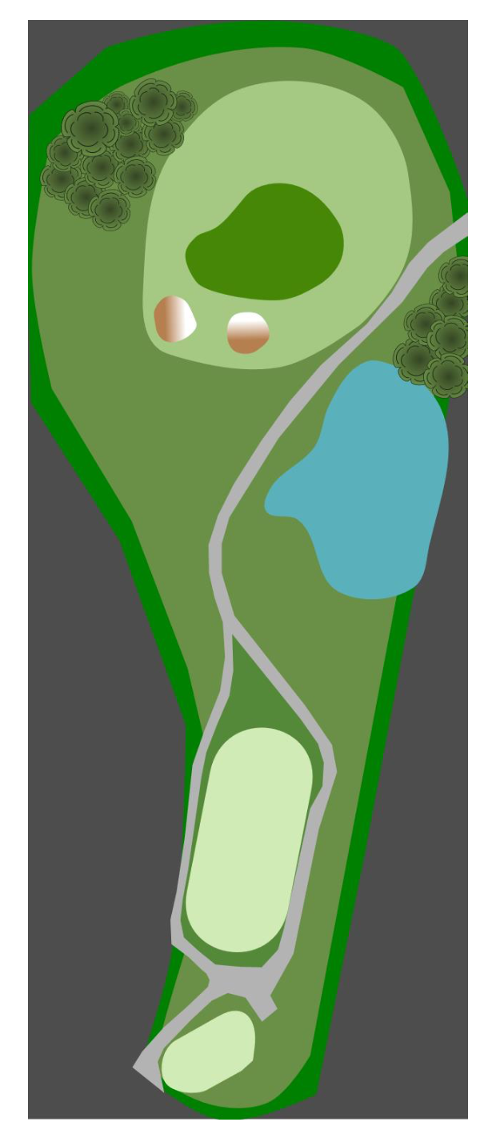
SVG Image creation
Focus on accurate recreation
Satellite imagery
Google Earth Satellite Image
SVG Recreation

