Slide 1
Strings 12.1, 12.3
CMPT 225

Slide 2

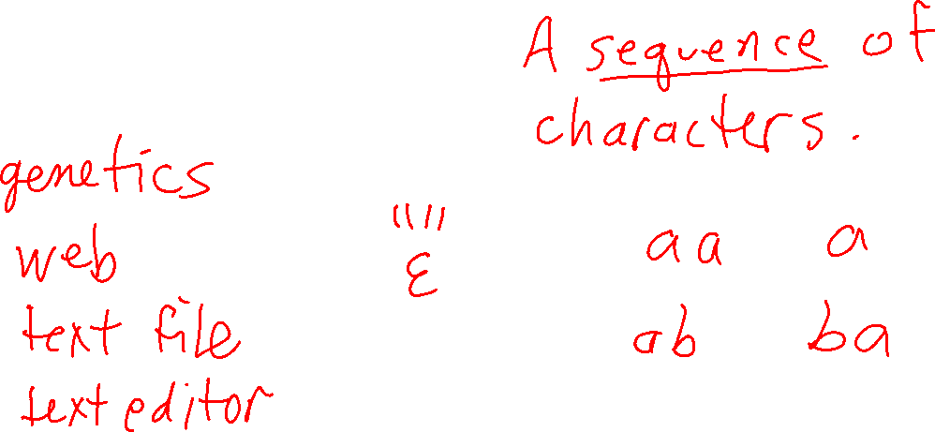
What is a string?

Slide 3
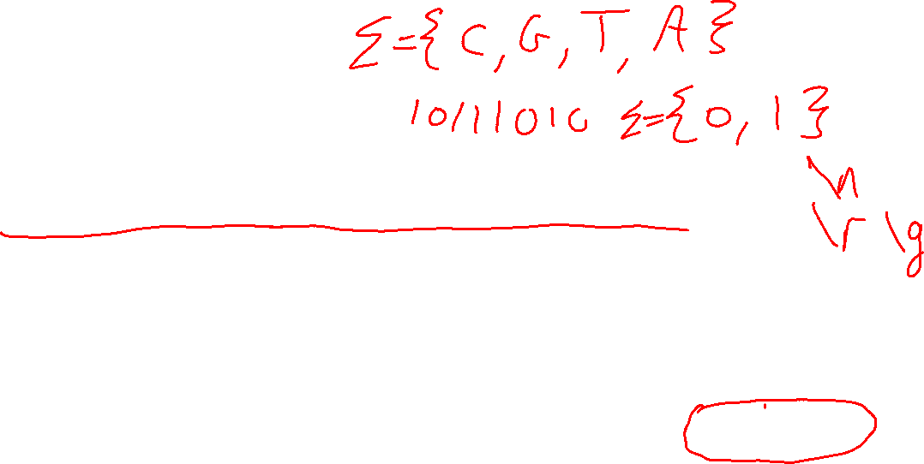
What is a string?
A string is a contiguous sequence of characters.
CGTAAACTGCTTTAATCAAACGC
www.sfu.ca
individual characters in the string are precisely defined values (e.g. Unicode)

Slide 4
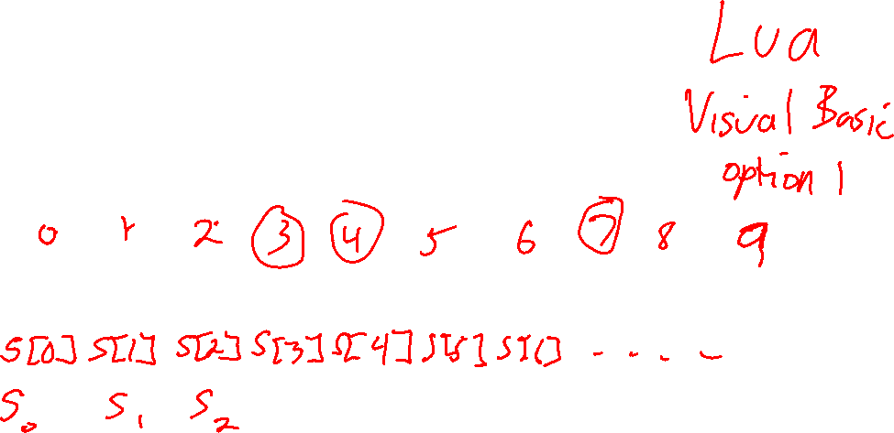
What is a string?
A string is a contiguous sequence of characters.
Question What are the index values of the characters in a string?
w | w | w | . | s | f | u | . | c | a
s

Slide 5
What is a string?
A string is a contiguous sequence of characters.
Careful! C++ starts indexing at 0, but some languages, and some books/papers, start at 1
0 | 1 | 2 | 3 | 4 | 5 | 6 | 7 | 8 | 9
w | w | w | . | s | f | u | . | c | a
s

Slide 6
What is a string?
A string is a contiguous sequence of characters.
0 | 1 | 2 | 3 | 4 | 5 | 6 | 7 | 8 | 9
w | w | w | . | s | f | u | . | c | a
s
String s consists of 10 characters: s[0], s[1], s[2], s[3], s[4], s[5], s[6], s[7], s[8], s[9]

Slide 7
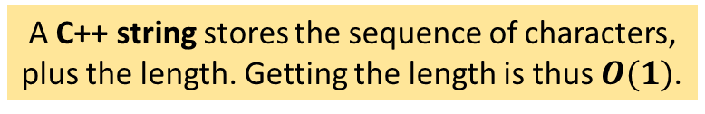
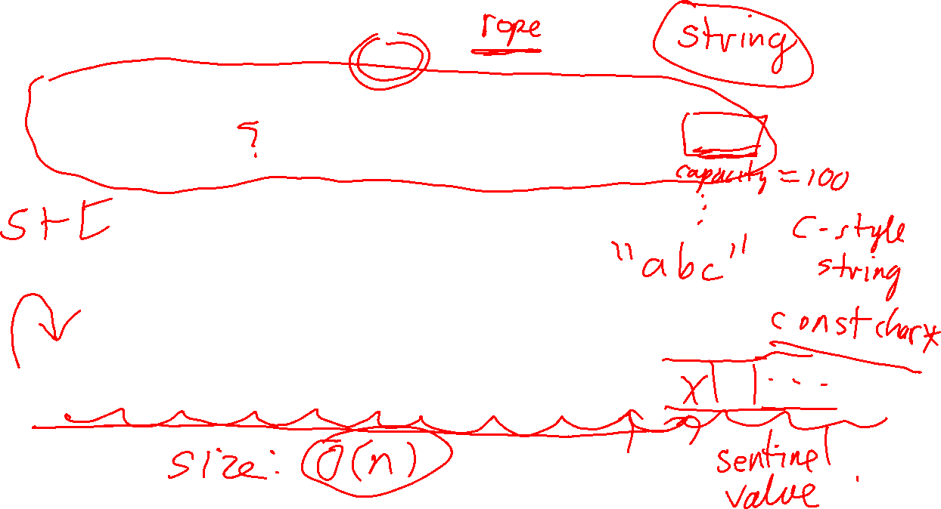
A C++ string stores the sequence of characters, plus the length. Getting the length is thus $O(1)$.
0 | 1 | 2 | 3 | 4 | 5 | 6 | 7 | 8 | 9
w | w | w | . | s | f | u | . | c | a
s
Size: 10
Question
A C-style string is just an array of characters. How does it know its length?
0 | 1 | 2 | 3 | 4 | 5 | 6 | 7 | 8 | 9
w | w | w | . | s | f | u | . | c | a
t

Slide 8
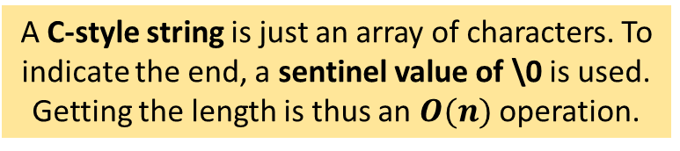
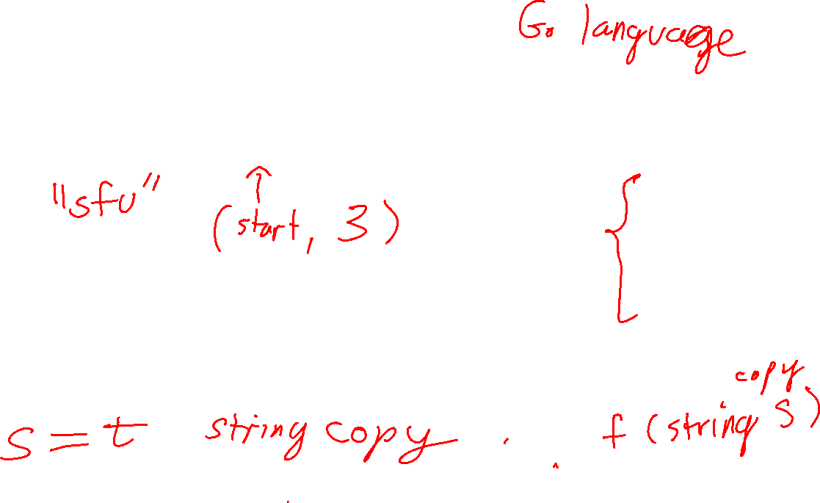
A C++ string stores the sequence of characters, plus the length. Getting the length is thus $O(1)$.
0 | 1 | 2 | 3 | 4 | 5 | 6 | 7 | 8 | 9
w | w | w | . | s | f | u | . | c | a
s
Size: 10
In general, you should avoid C-style strings. They can be surprisingly difficult to use correctly, in part because their memory management is left to the programmer.
A C-style string is just an array of characters. To indicate the end, a sentinel value of \0 is used. Getting the length is thus an $O(n)$ operation.
0 | 1 | 2 | 3 | 4 | 5 | 6 | 7 | 8 | 9 | 10
w | w | w | . | s | f | u | . | c | a | \0
t

Slide 9
The string_view Type
0 | 1 | 2 | 3 | 4 | 5 | 6 | 7 | 8 | 9
w | w | w | . | s | f | u | . | c | a
s
Size: 10
Question
Suppose you want to somehow refer to the substring “sfu” is this string? How can you do that in C++?

Slide 10

The string_view Type
0 | 1 | 2 | 3 | 4 | 5 | 6 | 7 | 8 | 9
w | w | w | . | s | f | u | . | c | a
s
Size: 10
A string_view object typically “points” to an underlying C++ or C-style string. It is sometimes called a fat pointer because it behaves similarly to a regular pointer, but uses more memory.
begin: length: 3
string_view sv "sfu"
C++ has another very useful string-like type called std::string_view. It’s usually implemented as a pointer to a character (in a sequence of characters), plus a length.

Slide 11
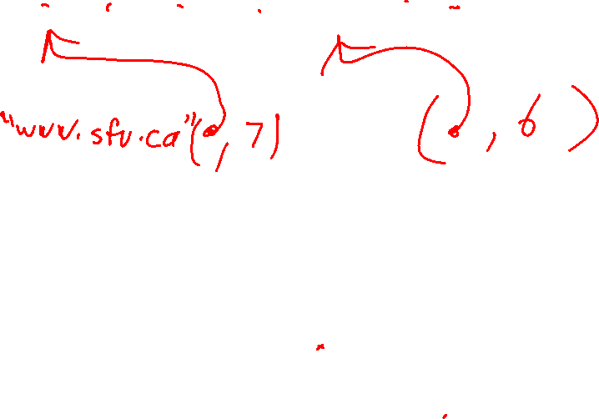
The string_view Type
0 | 1 | 2 | 3 | 4 | 5 | 6 | 7 | 8 | 9
w | w | w | . | s | f | u | . | c | a
s
Size: 10
begin: length: 3
string_view sv "sfu"
Questions
Create a string_view that refers to "www.sfu"
Create a string_view that refers to "sfu.ca"

Slide 12
The string_view Type
0 | 1 | 2 | 3 | 4 | 5 | 6 | 7 | 8 | 9
w | w | w | . | s | f | u | . | c | a
s
Size: 10
begin: length: 7
Multiple string views can point to the same underlying string, even overlapping as shown here.
string_view sv2 "www.sfu"
begin: length: 6
string_view sv3 "sfu.ca"
begin: length: 3
string_view sv "sfu"

Slide 13
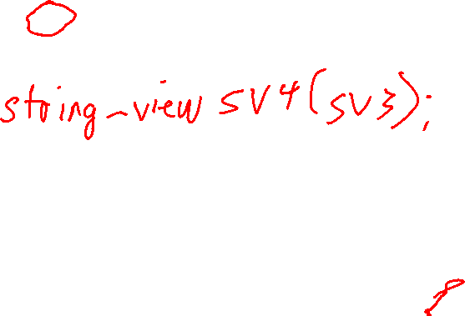
The string_view Type
0 | 1 | 2 | 3 | 4 | 5 | 6 | 7 | 8 | 9
w | w | w | . | s | f | u | . | c | a
s
Size: 10
begin: length: 7
Question
What happens if you copy of string_view sv3?
string_view sv2 "www.sfu"
begin: length: 6
string_view sv3 "sfu.ca"
begin: length: 3
string_view sv "sfu"

Slide 14
The string_view Type
0 | 1 | 2 | 3 | 4 | 5 | 6 | 7 | 8 | 9
w | w | w | . | s | f | u | . | c | a
s
Size: 10
begin: length: 7
string_view sv2 "www.sfu"
begin: length: 6
string_view sv3 "sfu.ca"
begin: length: 3
string_view sv "sfu"
begin: length: 6
string_view sv4(sv3) "sfu.ca"
copying a string_view is cheap: it only copies the begin/length, not the underlying string

Slide 15
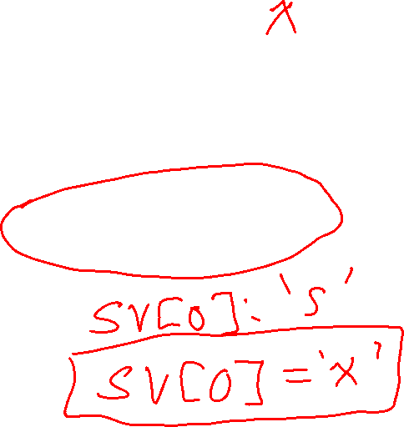
The string_view Type
0 | 1 | 2 | 3 | 4 | 5 | 6 | 7 | 8 | 9
w | w | w | . | s | f | u | . | c | a
s
Size: 10
Question
Can you modify the underlying string with a string_view?
begin: length: 7
string_view sv2 "www.sfu"
begin: length: 6
string_view sv3 "sfu.ca"
begin: length: 3
string_view sv "sfu"
begin: length: 6
string_view sv4(sv3) "sfu.ca"

Slide 16
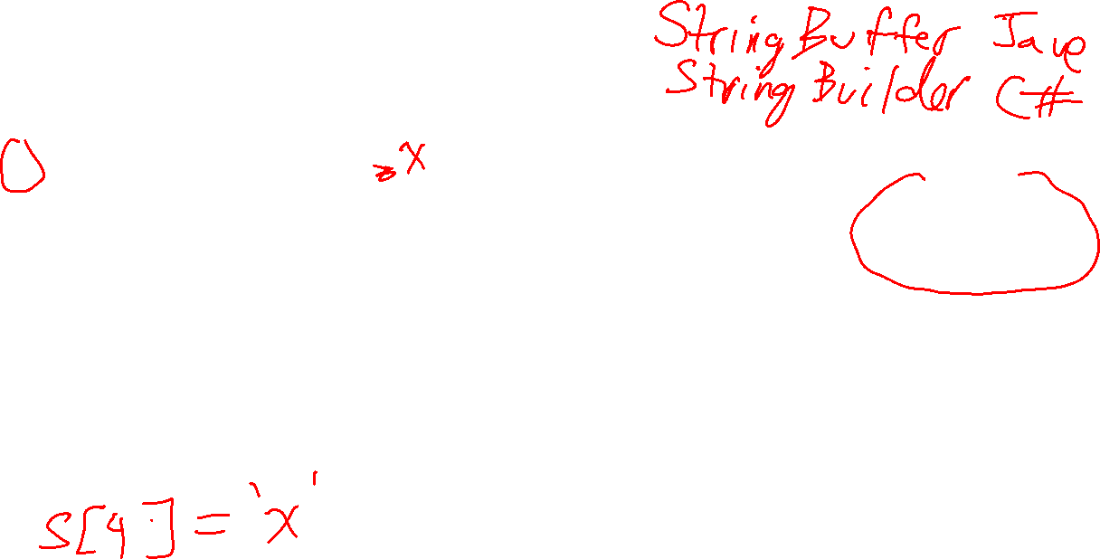
The string_view Type
0 | 1 | 2 | 3 | 4 | 5 | 6 | 7 | 8 | 9
w | w | w | . | s | f | u | . | c | a
s
Size: 10
you cannot modify a string_view itself, and through the string_view you cannot modify the underlying string it points to
begin: length: 7
string_view sv2 "www.sfu"
begin: length: 6
string_view sv3 "sfu.ca"
But it is quite possible to modify the underlying in some other way. Use caution!
begin: length: 3
string_view sv "sfu"
begin: length: 6
string_view sv4(sv3) "sfu.ca"

Slide 17

Immutable vs Mutable Strings
Strings in most modern programming languages are immutable
once you create a string it cannot be changed in any way
operations like copying and getting sub-strings from it are fast and easy using string_view-like ideas
C++ and C-style strings are mutable
this makes changing characters in them fast and easy
but copying operations are expensive
plus mutable strings make using shared pointers and references and string_view riskier, because the underlying characters could change
A common solution provided by many languages is to provide both mutable and immutable strings.
In C++, the default string is mutable, while in most other languages the default string is immutable.

Slide 18
The Dangers of string Mutability
The following example shows why C++’s strings being mutable can be a problem when using string_view ...

Slide 19
string s = "fold";
0 | 1 | 2 | 3
f | o | l | d
s

Slide 20
string s = "fold";
string_view sv(s);
0 | 1 | 2 | 3
f | o | l | d
s
sv: ( , 4)

Slide 21
string s = "fold";
string_view sv(s);
cout << sv << endl;
0 | 1 | 2 | 3
f | o | l | d
s
sv: ( , 4)
fold

Slide 22

string s = "fold";
string_view sv(s);
cout << sv << endl;
sv = sv.substr(1, 3);
0 | 1 | 2 | 3
f | o | l | d
s
sv: ( , 3)
sv.substr(i,n) returns a new string_view of size n starting at index i of sv

Slide 23
string s = "fold";
string_view sv(s);
cout << sv << endl;
sv = sv.substr(1, 3);
cout << sv << endl;
0 | 1 | 2 | 3
f | o | l | d
s
sv: ( , 3)
old
So far, so good! All the string_view operations make sense and work correctly.

Slide 24
string s = "fold";
string_view sv(s);
cout << sv << endl;
sv = sv.substr(1, 3);
cout << sv << endl;
s = "foldable";
0 | 1 | 2 | 3 | 4 | 5 | 6 | 7
f | o | l | d | a | b | l | e
s
sv: ( , 3)
Uh oh: s has changed, and sv doesn’t know about the change

Slide 25

string s = "fold";
string_view sv(s);
cout << sv << endl;
sv = sv.substr(1, 3);
cout << sv << endl;
s = "foldable";
cout << sv << endl;
0 | 1 | 2 | 3 | 4 | 5 | 6 | 7
f | o | l | d | a | b | l | e
s
sv: ( , 3)
old
We got lucky: sv is still the same value, i.e. it appears not to have changed

Slide 26

string s = "fold";
string_view sv(s);
cout << sv << endl;
sv = sv.substr(1, 3);
cout << sv << endl;
s = "foldable";
cout << sv << endl;
s = "!";
0
!
s
sv: ( , 3)
through no fault of its own, sv is no longer a valid string_view!
Uh oh: s has changed again, and this time it’s bad

Slide 27

string s = "fold";
string_view sv(s);
cout << sv << endl;
sv = sv.substr(1, 3);
cout << sv << endl;
s = "foldable";
cout << sv << endl;
s = "!";
cout << sv << endl;
0
!
s
sv: ( , 3)
ld
it prints “ld” for me. But it could print anything, or crash, it is no longer valid
when run with valgrind, no error is reported!

Slide 28
The Dangers of string Mutability
The moral is to be very careful using string_view in C++!
They are like pointers to strings: be certain that the underlying string won’t change.
Easier said than done sometimes!
Replacing const string& in functions is one place where it is usually okay to use a string_view instead …

Slide 29
When should you use string_view?

Slide 30
When Should You use string_view?
Replacing const string& in functions can make them more flexible and efficient …

Slide 31
C-style string
int count_char(string_view s, char c)
{
int count = 0;
for (int i = 0; i < s.size(); i++)
{
if (s[i] == c) count++;
}
return count;
}
assert(contains("Hello", 'e'))
C++ string
assert(contains(string("Hello"), 'e'))
string_view
assert(contains(string_view("Hello"), 'e'))
count_char works efficiently with C-style strings, C++ strings, and string views

Slide 32
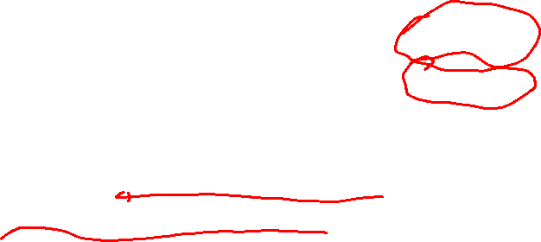
Finding Substrings in a String
We often want to know if a source string contains a pattern string as a sub-string
E.g. searching for a word in a document
bool contains(const string& source, const string& pattern)
returns true if pattern is a sub-string somewhere in source, and false otherwise
If pattern is shorter than source, then false is returned
If pattern is the empty string, then true is returned

Slide 33

Finding Substrings in a String
C++’s std::string has the find method that does solves this problem
string source = "www.sfu.ca"; string pattern = "sfu";
size_t result = source.find(pattern);
if (result == string::npos) { cout << "string not found";
} else { cout << "string found starting index " << result; }
size_t is an unsigned int, so its smallest possible value us 0
string::npos is the value find returns when the pattern is not found

Slide 34
Finding Substrings in a String
The “obvious” algorithm for finding a sub-string is to “slide” the pattern along the source, looking for matches
the textbook calls this the brute force algorithm
E.g. to determine if “www.sfu.ca” contains “sfu”, write “sfu” underneath and “slide” it along until you match all characters, or reach the end

Slide 35

//
// Returns true if source contains target as sub-string,
// and false otherwise.
//
// Based on code from the textbook.
//
bool contains_text(string_view source, string_view target)
{
int n = source.size();
int m = target.size();
for (int i = 0; i <= n - m; i++)
{
int j = 0;
while (j < m && source[i + j] == target[j])
{
j++;
}
if (j == m)
{
return true;
}
}
return false;
}
source and target are not changed, so we can use string_view
instead of returning true/false, you could instead return a pointer (or index) to the first match
Brute force string searching algorithm

Slide 36
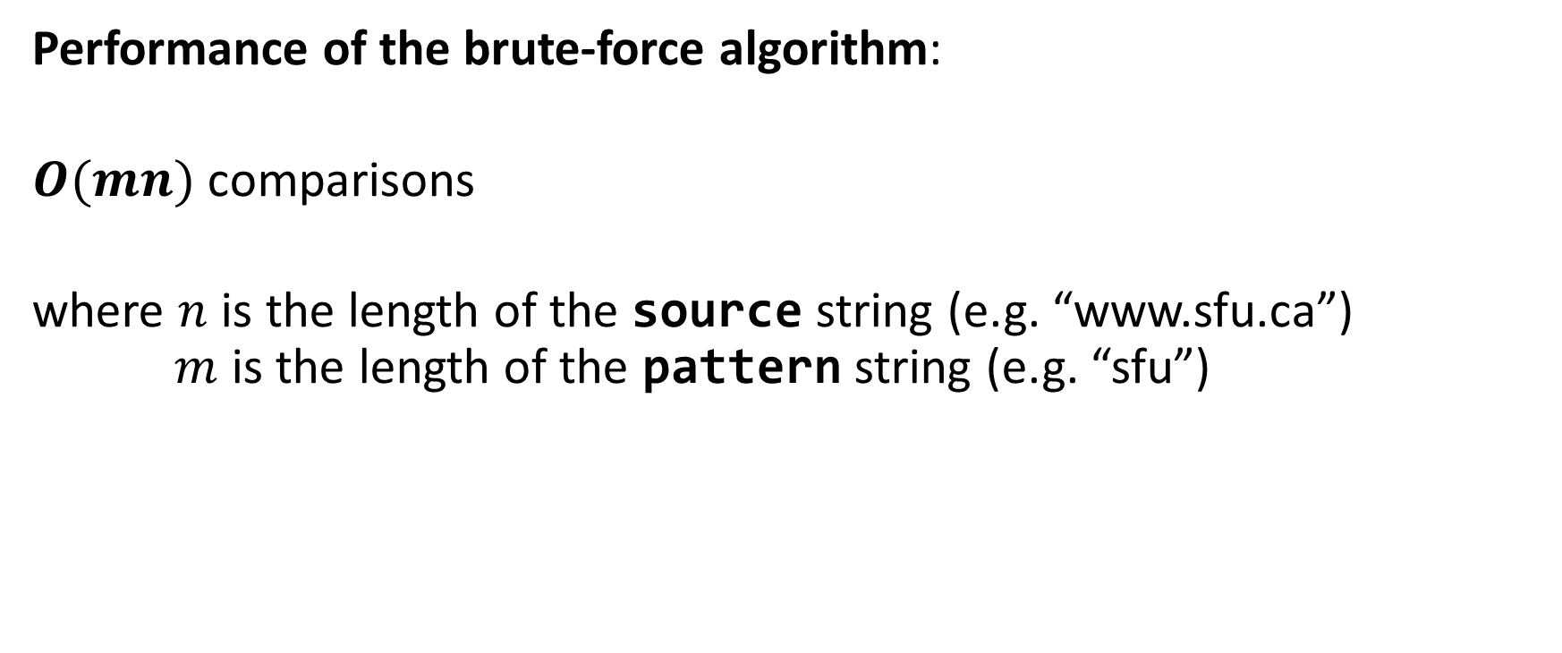
Finding Substrings in a String
Performance of the brute-force algorithm:
$O(mn)$ comparisons
where $n$ is the length of the source string (e.g. “www.sfu.ca”) $m$ is the length of the pattern string (e.g. “sfu”)

Slide 37

Finding Substrings in a String
We can do better!
The Boyer-Moore string matching algorithm uses two neat tricks to speed up searching:
It compares characters in the pattern going from the right end of the pattern to its left end
After a mis-match, it shids the pattern to the right as many spaces as possible, i.e. until a character in the pattern matches the mis-matched pattern. Sometimes the entire pattern can be shifted by its entire length.

Slide 38
Finding Substrings in a String
1 comparison
www.sfu.ca
x
sfu
w and u don’t match Since w doesn’t appear in the pattern, shift it 3 positions right

Slide 39
Finding Substrings in a String
2 comparisons
www.sfu.ca
x
sfu
f and u don’t match Move the pattern so its first f is under the source f

Slide 40

Finding Substrings in a String
3 comparisons
www.sfu.ca
sfu

Slide 41
Finding Substrings in a String
4 comparisons
www.sfu.ca
sfu

Slide 42
Finding Substrings in a String
5 comparisons
www.sfu.ca
brute force would do 7 comparisons
sfu

Slide 43
Finding Substrings in a String
Try searching for “pet” in “www.sfu.ca”. How many comparisons does it do?
Try searching for “ubc” in “www.sfu.ca”. How many comparisons does it do?
For a nice step-by-step example, see this example from Moore’s home page.

Slide 44
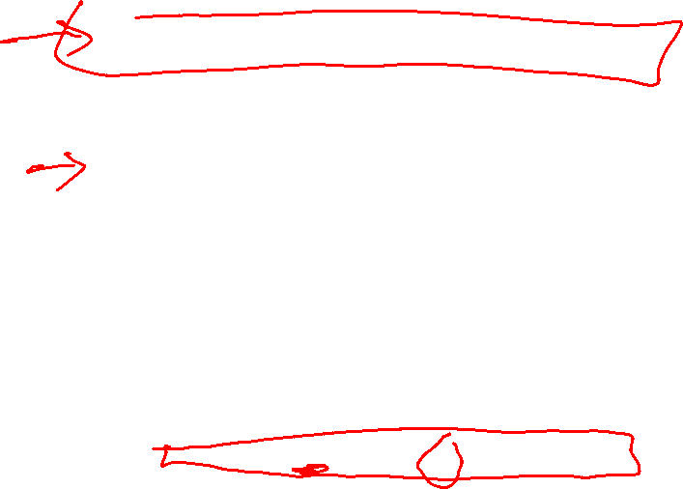
bool contains_boyer_moore(const string &source, const string &pattern) {
vector<int> last = make_last_function(pattern);
int m = pattern.size(), n = source.size();
if (m > n) return false; // is pattern longer than source?
else if (m == 0) return true; // is pattern is empty?
int i = m - 1;
int j = m - 1;
do {
if (pattern[j] == source[i]) {
if (j == 0) return true; // a match!
else {
i--; j--;
}
} else {
i += m - min(j, 1 + last[source[i]]);
j = m - 1;
}
} while (i <= n - 1);
return false; // no match
}
last is a table of “shifts” that tell the algorithm how far to slide the pattern on a mis-match

Slide 45
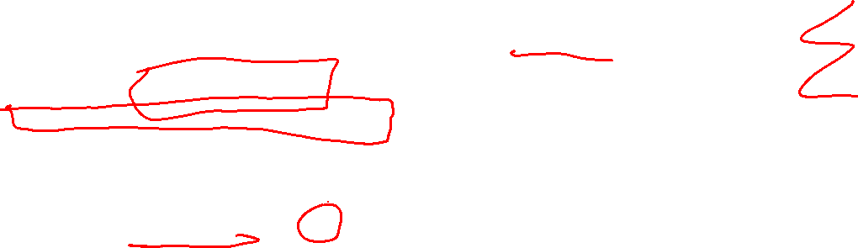
vector<int> make_last_function(const string &pattern)
{
const int N_ASCII = 128; // assume ASCII character set
vector<int> last(N_ASCII, -1);
for (int i = 0; i < pattern.size(); i++)
{
last[pattern[i]] = i; // (implicit cast to ASCII code)
}
return last;
}

Slide 46
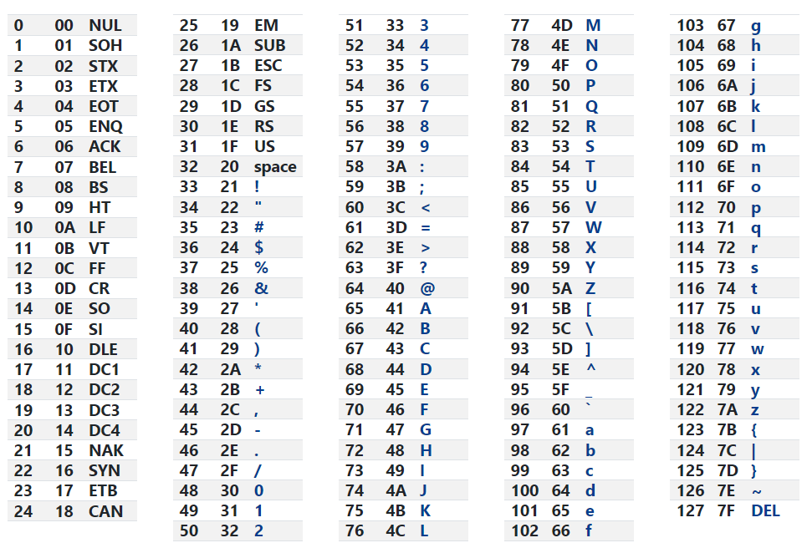

ASCII Table of Characters first column is the character code
s f u 115 102 117

Slide 47
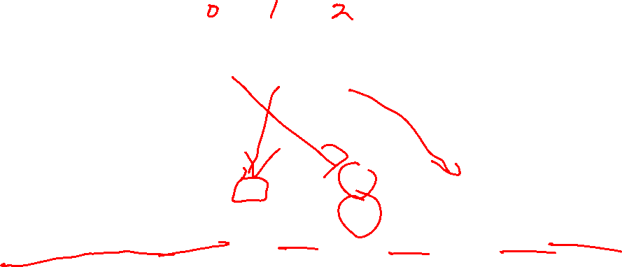
s f u 115 102 117
0 | 1 | 2 | … | 102 | … | 115 | 116 | 117 | … | 127
-1 | -1 | -1 | … | 1 | … | 0 | -1 | 2 | … | -1
last
f
s
u
last[c] is the index of the right-most occurrence of c in the pattern string

Slide 48
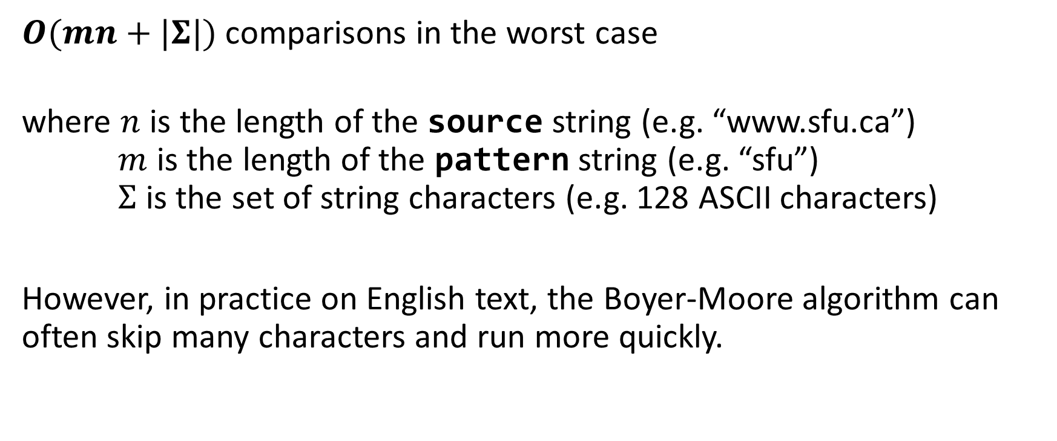

Boyer-Moore Performance
$O(mn+|Σ|)$ comparisons in the worst case
where $n$ is the length of the source string (e.g. “www.sfu.ca”) $m$ is the length of the pattern string (e.g. “sfu”) $Σ$ is the set of string characters (e.g. 128 ASCII characters)
However, in practice on English text, the Boyer-Moore algorithm can often skip many characters and run more quickly.

Slide 49
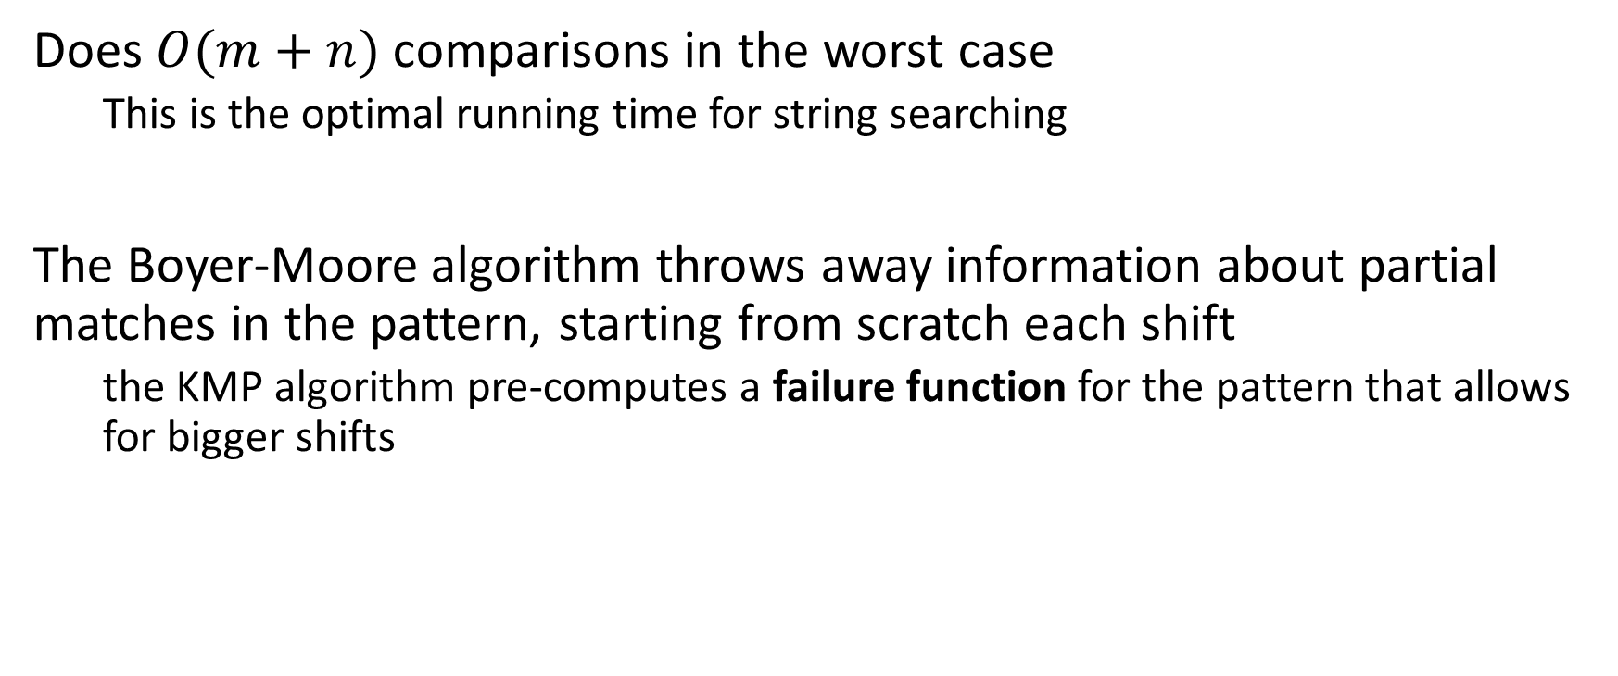

The Knuth-Morris-Pratt (KMP) Algorithm
Does $O(m+n)$ comparisons in the worst case
This is the optimal running time for string searching
The Boyer-Moore algorithm throws away information about partial matches in the pattern, starting from scratch each shift
the KMP algorithm pre-computes a failure function for the pattern that allows for bigger shifts

Slide 50
Some Performance Numbers
Each search algorithm was tested by searching 79339 different patterns (a dictionary of English words) on an English text of 1115394 characters
Textbook Brute Force | 73 s
GPT-4 Suggested Brute Force
Textbook Boyer-Moore
C++ string::find

Slide 51
Some Performance Numbers
Each search algorithm was tested by searching 79339 different patterns (a dictionary of English words) on an English text of 1115394 characters
Textbook Brute Force | 73 s
GPT-4 Suggested Brute Force | 66 s
Textbook Boyer-Moore
C++ string::find

Slide 52
Some Performance Numbers
Each search algorithm was tested by searching 79339 different patterns (a dictionary of English words) on an English text of 1115394 characters
Textbook Brute Force | 73 s
GPT-4 Suggested Brute Force | 66 s
Textbook Boyer-Moore | 52 s
C++ string::find

Slide 53
Some Performance Numbers
Each search algorithm was tested by searching 79339 different patterns (a dictionary of English words) on an English text of 1115394 characters
Textbook Brute Force | 73 s
GPT-4 Suggested Brute Force | 66 s
Textbook Boyer-Moore | 52 s
C++ string::find | 25 s
string::find implementations are usually highly optimized to take advantage of modern computer hardware
e.g. see this string::find implementation

Slide 54
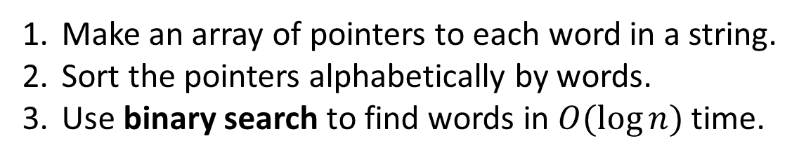
Using an Index
Faster than plain text searching
But …
Can only find full words
E.g. “row” is not indexed
Extra time and space to create the index
Good if you are doing multiple searches
Make an array of pointers to each word in a string.
Sort the pointers alphabetically by words.
Use binary search to find words in $O(\log{n})$ time.
the quick brown fox jumped over the lazy dogs

