Slide 1
HyperV and its Memory Manager
Andrea Allievi – Microsoft Ltd
Recon Montreal 2017

Slide 2
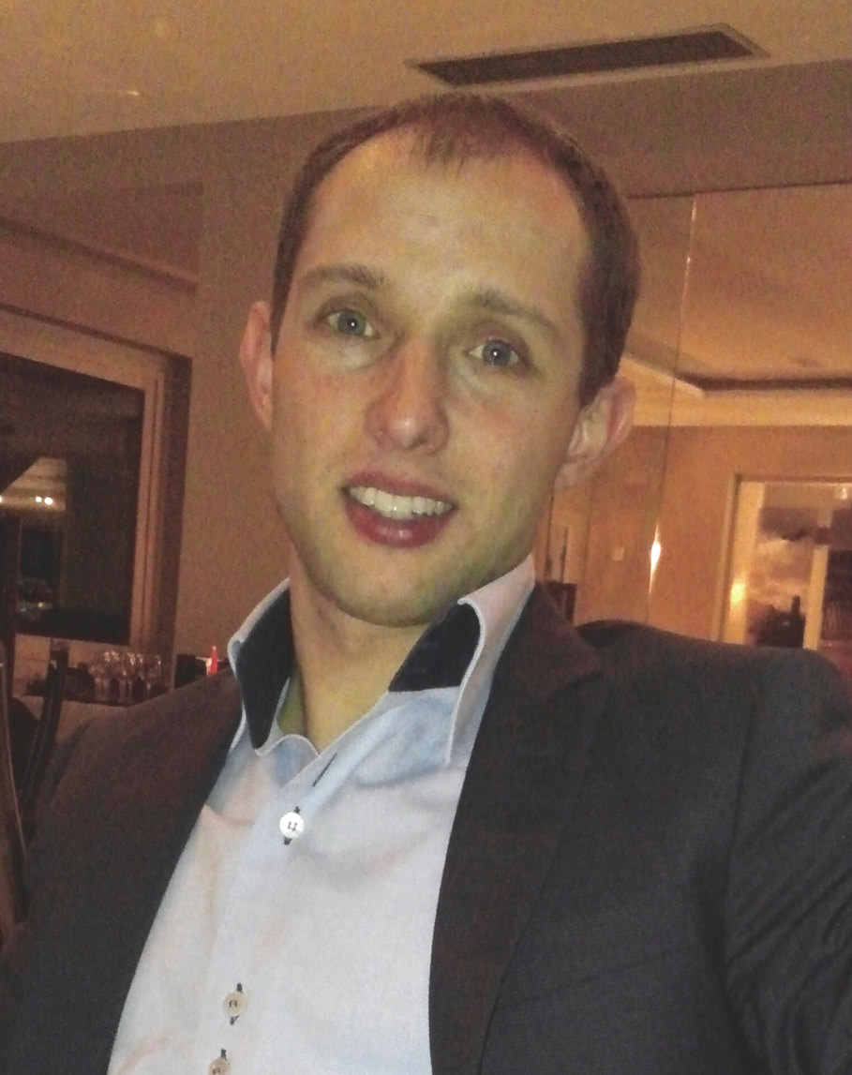
Who I am - Andrea Allievi
Italian Security research Engineer, mainly focused on OS Security, Kernel Analysis and Malware Research
Microsoft OSs Internals enthusiast / Kernel system level developer / Windows Internals Book Collaborator
Work for the Threat Intelligence Center of Microsoft Ltd (MSTIC)
Previously worked for Cisco Systems in the TALOS Security Research and Intelligence Group
Previously worked for PrevX, Webroot and Saferbytes
Original designer of the first UEFI Bootkit in 2012, Patchguard 8.1 bypass in 2014, and other research projects/analysis
Windows Intel Pt Driver designer and developer
Enthusiastic Tennis Player ☺
Notes:
ANDREA

Slide 3
Contents
Part 1 - Introduction
What is HyperV
Big Picture - The architecture
The Boot Process
HyperV Processes and Threads
Part 2 – The Memory Manager
Nested/Shadow Paging
The VM Memory model
Identity Mapping and Child Partitions
The VID Driver and VMWP process
Reserving, Committing and Releasing Memory
The Windows Server 2016’ Improvements
PFN Database and Dynamic Memory
Part 3 – The Intercepts
What is an Intercept Driver?
HyperCalls and the WinHv driver
Demo
Extra

Slide 4
Introduction
The HyperV Architecture

Slide 5
What is Hyper-V
A type-1 (native) Hypervisor that runs on the host ‘s hardware and manages the “Root” Windows OS (that runs under the Hyper-V control)
Defines “Partitions”, as the main isolation unit, in which a OS executes
A “Partition” is composed by some physical Memory, one or more Virtual CPUs, and some virtualized peripherals
“Partitions” are organized in a hierarchic organization, where the main parent partition is the “Root”.
A parent partition receive some events from the child partitions
The majority of the physical hardware accesses are passed-through in the “Root” partition, while the majority of the hardware is virtualized in a Child partition
Starting from Windows Server 2016, Hyper-V supports the Nested Virtualization

Slide 6
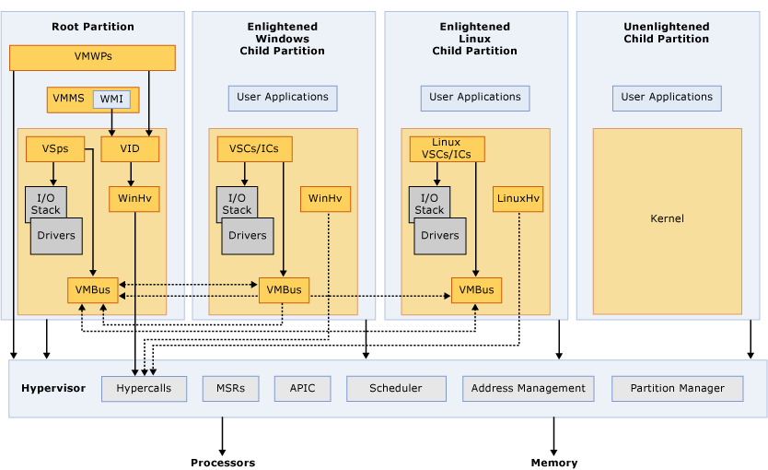
Big Picture
Notes:
https://msdn.microsoft.com/en-us/library/cc768520(v=bts.10).aspx

Slide 7
The Architecture
HyperCall – The interface that the guest OS uses to communicate with the Hypervisor. Implemented through the VMCALL hardware instruction (see the Intel manuals)
VMBus – The communication mechanism used for inter-partition communication. Implemented using the logical “Synthetic Interrupt Controller” (SynIC) in “vmbus.sys” driver
SynIC – The Synthetic Interrupt Controller is a software virtual controller that takes the interrupts from the hardware (in the Hypervisor), and correctly dispatches to the right target partition
VMMS – Virtual Machine Management service is responsible in managing the states of each VM. It is connected to the HyperV management console (using COM) and is responsible in spawning a VMWP instance for each VM
VMWP – Virtual Machine Worker Process: orchestrates the life of the VM, and is responsible in communicating with the VID driver
VID - Virtualization Infrastructure Driver – Provides partition management services, virtual processor management services, and memory management services for partitions.
WinHv – Implement each Hypercall for the Root partition and for a child Partition (2 different versions)

Slide 8
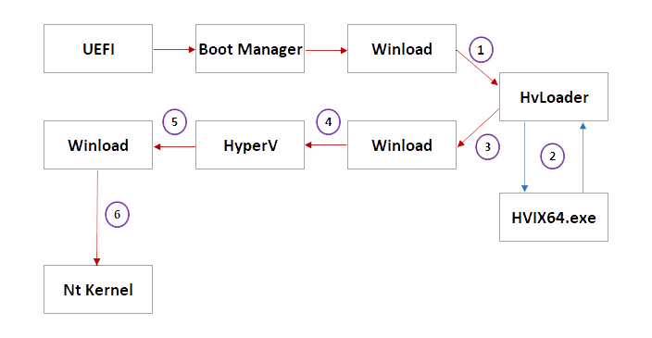
The Boot Process

Slide 9
The Boot Process
The OslArchHypervisorSetup checks the boot options: if the system is not in Safe mode and if the Hypervisor Launch type is set to Auto, the phase 0 of the Hypervisor setup is launched
HvLoader is the module responsible in detecting the proper hardware, verify its capabilities, and load the proper HyperV image in memory
Execution control is returned to Winload
Winload continues its standard initialization (Mm, ASLR, CI, Boot modules, …), calls ExitBootServices UEFI API, and finally launches the Hypervisor (OslArchHypervisorSetup final phase 1)
The HyperV main executable is a mini OS. After the INIT phase, it creates a Root Partition, and VP and executes a VMLAUNCH. The new VM start from Winload*
Winload executes the Windows Kernel as normal (loaded at step 4)
* HyperV has a Thread/Process notion, completely different compared to the NT Kernel one
Notes:
2. If the hardware is AMD64/Intel
3. The Hv data is returned with a _HV_MINI_LOADER_BLOCK structure
4. OslArchHypervisorSetup routine
5. (HVIX64 or HVAX64, depending on the architecture) -

Slide 10
The HyperV Processes and Threads
HyperV represent a VM with a Partition data structure
Each CPU in a VM is represented by a “Virtual Processor” structure
Like in Windows environment, HyperV OS should be able to do context switches between each VP, of different Virtual Machines
Process –> Container for a Virtual address space / an executing program –> In HyperV is a container of a physical address space / an executing VM
Thread -> Basic execution unit -> In HyperV is the same, it represent a virtual processor that could be scheduled by the Hypervisor

Slide 11
The HyperV Process and Thread
Basic Things to remember:
A hypervisor process is created only at a Partition-initialization time
A hypervisor thread is spawned only when a Virtual processor is created
The Hypervisor dispatch loop (the code that processes VMEXITs) runs in a per-thread context

Slide 12
Part II
The Memory Manager

Slide 13
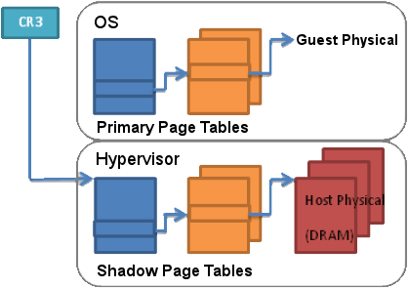
Shadow Paging
2 types of Guest Physical memory management:
Shadow Page Tables
The Hypervisor maintains the real guest Page table in his private memory and intercept every page fault (lazy update) of the guest VM
This method is slow and requires per-process page table shadowing
HyperV doesn’t support this method anymore since Windows 8.1

Slide 14
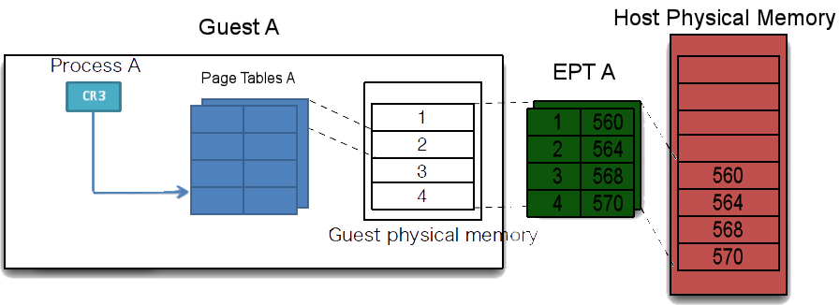
Nested Paging
(aka Second Level Address Translation)
2 types of implementation:
Intel EPT (Extended page tables)
AMD NPT (Nested page tables)
HyperV supports both Implementations

Slide 15
The Vm Memory Model
The Virtual Machine memory space is created at Partition Creation time
The Address manager component decides which type of Address domain to use:
The Root partition is the only one that uses the IDENTITY domain
Child partitions uses a domain defined by the VID driver (the Partition is created empty, with only a PML4 table)
The address space created is then applied using the “Nested Paging” hardware support at Virtual Processor creation time
Currently HyperV support AMD, Intel hardware units
HyperV support maximum 4 different mapping (depends on the VTLs/IoMmu support)

Slide 16
Identity Mapping
The NT Boot loader, in the very early stages, initializes the system memory map using the firmware (GetMemoryMap Boot Service or INT 15h, service 0xe820)
The Boot manager stores all the memory ranges in the Loader Block
HyperV uses these information to create the identity mapping:
For each page that belongs to the range it write an identity page in the EPT
Guest PA = System PA
EXCEPT for the physical pages that belongs to the Hypervisor.
Those pages are marked as invalid in the EPT -> The root partition can’t access Hypervisor pages

Slide 17
Identity Mapping
kd> dq /p 05ba5000 + (0x1F * 8)
00000000`05ba50f8 00c00000`05b52030
EPT Entry (see Intel Manuals):
0 - Read Access
0 - Write access
0 - Execute access
6 - EPT memory type: Write Back
0x5b52000 - PFN of a dummy physical page
kd> db /p 05b52000
00000000`05b52000 ff ff ff ff ff ff ff ff-ff ff ff ff ff ff ff ff ..............
00000000`05b52010 ff ff ff ff ff ff ff ff-ff ff ff ff ff ff ff ff ..............

Slide 18
Child Partitions
For the child VMs, the partition will be created with an empty guest physical address space -> Only the root PML4 is allocated with no valid pages inside
An Hypercall generated from the Root VM requests the Child Partition object creation (as opposed to the Root Partition, that is created by the HyperV startup code)
Another Hypercall creates the Child VM Boot processor, and requires some memory to be mapped into the Child Partition
Who is the responsible of these Hypercalls?

Slide 19
The VID Driver
Virtualization Infrastructure Driver - Actual driver that implements the kernel-mode VM management services and the communication with the Hypervisor through HyperCalls
It is statically linked to WinHvr, the driver that encapsulates all the Hypercalls
The Infrastructure and the Hypercall list are well documented here:
docs.microsoft.com/en-us/virtualization/hyper-v-on-windows/reference/tlfs
It is the responsible for allocating the physical memory for the guest VM

Slide 20
The VM Worker process
When the user requests to start a VM, the frontend¹ communicate with the VMMS service, and requests a VM to run
The VMMS service, after having identified the correct Partition ID, spawns a VMWP process that is delegated to manage the life cycle of the target VM
Both the VMMS and VMWP are implemented in C++ and use heavily COM+ to communicate with each other
The VM Worker process² is the only one attached to the device object created by the VID driver
The actual start request begins exactly inside VMWP:
Load the VM BIOS
Construct the VM Memory
Switch on the Virtual Motherboard and all the virtual perhiperals
Finally starts the VM
Notes:
1. It could be the MMC snap-in, a powershell script (WMI providers), or so on… (even the system itself)
2. Precisely is the VID.DLL, mapped inside the VMWP, that actually performs the communication

Slide 21
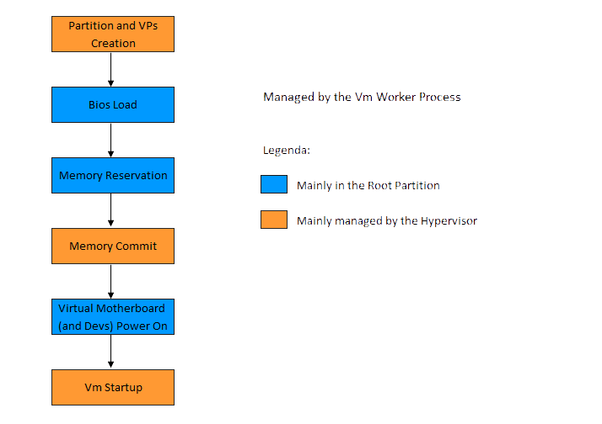

Slide 22
Reserving, Committing and Releasing Memory
In the Windows OS the Virtual memory could be in 3 different states:
Reserved memory – Memory that is only part of the address space, but not backed by any pages (from memory or page file) -> A descriptor is created in the VAD tree
Committed memory – Memory that is backed by some physical page or page file -> Page tables are created
Free memory
In HyperV the concepts are similar, but the meaning is totally different

Slide 23
Reserving, Committing and Releasing Memory
HyperV relies on the root partition for allocating memory for a child VM
Different types of VM Physical Memory:
Reserved – Allocated physical memory that is reserved and accessible only from the parent partition (no EPT mapping, belongs to the Parent partition)
Committed – Physical memory that is mapped into the child Partition physical space (the EPT entries are valid inside the child partition)
Free – physical memory returned to the parent partition PFN database (the child partition will not use it anymore)

Slide 24
Reserving and Committing Memory
The VM Worker process initializes the guest VM memory construction in 2 phases:
Reserving the memory for the VM. The VID driver starts to allocate a bunch of MDL describing blocks of physical pages.
The size of the blocks is calculated by the VMWP based on the amount of available physical memory (from 64 MB to 4 GB blocks)
All the allocated MDLs are stored (without headers) in a “Bucket” structure that belongs to Root Partition
Committing all the reserved memory
The VID driver sends the list of the pages to the Hypervisor (through an Hypercall). The hypervisor maps the physical pages into the child partition and fills the EPT
Notes:
Ask what is a MDL and a PFN to the attendant.
Verify if the root partition has still access to the physical pages

Slide 25
The PFN Search Algorithm
Usually a PFN is in one of many different lists. A zeroed/freed PFN is linked to another PFN (of the same list) through a forward pointer located in the first 8-bytes
The Physical Pages search algorithm looks at the PFN database (from the last physical page to the first one), searching for zeroed, freed and modified pages
If it founds a freed or zeroed page, it looks even at the large page list*
Under some conditions, if it can, it obtains the entire large page for our MDL.
Otherwise it takes only the 4KB page and go ahead with the next candidate (demoting the large page list if needed)

Slide 26
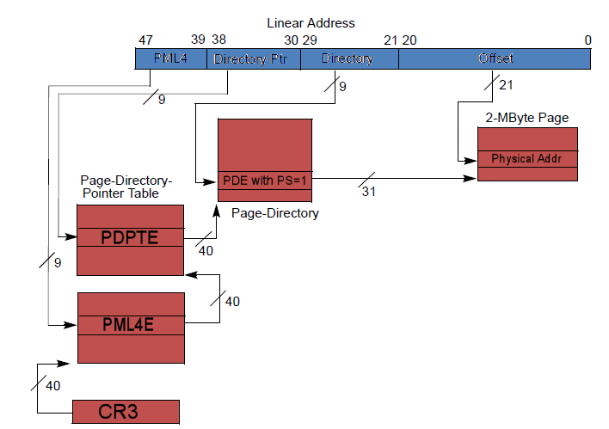
Memory reservation - Issues
The physical memory size of a VM is often big
Searching inside a list of PFN in the root partition is very time consuming
The algorithm just described is clearly not well suited
Since Windows Vista, the kernel has a basic knowledge of LARGE_PAGE

Slide 27
Large Pages
The memory manager, at initialization time, creates a list of large pages, sorted by size and type
Only the first PFN that belongs to the large page is indexed into the list
The other PFNs that belongs to the large page are marked by the kernel with a special “PTE Frame” index
The first PFN is linked into the large page list using a LIST_ENTRY structure (16 bytes), and not using the forward pointer
A new variant of the search algorithm correctly process the new lists (MM_ALLOCATE_FAST_LARGE_PAGES flag)
The search algorithm in the right conditions can break the large pages

Slide 28
Windows Server 2016
Grabbing physical pages from the large lists is very fast
Breaking the large page cluster causes fragmentation and reduces the speed of the algorithm
The WS2016’ VMWP process tries to reserve the physical pages in 4 different ways:
Same Numa node, from large pages ONLY
Same Numa node, small and large pages
Any Numa nodes, large pages only
Any Numa nodes, small and large pages
The HyperV physical pages research algorithm, starts looking at large pages only (remember that the requested size is ALWAYS a multiple of 2 MB)
The new algorithm is EXTREMELY fast (in the right conditions)

Slide 29
Releasing Memory
When the user stops a VM, the VMWP worker process starts by switching off each virtual processors, the virtual motherboard, and each virtual device through Hypercalls
In the process of destroying the Virtual memory device, the VM Worker process asks the VID driver to release the reserved memory
The VID driver grabs the physical pages from the Partition, re-creates a MDL, and sends back it to the system free routine (MmFreePagesFromMdlEx)
The Partition is then destroyed (and the GPA unmapped implicitly)

Slide 30
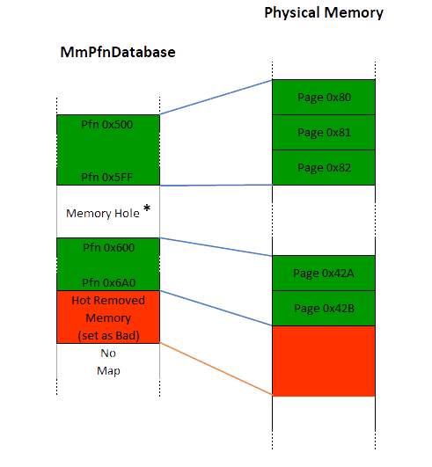
The PFN Database
When the Windows Kernel startup, it needs to create the PFN database
The highest physical address is calculated based on some license data and processor limitations (on my WS2016 test system, this was set to 24 TB)
The Windows kernel allocates a virtual address space large enough for the maximum possible number of PFNs, using a technique called Sparse Memory
Only the PFNs that describe actual physical memory are actually mapped
* Only for example purposes
Notes:
Say about the example

Slide 31
Dynamic Memory
Dynamic memory is a cool feature that allow to dynamically resize the physical memory of a child VM, while is running
It is implemented primarily using a technique called Hot Memory (add or removal of physical memory of a Server while it is running)
Different component coordinate: The memory balancer (VmCompute service) and VM worker process in the root partition, the Dynamic memory driver in the child partition (“dmvsc.sys”) and the VMBus
Every seconds the Memory balance decide whether add or remove chunks of memory from a child partition (based on the guest physical memory status)
The VID driver reserves the needed memory that the balancer has decided to add to the child VM
The hypervisor get informed only in case of nested partitions, otherwise its only duty is to commit physical memory in the child partition

Slide 32
Dynamic Memory
The Nt Kernel of the child partition maps new PFNs in the database in case of new hot memory addition (MmAddPhysicalMemory)
Otherwise, in case of memory removal, it marks those PFN in a BAD state (Ballooned memory)
Completely describe the Dynamic Memory feature is outside the scope of this talk
Notes:
Completely describe the process is outside the scope of this talk

Slide 33
Part III
The Intercepts

Slide 34
What is an Intercept Driver
HyperV could be dynamically modified without touching his code
An Intercept is a driver (kernel mode software) that can receive and modify certain events of the child partition
The original purpose of the Intercepts is to allow a virtualization aware parent to create a virtual environment that allow the guest VM to run.
4 types of events could be intercepted: Access to I/O ports and MSRs, execution of CPUID instruction, Exceptions
HvInstallIntercept is the Hypercall that allow a parent partition to register an Intercept
See the HyperV TLFS Specification
Notes:
Ask what is a MDL and a PFN to the attendant.
Verify if the root partition has still access to the physical pages

Slide 35
Intercept Drivers
From HVGDK.h:
typedef UINT64 HV_PARTITION_ID, *PHV_PARTITION_ID;
typedef UINT32 HV_INTERCEPT_ACCESS_TYPE_MASK;
typedef UINT16 HV_X64_IO_PORT, *PHV_X64_IO_PORT;
// Define intercept types.
typedef enum _HV_INTERCEPT_TYPE
{
// Platform-specific intercept types.
HvInterceptTypeX64IoPort = 0x00000000,
HvInterceptTypeX64Msr = 0x00000001,
HvInterceptTypeX64Cpuid = 0x00000002,
HvInterceptTypeX64Exception = 0x00000003,
HvInterceptTypeRegister = 0x00000004
} HV_INTERCEPT_TYPE, *PHV_INTERCEPT_TYPE;
// Definition of the HvCallInstallIntercept hypercall input
// structure. This call sets an intercept.
typedef struct _HV_INPUT_INSTALL_INTERCEPT
{
HV_PARTITION_ID PartitionId;
HV_INTERCEPT_ACCESS_TYPE_MASK AccessType;
HV_INTERCEPT_TYPE InterceptType;
HV_INTERCEPT_PARAMETERS InterceptParameter;
} HV_INPUT_INSTALL_INTERCEPT, *PHV_INPUT_INSTALL_INTERCEPT;
typedef enum _HV_CALL_CODE
{
// ...
HvCallInstallIntercept = 0x004d,
// ...
}
Notes:
Ask what is a MDL and a PFN to the attendant.
Verify if the root partition has still access to the physical pages

Slide 36
Hypercalls and the WinHv(r) driver
Hypercalls have a well-defined calling convention and depend on the target architecture (documented in the TLS)
The documentation says: it is necessary for the hypervisor to abstract this difference. This is done through a special hypercall page.
#define HV_X64_MSR_HYPERCALL 0x40000001
To further abstract this difference, all the hypercalls are wrapped by the Windows Hypervisor Interface Driver
WinHv, together with portion of NT Kernel, write the HV_X64_MSR_HYPERCALL for you
2 implementations of the same driver: Root and Guest Partition
Notes:
Ask what is a MDL and a PFN to the attendant.
Verify if the root partition has still access to the physical pages

Slide 37
Demo
Using an Intercept to modify the Child Environment
(not supported)

Slide 38
Extra

Slide 39
Windows Os Memory Improvements
Page Tables and PFN Database randomization
Preliminary support for the Huge pages (no Page Directory Entry)
Support for physical memory partitions (Game mode)
Improved memory combining
Memory Compression of the pages belonging to the Modified list
Support of SGX Enclave memory
Many more… (see Windows Internals book for details)

Slide 40
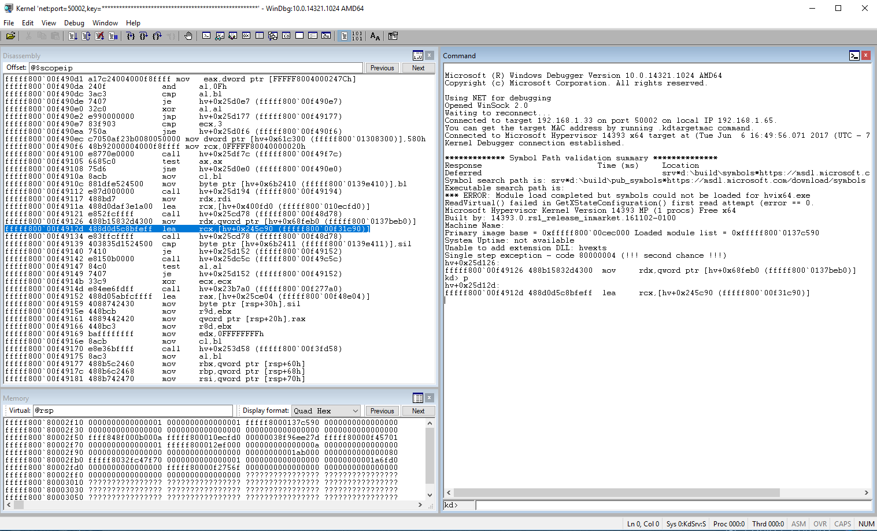
The HyperV Debugger
Not officially supported, but exits (like VmWare)
Firewire, Network and Serial interfaces
No Symbols
https://docs.microsoft.com/en-us/windows-hardware/drivers/debugger/attaching-to-a-target-computer-running-hyper-v

Slide 41
Suggested readings:
Ring 0 to Ring -1 Attacks (Syscan 2015 - Alex Ionescu)
Windows 10 Device Guard and Credential Guard Demystified (Microsoft)
The Battle of SKM and IUM (Alex Ionescu)
HyperPlatform – an open source hypervisor (Satoshi Tanda)
Mitigating arbitrary native code execution (Miller/Weston 2017)
Extending KVM with the new Intel Virtualization Technology
Windows Internals 7th Edition – Part 1

Slide 42

Question Time

Slide 43
Thank you
Recon
@aall86 andrea.allievi@microsoft.com

