Slide 1
DeathNote of Microsoft Windows Kernel
windows kernel internals

Slide 2
$whoami
Peter
Daniel
@zer0mem
Windows kernel research at KeenLab, Tencent
pwn2own winner (2015 / 2016), pwnie nominee (2015)
fuzzing focus : state
wushu player
@long123king
Windows kernel research at KeenLab, Tencent
pwn2own winner (2016)
fuzzing focus : data 'format'
windbg guy

Slide 3
agenda
sandbox
ntoskrnl
extension
clfs
internals

Slide 4
Sandbox
limiting attack surface
potantional landscape for bugs
available methods for abusing it
ACL vs access to various kernel objects
non ntos, non w32k drivers
various ntos objects
w32k filtering
depends on sandboxed app needs
w32k lockdown

Slide 5
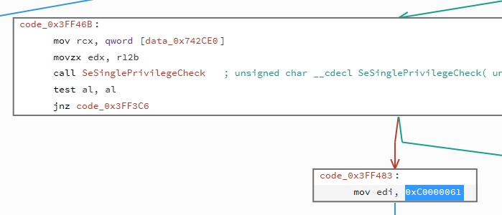
Sandbox targets
mutex
memory
thread
PE
section
pipe
...

Slide 6
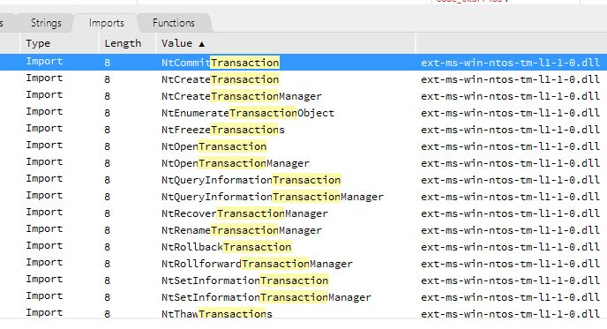
... plus ?
Nt*Transaction*
Nt*Enlistment*
Nt*Manager*

Slide 7
what ?
Kernel Transaction Manager
Purpose
The Kernel Transaction Manager (KTM) enables the development of applications that use transactions. The transaction engine itself is within the kernel, but transactions can be developed for kernel- or user-mode transactions, and within a single host or among distributed hosts.
The KTM is used to implement Transactional NTFS (TxF) and Transactional Registry (TxR). TxF allows transacted file system operations within the NTFS file system. TxR allows transacted registry operations. KTM enables client applications to coordinate file system and registry operations with a transaction.

Slide 8
tm.sys
simple object state
few syscalls available
not much code involved
however interestingly interconnected
Results :
1 nullptr deref
1 exploitable vulnerability

Slide 9
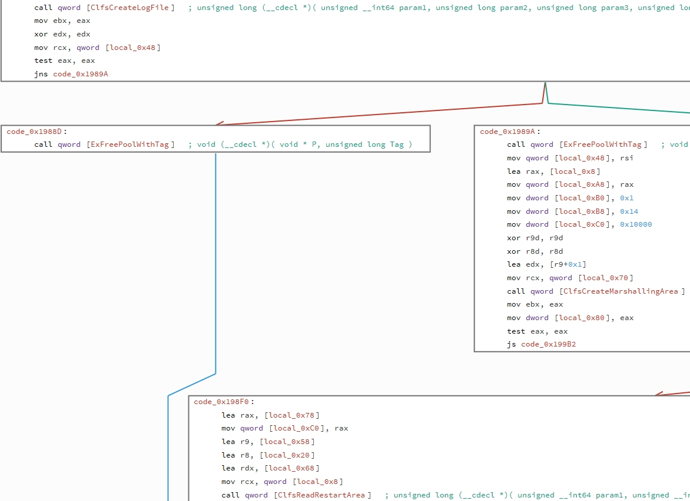
tm indirection
tm.sys simple
purpose driver
but interesting
module involved
at backend
CLFS.sys

Slide 10
CLFS.sys
Purpose
The Common Log File System (CLFS) API provides a high-performance, general-purpose log file subsystem that dedicated client applications can use and multiple clients can share to optimize log access.
Any user-mode application that needs logging or recovery support can use CLFS.
Where applicable
You can use CLFS for data and event management and to develop server and enterprise applications.
For data management, you can use CLFS with the following:
Database systems
Messaging, such as store-and-forward systems
Online transactional processing (OLTP) systems
Other kinds of transactional systems

Slide 11
CLFS.sys
well integrated to transactions and more!
c++ code base
serve fair attack surface
... but not at appcontainer or untrusted level ...
or does it ?

Slide 12
NtCreateTransactionManager
depends on CLFS
use CLFS for its checkpoints
therefore implies :
Opens CLFS
*PARSE* CLFS
interact with CLFS
lets try it out!

Slide 13
CLFS - data fuzzing I.
i am not fan of data fuzzing in kernel
as i am strongly against data parsing at kernel at all :)
lets do quick probe, that i am ok with :
mutate randomly file
results = 0
cool for me, i am not much interested anyway
get back to original idea!

Slide 14
CLFS - state fuzzing
approach 1.
RE clfs.sys
go to ioctl
.. ah too lazy to do that from scratch ...
approach 2.
go trough msdn docs
understand how those api works
callstack necessary to suceed to call one or another api
implement that logic to Qilin (our internal fuzzer)
mess with logic in Qilin little bit

Slide 15
bugz++
after first dry run of fuzzer in 15 min first crashes
... wtf
but ddos only
eliminate that
another bugz apear
now time to rethink .. data fuzzing really so bad idea afterall ?

Slide 16
CLFS - data fuzzing II.
RE where & how are data parsed
EntryPoint : ClfsCreateLogFile
ouch ... magic .. dummy fuzz proof
I. crc
II. rellocation required

Slide 17
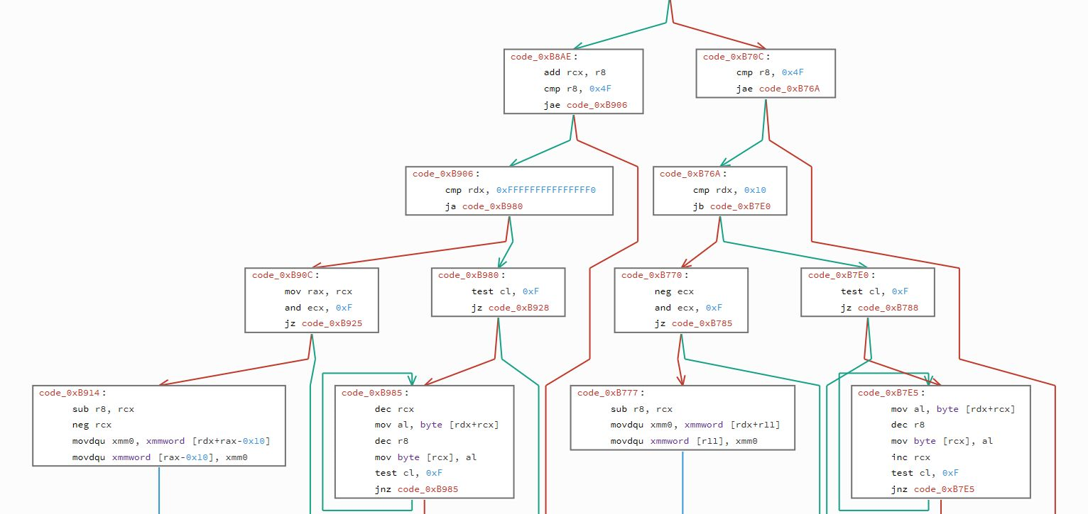
CLFS - lets fuzz more seriously
too lazy to re-implement existing code, but is it even necesary ?

Slide 18
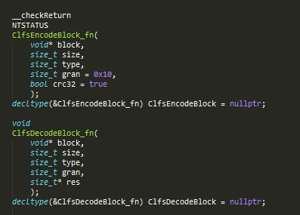
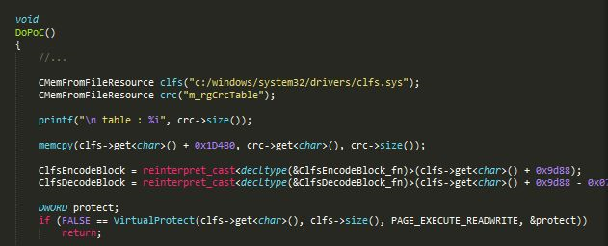
CLFS - lets fuzz more seriously
too lazy to implement crc & rellocations

Slide 19
CLFS { state, dummy, enhanced }

Slide 20
CLFS internals
... under the hood ...

Slide 21
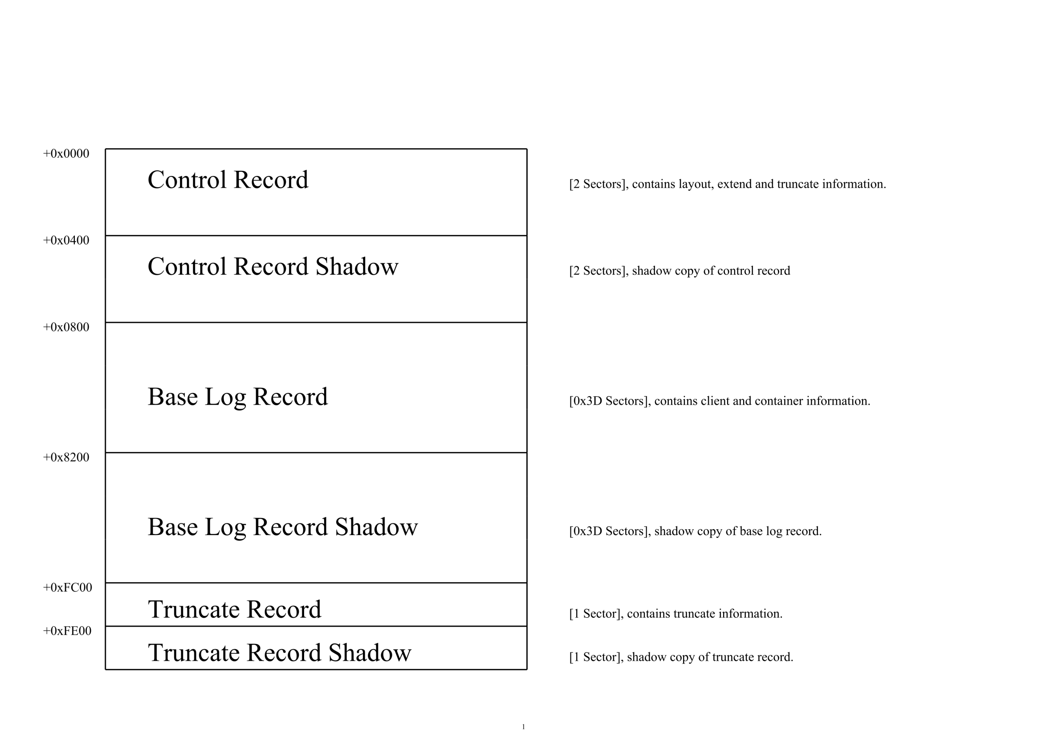

BLF (Base Log File) Format

Slide 22
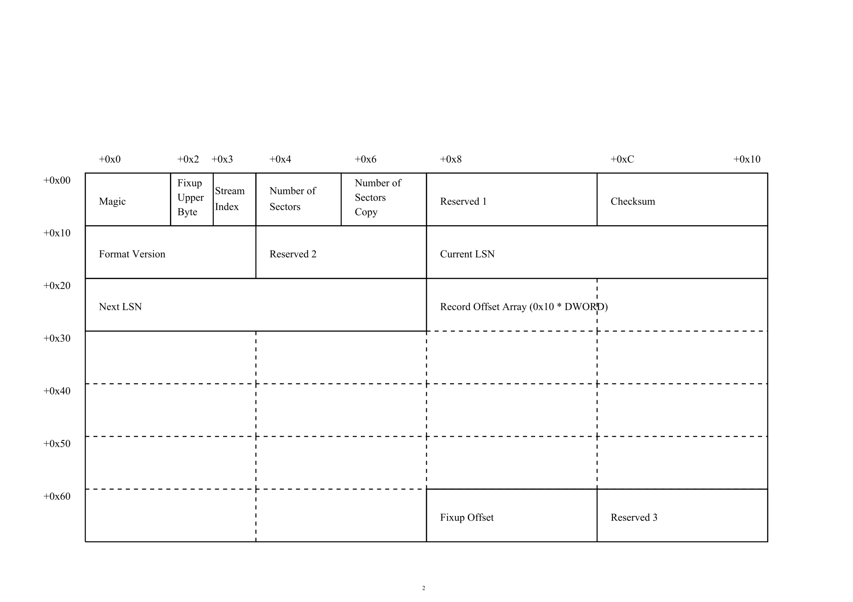
Record Header

Slide 23
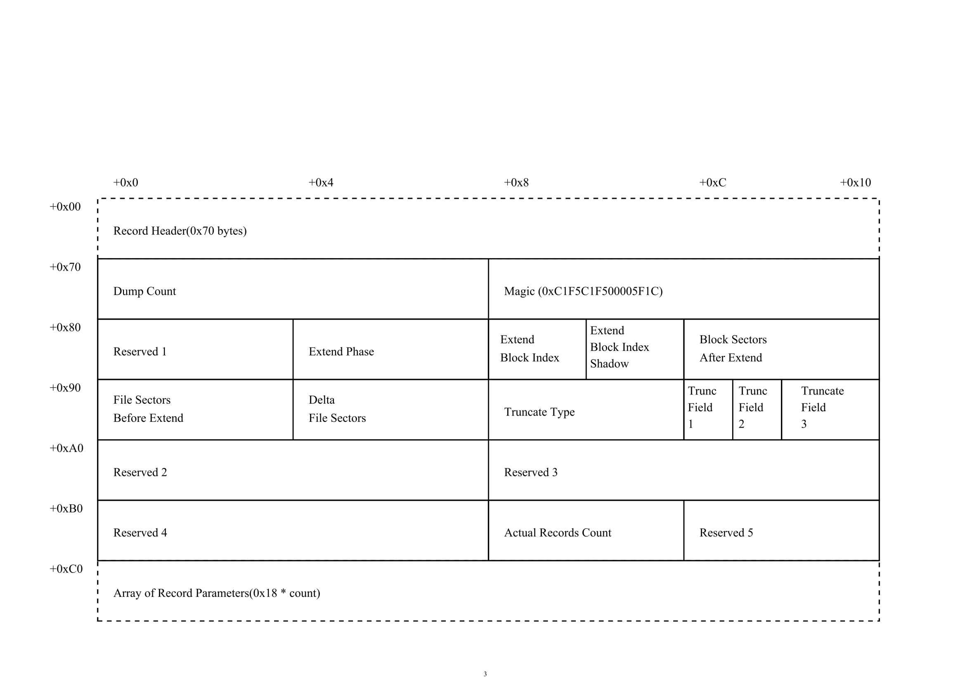
Control Record

Slide 24
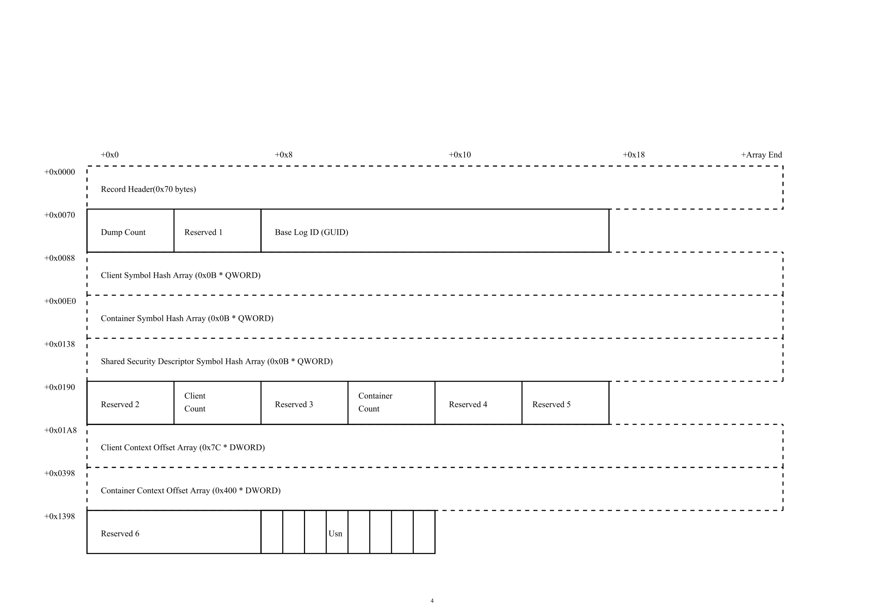
Base Log Record

Slide 25
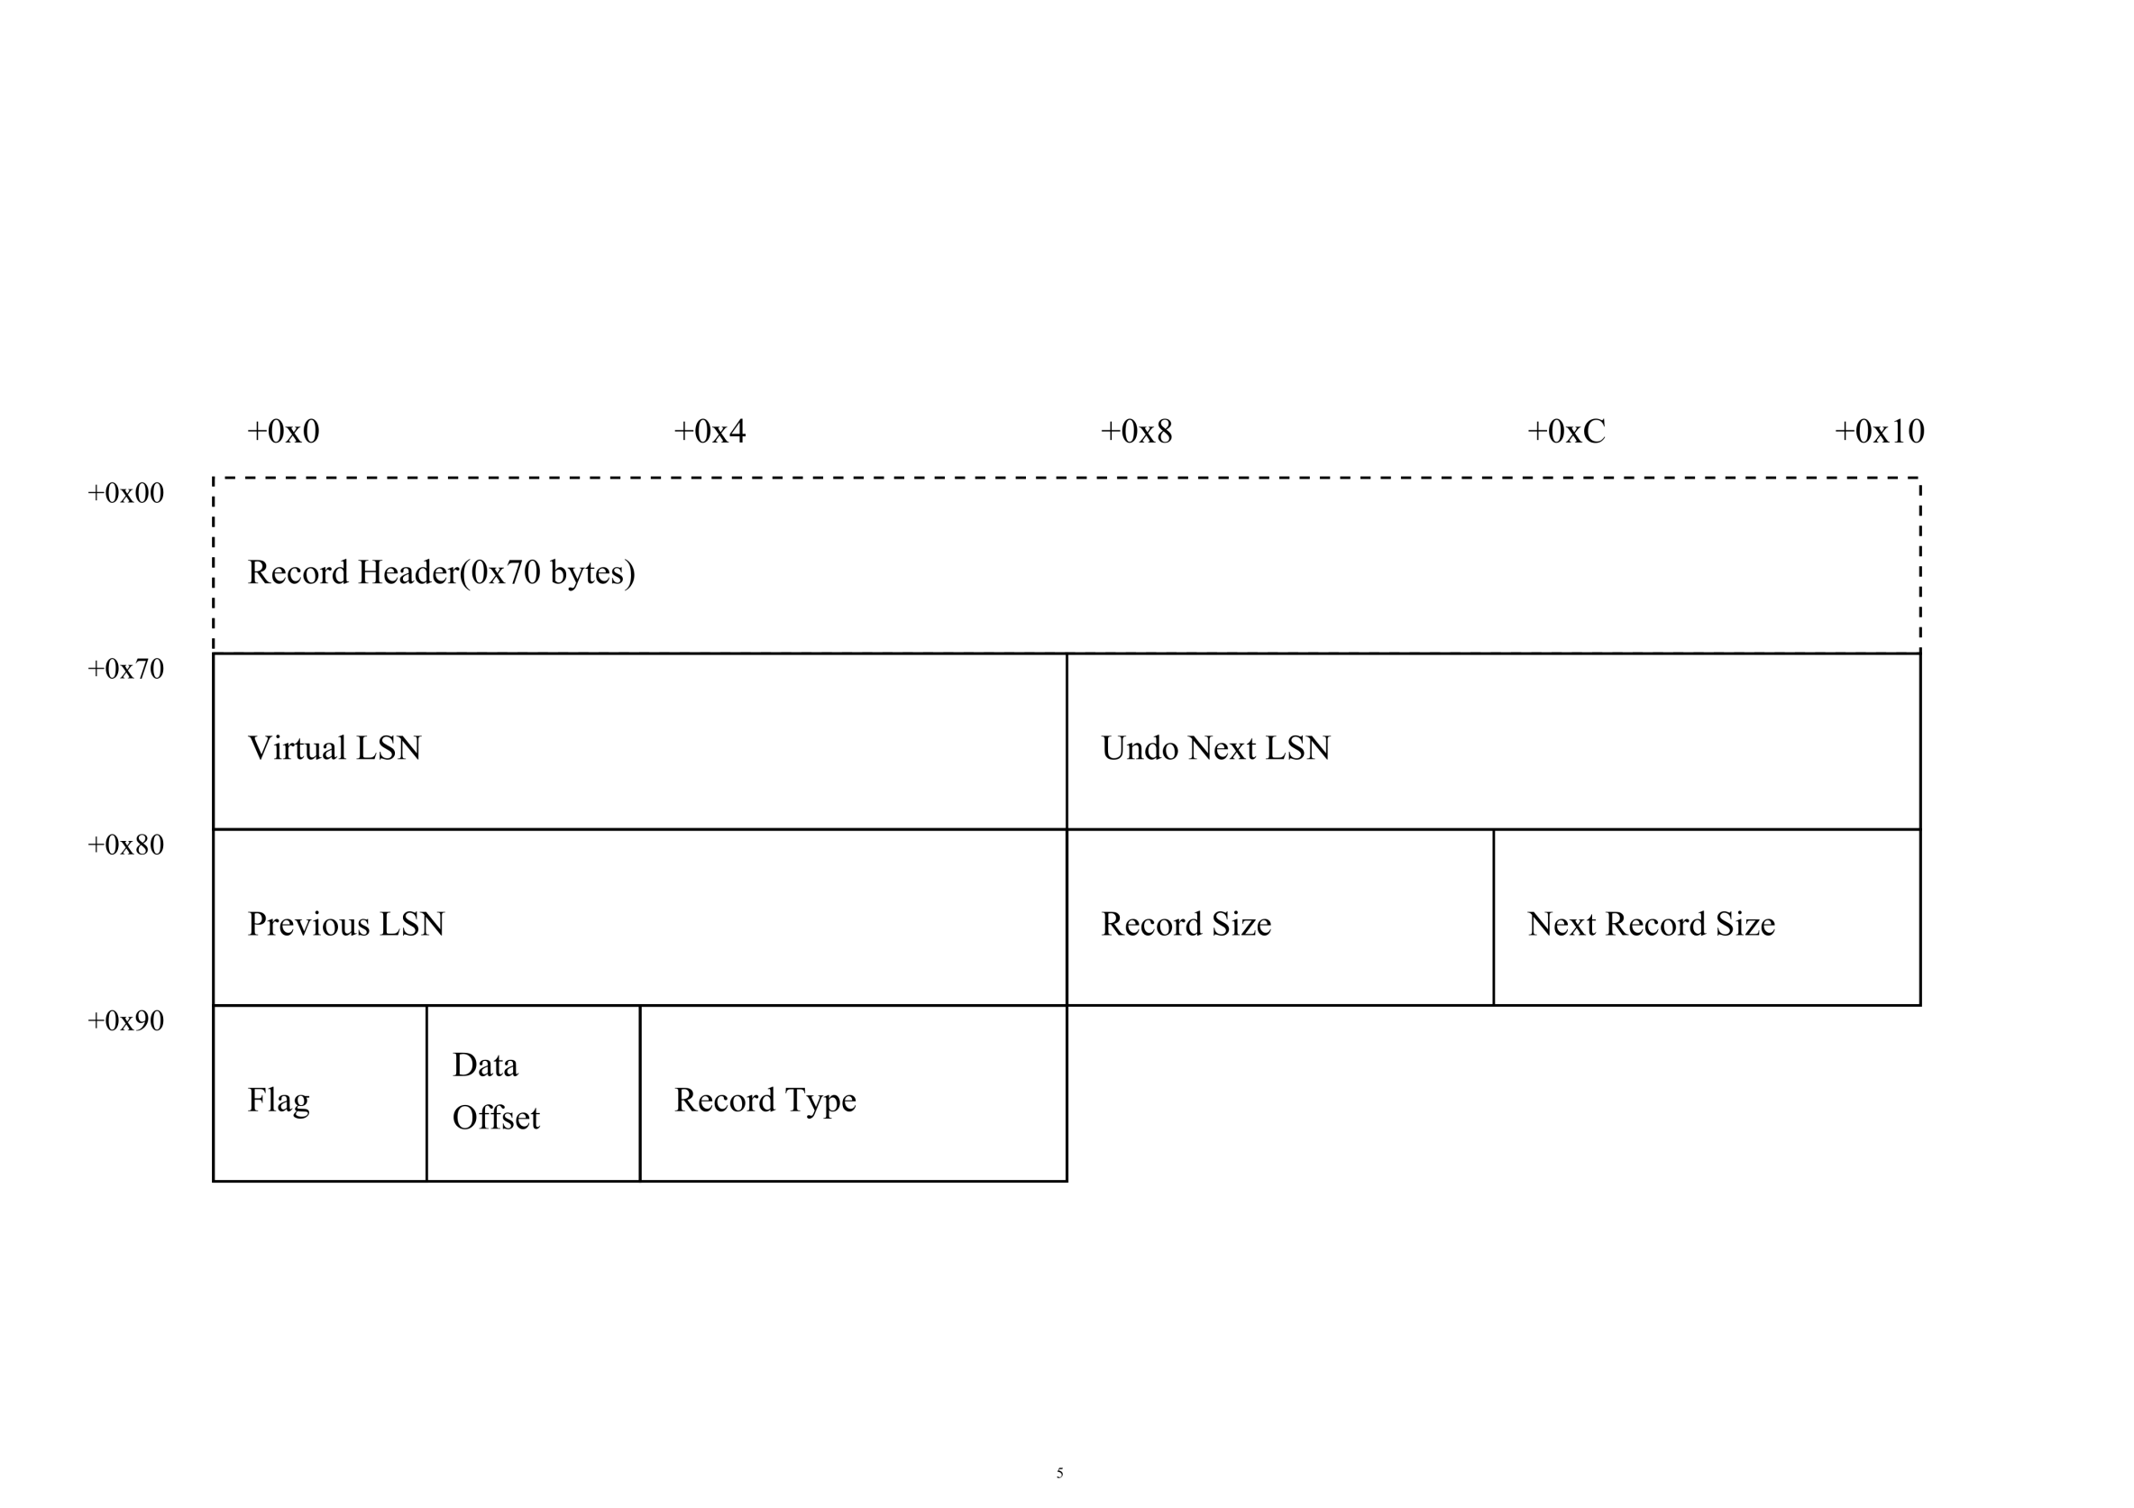
Container Record

Slide 26
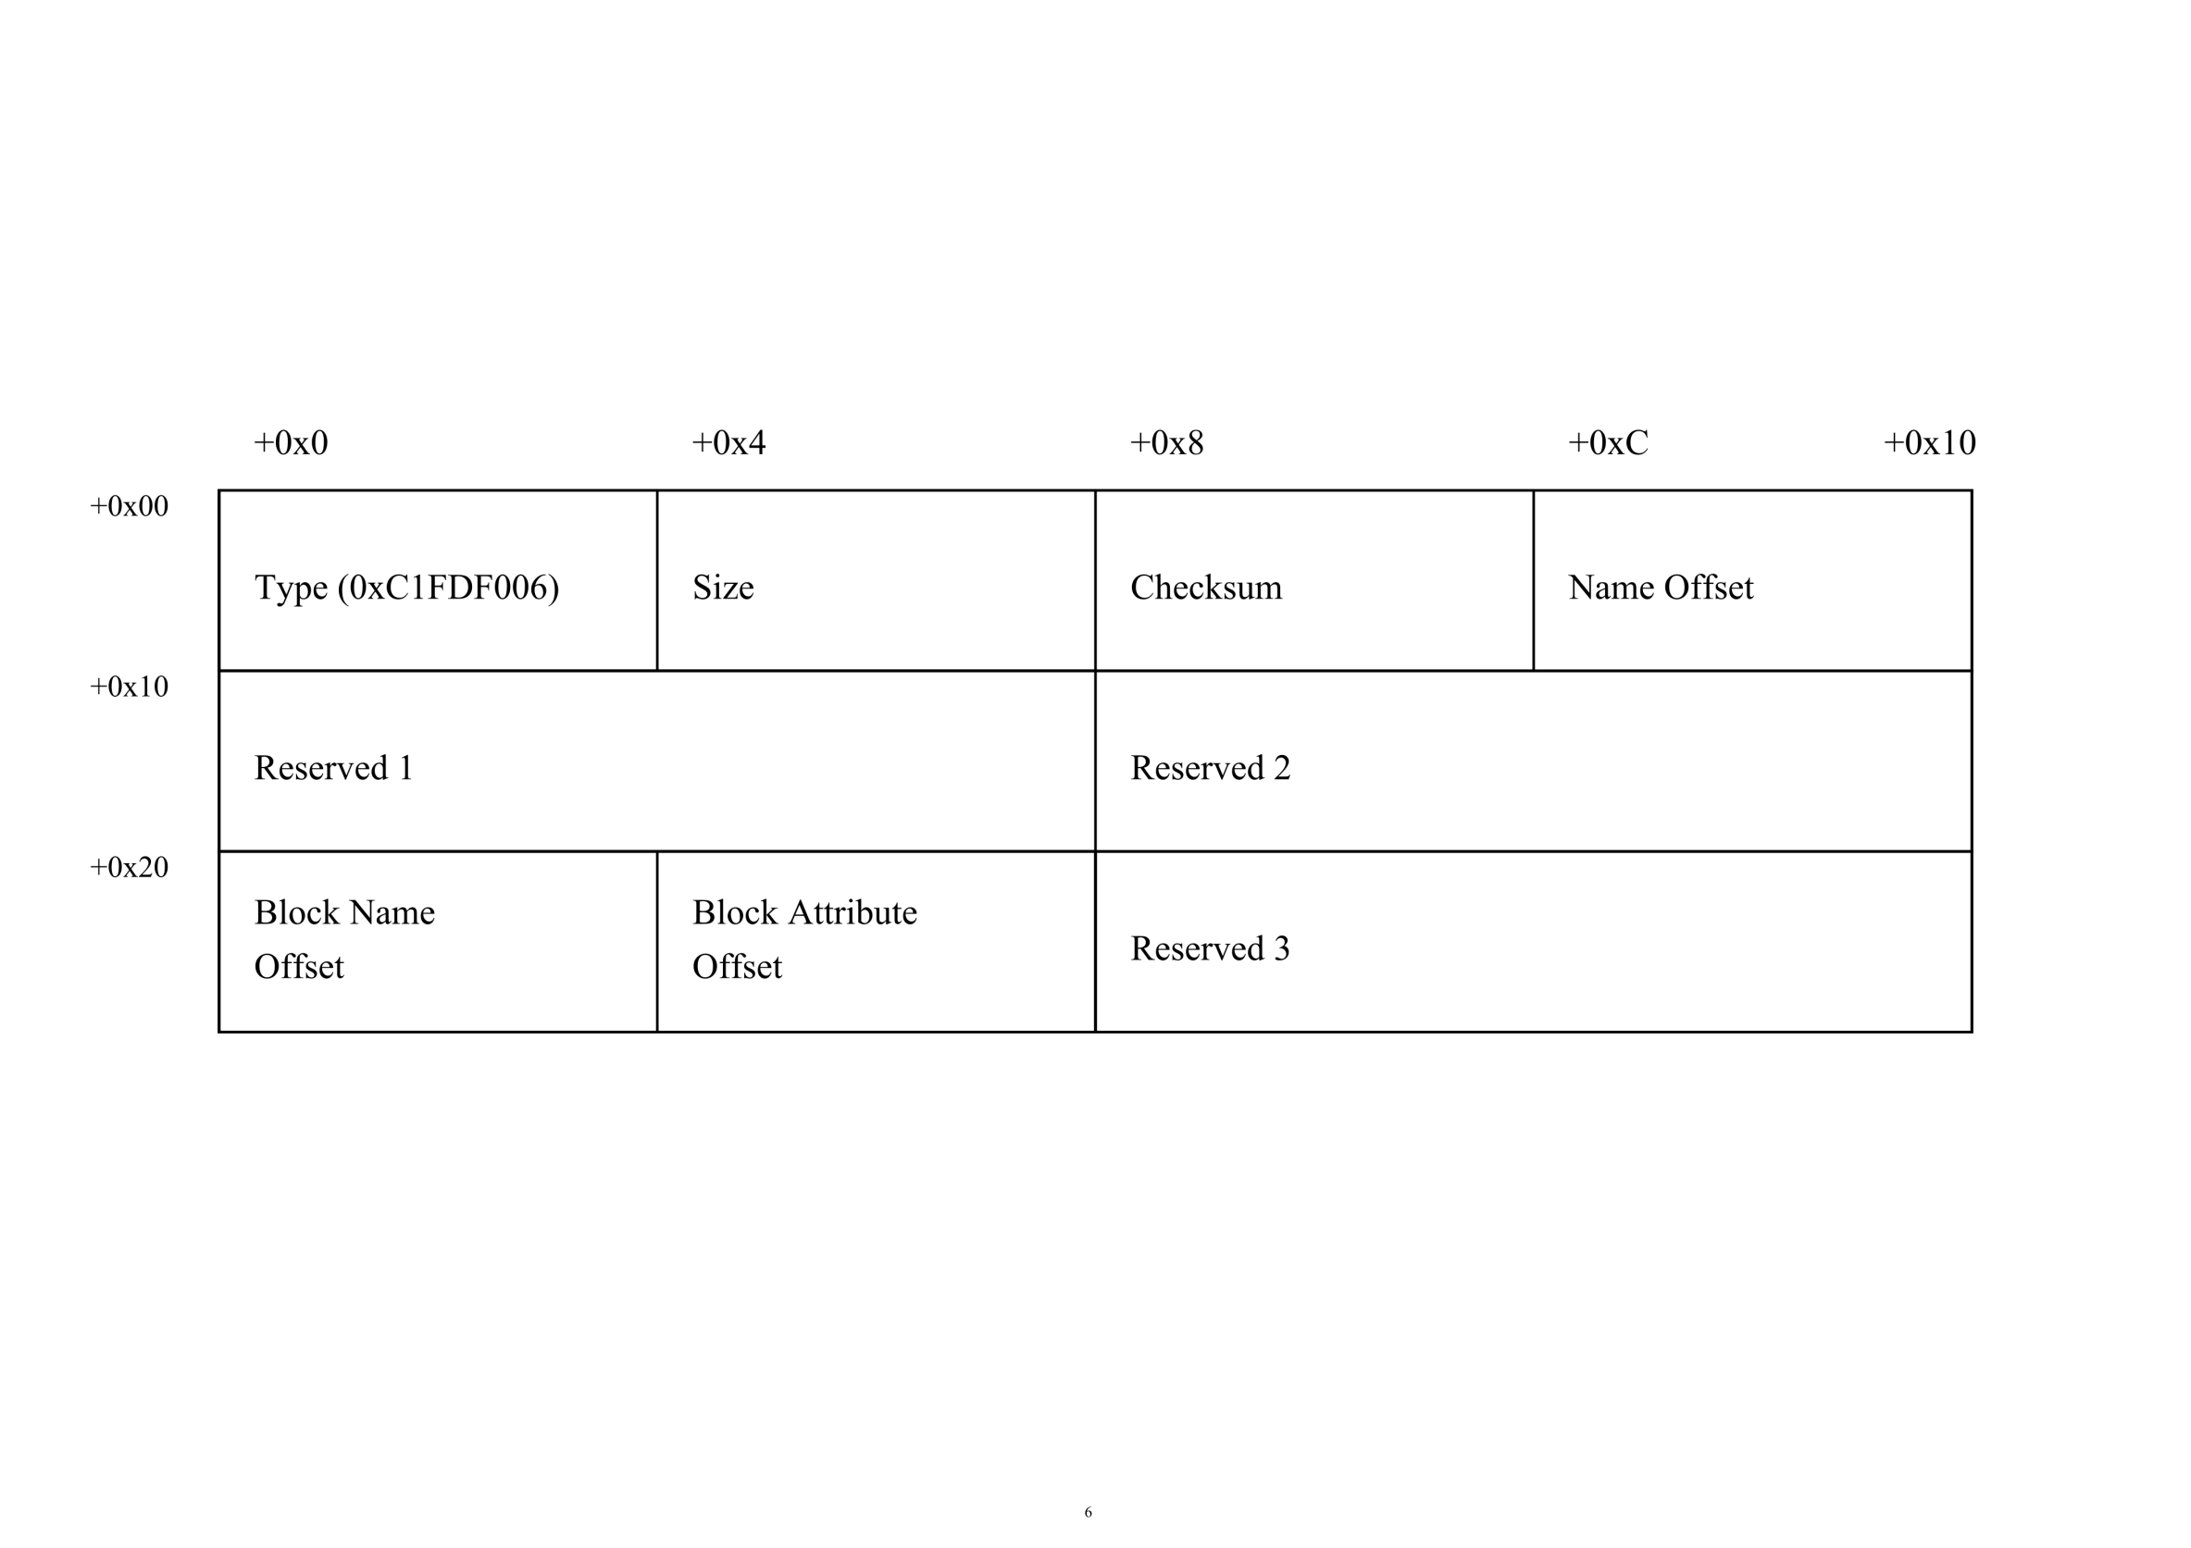
Symbol Header

Slide 27
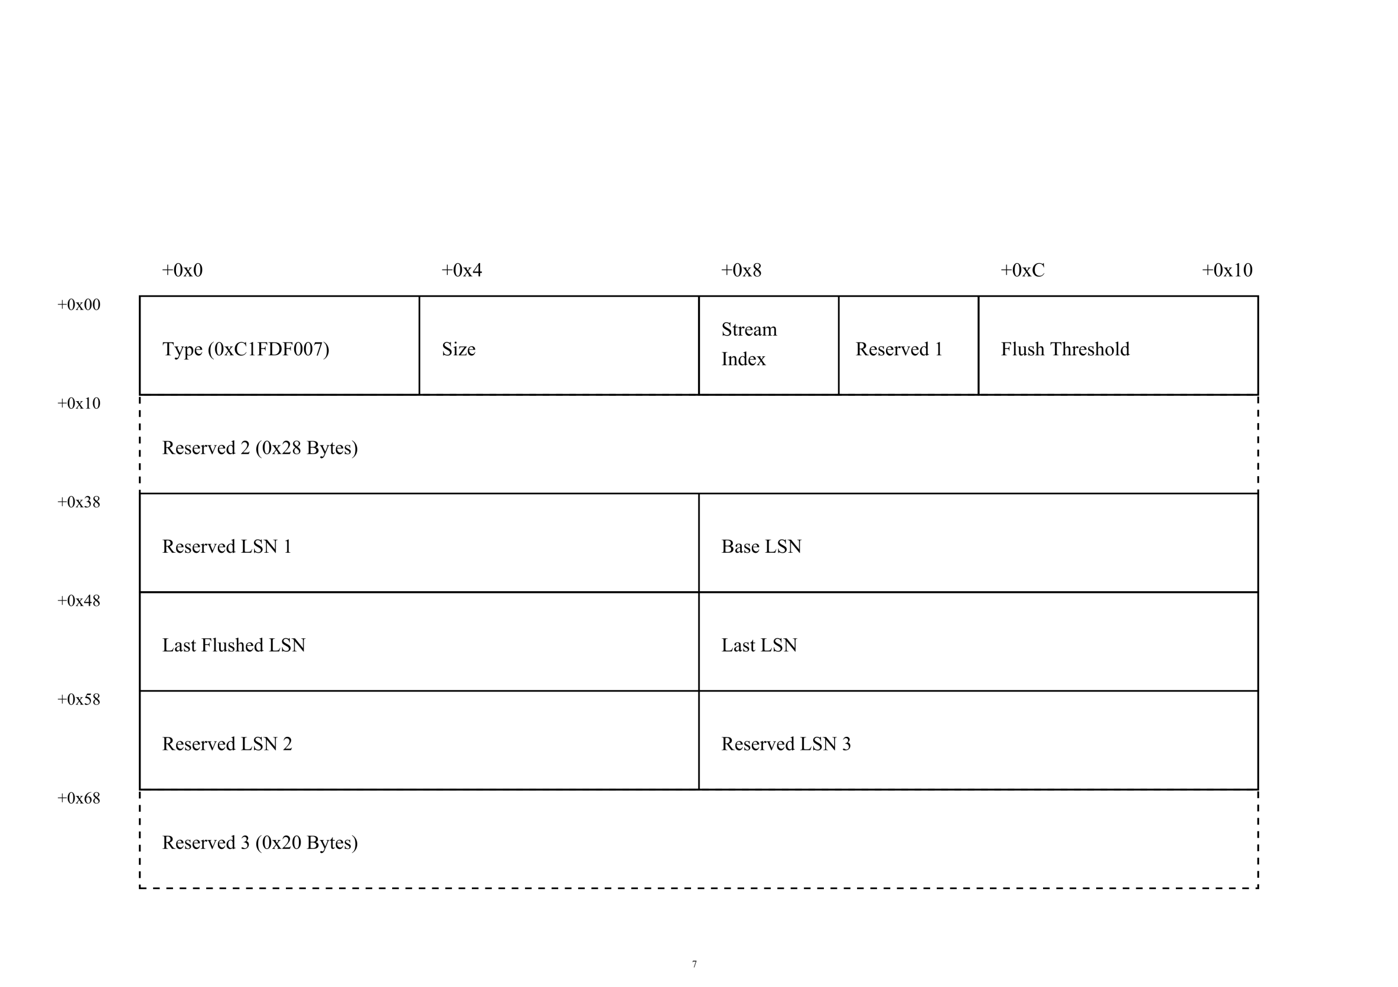
Client Context

Slide 28
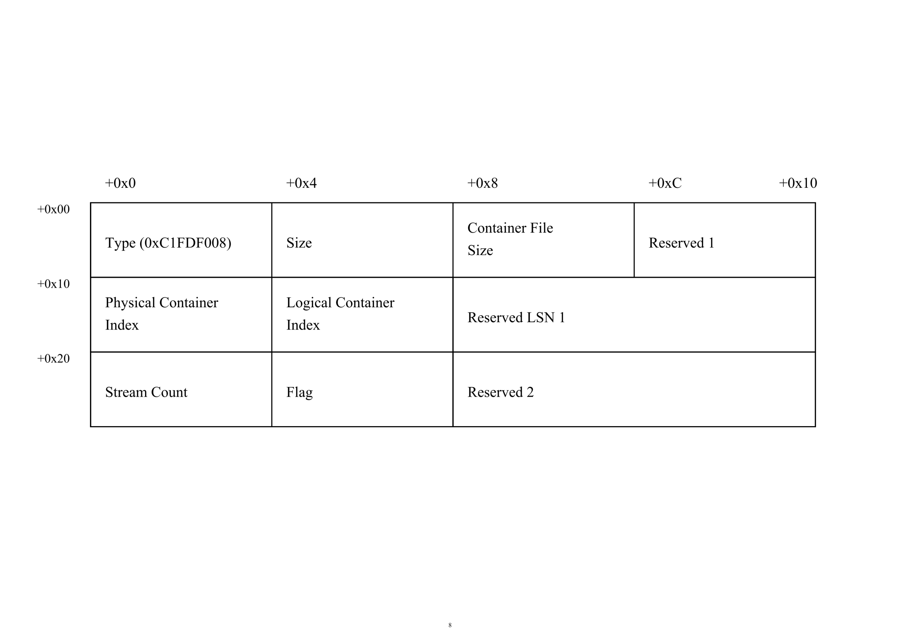
Container Context

Slide 29
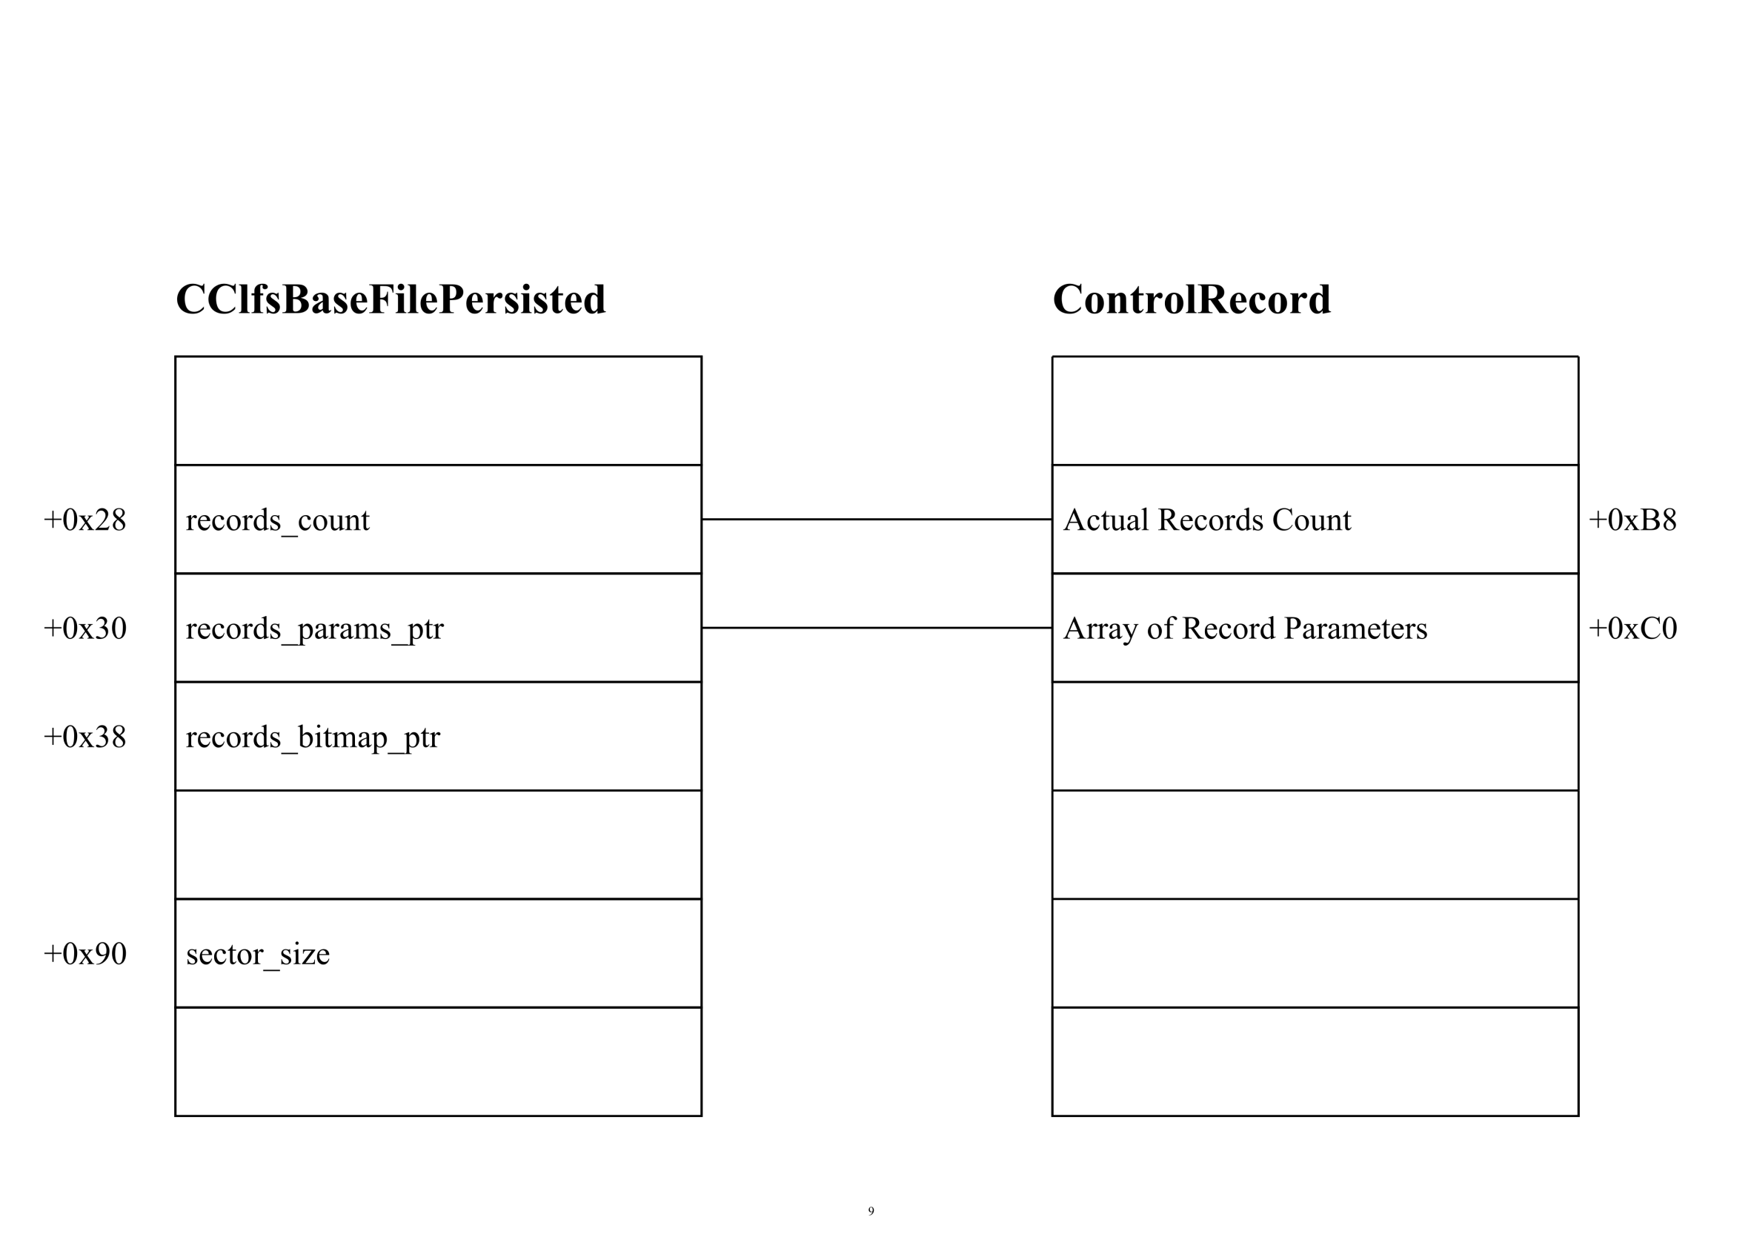
CClfsBaseFilePersisted::ReadImage

Slide 30
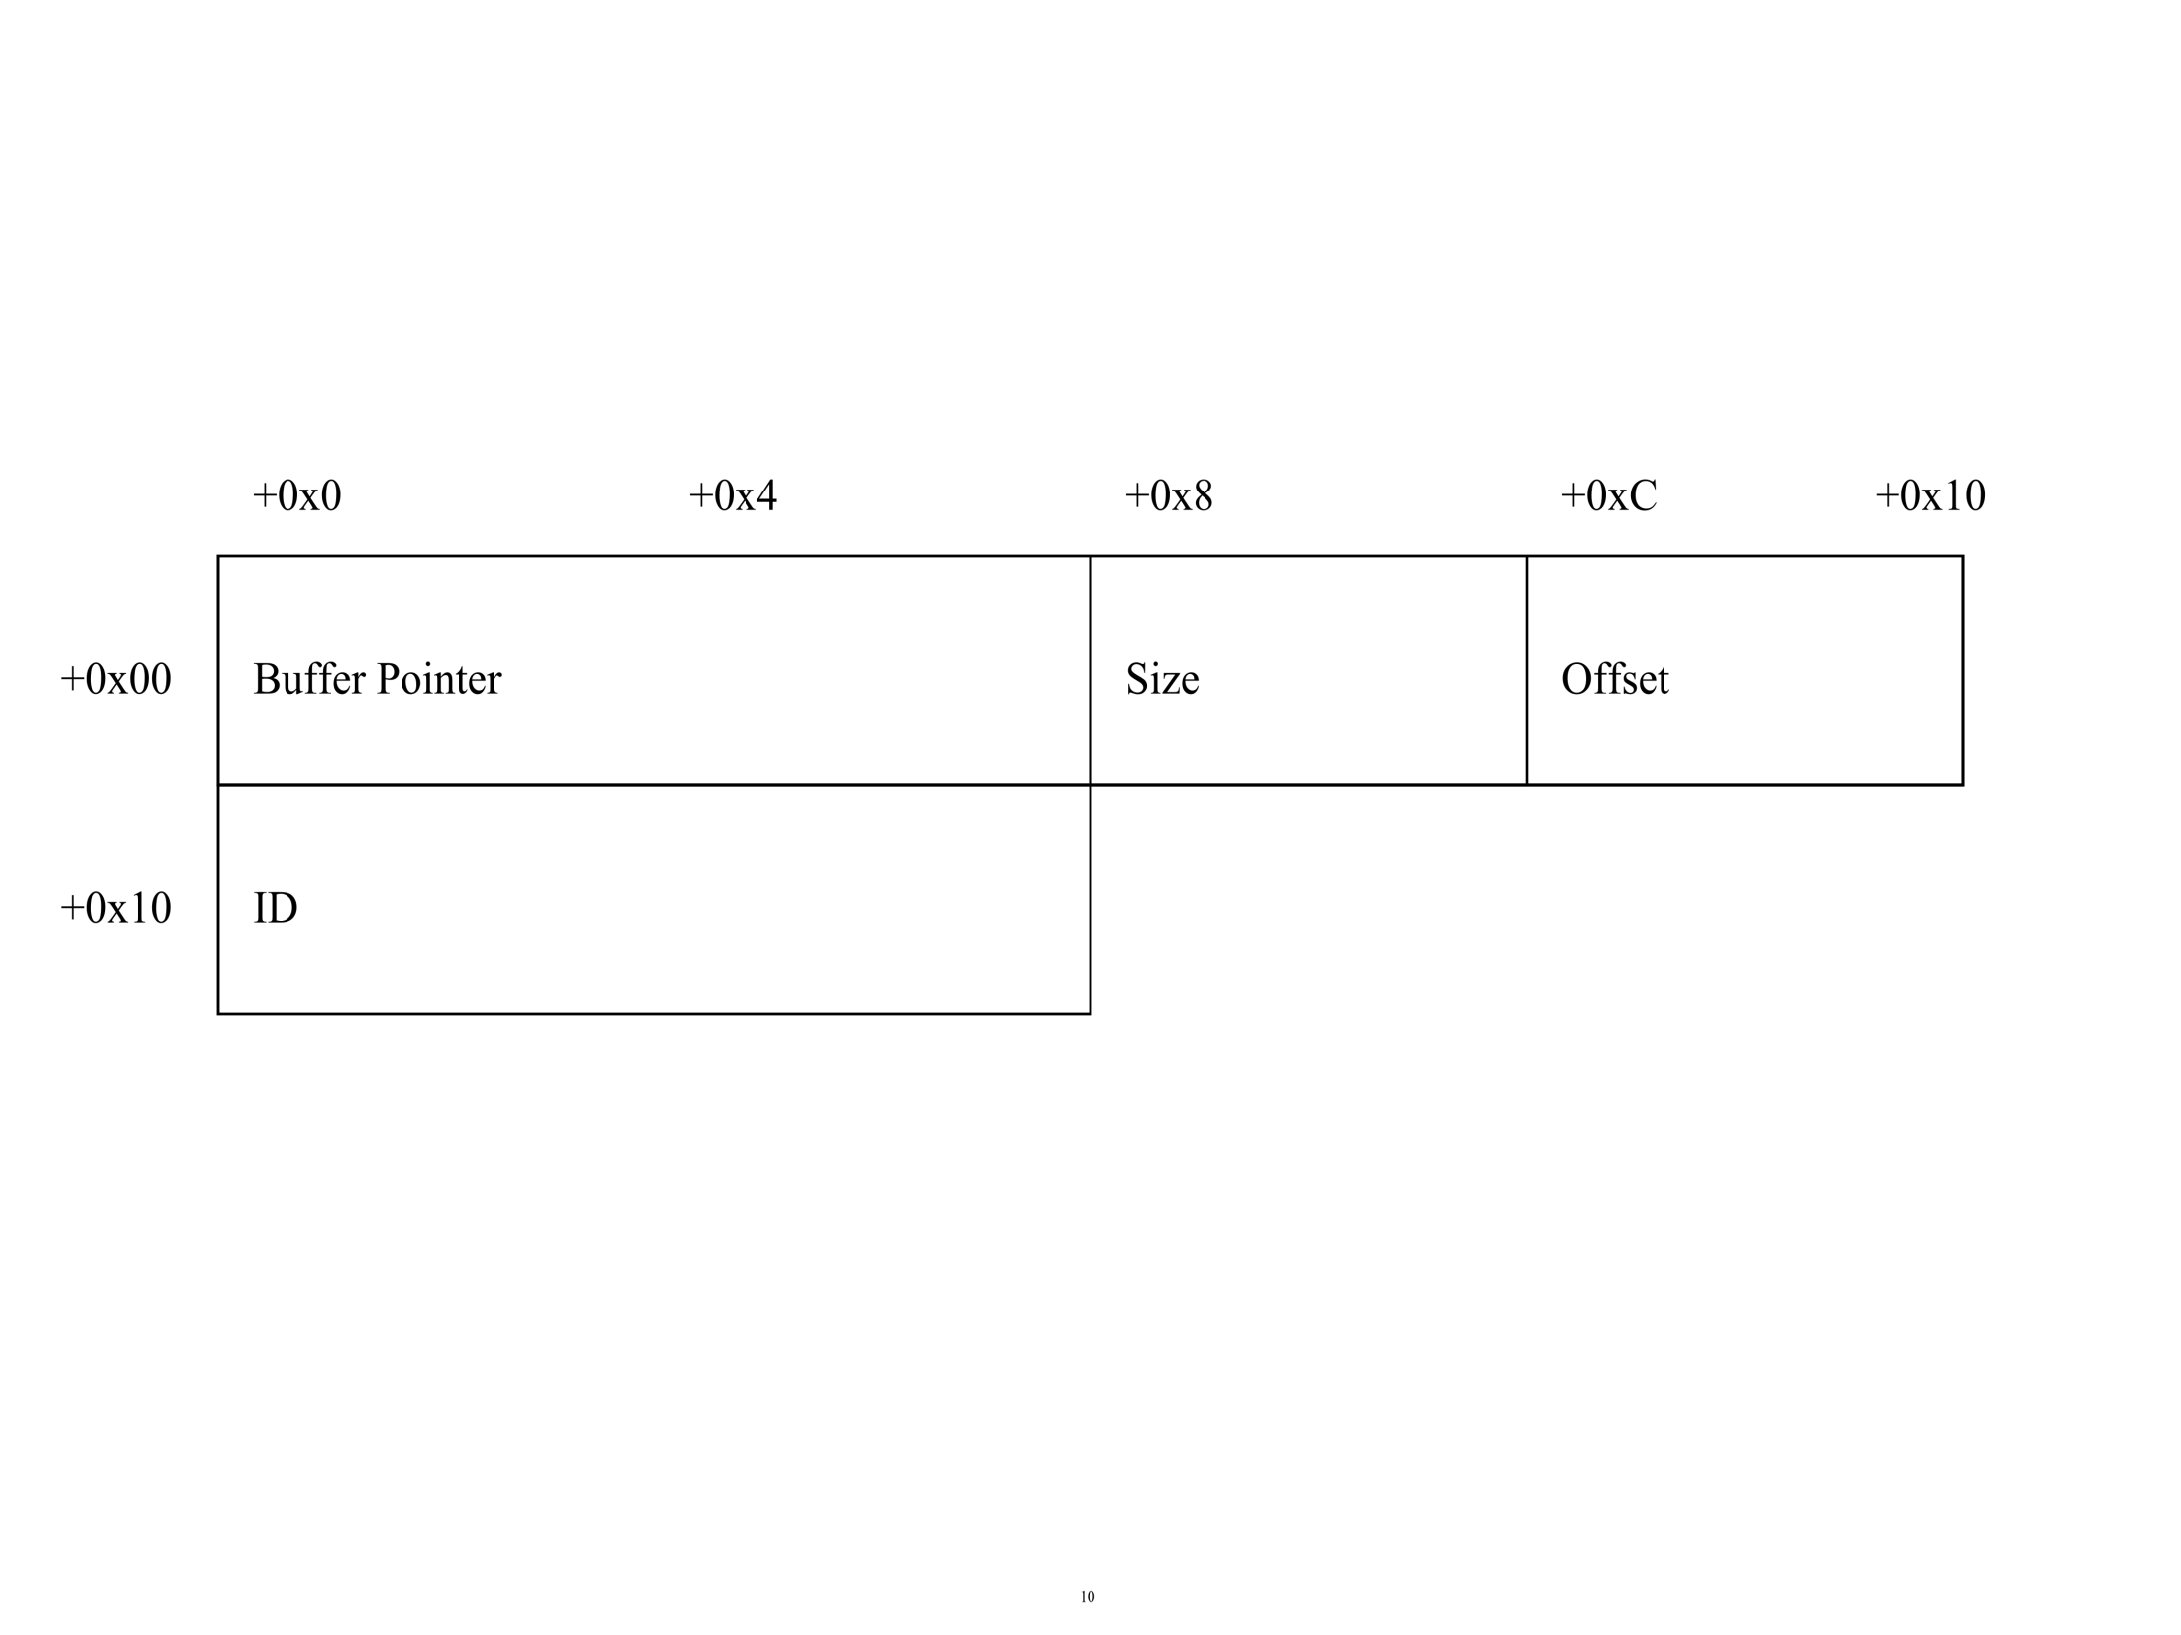
Record Parameter

Slide 31
CClfsBaseFile::GetBaseLogRecord
CClfsBaseFile::GetBaseLogRecord(CClfsBaseFile* this)
xor eax, eax
cmp ax, [rcx+28h]
jz short locret_1C00335DB
mov rcx, [rcx+30h]
mov rcx, [rcx+30h]
test rcx, rcx
jz short locret_1C00335DB
mov eax, [rcx+28h]
add rax, rcx
locret_1C00335DB:
retn

Slide 32
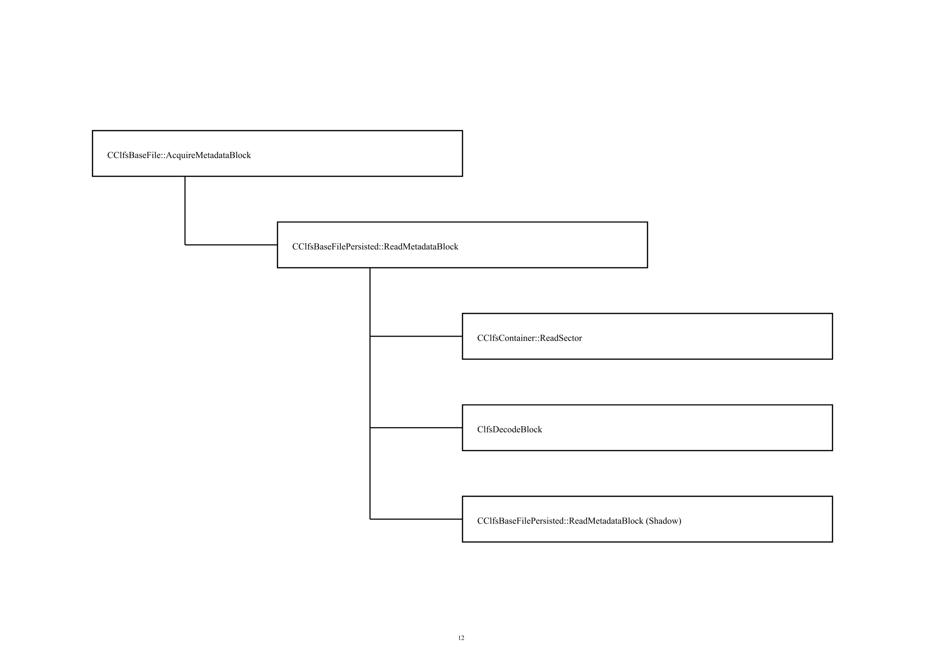
CClfsBaseFile::AcquireMetadataBlock

Slide 33
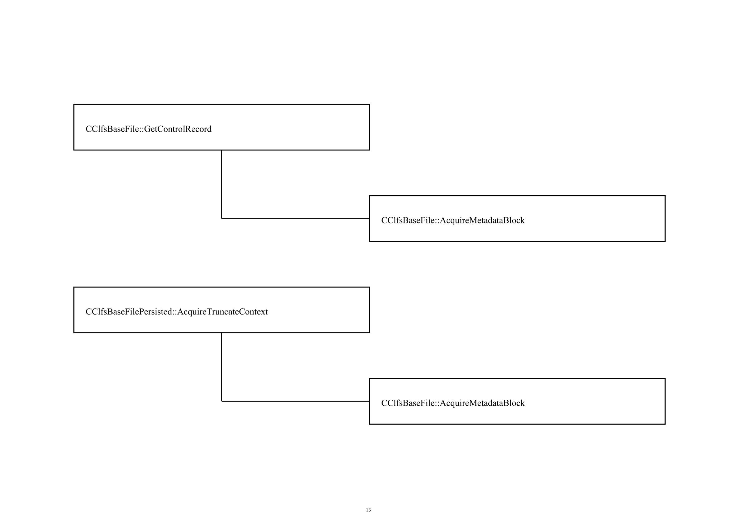
Use of AcquireMetadataBlock

Slide 34
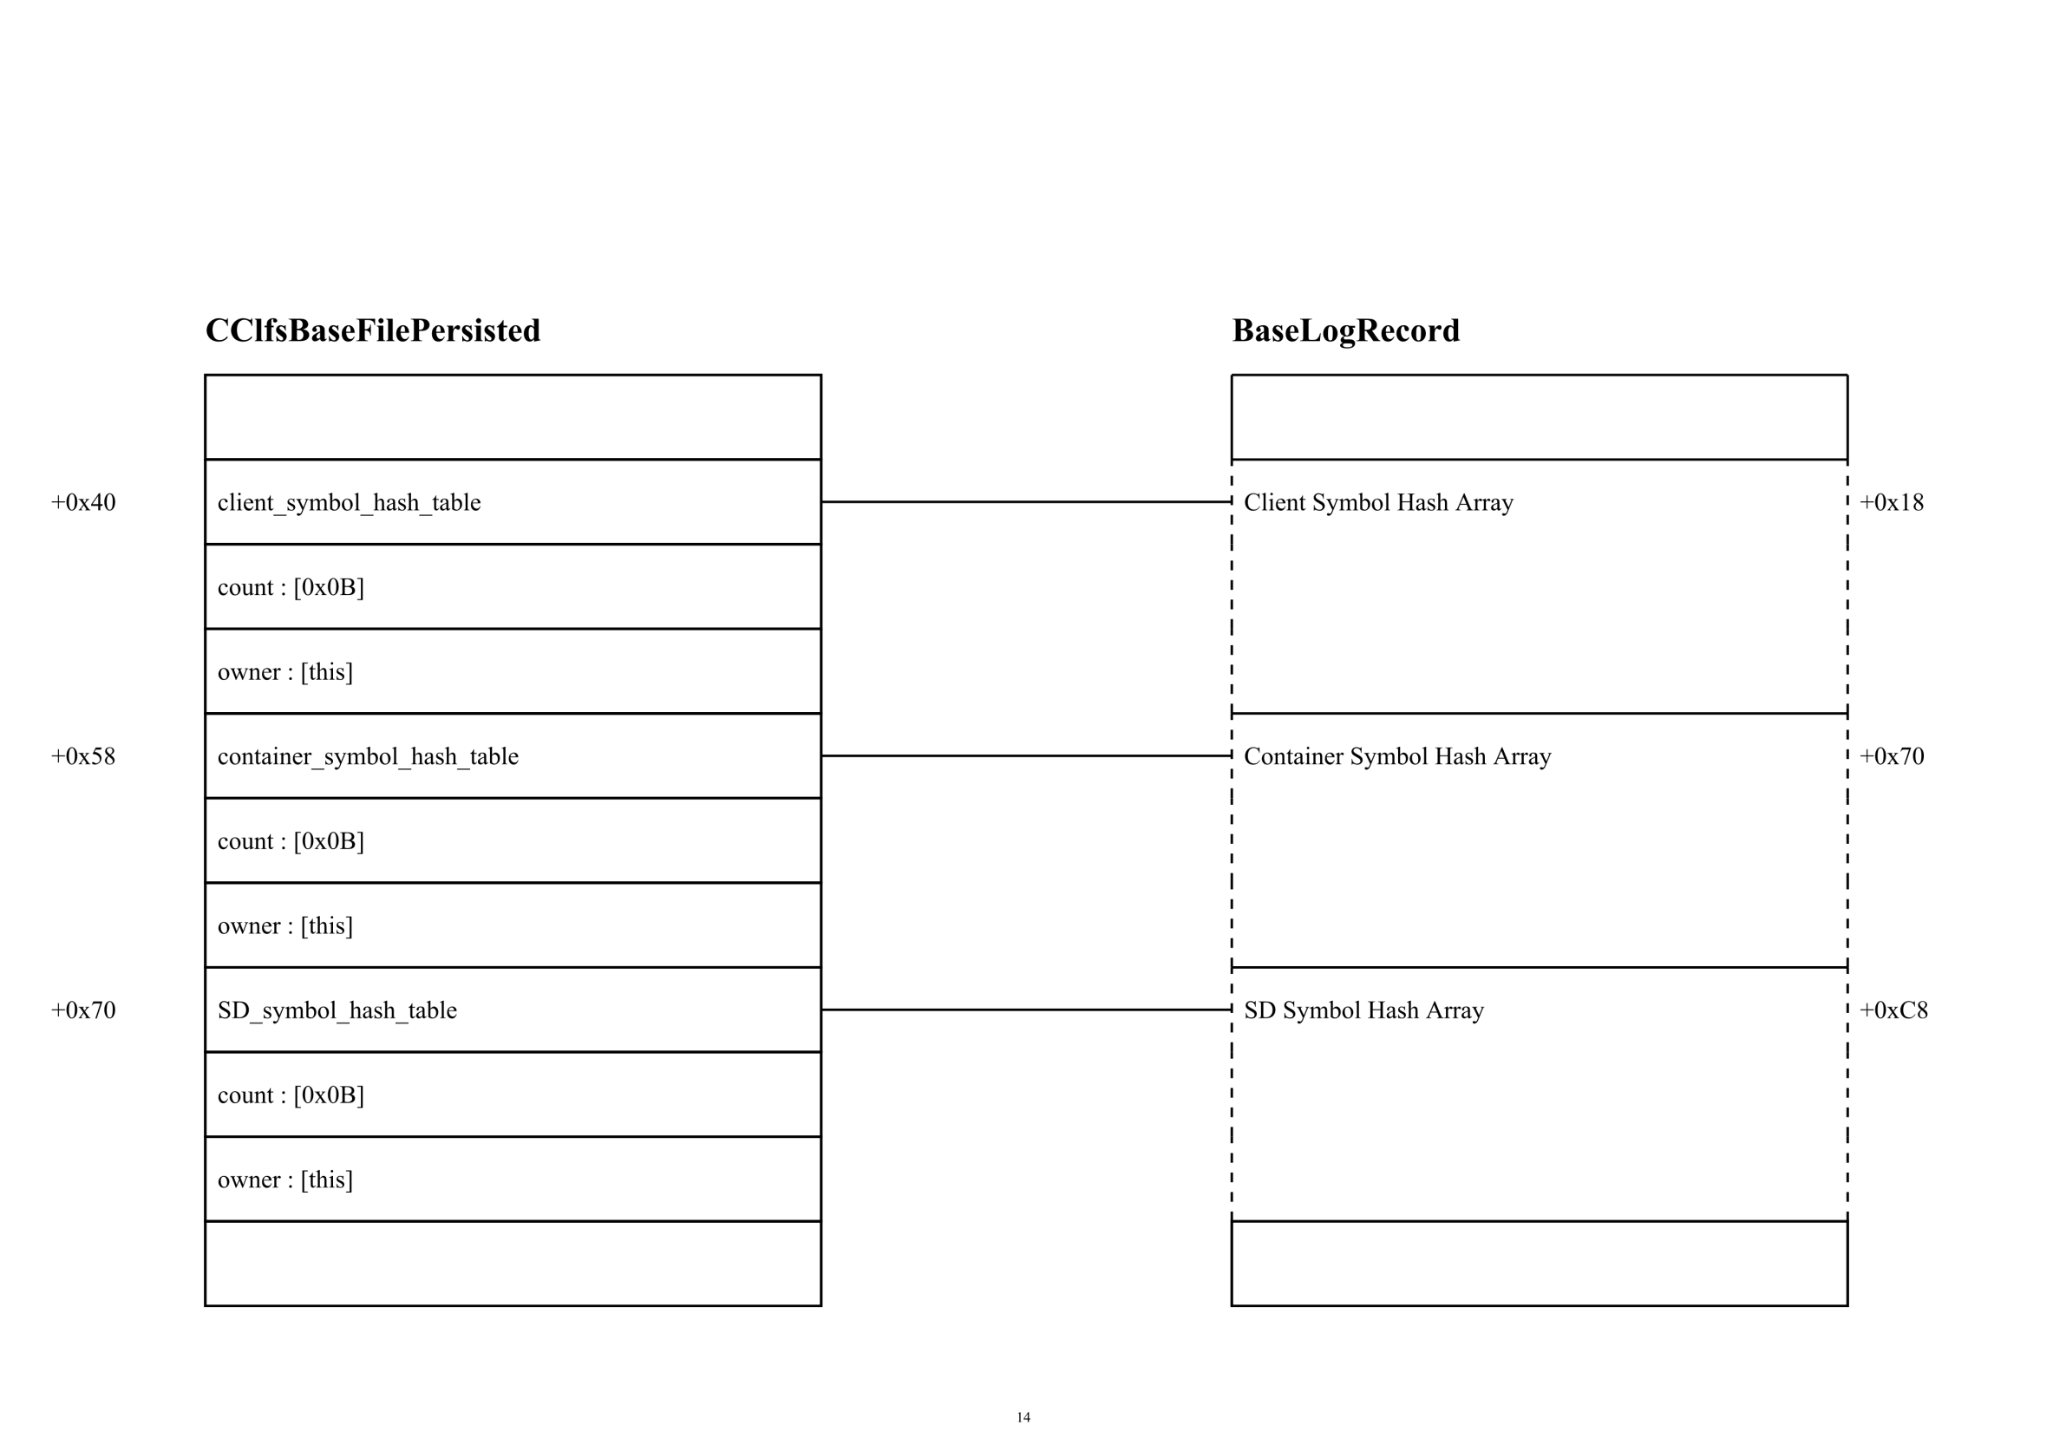
CClfsBaseFilePersisted::OpenImage

Slide 35
Symbol Hash Function
__int64 ClfsHashPJW(const struct _UNICODE_STRING *a1)
{
unsigned int v1 = 0, v4 = 0, v6;
PWSTR wchar_buffer = a1->Buffer;
const struct _UNICODE_STRING *v3 = a1;
if ( a1->Length & 0xFFFE ){
do{
int v5 = 0x10 * v1 + RtlUpcaseUnicodeChar(*wchar_buffer);
v6 = v5 & 0xF0000000;
if ( v5 & 0xF0000000 )
v5 ^= v6 >> 0x18;
v1 = v6 ^ v5;
++wchar_buffer;
++v4;
}
while ( v4 < (unsigned int)v3->Length >> 1 );
}
return v1;
}

Slide 36
Enhanced CLFS format fuzzing
If you know the target well enough, you can fuzz it well.
Since now, we know:
BLF file format
Control Record
Base Log Record
Symbol Header
Client Context
Container Context
Container Record
Clfs.sys has its own logic to parse these formats, is it robust enough?

Slide 37
Enhanced CLFS format fuzzing
Mutate
Inmune
Serialize
Select
Deserialize
push

Slide 38
Enhanced CLFS format fuzzing
class CControlRecord : public CFormatBase<CControlRecord>
{
……
virtual bool serialize(ostream & out) const override;
virtual bool deserialize(istream & in) override;
virtual bool mutate() override;
……
};
class CBaseLogRecord : public CFormatBase<CBaseLogRecord>
{
……
virtual bool serialize(ostream & out) const override;
virtual bool deserialize(istream & in) override;
virtual bool mutate() override;
……
};
……

Slide 39
Enhanced CLFS format fuzzing
bool CCLFSFormat::deserialize(istream & in)
{
……
m_controlRecord.deserialize(in);
m_controlRecordShadow.deserialize(in);
m_baseLogRecord.deserialize(in);
m_baseLogRecordShadow.deserialize(in);
m_truncateRecord.deserialize(in);
m_truncateRecordShadow.deserialize(in);
……
}
bool CCLFSFormat::mutate(istream & in)
{ …… }
bool CCLFSFormat::serialize(istream & in)
{ …… }

Slide 40
Enhanced CLFS format fuzzing
CCLFSDocument::CCLFSDocument(const string filename)
:m_template_filename(filename)
,m_template_stream(filename, ios::in | ios::binary)
{
/* number: 0 */m_engine.registerFilter(make_unique<CCommonErrorBypass>());
/* number: 1 */m_engine.registerFilter(make_unique<CPOC_XXX_1>());
/* number: 2 */m_engine.registerFilter(make_unique<CPOC_XXX_2>());
/* number: 3 */m_engine.registerFilter(make_unique<CPOC_XXX_3>());
/* number: 4 */m_engine.registerFilter(make_unique<CPOC_XXX_4>());
/* number: 5 */m_engine.registerFilter(make_unique<CPOC_XXX_5>());
……
}
void CCLFSDocument::mutate()
{
m_clfs_format.mutate();
m_engine.triggerFilter(3, m_orginal_clfs_format, m_clfs_format);
}

Slide 41
Enhanced CLFS format fuzzing
bool CPOCFilterEngine::triggerFilter(size_t filterIndex, CCLFSFormat& originalFormat, CCLFSFormat& format)
{
bool b_triggered = false;
for (size_t i = 0; i < m_filters.size(); i++)
{
if (i == filterIndex)
{
m_filters[i]->infect(originalFormat, format);
b_triggered = true;
}
else
m_filters[i]->immune(originalFormat, format);
}
return b_triggered;
}

Slide 42

Q & A
Thank you!

