Slide 1

You didnt see it’s coming?
“Dawn of hardened Windows Kernel”

Slide 2
$whoami
Peter
@zer0mem
Windows kernel research at KeenLab, Tencent
pwn2own winner (2015 / 2016), pwnie nominee (2015)
fuzzing focus : state
wushu player

Slide 3
agenda
Kernel attack surface
Fuzzing
Exploitation techniques
Mitigations

Slide 4
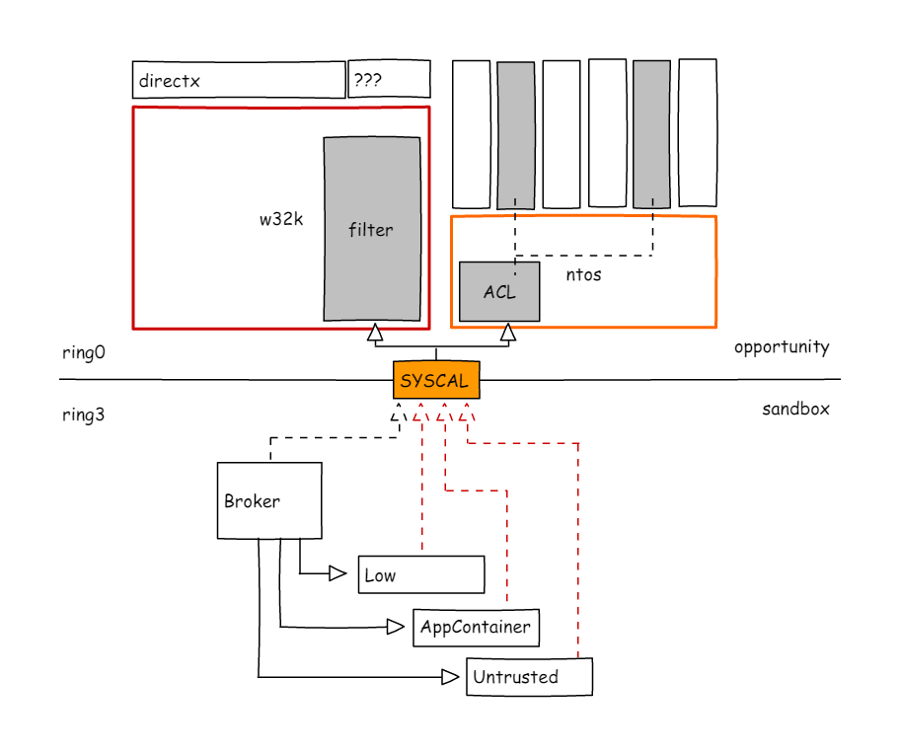
windows sandbox kernel attack surface

Slide 5
path of less resistance - w32k*
resides in ring 0
natural := ( level < medium ) -> SYSTEM (/kernel code exec) escape
huge attack surface
huge in comparsion to ntoskrnl counterpart or in-ring3-sandbox interface
state logic, window callbacks, hidden syscalls, directx, format parsing, ...
accessible from sandbox-es
nowdays more or less => big success!
easy develepoing of exploitation techniques

Slide 6
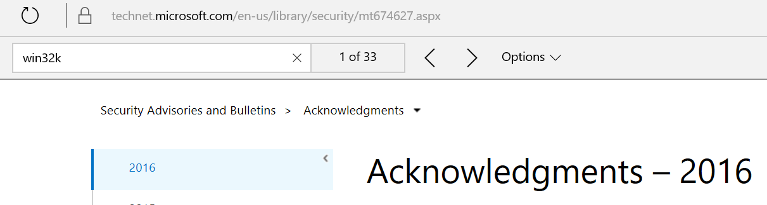
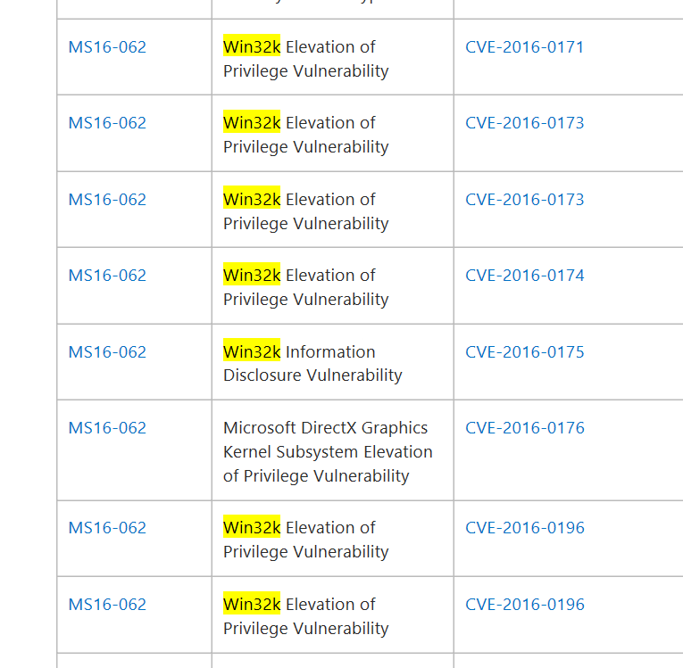
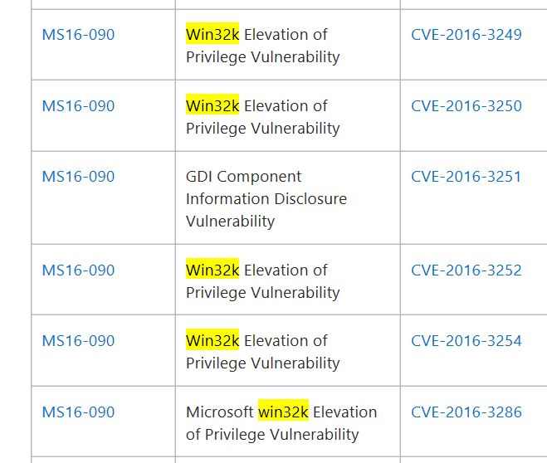
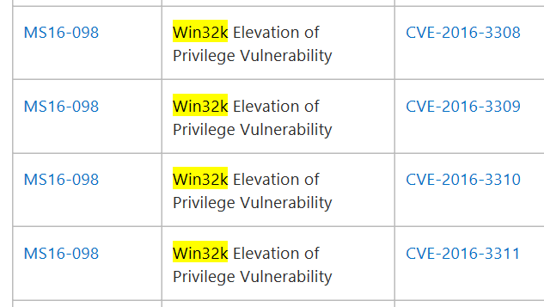
w32k vs 2016

Slide 7


what is going on ?
huge numbers of syscalls
lot of objects
lot of hardcore graphics stuffs
lot of things i dunno

Slide 8
w32k vs Qilin
Qilin - internal multi-platform fuzzing framework
Target – gdi - part of w32k
Technique :
knowledge based
random driven
interconnection aware
Results in graph
technique ++ code coverage
feedback + knowledge based (ongoing)
http://www.slideshare.net/PeterHlavaty/rainbow-over-the-windows-more-colors-than-you-could-expect

Slide 9
from bug to take over SYSTEM
except huge code base with lot of space for bugs
huge code base with lof of space for missusing existing mechanisms
valuable arsenal
virtual tables and alikes
unprotected lengths
plain state members
buffer pointers
prequisites :
call syscalls

Slide 10
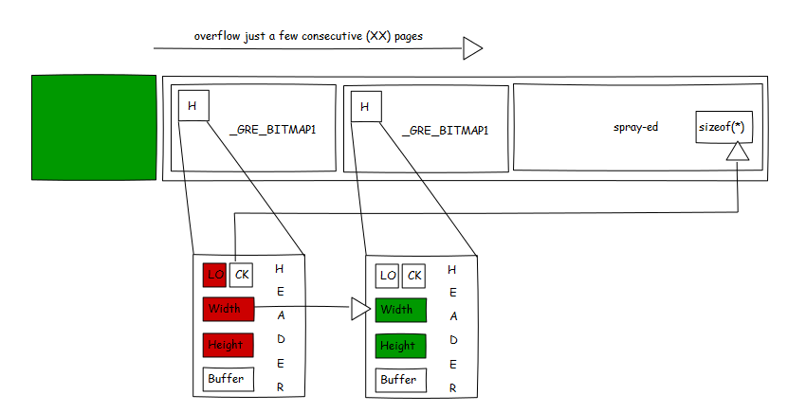
W32k kernel io : _gre_bitmap
Simple & *reliable*
pool layout
Direct syscalls for content manipulation
Pivot -> worker technique

Slide 11

w32k out of scope of interest ?
somehow :
going to be locked down & filtered out
not so cool anymore, many research done, many bugs out, ...
so complex so it even gets boring after time of researching there
if you trying to find something -> you will : if no, then try harder...
however in nowadays still applies (and some time will)
weakest points of windows kernel
accessible from most sandboxes
best attack vector nowadays
attackers are lazy, why do something hard if no need ?
*PERFECT GROUND FOR YOUR FUZZER*

Slide 12
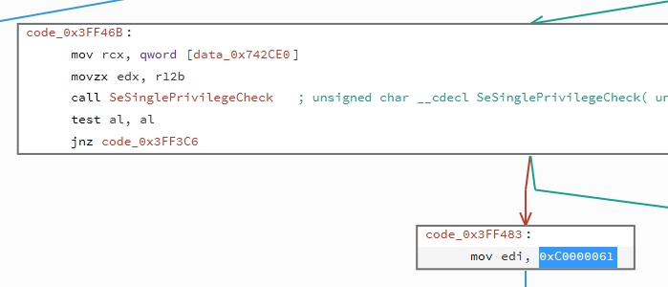
ntos : lets move from win32k
mutex
memory
thread
(a)lpc
section
pipe
...

Slide 13

ntos - attack surface
difference :
seemingly no data parsing +-
state only
from untrusted level / app container not much to touch
small number of state changing syscalls
state changes are minimalistic in most cases*

Slide 14
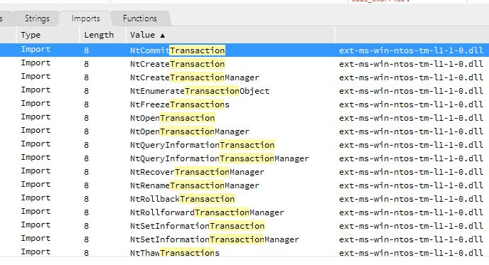
ntos under the microscope - extensions
Nt*Transaction*
Nt*Enlistment*
Nt*Manager*

Slide 15
tm.sys
ntos extension
Kernel Transaction Manager
however not much attack surface as well
simple states & minimum syscalls
however interconnections
Qilin vs tm, round1 :
1 nullptr
1 exploitable double ObDeref -> type confusion -> uaf

Slide 16
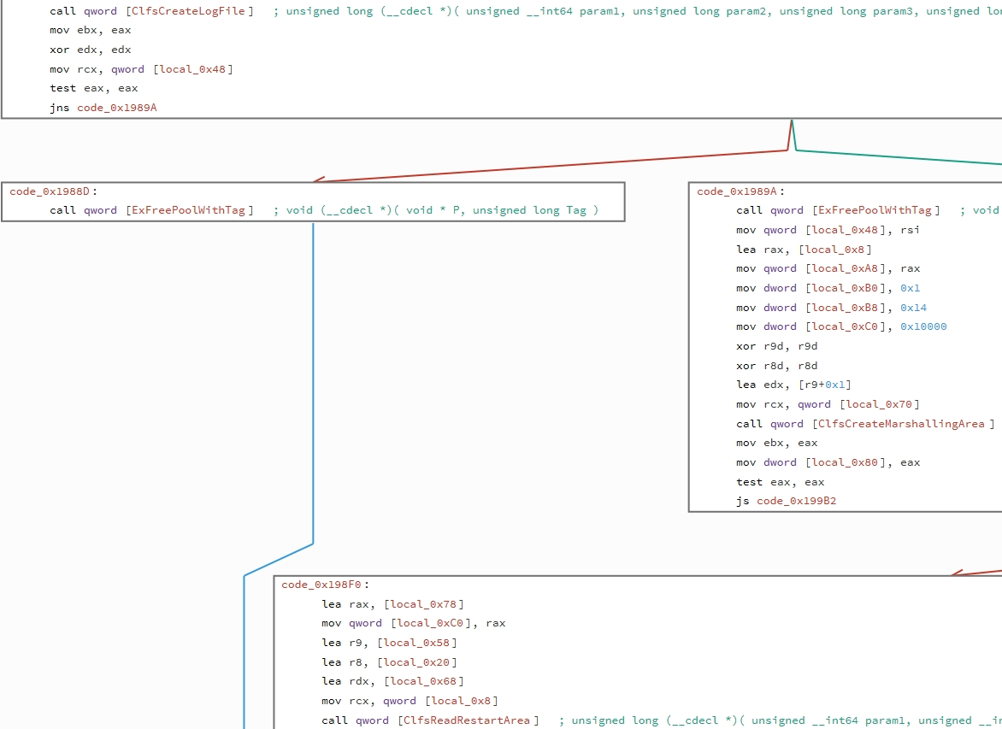
explore unknown : indirections++
tm.sys simple
purpose driver
but interesting
module involved
at backend
CLFS.sys

Slide 17
CLFS.sys : unseen hand behind the scenes
Common Log File System
not everything need to be direct
easy to get interest if you look at simplistic tm.sys
clfs used at many different places in ntos itself as well
clfs on other hand more complex
c++ code base
complex state
involve data parsing
Qilin vs clfs : 3~5 state bugs, 6~8 data parsing
Advanced *data* fuzzer : covers all first hand bugs, and extend 4+
by @long123king

Slide 18

bug hunting
research, fuzzing, feedback, analysis, loop back

Slide 19
kick off
select target
collect related syscalls ( apis )
research attack surface
go trough related msdn part (if any)
understand abstracted functionality
what it is purpose
what is usual way of working with it
double check interesting points with kernel implementation

Slide 20
fuzzer
make some code to automate working with target
optionally use existing framework, just add functionality per target
make it work
most basic syscalls working (open, close, get)
make use of previous reseach
implement basic schema from previous step
ensure that your fuzzer can sucessfully work on target based on documentation of target
introduce randomnes with preserving certain sucess ratio
introduce connections (syscall & handle dependencies)

Slide 21
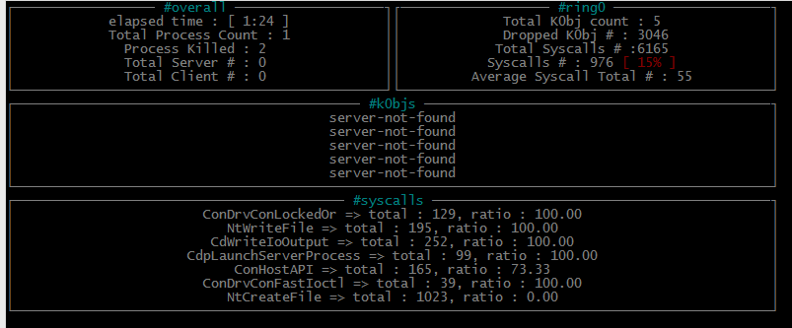
feedback
how good is your fuzzing ?
sucess ratio % ?
code coverage ?

Slide 22
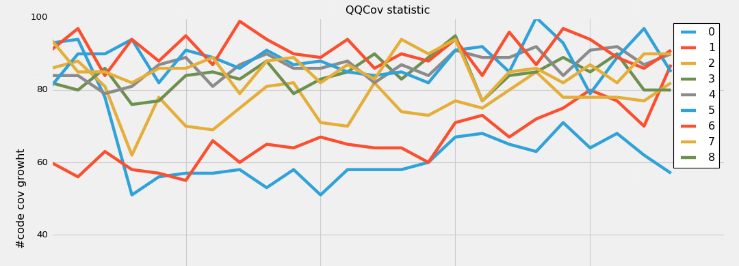
meassure your fuzzing

Slide 23
research
fuzzing is one part
you want more bugz ? you need know your target well
not only target, but your fuzzer as well
analyze less covered parts
think of possible buggy scenarios
implement back to fuzzer
loop back (from documentation, trough fuzzing up to understanding)
fuzzing
update
analyze

Slide 24
additional thoughts
fuzzing is not enough
you need to understand what you are fuzzing
better understanding helps to build more tricky logic
hower once you concrete too much, then you puting yourself into corner
better to be backuped with code coverage corpus
corpus is essential to keep & update, but not recycle (scatter&replace) often
fuzzer is not all you need
runtime tools [ adress sanitizers, race tools, debugger plugins, .. ]
static tools [ helping your fuzzer, helping your analysis ]

Slide 25
lets move to exploitation techniques!

Slide 26
options
w32k easy to go, however not so easy from locked down / filtered state anymore
can go trough chaining, but we can do better
ntos, harder to go
not much available syscalls - harder to setup & control technique properly
not much used before - why to go harder way if no need ?
less objects, with less nasty states

Slide 27
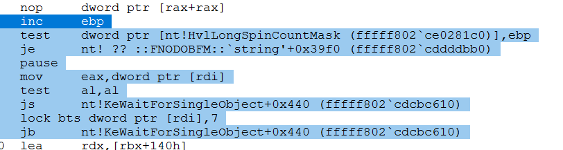
nt!KeWaitForSingleObject
small object
relativelly simple
interesting logic behind usage
lock / unlock
wait
kernel pointers
ethreads
offers various primitives :
arbitrary decrease
arbitrary write where - kernel pointer*
...

Slide 28
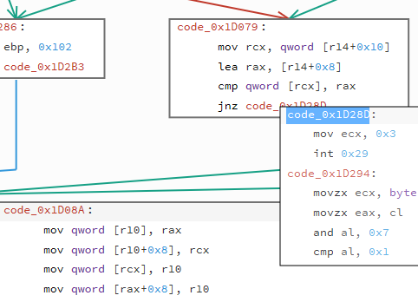
SafeLink write where primitive
Introduced to deal
meta data link corruptions
previously lead to :
write where - what
now it leads to int 0x29
... not necessary, or ?
B
C
A

Slide 29
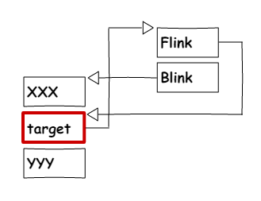
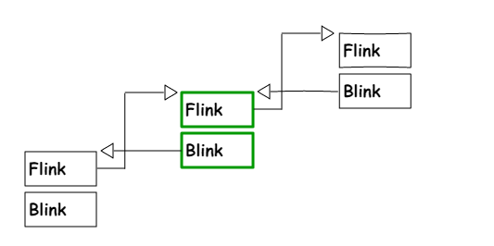
Arbitrary write – kernel pointer
target needs to point to semaphore / event
Problem ? .. Well not much :
You can predict kernel mode memory members
You can misalign
Flink –> Blink == Blink -> Blink
http://www.slideshare.net/PeterHlavaty/how-safe

Slide 30
ALPC
not everything touchable in ntos is really minimalistic
more complex mechanism
more complex state
good interconnections
.. however well written code ..
lot of safe checks
safe user mode memory handling (via 'getters')
seems well designed
http://alex-ionescu.com/Publications/SyScan/syscan2014.pdf

Slide 31
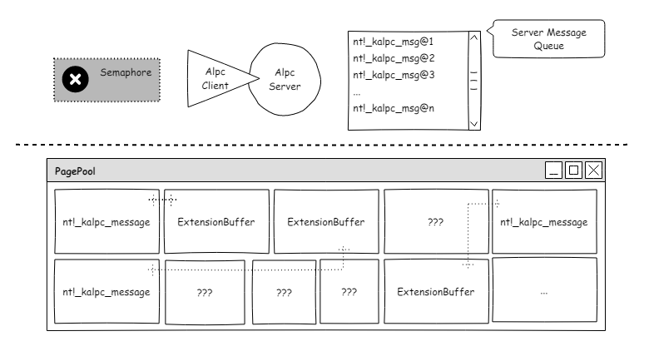
ALPC #spray
kd> dt nt!_kalpc_message
…
+0x010 PortQueue
+0x018 OwnerPort
…
+0x068 MessageAttributes
+0x0b0 DataUserVa : Ptr64 Void
…
+0x0d8 ExtensionBuffer : Ptr64 Void
+0x0e0 ExtensionBufferSize : Uint8B
+0x0e8 PortMessage : _PORT_MESSAGE
kd> dt nt!_kalpc_message PortMessage->u1->*
+0x0e8 PortMessage :
+0x000 u1 :
+0x000 s1 : <unnamed-tag>
+0x000 Length : Uint4B
+0x004 u2

Slide 32
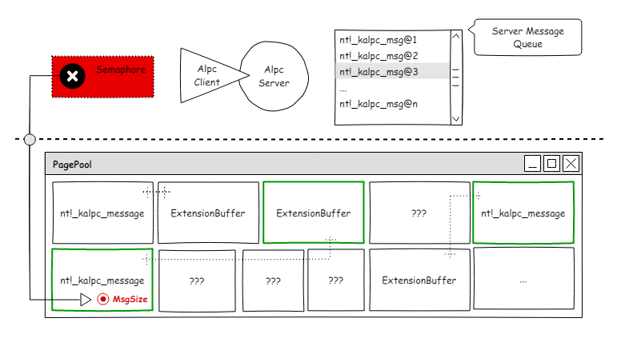
ALPC #detect
kd> dt nt!_kalpc_message
…
+0x010 PortQueue
+0x018 OwnerPort
…
+0x068 MessageAttributes
+0x0b0 DataUserVa : Ptr64 Void
…
+0x0d8 ExtensionBuffer : Ptr64 Void
+0x0e0 ExtensionBufferSize : Uint8B
+0x0e8 PortMessage : _PORT_MESSAGE
kd> dt nt!_kalpc_message PortMessage->u1->*
+0x0e8 PortMessage :
+0x000 u1 :
+0x000 s1 : <unnamed-tag>
+0x000 Length : Uint4B
+0x004 u2

Slide 33
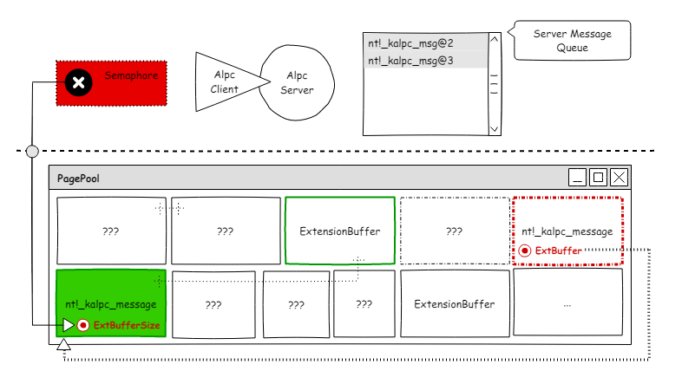
ALPC #overflow
kd> dt nt!_kalpc_message
…
+0x010 PortQueue
+0x018 OwnerPort
…
+0x068 MessageAttributes
+0x0b0 DataUserVa : Ptr64 Void
…
+0x0d8 ExtensionBuffer : Ptr64 Void
+0x0e0 ExtensionBufferSize : Uint8B
+0x0e8 PortMessage : _PORT_MESSAGE
kd> dt nt!_kalpc_message PortMessage->u1->*
+0x0e8 PortMessage :
+0x000 u1 :
+0x000 s1 : <unnamed-tag>
+0x000 Length : Uint4B
+0x004 u2

Slide 34
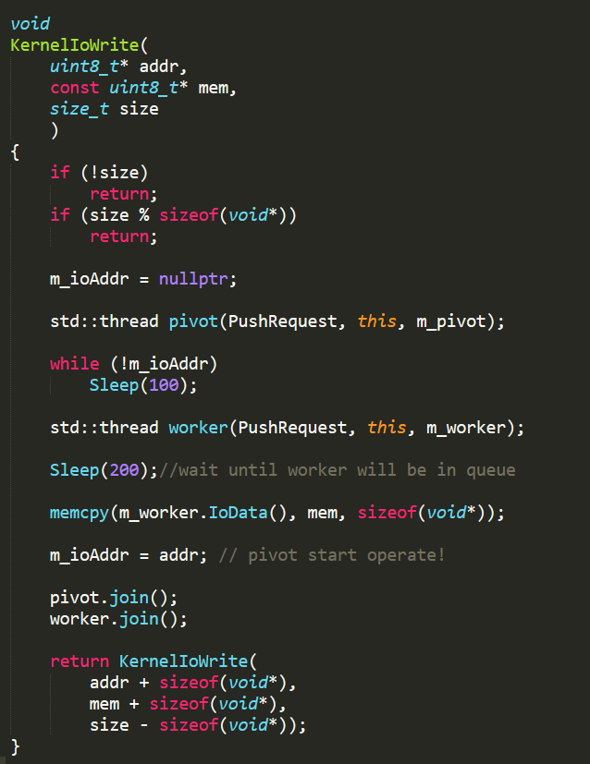
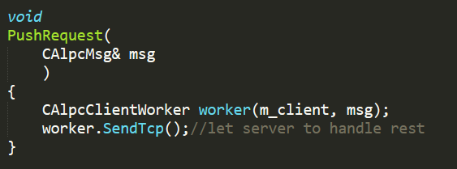
ALPC #io
#4 threads
( gdi tech, only #1 thread )
io
pivot
worker
server
Performing additional write per io !
synchronization
Undocumented ALPC
Setup server – client
Keeping messages alive
pool feng shui is problematic

Slide 35
Hardenings !?
SMEP, KASLR, Nx, CFG, RFG, ACL, SafeLink ...

Slide 36
from user to kernel, from kernel to jail : w32k
Filtering
? win32k – win32kfull – win32kbase ?
win32k -> wrapper to add stub* with access checks
restrict access only to necessary parts
maybe not 'clean' solution, but security++ (relatively)
app can have different sandboxed entities, and per entity different attack surfaces
find way from one to another, and you can find way out of filter
in optimal scenario limit potential bug landscape
first part of good effect
in optimal scenario limit exploitation techniques
this is the second good effect
lockdown
wow, this sure solve something in crazy *absolute* way O_o

Slide 37
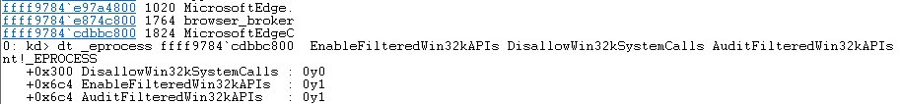
w32k is here for you if you need it!
One can have arbitrary decrease ? [ see previous semaphore slides ]
Or any suitable primitive, just necessary be creative
Would he choose alpc technique ?
If he is lazy (smart) enough, then no …
Re-enable w32k instead!
even allow more proc in your job in case of need
do one-bit kernel pwn via win32k!_gre_bitmap and enjoy life!

Slide 38
kernel code exec vs mittigations
KASLR, code signing, Nx, CFG, SMEP
set some good security boundaries
however getting code exec no problem after all
kaslr - good bug or additional info leak
code signing : we will ship our code to kernel via kernel io, and exec it
Nx + SMEP : find rwe page, or create it
CFG : find good trampoline or target stack

Slide 39
easy to be said, harder to be done ?
not actually
kernel-io techniques already described
still headache with kernel Nx / SMEP ?
NtUserMessageCall [ following slide ]
CFG
prevents only from ROP to be kicked of
i dont like ROP neither, target stack [ + functions ]
CFG alone is not enough (in terms of code exec) !

Slide 40
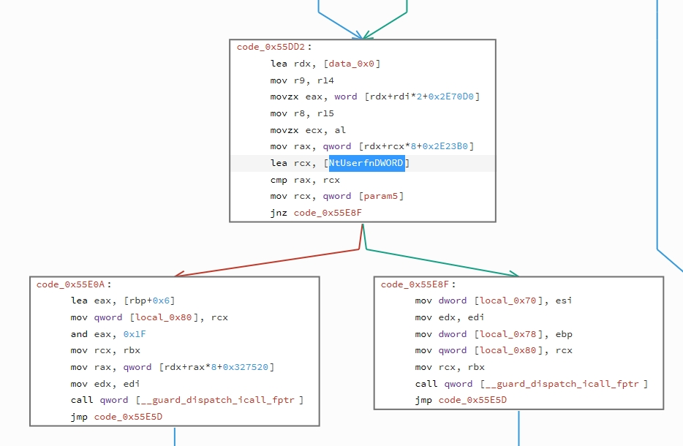
NtUserMessageCall
Function of many faces
7 parameters
Full control over them
Indirect call invoked
7+ member of vtable <- dummy!
vcall return is passed to user!
Enough primitives for kernel code exec, with valid function (no ROP) !

Slide 41
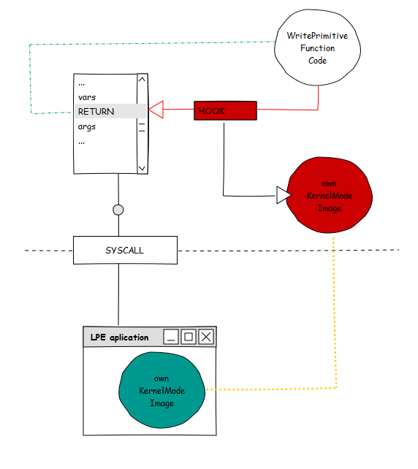
Get kernel code exec
Misuse existing functions
NtUserMessageCall
Allocate RWE memory
memcpy you kernel driver
Stack hook
Game over

Slide 42
SMAP - tale of lacking feature
prevents kernel unwanted access to user mode memory
sets bare metal borders between data in user mode and kernel
should serve as fine security feature … does it ?

Slide 43
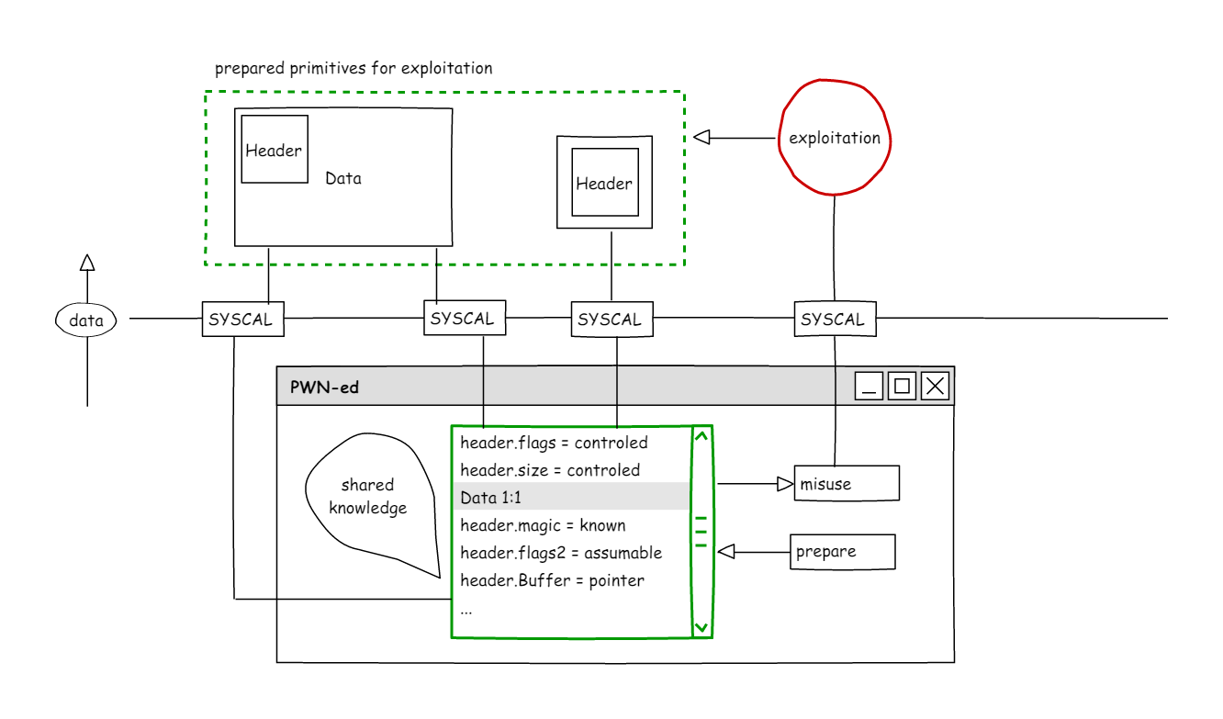
SMAP - tale of lacking feature

Slide 44
SMAP - tale of lacking feature
... however ...
without proper security schema in underlying OS, it is just shinny ...
nullptr deref protection - anything bellow 0x10000
poisons should be *not-mappable* by user by default!
you need controlled data at exploitation ? why you need them in user mode ?
easy to put in kernel (pipes, direct mem mapping, physmap, kernel stack, ...)
in occasional cases one more bug to leak address layout
in most cases you can get them out from mem corruption bug (unprotected raw pointers, ...)
security features is good to have, but better to use to max potential
which OS nowadays is using SMAP in way that it is really obstacle for attackers ?

Slide 45
Control Flow – hardware!
CET-IBT
Indirect jumps / calls + endbrXX
Similar idea with CFG indeed
Your jumps can not go wild, like ROP do!
CET-Shadow Stack
nicely done!
You can not subvert control flow via stack hooking anymore!
so seriously, what now ?
… wait for some time to adapt to mainstream O_o
https://software.intel.com/sites/default/files/managed/4d/2a/control-flow-enforcement-technology-preview.pdf

Slide 46
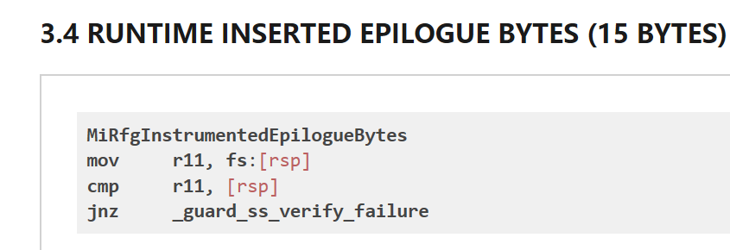
Return Flow Guard
Rumors about RFG
Return Flow Guard
Preliminary documentation (nice!) :
http://xlab.tencent.com/en/2016/11/02/return-flow-guard/
Simple & fast & effective
Effective ?
Shadow Stack alike, therefore yes!
.. and we are back with FS on x64! fs:[rsp]
arbitrary read / write will not touch it!
in combination with CFG ? – hell, a lot!
Two simple & effective mitigations together are pretty solid!
Can be implemented with todays hardware!
https://people.eecs.berkeley.edu/~dawnsong/papers/osdi14-paper-kuznetsov.pdf

Slide 47
{C/R}FG vs CET vs CFI
CET-IBT
some criticize that it lacks type integrity hash checks
It sets bare metal rules – how calls / ret must behave
CET is *not* about control flow *integrity* in particular
Implies : ROP is over but you can jump to *any* function instead!
CFG + RFG
very close to CET
Added some integrity checks on top of it
black-list (not include into bitmap) “dangerous” functions
Implies : ROP is over but you can jump to large *subset* of functions instead!
depends on corner cases however
As you can see CFG improvements over time, cat – mouse game ?

Slide 48
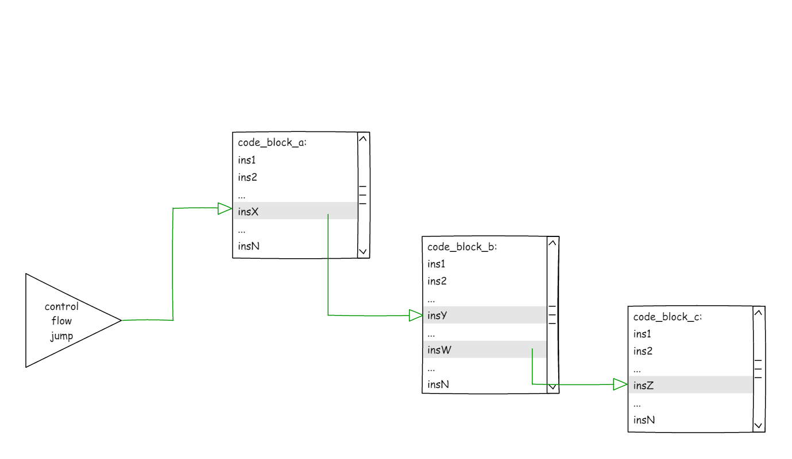
ROP – wild technique

Slide 49
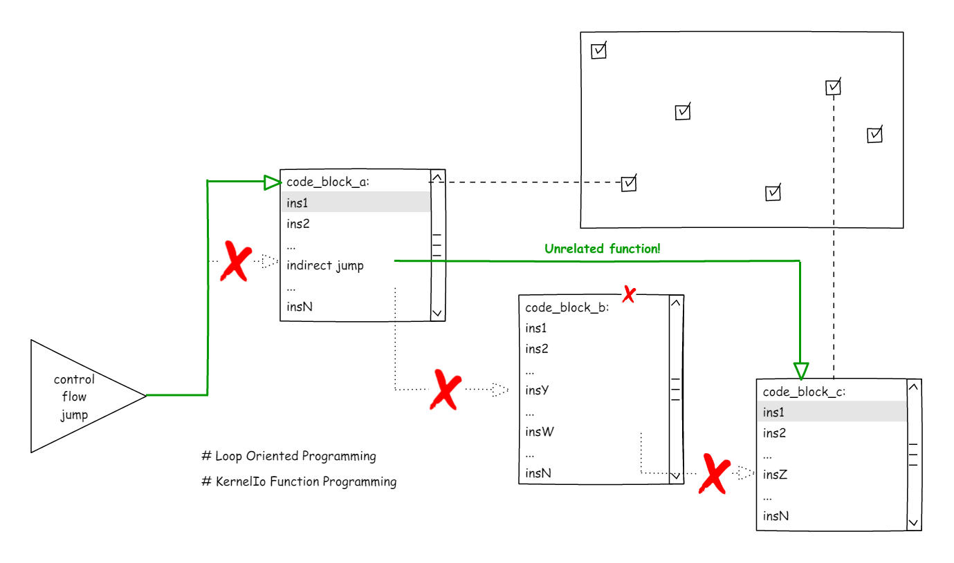
Function oriented - restricted technique
http://dl.acm.org/citation.cfm?id=2848479

Slide 50
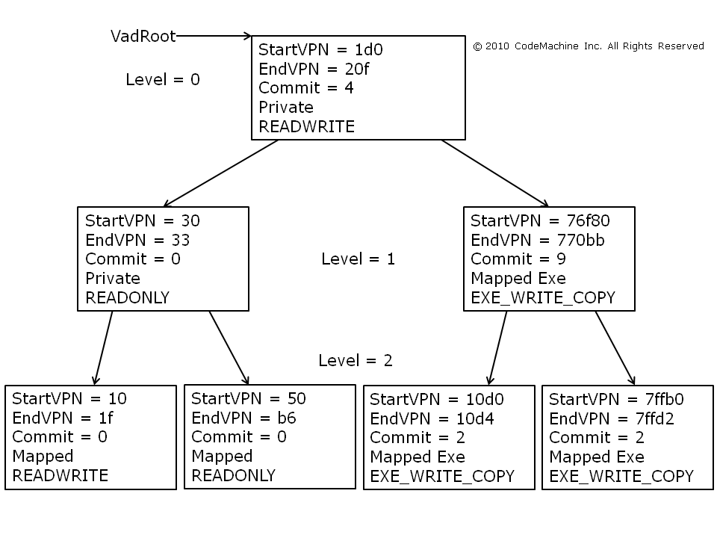
CET-{IBT+ShadowStack} / {C/R}FG
Gadgets == functions (Loop dispatcher / KernelIo)
Proper CFI needed (clang / pax)
Kernel Code Exec, doable ?
Well, if you want install old school rootkit, doable
RWE on kernel component in your reach
Patch legitimate kernel
Jump
Patch back
Obviously bad code!
any reasonable benefits from kernel code exec ?
Kernel Code Exec, needed ?
do you even need your own _eproc ?
why don’t just use kernel io (legit non-harm) syscalls
force(trick) other _ethreads to do job for you
Patching their stacks (params / rets) should do the job
( VadRoot technique )
http://www.pcc.me.uk/~peter/acad/usenix14.pdf
http://www.slideshare.net/PeterHlavaty/back-to-the-core
https://pax.grsecurity.net/docs/PaXTeam-H2HC15-RAP-RIP-ROP.pdf

Slide 51
Data attacks! - TODO
What is your goal ?

Slide 52
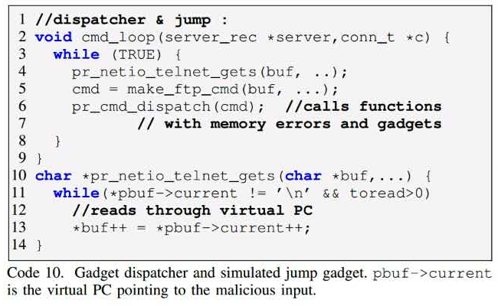
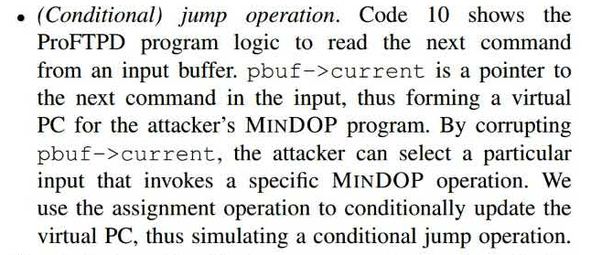
DOP – Turing Complete
https://www.comp.nus.edu.sg/~shweta24/publications/dop_oakland16.pdf f

Slide 53
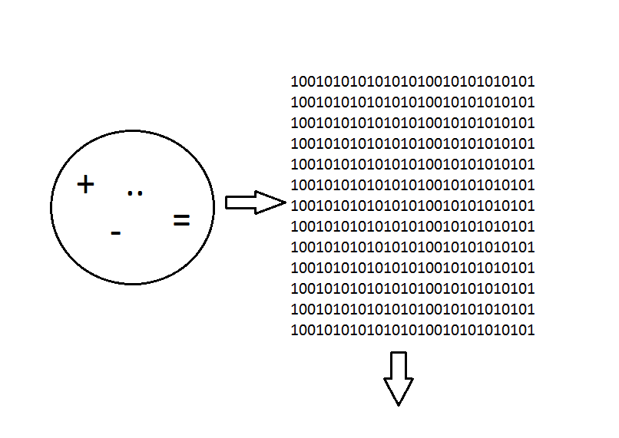
Kernel Io
In the end data are all what matters!
Code is just group of instructions
working over those data
Your ultimate goal is to access data
No need to be SYSTEM
No need to do Kernel Exec
Kernel io can ‘emulate’ apis
You can do math operations
...

Slide 54
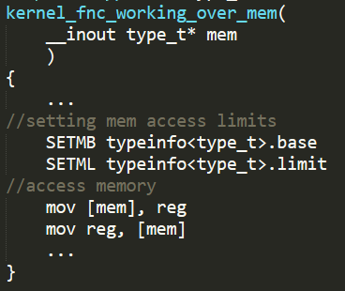
Data attack prevention
https://taesoo.gtisc.gatech.edu/pubs/2016/song:kenali.pdf
Same piece of code should work on same memory type
w32k gdi function will not touch _eprocess
possible to simple set ranges (hardware) ?
Pool isolation
Isolated heap (object caches) ?
local vars (thread) by default allowed
Existing solutions ?
Intel mpx – seems not going to succeed ?
PAC – looks like game changer (CPI approach) ?
Isolation ? ☺
https://software.intel.com/en-us/blogs/2013/07/22/intel-memory-protection-extensions-intel-mpx-support-in-the-gnu-toolchain
https://community.arm.com/groups/processors/blog/2016/10/27/armv8-a-architecture-2016-additions

Slide 55
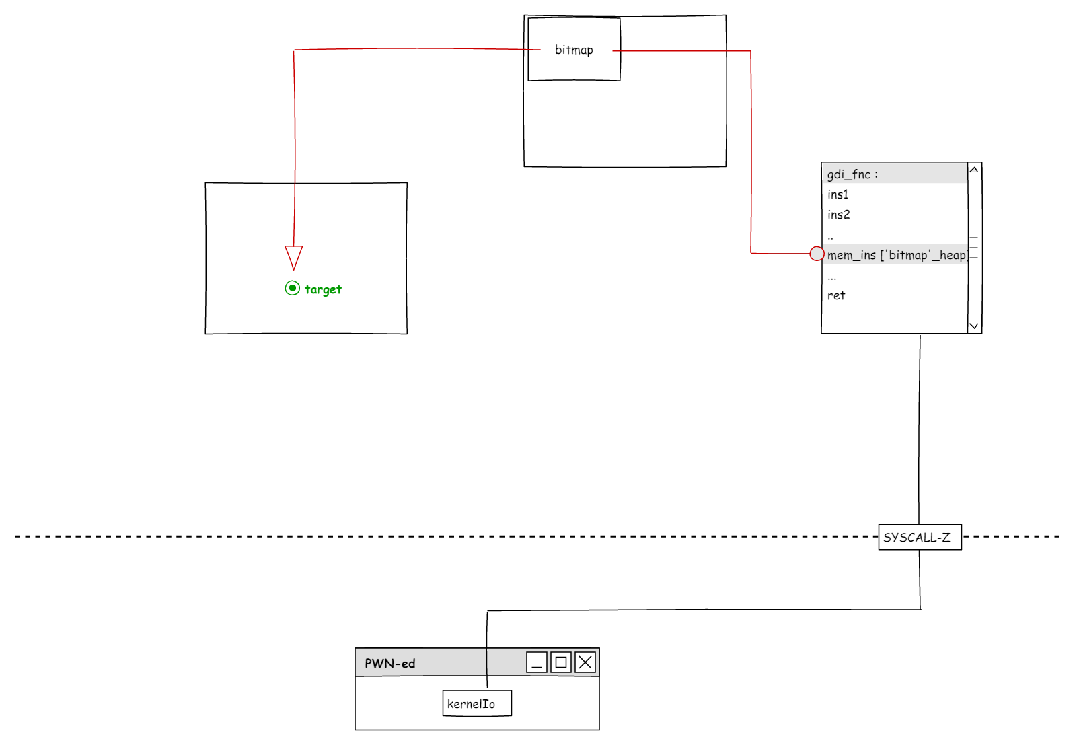
Kernel Io vs cross heap checks

Slide 56
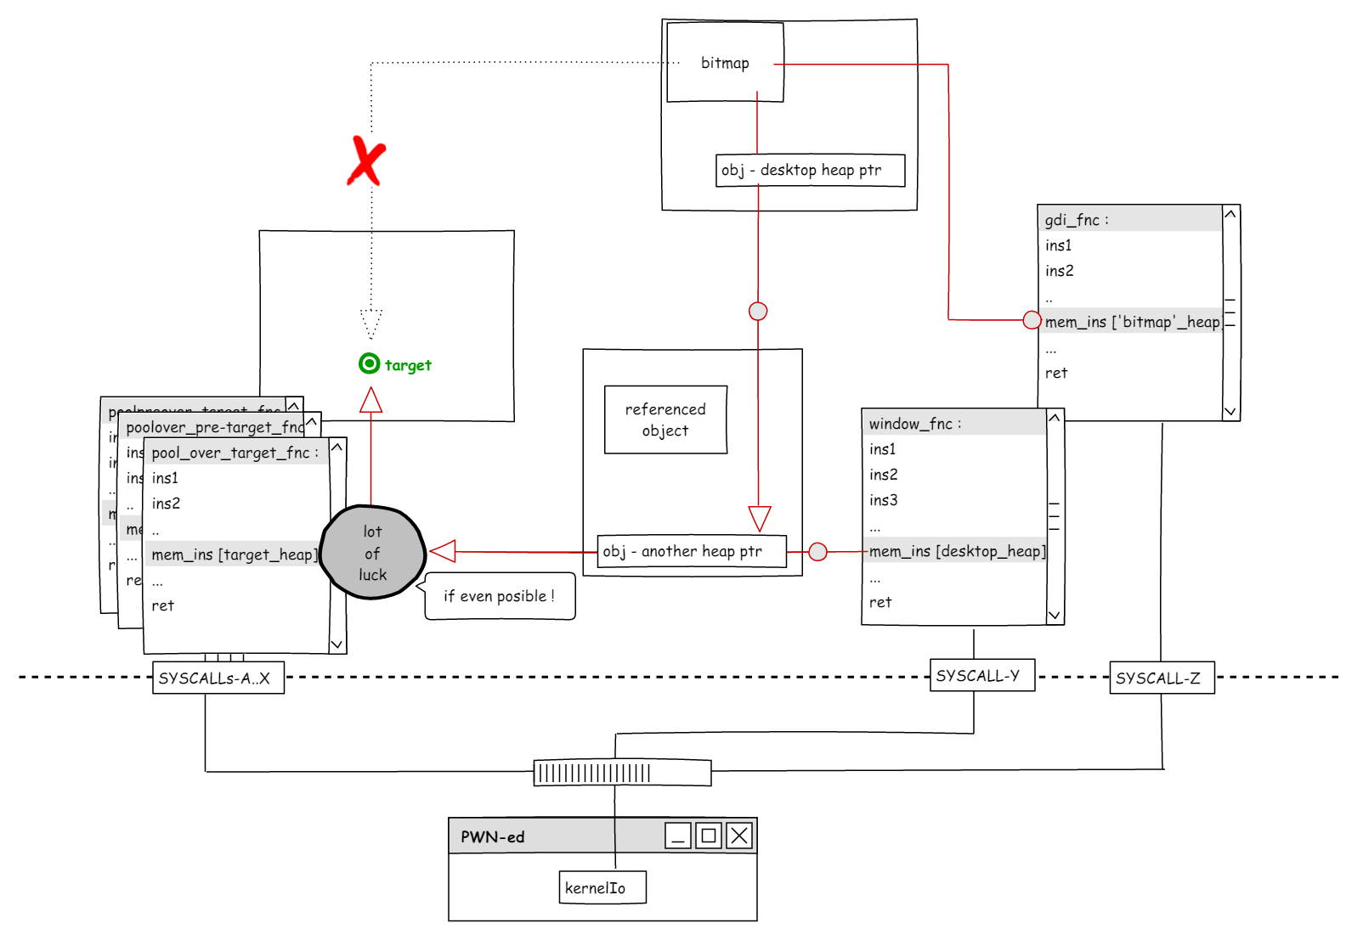
Kernel Io vs cross heap checks

Slide 57
Application Guard!
well, this can change things lot!
still kernel-Io is here real power ?
… well …
doomed within domain
One does not simple do exec when ring -1 is watching!
no real RWE page [ ept ]
code signing [ rw -> e ]

Slide 58
Containers
But, as always .. it is just another layer, another ring ...
bugs
logical issues
with small big difference
less code
code quality ++
http://www.alex-ionescu.com/syscan2015.pdf

Slide 59
conclusions
KASLR, nullptr-deref, Nx, SMEP
very well adapted!
ACL for kernel object access
good security model!
w32k re-designing { filtering & lockdown }
tackling biggest security problem in windows kernel!
{C/R}FG
nice anti-exploitation approaches! { - step by step to adapt to kernel }
CET - IBT & Shadow Stack
nice co-operation towards to new security model!
HyperV based App Containers
moving operating system to another league in terms of security

Slide 60
conclusions - todo#memory-corruptions
Control flow integrity – to improve
fine grained CFG – fast, smart, compat! but can it be fine enough ?
adapt { forwarded-edge ( clang ) / type-hash ( pax ) } – existing, fast, does the job!
Make code reuse attacks to disappear ?
Data attacks break down – to tackle
Memory access boundary checks
pointer load / function to heap memory access
Make kernel io disappear ?
Will it move memory corruptions from attack vector to state of art ?
memory corruption == ddos only ?
Not yet, long way to go, but now we can see that possibility
However maybe that can even happen in foreseeable future ?

Slide 61
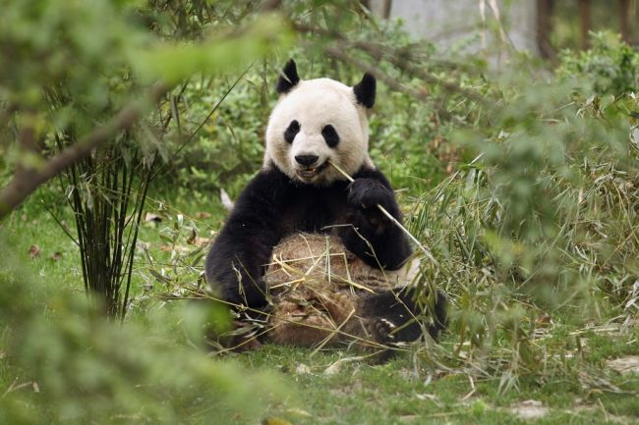

Thank you!
Q & A

