Slide 1

SMART: Real-time Analytics for Environment Monitoring & Actuation
Mohamed ElSioufy
Master Thesis Presentation
Notes:
Welcome everyone, my name is mohamed el siouffy and today i will be presenting my master theisis.

Slide 2
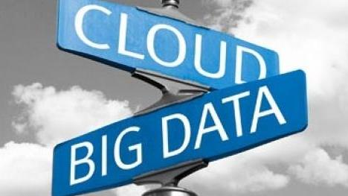
Overview
SMART: Real-time Analytics for Environment Monitoring & Actuation
Time: 45 Minutes
Notes:
Todays talk will be about Cloud computing and big data analysis. This is a development project and there is a final system, called SMART, that i will be demonstrating.
The presentation will take 45 minutes. In 30 minutes i will be presenting the work that has been done in the project, and ill take the last 15 minutes for a demonstration.

Slide 3
Overview
Motivation
System Modeling & Description
System Deployment
Live Demo
Questions
Notes:
So Ill start by a motivation. So what drove us to implement the system and what’s the benefit of having such system.
I wont go through related work, because basically this type of research is highly coupled with the used technologies.
And your specific use case.
There was nothing that does exactly what we are going to present, but we have reviewed several systems
that are concerned with stream processing and data analytics. We have been inspired by many of these systems,
Ex. in data modeling. But ex. The main operation of the system and the system model are built from ground up
To fit our use case.
After that I will present the system, And the Technologies used to enable the system
Finally, I will speak about the deployment of the system.
After I finish the presentation, I will run a live demo.
In the demo will demonstrate the systems operation and
Things like accuracy
Then you can have time
For any quesitons.

Slide 4
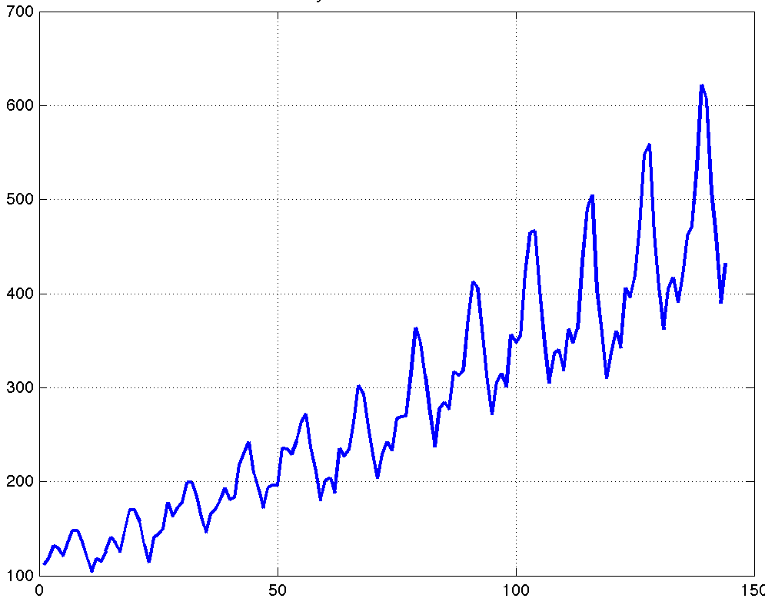
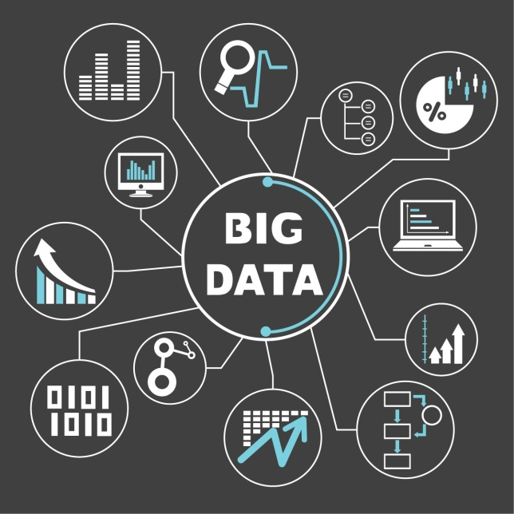
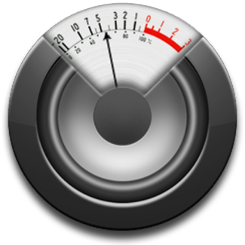
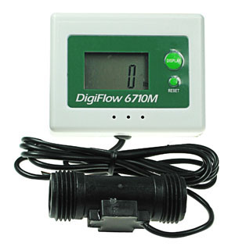
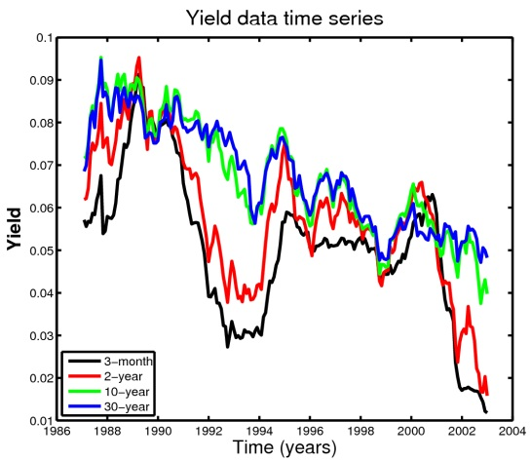
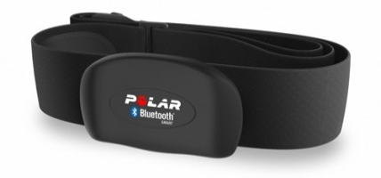
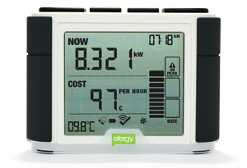
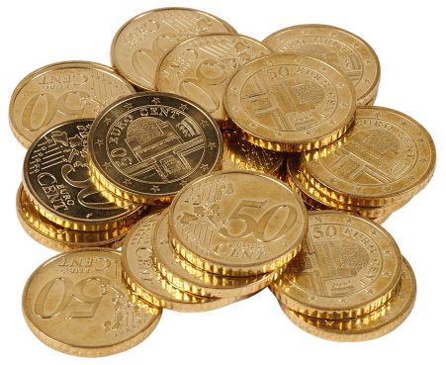


Motivation
Notes:
So the whole thing starts with BigData, and I will zoom in to specific kinds of data that comes from sensors, or i would refer to as time-series data.
So basically sensors can detect and measure many things in our daily life. if we cosider a room like this, there can be a sensor to measure the number of people in the room,
temperature sensors, the humidity, gas consumption of the heaters, water used in the tape and much more.
Sensors can be used to generate millions of data points over time and basically turn every object in our life into data generating object. like this room for example.
sensors also have relatively cheap prices, and are becoming more energy efficient. earlier problems with changing batteries and so on are kind of resolved.
Now that we have all of this Big Data, How can we make use of it ?

Slide 5
Motivation
How To [efficiently] Store and Query the big data and make use of it ?
Notes:
This forms our first research question : How To [efficiently] Store and Query the big data and make use of it.

Slide 6

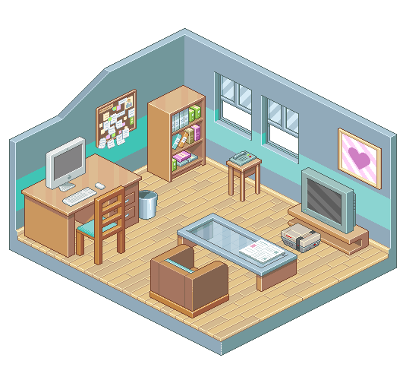
Environment Monitoring and Actuation
Notes:
The use case that we had in mind is to make use of the data in the domain of environmental monitoring and actuation.
This project was actually driven by the problem of regulating the room temperature.
So basically we have a room that is equipped with sensors, measuring information about its state
(ex. the number of people in the room, what is the heating level, what is the external weather conditions)
And we want a system that can receive all the state data (say for every minute or two) and try to learn how all of these data can affect the room temperature.
ex. if the heaters are closed and the outside temperature is -10 then probably the room is going to freeze, but if the outside temp. is 20 its alright.
once the system learns such behavior, it can be used to answer questions like, how long is it going to take to get the room temperature to 20 degrees.
what if we turned off the heaters level to 4 instead of 2. will it take less time to heat up the room … and so on.
Answering questions like these can be used to provide automatic control on the room temperature.

Slide 7





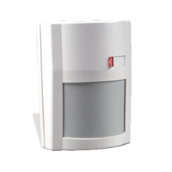

Environment Monitoring and Actuation
Notes:
The use case that we had in mind is to make use of the data in the domain of environmental monitoring and actuation.
This project was actually driven by the problem of regulating the room temperature.
So basically we have a room that is equipped with sensors, measuring information about its state
(ex. the number of people in the room, what is the heating level, what is the external weather conditions)
And we want a system that can receive all the state data (say for every minute or two) and try to learn how all of these data can affect the room temperature.
ex. if the heaters are closed and the outside temperature is -10 then probably the room is going to freeze, but if the outside temp. is 20 its alright.
once the system learns such behavior, it can be used to answer questions like, how long is it going to take to get the room temperature to 20 degrees.
what if we turned off the heaters level to 4 instead of 2. will it take less time to heat up the room … and so on.
Answering questions like these can be used to provide automatic control on the room temperature.

Slide 8


Environment Monitoring and Actuation
how long is it going to take to get the room temperature to 20 degrees ?
# people in the room
outside temperature
heating level
what if we changed the heating level to 4 instead of 2. will it take less time to heat up the room ?
# people in the room
outside temperature
heating level
..
# people in the room
outside temperature
heating level
Notes:
our vision was even wider than that. so basically such use case can be enabled on a single server by current machine learning algorithms
for a ml algorithm, the more data you get the more accurate you become, and the faster you learn.
so what about instead of having data from a single room we can have data from 2 rooms, will this get us more accurate? Yes but it needs more processing
what about 10 rooms, or the whole building .. what is the limit ?

Slide 9
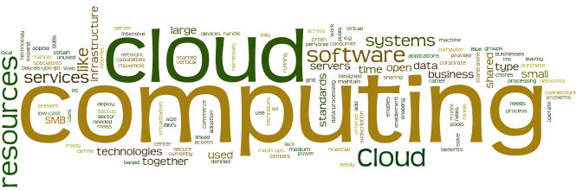
Environment Monitoring and Actuation
how long is it going to take to get the room temperature to 20 degrees ?
# people in the room
outside temperature
heating level
what if we changed the heating level to 4 instead of 2. will it take less time to heat up the room ?
# people in the room
outside temperature
heating level
# people in the room
outside temperature
heating level
Notes:
there is no limit ? and this is where Cloud Computing Fits.
As you will also see later, that cloud computing doesn't only allow us to ex. add more instances to learn about and query, but also improve the learning process.
what about instead of creating a single learning model to learn the temperature behavior of the rooms, we can create 10 models and use the best for prediction.
A lot of opportunities are possible when big data gets next t cloud computing

Slide 10
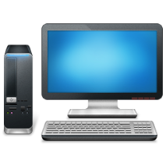


HL Architecture
SYSTEM
Notes:
Now I will go to system modeling.
While controlling the room temperature was our motivation, we wanted to develop a system that can generalize to a wider class of problems and application domains.
In a very high level, we have a couple of environment instances (ex. rooms) that are continuously sending data about their state to the system, the system will use this data in real time to learn about the behavior of the these environment instances.

Slide 11

HL Architecture
SYSTEM
Environment
Queries
Target Environment
Prediction Problem
Notes:
Once it learns, it can be used to answer specific queries.
To include a wide class of application domain and a wide class of possible queries
Our model mainly includes two entities, these are a target environment and prediction problem

Slide 12
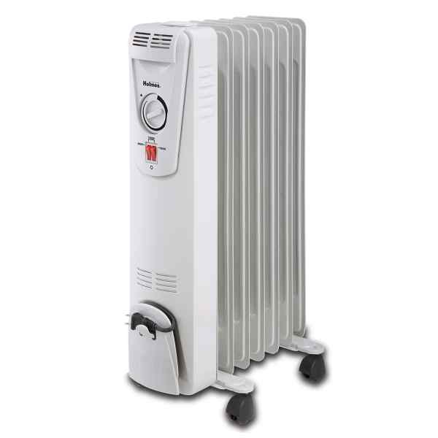
System Modeling
Target Environment
Variables: roomTemp, #occupants, heatinLevel
Attributes: roomVolume, heatingCapacity …etc.
Notes:
a target environment has of a set of attributes and variables defining its state. variables corresponds to
ex. #people in a room, current temp, heating level ..etc. their values are changing over time.
attributes as facts about a target environment that never change.
For a room ex, this would be the the room volume, insulating material, heating capacity ... attributes are very important and actually are essential for the
learning models.
ex. if we are learning about these two rooms that have the same volume and the heaters in the picture, we will have very
contradicting data. as the heater in one room actually doesn't ahave any effect on the temperature, while
the heater in the other room have complete effect. If the room capacity is not included as an attribute,
the learning model will just never learn.

Slide 13
System Modeling
Target Environment
Variables: roomTemp, #occupants, heatinLevel
Attributes: roomVolume, heatingCapacity …etc.
Environment Instance
ID
Attribute Values
Variables Sensors Mapping
Notes:
While the target environment represents an abstract entity an environment instance
represent an intonation of the te in the real world.
an instance, is defined by an Id,
Attribtue values
sensor mappings from a sensor id to a state variable.
and what is meant by that is that foe each defined variable in the target environment
There shall be a sensor in the env. Instance that continusly sends data about this variable

Slide 14
System Modeling
Target Environment
Variables: roomTemp, #occupants, heatinLevel
Attributes: roomVolume, heatingCapacity …etc.
Prediction Problem
Name
Goal Variable
Explanatory Variables
How Long will it take to cause a unit change to the GoalVariable considering the current values of the explanatory variables
Notes:
The second abstraction we defines is a prediction problem. A prediction problem
Correponds to a type of query or a question that the user want to ask to the system.
Each prediction problem have a name, a goal variable , this corresponds to the variable you want to learn about
and a set of exp. variables. there are the independent variables.
in our model, we also allow to apply a set of cross validation settings on our prediction problems.
basically the learning process takes some time.
when the system starts to run , its starts with zero knowledge about the target enc.
so if you ask the system it will give you false resutls.
In our cross validation the user can tell the user things like,
Don’t give me answers unless your accuracy is X
Bastically these two entities are all what it takes for you to define your problem and how you will qeury
the system. the reaminiing things in the model are conerned with specific configurations about the technologies
and how you are going to use the system.

Slide 15
System Modeling
Target Environment
Variables: roomTemp, #occupants, heatinLevel
Attributes: roomVolume, heatingCapacity …etc.
Prediction Problem
Name
Goal Variable
Explanatory Variables
Cross Validation !
How Long will it take to cause a unit change to the GoalVariable considering the current values of the explanatory variables
Don’t give me answers unless your accuracy is X
Notes:
The second abstraction we defines is a prediction problem. A prediction problem
Correponds to a type of query or a question that the user want to ask to the system.
Each prediction problem have a name, a goal variable , this corresponds to the variable you want to learn about
and a set of exp. variables. there are the independent variables.
in our model, we also allow to apply a set of cross validation settings on our prediction problems.
basically the learning process takes some time.
when the system starts to run , its starts with zero knowledge about the target enc.
so if you ask the system it will give you false resutls.
In our cross validation the user can tell the user things like,
Don’t give me answers unless your accuracy is X
Bastically these two entities are all what it takes for you to define your problem and how you will qeury
the system. the reaminiing things in the model are conerned with specific configurations about the technologies
and how you are going to use the system.

Slide 16
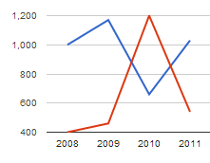

Technologies
Visualization
Messaging Queue
Streaming Engine
Persistence Module
What are the technologies that shall be used to enable such system?
Notes:
Now that we have an idea about how will we solve the problem, we had to chose the technologies.
A system like this would minimally require a messaging queue and a streaming engine. Data is received
at the messaging queue, streamed into the streaming engine, that makes the actual processing on the data
and maintain the machine learning models that can be used in prediction. We however, wanted to persist all
the received data so that we can even do processing later on.so this adds the requ. For a persistence module. We also
added a visualization module, so we can allow the user to even visualize the current states of the environment
and how they change wrt each other.
Our Next research Question was concerning the Technologies.

Slide 17
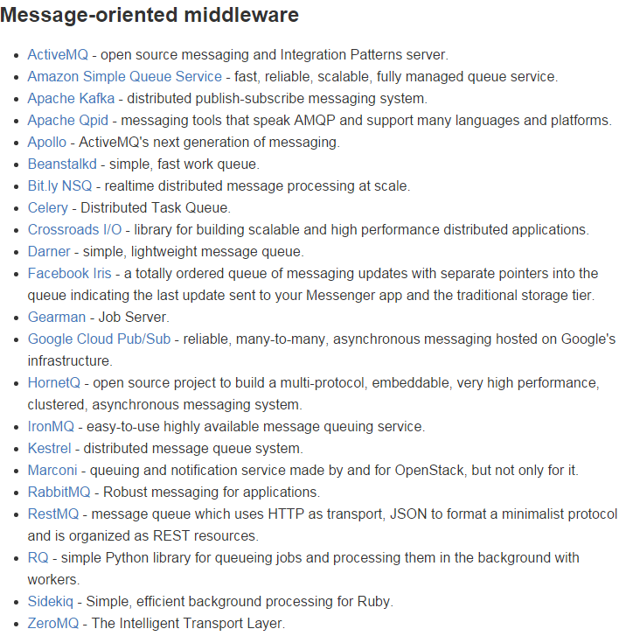
Technologies
Visualization
Messaging Queue
Streaming Engine
Persistence Module
What are the technologies that shall be used to enable such system?
Notes:
If we take a look on the available big data technologies we can see how many they are. ex. this is an even
incomplete list of available messaging queues. so all of these can probably fit as a messaging queue for a system like
The one we want to build.

Slide 18





Technology Overview
Visualization
Lightning
Messaging Queue
Streaming Engine
Persistence Module
What are the technologies that shall be used to enable such system?
Notes:
Before starting the project, we had an idea on the streaming engine that we will use. this was Apache Spark.
of course we have reasoned about spark vs other streaming engines but i won't go through any of these in this
presentation. Actually in the thesis manuscript there a complete chapter about why we have chosen specific
technologies.
One thing i would like to include here is that Spark is not only
A streaming engine, but also Includes scalable machine learning extension
spark gave us out of the box distributed machine learning algorithms including streaming machine learning,
to perform online learning. Which perfectly fits our use case.
Having Spark Streaming and Time-series data we end up using Kafka and Rabbit-MQ as Messaging queues, Cassandra
for persistence and Lightning-viz for visualization

Slide 19
Workflow
Cassandra
FeatureVectors
Stream
ProblemState
Stream
visualize
Predict / Train
UpdatedModels
Create
Lightning
SensorData
Stream
updateEnvironmens
State
Environments
StateStream
visualize
RMQ
RMQ
QueryRequest
Stream
ProcessUserQueries
QueryResponse
Stream
Kafka
Kafka
QID
ProblemName
Te_ID
Target
How long will it take for the goal variable to reach “target” under the current environments state
StateOverride
Notes:
This is a very high level view of the systems operation, since the sensor data enters the system.
I want to include here that the actual processing of the timeseries is performed in the step,
and actually for this I have implemented a whole API that provides distributed primitives for the processing of time series data
Again, there is a complete chapter in the thesis document about the API and how we implemented the ts functions. Mainly the operations were
Concerning resampling, identifying transitions in the values … so on.

Slide 20
System Deployment
Visualization
Lightning
Messaging Queue
Streaming Engine
Persistence Module
Notes:
The last thing I will speak on, is about the deployment of the system.
If we take a look at the HL architecture, we can think of any of these technologies to be running as
A cluster.

Slide 21

System Deployment
Lightning
How can we deploy such system ?
Notes:
The last thing I will speak on, is about the deployment of the system.
If we take a look at the HL architecture, we can think of any of these technologies to be running as
A cluster. So Kafka runs on a separate cluster, Cassandra …etc. How to deploy our system was actually our third research Questions

Slide 22


System Deployment
+
Notes:
We have used Docker and Weave technologies For the deployment of the system.
We have used docker to run all of these servers as containers. However, the problem with docker is that these containers can’t
Communicate across hosts … it has been provided recently but, this is really very complicated process. Weave is build on top of docker
To make this possible.
It basicaly build a weave network acorss multple docker hosts and you can allow all the cont.
within the weav network to communicate. it has some problems with efficency but its very simple.
We have actually used the combination of weave and docker to provide both local and cluster deployments of the
System.
in the thesis manufscprt wwe provide a script to launch a cluster of the following ...
ofcourse to be able to do this, we had to create docker images that are comaptible with weave and our system
Weave and Docker for local deployment
using Docker - compose, which is s

Slide 23

System Deployment
Spark
worker
kafka
Spark
worker
kafka
Weave
Zookeeper
cassandra
RMQ
Lightning
Weave
Weave
Spark
Master
cassandra
Notes:
We have used Docker and Weave technologies For the deployment of the system.
We have used docker to run all of these servers as containers. However, the problem with docker is that these containers can’t
Communicate across hosts … it has been provided recently but, this is really very complicated process. Weave is build on top of docker
To make this possible. It basicaly build a weave network acorss multple docker hosts and you can allow all the cont.
within the weav network to communicate. it has some problems with efficency but its very simple.
We have actually used the combination of weave and docker to provide both local and cluster deployments of the
System.
in the thesis manufscprt wwe provide a script to launch a cluster of the following ...
ofcourse to be able to do this, we had to create docker images that are comaptible with weave and our system

Slide 24
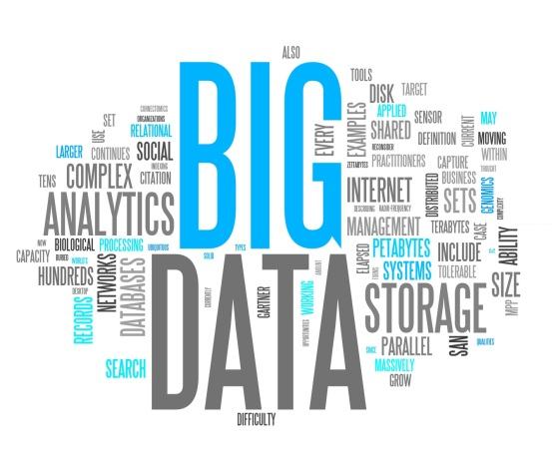
Summary
Motivation
System Modeling & Description
System Deployment
1- How To [efficiently] Store and Query
the big data and make use of it ?
2- What are the technologies that shall be used to enable such system?
System model and architecture
3- How can we deploy such system ?

Slide 25
Conclusion
Big Data Analytics
Time Series Data
Environmental Monitoring and Actuation
Technologies
Rapidly Changing Ecosystem
Thesis
Research [Available Systems, Technologies, Particular Technologies]
Implementation [time-series API, SMART]
Deployment [Scripts, Docker-images]
Research Community [Web]

Slide 26
Demo

Slide 27

Heating Problem
Environment Name : Room
Environment Variables
Room Occupants
Outside Temperature
Heating Level
Room Temperature
Environment Attributes
Room Material
Heating Capacity
Room Volume
Room Simulation
Room Occupants: Randomly changing [0-30]
Outside Temperature: 0
Heating Level :
if temp >=30 heating=2 (temp starts to dec.)
If temp <= 10 heating=4 (temp start to inc.)
Room Temperature:
heating level
room occupants
external temperature

Slide 28
DEMO
Local SMART Cluster
Spark Driver
Cassandra
Weave
RMQ
Lightning
Prediction Problems Settings:
Normalized Polynomial
Normalized Linear
Visualization:
Environments State
Prediction Problems Accuracy
Prediction Problems #feature vectors
Simulation Settings:
Spark:
Stream: 2 minutes
Train : 60 minutes
1 minute = 1 second

