Slide 1
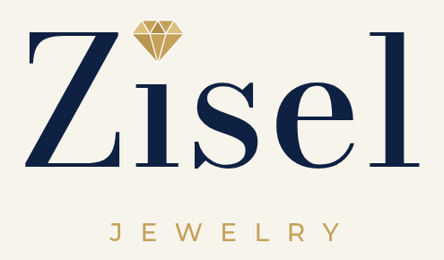
MARKET SNAPSHOT
Who you’re up against, where you can win, and what to decide next
Las Vegas | Holiday 2026
Prepared by Jonathan Yu | October 2026

Slide 2
Bottom line: post your prices, and host the party
1
2
3
Vegas jewelers all sound the same
Two lanes are wide open
Start small and sharp
Wholesale roots, private appointments, lifetime care. Every local says it.
No local posts its prices online, and no fine jeweler hosts showing parties.
Tennis bracelets, diamond studs, and gold chains, priced below the online stores.
Based on our review of 15 competitors (8 Las Vegas jewelers, 4 online/mall, 3 luxury), October 10, 2026. Points 2 and 3 are our recommendations.
Zisel Market Snapshot
2

Slide 3
Three kinds of competitors. The locals are your real fight.
TIER 1
TIER 2
TIER 3
Las Vegas locals
Online and mall
Strip luxury
Your direct competition
Where buyers check prices
The dream reference
Sky Diamonds
The Jewelers of Las Vegas
D&R House of Diamonds
MJ Christensen
Dumoni Jewelers
DiamondsNColors, The Diamond Store, Jeffrey White
Brilliant Earth
Blue Nile
Mejuri
Kay (Meadows Mall)
Tiffany & Co.
Cartier
Van Cleef & Arpels
Graff and Bulgari (Shops at Wynn)
Recommendation: compete with the locals, price against online, and borrow ideas from luxury.
Zisel Market Snapshot
3

Slide 4
The locals win on trust built over decades
Jeweler | What they win on | Proof
Sky Diamonds | Ex-wholesale family: “no brand name markup” | 40+ years wholesaling; 4.8 stars on 136 Yelp reviews
The Jewelers of Las Vegas | Size and history | Family-owned since 1976; 3 locations; Best of Las Vegas every year since 2008
D&R House of Diamonds | Private office: you meet the two owners | Appointment only; 4.9 stars on about 200 reviews
MJ Christensen | The established name, plus events | 80+ years; 4.9 stars on about 2,500 Google reviews
Dumoni Jewelers | Custom gold, with prices posted | Full price menu online; about 48,400 Instagram followers
What it means: Zisel is new, so it can’t win on years. It has to win on openness.
Sources: company websites, Yelp via Apple Maps, Chamber of Commerce, Instagram count via a third-party tracker. Checked October 10, 2026.
Zisel Market Snapshot
4

Slide 5
Two lanes nobody in Las Vegas owns yet
1
Posted wholesale prices
2
Hosted showing parties
Almost no Las Vegas independent shows prices online. The online stores all do.
No Las Vegas fine jeweler we found markets them.
Proof it can work here: Dumoni posts a full price menu.
Today this belongs to costume and direct-sales brands like Park Lane and Touchstone.
Recommendation: own both. Prices make “wholesale” provable; parties bring buyers to you.
Source: our competitor research, October 10, 2026; Park Lane and Touchstone host program pages.
Zisel Market Snapshot
5

Slide 6
These are the prices your customers will compare you to
What they’ll compare | Where | Price to beat
Lab-grown diamond studs, 1 ct total | Kay (sale) | $909.99
Natural diamond studs, 1 ct total | Blue Nile (sale) | $1,785 to $2,674
Lab-grown tennis bracelet, 3 ct | Brilliant Earth | $2,850
Natural tennis bracelet, 2 ct | Blue Nile | $3,730
14k gold rope chain, 18 in | Kay (sale) | $844.99
4 mm Cuban chain | Dumoni (Vegas) | $1,650
RECOMMENDATION
Post 5 to 8 “from” prices that visibly beat these on the same specs.
Watch out: holiday promos already go lower, like a 3 ct lab tennis bracelet at $1,595 (Van Adams, Black Friday 2025). Tiffany’s tennis bracelet is $16,400.
Listed prices seen October 10, 2026 on each retailer’s site; Van Adams from its Black Friday 2025 page. Most items are 14k gold. Diamond quality varies slightly by retailer.
Zisel Market Snapshot
6

Slide 7
Holiday buyers want tennis bracelets, studs, and gold chains
TOP STYLES FOR HOLIDAY 2026
Lab vs natural, in plain words
Tennis bracelets the #1 holiday gift
Price of a comparable diamond
Diamond studs the classic first fine-jewelry gift
Lab-grown
about $450
Natural
Tennis necklaces right behind bracelets
$2,800 to $3,200
Gold chains Cuban (the Vegas favorite), rope, paperclip
Lab-grown: much more size for the money. 61% of 2025 engagement rings used one.
Natural: mined. A 1 ct stone averages $3,898, down 51% since 2021.
Recommendation: offer both side by side, clearly labeled.
Huggies and sculptural hoops beating plain hoops
Pendants and initials incl. Star of David for Hanukkah
Sources: National Jeweler (via Beyond Two Rings), Brilliant Earth 2026 trend guide, Dainty London, Nevada Coin Mart; CNBC, Sep 26, 2026 (Rapaport, The Knot, Brilliant Earth prices).
Zisel Market Snapshot
7

Slide 8
Showing parties bring the showroom to your customers
HOW OTHERS REWARD HOSTS
PROPOSAL: ZISEL HOST REWARDS
Mejuri
Holiday Sip & Shop: no fee for 40+ guests, 15% off
STEP 3
Big party
Park Lane
STEP 2
15% to 20% credit, plus lab diamond studs
Host’s favorite piece for $35, plus $40 credit at 10+ orders
Party goal met
STEP 1
10% of party sales as jewelry credit
Touchstone Crystal
Host a showing
Host gets 15% to 25% of sales as free credit
A thank-you gift for hosting
The Finery House
Host gift: a 3 ct lab diamond at $20,000 in sales
Holiday Sip & Shop idea: an evening at Ben’s showroom, invites texted before Thanksgiving, and a free gift with purchase instead of a % discount. You set the goals and numbers.
Sources: Mejuri events page and LinkedIn post; Park Lane, Touchstone Crystal, and The Finery House host pages. Reward percentages in the proposal follow the 10% to 25% market range.
Zisel Market Snapshot
8

Slide 9
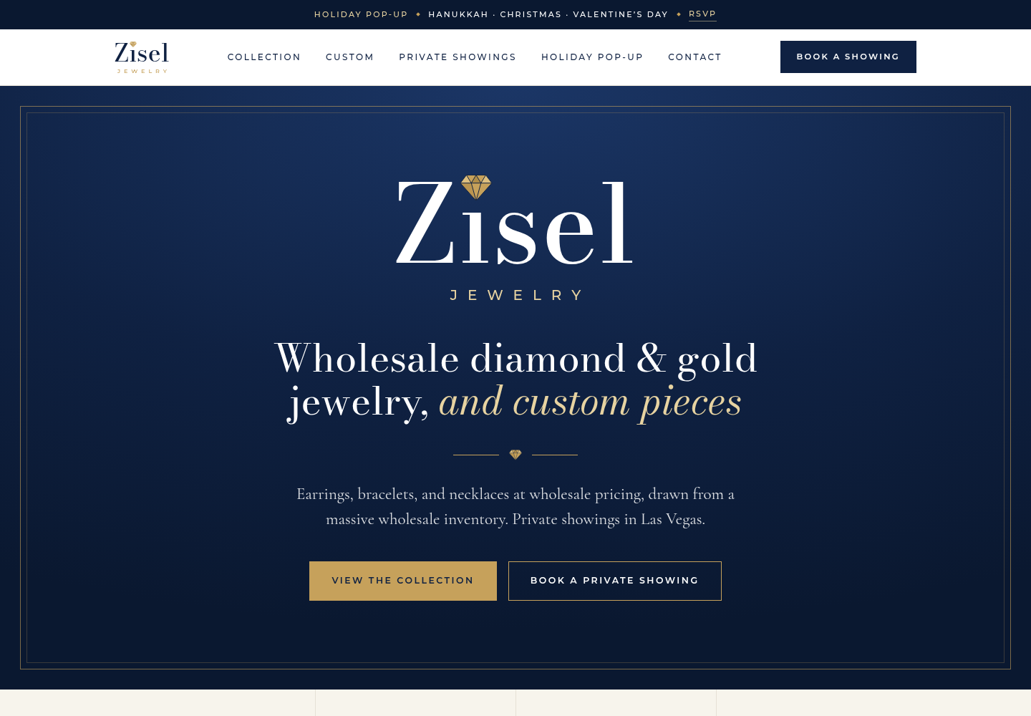
Website: lead with parties, and explain the wholesale prices
ADD NOW
Hours and phone number at the top
A real booking calendar to pick a time
A 3-point trust strip
Holiday pop-up section with its own dates
Gift shopping by price
Each piece labeled lab-grown or natural, with IGI/GIA badge
ADD LATER
SKIP
Reviews: first name + piece
Promo-code banners
Virtual appointments
Giant drop-down menus
Design your own
Your draft site today: sip-coder.github.io/zisel-jewelry
Recommendations from our designer’s review of Sky Diamonds, D&R House of Diamonds, The Fine Diamond, Brilliant Earth, Blue Nile, Mejuri, Catbird, and Cartier.
Zisel Market Snapshot
9

Slide 10
Five must-dos for trust, and one of them is the law
FTC RULE
EXPECTED
EXPECTED
Say “laboratory-grown” next to “diamond”
A grading report with every center stone
A written warranty
Every time: website, texts, and flyers. A footnote or hashtag may not count.
IGI for lab-grown, GIA for natural. GIA stopped full grades on lab stones in Oct 2025.
Blue Nile and Brilliant Earth offer lifetime; Mejuri 2 years.
EXPECTED
EXPECTED
A clear returns policy
Offer financing
Online: free 30-day returns. Locals are stricter. Custom is final sale almost everywhere.
Brilliant Earth: Affirm 0% for up to 36 months.
Sources: FTC Jewelry Guides guidance; GIA and National Jeweler; Blue Nile, Brilliant Earth, Mejuri, Kay, The Jewelers of Las Vegas policies. Items 2 to 5 are recommendations.
Zisel Market Snapshot
10

Slide 11
Order-by dates: Hanukkah custom orders are due next week
= order custom by
Today Oct 10
Hanukkah Dec 4-12
Christmas Dec 25
Valentine’s Feb 14
Oct
Nov
Dec
Jan
Feb
Oct 16
Nov 6
Thanksgiving Nov 26: text invites go out before
Dec 27
Hanukkah Starts Dec 4
Christmas Dec 25
Valentine’s Day Feb 14, 2027
Order custom by Oct 16
Order custom by Nov 6
Order custom by Dec 27
Absolute latest, if all goes well: Nov 13
Absolute latest, if all goes well: Dec 4
Absolute latest, if all goes well: Jan 24
Recommendation. Basis: simple custom pieces take 1 to 3 weeks (Dumoni), plus 2 to 4 extra weeks in the Nov to Feb rush (Jeffrey White), so 7 weeks is safe and 3 is the floor. Hanukkah dates: AJLuxe. Major brands set Feb 11-12 Valentine’s cutoffs (USA Today).
Zisel Market Snapshot
11

Slide 12
Seven decisions we need from you
1
2
3
4
Show prices online?
Your real prices
Order-by dates
Contact details
Full prices, “from” prices, or none
For the 5 to 8 hero pieces
The custom deadlines you can promise
Phone, hours, booking link, Instagram
5
6
7
Real photos
Lab vs natural mix
Host rewards
Of your own pieces, no stock images
How much of each in the collection
Approve or change the party ladder
Most urgent: order-by dates and contact details, so invites can go out before Thanksgiving.
Zisel Market Snapshot
12

Slide 13
Sources
Sky Diamonds, about
Sky Diamonds, Yelp via Apple Maps
The Jewelers of Las Vegas, FAQ
The Jewelers of Las Vegas, custom
D&R House of Diamonds
D&R reviews, Chamber of Commerce
MJ Christensen, custom
MJ Christensen, events
MJ Christensen reviews (places listing)
Dumoni, custom and lead times
Dumoni, chain prices
Dumoni Instagram count (tracker)
Jeffrey White, custom timeline
Brilliant Earth, lab tennis bracelet
Brilliant Earth, 2026 trends
Blue Nile, tennis bracelet
Blue Nile, halo studs
Blue Nile, six-prong studs
Kay, lab studs
Kay, rope chain
Van Adams, Black Friday 2025
Tiffany Victoria bracelet
Shops at Wynn
Mejuri, events
Mejuri Holiday Sip & Shop (LinkedIn)
Park Lane, hosting
Touchstone Crystal, hosting
The Finery House, Traveling Jeweler
Holiday 2026 trends (National Jeweler)
Dainty London, gift trends 2026
Nevada Coin Mart, Cuban chains
CNBC, diamond prices, Sep 26 2026
FTC, advertising diamonds
GIA, lab-grown terminology
AJLuxe, Hanukkah 2026
USA Today, Valentine’s deadlines
Each line is a clickable link. All facts checked October 10, 2026. Website ideas come from our designer’s review of competitor sites.
Zisel Market Snapshot
13

