Slide 1
Graph-Based Wildfire Spread Simulation System
A Desktop Application for Modeling and Visualizing Wildfire Propagation using Graph ADT
Team Members:
221003128 TL Ngwenya
221030546 NN Mafoko
223132416 S Mnyamana
222017962 AA Oduwole
Computer Science 3A — Mini Project, May 2026

Slide 2
The Problem
CONTEXT
Wildfires are a major environmental and economic threat in South Africa, particularly in the Western Cape region. Areas with dry vegetation and complex terrain experience rapid and unpredictable fire spread.
Traditional wildfire monitoring methods are often slow, resource-intensive, and lack the ability to predict how fire will propagate across different types of terrain such as dry grass, forest, and water bodies.
There is a clear need for an interactive system that can analyze real terrain images, model fire spread behavior, and provide clear visual predictions of high-risk areas to support better disaster response and planning.

Slide 3
Our Solution
INNOVATION
We developed the Graph-Based Wildfire Spread Simulation System, an interactive Java desktop application that:
Loads a terrain or satellite image
Converts the image into a weighted graph where each block becomes a node
Classifies terrain types (Dry Grass, Grass, Forest, Water)
Assigns realistic fire spread costs to each node
Generates a color-coded risk mask showing fire danger levels
Displays detailed statistics by terrain type
Allows running Dijkstra's algorithm to show the most likely fire propagation path

Slide 4

System Architecture
TECHNICAL DESIGN
Input
User loads a terrain or satellite image
Processing
Image is divided into blocks, each block becomes a node in a 2D grid graph, terrain is classified, and edges are created with fire spread costs
Core Algorithm
Dijkstra's algorithm finds the lowest-cost (fastest spreading) path
Output
Color-coded wildfire risk mask and detailed terrain statistics

Slide 5
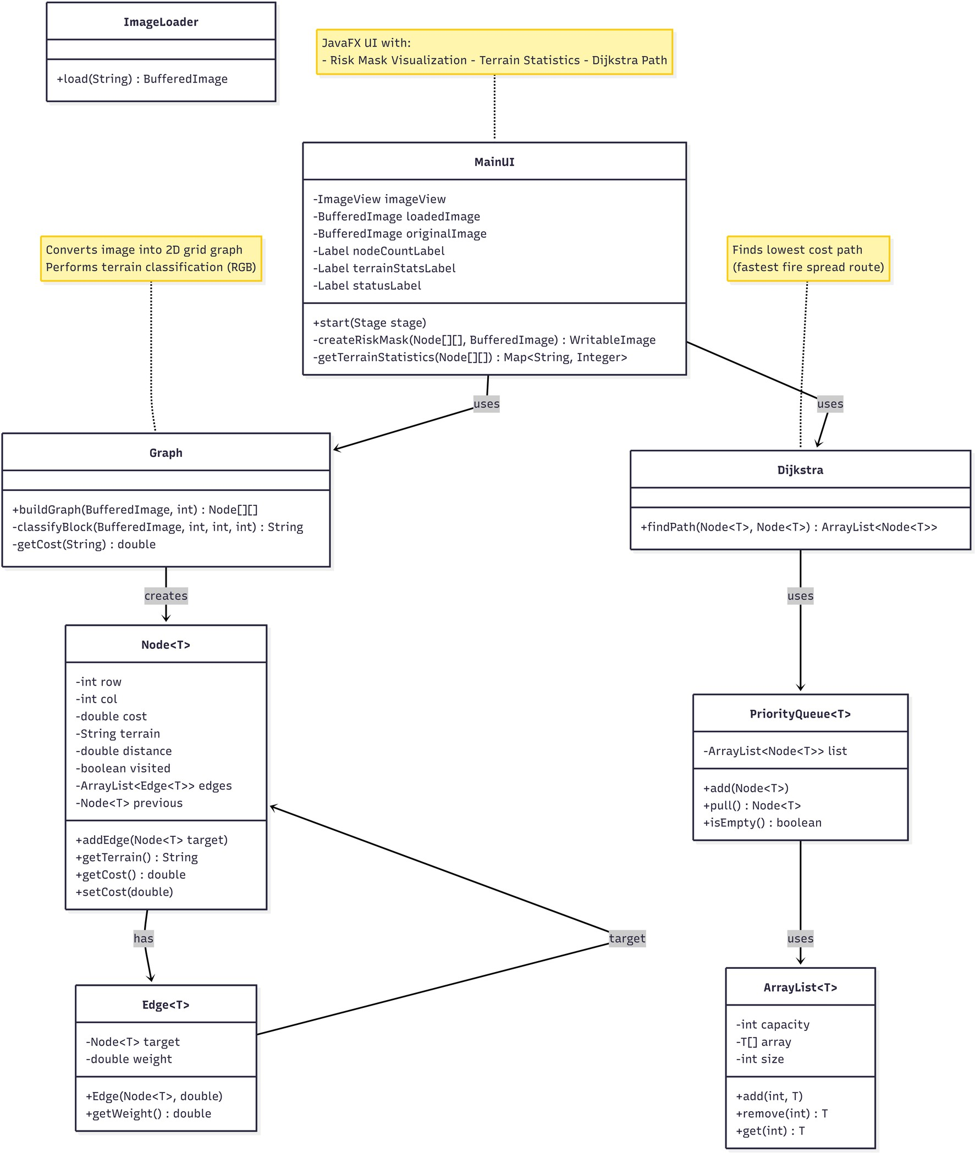
Class Diagram

Slide 6
Key Approaches and Design Decisions
IMPLEMENTATION
Image is divided into 10 by 10 pixel blocks to create a manageable 2D grid graph
Custom algorithm classifies each block using average RGB values into Dry Grass, Grass, Forest, or Water
Realistic fire spread costs are assigned (Dry Grass = 1, Grass
= 2, Forest = 3, Water = infinite)
Adjacency edges connect neighboring nodes to form the graph
Dijkstra's algorithm with custom PriorityQueue finds the most likely fire propagation path
All required data structures (ArrayList, PriorityQueue, Node, Edge) were implemented from scratch

Slide 7



Graphical Representation and User Interface
VISUALIZATION
We used a color-coded risk mask overlaid on the original image for clear and intuitive visualization:
Red areas represent High Risk zones (mainly Dry Grass) where fire spreads very quickly
Yellow areas represent Medium Risk zones (Grass and Forest)
Blue areas represent Low Risk or Blocked zones (Water bodies) where fire cannot spread
The interface also displays:
Total number of nodes in the graph
Breakdown of nodes by terrain type (Dry Grass, Grass/Forest, Water)
Dijkstra shortest path output when requested

Slide 8
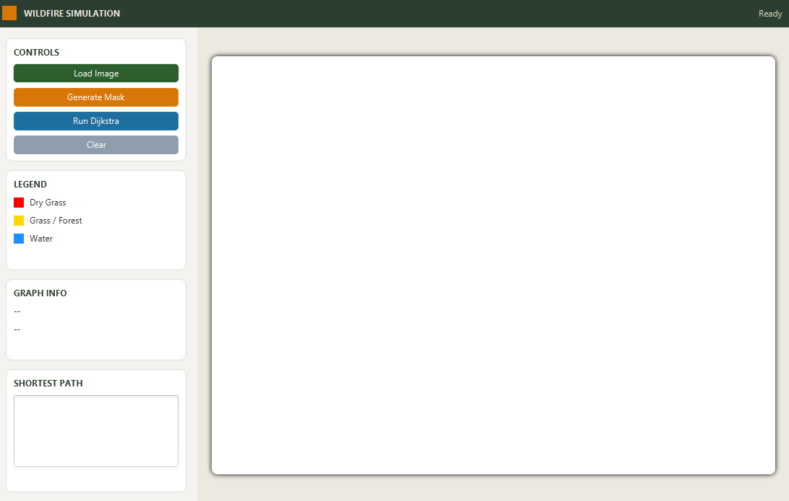
User Interface

Slide 9
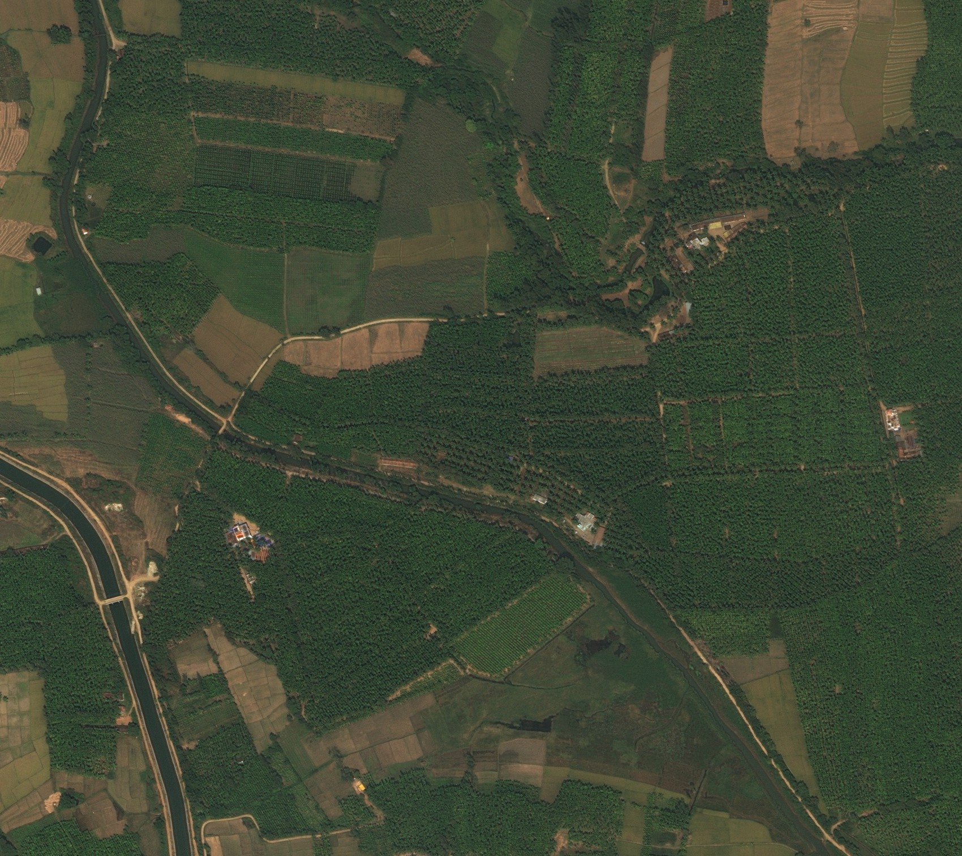
Test Data

Slide 10
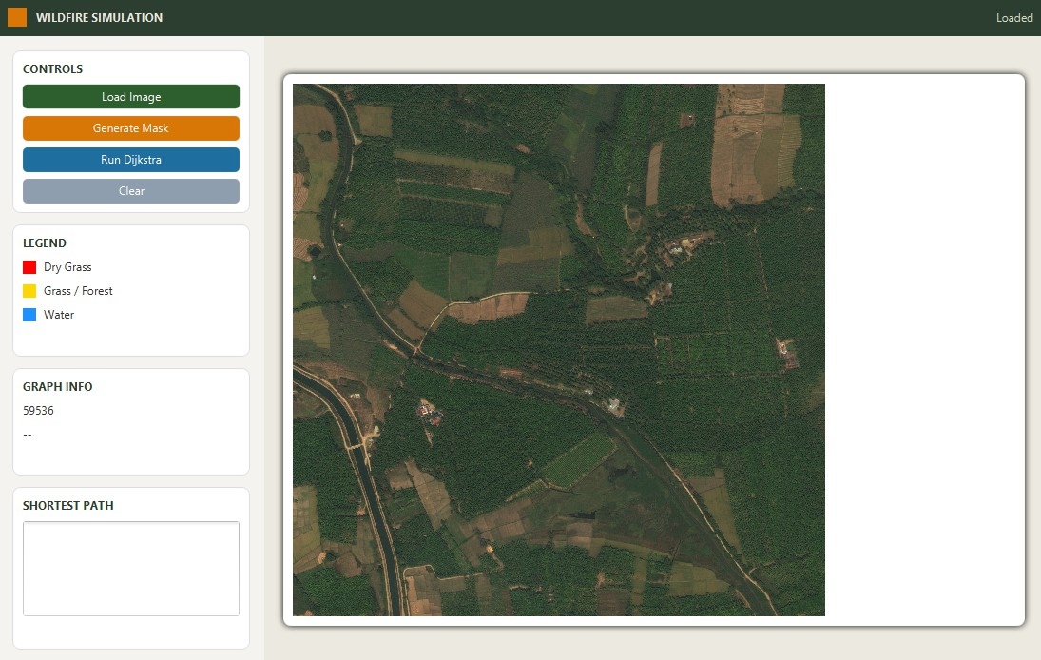

Slide 11
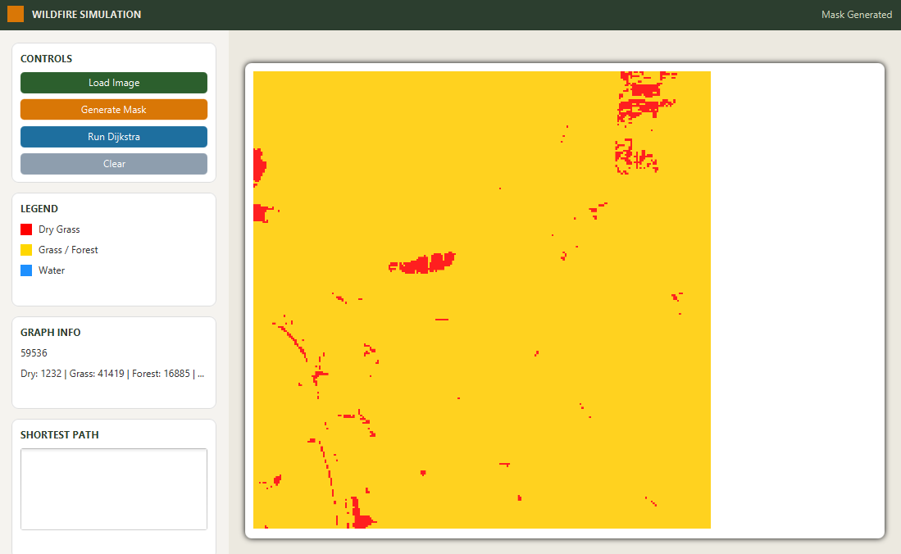
Generate Mask Result

Slide 12
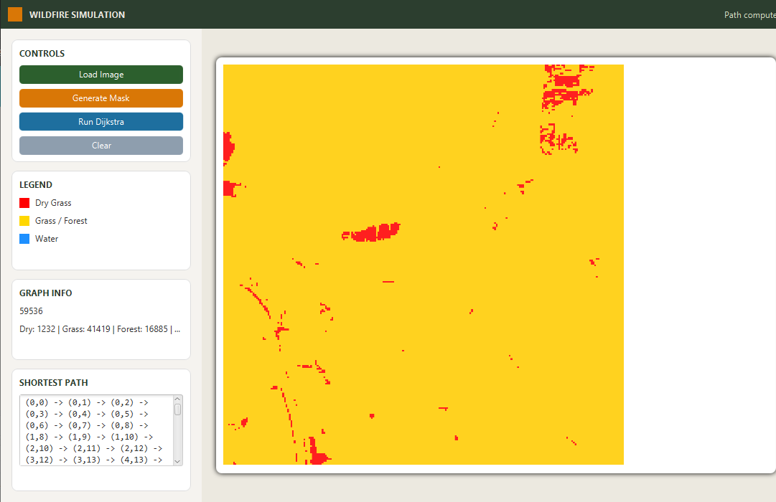
Run Dijktra Result

Slide 13
Conclusion
SUMMARY
The Graph-Based Wildfire Spread Simulation System successfully demonstrates how Graph Abstract Data Type and Dijkstra's algorithm can be applied to solve a real-world environmental problem.
Through this project we gained practical experience in image processing, graph construction, algorithm implementation, and building an interactive desktop application.
The system provides a strong foundation that can be extended in the future with more advanced features.
Thank You

