Slide 1
Diamond in the Rough
Ryan Sippy

Slide 2
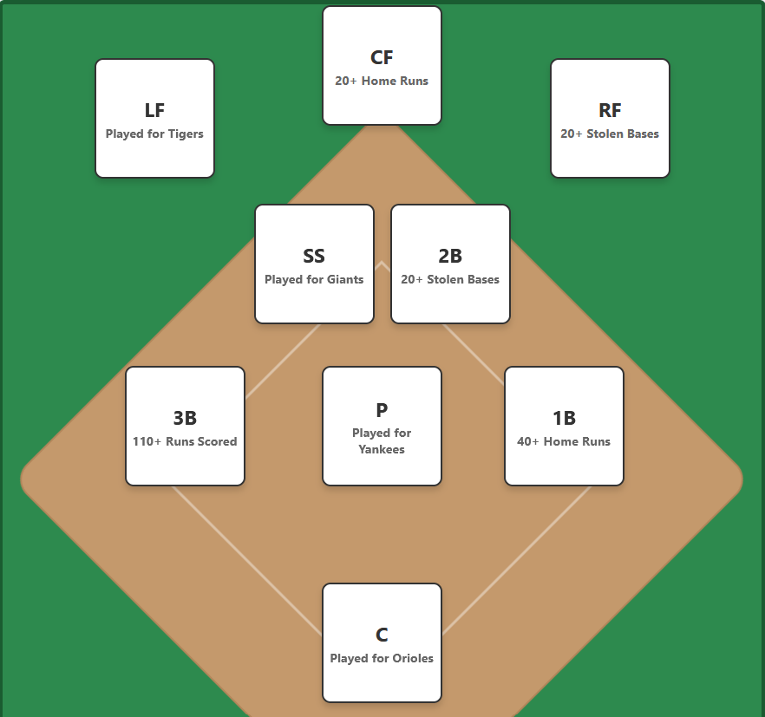
Project Overview
Daily Baseball trivia game in the style of Wordle or the Immaculate Grid
Players get a baseball field where they must identify a player & season that fits the given category for each position
Goal is to identify player/season combos with the highest WAR(Wins Above Replacement)

Slide 3
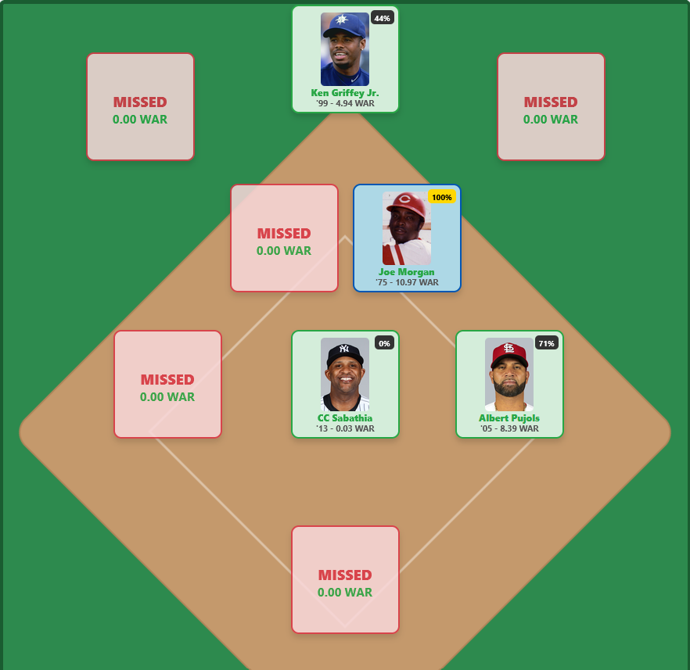
Project Overview(cont)
Categories change every day(similar to Wordle)
Players can play in Easy or Hard Mode
  Hard Mode restricts them to one guess per box
Players can share their results in the form of an emoji grid that shows how they did

Slide 4

Tech stack
Data is stored in a PostgreSQL database hosted on neon.tech
  Data was acquired from https://thebaseballscholar.com/data-library/ and then merged with team and MLB Advanced Media ID
Backend is Python Flask application that is hosted on Render
  Sends SQL queries to the database and returns the results to the Frontend
Frontend is simple HTML, CSS, and Javascript hosted on Github Pages
  Handles state management, daily seed generation, and API interactions

Slide 5
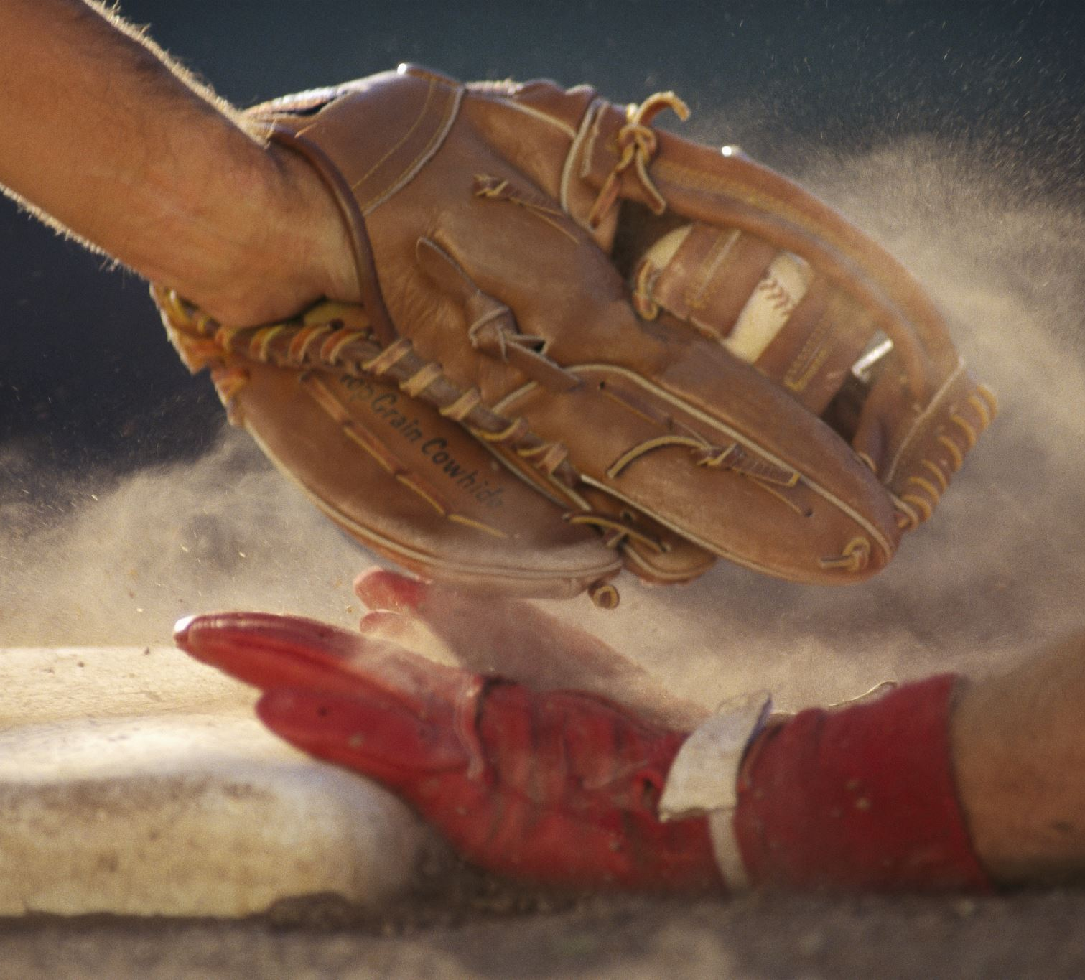
Challenges
Merging data from 3 different sources
  Original dataset did not contain teams for each player/season, so I had to source that data from the Lahman Baseball Database
  I also had to combine with the MLB Advanced Media ID so that I could use the ID to source the player pictures in the frontend
Lots and Lots of design iterations
  I had a basic idea of what I wanted this to look like, but I am not a designer
  It took many iterations to get the front end to look close to a baseball field
Hosting an application online
  This was my first time creating a web application that did not just run locally
  I had to learn how and where to host the various aspects of my project so they could be accessed through the web

Slide 6
Future work
Improve the UI/UX
  Pressing Enter when in either field should submit
  Add a way to toggle the best lineup option after closing the initial pane
  Add a way to see the maximum possible score
  Once I get enough player data, add a way to see where you rank in all the people who played
  Improve the way the share emojis looks
Add Mobile Support/Fix UI on Mobile
Add more categories
  Awards, Playoffs, Won a World Series, etc.
Add an “endless” mode
  Allow users to shuffle the categories and play a new board immediately

