Slide 1
Local AI Deployment in Healthcare Enterprise Operations: Preserving Sovereignty, Data Privacy, and Continuity in Prior Authorization
Jason Siputro
Seattle University

Slide 2
The Problem: Prior Authorization Bottleneck
Administrative Burdens:
Providers process 43 authorization requests a week, spending over 12 staff hours in manual documentation and review connected to Prior Authorization.
Prior-auth staffing jumped 43% between 2019 and 2024.
Patient Burden:
29% of physicians reported that patients in their care suffered serious adverse event because treatment was stalled.
Most providers report that prior auth barriers results in treatment abandonment.
CMS Interoperability and Prior Authorization Final Rule (CMS-0057-F):
Payers must process standard prior authorization within 7 calendar days, and urgent requests within 72 hours, effective Jan 1st, 2026.
Payers must implement and manage FHIR-based Application Programming Interface to streamline data sharing (patient access, provider access, prior authorization APIs), effective Jan 1st , 2027.
Notes:
- Current prior authorization system is severely administrative heavy and directly harms patient outcomes.
Source:
- https://www.medicaleconomics.com/view/prior-authorization-history-burden-ai-future

Slide 3

The Problem: Third-party API Vulnerabilities in Healthcare
Third-party APIs introduce operational risks:
  Data Leaks: risk of exposing protected health information (PHI) & proprietary business processes.
  High friction dependency: your system is at the mercy of the API providers (pricing, model availability, usage policy).
  No ownership of AI model: you don’t own any of the intellectual property control.
Notes:
Third Party API’s introduce 3 major risks:
Protected health information and proprietary business information/processes sent to these third party providers
Sources:
https://pub.towardsai.net/i-reverse-engineered-200-ai-startups-73-are-lying-a8610acab0d3

Slide 4
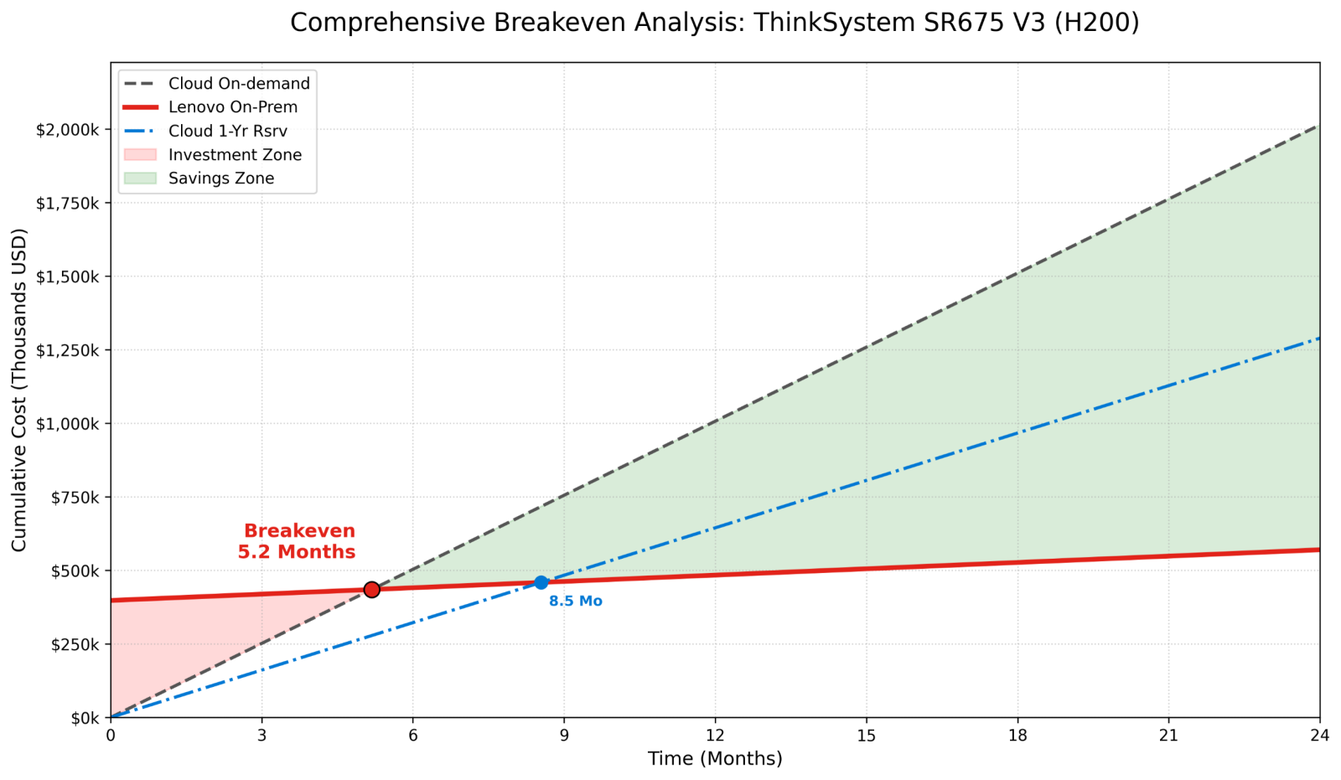
The Solution: Local deployment of LLMs
Deploying open-weight LLMs locally resolves such vulnerabilities:
  Data Sovereignty: Data is not sent to third party LLM providers, guaranteeing HIPAA compliance and securing company trade secrets/ intellectual properties.
  Ownership of Model: you own the deployment, weights, fine-tuned params and control of the model.
  Predictable cost: converts unpredictable per-token operational expenditure into stable capital infrastructure investment.
Note on the cons:
  High initial Capital Expenditures
  Local team for maintenance and security
Breakeven point against hyperscale cloud providers in as little as 6 months
Notes:
Here I propose a local deployment of LLMs:
With this solution, we are resolving such vulnerabilities
Sources:
- https://lenovopress.lenovo.com/lp2368-on-premise-vs-cloud-generative-ai-total-cost-of-ownership-2026-edition

Slide 5
System Architecture
End-to-end privacy-preserving audit pipeline — everything runs locally
DATA SOURCES
PROCESSING ENGINE
AI OUTPUT
HUMAN REVIEW
Patient FHIR R4
Bundles (Synthea)
Risk Classification
Low · Moderate · High
Streamlit
Dashboard
FHIR R4 Parser
(fhir_parser.py)
• Approve
• Deny
• Request Info
• Review CoT
• Check citations
• Auditor notes
Chain-of-Thought
Step-by-Step Reasoning
Coverage Policies
CP-101 · CP-202 · CP-303
Policy Matcher
(policies.py)
Verbatim Citations
Policy & Record Evidence
PA Claim Request
(Procedure + SNOMED)
Agentic Audit Engine
Ollama qwen2.5:7b
CoT Reasoning · JSON Output
Final Rationale
5 / 12

Slide 6
DEMO

Slide 7
Future Improvements
AI-based parser: Extracting Important information and converting to FHIR-based output using an Agentic AI.
RAG implementation: efficiently retrieving relevant information for Agentic AI workflow.
Fine-Tuning: Train model to be an expert at a specific field in TPOs.

Slide 8
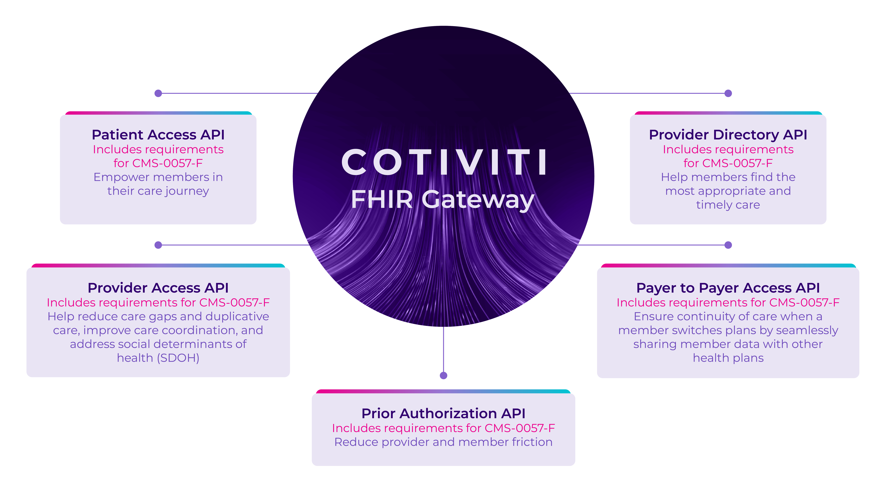
Strategic Impact for Cotiviti
Local deployment of LLMs extends its benefits to all Cotiviti’s solutions:
  Positioning Cotiviti as a secure AI solution for Healthcare enterprises
    Zero Data leaving locally hosted server to Third Party LLM API provider.
  Ownership of Model, its governance and fine-tuning.
  Decoupling core operations from volatile Cloud API pricing and risk of model deprecation by transitioning to stable capital infrastructure.
Notes:
Decoupling from high friction dependency

