Slide 1
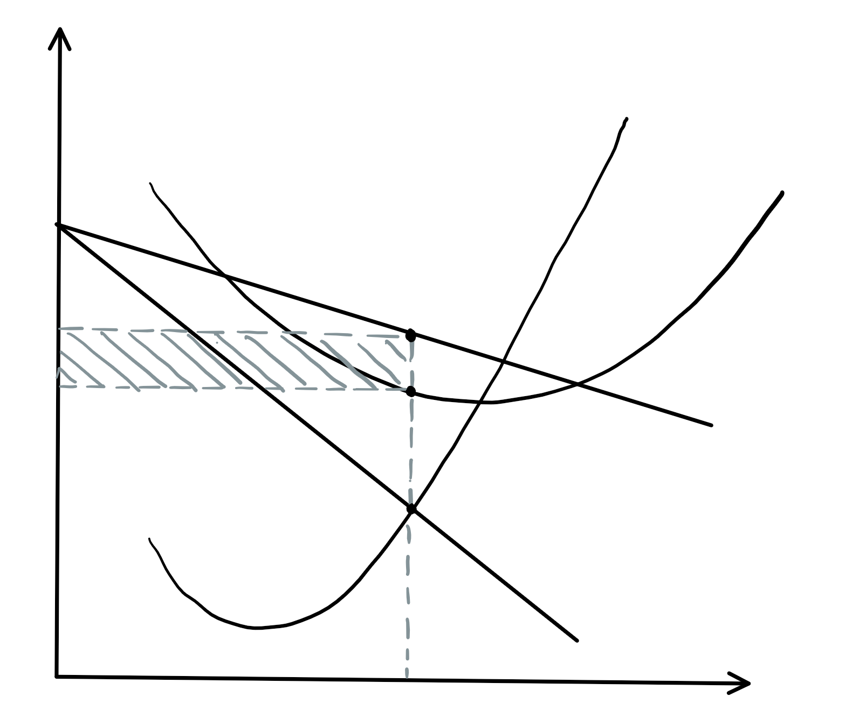
Price,
Costs,
Revenues
MC
AC
P
AC
AR = D = MB
Welfare loss
MR
O
Q
Quantity of Output

Slide 2
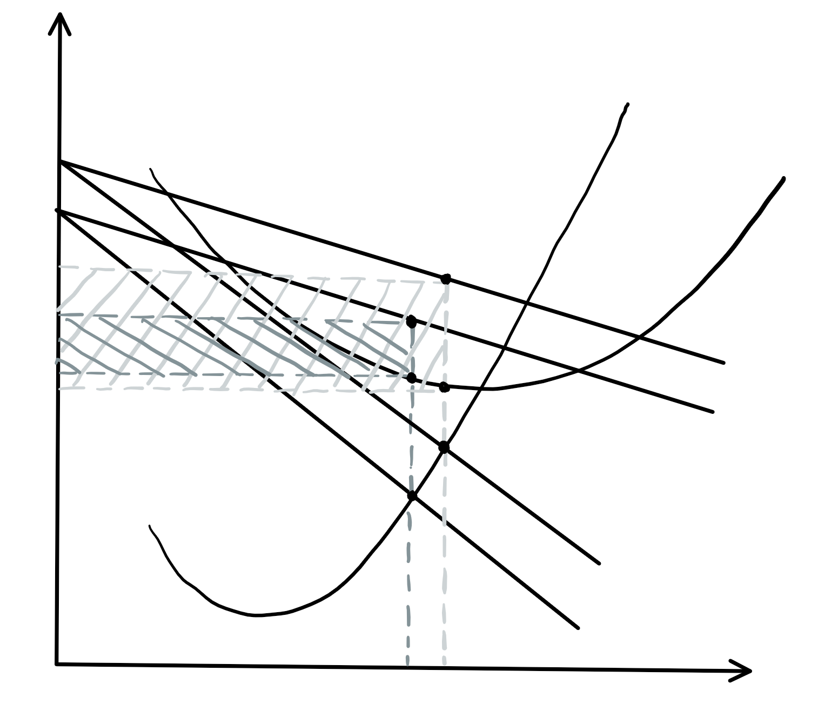
Price,
Costs,
Revenues
MC
AC
P
P’
AC’
AR
AC
AR’
MR
MR’
O
Q’
Q
Quantity of Output

