Slide 1
Development of Ocular Disease Auxiliary Diagnosis System
Jerry Pan

Slide 2
Background
Deep Learning in retinal disease diagnosis
Disease diagnosis from OCT images
Abnormality diagnosis from OCT images
Diagnosis from fundus images
Multi-modal Architecture

Slide 3
Purpose
Simulate the comprehensive diagnosis process
Present more interpretable findings
Provide the probabilities of retinal diseases
Accessible to all people
More flexible by allowing user to input multiple images

Slide 4
Model
Back-end Model
OCT-Models
Fundus-Models
Diagnosis-Model
Front-end UI
Website
APP

Slide 5
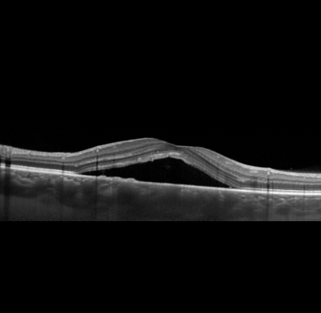
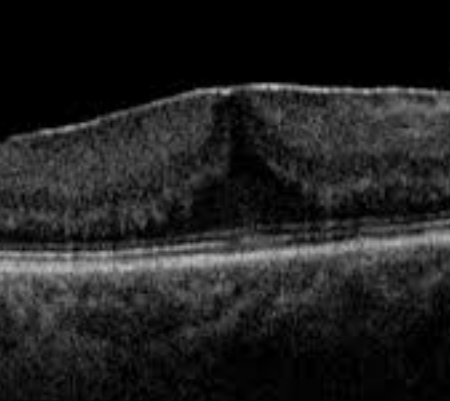
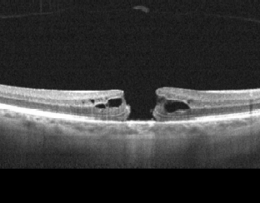
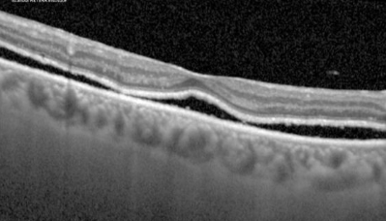
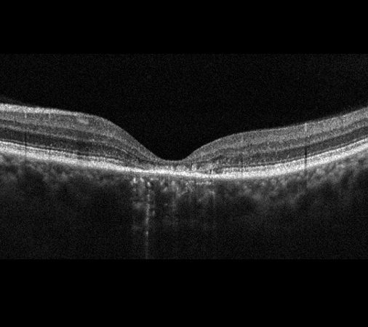
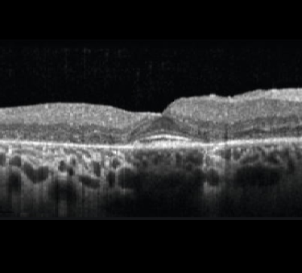
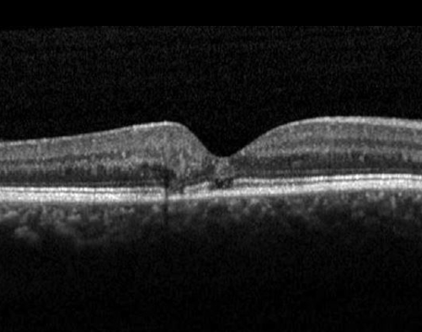
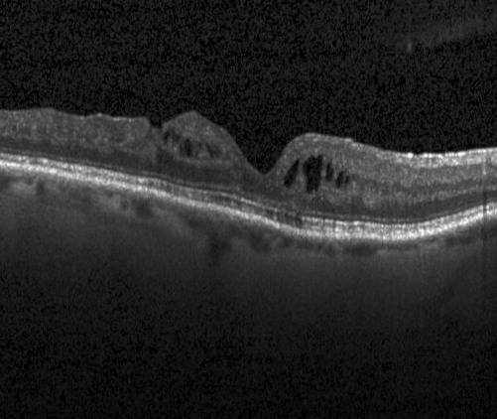
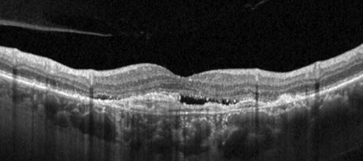
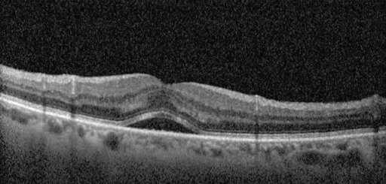
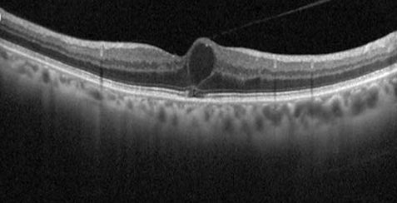
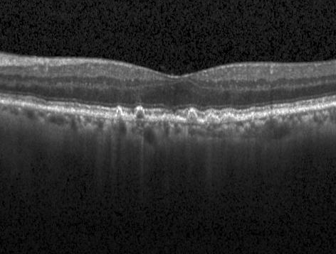
Abnormalities and Disease OCT Abnormalities
central serous chorioretinopathy (CSC)
epiretinal membrane (ERM)
macular hole (MH)
retinal detachment
Stargardt disease
retinitis pigmentosa (RP)
macular telangiectasia (Mactel)
diabetic macular edema (DME)
macular neovascularization
subretinal fluid
intraretinal fluid
drusen

Slide 6
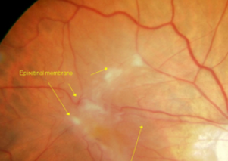
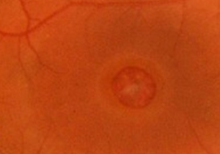
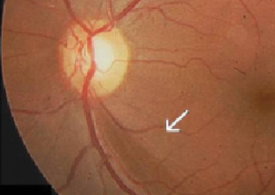
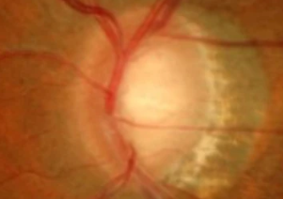
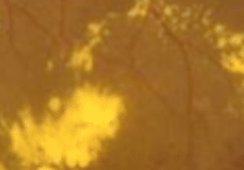
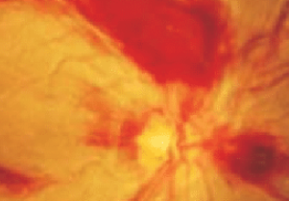
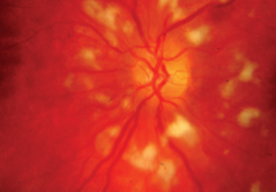
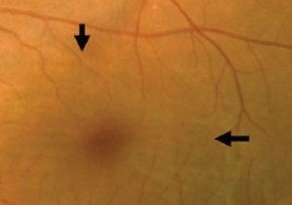
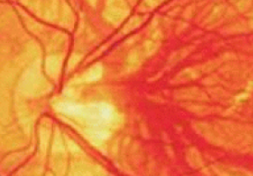
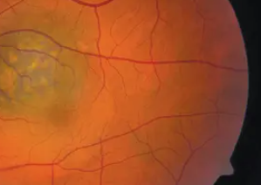
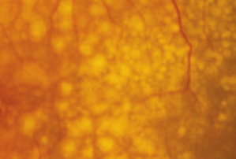
Abnormalities and Disease Fundus Abnormalities
epiretinal membrane (ERM)
Macular Hole
Retinal Nerve Fiber Layer Defect
Glaucomatous Disc Change
Hard Exudate
Hemorrhage
Cotton Wool Patch / Soft Exudate
Fluid Accumulation
Vascular Abnormality
Chorodial Lesion
drusen

Slide 7
Abnormalities and Disease Diseases
Central Serous Chorioretinopathy
Epiretinal Membrane
Macular Hole
Glaucoma Suspect
Retinal Detachment
Stargardt Disease
Macular Telangiectasia (Mactel)
Mild DR
Referable DR
Dry AMD
Wet AMD
BRVO / HCRVO
CRVO
Retinitis Pigmentosa (RP)

Slide 8
Back-end Model
1
2
…
K1
Normal
K1 + 1
K1 + 2
…
K2
Normal
…
Kn-1 + 1
Kn-1 + 2
…
Kn
Normal
OCT-Model 1
OCT-Model 2
OCT-Model n
Front-end UI
Diagnosis-Model
Fundus-Model 1
Fundus-Model 2
Fundus-Model m
1
2
…
L1
Normal
L1 + 1
L1 + 2
…
L2
Normal
…
Lm-1 + 1
Lm-1 + 2
…
Lm
Normal

Slide 9
Back-end Model classifiers
…
1
2
3
Normal
adopt 3
OCT-Model 1
…
…
1
2
Normal
1
2
Normal
adopt 2
abandon 3
OCT-Model 1
OCT-Model 1
…
1
2
…
K1
Normal
1
Normal
…
OCT-Model 1
OCT-Model 1
1
Normal
1
3
Normal
abandon 2
adopt 3
OCT-Model 1
OCT-Model 1
…
abandon 3
…
1
Normal
OCT-Model 1
…

Slide 10
Back-end Model OCT-Model and Fundus-Model
Flatten
Feature
Modified ResNet50
…
…
…
…
Abnormalities Probabilities

Slide 11
Back-end Model Diagnosis-Model – Fusion Timing
OCT-Models / Fundus-Models
OCT-Models / Fundus-Models
Diagnosis-Model
Diagnosis-Model
…
…
…
…
…
…
Feature vector
Probability vector
…
…
…
…
…
…
…
…
…
…
Disease Probabilities
Disease Probabilities
Feature vector
Probability vector
…
Feature vector
…
Probability vector
…
…
…
…
…
…

Slide 12
Back-end Model Diagnosis-Model – Conversion Criteria
Central Serous Chorioretinopathy
Central Serous Chorioretinopathy
Mild DR
Epiretinal Membrane
Hard Exudate
Epiretinal Membrane
Referable DR
Diabetic Macular Edema
Epiretinal Membrane
Hemorrhage
Drusen
Dry AMD
Macular Hole
Drusen
Macular Hole
Cotton Wool Patch / Soft Exudate
Macular Hole
Wet AMD
Chorodial Lesion
Retinal Nerve Fiber Layer Defect
Fluid Accumulation
Choroidal Neovascularization
BRVO / HCRVO
Glaucoma Suspect
intraretinal fluid
Glaucomatous Disc Change
Vascular Abnormality
CRVO
subretinal fluid
Retinal Detachment
Retinal Detachment
Retinitis Pigmentosa
Retinitis Pigmentosa
Stargardt Disease
Stargardt Disease
macular telangiectasia
Macular Telangiectasia

Slide 13
Back-end Model Training
Training sequence
2 public dataset for OCT-Model training
5 public dataset for Fundus-Model training
Diagnosis-Model training data
Plan A - Use data from hospital
Plan B - Make up data

Slide 14
Back-end Model Results
Confusion Matrix
Accuracy
Precision
Recall (Sensitivity)
Specificity
F1-score
ROC
AUC
t-SNE

Slide 15
Front-end UI
Taking photo button
Selecting photo button
List of abnormalities
Probabilities pie graph for diseases
diagnosis report
Highlighting abnormalities
Reset button
Upload button
Up to 10 images
Maximum probability vector
Grad-CAM
Upload images for better ODADS

Slide 16
Innovation
Bi-modal architecture
Probabilities of ocular diseases
Output the abnormalities
Front-end UI
Optimal classifier generation & fusion timing

Slide 17
Plan
March
April
May
June
Read literature. Study ophthalmology, OCT and fundus Images, abnormality and disease, deep learning and related algorithm
Collect OCT and fundus images from website. Prepare training images.
OCT-Models
Fundus-Models
Diagnosis-Model
Website & App
July
August
Complete paper draft
Keep on developing
September
October
Paper revision
Keep on developing
November
Finalize paper

Slide 18
Thank You!

