Slide 1
March
April
May
June
Read literature. Study ophthalmology, OCT and fundus Images, abnormality and disease, deep learning and related algorithm
Collect OCT and fundus images from website. Prepare training images.
OCT-Models
Fundus-Models
Diagnosis-Model
Website & App
July
August
Complete paper draft
Keep on developing
September
October
Collect & label real data
Paper revision
Keep on developing
November
Finalize paper

Slide 2
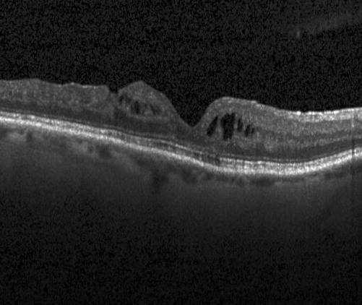
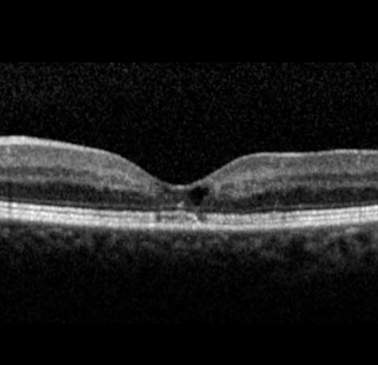
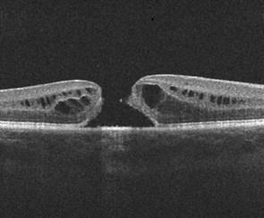
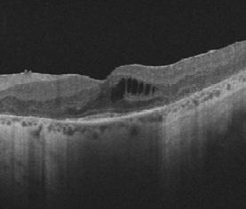
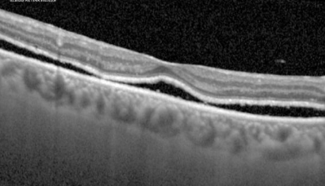
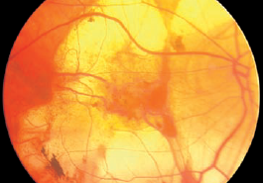
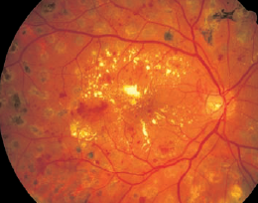
OCT-Disease Model
Diagnosis Model
OCT-Abnormity Model
Retinal-Layer Model
Fundus-Disease Model

Slide 3
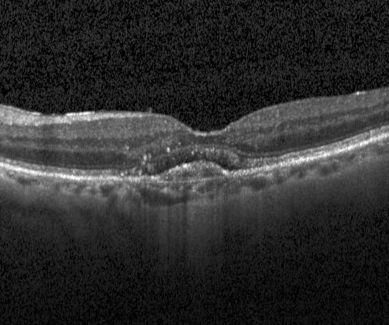
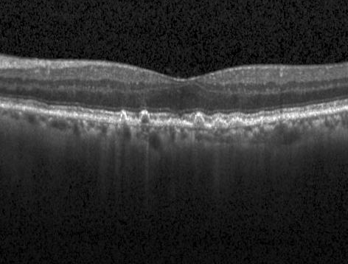
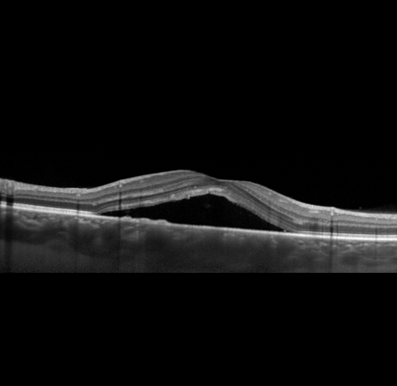
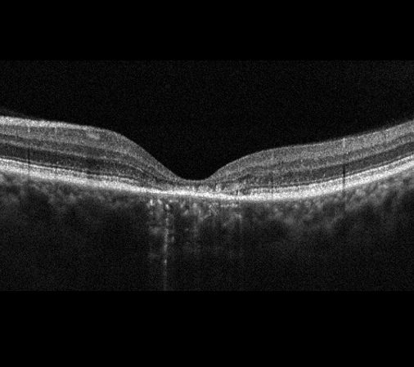
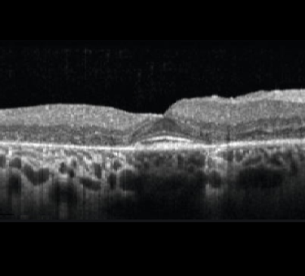
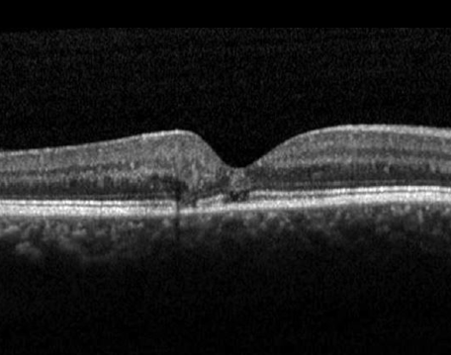
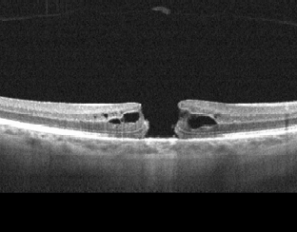
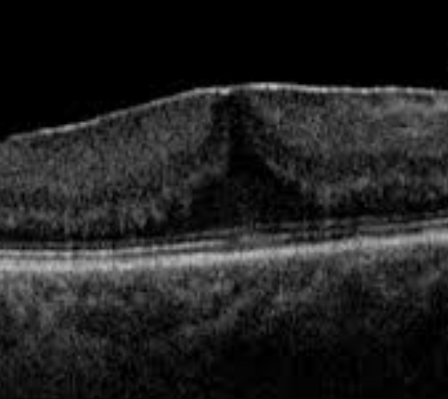
diabetic macular edema (DME)
choroidal neovascularization (CNV)
drusen
retinal detachment
central serous chorioretinopathy (CSC)
Stargardt disease
retinitis pigmentosa (RP)
macular telangiectasia (Mactel)
macular hole (MH)
epiretinal membrane (ERM)

Slide 4
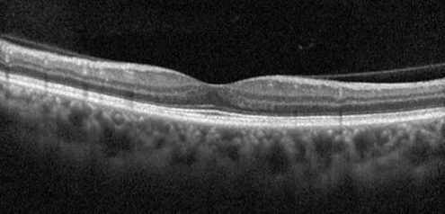
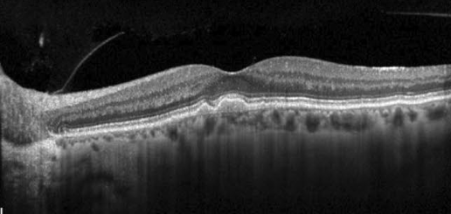
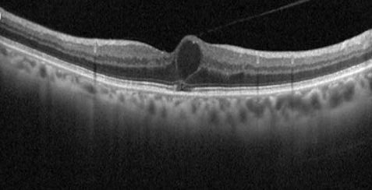
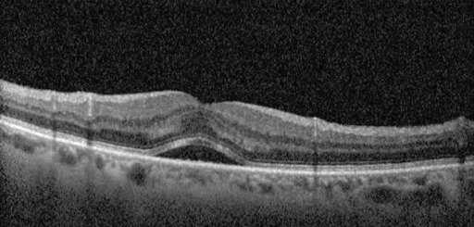
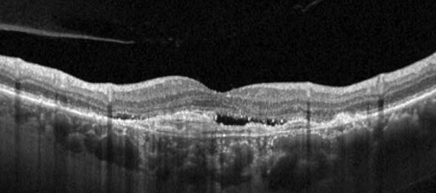
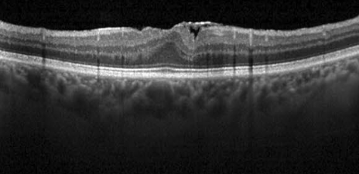
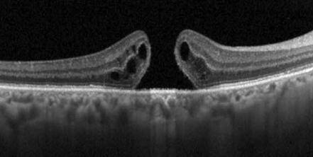
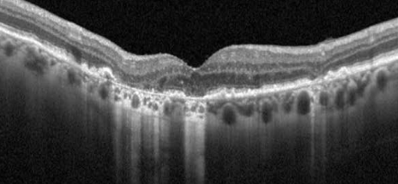
vitreomacular adhesion
drusen
intraretinal fluid
subretinal fluid
macular neovascularization
epiretinal membrane
macular hole
backscattering

Slide 5
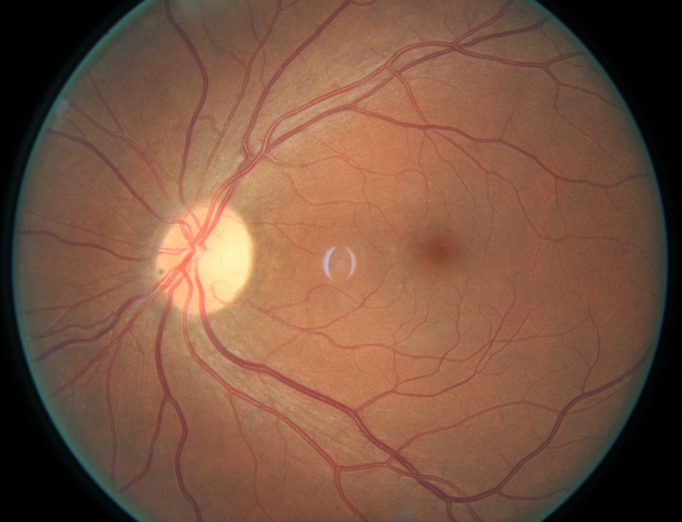
Flatten
Feature
Abnormalities Probabilities
…
…
…
…
Modified ResNet50
Flatten
Feature
Modified ResNet50
…
…
…
…
Abnormalities Probabilities

Slide 6
1
2
…
K1
Normal
K1 + 1
K1 + 2
…
K2
Normal
…
Kn-1 + 1
Kn-1 + 2
…
Kn
Normal
OCT-Model 1
OCT-Model 2
OCT-Model n
Diagnosis-Model
Front-end UI
Fundus-Model 1
Fundus-Model 2
Fundus-Model m
1
2
…
L1
Normal
L1 + 1
L1 + 2
…
L2
Normal
…
Lm-1 + 1
Lm-1 + 2
…
Lm
Normal

Slide 7
…
1
2
3
Normal
adopt 3
OCT-Model 1
…
…
1
2
Normal
1
2
Normal
adopt 2
abandon 3
OCT-Model 1
OCT-Model 1
…
1
2
…
K1
Normal
1
Normal
…
OCT-Model 1
OCT-Model 1
1
Normal
1
3
Normal
abandon 2
adopt 3
OCT-Model 1
OCT-Model 1
…
abandon 3
…
1
Normal
OCT-Model 1
…

Slide 8
Flatten
Feature
Abnormalities Probabilities
…
…
…
…
Modified ResNet50
Flatten
Feature
Modified ResNet50
…
…
…
…
Abnormalities Probabilities

Slide 9
OCT-Models / Fundus-Models
OCT-Models / Fundus-Models
Diagnosis-Model
Diagnosis-Model
…
…
…
…
…
…
Feature vector
Probability vector
…
…
…
…
…
…
…
…
…
…
Disease Probabilities
Disease Probabilities
Feature vector
Probability vector
…
Feature vector
…
Probability vector
…
…
…
…
…
…

Slide 10
central serous chorioretinopathy (CSC)
epiretinal membrane (ERM)
macular hole (MH)
retinal detachment
Stargardt disease
retinitis pigmentosa (RP)
macular telangiectasia (Mactel)
diabetic macular edema (DME)
macular neovascularization
subretinal fluid
intraretinal fluid
drusen

Slide 11
Central Serous Chorioretinopathy
Central Serous Chorioretinopathy
Mild DR
Epiretinal Membrane
Hard Exudate
Epiretinal Membrane
Referable DR
Diabetic Macular Edema
Epiretinal Membrane
Hemorrhage
Drusen
Dry AMD
Macular Hole
Drusen
Macular Hole
Cotton Wool Patch / Soft Exudate
Macular Hole
Wet AMD
Chorodial Lesion
Retinal Nerve Fiber Layer Defect
Fluid Accumulation
Choroidal Neovascularization
BRVO / HCRVO
Glaucoma Suspect
intraretinal fluid
Glaucomatous Disc Change
Vascular Abnormality
CRVO
subretinal fluid
Retinal Detachment
Retinal Detachment
Retinitis Pigmentosa
Retinitis Pigmentosa
Non-Glaucomatous Disc Change
Retinal Pigmentary Change
Stargardt Disease
Stargardt Disease
macular telangiectasia
Macular Telangiectasia
Myelinated Nerve Fibre
Chorioretinal Atrophy

Slide 12
New
Central Serous Chorioretinopathy
Central Serous Chorioretinopathy
Mild DR
Microaneurysm
Epiretinal Membrane
Hard Exudate
Epiretinal Membrane
Referable DR
Diabetic Macular Edema
Epiretinal Membrane
Hemorrhage
Drusen
Dry AMD
Macular Hole
Drusen
Macular Hole
Cotton Wool Patch / Soft Exudate
Macular Hole
Wet AMD
Choroidal Neovascularization
intraretinal fluid
BRVO / HCRVO
Glaucoma Suspect
subretinal fluid
Glaucomatous Disc Change
Vascular Abnormality
CRVO
Retinal Detachment
Retinal Detachment
Retinitis Pigmentosa
Retinitis Pigmentosa
Retinitis Pigmentosa
Stargardt Disease
Stargardt Disease
macular telangiectasia
Macular Telangiectasia

Slide 13
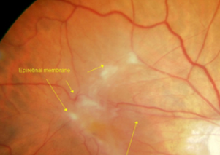
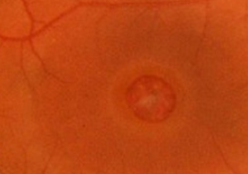
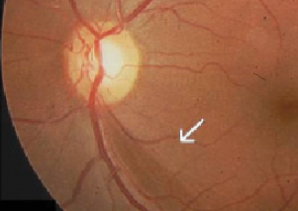
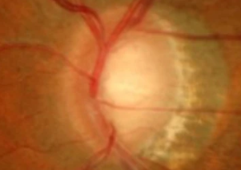
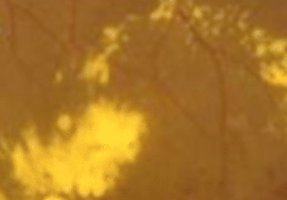
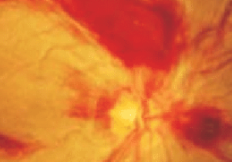
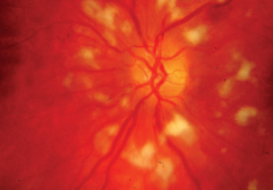
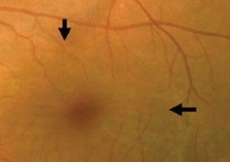
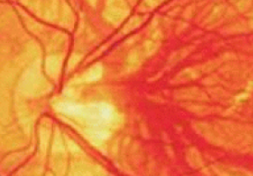
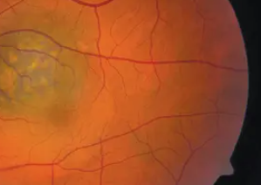
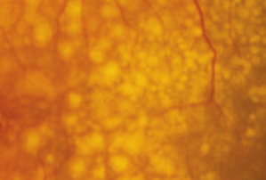
epiretinal membrane (ERM)
Macular Hole
Retinal Nerve Fiber Layer Defect
Glaucomatous Disc Change
Hard Exudate
Hemorrhage
Cotton Wool Patch / Soft Exudate
Fluid Accumulation
Vascular Abnormality
Chorodial Lesion
drusen

Slide 14
 |  | Predicted condition
Actual condition | Total population = P +N = PP + PN | Positive (PP) | Negative (PN)
 | Positive (P) | True Positive (TP) | False Negative (FN)
 | Negative (N) | False Positive (FP) | True Negative (TN)

