Slide 1
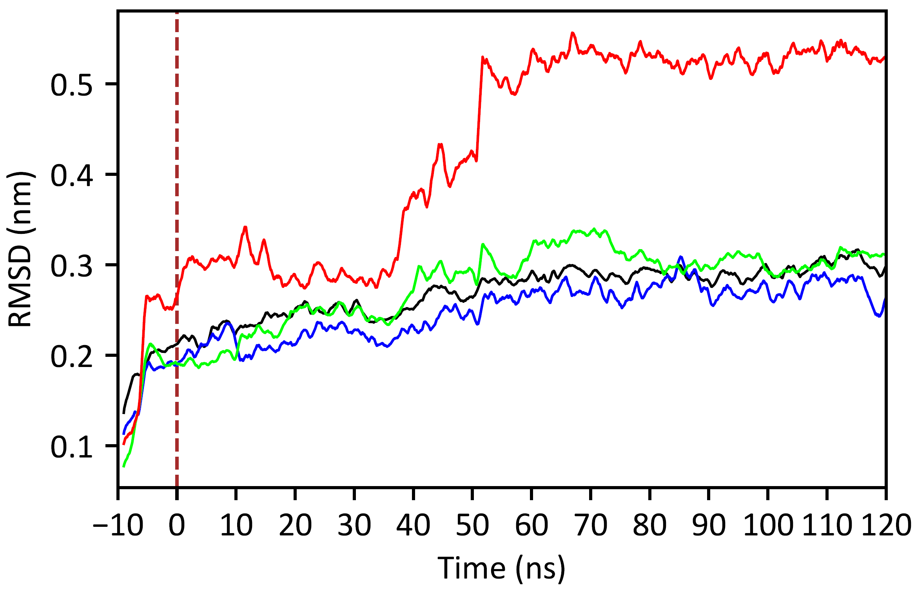
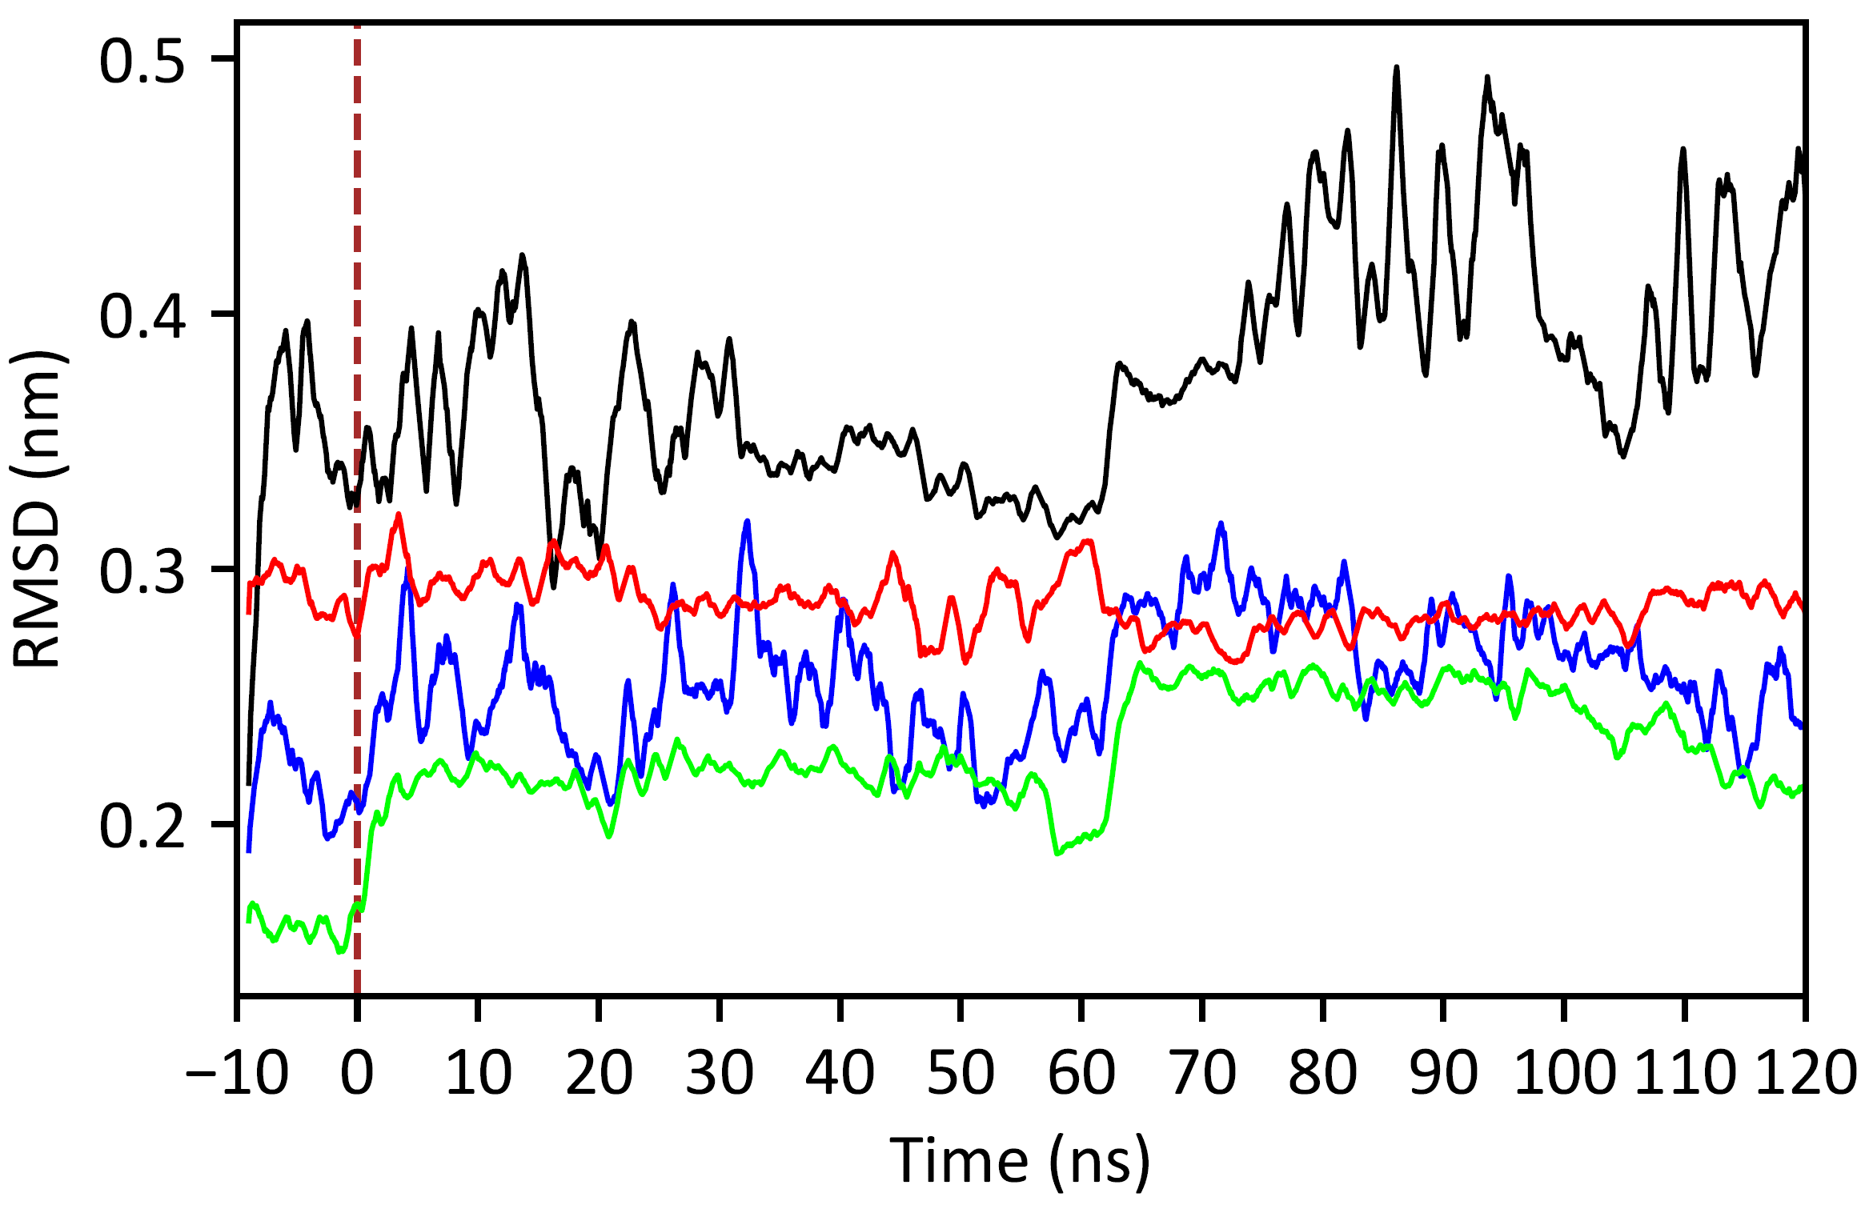
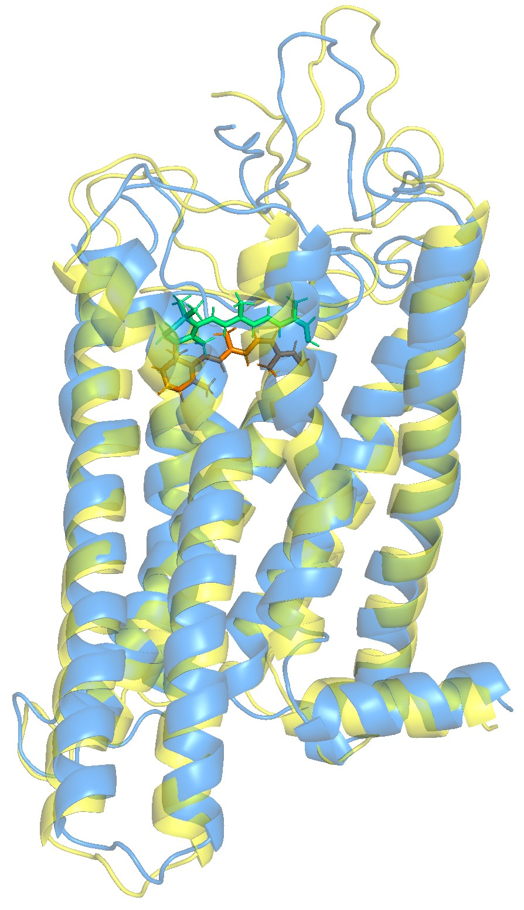
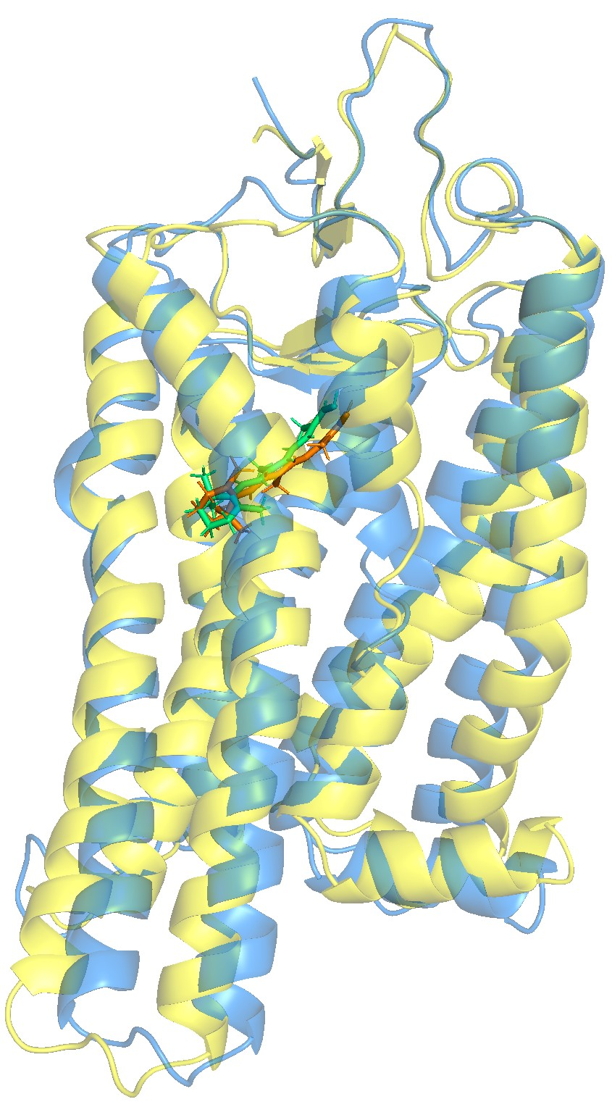
a)
Native Protein
b)
QTY Analog
c)
cis-state OPN2 vs trans-state OPN2 (RMSD = 2.300 Å)
cis-state OPN2^{QTY} vs trans-state OPN2^{QTY} (RMSD = 2.106 Å)
cis-state OPN2
vs
cis-state OPN2^{QTY}
(RMSD = 2.034 Å)
trans-state OPN2
vs
trans-state OPN2^{EXP}
(RMSD = 2.894 Å)

Slide 2
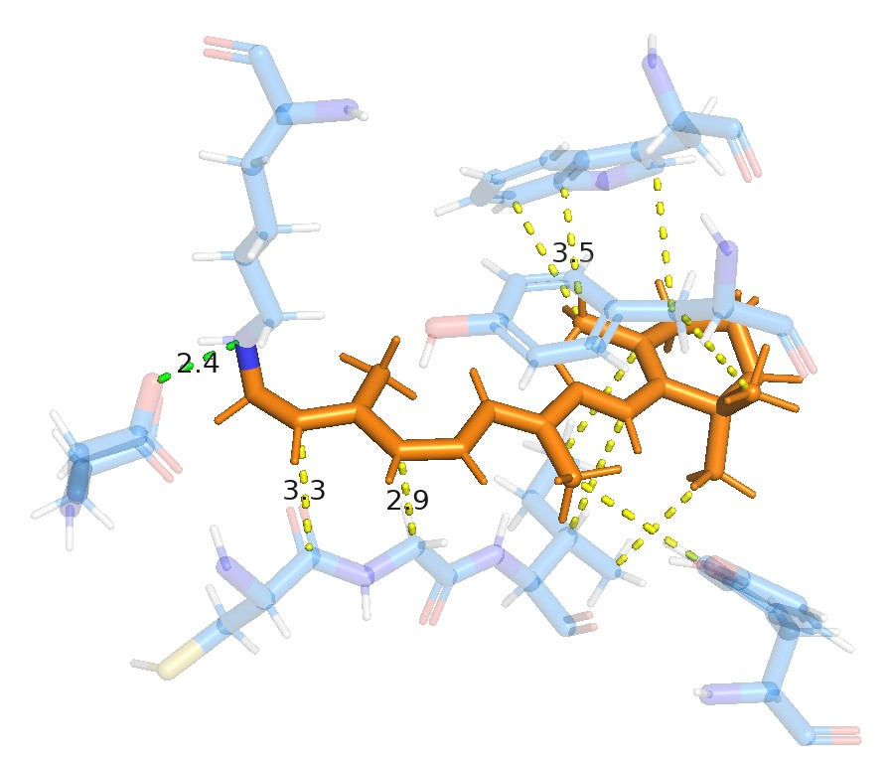
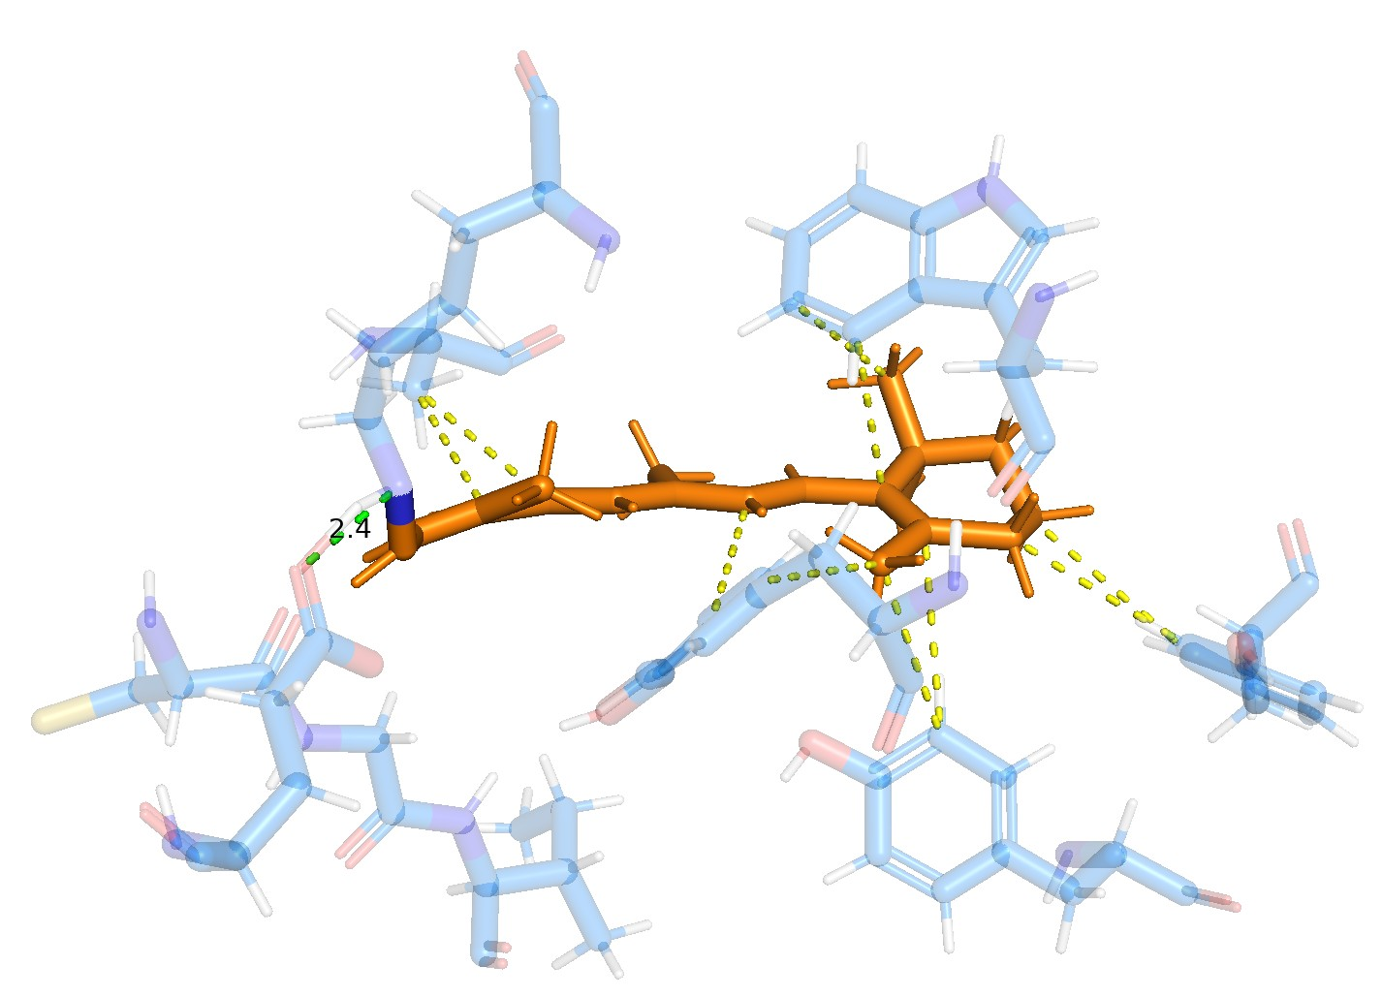
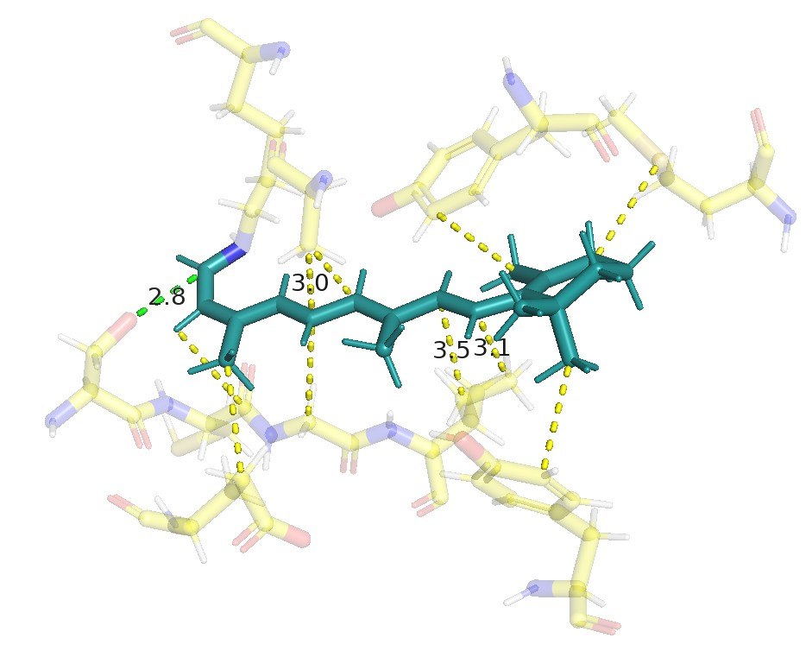
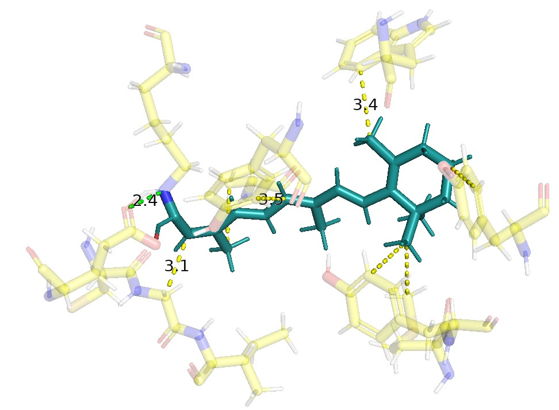
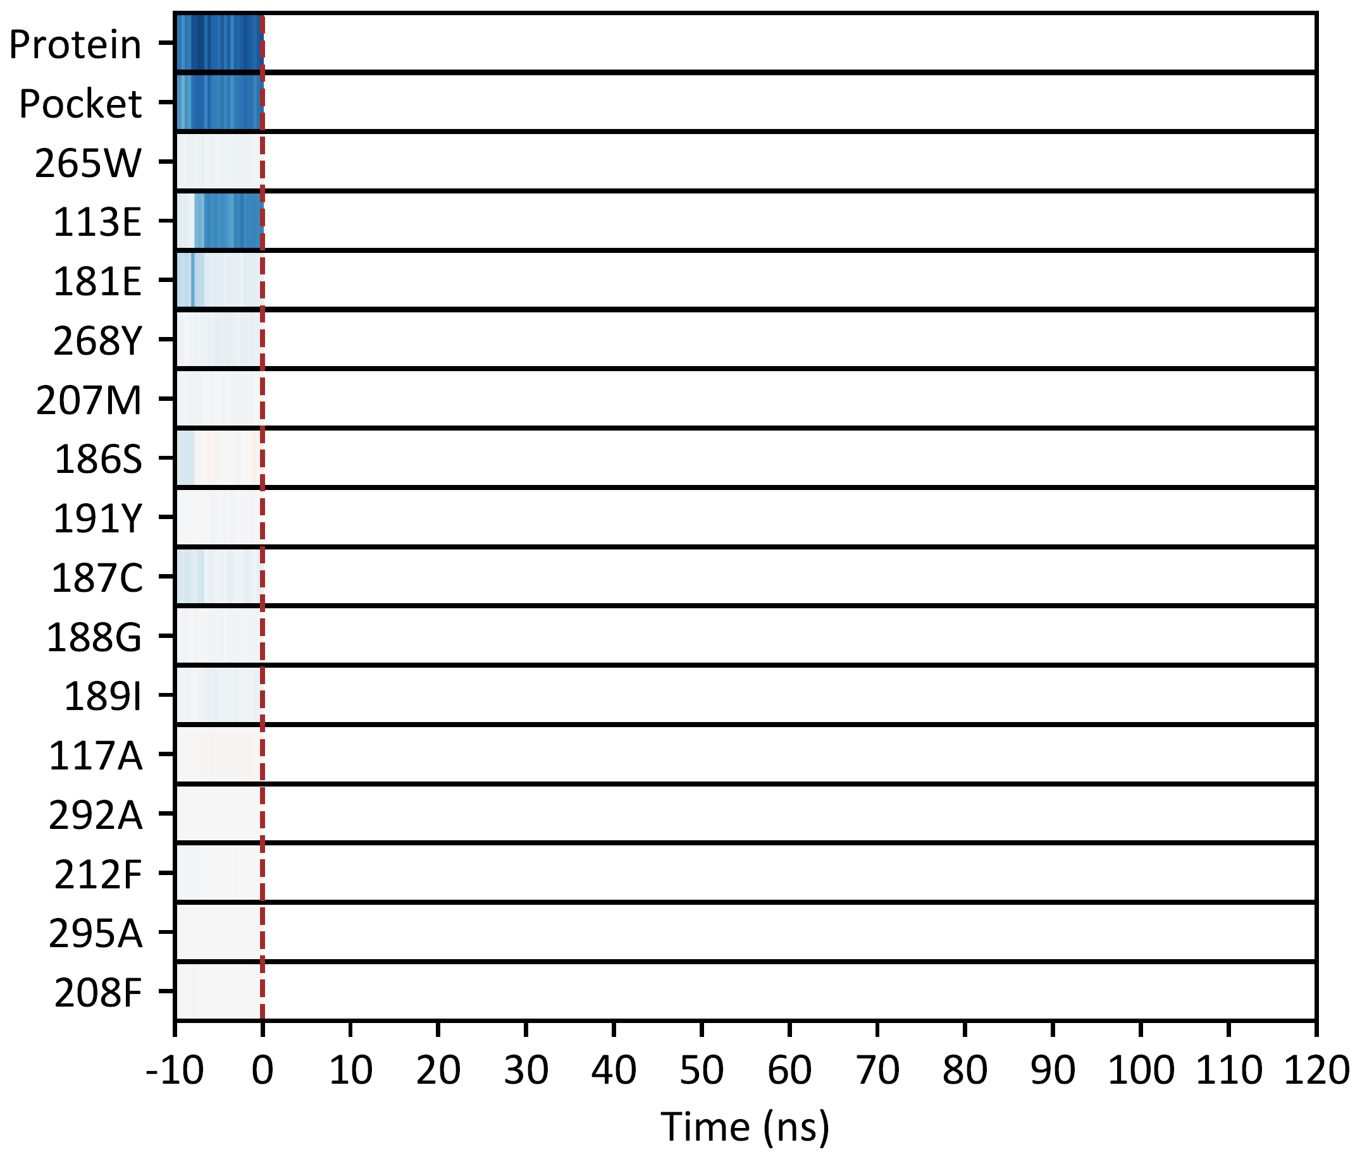
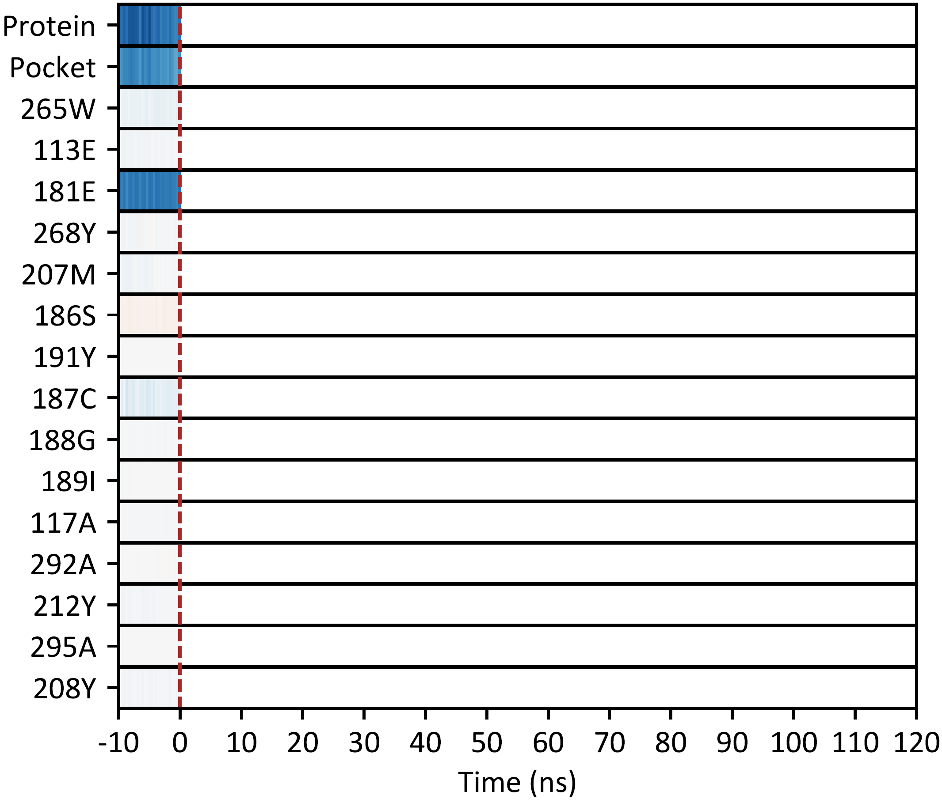
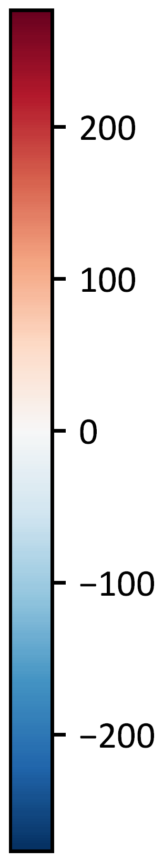
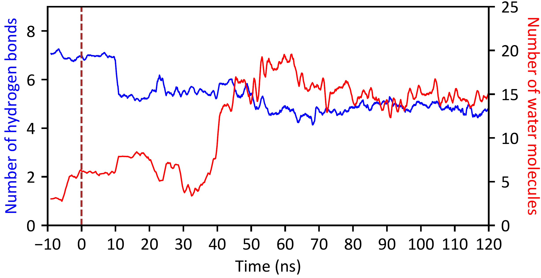
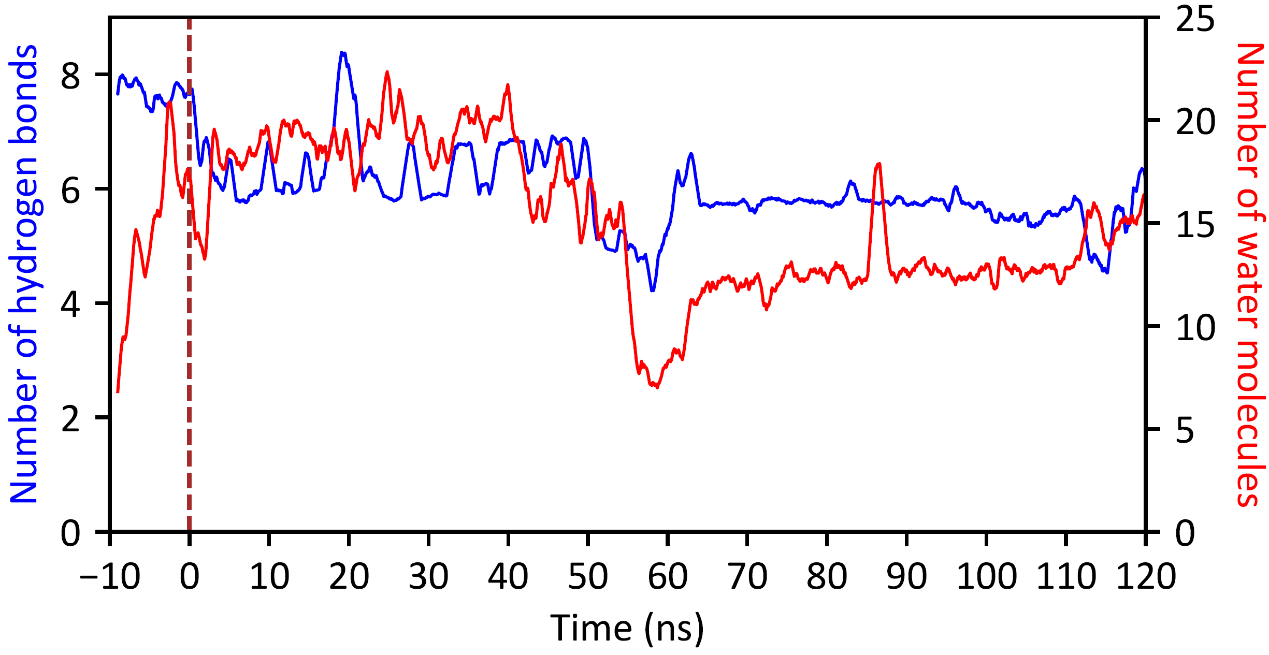
Native Protein
QTY Analog
a)
265W
b)
265W
296K
268Y
117A
113E
296K
RET
RET
181E
268Y
212Y
191Y
187C
188G
208Y
187C
188G
189I
189I
c)
268Y
d)
265W
296K
292A
268Y
RET
207M
296K
117A
212Y
117A
RET
181E
187C
188G
189I
188G
208Y
207M
181E
191Y
187C
191I
e)
f)
g)
h)

