Slide 1
Steganography: Tool Comparison & Automation
By Siri Siqveland

Slide 2
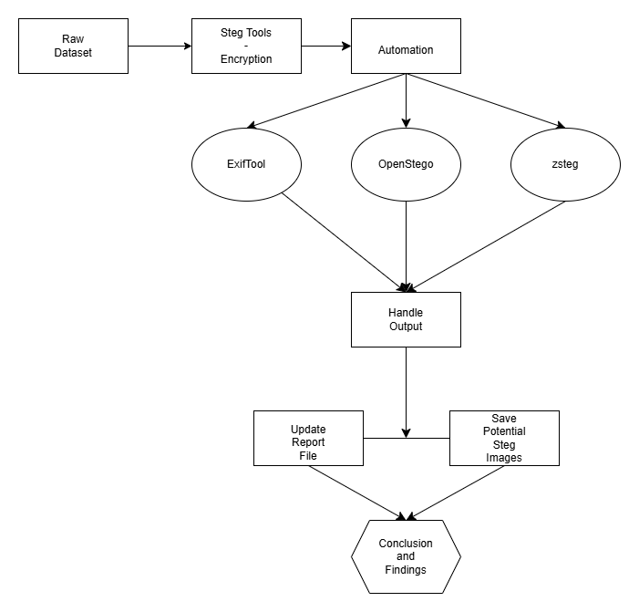
Context:

Slide 3
Conclusion
Learned:
OpenStego Decrypt only works if OpenStego Encrypted
ExifTool finnicky when working with cmd line, prone to false positives
Zsteg marks PNG as hidden steg 100% of the time
Even with professional tools, steganography can be difficult
Automation works well for identifying steg, but not extracting
Would be a separate task to successfully extract hidden data in its original format
Improvements if Re-Done:
Swap ExifTool for another stego tool
Use more images, specifically PNG (many false positives)
Encrypt one part of the dataset with OpenStego for a better OpenStego test
Improve code complexity (try and reduce execution time)

Slide 4
Questions

