Slide 1
DES Cryptanalysis Attack
By Siri Siqveland

Slide 2
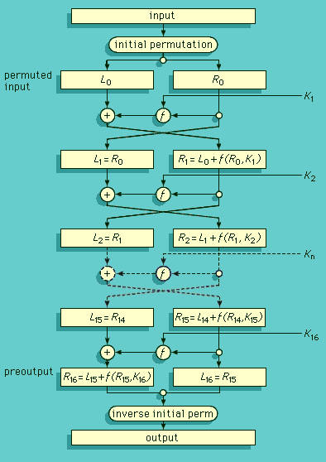
Objective & Scope
Objective:
Implement a DES Cryptanalysis Attack
Used Chosen Plaintext attack
Try to get probabilities for subkeys to match actual subkey
Compare test attack results with actual data
Note: Scope changed from original draft proposal slightly

Slide 3
Technical Implementation
Hurdles Faced
Cryptanalysis is probability based: Full guess != Actual subkey
Without full subkey match, finding full key would be difficult
Moved to refining Subkey matching instead
Learning python syntax while coding project
Time Constraints
Spent too long debugging Sbox part of attack
Shift scope to focusing on getting parts of the subkeys to match
Issues ensuring attack working right
Added extra code to ensure DES enc and dec working as intended

Slide 4
Conclusion
Results Show:
Chosen plaintext attacks take time and runs on probability
Probability = Not all parts of guessed subkeys match actual subkey
With enough computability, cryptanalysis can crack DES
Chosen P difference does not give strong differential bias to sboxes 1-4 unlike 5-8 (Would like to test more)
Lessons Learned:
DES is more complicated than I thought
Cryptanalysis takes time to guess bit pairs, but more guesses is more accurate

