Slide 1
ARI711S Group Project
Neural-Domination Group:
https://github.com/Sir-CxdesAlot/Neural-Domination-Group-Project

Slide 2
Problem Framing
• Three AI tasks:
- Part 1: Graph Search (Flight Connections)
- Part 2: CSP (Hospital Scheduling)
- Part 3: Machine Learning (Traffic Signs)
• Implementation in single submission notebook
• All parts demonstrated with evaluation metrics

Slide 3
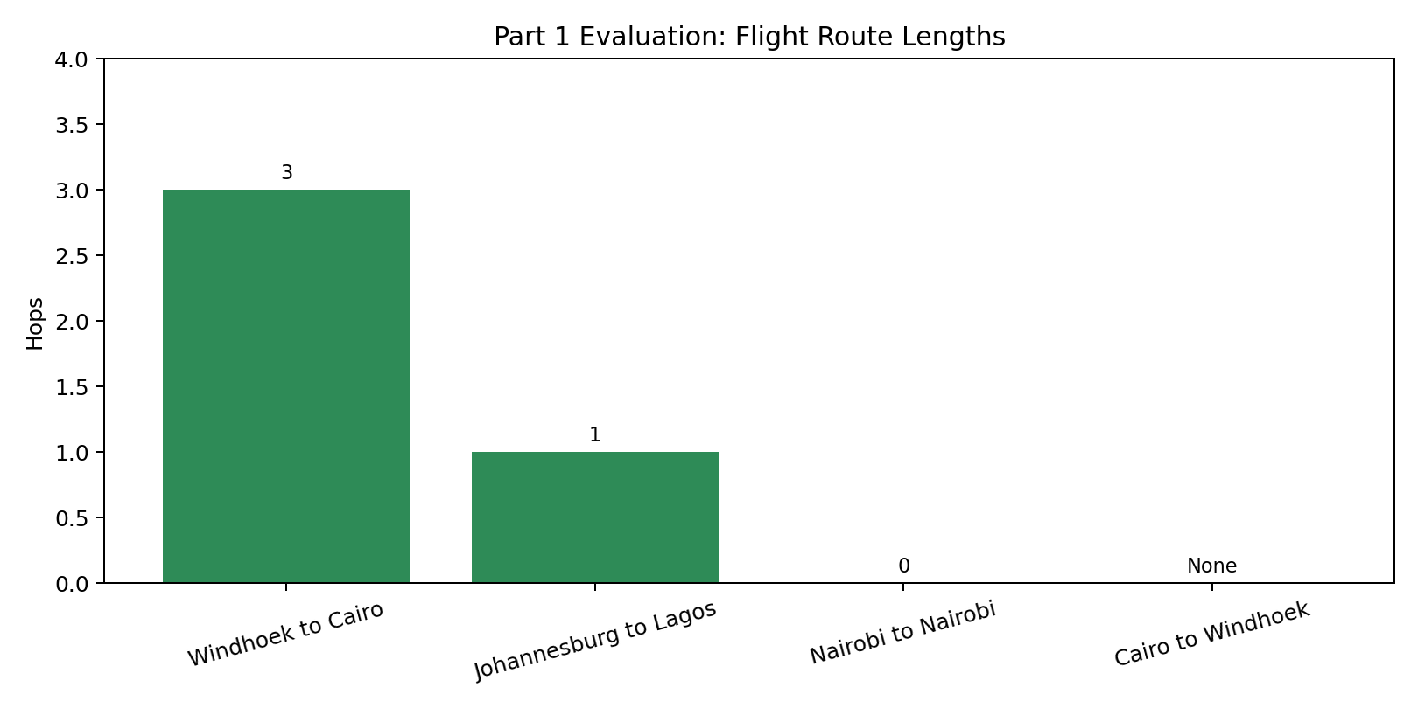
Part 1: Flight Connections (BFS)
• Graph Model: Cities = nodes, flights = edges
• Algorithm: Breadth-First Search
• Finds shortest path (minimum hops)
Key Result: 4/4 test cases passed ✓
Example: Windhoek → Cairo (3 hops)

Slide 4
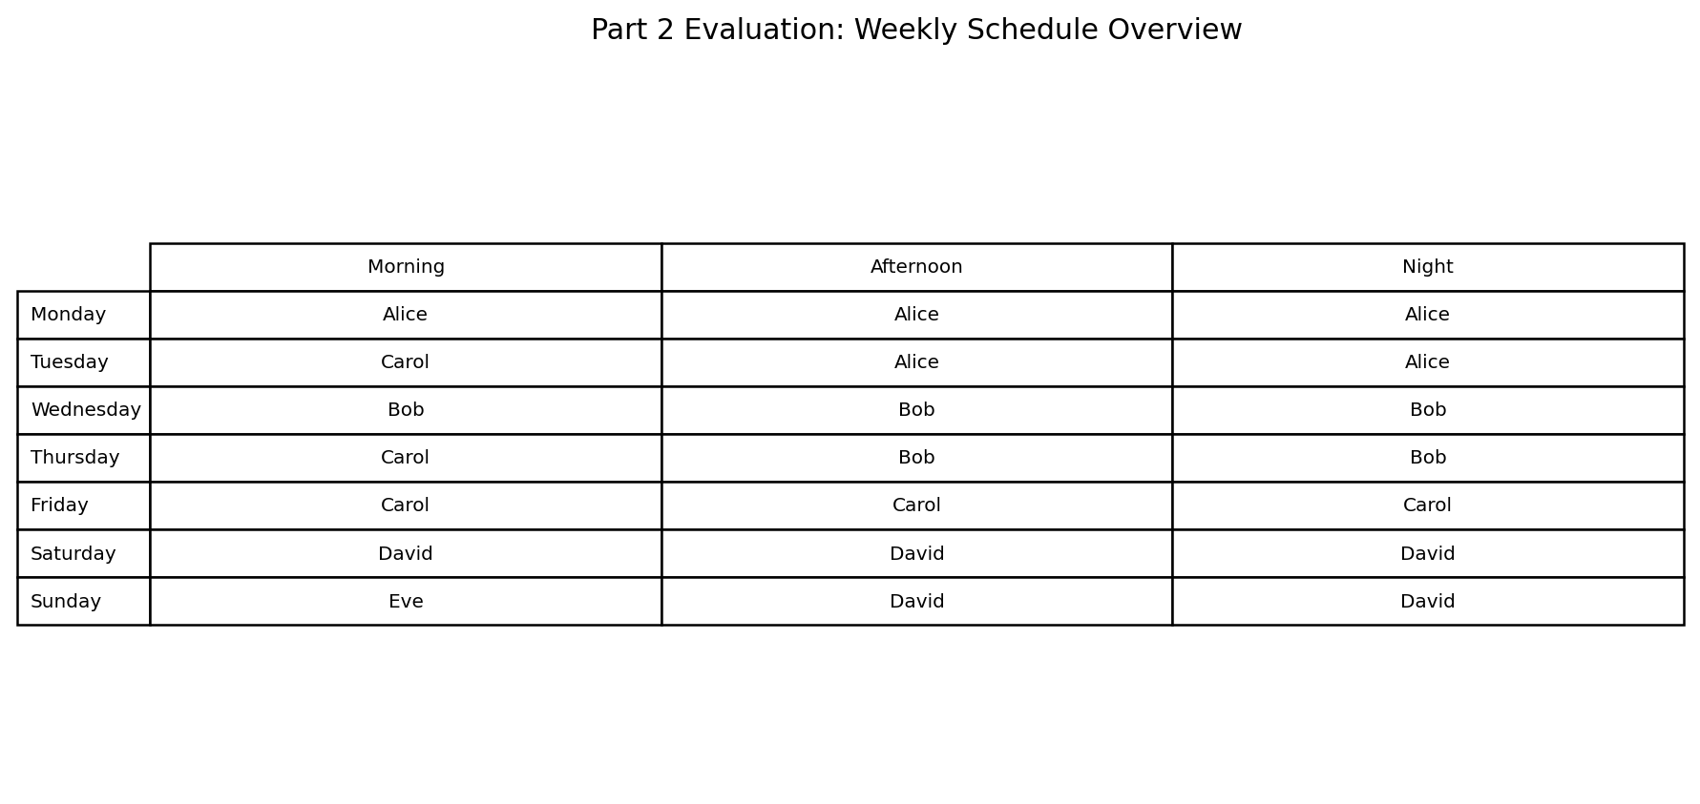
Part 2: Hospital Shift Scheduling (CSP)
• 21 shifts (7 days × 3 shifts)
• Constraints: Leave, Rest rules, Max 5/week
• Solver: AC-3 + MRV Backtracking
Results: All 21 assigned, 0 violations ✓

Slide 5
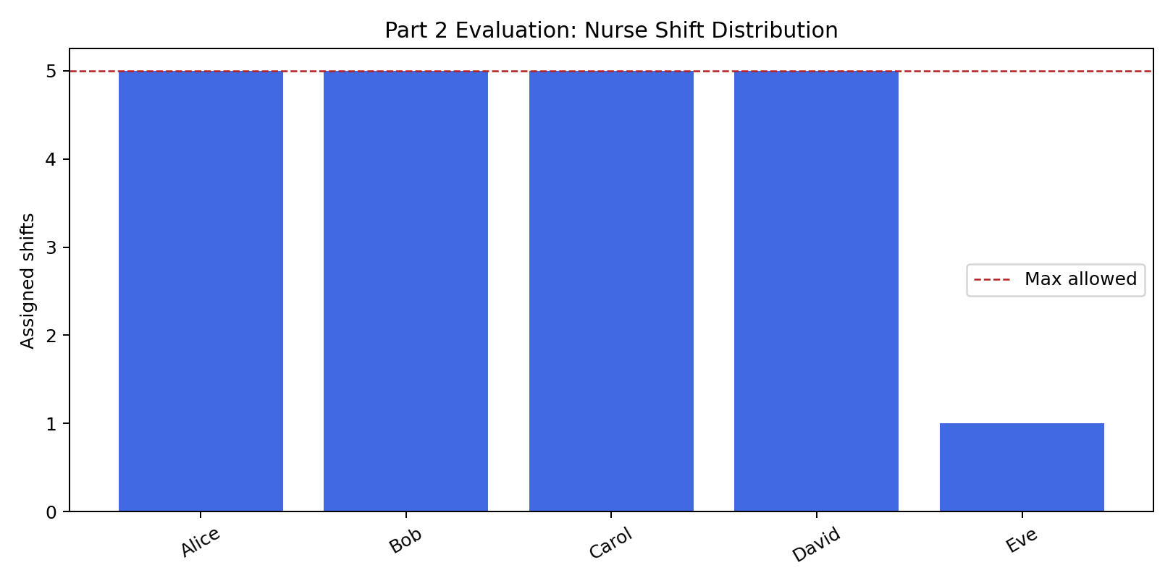
Part 2: Shift Distribution
• Fairness (StdDev): 1.6
• Max per nurse: 5
• Workload balanced
All constraints satisfied ✓

Slide 6
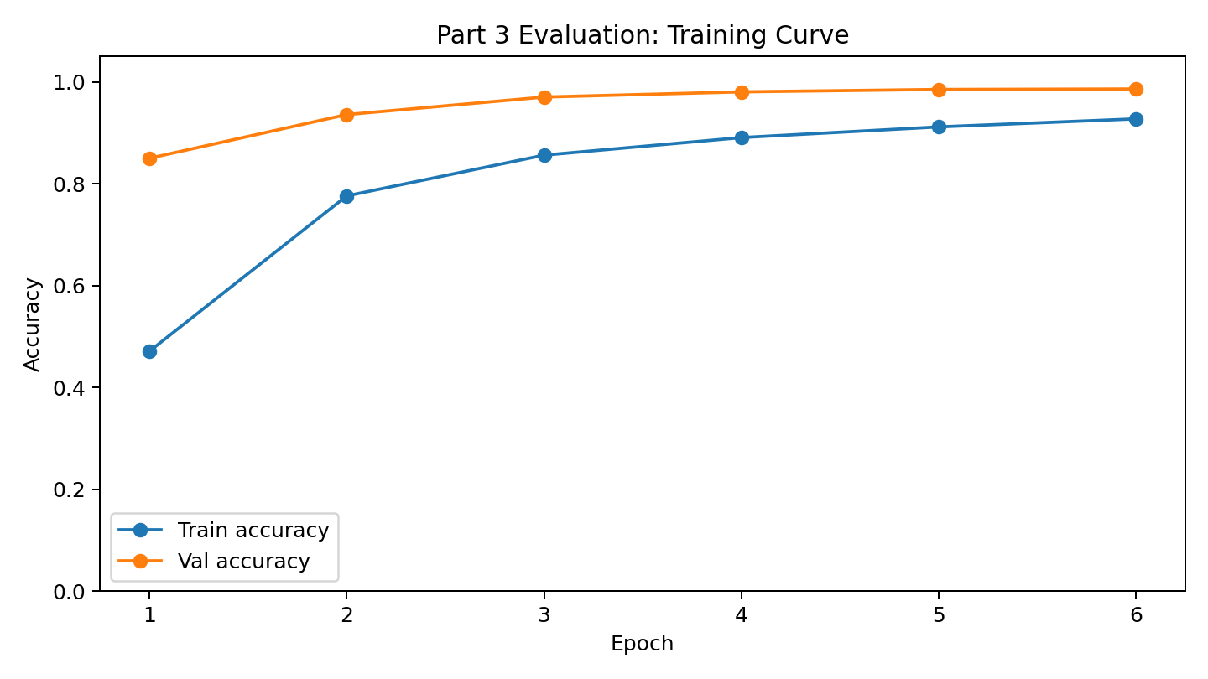
Part 3: Traffic Sign Recognition (CNN)
• Dataset: GTSRB (43 classes, 39,209 images)
• Model: Convolutional Neural Network
- Conv2D + MaxPooling ×2
- Dense layers, Dropout
• Training: 6 epochs, batch size 32

Slide 7
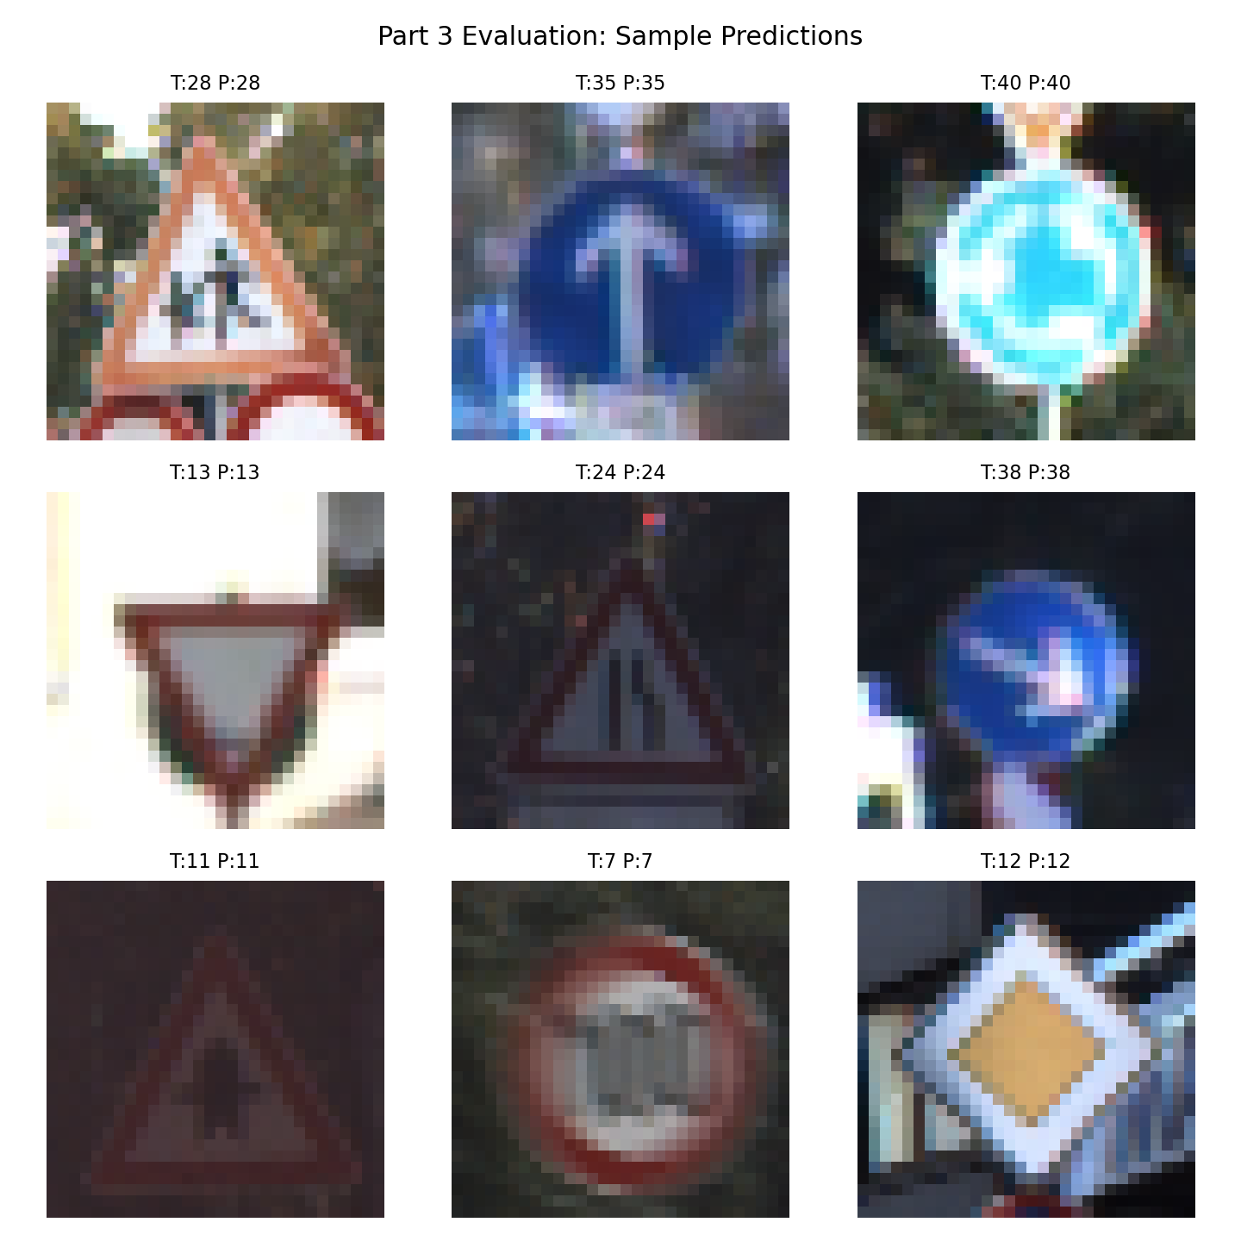
Part 3: Classification Results
★ Test Accuracy: 98.72%
(7,742 / 7,842 correct)
• Test Loss: 0.0693
• Model: gtsrb_model.keras
• Strong generalization ✓

Slide 8
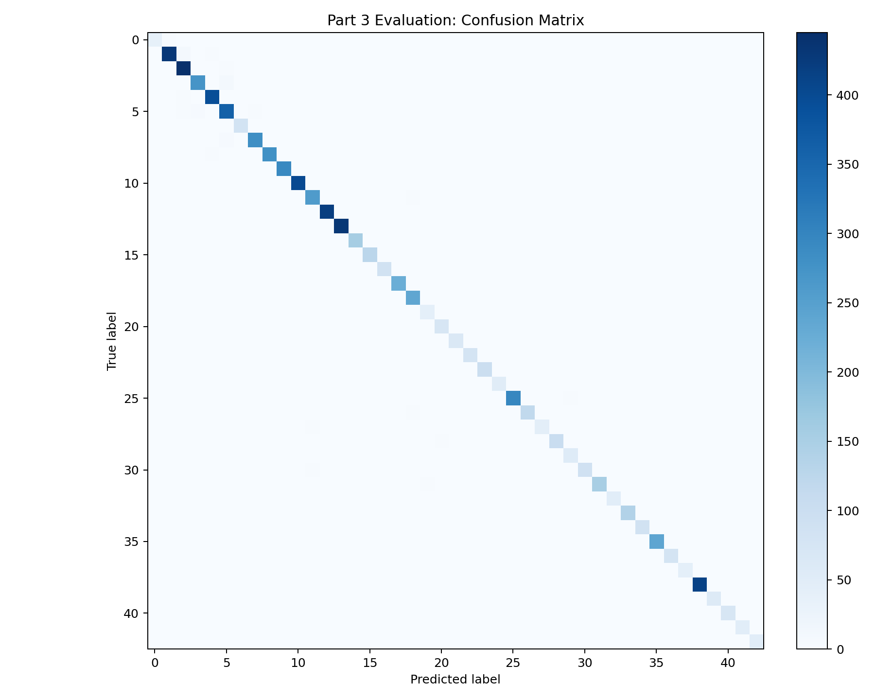
Evaluation: Confusion Matrix
• 43×43 prediction distribution
• Diagonal dominance indicates quality
• Minimal confusion between classes
Performance: Strong ✓

Slide 9
Project Summary
Part 1 (BFS): 4/4 test cases passed
Part 2 (CSP): 21/21 shifts, 0 violations
Part 3 (CNN): 98.72% accuracy
✓ All objectives completed
✓ Implementation validated

Slide 10
Limitations & Next Steps
• Parts 1-2 use generated demo data
• Official datasets not in repo
Before submission:
• Run on real flight/staff data
• Verify GTSRB results

Slide 11
Questions?
Neural-Domination Group Project

