Slide 1


Antony Mathenge 25-Jun-2025

Slide 2
Outline
Executive Summary
Introduction
Methodology
Results
Conclusion
Appendix

Slide 3
Executive Summary
Data Preparation and Wrangling to organise and filter relevant data such that the feature and target variable relationships can be investigated.
Exploratory Data Analysis (EDA) using Pandas, Matplotlib and SQL, to gauge the importance of each feature in predicting the target outcome.
Data Visualisation, with Folium and Plotly Dash, to investigate trends and relative effects of changing each feature variable.
Model Evaluation to determine predictive power of feature variables.
Future SpaceX launches have a high probability of successfully landing the first stage, particularly for heavy payloads, those sent into VLEO orbit, and those launched at KSC LC 39A.

Slide 4
Introduction
The company executives at SpaceCorp wish to make a data-driven decision on whether they should bet against the next SpaceX launch by analysing the cost effectiveness of SpaceX payload launches.
The most significant factor determining cost of a launch is whether the first stage of the launch spacecraft will remain intact after launch, as first stages may be reused at no additional cost for multiple launches.

Slide 5

Section 1
5

Slide 6
Methodology
Executive Summary
Data collection methodology:
Describe how data was collected
Perform data wrangling
Describe how data was processed
Perform exploratory data analysis (EDA) using visualization and SQL
Perform interactive visual analytics using Folium and Plotly Dash
Perform predictive analysis using classification models
How to build, tune, evaluate classification models
6

Slide 7
Data Collection
Datasets Used:
SpaceX Launch Historical Data - https://api.spacexdata.com/v4/launches/past
Booster Falcon 9 Flights Data table -
Collection Process
API Call
Select Dataset Features
Filter Falcon 9 launches
Webscrape Falcon 9 table
7

Slide 8








Data Collection – SpaceX API
SpaceX API Call
Get JSON response to API calls and store as Pandas Dataframe
https://github.com/zanevc 5555/IBM_DataScience_ Capstone/blob/main/jupyt er-labs-spacex-data-colle ction-api.ipynb
/rockets/
/payloads/
/cores/
/launchpads/
Response json
-> Pandas Dataframe
8

Slide 9
Data Collection - Scraping
Extract a Falcon 9 launch records HTML table from Wikipedia
Parse the table and convert it into a Pandas data frame
HTML Request to Wikipedia page
Load page contents into BeautifulSoup object
Extract data from <td> tags
Extract headers from
<th> tags
https://github.com/zanevc55 55/IBM_DataScience_Capst one/blob/main/jupyter-labs- webscraping.ipynb
9

Slide 10
Data Wrangling
Problem:
Dataset is not properly formatted for modelling
Target variable too specific; only need True and False outcomes
Solution:
Transform categorical target data to binary numerical data
Inspect launch categorical subsets
Inspect data types and null values
Transform ‘landing outcomes’ column
10
https://github.com/zanevc5555/IBM_DataScience_Capstone/ blob/main/labs-jupyter-spacex-Data%20wrangling.ipynb

Slide 11
EDA with Data Visualization
Chart Types:
Scatter Plots (Flight Number vs. Feature) - Observe overall trend of feature variables.
Scatter Plots (Payload Mass vs. Feature) - Characterise SpaceX launches by payload mass.
Bar Plot (Orbit vs. Class) - Investigate relationship between launch orbit and success rate.
https://github.com/zanevc5555/IBM_DataScience_Capstone/blob/main/eda dataviz.ipynb
11

Slide 12
EDA with SQL
SQL Queries:
Display the names of the unique launch sites in the space mission
Display the total payload mass carried by boosters launched by NASA (CRS)
List the total number of successful and failure mission outcomes
List the date when the first successful landing outcome in ground pad was achieved.
Rank the count of landing outcomes (such as Failure (drone ship) or Success
(ground pad)) between the date 2010-06-04 and 2017-03-20, in descending order.
12
https://github.com/zanevc5555/IBM_DataScience_Capstone/blob/main/jupyter-labs-eda-sql-coursera_sqllite.ipynb

Slide 13
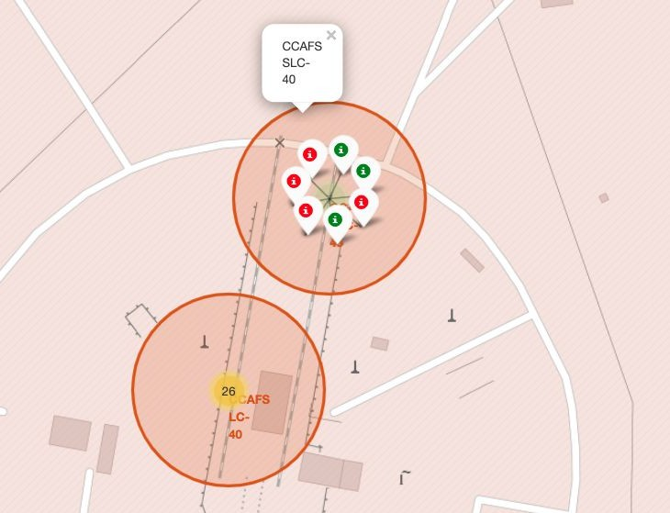




Build an Interactive Map with Folium
Folium Map Features:
MarkerCluster object groups icons by coordinates, green for launch success and red for launch failure.
Circle object shows coloured zone and pop up label at selected coordinate.
Individual markers provide text label for each site of interest.
13

Slide 14
Build a Dashboard with Plotly Dash
Dashboard Features:
Dropdown widget to choose which launch site to analyse.
First plot - Pie chart to visualise distribution of launch successes by launch site, or visualise proportion of successes/failure for a selected site.
Range slider to filter second plot results by a given range of payload masses.
Second plot - Scatter plot of launch success/failure ordered by payload mass, grouped by booster category.
https://github.com/zanevc5555/IBM_DataScience_C apstone/blob/main/spacex_dash_app.py
14

Slide 15
Predictive Analysis (Classification)
Standardise feature variables
Models:
Split data into training and testing sets
Logistic Regression
Support Vector Machine (SVM)
Optimise model parameters with GridSearchCV
Decision Tree
K-Nearest NeighboZZrs (KNN)
Use metrics such as
R-squared to evaluate model accuracy.
https://github.com/zanevc5555/IBM_DataScienc e_Capstone/blob/main/SpaceX_Machine%20Le arning%20Prediction_Part_5.ipynb
15

Slide 16
Results
Exploratory data analysis results
Interactive analytics demo in screenshots
Predictive analysis results
16

Slide 17

Section 2

Slide 18
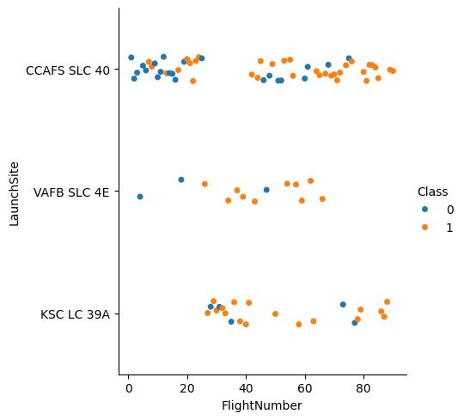
Flight Number vs. Launch Site
This scatter plot orders all SpaceX launches by launch site and denotes each first stage landing outcome as dot colour. Blue dots are failures, while red dots are successes.
The launch site category CCAFS SLC 40 features both the highest number of launches and the highest proportion of landing failures.

Slide 19
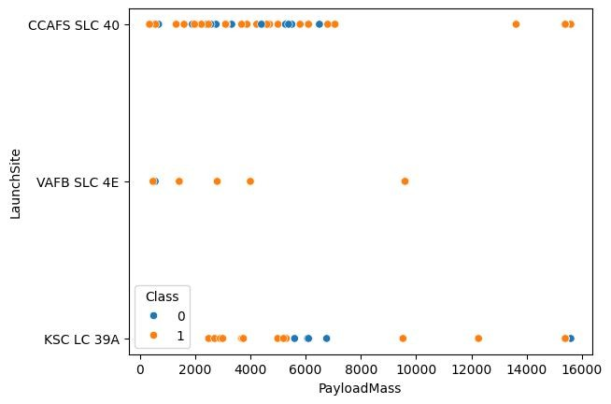
Payload vs. Launch Site
This plot shows the variation of payload masses corresponding to each launch site category, alongside landing outcome for each launch.
The majority of payloads at sites CCFAS SLC 40 & KSC LC 39A are evenly distributed across the
500-7000 kg range, while payloads launched at VAFB SLC 4E cluster around the 500 kg mark with some right skew.

Slide 20
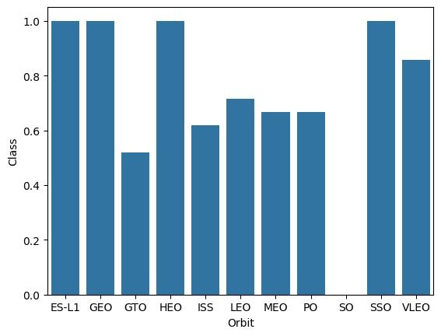
Success Rate vs. Orbit Type
Bar chart of the proportion of first stage landing successes where launches are grouped by the destination payload orbit.
Payloads sent to certain orbits like GEO, SSO and VLEO, correspond to a high landing success rate. Orbits like ISS, LEO and MEO, correspond to ~60% success rates.

Slide 21
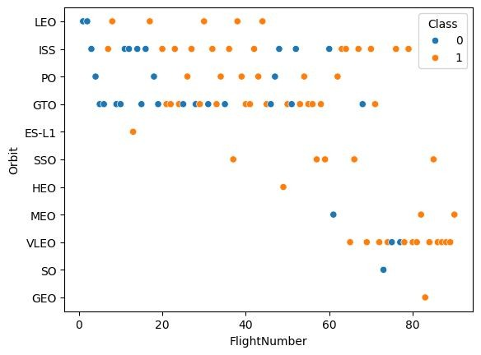
Flight Number vs. Orbit Type
Scatter plot showing all launches grouped by the payload orbit, with landing outcome represented in colour.
Many payloads have been sent into GTO and VLEO orbits, while very few payloads have been sent into HEO and MEO orbits.

Slide 22
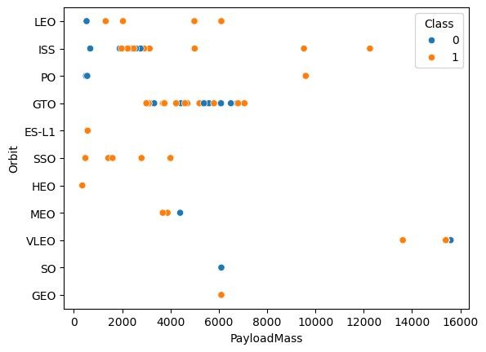
Payload vs. Orbit Type
Scatter plot of all launches grouped by payload orbit and ordered by payload mass, with landing outcome by dot colour.
Most orbits groups feature launches with low payload masses, however all launches sent into VLEO orbit had payload masses exceeding 13000 kg.

Slide 23
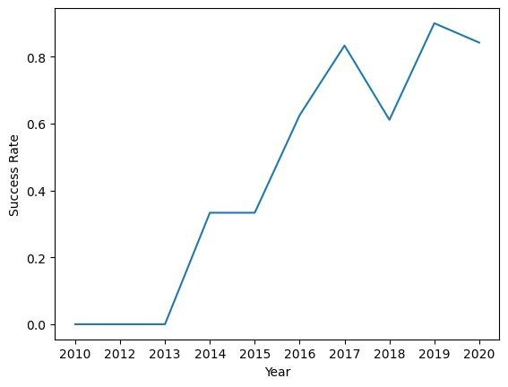
Landing Success Yearly Trend
Line chart showing trends in annual landing success rate across the years from 2010 to 2020.
First stage landing success rates drastically increased from zero percent to nearly ninety percent starting from 2013.

Slide 24
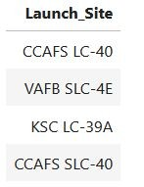
All Launch Site Names
All four SpaceX payload launch sites.

Slide 25
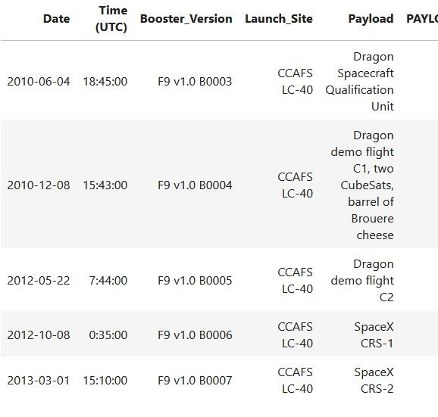
Launch Site Names Begin with 'CCA'
First five entries in dataset with a launch site name starting with ‘CCA’, where all five entries were launched from CCAFS LC-40.

Slide 26

Total Payload Mass
Sum of payload masses from NASA (CRS) payloads launched by SpaceX.

Slide 27

Average Payload Mass by F9 v1.1
Payloads with the booster F9 v1.1 have an average payload mass of 2928.4 kilograms.

Slide 28

First Successful Ground Landing Date
The first successful first stage landing was during the 12th of December 2015

Slide 29
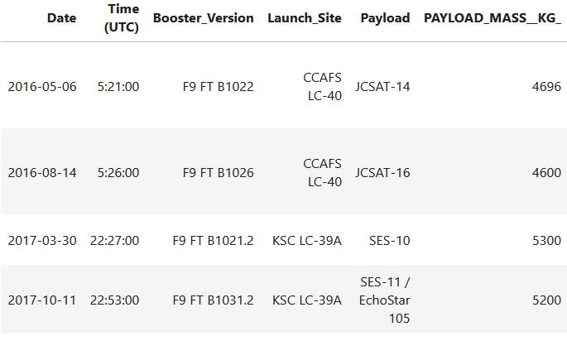
Successful Drone Ship Landing with Payload between 4000 and 6000
There are four launches with a successful drone ship landing with a payload between 4000
and 6000 kilograms.

Slide 30
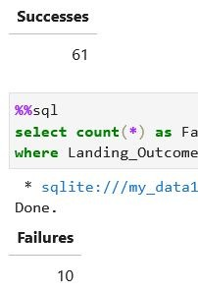
Total Number of Successful and Failure Mission Outcomes
Total landing successes: 61
Total landing failures: 10

Slide 31
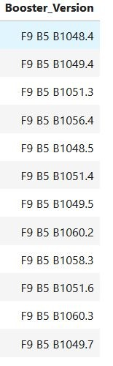
Boosters Carried Maximum Payload
All payloads with the maximum payload mass were launched using one of these boosters.

Slide 32
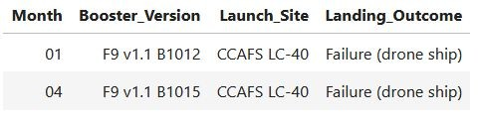
2015 Launch Records
There are two launches that resulted in drone ship failure in the year 2015. One was during January with te booster version F9 v1.1 B1012, and the other was during April with the booster version F9 v1.1 B1015.

Slide 33
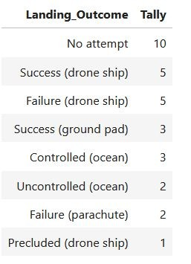
Rank Landing Outcomes Between 2010-06-04 and 2017-03-20
A ranking of landing outcomes for launches between 4th June 2010 and 20th March 2017.
The most common outcome was not attempt to recover first stage, and the least common outcome was a precluded landing by drone ship.

Slide 34

Section 3

Slide 35
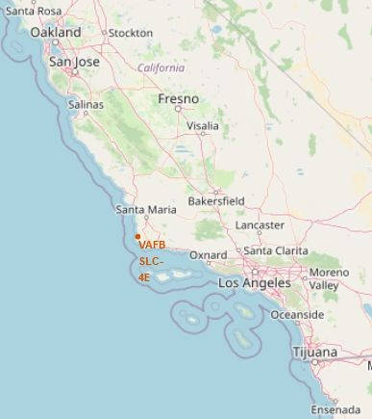
Global SpaceX Launch Sites
SpaceX launch sites were located either at Vandenberg Space Force base near Los Angeles or next to John F. Kennedy Space Center in Florida.

Slide 36
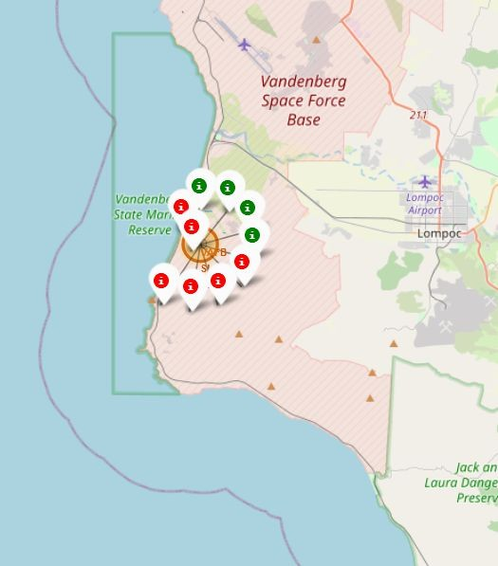
Launch Locations with Outcome
There were eleven launches, with four successful first stage landings, at Vandenberg Space Force base.
There were forty-six launches, with more than ten successful first stage landings, next to John F. Kennedy Space Center.

Slide 37
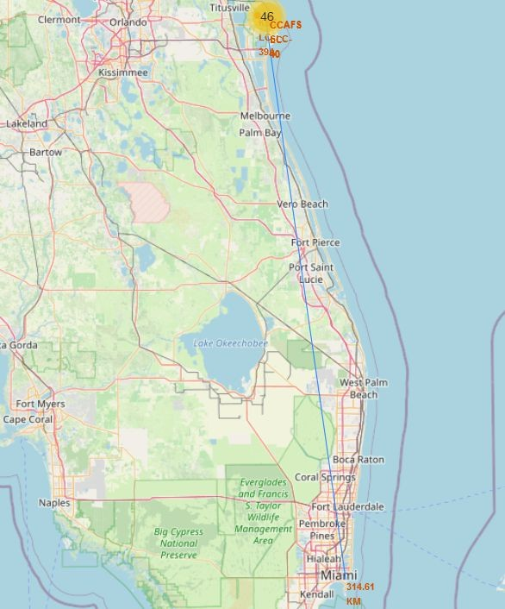
Distance between Launch Site and Major Cities
There is a distance of
314.61 km between the JFK SC launch sites and the city of Miami, heart of the largest metropolitan area in Florida.

Slide 38

Section 4

Slide 39
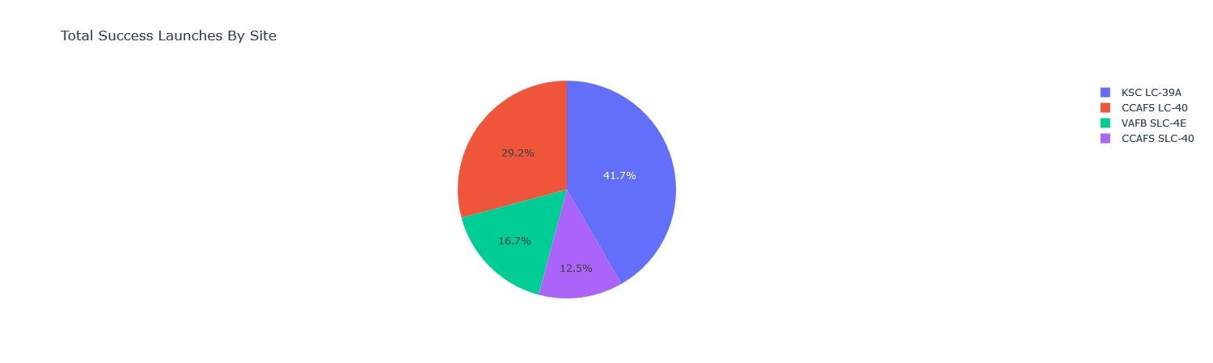
Launch Successes by Launch Site
The highest proportion of successes come from site KSC LC-39A. The lowest proportion of successes come from site CCAFS SLC-40.

Slide 40
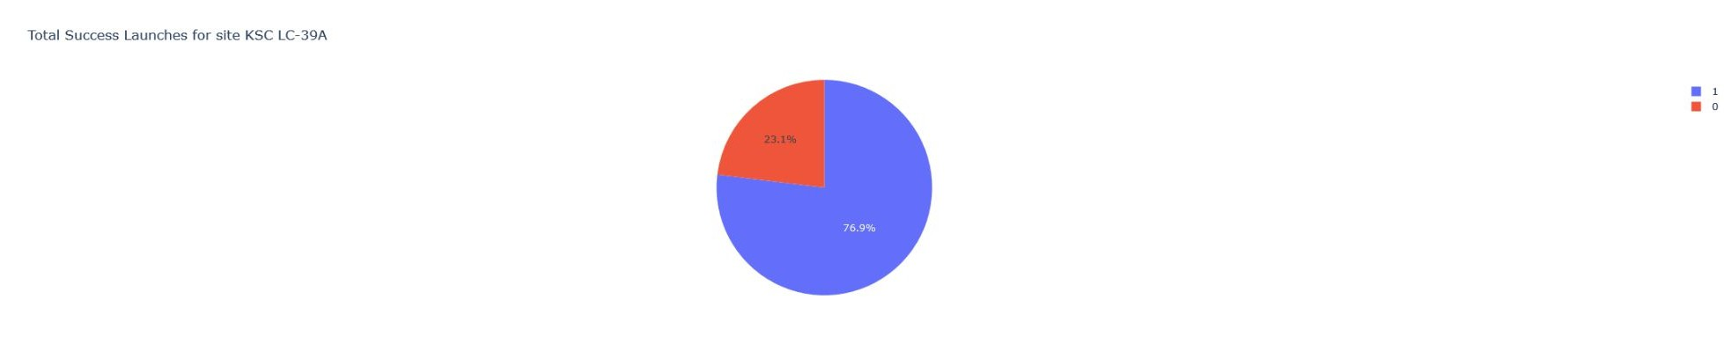
Successes/Failures for KSC LC-39A
The launch site with the highest proportion of successes, KSC LC-39A, has a 76.9% success rate.

Slide 41
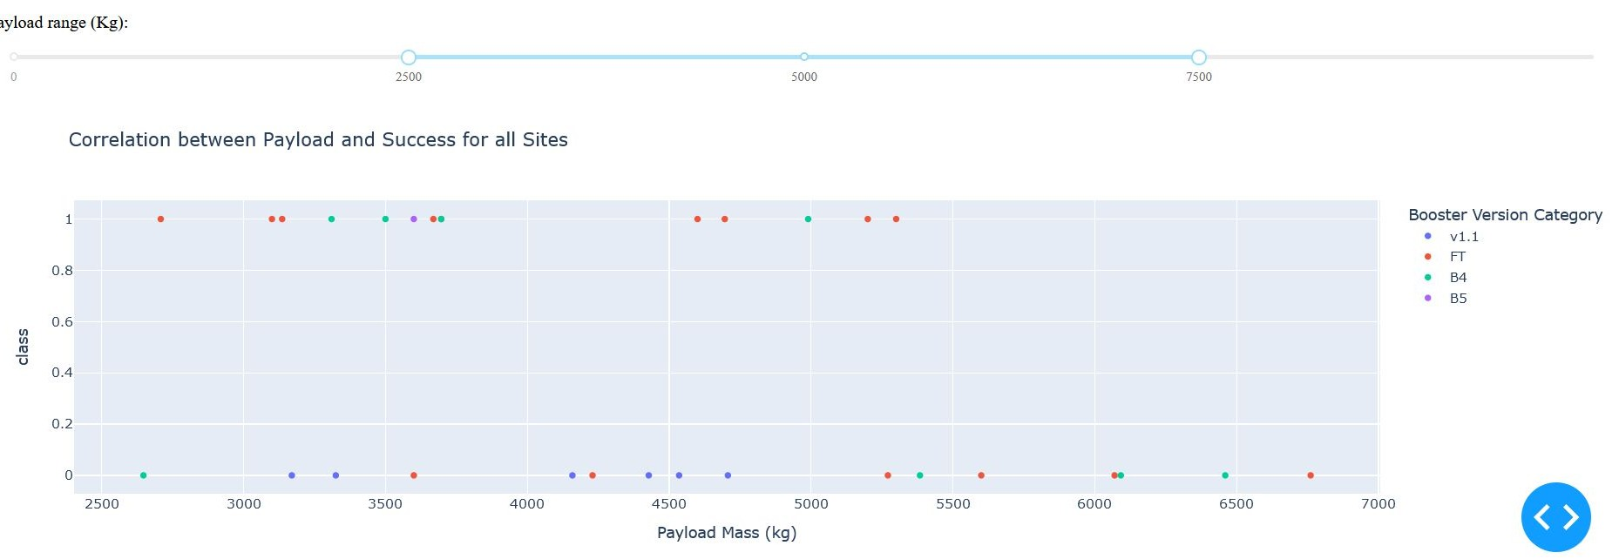
Payload Mass vs. Launch Outcome for all Sites
The average payload mass of payloads with booster versions FT and B4 are higher than the average payload mass of payloads with booster versions v1.1 and B5.
41

Slide 42

Section 5

Slide 43
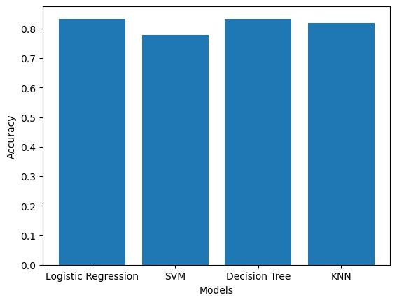
Classification Accuracy
The logistic regression and decision tree models most accurately classify the landing outcome given the feature variables
Mutual accuracy score of 0.833

Slide 44
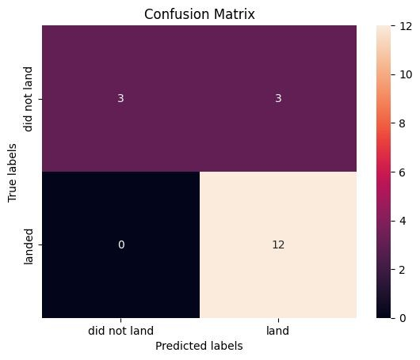
Confusion Matrix
100% precision, 50% recall for failed outcomes
80% precision, 100% recall for successful outcomes

Slide 45
Conclusions
The overall trend of landing success rate over time has changed from certain failure during 2010 to very likely success (~90%) during 2020.
Landing success rate does tend to increase for heavy payloads over light payloads, however, the trend is not conclusive as there are comparatively few launches with heavy (>10000 kg) payloads.
Most orbit types that correlate with high success rate have less than five launch data points, except for VLEO orbit, with high success rate (~90%) and sufficient data points (14 launches).
The launch site KSC LC 39A has the highest overall success rate per site (76.9%) with sufficient data to support this conclusion (22 launches).

Slide 46
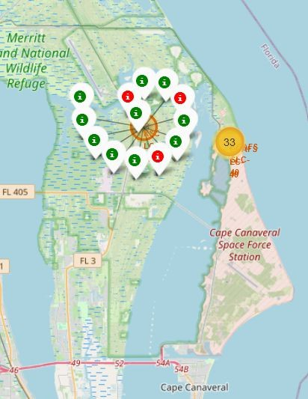
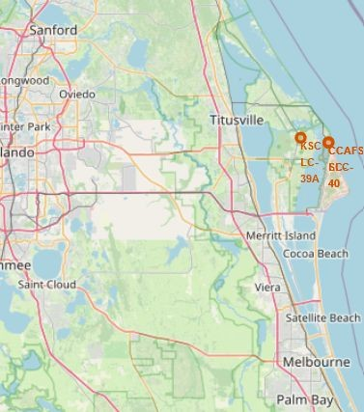
Appendix
Global Sites Second Screenshot
Launch Outcome Icons Second Screenshot

Slide 47


