Slide 1
Covid19 Predictor

Slide 2
Problem
The aim of this project is to create a fast, non-invasive and reliable test for determining whether a user is infected with Covid19 or not.
The model is meant to take into account features that can be easily measured or are already known by the user (symptoms, vital signs reading, patient history, etc.).
The model is deployed into a Flask App to a server so that it can be easily queried (using either a web browser or a mobile application).

Slide 3
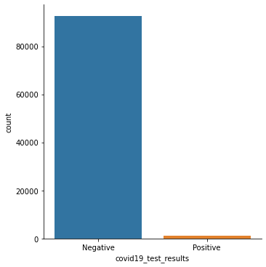
Dataset
The dataset used was the Coronavirus Disease 2019 (COVID-19) Clinical Data Repository (https://github.com/mdcollab/covidclinicaldata) and in its raw form contains 93995 examples and 45 features (with 7 of these being numeric while the rest are categorical) distributed in 30 files that correspond to different batches of patients whose data was collected on different dates. The target classes were given by the feature covid19_test_results, which labelled each of the examples as either Positive or Negative.
One of the main problems in this dataset is that it is very imbalanced, with Positive cases making up only around 1.4 % of the data (1313 examples), as shown in the figure to the right.
Furthermore, a lot of the features have many null values, with 6 of them having less that 1000 non-null values.

Slide 4
Data Cleaning Process
The first step is remove the features that will be of no use to us due to the scope of the project (the date of the batch, the type of test taken, the type of swab used for the test and whether the patient was referred to the ER or not), as well as features that have less than 1000 null values (all the radiological findings and rapid lab results for flu and strep).
Next, some correction was applied to features that seemed to be incorrect: there were some examples that did not report a severity for the cough even though they had a cough present or that did not present a cough even though they had a severity value for it; this occurred with patients that had shortness of breath and the severity for it. Additionally, a None value was included in both severities for the cases where a patient may have a False value for cough/shortness of breath.
This correction was also applied to patients that reported a fever since there were some that, with a temperature less than 37° C claimed to have a fever and others that claimed not have a fever even if their temperature showed that they were over 37° C, with some reaching as high as 39°C.

Slide 5

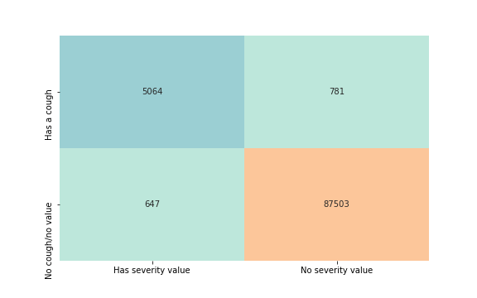

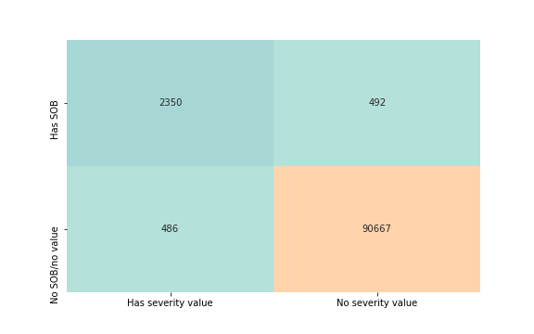
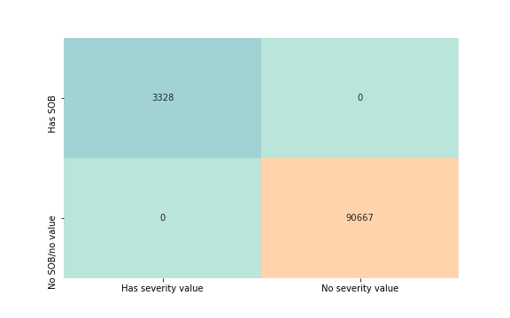
Correction for cough and shortness of breath
Before
After
Cough
Shortness of Breath
*The ‘No severity value’ column includes examples with the added None value after the correction.

Slide 6
Following that, the features were explored to determine whether a categorical feature had any values that were only appearing in either of the classes and confirm they were sensible values.
It was found on this analysis that only 52 patients presented Chronic Obstructive Pulmonary Disease (COPD) and none of them were Negative. This could bias the model into thinking that having COPD would be a good indicator of not having Covid19. Furthermore, if we look at the proportion of patients with COPD (52 patients out of 93943) cases in all data, the number of patients in the positive data necessary to keep that proportion would not even reach one case (0.726 patients would need to exist with COPD and Positive result) so it is very likely we just don’t have positive patients with COPD because the sample isn't big enough, making the feature irrelevant.
On a similar conclusion it was also found that patients with Severe shortness of breath exist only among the Negative results. Again, there was a lack of Positive patients with Severe shortness of breath (only 126 exist in the whole dataset, with all of them being Negative), which could bias the model. However, since this feature seems to be important at first glance, I opted for just dropping the patients that have Severe shortness of breath from the dataset.

Slide 7
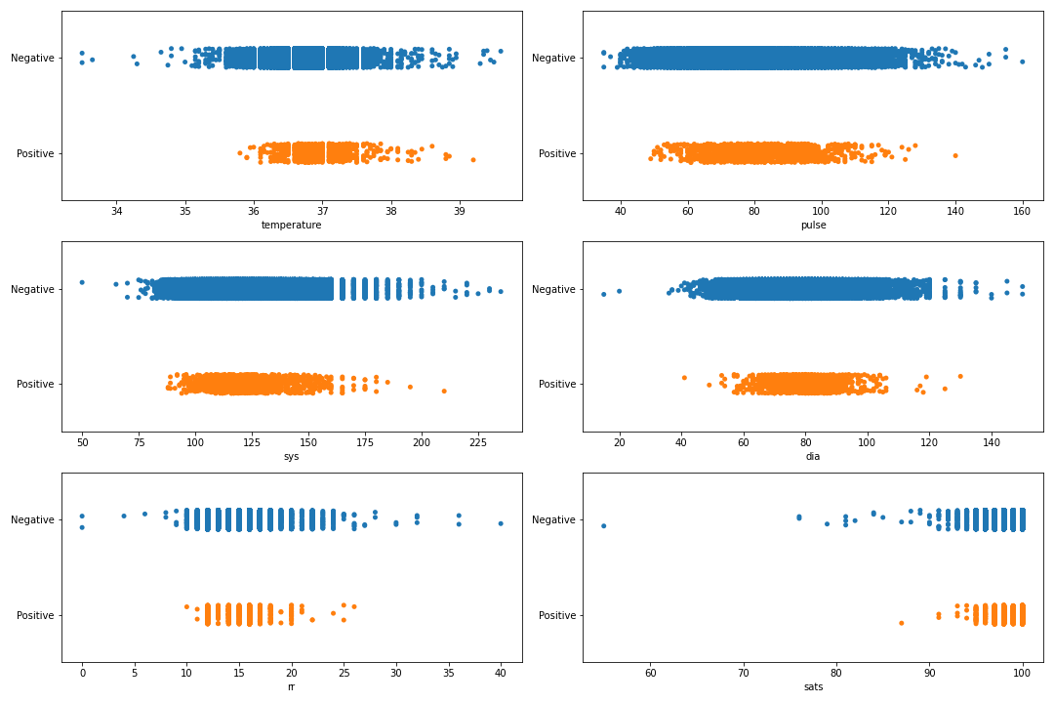
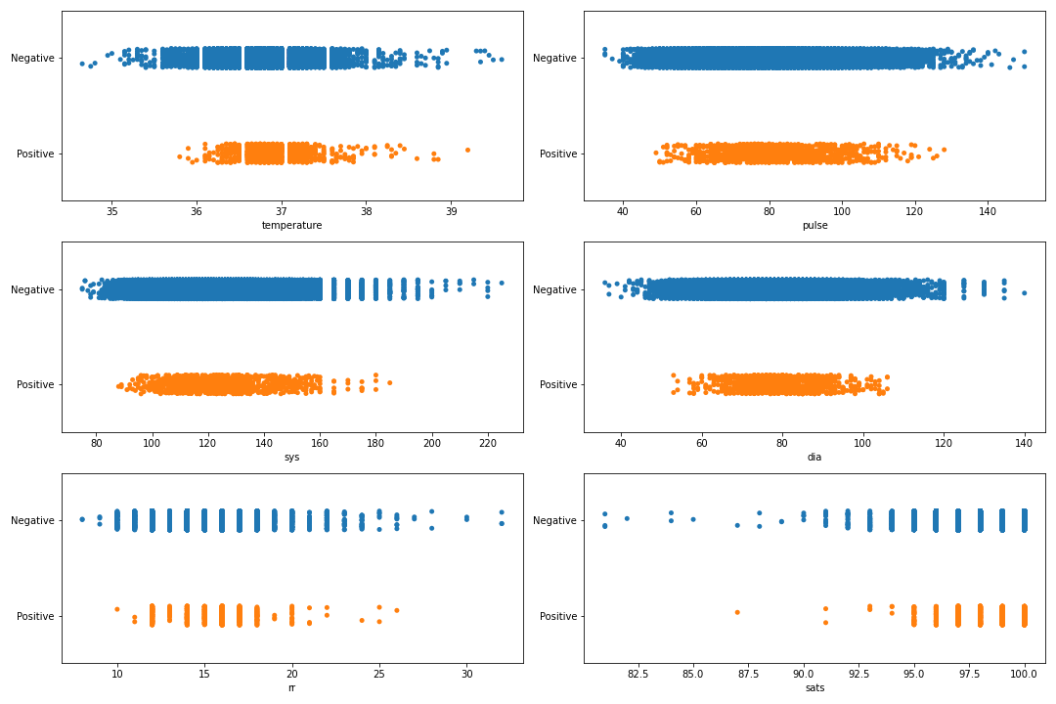
The next part was cleaning the numeric features of outliers, setting up the ranges so that I would be able to preserve as many Positives as I could. The figure below shows the distribution of the 6 numeric features before the data cleaning process (left) and after the data cleaning process (right).

Slide 8
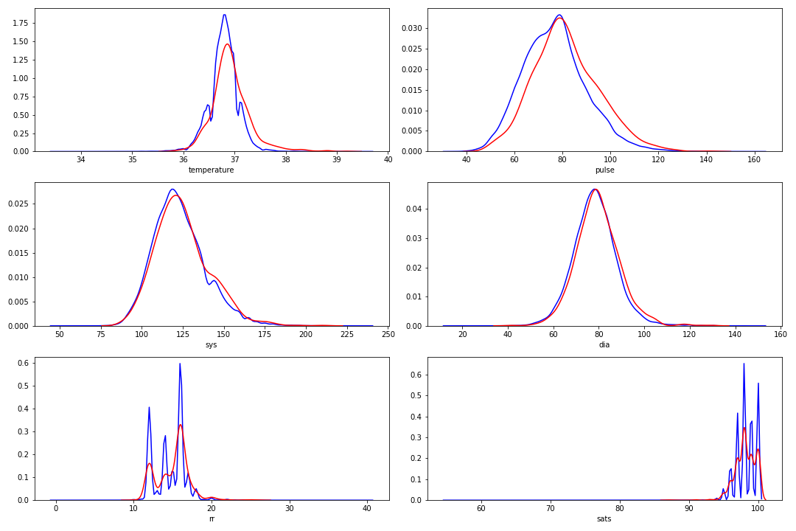
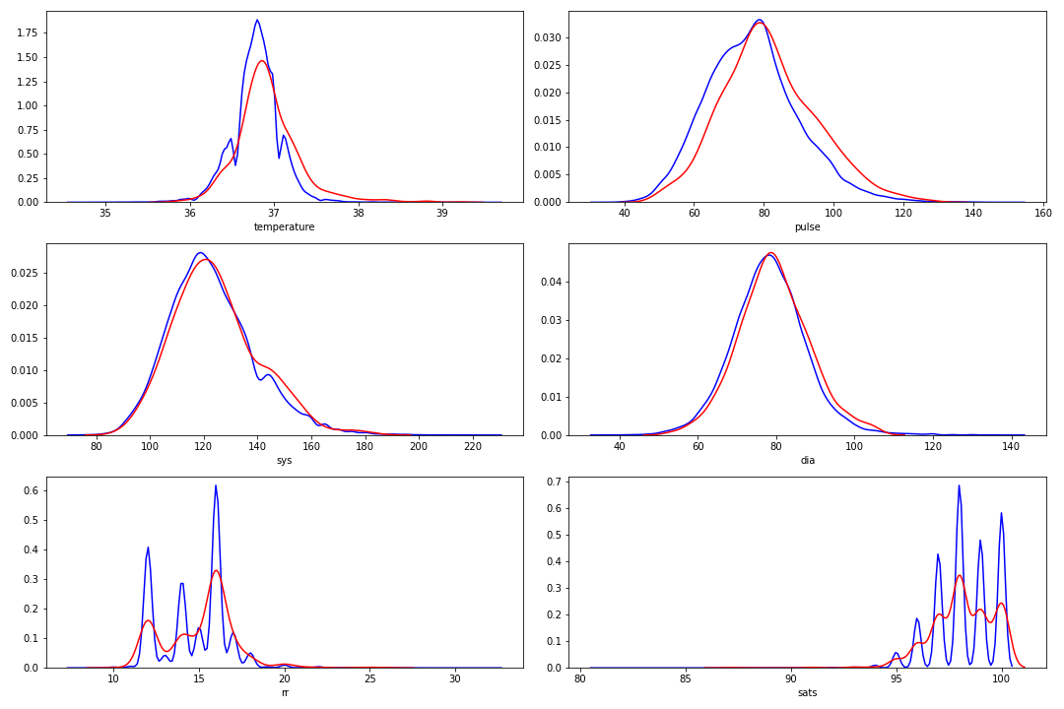
Here we can see the same distribution using a density plot instead, with the left figure representing the numeric features before the data cleaning process and the right figure representing them after the data cleaning process.

Slide 9
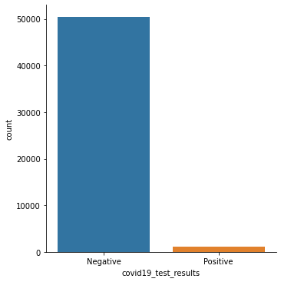
Since the Age of each patient was sensibly randomized due to privacy policies, it made sense to segment the feature into 4 different but ordered groups: ages 0-28, ages 29-37, ages 38-50. Each of the cut off ages represent the first, second and third quartiles for the original age values.
Both Cough severity and shortness of breath severity were encoded to represent numbers for each of the possible values: 0 for None, 1 for Mild, 2 for Moderate and 3 for Severe.
Finally, I dropped all values that were duplicated and thus I ended with 51657 examples of which around 2.3% (1189 examples) were Positive.
* For more detail on the data cleaning process, check the DataAnalysis.ipynb notebook.

Slide 10
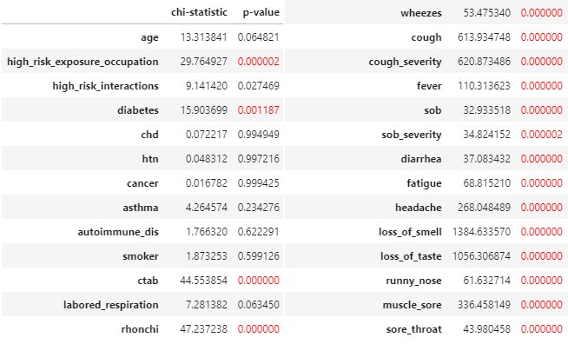
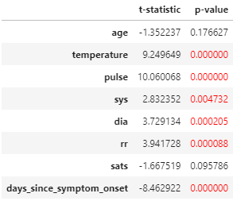
Data Analysis
I used significance ‘t’ tests for numerical features and χ² tests for categorical features to determine which of those features presented statistically significant differences between Positive and Negative examples in the datasets. A significance level (α) of 0.005 was used to determine if the feature was significant or not. The results of this analysis are presented below with the selected features highlighted in red.
Significance ‘t’ test results
χ² tests results

Slide 11
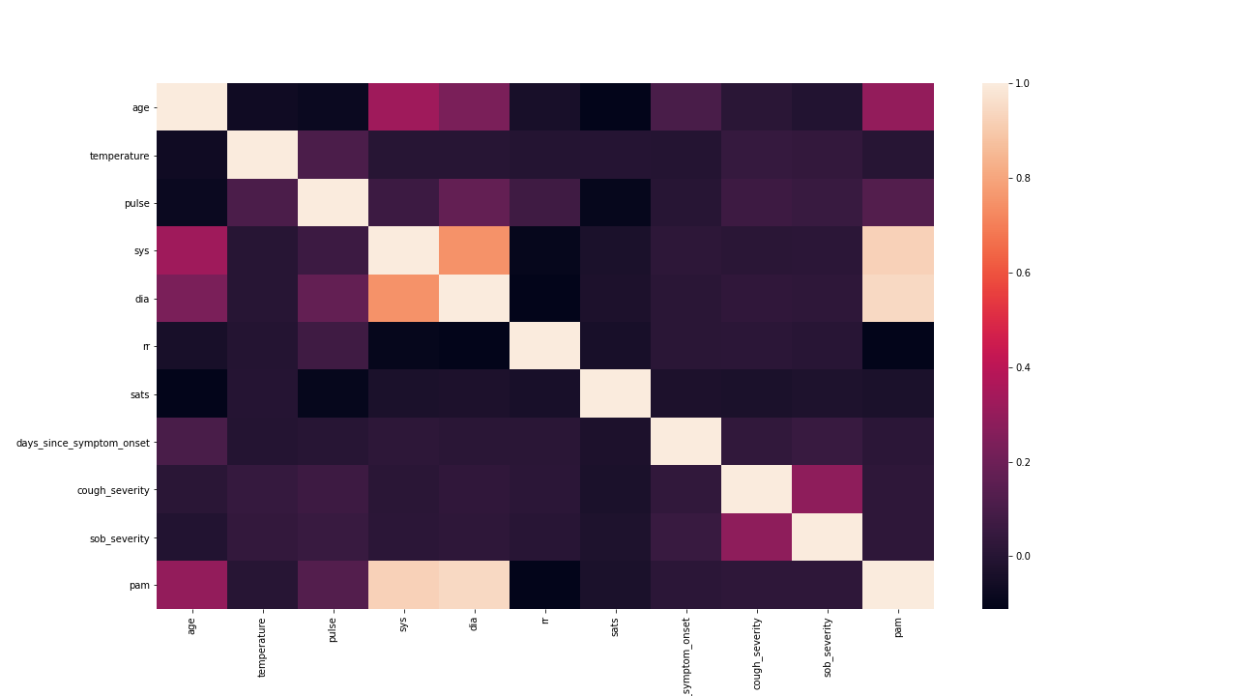
A correlation analysis of the selected numeric features was done using Pearson’s correlation coefficient.
The analysis unsurprisingly shows that systolic blood pressure and diastolic blood pressure were highly correlated with each other as well as slightly correlated with age (now divided in groups). Therefore I decided to create a new feature Mean Arterial Pressure (abbreviated as PAM in Spanish) that is defined by the following formula:
Where:
S = Systolic blood pressure
D = Diastolic blood pressure

Slide 12
Building the Data Imputer
A custom DataImputer class was created to handle missing values in both the data that was used to train the model as well as the data for which we want to make a prediction (which might be incomplete). The reason for using a custom imputation method over an existing library was to provide more flexibility over how each individual feature of the dataset would be imputed; this meant that I could have features that were assigned a completely different value during training than the one they were assign during prediction, apply some target encoding for other features, etc. Furthermore, this custom class is able to generate the PAM feature discussed previously, standardize the vital signs and it can be integrated with the Pipeline objects from the scikit-learn and imblearn libraries.
Most categorical features (including cough severity and shortness of breath severity) were imputed with the most frequent value for each feature during both training and prediction; the exceptions to this were high risk exposure occupation, which was imputed with the most frequent value at training time while imputed with True if the transformation was done at prediction time, and high risk interactions, which was imputed with the high risk exposure occupation value. The assumption behind this reasoning is that if we don’t know either of those values, we should assume that if someone has a high risk occupation they will also have high risk interactions.
For the numerical features, the median was used to impute most of them during both training and prediction times; the exceptions to this were the temperature and the PAM, which were imputed with the mean at both training and prediction times instead, and the days since the first symptom onset which was imputed with the mean of its corresponding class during training (obtaining the median before doing this) and with the median during prediction time. Finally, all vitals (temperature, respiratory rate, pulse, saturation levels and PAM) were standardized.
*For more detail check the DataImputer() class in the CovidClinicalData.py file inside the WebApp folder.

Slide 13
Experiments Design
Baseline: For this project, the baseline is just random guessing; however, 2 methods of random guessing were used: Uniform Random Guessing, which classifies an example into Positive or Negative with a 50-50% probability for each class; and Stratified Random Guessing which classifies an example into Positive or Negative depending on the proportion of Positive or Negative examples in the dataset (predictions for a dataset with a larger number of Negative examples would be mostly Negative). This was done to observe the behaviour of both strategies due to the imbalanced nature of this dataset.
Metric: Due to the imbalanced nature of the dataset, I selected F2 score (the harmonic mean of the precision and the recall, giving twice the importance to recall over precision) as the metric to be optimised; this was done to avoid selecting a model that would be biased towards the majority class, as well as to penalizing false negatives more than we would false positives (it is better to take safety measures if a patient is classified as Positive but it is not in reality than not detecting an actual Positive).

Slide 14
At the very beginning a test set was randomly selected from the data in a stratified manner (preserving the proportion of the classes). This was done to evaluate the performance of the final model on unseen data (the generalization error) in order to get an estimate of how it will behave in the real world.
Each model was be evaluated using a custom cross-validation method with the following characteristics:
  It is be able to oversample or undersample the training data during each fold according to a ratio specified by the user that ranges from -1 to 1:
      If the ratio is a negative number, the training data will be oversampled using SMOTE so that there are a number of Negative examples for each Positive equal to the absolute value of the ratio.
      If the ratio is a positive number, a random number of Negative examples will be selected from the training data so that there are a number of Negative examples for each Positive equal to the ratio.
      If the ratio is 0, no resampling occurs.
  Given a set of classification thresholds, each fold the trained model calculates probability predictions on its corresponding validation set and generates a the score for each classification threshold. The scores in each threshold are averaged across all folds.
  Given a special classification threshold each fold the trained model calculates probability predictions on its corresponding validation set and calculates a score for the threshold. At the end, all scores from each fold are averaged and their standard deviation is calculated in order to build a confidence interval of 95% certainty.

Slide 15
A total of 6 classifiers were initially selected:
  Random Forest Classifier: I chose it because I figured that since most of the features were binary features, a tree based model might prove to be a really good choice. It is also very fast and generally regarded as providing good results.
  XGBoost Classifier: Again, since this is a tree based model, it made sense to try this one due to the number of binary features in the dataset as well as the boosting component. Another reason I chose it was because it is very popular at Kaggle competitions.
  Support Vector Classifier (SVC): This one was selected because it is good at identifying decision boundaries in reasonably separable data in a low number of dimensions, such as the number of selected features for this dataset.
  K-Nearest Neighbors Classifier (KNN): I chose this one because it classifies data according to how similar examples are between each other, which might be an advantage.
  Logistic Regression: The simplest linear classifier. Useful to determine whether there is a linear relationship between the features and the probability of each class.
  AdaBoost Classifier (with a Decision Tree as base estimator): Another tree-based model which uses boosting. The reason for including it was to compare how different tree-boosting models perform in this dataset.
The idea was to run these models using the methodology described in the previous slide so we could select 3 top performing models over any threshold and then try hyper-parameter tuning on them to see how the performance can be increased.

Slide 16
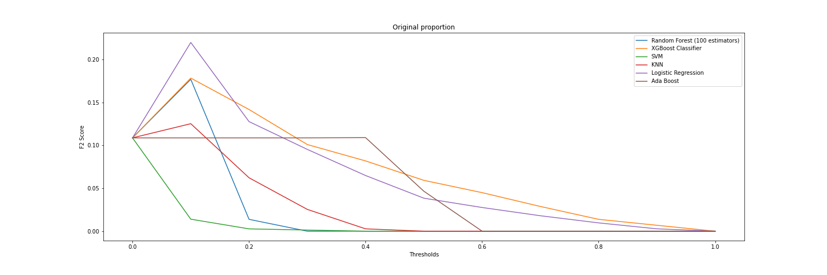
Original proportion
The best performing model when using the original proportion of data was Logistic Regression with a score of 0.220008 on threshold 0.10 (anything with a probability of being Positive above 10% is classified as Positive). The next 2 best performing models were XGBoost Classifier and Random Forest, also on threshold 0.10, with a score of 0.178464 and 0.177016 respectively.

Slide 17
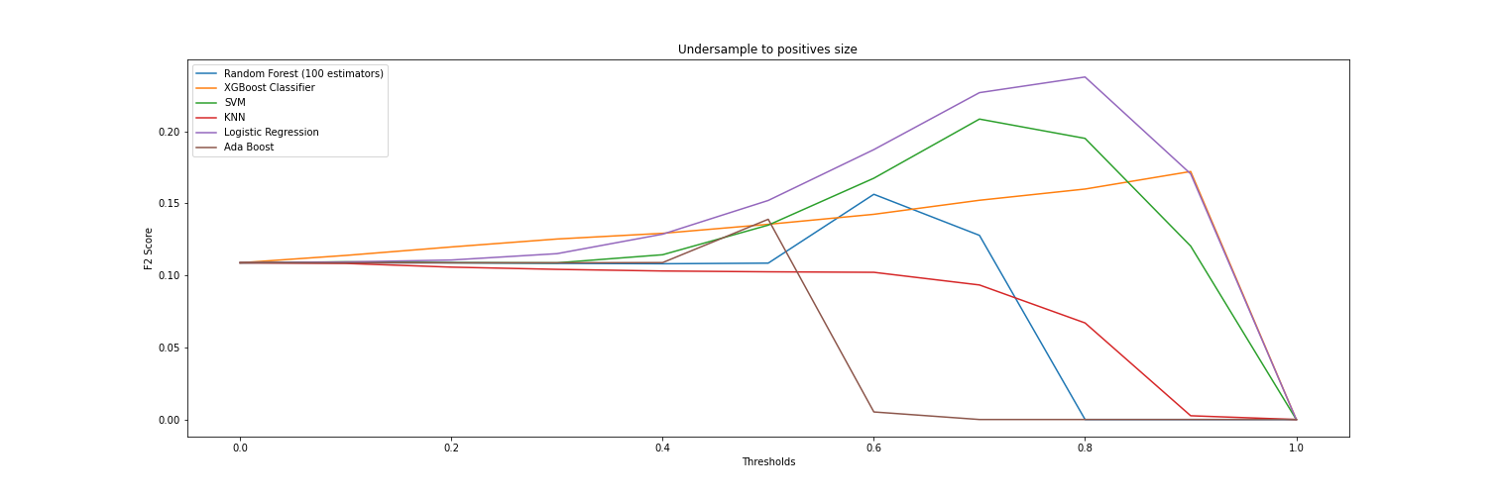
Undersampling
The best performing model when undersampling using a ratio of 1 was also Logistic Regression with a score of 0.237720 on threshold 0.80 (anything with a probability of being Positive above 10% is classified as Positive). The next 2 best performing models were SVM on threshold 0.70 with a score of 0.208526 and XGBoost Classifier on threshold 0.90 with a score of 0.172133.

Slide 18
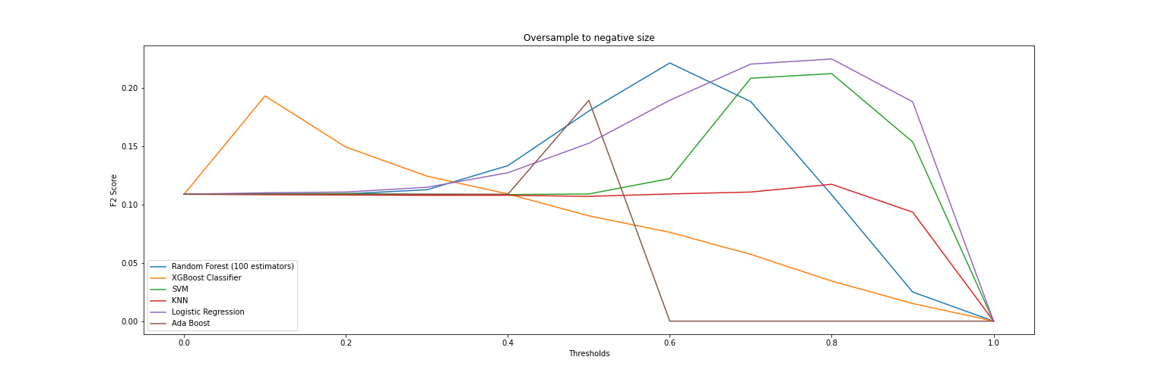
Oversampling using SMOTE
The best performing model when undersampling using a ratio of 1 was also Logistic Regression with a score of 0.224757 on threshold 0.80 (anything with a probability of being Positive above 10% is classified as Positive). The next 2 best performing models were Random Forest on threshold 0.60 with a score of 0.221323 and SVM on threshold 0.80 with a score of 0.212206.

Slide 19
First round analyisis
Looking at the previous experiments, it is clear that Logistic Regression is the model that yields the best overall performance so it is the one selected for parameter tuning.
Note: There were a few more experiments that were performed and which their results can be observed in the PredictorExperiments.ipynb notebook.

Slide 20
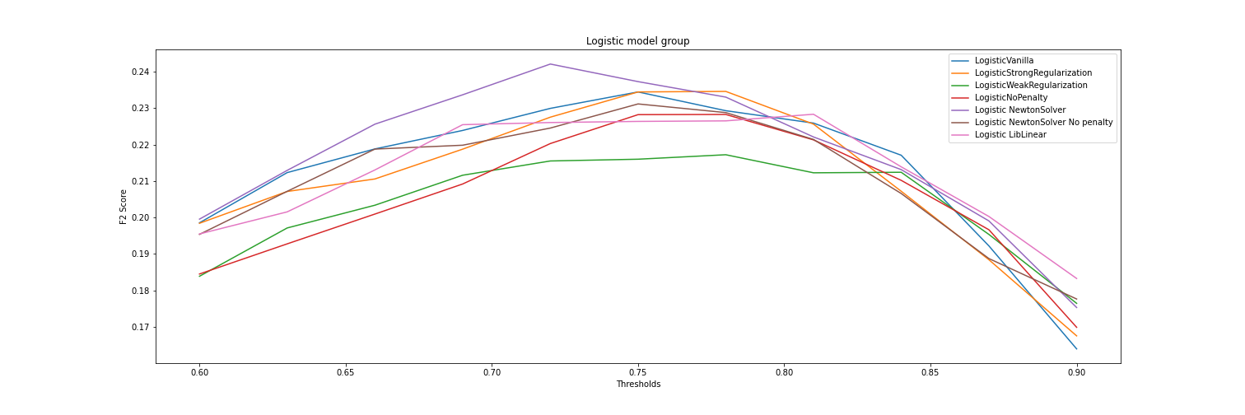
Logistic Model Group
A set of Logistic Regression models with different values for hyperparameters (a model group) was trained using the undersampling technique in order to determine the best possible model. The one with the best performance was Logistic Regression with a Newton solver at threshold 0.72 with a score of 0.242106.

Slide 21
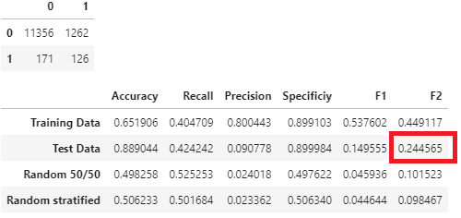
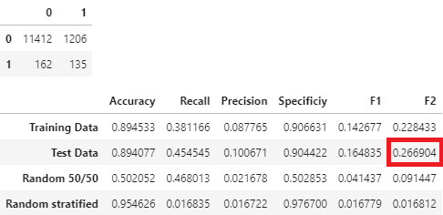
Final Evaluation
For the final evaluation, a custom method was used on which we pass the whole training set used for cross validation as well as a classification threshold and apply either oversampling or undersampling (both techniques were used for comparison), using the Data Imputer class to fill in missing data on the training set. Then the test data is transformed with the Data Imputer and used to evaluate the performance of the model on unseen data. The model used for the final evaluation was Logistic Regression with a Newton Solver using .72 as the classification threshold. Below are the final results of the model:
Undersampling results
(0 represents the Negatives and 1 represents the Positives in the confusion matrix)
SMOTE results
(0 represents the Negatives and 1 represents the Positives in the confusion matrix)
As we can observe from the tables above, in both cases the model did really well at identifying the Negative class, however it was not very good at identifying the Positive class and also produced many false positives. Overall, we can see that using SMOTE for resampling produces better results with a threshold of .72. This can be observed in the F2 scores, as well as in the confusion matrix. However, in both cases we can see that the model is noticeably better at doing predictions that Uniform Random Guessing and Stratified Random Guessing, especially when using oversampling. Furthermore, by looking at Precision we can tell that even if the model is not very good at identifying Positive cases, it is better than both versions of the baseline, so we can confidently say that we have a good model.

Slide 22
Final model deployment
A Python script was developed with the purpose of reading the training data in the repo, cleaning the data, apply oversampling, select features and train the model. Finally, the script dumps the serialized model into a folder, along with the trained Data Imputer so that they can be consumed later by the Flask application. The script is named TrainingScript.py and it is located inside the WebApp folder.
The model then can be queried via the Flask application, which can be deployed by running the FlaskApp.py inside of the WebApp folder and at this moment consists of 3 endpoints:
  The home endpoint which is used for a very simple website that contains an interface to get the inputs for the user.
  The predictHtml endpoint, which is used by the interface to make predictions.
  The predict endpoint, which can be queried with a POST request with the inputs passed as a json in “record” format (for 2 records and 2 features the json would be [{feature1:value, feature2:value},{feature1:value, feature2:value}]).

Slide 23
Summary and Future work
Summary: The result of the experiments done with this project show that a Logistic Regression model with a Newton solver, trained with 1-to-1 oversampled data and using a classification threshold of 0.72 is the model with the highest F2 score at 0.266904, showing that the model is very good at recognizing Negative examples, and at least better at recognizing Positive examples than random guessing, which makes it a viable alternative for identifying a patient that is potentially infected with Covid19.
Future work: Even though the model performs decently, it is clear that the performance is far from optimal when compared to regular coronavirus tests; furthermore, the deployment of the model is still quite simple, which gives us a lot of areas of opportunity that we can explore and improve, such as:
  Using different ratios of oversampling to observe how they impact performance.
  Experiment with different oversampling techniques such as Borderline SMOTE to synthesize specific examples on the minority class so the model can identify it better.
  Perform Grid search on the best models on this project to determine if different combinations of hyper-parameters can improve our current performance.
  Create a companion mobile app that can be used to query the model via the predict endpoint of the Flask application.

