Slide 1

Analysis and Prediction of Gym Member Subscription Length
By
Jeshua Perzabal

Slide 2
Objective
To find any patterns and relationships between some member characteristics that will allow us to determine the length in months of that member’s subscription to a certain gym franchise

Slide 3
Methodologies
Data was cleaned, transformed and plotted to look for patterns.
A model (Random forest) was trained to predict the number of months a member would be subscribed to the gym.
An analysis was conducted to contrast the importance the model put on some characteristics with the patterns previously found.

Slide 4
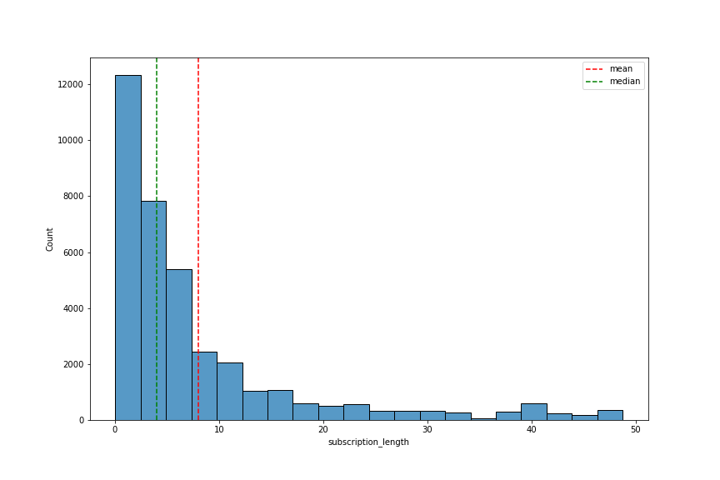
Results
Members: 36,869
Subscription length info:
  Mean: 7.97 months
  Median: 4.01 months
  Range: 0.03 – 48.76 months
Model:
  Random Forest (200 estimators)
  6.543 months of error on average

Slide 5
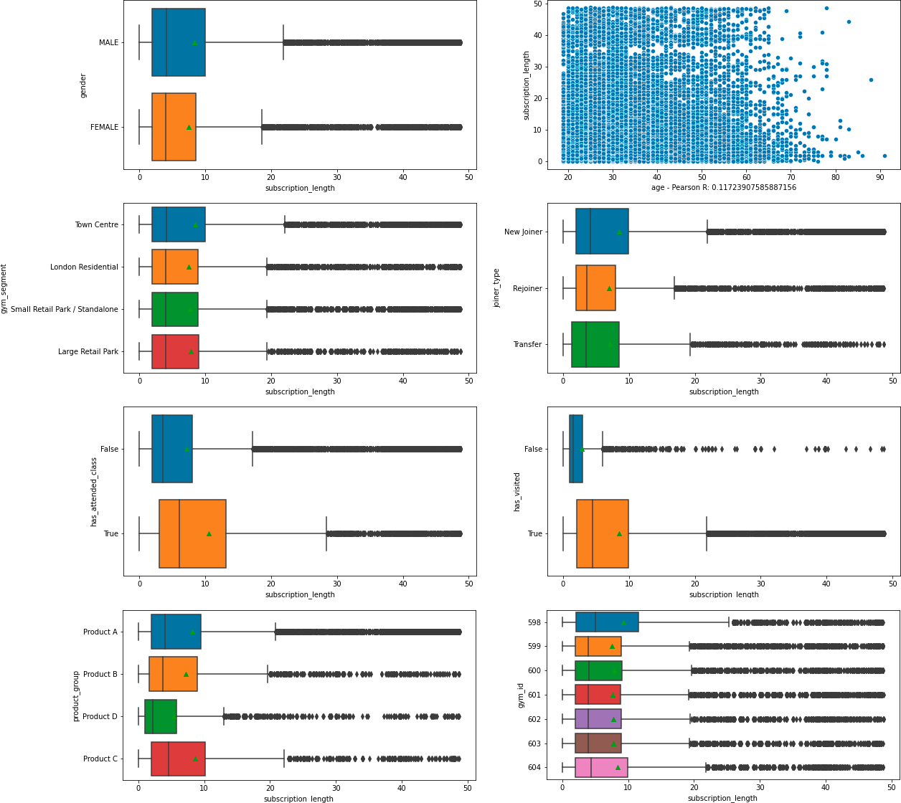
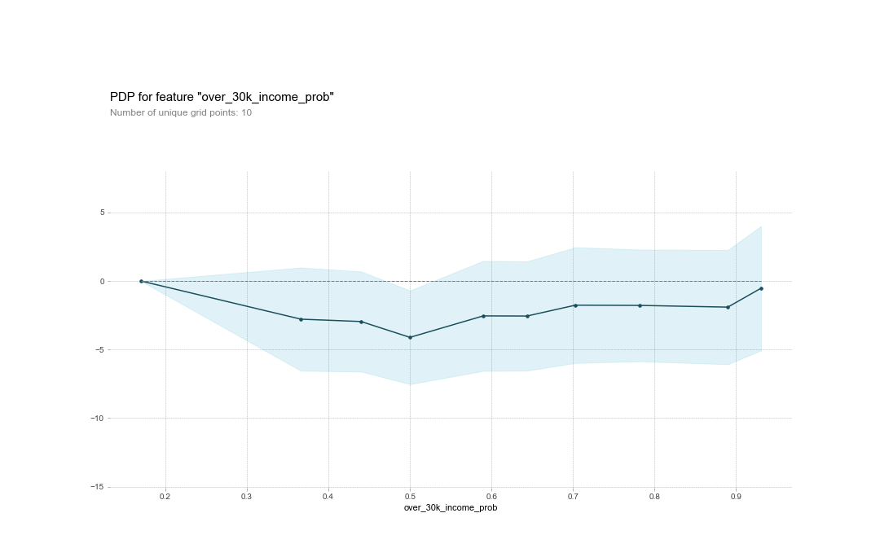
Most relevant characteristics
  Product Group
  Activity (visiting the gym and/or attending to classes
  Probability of income

Slide 6
Recommended solutions and future work
Product D: Stop doing it!!
Offer incentives to engage with the gym (either attending classes or just visting it)
Gather more data about loyal members
Classify members into short-term and long term

