Slide 1

DATABASE MANAGEMENT SYSTEM
ONLINE SHOPPING SYSTEM
Project Review 1 & 2
Project Team:
B.SRI KOUSHIK - 25B11AI155
D.AVINASH - 25B11AI244
O.VENU GOPAL - 25B11AI856
T.SAI SUSHMANTH - 25B11AIA51
Project guide/subject in charge:
GL NARASAMBA VANGURI MAM

Slide 2

Introduction
Online shopping has become the primary way customers discover and buy products. Behind every storefront is a database that keeps products, customers, orders and payments consistent.
1
Catalogue
Products, categories, stock
Customers browse a catalogue, add items to a cart and place orders online.
All product, user, order and payment data is stored in a relational database.
Relationships between tables keep records linked, accurate and easy to query.
The project applies DBMS concepts to a real, everyday business problem.
2
Customers
Profiles and addresses
3
Orders
Cart, checkout, delivery
4
Payments
Modes, status, invoices

Slide 3
1. Abstract
1
The Online Shopping System is a database-driven application for managing an e-commerce store.
2
It stores products, categories, customers, carts, orders, payments and shipping information.
3
The system reduces manual record keeping, data duplication and inconsistent stock information.
SQL operations are used to insert, update, delete and retrieve shopping data.
4
ONLINE SHOPPING SYSTEM • DATABASE MANAGEMENT SYSTEM PROJECT

Slide 4
2. Finalize Title, Objectives & Problem Statement
Final Title: ONLINE SHOPPING SYSTEM
OBJECTIVE
PROBLEM
Objective: Build a centralised database to manage products, customers, orders, payments and delivery.
Problem: Manual and scattered records make stock, order tracking and customer information difficult to manage.
The proposed DBMS provides organised, reliable and easily retrievable data.
ONLINE SHOPPING SYSTEM • DATABASE MANAGEMENT SYSTEM PROJECT

Slide 5
Problem Statement
Traditional and manually managed stores cannot track products, customers and orders at the scale online selling demands.
Scattered data
Stock errors
Product, customer and order records kept in separate files or registers.
Stock counts are not updated in real time, causing over-selling.
Slow retrieval
No order tracking
Finding an order or purchase history takes manual searching.
Customers cannot see order or payment status reliably.

Slide 6
Project Objectives
1
Build a centralised database for all online shopping data.
2
Maintain product, category, stock and pricing information accurately.
3
Manage customer registration, profiles and delivery addresses.
4
Handle cart, order placement, order items and order status.
5
Record payment mode, transaction status and invoice details.
6
Enforce data integrity with primary keys, foreign keys and constraints.

Slide 7
3. Identify Entities & Attributes
1
Customer: Customer_ID, Name, Email, Phone, Address
2
Product: Product_ID, Product_Name, Category_ID, Price, Stock
ONLINE
SHOPPING
3
Category: Category_ID, Category_Name
4
Order: Order_ID, Customer_ID, Order_Date, Total_Amount, Status
5
Payment: Payment_ID, Order_ID, Payment_Mode, Payment_Status, Invoice_No
ONLINE SHOPPING SYSTEM • DATABASE MANAGEMENT SYSTEM PROJECT

Slide 8
4. Design ER Diagram & Relationships
CUSTOMER
ORDER
ORDER ITEM
PRODUCT
CATEGORY
1
Customer places one or more Orders.
2
Order contains one or more Order Items.
3
Product belongs to a Category and can appear in many Order Items.
4
Order is associated with Payment and Shipping information.
5
Primary-key and foreign-key relationships connect the entities.
ONLINE SHOPPING SYSTEM • DATABASE MANAGEMENT SYSTEM PROJECT

Slide 9
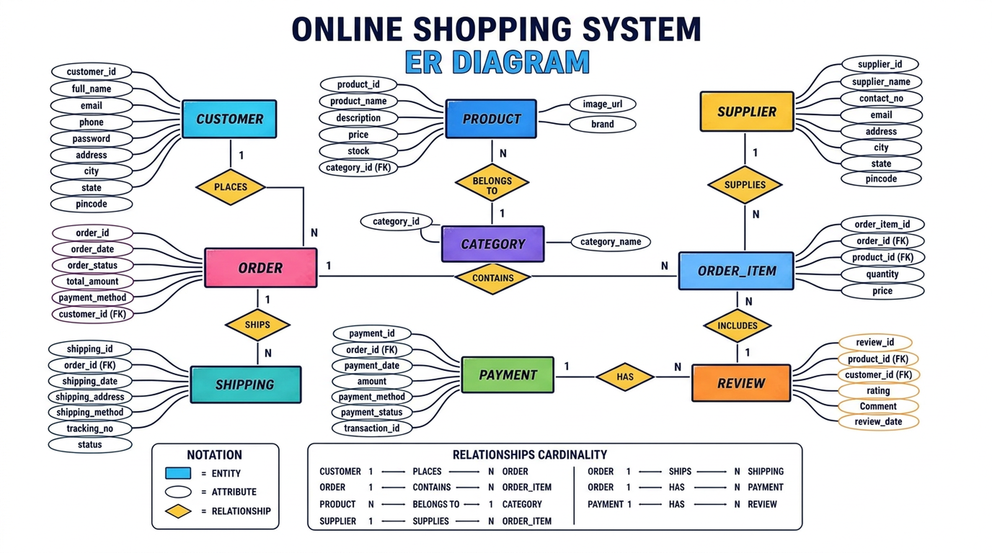
ER Diagram

Slide 10
5. Prepare Relational Database Schema
CUSTOMER(Customer_ID, Name, Email, Phone, Address)
CATEGORY(Category_ID, Category_Name)
PRODUCT(Product_ID, Category_ID, Product_Name, Price, Stock)
ORDERS(Order_ID, Customer_ID, Order_Date, Total_Amount, Status)
PAYMENT(Payment_ID, Order_ID, Payment_Mode, Payment_Status, Invoice_No)
ONLINE SHOPPING SYSTEM • DATABASE MANAGEMENT SYSTEM PROJECT

Slide 11
6. Define Primary & Foreign Keys
PRIMARY KEYS
FOREIGN KEYS
Primary keys uniquely identify every record in a table.
Foreign keys connect related tables and maintain referential integrity.
PRODUCT.Category_ID → CATEGORY.Category_ID
Customer_ID, Product_ID, Category_ID, Order_ID and Payment_ID act as primary keys.
ORDERS.Customer_ID → CUSTOMER.Customer_ID and PAYMENT.Order_ID → ORDERS.Order_ID
ONLINE SHOPPING SYSTEM • DATABASE MANAGEMENT SYSTEM PROJECT

Slide 12
7. Create GitHub Repo & Responsibilities
Create a shared GitHub repository for database scripts, documentation and presentation files.
TEAM MEMBER 1
B.SRI KOUSHIK - 25B11AI155: database/schema work
TEAM MEMBER 2
D.AVINASH - 25B11AI244: SQL queries and testing
TEAM MEMBER 3
O.VENU GOPAL - 25B11AI856: ER diagram and documentation
TEAM MEMBER 4
T.SAI SUSHMANTH - 25B11AIA51: presentation, integration and demonstration
ONLINE SHOPPING SYSTEM • DATABASE MANAGEMENT SYSTEM PROJECT

Slide 13
8. Database Creation & Constraints
1
Create the Online Shopping database and required relational tables.
2
Apply PRIMARY KEY, FOREIGN KEY, NOT NULL, UNIQUE and CHECK constraints where required.
DATABASE
INTEGRITY
3
Use suitable data types for IDs, names, prices, dates and status fields.
4
Constraints prevent invalid, duplicate or inconsistent records.
ONLINE SHOPPING SYSTEM • DATABASE MANAGEMENT SYSTEM PROJECT

Slide 14
9. Insert Sample Data
CATEGORIES
PRODUCTS
Insert sample categories such as Electronics, Fashion and Home Appliances.
Insert products with product ID, category, price and available stock.
CUSTOMERS
ORDERS + PAYMENT
Insert customer records with names, email, phone and delivery address.
Insert orders, order items and payment records to demonstrate the complete purchase flow.
ONLINE SHOPPING SYSTEM • DATABASE MANAGEMENT SYSTEM PROJECT

Slide 15
10. DDL, DML & DQL Operations
DDL
DML
DQL
DDL: CREATE, ALTER, DROP and TRUNCATE are used to define database structures.
DML: INSERT, UPDATE and DELETE are used to modify records.
DQL: SELECT is used to retrieve and analyse data.
These operations demonstrate practical SQL usage in the Online Shopping System.
ONLINE SHOPPING SYSTEM • DATABASE MANAGEMENT SYSTEM PROJECT

Slide 16
11. CRUD Operations & SQL Queries
1
2
3
4
CREATE
READ
UPDATE
DELETE
Create: add a new customer, product or order using INSERT.
Read: retrieve products, customers or orders using SELECT.
Update: modify stock, price or order status using UPDATE.
Delete: remove eligible records using DELETE while respecting relationships.
Queries can also use WHERE, JOIN, ORDER BY and aggregate functions.
ONLINE SHOPPING SYSTEM • DATABASE MANAGEMENT SYSTEM PROJECT

Slide 17
12. Data Integrity & Validation
ENTITY
REFERENTIAL
COMPLETENESS
VALIDATION
Entity integrity is maintained using primary keys.
Referential integrity is maintained using foreign keys.
NOT NULL and UNIQUE constraints prevent incomplete or duplicate data.
CHECK constraints can validate values such as price, stock and status.
Validation keeps customer, product, order and payment records consistent.
ONLINE SHOPPING SYSTEM • DATABASE MANAGEMENT SYSTEM PROJECT

Slide 18
13. Project Documentation
Document the project title, abstract, objectives and problem statement.
Record SQL table creation, constraints, sample data and important queries.
Use the documentation as a guide for development, testing and presentation.
1
2
3
4
5
Include identified entities, attributes, ER diagram and relational schema.
Maintain GitHub files, team responsibilities, screenshots and database outputs.
ONLINE SHOPPING SYSTEM • DATABASE MANAGEMENT SYSTEM PROJECT

Slide 19
14. Demonstrate & Present Database
1
2
3
4
5
Demonstrate database creation and table structure.
Show sample records for customers, products, orders and payments.
Execute representative DDL, DML, DQL and CRUD queries.
Explain primary keys, foreign keys, constraints and relationships.
Present the complete shopping flow from product selection to payment and delivery.
CREATE → LOAD → QUERY → EXPLAIN → PRESENT
ONLINE SHOPPING SYSTEM • DATABASE MANAGEMENT SYSTEM PROJECT

Slide 20
Existing System
Product and stock details are maintained manually in files or spreadsheets.
Customer information is collected repeatedly for every purchase.
Orders are recorded on paper, so tracking status is difficult.
Stock is updated late, leading to wrong availability and cancelled orders.
Payment records are stored separately from order records.
Generating sales or purchase reports requires manual effort.
Limitations
Data duplication
Inconsistent stock
Slow retrieval
No order tracking
Weak data security
Hard to scale

Slide 21
Proposed System
A centralised relational database powers the whole store, so every module reads and writes the same trusted data.
Browse
catalogue
Add to
cart
Place
order
Make
payment
Track
delivery
Single database stores products, customers, orders, payments and shipping.
Stock updates automatically as orders are confirmed or cancelled.
Order and payment status is available to the customer at any time.
Foreign keys and constraints keep related records consistent.

Slide 22
Key Features
1
2
3
User accounts
Product catalogue
Search & filter
Registration, login and saved delivery addresses.
Products grouped by category with price and stock.
Find items by name, category or price range.
4
5
6
Shopping cart
Order management
Payment records
Add, update quantity or remove items before checkout.
Order items, totals and status from placed to delivered.
Payment mode, transaction status and invoice details.

Slide 23
System Architecture
Presentation Layer
Web / mobile storefront — product pages, cart, checkout, order history
Application Layer
Business logic — search, cart handling, order processing, payment validation
Database Layer
MySQL relational database — Customer, Product, Order, Payment, Category tables
Each layer talks only to the layer below it, keeping the design modular and easy to maintain.

Slide 24
15. Conclusion
The Online Shopping System provides a structured relational database for e-commerce activities.
2
3
4
It centralises product, customer, order, payment and shipping information.
Keys and constraints improve data integrity and reduce duplication.
SQL queries support efficient data insertion, modification, retrieval and management.
The project demonstrates practical application of DBMS concepts to an everyday business system.
ONLINE SHOPPING SYSTEM • DATABASE MANAGEMENT SYSTEM PROJECT

Slide 25
THANK YOU
Online Shopping System • Database Management System Project

