Slide 1
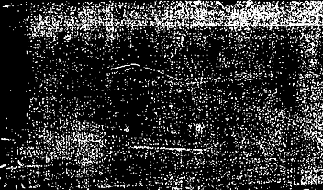



Abalone data set
Phuong Dinh – Khue Do – Huy Duong

Slide 2
introduction
+ Analyze a dataset on abalones, which are a type of sea snail, as well as the number of rings found in their shells.
+ Counting rings can be a tedious and challenging task, so the goal is to develop a machine learning algorithm that can accurately predict the number of rings based on other physical characteristics.
+ By building such an algorithm, it would be possible to streamline the process of estimating the age of abalones, which could have important implications for both scientific research and commercial applications.

Slide 3
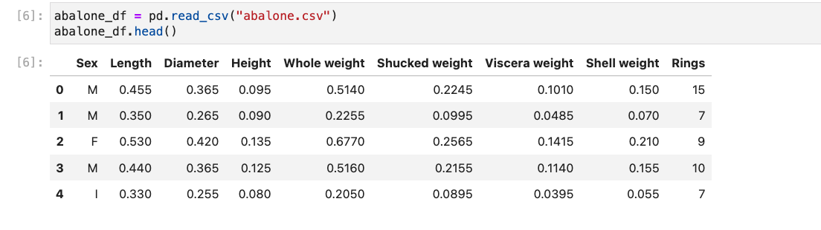
aBOUT the data set

Slide 4
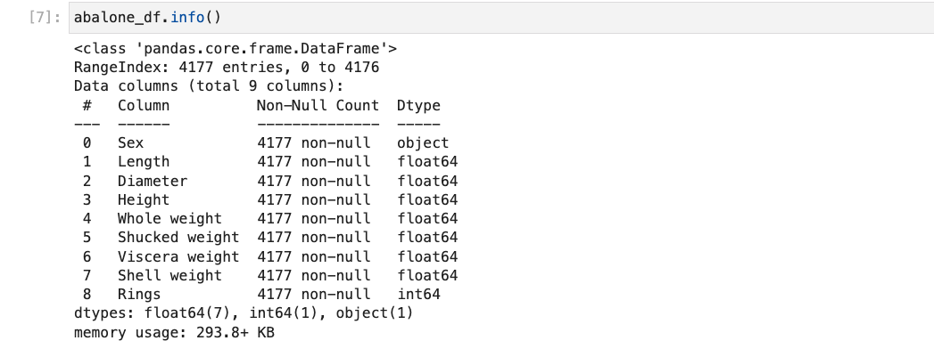
DATA EXPLORATION

Slide 5
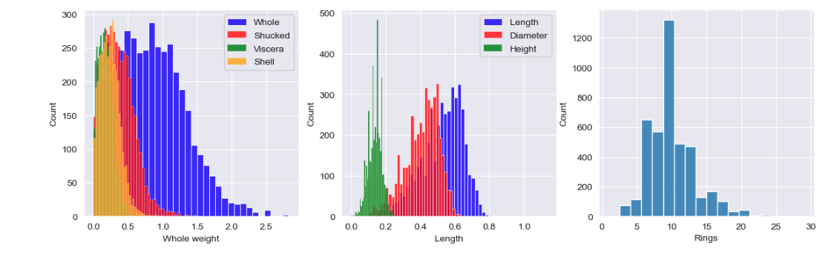
The whole weight has the highest frequency, followed by the shucked weight and the shell weight, with the viscera weight having the lowest frequency.
Length has the highest frequency, followed by diameter and height.
The histogram shows that most of the abalones have between 5 and 15 rings, with a peak around 9-10 rings.
Notice: we found that there are some values have height equal to zero

Slide 6
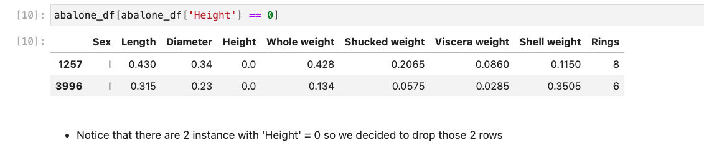
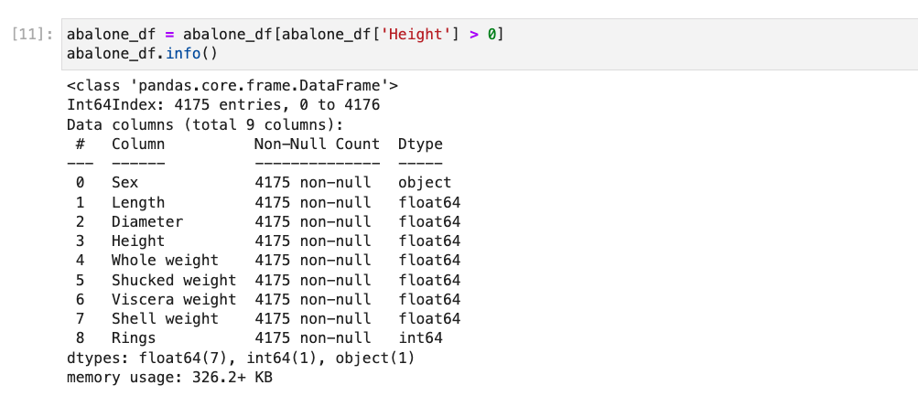

Slide 7
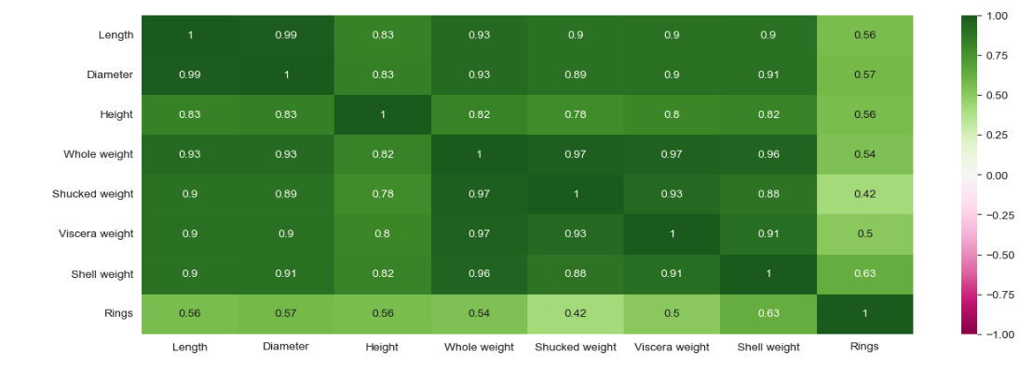
Heat map multiple high independent attribute correlations (0.93, 0.83, etc). On the other hand, the correlation between the independent attributes and the dependent variable is average at (0.57, 0.63, etc).

Slide 8
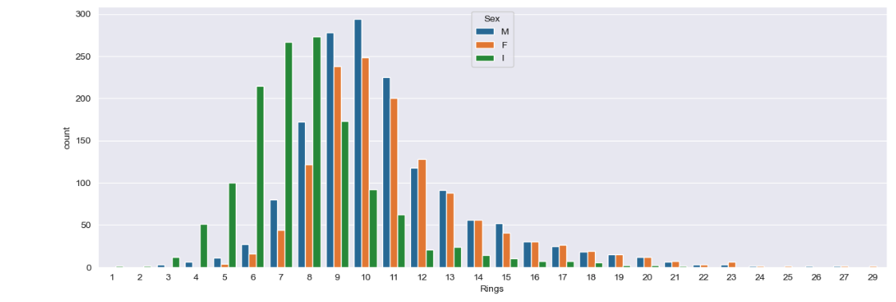
There are more male abalones than female and infant abalones combined for most of the number of rings, and that the number of female and infant abalones increases as the number of rings increases.

Slide 9
iDENTIFYING OUTLIERS

Slide 10
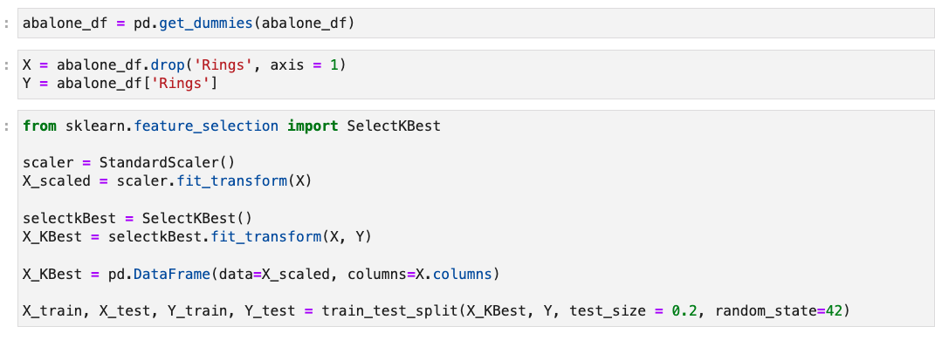
Data preprocessing

Slide 11
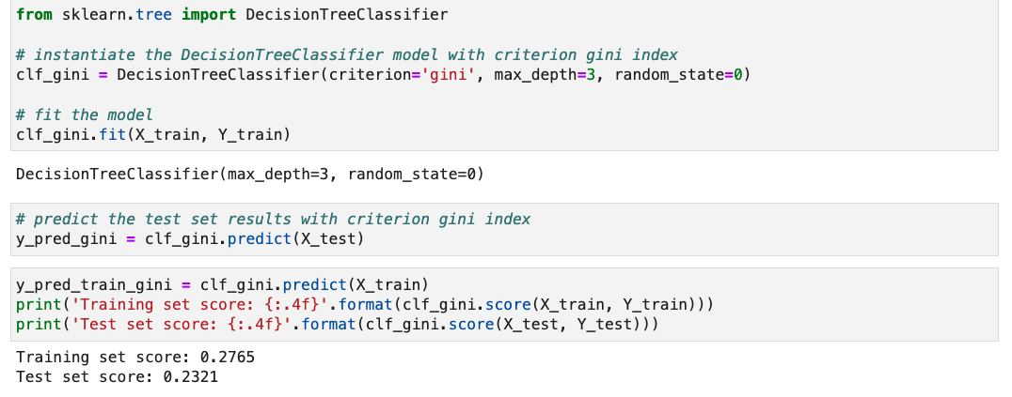
Decision tree

Slide 12
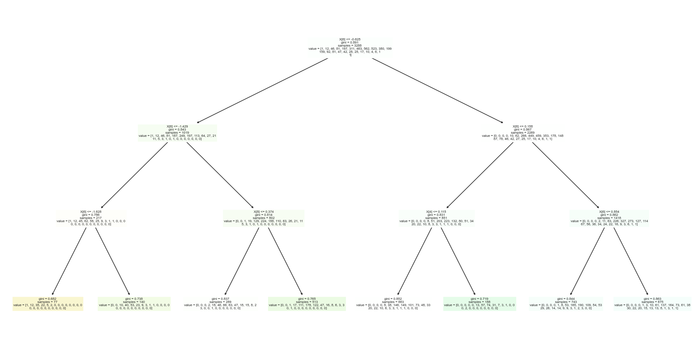

Slide 13
Random forest

Slide 14
Neural network

Slide 15
conclusion

