Slide 1
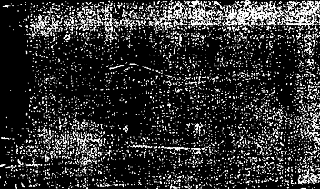



Abalone data set
Phuong Dinh – Khue Do – Duc Duong

Slide 2
introduction
+ Analyze a dataset on abalones, which are a type of sea snail, as well as the number of rings found in their shells.
+ Counting rings can be a tedious and challenging task, so the goal is to develop a machine learning algorithm that can accurately predict the number of rings based on other physical characteristics.
+ By building such an algorithm, it would be possible to streamline the process of estimating the age of abalones, which could have important implications for both scientific research and commercial applications.

Slide 3
Abalone data set
Abalone set on UCI website.
Default task is classification which is the method we have chosen to categorize Abalone’s rings.
The three classification methods we chose are: Decision Tree, Random Forest, and Neural Network.

Slide 4
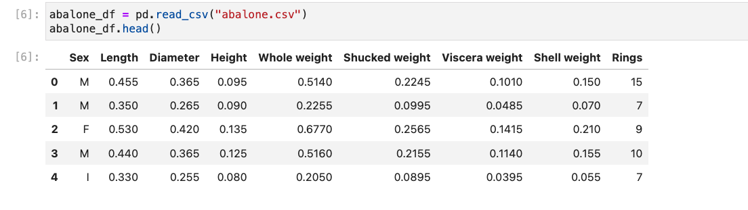
aBOUT the data set

Slide 5
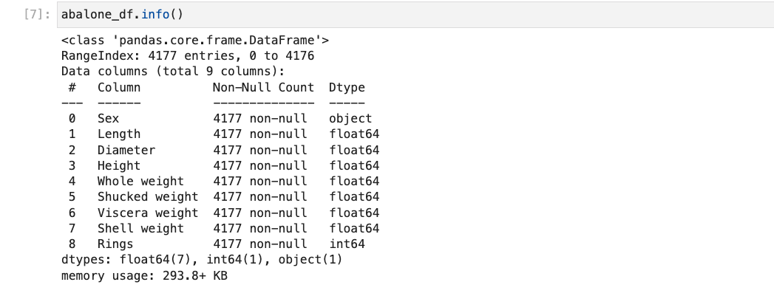
DATA EXPLORATION

Slide 6
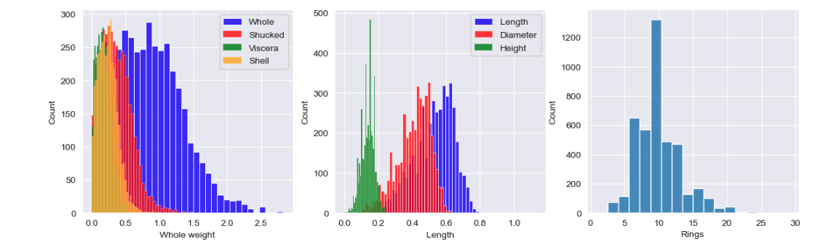
The whole weight has the highest frequency, followed by the shucked weight and the shell weight, with the viscera weight having the lowest frequency.
Length has the highest frequency, followed by diameter and height.
The histogram shows that most of the abalones have between 5 and 15 rings, with a peak around 9-10 rings.
Notice: we found that there are some values have height equal to zero

Slide 7
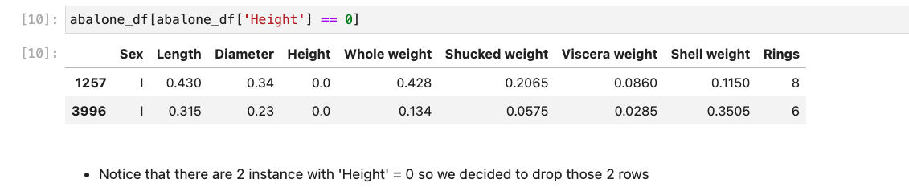
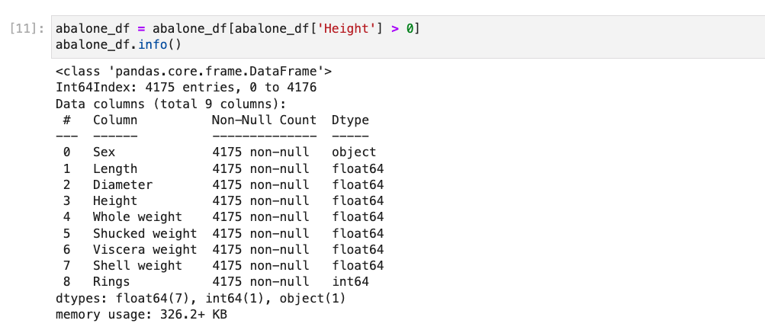

Slide 8
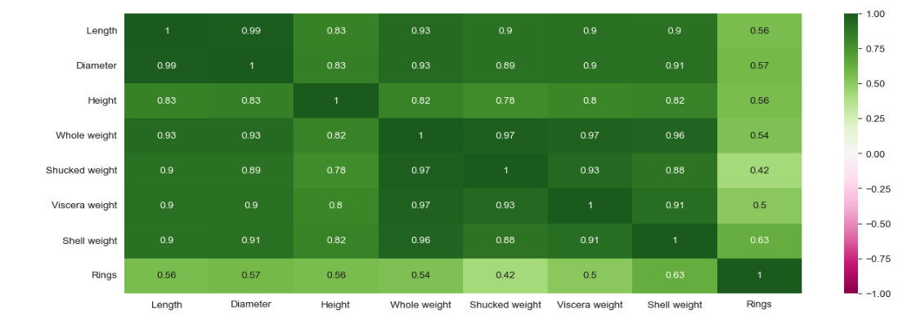
Heat map multiple high independent attribute correlations (0.93, 0.83, etc). On the other hand, the correlation between the independent attributes and the dependent variable is average at (0.57, 0.63, etc).

Slide 9
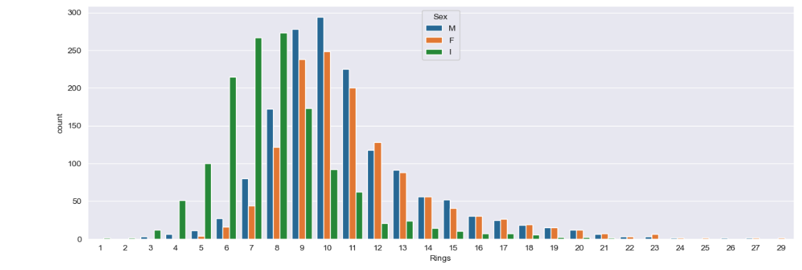
There are more male abalones than female and infant abalones combined for most of the number of rings, and that the number of female and infant abalones increases as the number of rings increases.

Slide 10
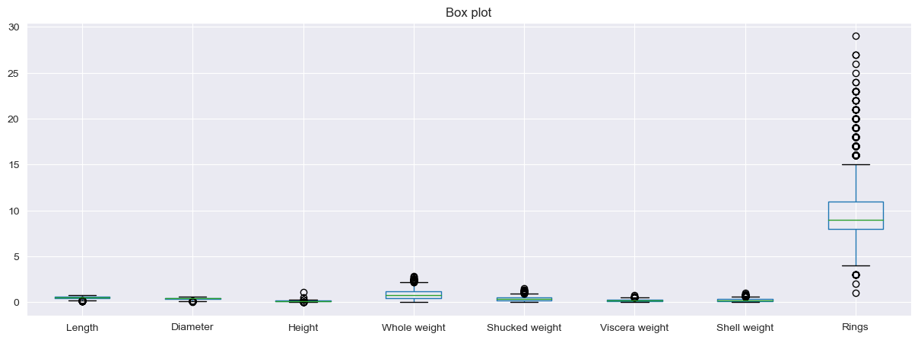
iDENTIFYING OUTLIERS

Slide 11
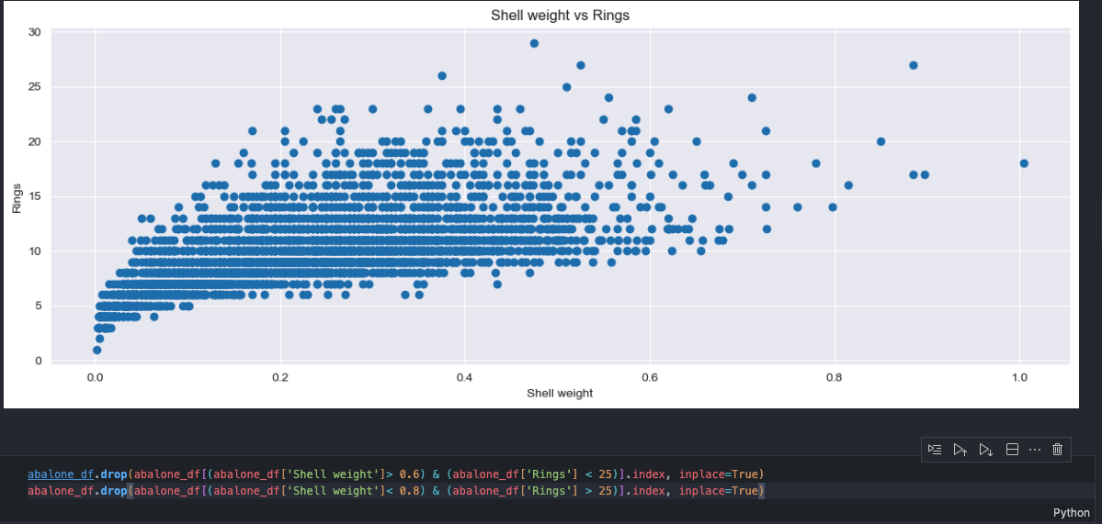
Visualize and handle Feature outliers

Slide 12
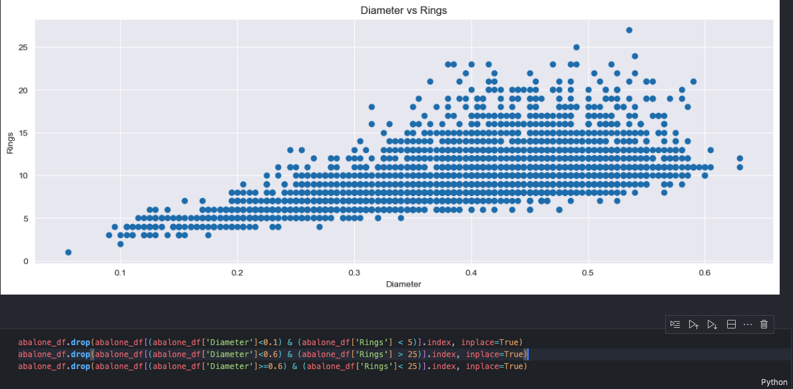
Visualize and handle Feature outliers

Slide 13
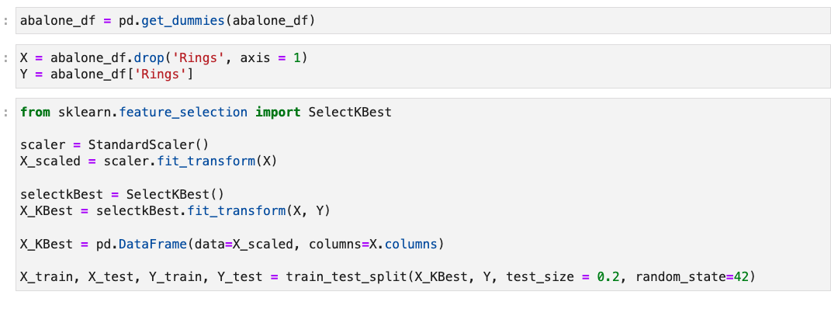
Data preprocessing

Slide 14
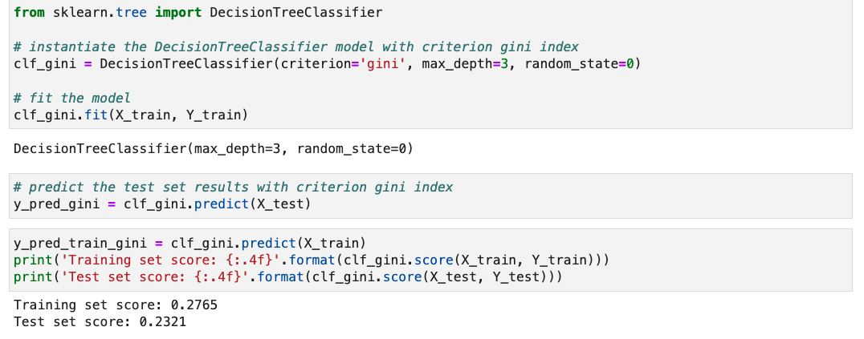
Decision tree

Slide 15
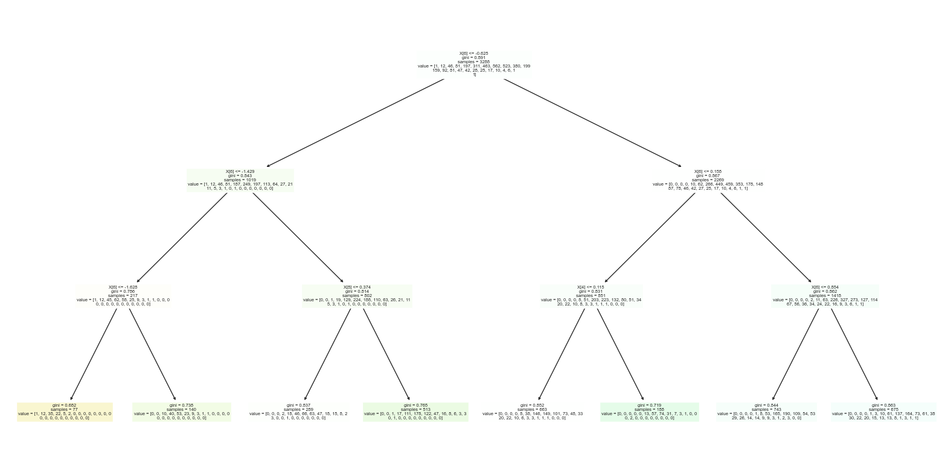

Slide 16
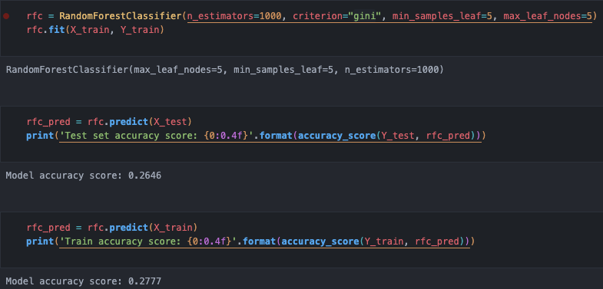
Random forest

Slide 17
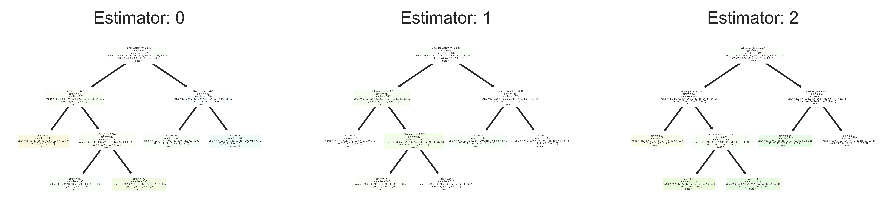
Random forest visualization

Slide 18
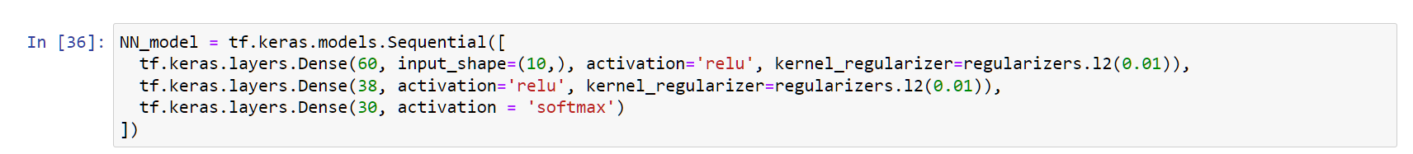
Neural network

Slide 19
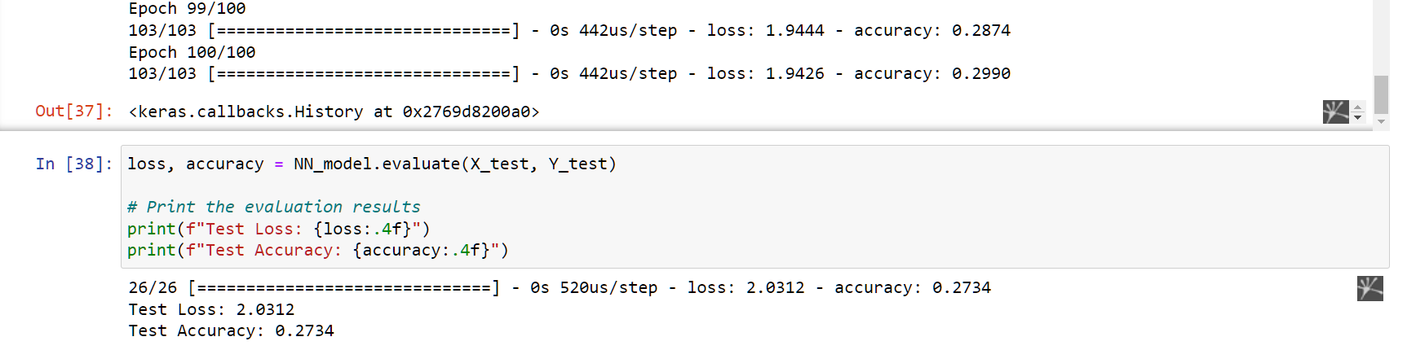
Neural network Initial Result

Slide 20
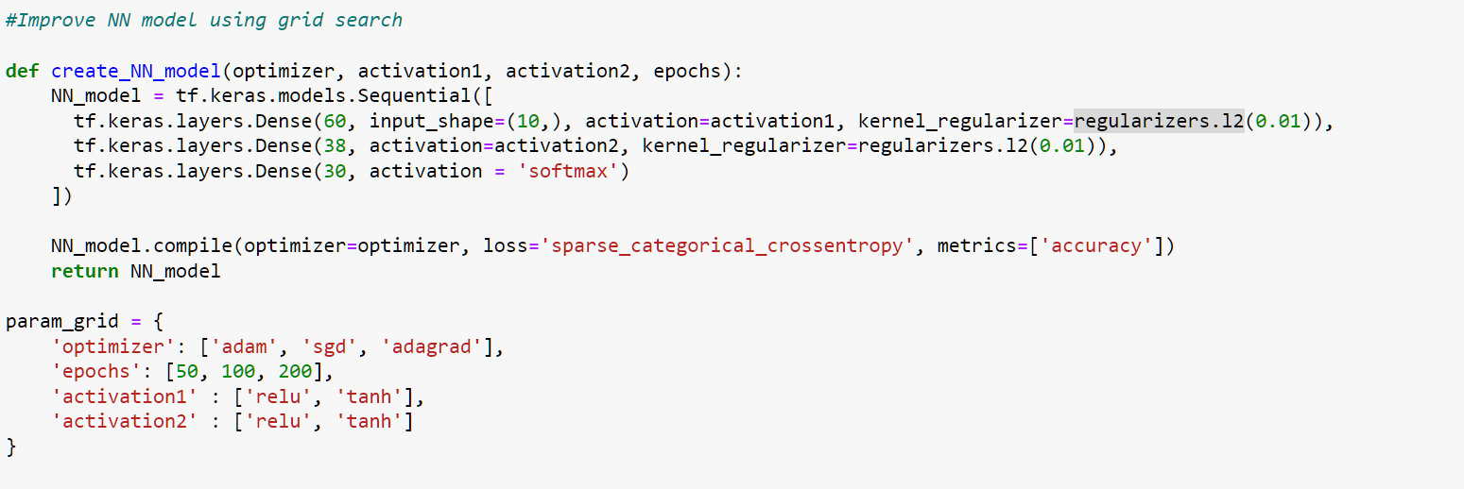
Neural network Grid search

Slide 21
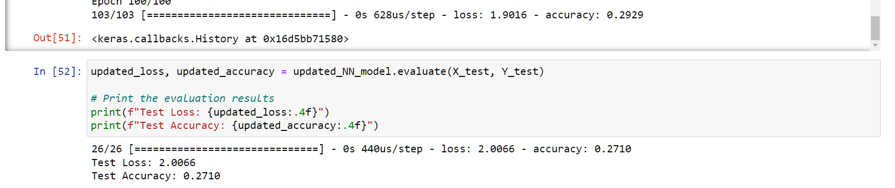
Neural network Final Result

Slide 22
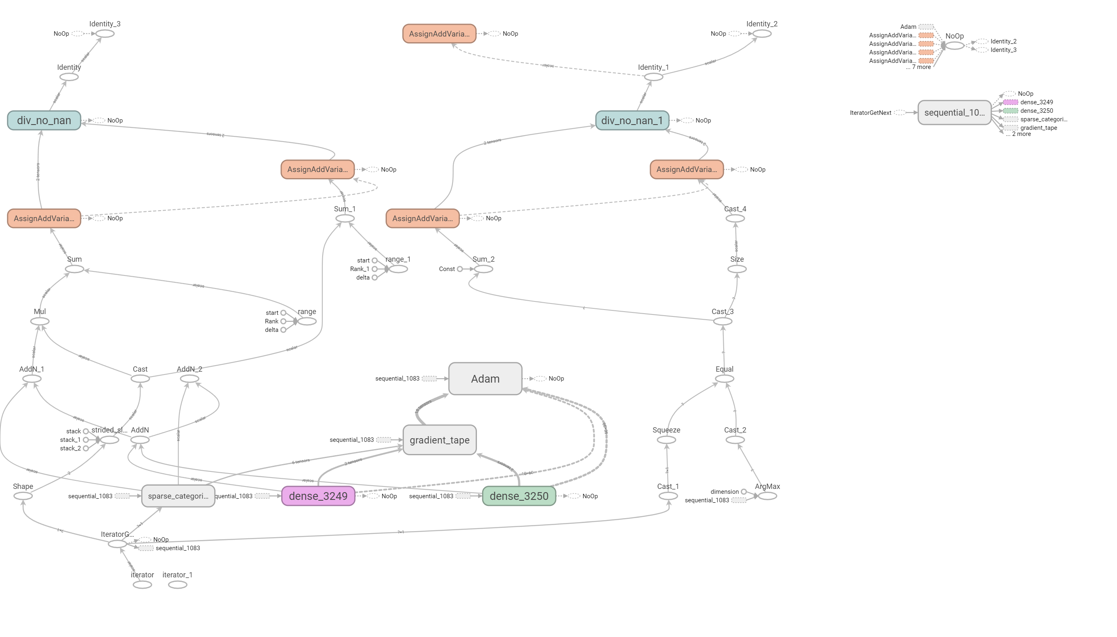

Slide 23
conclusion
Overall, we tried three different methods of classification to classify abalone’s rings based on 10 distinct attributes.
Although the attributes have high correlation with each other and average correlation with the target, we have applied multiple different methods to reduce the correlation between variables.
The result concludes:
The worst performer is the decision tree model at training accuracy of 0.27 and testing accuracy at 0.23.
The random forest model and the neural network model perform about the same. The two models both hover around 0.28 for training accuracy and 0.27 for testing accuracy.
All 3 models have low accuracy despite much effort into optimizing each model. Thus, we conclude classification is not the best method for the problem.
Instead, regression is a better approach.

