Slide 1

MS DATA SCIENCE · THESIS DEFENCE
HeatFlood Sentinel
Scalable Big Data and Deep Learning Framework for Heatwave and Flash-Flood Forecasting and Detection in Pakistan
Aseef Ahmed
Roll No. DS-029/2025/26
Supervisor: Dr. Maria Andaleeb Siddiqui
Department of Computer Science & IT, NED University of Engineering & Technology, Karachi
Defence date: [PLACEHOLDER — TO BE CONFIRMED]
Internal examiner: [PLACEHOLDER]
External examiner: [PLACEHOLDER]
Thesis results: ERA5, 20 cities, 2015–2022 (test year 2022) · Big Data results: single-node pseudo-distributed Hadoop/YARN/Spark/Kafka cluster
Notes:
Good morning. I am Aseef Ahmed, MS Data Science, roll number DS-029/2025/26, supervised by Dr. Maria Andaleeb Siddiqui. My thesis builds HeatFlood Sentinel: a Big Data and deep-learning pipeline that forecasts temperature and precipitation and detects heatwaves and flash-flood risk for 20 Pakistani cities. Two scoping facts up front: every thesis result uses ERA5 reanalysis for 2015-2022 with 2022 held out as the test year; and the Hadoop, Spark and Kafka results I show later were run on a single-node pseudo-distributed cluster, not a multi-node cluster. The date and examiner names on this slide are placeholders to be filled before the defence. Thesis title from main.tex (\thesistitle).

Slide 2
ROADMAP
The talk follows the argument from hazard to evidence to limits
01
02
03
04
Motivation
Problem, RQs & gap
Data & methods
Big Data architecture
Deadly heat and floods in Pakistan
What is missing in 99 reviewed studies
ERA5, labels, models, evaluation
HDFS · YARN · Spark · Kafka
05
06
07
B
Results
Streaming
Limits & conclusion
Backup
Forecasting and detection skill
Latency, throughput, fault tolerance
Limitations, RQ answers, future work
Full tables for questions
NED UET · CSIT · MS Data Science · Aseef Ahmed (DS-029/2025/26)
2
Notes:
Roadmap. I start with why this matters for Pakistan, then the problem, research questions and literature gap; then the data and methods; the Big Data architecture; the forecasting and detection results; the streaming results; and finally limitations, answers to the research questions and future work. Backup slides hold the full tables.

Slide 3
01
Motivation
Pakistan faces lethal heat and catastrophic floods — often in the same pre-monsoon and monsoon season.
SECTION
NED UET · CSIT · MS Data Science · Aseef Ahmed (DS-029/2025/26)
3
Notes:
Section 1: motivation. Two recent disasters frame the work: the June 2015 Karachi heatwave and the 2022 floods.

Slide 4
MOTIVATION · HEAT
Karachi 2015: one week of heat killed more than 1,200 people
>1,200
44.8 °C
≈66 °C
deaths in Karachi during the 17–24 June 2015 heatwave
maximum temperature on 20 June 2015, 11.1 °C above normal
heat index on the peak day (high humidity, low wind)
Why it matters for this thesis
The Ministry of Climate Change report calls the event unprecedented in its persistence, not its peak. Multi-day duration is therefore built into the heatwave label — and, as the results show, persistence is also the hardest baseline to beat.
Source: Ministry of Climate Change (MoCC), Technical Report on Karachi Heat Wave, June 2015 (Aug 2015), mocc.gov.pk
NED UET · CSIT · MS Data Science · Aseef Ahmed (DS-029/2025/26)
4
Notes:
June 2015, Karachi. The Ministry of Climate Change technical report (Chaudhry, Rasul et al., 2015) states the 17-24 June heatwave took more than 1,200 lives; the highest maximum temperature was 44.8 degrees C on 20 June, a departure of 11.1 degrees C from normal, and the heat index reached about 66 degrees C on the peak day because of low pressure, low wind and very high humidity. The same report says the event was unprecedented in terms of persistence. That is why my heatwave label requires at least three consecutive hot days, and it foreshadows a key result: a simple persistence rule is a very strong next-day heatwave detector. Source: https://mocc.gov.pk/SiteImage/Misc/files/Final%20Heat%20Wave%20Report%203%20August%202015.pdf

Slide 5
MOTIVATION · FLOOD
The 2022 floods affected 33 million people and caused over US$14.9 billion in damage
33 million
>1,730
>$14.9 bn
≈$15.2 bn
people affected
lives lost
damages (US$)
economic losses (US$)
Why it matters for this thesis
2022 was also an exceptionally hot pre-monsoon year. It is the held-out test year here, so every model is judged on an extreme, out-of-distribution season.
Source: Pakistan Floods 2022 Post-Disaster Needs Assessment (PDNA), MoPD&SI with ADB, EU, UN, World Bank, Oct 2022
NED UET · CSIT · MS Data Science · Aseef Ahmed (DS-029/2025/26)
5
Notes:
The 2022 floods. The Post-Disaster Needs Assessment, led by the Ministry of Planning, Development and Special Initiatives with ADB, EU, UN agencies and the World Bank, estimates damages above US$14.9 billion and economic losses of about US$15.2 billion; the floods affected 33 million people and more than 1,730 lost their lives (World Bank/UNDP PDNA press release, 28 Oct 2022). For my work, 2022 is the held-out test year: it combined extreme pre-monsoon heat with extreme monsoon rain, which makes it a stringent out-of-distribution test. Sources: https://www.pc.gov.pk/uploads/downloads/PDNA-2022.pdf ; https://www.worldbank.org/en/news/press-release/2022/10/28/pakistan-flood-damages-and-economic-losses-over-usd-30-billion-and-reconstruction-needs-over-usd-16-billion-new-assessme

Slide 6
MOTIVATION · APPROACH
Timely local warnings need data-driven models on scalable data infrastructure
NWP is costly locally
Climate data is Big Data
Agencies need explainable alerts
Numerical weather prediction is physically rigorous but expensive at the localised, sub-daily resolution that actionable warnings need.
ERA5 alone provides hourly global fields at 0.25° over decades: volume, velocity and variety beyond traditional pipelines.
Forecasts and alerts must be accurate, timely and explainable — and run on modest computing infrastructure.
Spark and Kafka make the infrastructure practical; LSTM and ConvLSTM make the models practical. The literature rarely joins the two — that join is this thesis.
NED UET · CSIT · MS Data Science · Aseef Ahmed (DS-029/2025/26)
6
Notes:
Why this approach. Chapter 1 argues three points: NWP is computationally expensive at the local, sub-daily resolution warnings need; statistical models like SARIMA assume linearity and stationarity that rarely hold for extremes; and climate data such as ERA5 (hourly, 0.25 degree, decades) has outgrown traditional pipelines. Distributed platforms such as Spark and Kafka, and deep learning such as LSTM and ConvLSTM, each address part of this, but the literature shows the two streams developed largely in isolation. Source: thesis Chapter 1, Background and Motivation.

Slide 7
02
Problem, research questions and gap
No reviewed study couples a streaming Big Data pipeline to trained heatwave and flash-flood detectors for Pakistan.
SECTION
NED UET · CSIT · MS Data Science · Aseef Ahmed (DS-029/2025/26)
7
Notes:
Section 2: the problem statement, objectives, research questions and the literature gap.

Slide 8
PROBLEM STATEMENT
Five gaps stand between current research and operational warning in Pakistan
i
No reviewed study couples a streaming Big Data ingestion pipeline to a trained heatwave or flash-flood detector.
ii
Processing latency and throughput are rarely reported alongside accuracy.
iii
Validation on Pakistan-specific data — PMD station data in particular — is scarce.
iv
Heatwaves and flash floods are not modelled within one pipeline.
v
Explainability is applied inconsistently.
Need: accurate, timely, explainable alerts produced on modest computing infrastructure.
NED UET · CSIT · MS Data Science · Aseef Ahmed (DS-029/2025/26)
8
Notes:
Problem statement, from Section 1.2 of the thesis. Agencies need heatwave and flash-flood forecasts and alerts that are accurate, timely and explainable, and that run on modest infrastructure. The literature reveals five gaps: (i) no streaming pipeline coupled to a trained detector; (ii) latency and throughput rarely reported with accuracy; (iii) little validation on Pakistan data, especially PMD stations; (iv) the two hazards are not modelled in one pipeline; (v) explainability is inconsistent. I will be explicit later that gap (iii) could not be closed because PMD data was not available.

Slide 9
AIM AND OBJECTIVES
Six objectives carried unchanged from the approved proposal
O1
Focused literature review of Big Data and deep learning for temperature, precipitation, heatwave and flash-flood work, with a South Asian focus.
O2
Identify the data sources, architectures and evaluation practices that most influence accuracy.
O3
Design and implement a distributed pipeline (Spark, Kafka, Hadoop) for ERA5 and PMD data.
O4
Build LSTM and ConvLSTM forecasters plus a heatwave and flash-flood detection module.
O5
Compare against SARIMA and XGBoost baselines, and available NWP outputs.
O6
Assess scalability, throughput and fault tolerance of the streaming pipeline.
NED UET · CSIT · MS Data Science · Aseef Ahmed (DS-029/2025/26)
9
Notes:
The aim is a scalable Big Data and deep learning framework for temperature and precipitation forecasting and heatwave and flash-flood detection in Pakistan. These six objectives are carried over unchanged from the approved proposal (Section 1.3). Where an objective could only partly be met - PMD data in O3 and O5, and the NWP comparison in O5 - the deviation is reported in Chapters 3 and 5 and on the limitations slide.

Slide 10
RESEARCH QUESTIONS
Four research questions — one answered by review and three by experiment
RQ1
State of the art in Big Data and ML for temperature and precipitation forecasting and heatwave and flash-flood detection, especially in South Asia?
Literature review · Ch. 2
RQ2
Do LSTM and ConvLSTM significantly beat SARIMA and XGBoost on RMSE, MAE and NSE — and how do they compare with NWP — for Pakistan?
Experiments · Ch. 5
RQ3
Can a Spark- and Kafka-based streaming prototype deliver near-real-time detection (latency, throughput, F1, CSI, false alarms)?
Experiments · Ch. 5
RQ4
How do scalability, throughput and fault tolerance vary with data volume and node configuration?
Experiments · Ch. 5
NED UET · CSIT · MS Data Science · Aseef Ahmed (DS-029/2025/26)
10
Notes:
The four research questions from the approved proposal (Section 1.4). RQ1 is answered by the literature review; RQ2 to RQ4 are answered empirically in Chapter 5. I return to each with a direct answer near the end.

Slide 11
LITERATURE REVIEW · 99 STUDIES
The review of 99 studies maps six gaps to the thesis design
Gap | What the literature lacks | How the thesis responds
G1 | Streaming Big Data pipeline coupled to a trained hazard detector | Kafka → Spark stream feeds the detectors
G2 | Latency and throughput reported with accuracy | Latency, throughput reported next to CSI/RMSE
G3 | Training or validation on PMD station data | PMD adapter built; no data obtained (limitation)
G4 | Heatwave and flash flood in one pipeline | Shared pipeline, separate detectors
G5 | Global data-driven models benchmarked for Pakistan | Out of scope → future work
G6 | Consistent explainability | SHAP feature groups for detectors
Source: Thesis Ch. 2, Table 'Research Gaps and Their Mapping to Thesis Objectives and Research Questions'; 87 original + 12 update-search studies
NED UET · CSIT · MS Data Science · Aseef Ahmed (DS-029/2025/26)
11
Notes:
RQ1 is answered by Chapter 2, which reviewed 99 studies (87 retained by the original search and 12 from an update search). Six gaps are consolidated in the gap table. The central one is G1: no reviewed work integrates a streaming Big Data pipeline with a trained heatwave or flash-flood detector. G2 motivates reporting latency and throughput as first-class metrics. G3, PMD station data, motivated the design but could not be closed because no PMD data was available. G5, data-driven global models such as GraphCast and Pangu-Weather, is future work. The review also concluded that statistical and tree-based baselines remain competitive and must be reported - which turns out to be central to my results.

Slide 12
03
Data and methods
ERA5 reanalysis for 20 cities, leakage-safe labels, strong baselines and paired significance tests.
SECTION
NED UET · CSIT · MS Data Science · Aseef Ahmed (DS-029/2025/26)
12
Notes:
Section 3: data, hazard labels, models and evaluation design.

Slide 13
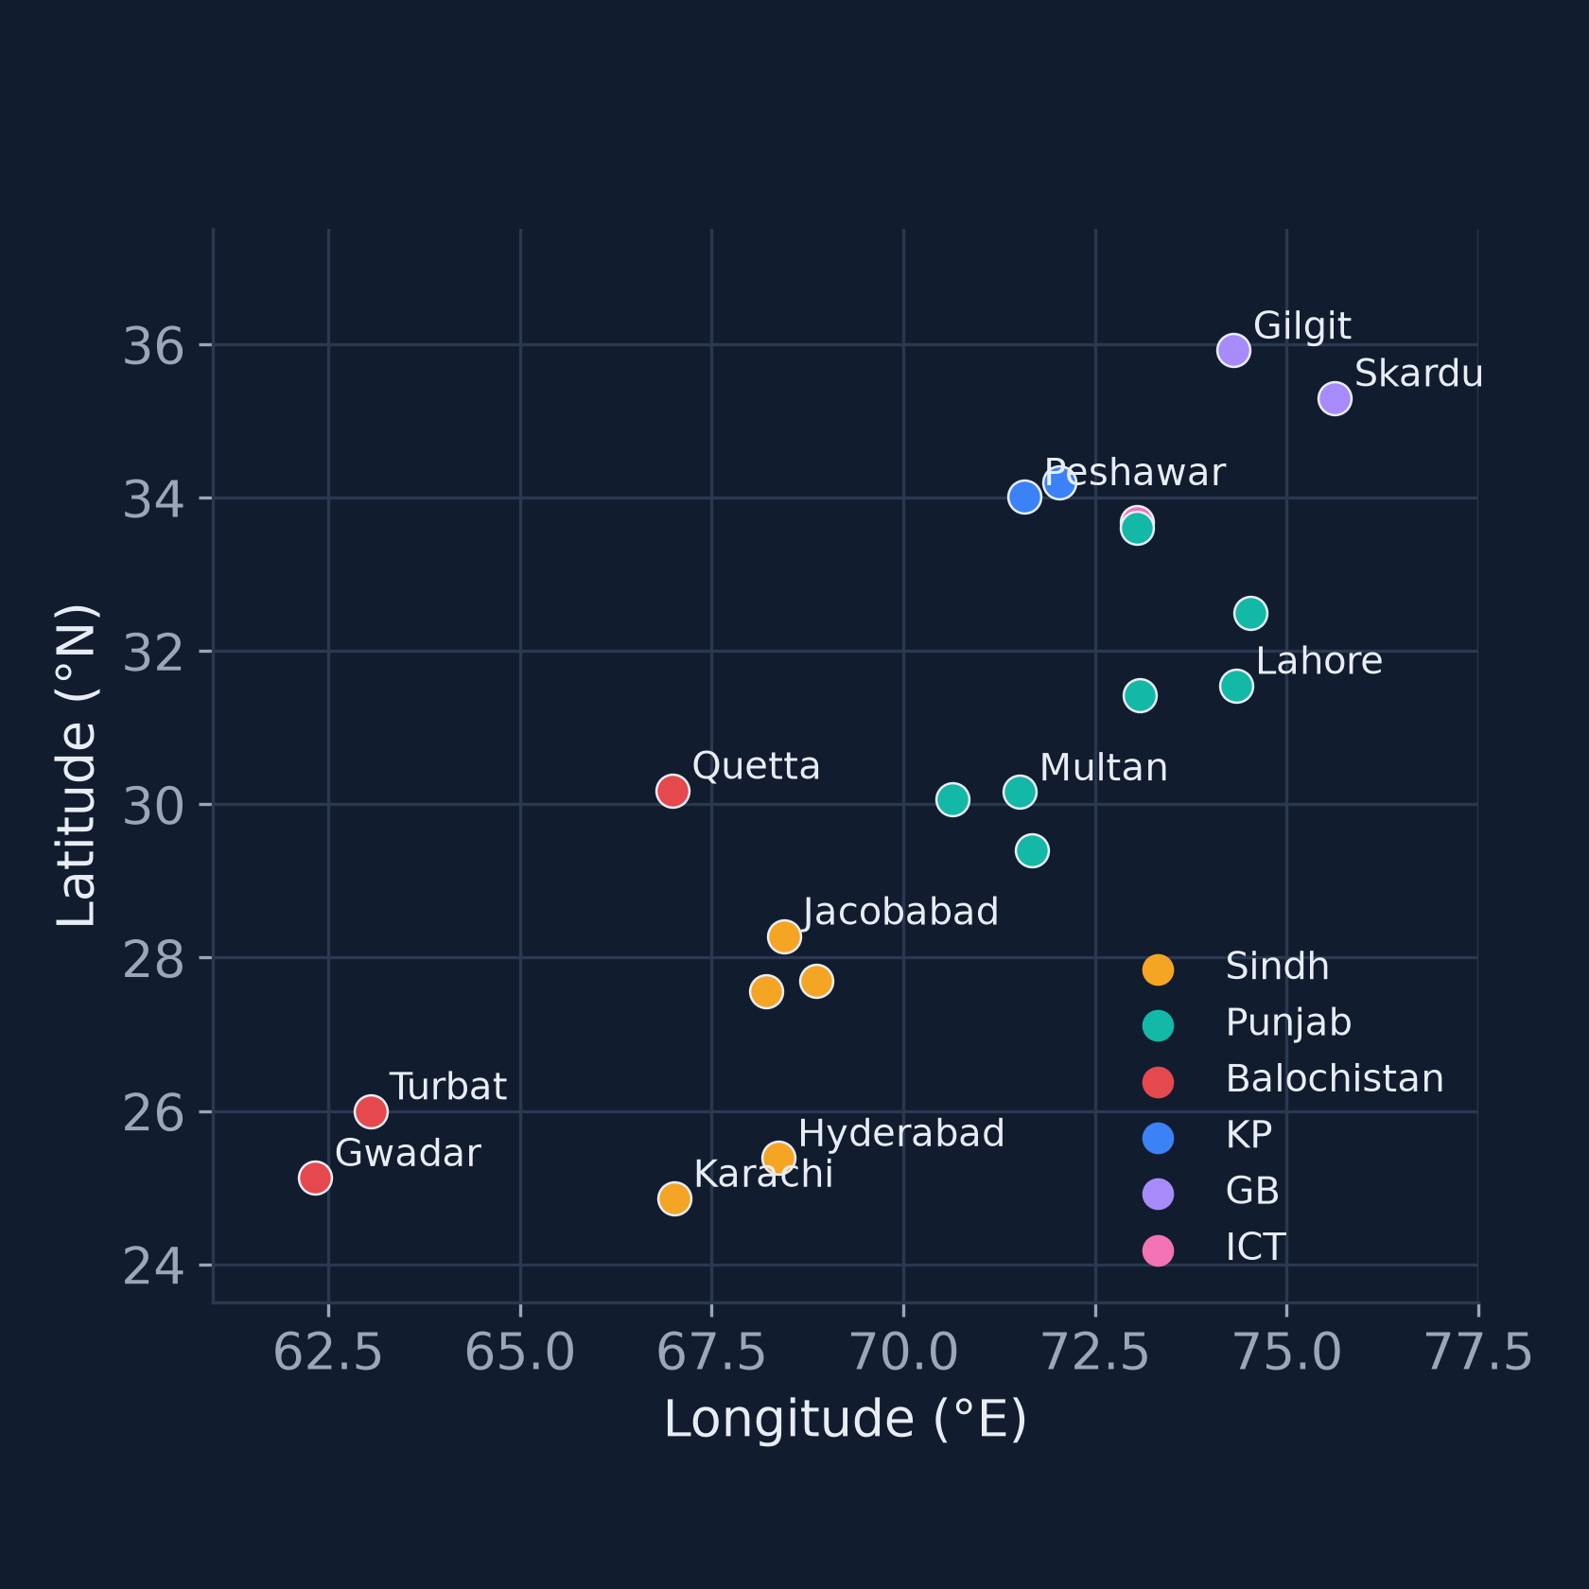
DATA
Thesis results use ERA5 for 20 cities from 2015 to 2022
■ ERA5 reanalysis via the Open-Meteo archive (models = era5)
■ 20 cities, nearest 0.25° cell, hourly 2015–2022: 1.40 M rows
■ 2° regional lattice (7 × 8 cells) for the ConvLSTM
■ Split: train 2015–2020 · validation 2021 · test 2022 (held out)
■ Extension to 1990–2026 in progress: 1990–1999 + 2015–2022 already in HDFS (3.11 M rows); not used for thesis numbers
■ PMD stations: adapter implemented, no data obtained
Source: DEVIATIONS.md D4–D5, D8; results/bigdata/hdfs_load.json; thesis Appendix C (study cities)
NED UET · CSIT · MS Data Science · Aseef Ahmed (DS-029/2025/26)
13
Notes:
Data. Every thesis number comes from ERA5 reanalysis retrieved through the Open-Meteo archive with models=era5: 20 reference cities across all provinces, nearest 0.25 degree point, hourly from 2015 to 2022, 1.40 million rows; plus a 2-degree, 7 by 8 cell subsample of the lattice for the ConvLSTM. Train 2015-2020, validation 2021, test 2022 held out. The dataset is being extended to 1990-2026. At the time of the Big Data run the download was partial: 1990-1999 plus 2015-2022, 355 partitions and 3.11 million hourly rows, loaded to HDFS (fsck HEALTHY). Because of the 2000-2014 gap, the thesis comparisons use only the 2015-2022 run. PMD station data: the adapter exists but was tested only with synthetic files; no PMD data was obtained. Climatologies and thresholds are fitted on 2015-2020 only, not the WMO 1991-2020 baseline, to avoid leakage.

Slide 14
HAZARD DEFINITIONS
Labels are percentile-based and fitted on training years only
Label | Definition | Positives (train / val / test) | Used for
Heatwave (relative) | Daily Tmax > local calendar-day p95 (±7-day window) on ≥3 consecutive days | 593 / 261 / 551 city-days | Detection target
Heatwave (absolute) | Daily Tmax ≥ 40 °C on ≥3 consecutive days | 4,596 / 620 / 870 | Reported
Flash-flood proxy A | 6-h rain ≥ max(50 mm, local p99) and antecedent precipitation index > p75 | 17 / 1 / 2 windows | Too rare: descriptive only
Flash-flood proxy B | Trailing 24-h rain ≥ local p99.5 of daily totals | 929 / 79 / 405 windows | Detection target
Flood labels are rainfall-extreme proxies, not observed floods — ERA5 does not observe floods.
Source: Thesis Ch. 3 hazard-definition table; results/bigdata/spark_etl_parity_2015_2022.json (label prevalence); DEVIATIONS.md D1
NED UET · CSIT · MS Data Science · Aseef Ahmed (DS-029/2025/26)
14
Notes:
Hazard labels (Chapter 3). Heatwave: daily maximum above the local calendar-day 95th percentile, with a plus-minus 7 day window fitted on training years, on at least three consecutive days; an absolute 40 degree variant is also computed. Flash flood: proxy A, the SRS definition, fires only 17, 1 and 2 times in train, validation and test - too rare to train or evaluate - so the detectors use proxy B, trailing 24-hour rain above the local 99.5th percentile, with 929, 79 and 405 positive 6-hour windows. Heatwave prevalence is much higher in 2022 than in the training years, which reflects 2022's exceptional heat. The flood labels are proxies, not observed floods; validation against NDMA/PDMA event records is future work. Counts from the Spark parity run, identical to pandas.

Slide 15
MODELS AND EVALUATION
Every model faces persistence and climatology on identical test samples
Baselines
Deep learning
Evaluation
■ Persistence (incl. diurnal)
■ Climatology (train-only)
■ SARIMA
■ XGBoost (default hyper-parameters)
■ Rule-based persistence detector
■ Daily and hourly LSTM
■ ConvLSTM encoder–forecaster on the 2° lattice (60,198 parameters, 6 h ahead)
■ CNN grid heatwave detector
■ Calibrated XGBoost detectors with SHAP
■ RMSE, MAE, NSE; skill vs persistence and climatology
■ CSI, F1, POD, FAR; ROC-AUC, PR-AUC, Brier
■ Diebold–Mariano and block bootstrap, Holm-corrected
■ Thresholds tuned on 2021, tested on 2022
Source: Thesis Ch. 3 (models, evaluation design); Appendix C hyper-parameters; DEVIATIONS.md D7
NED UET · CSIT · MS Data Science · Aseef Ahmed (DS-029/2025/26)
15
Notes:
Models. Baselines are persistence (and diurnal persistence for hourly), training-period climatology, SARIMA and XGBoost with default hyper-parameters (Optuna tuning was scripted but not run - DEVIATIONS D7). Deep models: daily and hourly LSTMs, a ConvLSTM encoder-forecaster on the 2 degree lattice with 60,198 parameters that reads 12 hourly frames and forecasts 6 hours, and a CNN grid heatwave detector. Evaluation is on identical samples. Regression: RMSE, MAE, NSE and skill scores. Detection: CSI, F1, POD and FAR, plus ROC-AUC, PR-AUC and Brier for probabilistic detectors. Paired Diebold-Mariano tests with block bootstrap confidence intervals and Holm correction. Detection thresholds are tuned on 2021 and applied unchanged to 2022.

Slide 16
04
Big Data architecture
One code path from HDFS to alert — executed on a single-node pseudo-distributed Hadoop, YARN, Spark and Kafka cluster.
SECTION
NED UET · CSIT · MS Data Science · Aseef Ahmed (DS-029/2025/26)
16
Notes:
Section 4: the Big Data architecture. I will say this repeatedly: everything ran on a single-node pseudo-distributed cluster.

Slide 17
ARCHITECTURE
Batch and streaming paths share storage, labels and alert logic
SOURCES
HDFS + SPARK ON YARN
MODELS
KAFKA + STREAMING
ERA5 (Open-Meteo archive)
HDFS bronze
Reference models
Kafka hf-obs
20 cities hourly 2015–2022; 1990–2026 extension in progress
city=*/year=* Parquet; 355 partitions, fsck HEALTHY
SARIMA · XGBoost · LSTM · ConvLSTM · CNN (pandas / PyTorch)
KRaft, 1 broker, 4 partitions; fed by ERA5 replay producer
Open-Meteo forecast
Spark ETL on YARN
Spark MLlib on YARN
Structured Streaming
Live 72-h feed, bias-corrected to ERA5
QC, PKT days, train-only climatology, labels, features
GBT regressor (Tmax) and classifier (heatwave)
Per-city state, HDFS checkpoint
PMD station adapter
HDFS silver / gold
Alert engine
Sinks
Implemented; no PMD data available
8 tables — parity with pandas reference
Rules + detectors → Watch / Warning / Emergency
hf-alerts (at-least-once) · HDFS scored Parquet (exactly-once)
All daemons on one 2-vCPU / 7.7 GB node — a single-node pseudo-distributed cluster. Real services and protocols; no multi-node parallelism.
Source: heatflood-sentinel docs/bigdata.md; DEVIATIONS.md D3, D8; thesis Ch. 4 architecture
NED UET · CSIT · MS Data Science · Aseef Ahmed (DS-029/2025/26)
17
Notes:
Architecture. Left to right: sources, HDFS plus Spark on YARN, models, and Kafka streaming. ERA5 city partitions land in HDFS bronze; a PySpark ETL job on YARN applies quality-control bitmasks, unit conversion, Pakistan-time days, training-only climatologies, hazard labels and lag and rolling features, writing silver and gold Parquet tables. The recursive antecedent precipitation index runs as a grouped pandas UDF. Models: the pandas and PyTorch reference implementation produced every thesis number; Spark MLlib GBT baselines run on YARN against the gold table. Streaming: a replay producer writes ERA5 hourly observations to the Kafka topic hf-obs; a Structured Streaming job keeps per-city state with an HDFS checkpoint and writes alerts to Kafka hf-alerts (at-least-once) and scored rows to HDFS Parquet (idempotent per batch). The live site uses the Open-Meteo forecast bias-corrected to ERA5 (DEVIATIONS D3). Everything runs on one machine: a single-node pseudo-distributed cluster.

Slide 18
CLUSTER SETUP
A real Hadoop stack ran end-to-end on one machine
Component | Version and configuration
HDFS | Hadoop 3.3.6 · NameNode + DataNode · replication 1
YARN | 1 ResourceManager + 1 NodeManager (4 GB / 4 vcores advertised)
Spark | 3.5.9 on YARN, client mode · 1 executor × 2 cores, 1 GB heap
Kafka | 3.9.2 KRaft, 1 broker · hf-obs 4 partitions, hf-alerts 1
Host | 2 vCPU aarch64 · 7.7 GB RAM · OpenJDK 17 · Python 3.12
Evidence | 9 YARN applications logged · 16 Big Data tests passed
What it demonstrates
■ Real HDFS blocks, YARN containers, Kafka log
■ Spark shuffle, state store, checkpoints
What it does not
■ No multi-node parallelism or network cost
■ No fault tolerance across machines
Source: results/bigdata/RUN_LOG.md (application IDs, versions, pytest); results/bigdata/streaming_kafka_spark.json (environment); DEVIATIONS.md D8
NED UET · CSIT · MS Data Science · Aseef Ahmed (DS-029/2025/26)
18
Notes:
The cluster. Hadoop 3.3.6 HDFS and YARN, Spark 3.5.9 on YARN in client mode, and Kafka 3.9.2 in KRaft mode with one broker, all on a single 2-vCPU, 7.7 GB aarch64 sandbox, replication factor 1. RUN_LOG.md records the YARN application IDs, wall times and HDFS paths; 16 Big Data unit and integration tests pass. Two early YARN attempts failed and are logged honestly: application 0001 because executors could not import numpy, and 0002 because executors were killed by the OS for memory in the 140-column hourly feature stage. The fix was one executor with 2 cores and city-chunked hourly features. This is a pseudo-distributed cluster: the services and protocols are real, but there is no multi-node parallelism, no cross-machine fault tolerance and no network cost. The numbers show the pipeline works end-to-end on real infrastructure, not how it scales.

Slide 19
SPARK ETL PARITY
Spark ETL on YARN reproduces the pandas pipeline on all 8 tables
Table (2015–2022) | Rows (pandas = Spark) | Result
Silver · city hourly | 1,402,560 | PASS
Silver · city daily | 58,420 | PASS
Gold · climatology hourly T2m | 175,680 | PASS
Gold · climatology hourly precip. | 175,680 | PASS
Gold · climatology daily Tmax | 7,320 | PASS
Gold · flash-flood 6-h labels | 233,760 | PASS
Gold · daily features | 58,420 | PASS
Gold · hourly features | 1,402,560 | PASS
8 / 8
tables match: same keys, labels exact
1.7 × 10⁻⁴
largest float difference (heat index, float32)
241.8 s
Spark ETL wall time on YARN (1.40 M hourly rows)
Source: results/bigdata/parity_2015_2022.json (atol 1e-3, rtol 1e-4); spark_etl_parity_2015_2022.json; DEVIATIONS.md D8
NED UET · CSIT · MS Data Science · Aseef Ahmed (DS-029/2025/26)
19
Notes:
Parity. I ran the Spark ETL on YARN over 2015-2022 and compared every output with the pandas reference. All 8 tables - silver hourly and daily, three climatologies, flash-flood labels, daily and hourly features (1.40 million rows by 138 hourly columns) - have identical row keys and identical label, integer and string columns, with tolerance atol 1e-3 plus rtol 1e-4 for floats. The largest float difference is 1.7e-4 in the heat index, float32 rounding. The one systematic difference is the provenance column feature_spec_hash, because a config file was edited after the pandas gold was built; it is metadata and reported separately. Wall time 241.8 seconds on YARN. This matters because it means the Spark path can produce the same training data as the thesis results.

Slide 20
05
Results
Strong baselines are hard to beat. Deep learning wins for hourly and gridded temperature — not for daily Tmax or next-day heatwaves.
SECTION
NED UET · CSIT · MS Data Science · Aseef Ahmed (DS-029/2025/26)
20
Notes:
Section 5: results on the held-out 2022 test year. The headline is that strong baselines are hard to beat, and I will show where deep learning wins and where it does not.

Slide 21
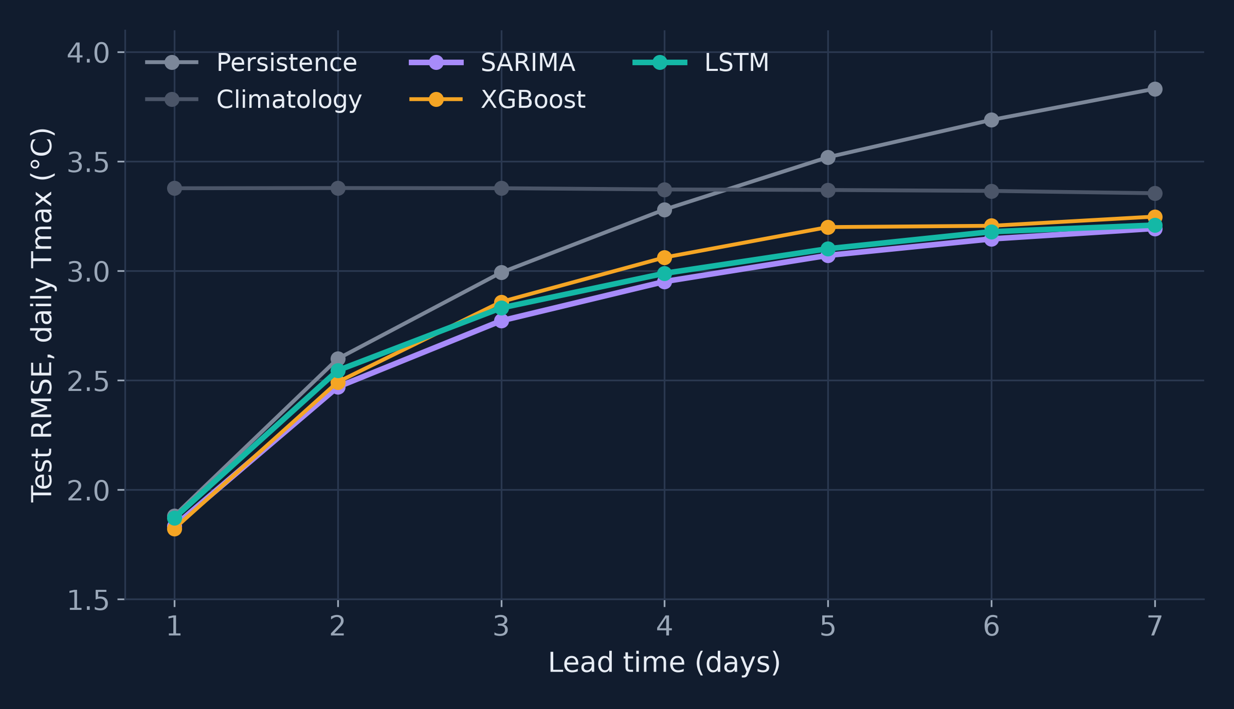
RESULTS · DAILY TMAX (RQ2)
Daily Tmax: SARIMA matches or beats the LSTM at every lead
■ +1 day RMSE: XGBoost 1.822, SARIMA 1.834, LSTM 1.871, persistence 1.881 °C
■ LSTM beats persistence significantly from +3 days (Holm-corrected DM test)
■ Precipitation: LSTM gives small significant gains at 3–7 days; no model forecasts heavy daily rain usefully
Source: results/tables/leaderboard_daily.csv, significance_daily.csv; RESULTS.md (test 2022)
NED UET · CSIT · MS Data Science · Aseef Ahmed (DS-029/2025/26)
21
Notes:
Daily maximum temperature, test year 2022, leads 1 to 7 days. At 1 day the four models are within 0.06 degrees: XGBoost 1.822, SARIMA 1.834, LSTM 1.871, persistence 1.881. The Diebold-Mariano tests with Holm correction show SARIMA significantly better than the LSTM at leads 1 to 3, XGBoost and SARIMA not significantly different at lead 1, and the LSTM significantly better than persistence from lead 3 onward. For daily precipitation, the LSTM gives small but significant gains over SARIMA and XGBoost at 3 to 7 days, but NSE stays near zero: no model forecasts heavy daily rain usefully. So for RQ2 the honest answer on daily Tmax is no - SARIMA is as good as or better than the LSTM at every lead.

Slide 22
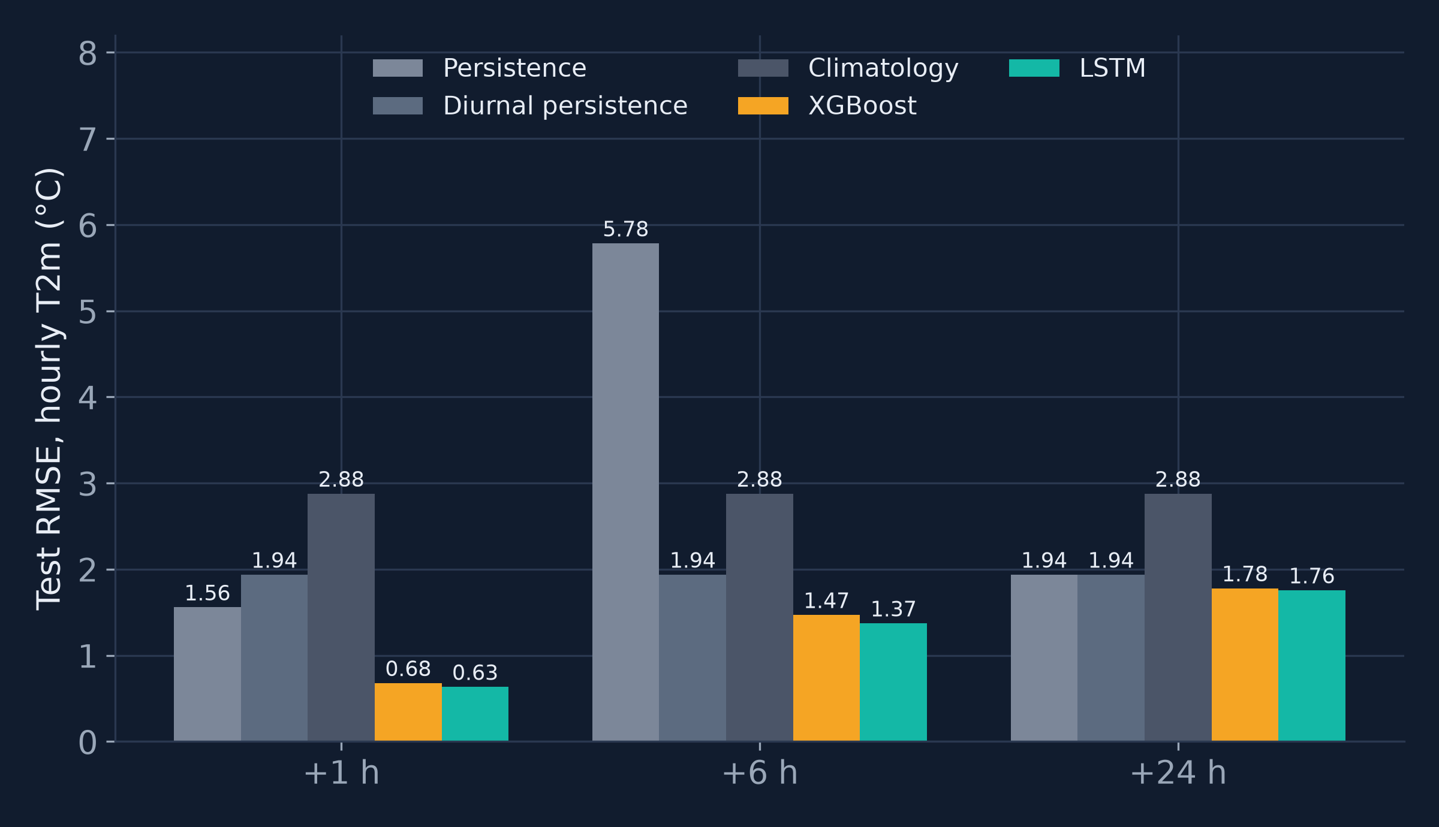
RESULTS · HOURLY T2M (RQ2)
Hourly LSTM beats XGBoost and persistence for temperature at every lead
0.634 °C
LSTM RMSE at +1 h (XGBoost 0.679, persistence 1.558)
1.372 °C
LSTM RMSE at +6 h (XGBoost 1.469, persistence 5.783)
1.756 °C
LSTM RMSE at +24 h (XGBoost 1.779, persistence 1.938)
Source: results/tables/leaderboard_hourly.csv; RESULTS.md; thesis Ch. 6 RQ2 answer
NED UET · CSIT · MS Data Science · Aseef Ahmed (DS-029/2025/26)
22
Notes:
Hourly 2-metre temperature. Here deep learning clearly helps: the LSTM has RMSE 0.634 degrees at 1 hour against 0.679 for XGBoost and 1.558 for persistence; 1.372 at 6 hours against 1.469 and 5.783; and 1.756 at 24 hours against 1.779 and 1.938 for diurnal persistence. The thesis reports that the LSTM significantly outperformed XGBoost for hourly temperature at all leads. For hourly precipitation the LSTM is marginally better than persistence at 1 hour (0.262 vs 0.278 mm/h) and close to XGBoost at 6 and 24 hours.

Slide 23
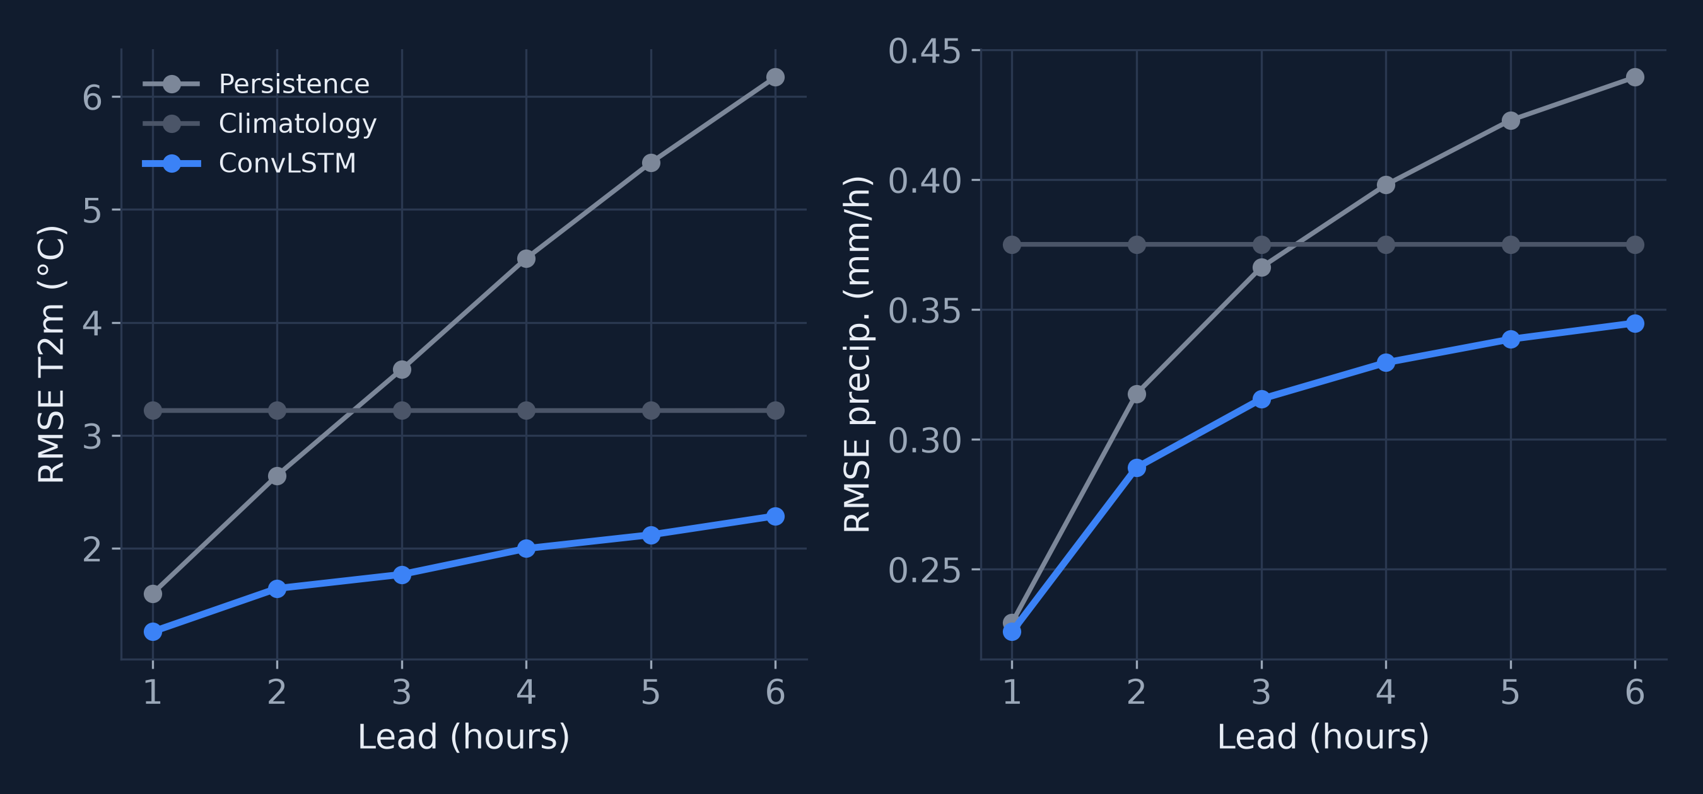
RESULTS · GRIDDED CONVLSTM (RQ2)
ConvLSTM beats persistence and climatology at every lead on the 2° lattice
■ T2m +1 h: 1.262 vs persistence 1.600 °C
■ T2m +6 h: 2.287 vs persistence 6.171 °C
■ Precip. +1 h: 0.226 vs 0.229 mm/h — marginal
■ Caveat: CPU prototype, 2° grid, ~6 epochs, one seed
Source: results/tables/grid_convlstm_test.csv (490,224 samples per lead); DEVIATIONS.md D2
NED UET · CSIT · MS Data Science · Aseef Ahmed (DS-029/2025/26)
23
Notes:
ConvLSTM on the 2 degree ERA5 lattice, test 2022, 490,224 cell-hours per lead. For temperature it beats persistence and climatology at every lead from 1 to 6 hours: 1.262 against 1.600 at 1 hour, and 2.287 against 6.171 at 6 hours. For precipitation it is marginally better than persistence at 1 hour and clearly better from 2 hours. Caveats from DEVIATIONS D2: an earlier 4-epoch model was worse than persistence at short leads; the kept model was retrained with origins every 3 hours and early stopping on 2021 validation loss, best epoch 3, stopped at epoch 6, 625 seconds on 2 vCPUs, one seed, no hyper-parameter search. It is a CPU prototype on a coarse grid.

Slide 24
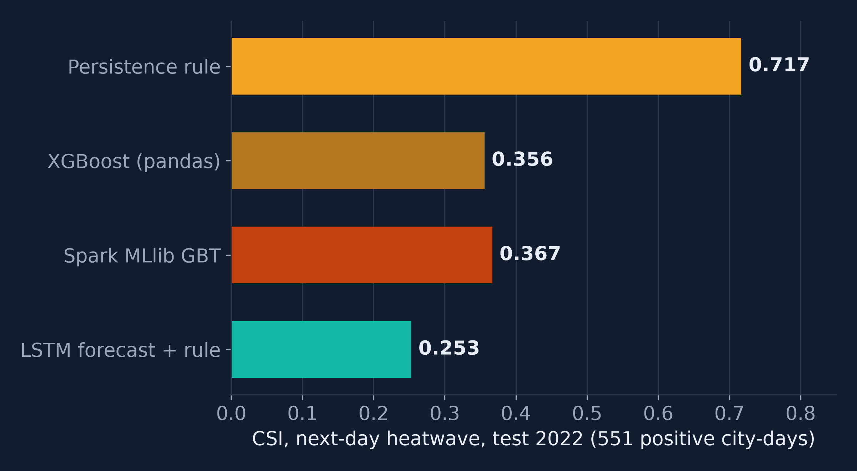
RESULTS · HEATWAVE DETECTION (RQ3)
Persistence detects next-day heatwaves twice as well as XGBoost
■ Persistence CSI 0.717 vs XGBoost 0.356 (ROC-AUC 0.943)
■ Spark MLlib GBT: CSI 0.367 — on par with XGBoost
■ +3 days: XGBoost issues no alerts at thresholds tuned on milder 2021 (CSI 0)
■ Lesson: heatwaves persist — the baseline sets the bar
Source: results/tables/detection_test.csv; results/bigdata/mllib_baseline.json (test 2022, 551 positives of 7,280)
NED UET · CSIT · MS Data Science · Aseef Ahmed (DS-029/2025/26)
24
Notes:
Next-day heatwave detection, 551 positive city-days out of 7,280 in 2022. The persistence rule - tomorrow is a heatwave day if today is - scores CSI 0.717 with POD and FAR of 0.835 and 0.165. The calibrated XGBoost classifier has excellent ranking (ROC-AUC 0.943, PR-AUC 0.589) but CSI only 0.356 at its 2021-tuned threshold. The LSTM forecast plus rule scores 0.253. The Spark MLlib GBT classifier on YARN reaches CSI 0.367. At 3 days, persistence drops to 0.348 and XGBoost issues no alerts at the threshold tuned on the milder 2021 season. I report this plainly: the threshold transfer from 2021 to an exceptional 2022 failed. Heatwaves are persistent, as the 2015 MoCC report emphasised, so persistence is the bar any learned detector must clear.

Slide 25
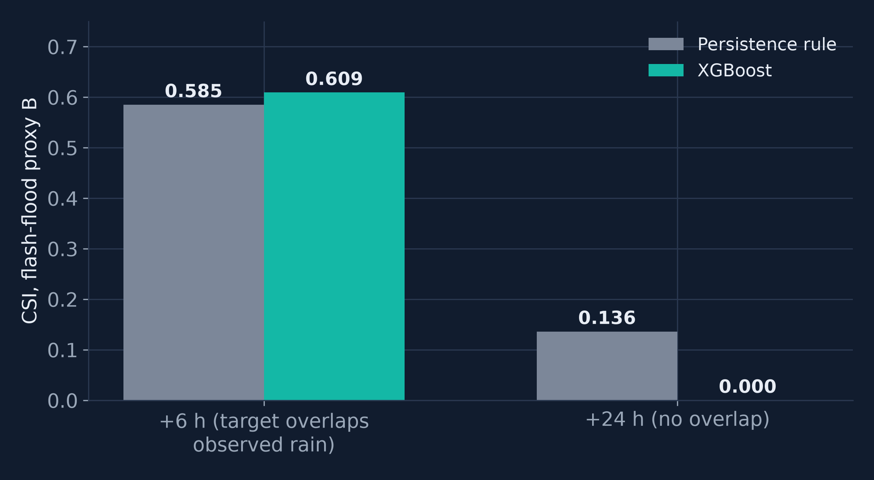
RESULTS · FLASH-FLOOD PROXY (RQ3)
The flood proxy +6 h CSI of 0.609 is an upper bound and not a forecast
■ +6 h: XGBoost CSI 0.609 vs persistence 0.585; PR-AUC 0.814
■ Window overlap: target shares 18 of 24 h with rain already observed
■ +24 h (honest forecast): CSI 0 at tuned threshold; ROC-AUC 0.939
■ Labels are rainfall proxies, not observed floods
Source: results/tables/detection_test.csv (405 positive windows in 2022); DEVIATIONS.md D1
NED UET · CSIT · MS Data Science · Aseef Ahmed (DS-029/2025/26)
25
Notes:
Flash-flood risk proxy B, 405 positive 6-hour windows in 2022. At 6 hours XGBoost scores CSI 0.609 against 0.585 for persistence, with PR-AUC 0.814 and ROC-AUC 0.984. But I must qualify this: the 6-hour target is a trailing 24-hour rain sum that shares 18 of its 24 hours with a feature available at issue time, so the detector largely recognises rain that has already fallen. It is an upper bound - nowcast or detection with overlap. The 24-hour detector, whose target window does not overlap the features, scores CSI 0 at the tuned threshold, with PR-AUC 0.216 and ROC-AUC 0.939. That is the honest forecast number. And these are rainfall-extreme proxies, never flood detection accuracy.

Slide 26
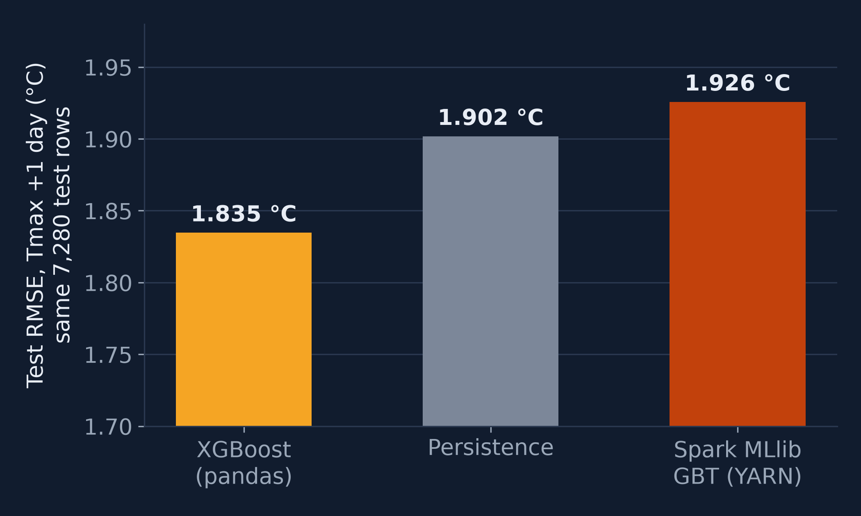
RESULTS · SPARK MLLIB ON YARN
Spark MLlib matches XGBoost for heatwave detection but not for Tmax regression
1.926 °C
MLlib GBT Tmax +1 d RMSE: XGBoost 1.835, persistence 1.902
CSI 0.367
MLlib GBT heatwave +1 d (XGBoost 0.356, persistence 0.717)
AUC 0.947
ROC-AUC; PR-AUC 0.618; threshold 0.15 tuned on 2021
Source: results/bigdata/mllib_baseline.json (YARN application_1792965347508_0004, seed 42; same 7,280 test rows)
NED UET · CSIT · MS Data Science · Aseef Ahmed (DS-029/2025/26)
26
Notes:
Spark MLlib on YARN, trained on the HDFS gold table with the same 2015-2020 / 2021 / 2022 split, seed 42. The GBT regressor for next-day Tmax reaches RMSE 1.926 degrees, worse than XGBoost on exactly the same 7,280 test rows (1.835) and worse than persistence on those rows (1.902) - so MLlib does not beat persistence for regression. (The thesis XGBoost figure of 1.822 uses a slightly different row set; 1.835 is the like-for-like comparison.) The GBT classifier for next-day heatwaves gets ROC-AUC 0.947, PR-AUC 0.618, and CSI 0.367 at a threshold of 0.15 tuned on 2021 - on par with XGBoost's 0.356, still far below persistence. Fit times 156.4 s and 71.7 s. Single seed. The point is that the Spark ML path reproduces the qualitative finding on real Big Data infrastructure, not that it improves skill.

Slide 27
06
Streaming
Streaming is fast enough for warnings and lost nothing under failure — on one node.
SECTION
NED UET · CSIT · MS Data Science · Aseef Ahmed (DS-029/2025/26)
27
Notes:
Section 6: streaming. Two runtimes: the local fallback runtime that produced the thesis numbers, and the new Kafka to Spark Structured Streaming runtime on YARN.

Slide 28
STREAMING · LOCAL RUNTIME (THESIS RESULTS)
The local stream processed a six-month season with zero lost alerts
87,840
210.5 /s
2.37 s
events replayed: Apr–Sep 2022, 20 cities, hourly
events per second sustained (183 daily batches)
p95 to process one day of data for all 20 cities
6 fault modes · 0 crashes
0 lost · 0 duplicate
duplicate, corrupt, out-of-order, delayed, missing, outage; 0 duplicate alerts
alerts after kill-and-restart (restored from checkpoint)
Source: results/streaming_local.json (runtime: local fallback, in-process queue + StreamProcessor); thesis RQ3 answer
NED UET · CSIT · MS Data Science · Aseef Ahmed (DS-029/2025/26)
28
Notes:
The thesis streaming results come from the local fallback runtime, the same StreamProcessor used by the Kafka consumer and Spark foreachBatch. Replaying April to September 2022 for 20 cities, 87,840 events in 183 daily batches, it sustained 210.5 events per second, about 37,900 times faster than real time, with p95 batch time 2.37 seconds per day of data. Six injected fault types - duplicates, corrupt records, out-of-order, delayed beyond watermark, missing data and an outage - caused no crash and no duplicate alerts; bad records went to the dead-letter queue. After a kill-and-restart, restored from batch 15 after being killed at batch 18, alerts were equal to the uninterrupted run: 0 lost and 0 duplicated.

Slide 29
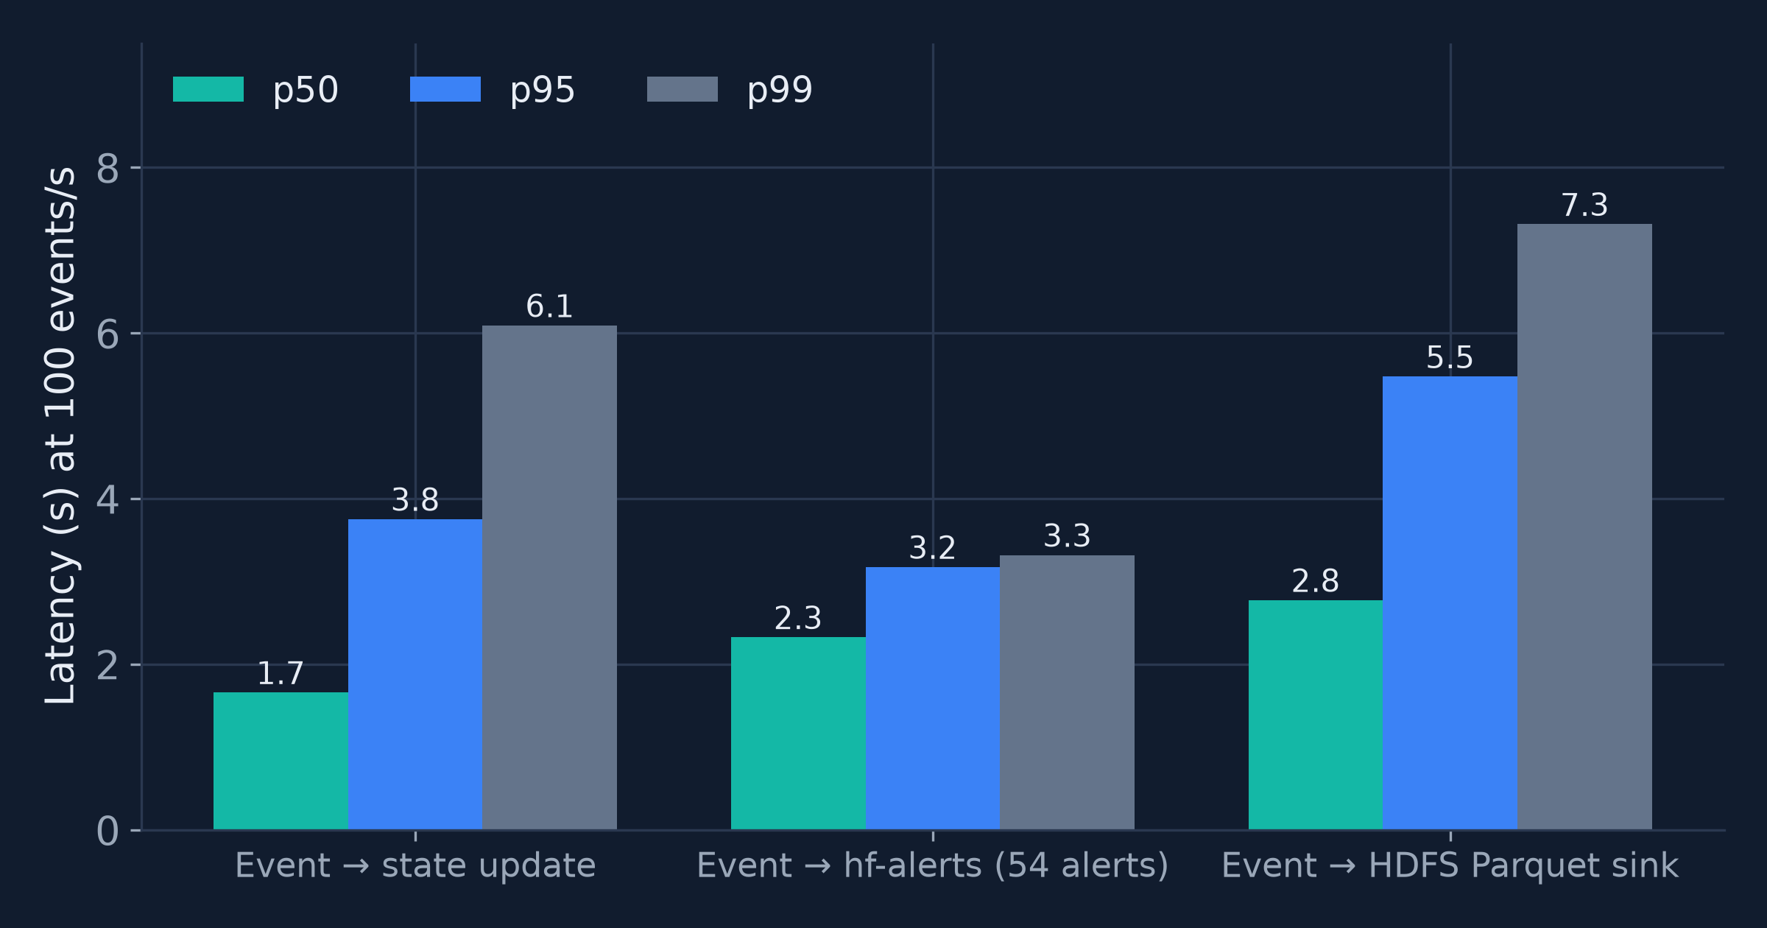
STREAMING · KAFKA → SPARK ON YARN
Kafka to Spark processed 2,739 events per second with a 5.5 s p95 to HDFS
2,739 /s
processing rate on a 58,560-event backlog (3 micro-batches)
5.5 s
p95 event → HDFS Parquet at 100 events/s (p50 2.8 s)
3.2 s
p95 event → Kafka hf-alerts (54 alerts)
Source: results/bigdata/streaming_kafka_spark.json (YARN apps _0005, _0006); single-node pseudo-distributed cluster
NED UET · CSIT · MS Data Science · Aseef Ahmed (DS-029/2025/26)
29
Notes:
Kafka to Spark Structured Streaming on YARN. Throughput test: 58,560 events from April to July 2022 were pre-loaded into hf-obs; Spark processed them in 3 micro-batches at 2,738.8 events per second by Spark's trigger-execution time, or 1,344 events per second including YARN start-up. Latency test: a producer at a steady 100 events per second with a 1-second trigger. Event to HDFS Parquet sink p50 2.8 s, p95 5.5 s, p99 7.3 s; event to state update p95 3.8 s; the 54 alerts reached the Kafka hf-alerts topic with p95 3.2 s. These are single-node pseudo-distributed figures: they show the pipeline works end-to-end on real Kafka and Spark, not how it scales across nodes.

Slide 30
STREAMING · FAULT TOLERANCE
Killing the Spark driver lost and duplicated nothing in the HDFS sink
21,600 / 21,600
0 · 0
212 = 212
Kafka events = HDFS sink rows (distinct offsets)
missing offsets · duplicate rows in Parquet sink
alerts identical to offline reference; features max |diff| 0.0
0 s
45 s
+43 s
+34.9 s
250 events/s
SIGKILL driver
restart from HDFS checkpoint
drain backlog
Kafka alert topic is at-least-once: 254 messages, 42 replayed from the in-flight batch — consumers must de-duplicate by event id.
Source: results/bigdata/streaming_kafka_spark.json → kill_restart (YARN apps _0007 → _0008)
NED UET · CSIT · MS Data Science · Aseef Ahmed (DS-029/2025/26)
30
Notes:
Kill-and-restart on the real stack. A producer sent 21,600 events at 250 per second; after 45 seconds I SIGKILLed the Spark driver, restarted it 43 seconds later from the HDFS checkpoint, and it drained the backlog in 34.9 seconds. Result: Kafka end offsets total 21,600; the HDFS Parquet sink has 21,600 rows and 21,600 distinct partition-offset pairs, 0 missing and 0 duplicates - exactly-once for the Parquet sink. Streaming state equals an offline reference: rolling features have max absolute difference 0.0 and the 212 alerts are identical. The Kafka alert topic is at-least-once: it holds 254 messages, 42 of them replayed from the batch in flight at the crash, so downstream consumers must de-duplicate by event id. An analysis-script bug (timestamp dtype merge) was fixed and re-analysed on the stored HDFS outputs; the job itself was not re-run - documented in RUN_LOG.md.

Slide 31
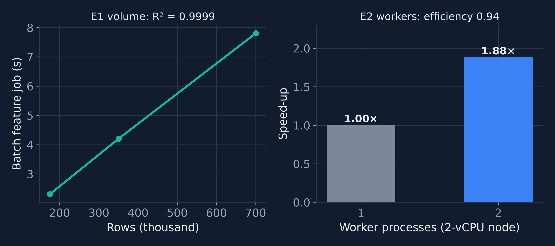
SCALABILITY (RQ4)
Batch feature cost scales linearly with volume on one node
■ E1 volume: linear, R² = 0.9999 over a 4× increase
■ E2 workers: speed-up 1.88 with 2 processes (efficiency 0.94)
■ Not shown: scaling across nodes — needs a multi-node cluster
Source: results/scalability_local.json (2-vCPU node, process-level); thesis RQ4 answer
NED UET · CSIT · MS Data Science · Aseef Ahmed (DS-029/2025/26)
31
Notes:
Scalability on the 2-core development machine. E1: the batch feature job time is linear in data volume, R-squared 0.9999 over a 4-fold increase from 175,200 to 700,800 rows. E2: 2 worker processes give a speed-up of 1.88, efficiency 0.94. Larger micro-batches raised streaming throughput almost proportionally at nearly constant batch latency. RQ4's honest answer is: yes on a single node; not yet demonstrated on a cluster. The machine was shared during measurement, and these results establish the scalability of the code path, not of a multi-node deployment.

Slide 32
07
Limitations, conclusions and future work
What the evidence supports, what it does not, and what comes next.
SECTION
NED UET · CSIT · MS Data Science · Aseef Ahmed (DS-029/2025/26)
32
Notes:
Section 7: limitations, answers to the research questions, contributions and future work.

Slide 33
LIMITATIONS
Six limitations bound every claim in this thesis
PMD station data unavailable
Proxy flood labels
All results use ERA5 reanalysis; the PMD adapter was tested only on synthetic files.
Rainfall-extreme proxies, not observed floods; +6 h target overlaps observed rain.
Single seed for some analyses
One exceptional test year
ConvLSTM, XGBoost and MLlib use one seed; only the daily LSTM has three seeds.
2022 only; percentile thresholds from six training years (2015–2020).
Single-node pseudo-distributed cluster
No NWP comparison
No multi-node scaling or cross-machine fault tolerance measured.
No archived 2022 NWP forecasts; short CPU training of neural networks.
Source: Thesis Ch. 5 threats to validity and Ch. 6 limitations; DEVIATIONS.md D1–D8; thesis Table 'Daily LSTM over three random seeds'
NED UET · CSIT · MS Data Science · Aseef Ahmed (DS-029/2025/26)
33
Notes:
Limitations. First, PMD station data was not available, so every number is ERA5 reanalysis; gap G3 is not closed. Second, flood labels are rainfall proxies, and the 6-hour target overlaps observed rain. Third, several analyses use a single seed - the ConvLSTM, XGBoost and the MLlib models with seed 42; only the daily LSTM was repeated over three seeds (42, 7, 2024), with Tmax RMSE 1.854 plus-minus 0.015 at 1 day. Fourth, one exceptional test year, with thresholds from six training years rather than a 30-year baseline. Fifth, the Big Data stack is a single-node pseudo-distributed cluster. Sixth, no NWP comparison, because no archived 2022 NWP forecasts were retrieved, and the neural networks were small and CPU-trained.

Slide 34
ANSWERS TO THE RESEARCH QUESTIONS
Each research question gets a qualified answer backed by evidence
RQ | Answer | Key evidence
RQ1 | Strong baselines + LSTM/ConvLSTM; streaming Big Data rarely coupled to detectors | 99-study review; gaps G1–G6
RQ2 | Partly: yes for hourly and gridded temperature; no for daily Tmax | LSTM 0.634 vs XGB 0.679 °C (+1 h); SARIMA ≥ LSTM daily
RQ3 | Partly: timely and robust; skill limited and hazard-dependent | Persistence CSI 0.717 > XGB 0.356; flood +6 h 0.609 (upper bound)
RQ4 | Yes on a single node; not yet shown on a multi-node cluster | R² 0.9999; 2,739 ev/s; 21,600/21,600 after kill
Source: Thesis Ch. 6 'Answers to the Research Questions'; results/*.json; results/bigdata/*.json
NED UET · CSIT · MS Data Science · Aseef Ahmed (DS-029/2025/26)
34
Notes:
Direct answers. RQ1: the state of the art combines strong statistical and tree-based baselines with recurrent and convolutional-recurrent networks and emerging global data-driven models; streaming Big Data infrastructure is rarely coupled to detection. RQ2: partly - the LSTM significantly beat XGBoost for hourly temperature, the ConvLSTM beat persistence and climatology on the lattice, but SARIMA was as good or better for daily Tmax, and NWP and PMD comparisons could not be done. RQ3: partly - the infrastructure meets timeliness and robustness requirements, but persistence is the best next-day heatwave detector and the flood score is an upper bound. RQ4: yes on a single node, now including a real single-node pseudo-distributed Hadoop, Spark and Kafka run; multi-node scaling is not demonstrated.

Slide 35
CONTRIBUTIONS
Five contributions that others can reuse and verify
1
An end-to-end open-source pipeline coupling streaming ingestion to trained heatwave and flash-flood-risk detectors (G1, G4).
2
Latency, throughput and fault tolerance reported next to RMSE and CSI (G2).
3
An honest benchmark against persistence, climatology, SARIMA and XGBoost with Holm-corrected significance tests.
4
Spark ETL parity (8/8 tables) and exactly-once HDFS sink verified on a single-node Hadoop/YARN/Spark/Kafka stack.
5
Public, reproducible artefacts: tagged GitHub release with CI and tests, plus a live site refreshed every 6 hours.
Source: Thesis Ch. 6 contributions; github.com/SirAseef/heatflood-sentinel (release v0.1.0); results/bigdata/RUN_LOG.md
NED UET · CSIT · MS Data Science · Aseef Ahmed (DS-029/2025/26)
35
Notes:
Contributions. One: an open-source pipeline that couples streaming ingestion to trained detectors for both hazards - addressing G1 and G4. Two: timeliness and fault-tolerance metrics reported alongside skill - G2. Three: an honest benchmark against strong baselines with paired significance tests, including the negative results. Four: the new Big Data evidence - Spark ETL parity on all 8 tables and an exactly-once HDFS sink after a driver kill, on a single-node pseudo-distributed cluster. Five: reproducible public artefacts - the GitHub repository with release v0.1.0, CI and tests, and a GitHub Pages site whose live snapshot regenerates every 6 hours. Note: the Big Data path in the repository is newer than release v0.1.0.

Slide 36
FUTURE WORK
Next steps close the gaps this thesis could not
Ground truth
1990–2026 record
Extreme-aware learning
Validate against PMD stations; replace proxies with NDMA/PDMA flood-event records.
Finish the download, rebuild the lake on HDFS and retrain on the full period.
Quantile or extreme-value losses; recalibrate seasonal, POD-constrained thresholds.
NWP and global models
Multi-node cluster
More architectures and hazards
Benchmark archived NWP, GraphCast and Pangu-Weather for Pakistan (G5).
Run multi-broker Kafka and multi-worker Spark; test node-failure tolerance.
Attention and graph models; drought and cold waves.
Source: Thesis Ch. 6 future work; DEVIATIONS.md D8 (data extension status)
NED UET · CSIT · MS Data Science · Aseef Ahmed (DS-029/2025/26)
36
Notes:
Future work, from Chapter 6 plus the data extension. Ground truth: PMD station validation and flood labels from NDMA/PDMA and disaster databases. The 1990-2026 record: the download is in progress; once complete, re-run the HDFS load and the Spark lake ETL and retrain - the partial lake run already showed that pooling the 1990s into the climatology lowers p95 thresholds and raises heatwave label counts from 593/261/551 to 1068/329/686, so thresholds must be refitted. Extreme-aware losses and seasonal recalibration of thresholds; NWP and global-model benchmarks; multi-node Kafka and Spark with node-failure tests; and attention or graph models and further hazards.

Slide 37


CONCLUSION
I request approval of the thesis as a reproducible and honestly bounded early-warning baseline for Pakistan
■ Deep learning helps for hourly and gridded temperature
■ Persistence remains the bar for next-day heatwaves
■ Streaming is timely and lossless on a single-node pseudo-distributed cluster
■ Next: PMD ground truth, 1990–2026 record, multi-node cluster
Live site
Code repository
siraseef.github.io/heatflood-sentinel
github.com/SirAseef/heatflood-sentinel
Defence date: [PLACEHOLDER]
Examiners: [PLACEHOLDER]
Thank you — I welcome the committee's questions.
NED UET · CSIT · MS Data Science · Aseef Ahmed (DS-029/2025/26)
37
Notes:
To conclude: deep learning helps where the signal is smooth and spatial - hourly and gridded temperature - but persistence remains the bar for next-day heatwaves, and the flood score is an upper bound on proxy labels. The streaming path is timely and lost nothing under failure on a single-node pseudo-distributed cluster. I request approval of the thesis as a reproducible, honestly bounded baseline. The QR codes open the live site, https://siraseef.github.io/heatflood-sentinel/, and the repository, https://github.com/SirAseef/heatflood-sentinel. Thank you; I welcome your questions.

Slide 38
B
Backup slides
Full tables for questions: forecasting leaderboards, detection metrics and fault-injection results.
SECTION
NED UET · CSIT · MS Data Science · Aseef Ahmed (DS-029/2025/26)
38
Notes:
Backup slides for questions.

Slide 39
BACKUP · DAILY LEADERBOARDS
Daily Tmax and precipitation RMSE by model and lead in 2022
Model | Tmax +1 d | Tmax +3 d | Tmax +7 d | Precip. +1 d | Precip. +3 d | Precip. +7 d
Persistence | 1.881 | 2.992 | 3.832 | 6.346 | 7.566 | 7.642
Climatology | 3.377 | 3.378 | 3.355 | 5.841 | 5.840 | 5.652
SARIMA | 1.834 | 2.772 | 3.194 | 5.656 | 5.996 | 5.809
XGBoost | 1.822 | 2.859 | 3.248 | 5.697 | 5.994 | 5.827
LSTM | 1.871 | 2.831 | 3.209 | 5.677 | 5.946 | 5.756
RMSE in °C (Tmax) and mm (precipitation); best per column in green. Test year 2022, 20 cities.
Source: results/tables/leaderboard_daily.csv; RESULTS.md
NED UET · CSIT · MS Data Science · Aseef Ahmed (DS-029/2025/26)
39
Notes:
Backup: daily leaderboards. Best per column in green. Note climatology is best for daily precipitation at 3 and 7 days - another sign that daily rain is barely predictable from these inputs. Full 1-7 day tables are in the thesis Chapter 5.

Slide 40
BACKUP · DETECTION METRICS
Full detection metrics for both hazards on the 2022 test year
Hazard · lead | Model | CSI | POD | FAR | F1 | ROC-AUC | PR-AUC
Heatwave · 1d | Persistence rule | 0.717 | 0.835 | 0.165 | 0.835 | — | —
Heatwave · 1d | LSTM forecast + rule | 0.253 | 0.258 | 0.066 | 0.404 | — | —
Heatwave · 1d | XGBoost | 0.356 | 0.407 | 0.261 | 0.525 | 0.943 | 0.589
Heatwave · 3d | Persistence rule | 0.348 | 0.517 | 0.485 | 0.516 | — | —
Heatwave · 3d | LSTM forecast + rule | 0.007 | 0.007 | 0.000 | 0.014 | — | —
Heatwave · 3d | XGBoost | 0.000 | 0.000 | — | 0.000 | 0.814 | 0.209
Flash flood · 6h | Persistence rule | 0.585 | 0.738 | 0.262 | 0.738 | — | —
Flash flood · 6h | XGBoost | 0.609 | 0.723 | 0.206 | 0.757 | 0.984 | 0.814
Flash flood · 24h | Persistence rule | 0.136 | 0.240 | 0.760 | 0.240 | — | —
Flash flood · 24h | XGBoost | 0.000 | 0.000 | — | 0.000 | 0.939 | 0.216
Heatwave · 1d | Spark MLlib GBT | 0.367 | 0.443 | 0.317 | 0.537 | 0.947 | 0.618
Source: results/tables/detection_test.csv; results/bigdata/mllib_baseline.json; FAR '—' = no alerts issued
NED UET · CSIT · MS Data Science · Aseef Ahmed (DS-029/2025/26)
40
Notes:
Backup: full detection metrics. FAR is undefined where the model issued no alerts. Heatwave positives 551 (1 d) and 549 (3 d); flash-flood proxy positives 405. Thresholds were tuned on 2021: XGBoost heatwave 0.325 at 1 d and 0.15 at 3 d; flood 0.2; MLlib 0.15.

Slide 41
BACKUP · FAULT INJECTION
Six injected fault types caused no crash and no duplicate alerts
Fault mode | Messages in | Dead-letter (reason) | Alerts vs baseline | Crashed | Duplicate alerts
Duplicate messages | 15,213 | 333 duplicate | 384 (+0) | No | 0
Corrupt records | 14,880 | 333 schema/range | 383 (-1) | No | 0
Out-of-order | 14,880 | 0 | 384 (+0) | No | 0
Delayed beyond watermark | 14,846 | 299 late beyond watermark | 383 (-1) | No | 0
Missing data | 14,880 | 0 | 383 (-1) | No | 0
Source outage | 13,440 | 0 | 342 (-42) | No | 0
Baseline window: 384 alerts. Kill-and-restart: killed after batch 18, restored from batch 15, 0 lost and 0 duplicate alerts.
Source: results/streaming_local.json → chaos (31-batch window, local runtime)
NED UET · CSIT · MS Data Science · Aseef Ahmed (DS-029/2025/26)
41
Notes:
Backup: fault injection on the local runtime over a 31-batch window. Duplicates and corrupt records go to the dead-letter queue; out-of-order data is reordered with identical alerts; delayed-beyond-watermark data is dead-lettered and can drop one alert; a source outage reduces alerts because data is missing. In no mode did the processor crash or emit a duplicate alert.

