Slide 1


Slide 2
Major Changes
The event is now only open to SHS students.
80 (45/35 Grade 11 and 12 --)
Licensing status
New date: MARCH 16, FRIDAY
CPA
Technical rehearsal (whole day) on March 15, Thursday

Slide 3
Event Management
On-the-day program and event flow

Slide 4
Communications, Editorial, Marketing
Descriptions and captions for the following:
Uprising (describing what it is)
Uprising Facebook Page
Invitation Letter
DP Blast
Beginning drafts of on-the-day scripts for hosts
Proposed list of event hosts (2 needed)

Slide 5
Sponsorships and Budgets
Budget plan
List of potential sponsors

Slide 6
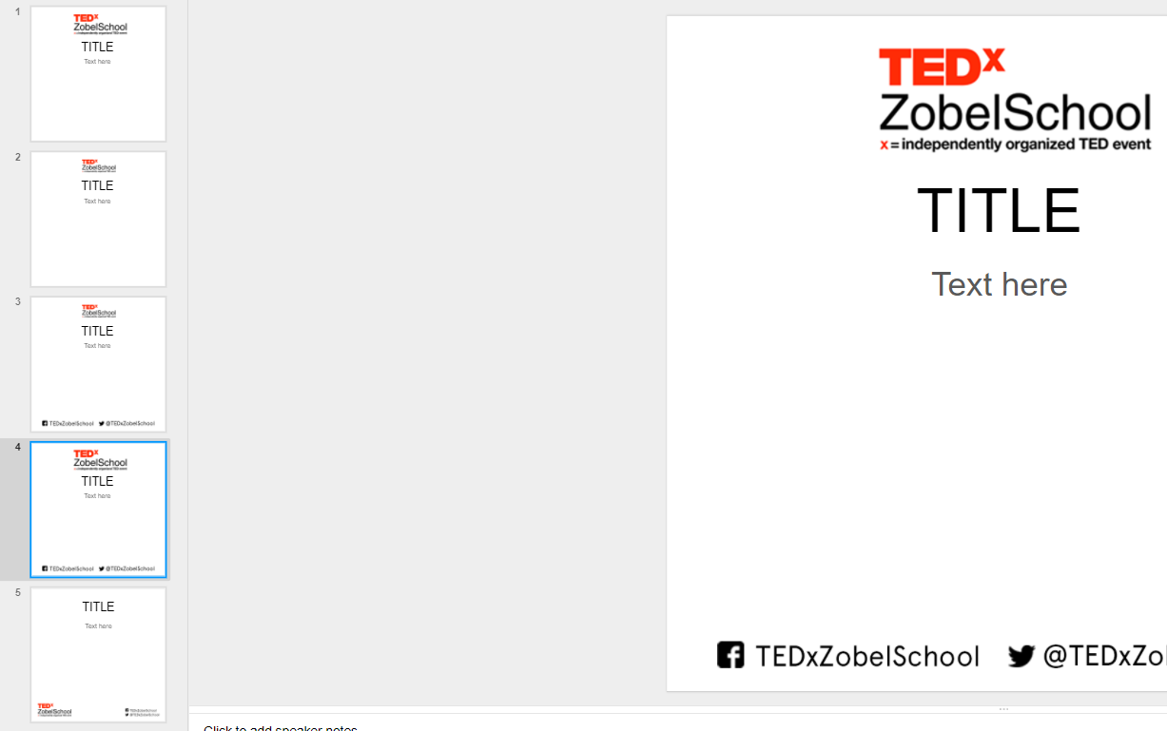


Designers

Slide 8
Curators
Speaker Nomination Form
Speaker Invitation Email
Tentative List of Proposed Speakers

