Slide 1
Formal Technical Review
Project Title : Food Delivery System
Project Guide : S. Rathi
Group Members : 1) Harshal Solanki
2) Ajaybir Singh
3)Udit Warikoo
4)Ashish Arora

Slide 2
Abstract
With popular and increasing use of various mobile operating systems like android and iOS, applications in these sectors are getting more significance than ever.
Corporate people are getting busier and this has led to increase in the demand for ordering and doorstep delivery of home cooked food.
Also the increase in demand and competition amongst restaurants to achieve full customer satisfaction has created a craze among the customers for trying out new food & offers.
Therefore people use various applications for ordering food.

Slide 3
Abstract
People who cannot cook mostly eat at a mess or order food some hotel. But eating hotel/restaurant food everyday is neither pocket friendly nor is it healthy.
Therefore our aim is create a platform where people can order hygienic home cooked food. This food is made by trained people.
In the this application our aim is to create a platform which provides the facility to order food from various sources and it also provides an efficient routing algorithm for delivery of these food items.

Slide 4
Introduction
Nowadays, most people order food on line as it saves a lot of time and it is very convenient Ordering food on line has become a norm nowadays. But lately, people have become more health concious and long for home cooked food. People, especially corporate employees, do not have the time to cook food themselves. Consuming outside food on a daily basis is not considered to be healthy or hygienic .
This system efficiently manages the delivery of home cooked food to our customers and provides an efficient routing algorithm for the delivery of the food.

Slide 5
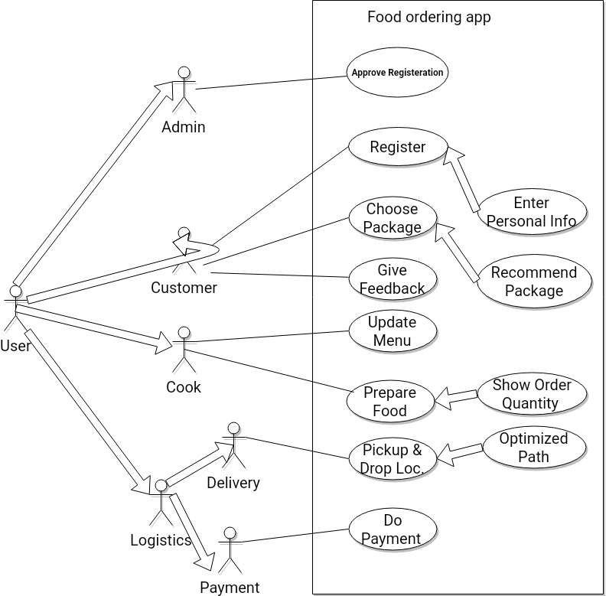
Use Case

Slide 6
Predictive Algorithm from feedback
This model will extract data in 2 ways for prediction
1) Using radio buttons in feedback form and accepting boolean or range values so it can be used as data for training the model in statistical algorithms like
-Linear regression
-Logistic regression
-Classification and Decision trees
-K means clustering
-Learning vector quantization
-Naïve Bayes
-SVM

Slide 7
2) Take input in the form of textual data as comments and apply text classification algorithm on this data.
-Naive Bayes
-Linear classifier
-SVM model
-Bagging model
-Boosting model

Slide 8
Advantages over Existing systems
Touring Optimization
Existing food delivery systems use point A to point B routing(Swiggy), We are going to implement efficient routing algorithm for multiple pickup and delivery points.
To do this. The application needs to have the configuration of:
-Address and exact coordinates of respective points
-Available Vehicles and number of delivery
The user will get a personalized service depending upon his/her dietary requirements
Suggestions based on the previous package selected

Slide 9
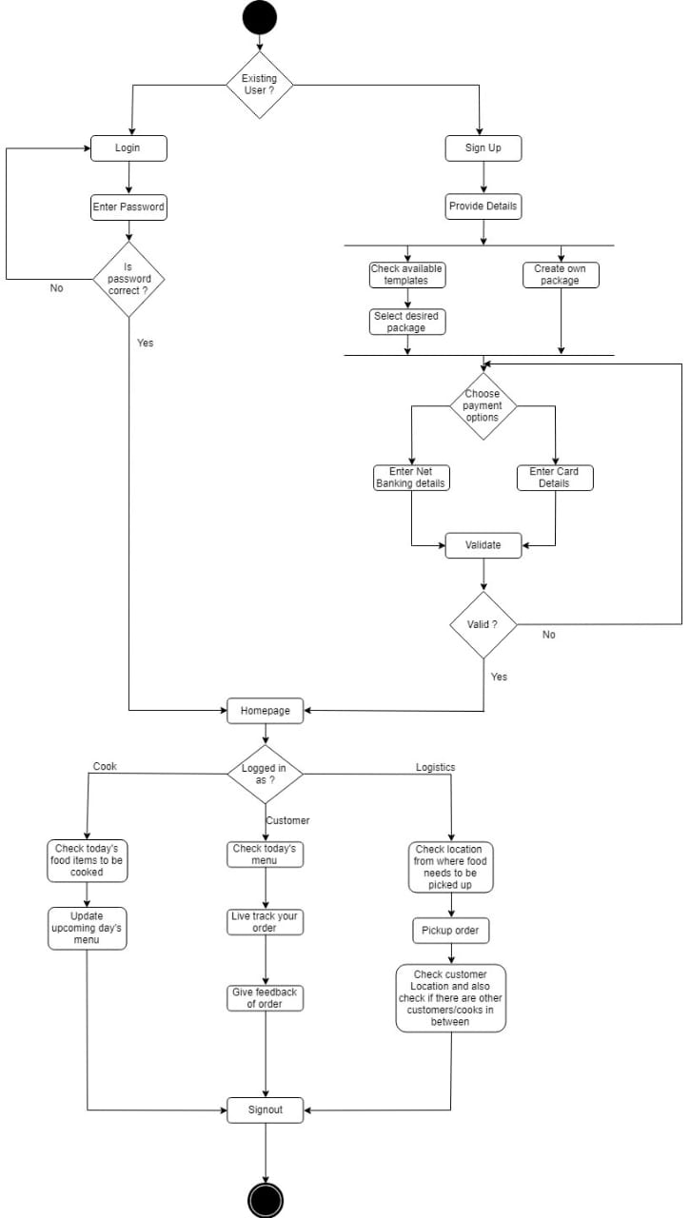
Activity flow

Slide 10
Algorithm ideology to be followed
Heuristic Algorithm for Routing Optimization
It is based on model of undirected weighted graph
Constructive heuristics algorithm uses nearest-neighbor aproach.
We are gonna incorporate priority node in this algorithm as follows:
1)Delivery man at intital point as the current vertex
2)Delivery man travels to nearest pickup node
3)Search next closest drop node and next closest pickup node
4) Compare two distances.
Two cases:
a)Pickup node closer than drop node
Since pickup node is higher priority than drop node proceed to pickup
b)Drop node closer than pickup node
If drop node criteria satisfied by Delivery man then proceed else proceed to pickup node
5)The point where Delivery man moves to is V and it is set as current vertex
6)Mark V as visited
7) Repeat 2-6
8)If all vertices have been visited,stop iteration

Slide 11
Highlights of Our Applications
Customer Registration and Cook registration
Subscription Selection (Base/Personalized)
Generate optimized delivery address routing incorporating pickup points for logistics.
Daily status checking
Feedback for food and delivery
Payment method(Third Party Outsourced)
Customer Care

Slide 12
Feasibility
People who order food on-line on a daily basis are fed up of eating hotel food. This system will provide a platform for people to order home made food on-line As there are very less sources of getting home made food on-line this system would be a promising one.
The admin will have the authority to control the cook registrations to maintain the number of authentic cooks and maintain professionalism.

Slide 13
References
P. Jayasheelan and F. M. M. Jane, "Effective route planning in road networks using multi constraint routing algorithm," 2016 IEEE International Conference on Current Trends in Advanced Computing (ICCTAC), Bangalore, 2016, pp. 1-6.
Digital Ordering System for Restaurant Using Android
Ashutosh Bhargave, Niranjan Jadhav, Apurva Joshi, Prachi Oke, Prof. Mr. S. R Lahane
Department of Computer Engineering,International Journal of Scientific and Research Publications, Volume 3, Issue 4, April 2013 1
ISSN 2250-3153
Shweta Shashikant Tanpure, Priyanka R. Shidankar, Madhura M. Joshi, "Automated Food Ordering System with Real-Time Customer Feedback", International Journal of Advanced Research in Computer Science and Software Engineering, vol. 3, no. 2, February 2013
Kirti Bhandge, Tejas Shinde, Dheeraj Ingale, Neeraj Solanki, Reshma Totare, "A Proposed System for Touchpad Based Food Ordering System Using Android Application", International Journal of Advanced Research in Computer Science & Technology (IJARCST 2015), vol. 3, no. 1, Jan.-Mar. 2015

