Slide 1
A Project on Personalised Food Delivery APP

Slide 2

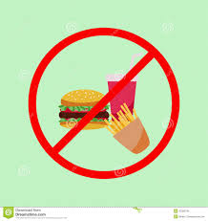
Introduction
Motivation
Problem Definition

Slide 3
Literature Review
Various Types Of Food Ordering Apps
Observations
What are we bringing to the table ?

Slide 4
Our System
Use of Machine Learning
Use of OSRM API
Home-made hygienic food
Customized Package

Slide 5
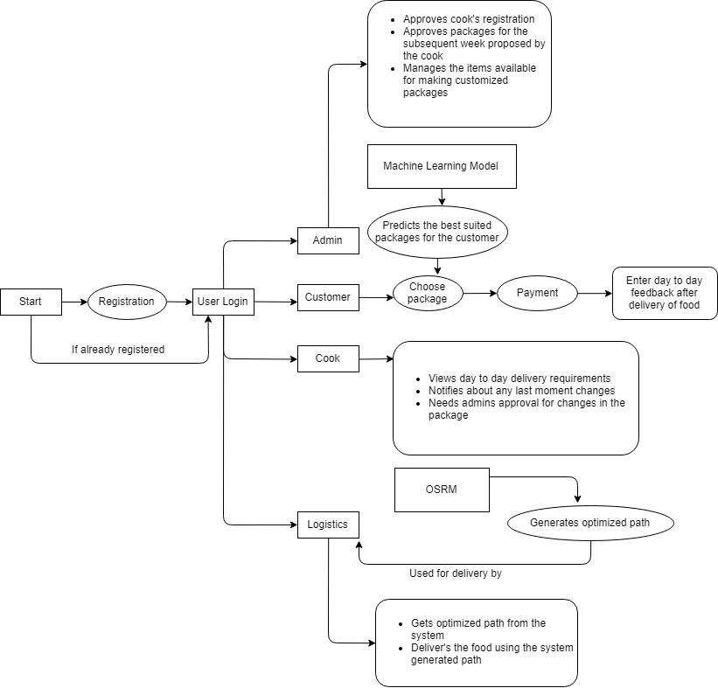
General flow of the system

Slide 6
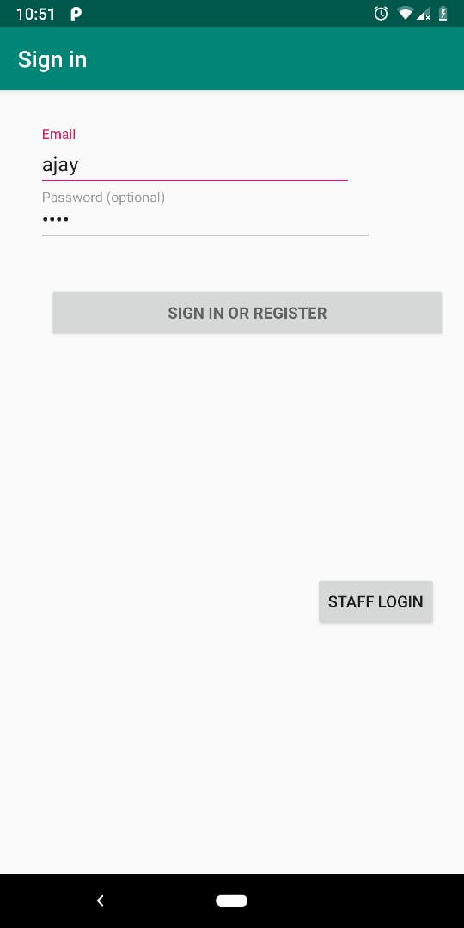
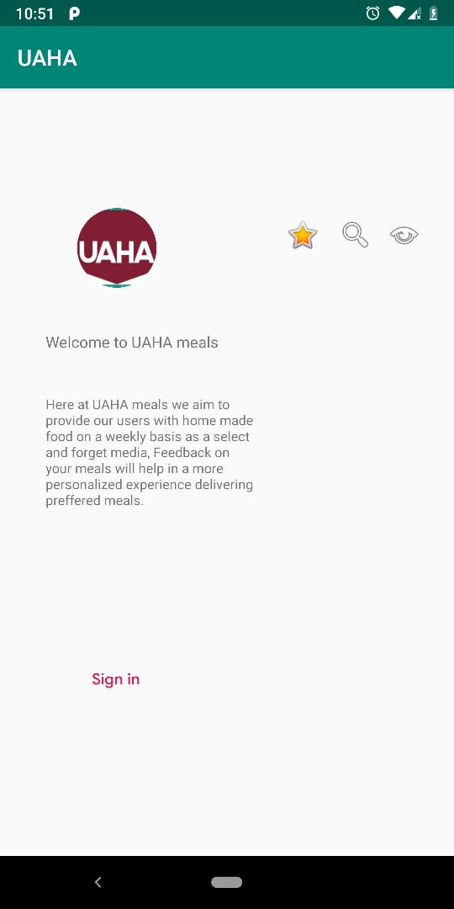
A rough Idea of how the app would look like

Slide 7
Limitations in the Existing System
Provides no suggestion based on the health of the user
No choice of customised package
No such mess-service which provides high-quality continental food
Routing is not so efficient

Slide 8
Advantages of our system
Optimised routing
Health based Package recommendation
Customised package selection

Slide 9
Limitations & Future Scope
Currently the system is developed to provide online food service within the selective areas of Pune.
No IOS support

Slide 10
Q and A

