Slide 1

Virtual Classmates: Embodying Historical Learners' Messages as Learning Companions in a VR Classroom through Comment Mapping
M. -Y. Liao, C. -Y. Sung, H. -C. Wang and W. -C. Lin, 2019 IEEE Conference on Virtual Reality and 3D User Interfaces (VR), pp. 163-171
Maria Cunha (93089)
Sofia Vaz (92968)
Human Computer Interaction
28th April 2021
Notes:
[Sofia]
Include in the 1st slide:
The complete reference of the paper (authors, title, publication, date, pages)
Name, number, and study program of the presenter
Name of the course and date of presentation
Add number to the slides except for first one

Slide 2



OUR CHOICE
Interesting area of study
Especially important right now
A bit weird
Notes:
[Sofia] – Why did we choose this?

Slide 3

REASONING BEHIND STUDY
Self-paced learning is good, but...
Critical to enhance learners' interests, motivation and persistence
Lower social connection
Lower motivation
Isolation
Harder to reach goals
Notes:
[Maria] – Introdução – Why ?

Slide 4
HOW OTHERS TRIED TO SOLVE THIS PROBLEM
Non-VR environments
> Based in Second Life
Synchronous learning
- not self-Paced
VR platforms
> educational games
- no social interaction
Notes:
[Sofia] – Related work (Cap2)

Slide 5
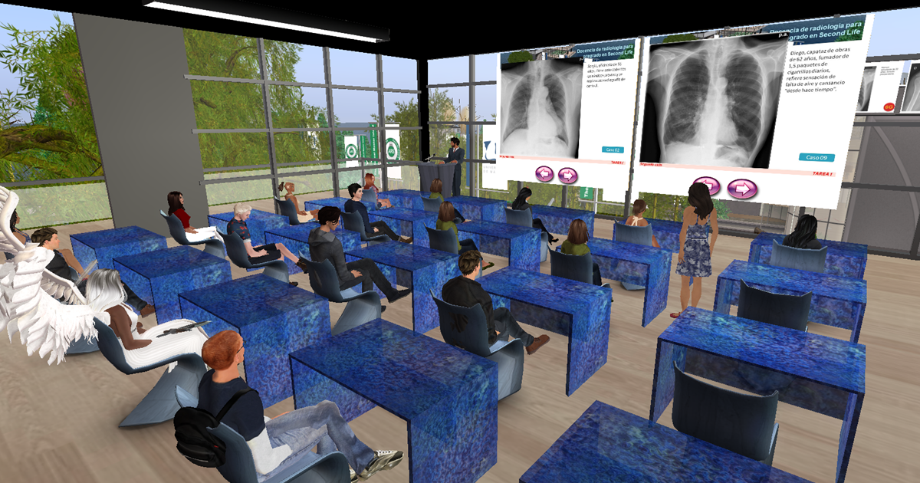
HOW OTHERS TRIED TO SOLVE THIS PROBLEM
- Non-VR environments (Second Life) -
RADIOLOGY EDUCATION GETS SECOND LIFE IN VIRTUAL WORLD
Notes:
[Sofia] – Related work (Cap2)

Slide 6
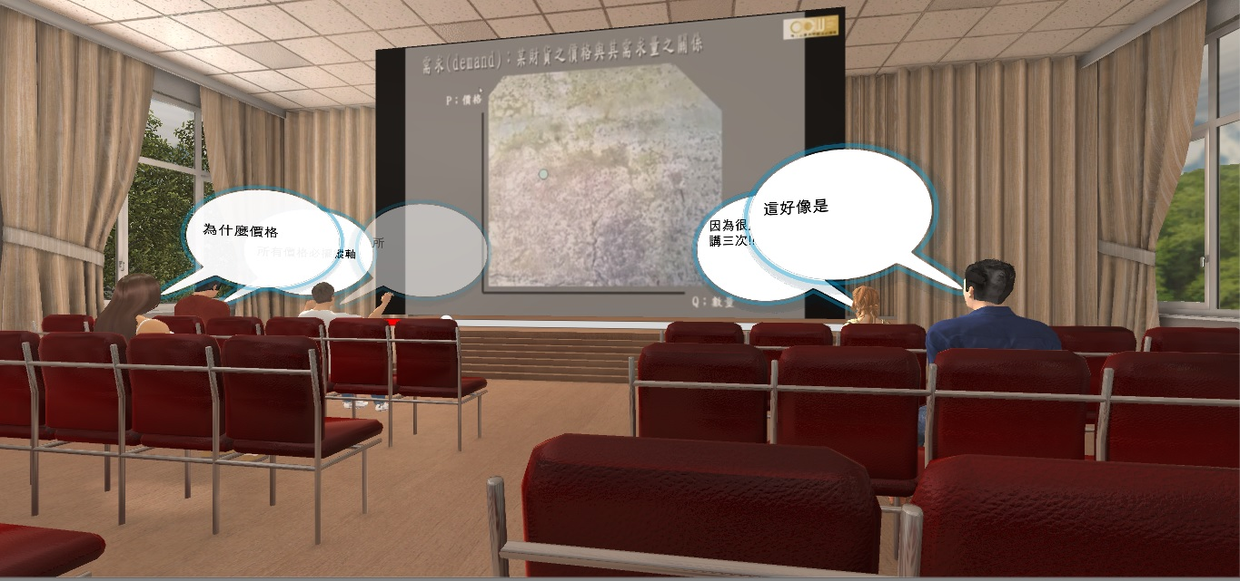
METHOD AND SYSTEM
Virtual classmates
> time anchored comments
What are time anchored comments
Also... you can choose your seat
Notes:
[Maria] – Method and System (Cap3)
Comment Mapping
Motion Mapping

Slide 7
METHOD AND SYSTEM
- COMMENT MAPPING -
Aggregation of comments by category:
GENERAL CONVERSATION
NOTES
OPINION
QUESTION
COMPLAINT
COMPLIMENT
OTHERS
EACH LEARNER Is classified
Similar Learners are mapped to the same virtual classmate
Notes:
[Maria] – Method and System (Cap3)
Comment Mapping
Motion Mapping

Slide 8
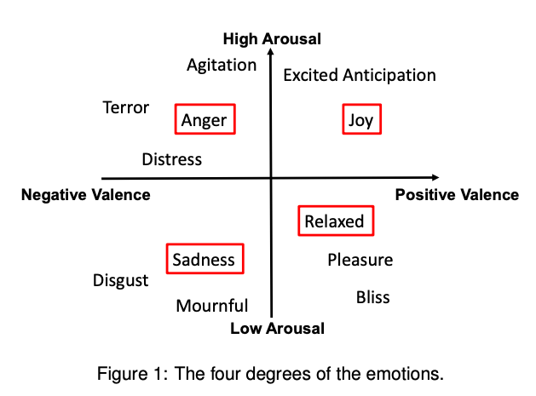
METHOD AND SYSTEM
- motion MAPPING -
CLASSIFICATION of THE comments’ EMOTION by category:
ANGRY
SADNESS
JOY
RELAXED
MAPPED A SUITABLE BEHAVIOR TO EACH COMMENT
Notes:
[Maria] – Method and System (Cap3)
Comment Mapping
Motion Mapping

Slide 9
RESEARCH QUESTIONS
1-Would virtual classmates with comment mapping techniques influence the learning experiences of learners?
2-Whether and how the number of virtual classmates influence the learning experiences of learners?
Notes:
[Sofia] – Research Questions (Cap 4.1)

Slide 10
EXPERIMENTAL FACTORS
C1 | C2 | C3 | C4 | C5
5 virtual classmates | 5 virtual classmates | 20 virtual classmates | 20 virtual classmates | Non-VR environment
With comment mapping | Without comment mapping | With comment mapping | Without comment mapping | Time anchored comments
18 participants | 19 participants | 19 participants | 18 participants | 20 participants
Notes:
[Maria] – Experimental Factors (Cap 4.2)

Slide 11
MEASURES
Learning outcomes
Post test – pre test
"what is a normal good?"
"After the increase in income, what changes do we usually make to the consumption of normal, neutral, and inferior good?"
Interview
Supplement survey data
User experience
Survey
14 questions
Scale of 1-5
Used to measure social and attitudinal influences
Notes:
[Sofia] – Measures (Cap 4.5)

Slide 12
PARTICIPANTS AND PROCEDURE
100 participants - 54 females aged 18-35 (mean=22.7)
All the participants had prior experience with asynchronous online learning (Coursera, Udemy,…)
93% scored less than 50/100 in the pretest
Introduction of experiment procedure
Pretest
Explanation of system interface
Help with setting up headset
Oculus Rift DK2 with 960 x 1080 resolution per eye and 72Hz refresh rate + PC with microsoft windows 10 operating system, Intel Core i7-6700K processor, 32GB RAM and NVIDIA GEFORCE GTX 1070
Notes:
[Sofia]

Slide 13
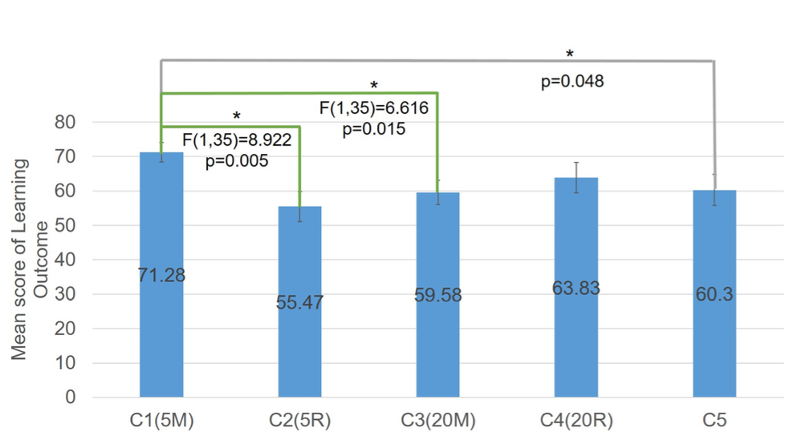
RESULTS
"To know whom you should look at when you want to find the key points" -C1
- LEARNING OUTCOMES -
C1 has better learning outcomes than c2 and c3
C1 has better learning outcomes than c5
With only 5 classmates, comment mapping would be more helpful
Notes:
[Maria] – Results (Cap 5)
- falar das research questions
- É preciso de explicar que valores aparecem no grafico?

Slide 14
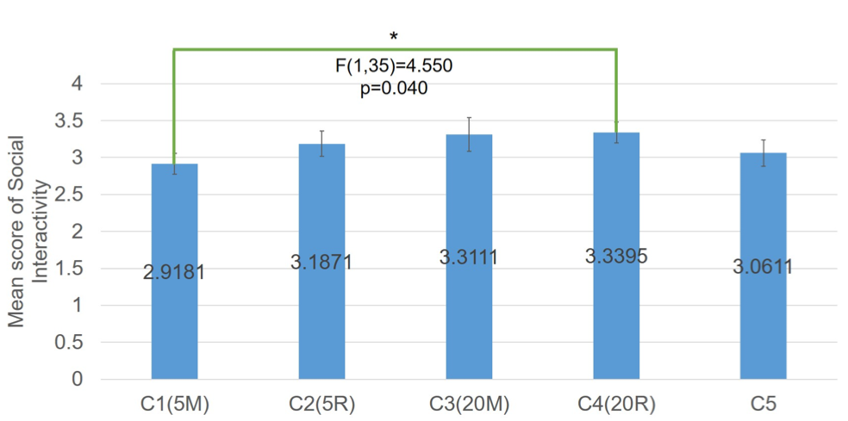
RESULTS
- SOCIAL OUTCOMES -
"it made me feel less alone like a general online course where I was alone" -C5
C1 has lower social interactivity than c4
20r has more social interactivity than 5m
Notes:
[Maria] – Results (Cap 5)
- falar das research questions
- É preciso de explicar que valores aparecem no grafico?

Slide 15
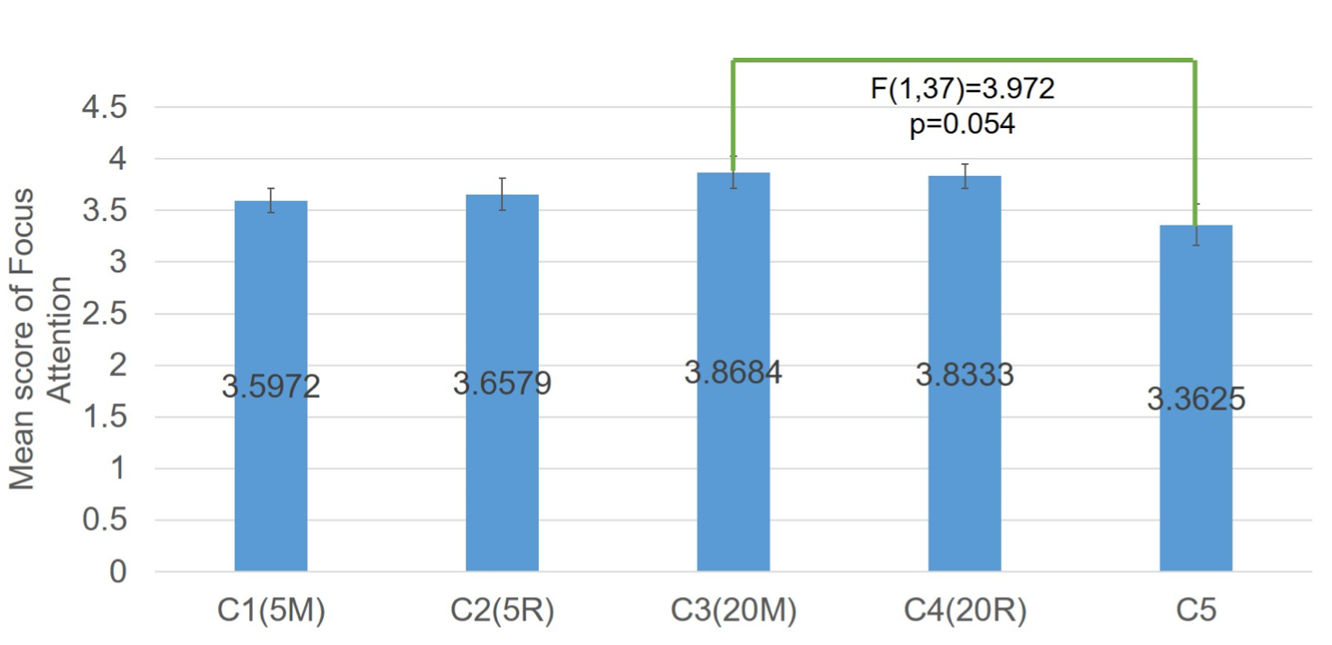
RESULTS
- FOCUS ATTENTION -
"The classmates' comments were sometimes too dense, and then I didn't know where to look" -C2
C3 has more focus attention than c5
20r has more focus attention than without vr
Notes:
[Maria]

Slide 16
DISCUSSION AND ACQUIRED KNOWLEDGE
Learning outcomes
Best in C1 (5M)
With comment mapping -> less classmates
w/o comment mapping -> more classmates
Social interactivity
Best in c4 (20R)
More classmates always yields better results
In conclusion...
You can't have your cake and eat it too
Focus attention
Best in C3 (20M)
Results close to each other
Notes:
[Sofia] – Discussion (Cap 6)

Slide 17
Virtual Classmates: Embodying Historical Learners' Messages as Learning Companions in a VR Classroom through Comment Mapping
M. -Y. Liao, C. -Y. Sung, H. -C. Wang and W. -C. Lin, 2019 IEEE Conference on Virtual Reality and 3D User Interfaces (VR), pp. 163-171
Maria Cunha (93089)
Sofia Vaz (92968)
Human Computer Interaction
28th April 2021
Notes:
[Sofia]
Include in the 1st slide:
The complete reference of the paper (authors, title, publication, date, pages)
Name, number, and study program of the presenter
Name of the course and date of presentation
Add number to the slides except for first one

