Slide 1
Observation At The Edge
A Novel Approach to Edge Node Security
Sofia Vaz, Catarina Silva, João Paulo Barraca, Diogo Gomes and Paulo Salvador; Instituto de Telecomunicações, University of Aveiro

Slide 2
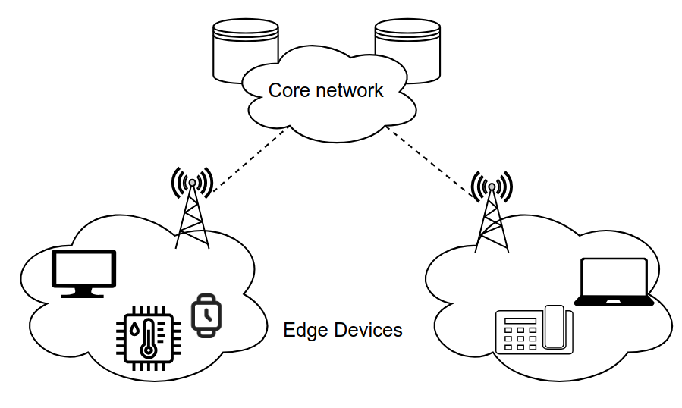
Edge Computing
www.nexusconference.uevora.pt
NEXUS International Conference - DGTMP 2024
Digital and Green Transition in Maritime Ports: Trends and Challenges
Distributed computing
geographically closer to end-users
Key benefits
reduced latency
higher throughput
better resource utilization
Use cases
factory automation
vehicular communication
ports
…

Slide 3
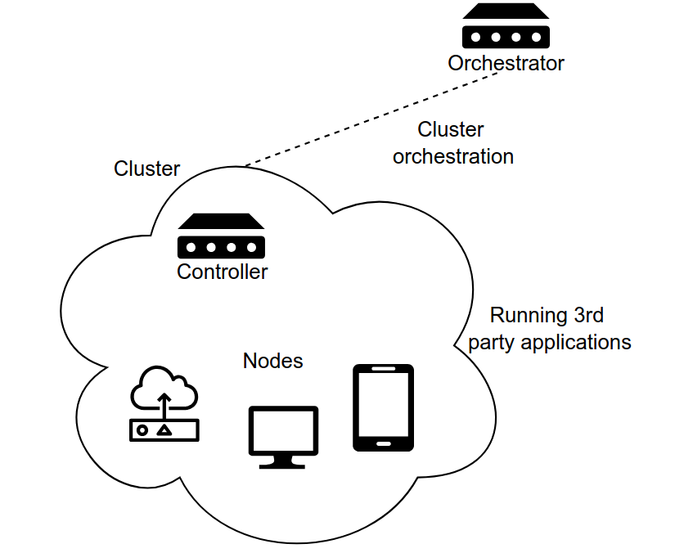
Current Scenario
Orchestrated environment
Running 3rd party applications
(Typical telco configuration for edge environments, NEXUS WP6)
How do we trust applications?
Observation – no need to trust developers, or applications, it is only necessary to watch them

Slide 4
Defending Edge Nodes
www.nexusconference.uevora.pt
NEXUS International Conference - DGTMP 2024
Digital and Green Transition in Maritime Ports: Trends and Challenges
Attack profiles
known dangerous behavior
- Security policies
based on attack profiles
- Rules based on policies
Observation based on how attackers to behave
specific to every deployment and service

Slide 5
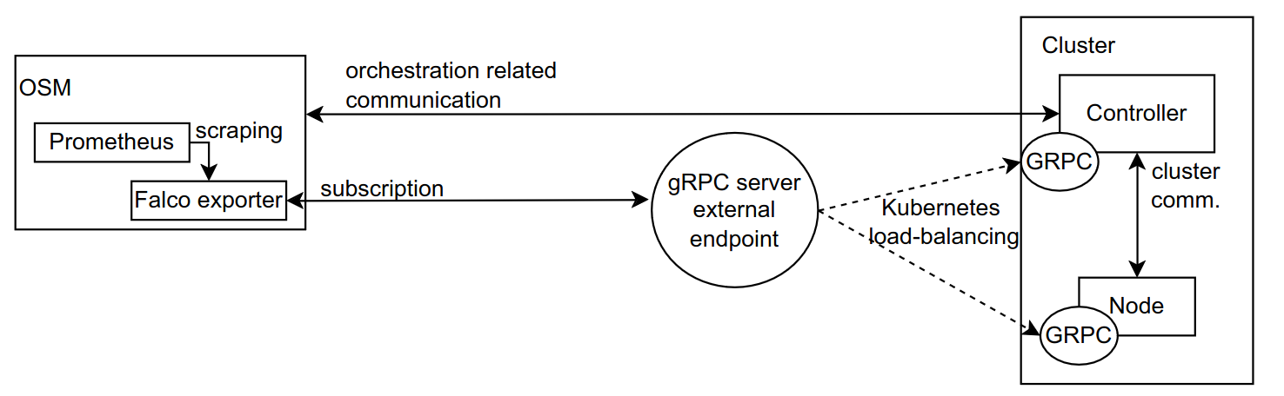
Solution Developed
*
*
*
*
*
*
orchestrator
security stack
cluster

Slide 6

Solution developed – dangerous behavior
log
log
(exposed)
log

Slide 7
Rules
Triggered at the kernel level
with observation ability from the kernel to the file, container, network and user levels
Pre-existing ruleset
with some focus on access and application behavior
Fully customizable
possible to cater rules to highly specific environments
Rule breaks are visible centrally
Prometheus + Grafana
Notes:
tornar explícito, enquanto falo, que a ideia é que dar provide à infrastrutura que depois podem usar para observar da maneira que querem (acho que faz sentido?)

Slide 8
Evaluation and Results
Evaluation Environment
Single Node Implementation
VM, 8GiB RAM, 4 CPU cores, 64 GiB memory, Ubuntu 20.04.4
Multi-Node Implementation
VM, 8GiB RAM, 4 CPU cores, 64 GiB memory, Ubuntu 20.04.4
Bare-metal, 16GB RAM, 8 CPU cores, 64 GB memory, Debian 11
Evaluation purpose
Functional validation of the solution developed
Inicial performance evaluation
Possible to compare how the system behaves with more nodes

Slide 9
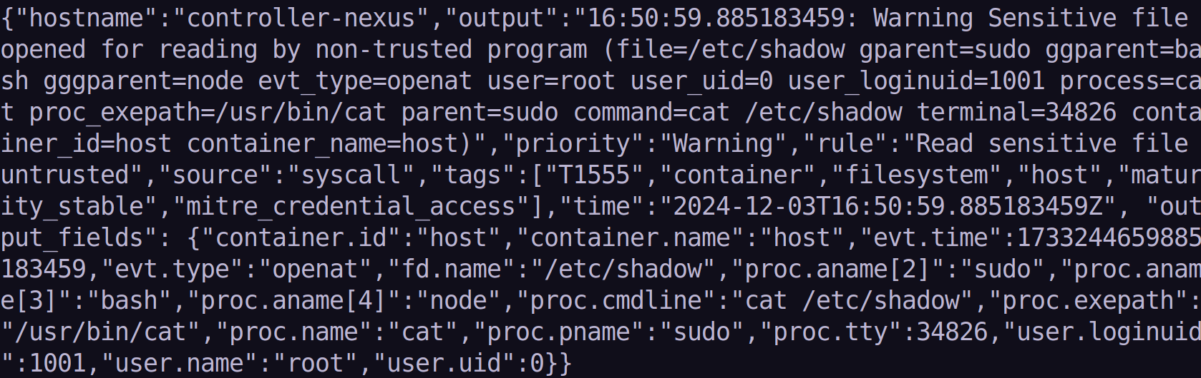
Results – alert data

Slide 10
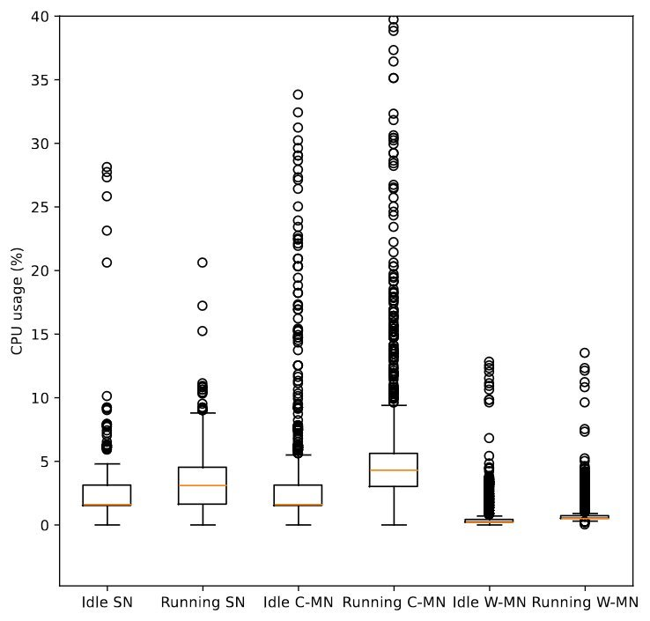
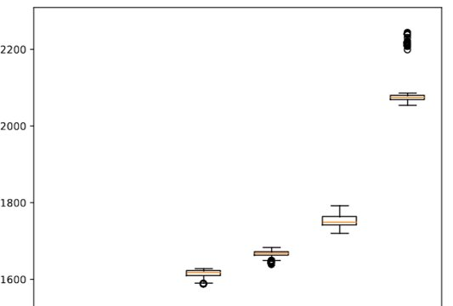
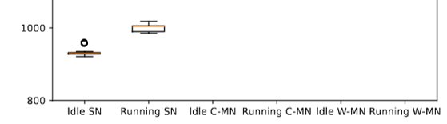
Results – resource consumption
322 MiB
51 MiB
69 MiB

Slide 11
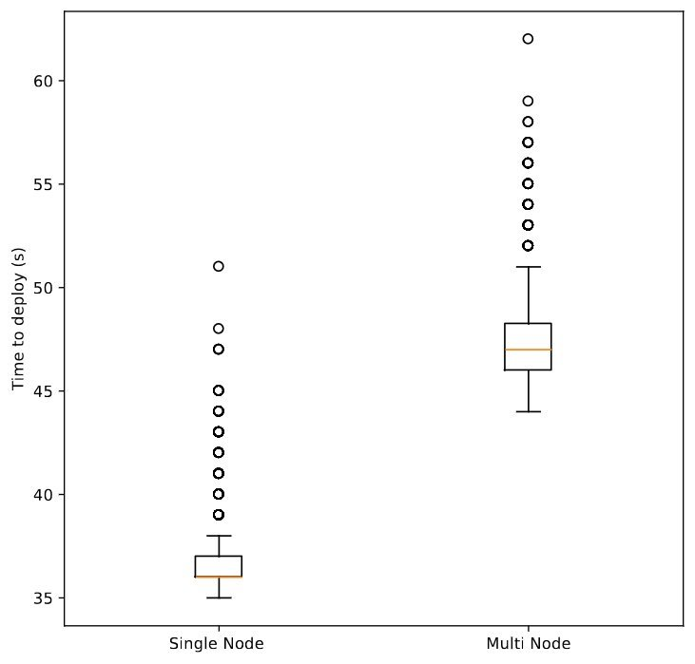
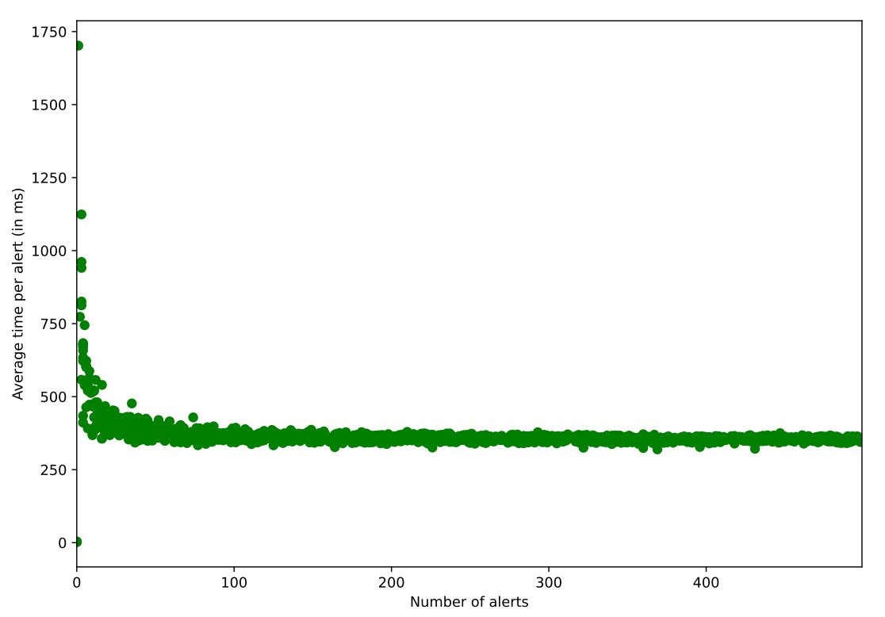
Results – times

Slide 12
Conclusions
Contributions:
Novel approach to security in orchestrated edge environments
Customizable environment, highly adaptable
Reliable and lightweight
Future Work:
Define defense profiles (Common Threats, Relevant Threat Actors, MITRE ATTACK)
Automated rule creation based on attackers, environment, etc.
Larger testbeds

Slide 13


Thank you all!
Sofia Vaz, Catarina Silva, João Paulo Barraca, Diogo Gomes and Paulo Salvador; Instituto de Telecomunicações, University of Aveiro
ÉVORA AND SINES, PORTUGAL

