Slide 1
Observing the Edge: Host Behavior as a Foundation for Workflow Security
Sofia Vaz, Vítor A. Cunha, Rui L. Aguiar

Slide 2
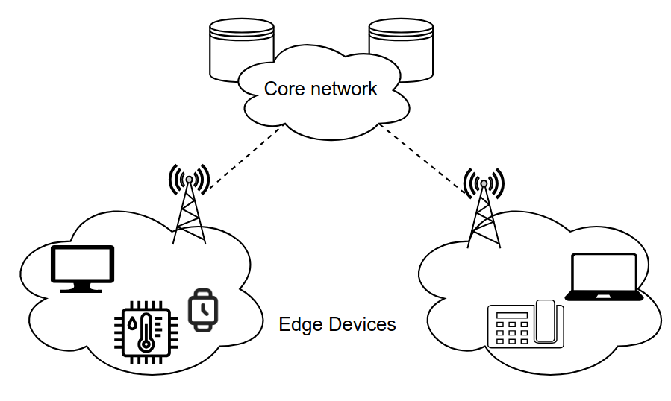
Why monitor hosts at the edge?
Edge computing – decentralized, high performance environments

Slide 3




Why monitor hosts at the edge?
Edge computing – decentralized, high performance environments
Workflows run there -> increased complexity and heterogeneity

Slide 4

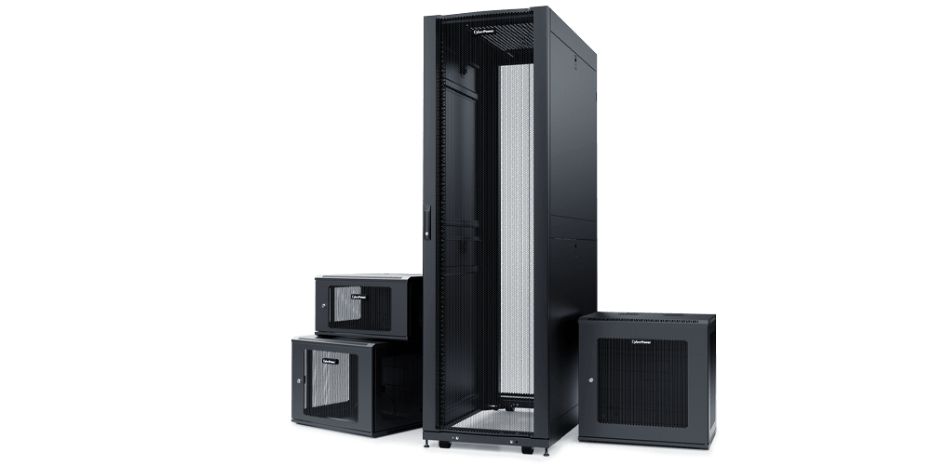




Why monitor hosts at the edge?
Edge computing – decentralized, high performance environments
Workflows run there -> increased complexity and heterogeneity
Security challenge: limited visibility, trust, and control over edge nodes

Slide 5
Why monitor hosts at the edge?
Edge computing – decentralized, high performance environments
Workflows run there -> increased complexity and heterogeneity
Security challenge: limited visibility, trust, and control over edge nodes
Goal: secure workflow execution by observing host behavior

Slide 6


What’s missing?
Cloud based monitoring does not meet edge-specific needs

Slide 7
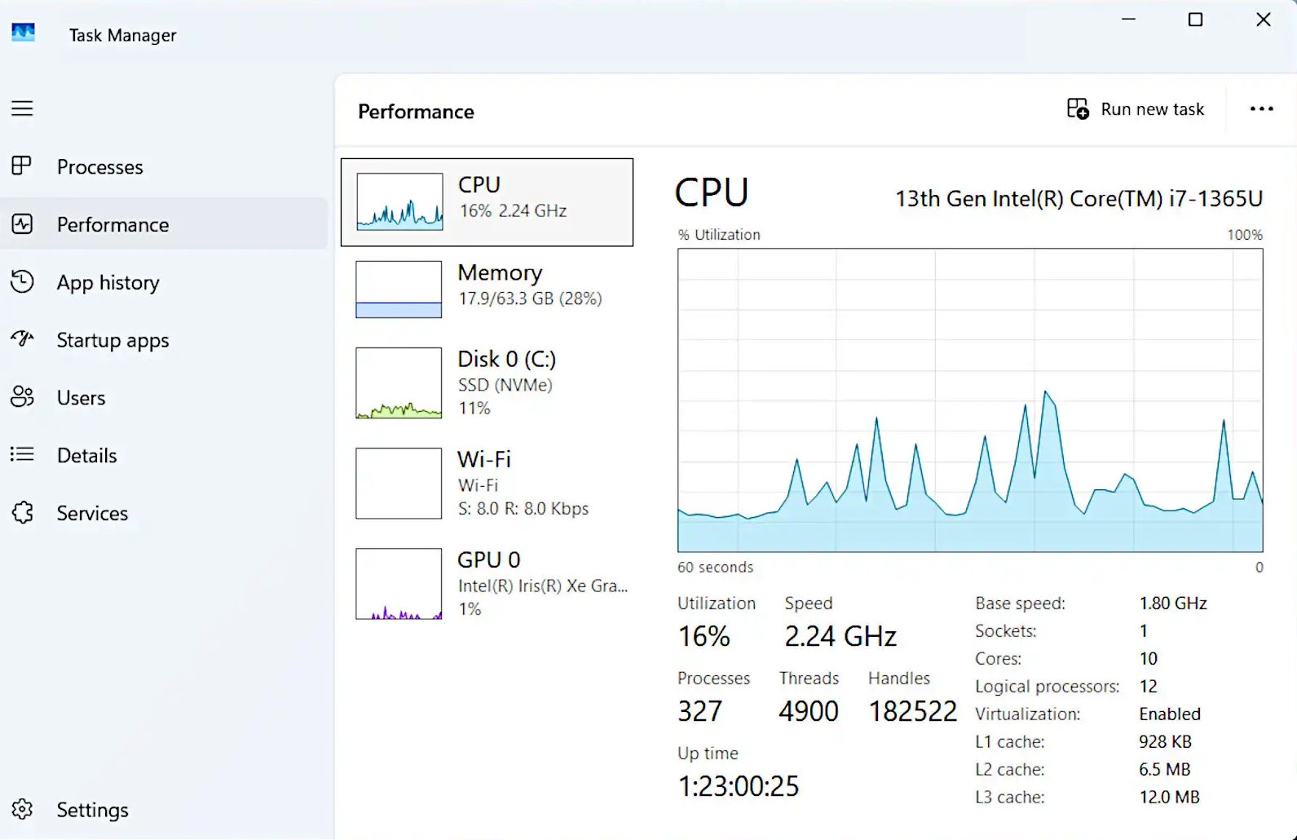

What’s missing?
Cloud based monitoring does not meet edge-specific needs
Resource metrics are not sufficient

Slide 8
What’s missing?
Cloud based monitoring does not meet edge-specific needs
Resource metrics are not sufficient
Existing tools lack direct behavioral security monitoring
Need for lightweight, rule-based, host-centric approach

Slide 9
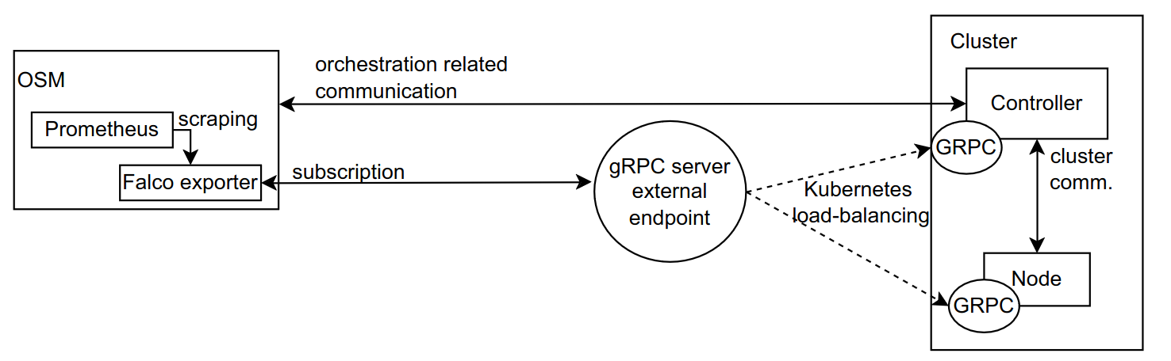
A Modular Host Monitoring System
*
*
*
*
*
orchestrator
*
security stack
cluster

Slide 10

Dangerous Behavior Detection
log
log
(exposed)
log

Slide 11
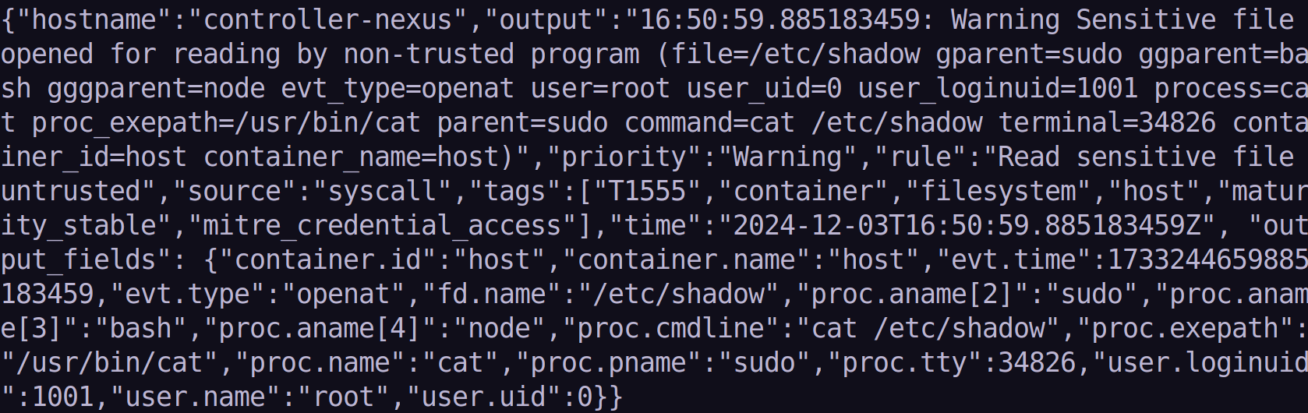
Use Case #1 – Initial Steps
Notes:
um dos ataques típicos começa com tentativas básicas para verificação de

Slide 12
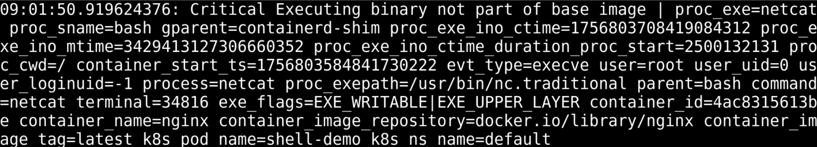
Use Case #2 – Exploitation

Slide 13
Evaluation Environment
Single Node Implementation
VM, 8GiB RAM, 4 CPU cores, 64 GiB memory, Ubuntu 20.04.4
Multi-Node Implementation
VM, 8GiB RAM, 4 CPU cores, 64 GiB memory, Ubuntu 20.04.4
Bare-metal, 16GB RAM, 8 CPU cores, 64 GB memory, Debian 11
Evaluation purpose
Functional validation of the solution developed
Initial (comparative) performance evaluation

Slide 14
Results
Metrics collected:
Alert responsiveness
Key Results:

Slide 15
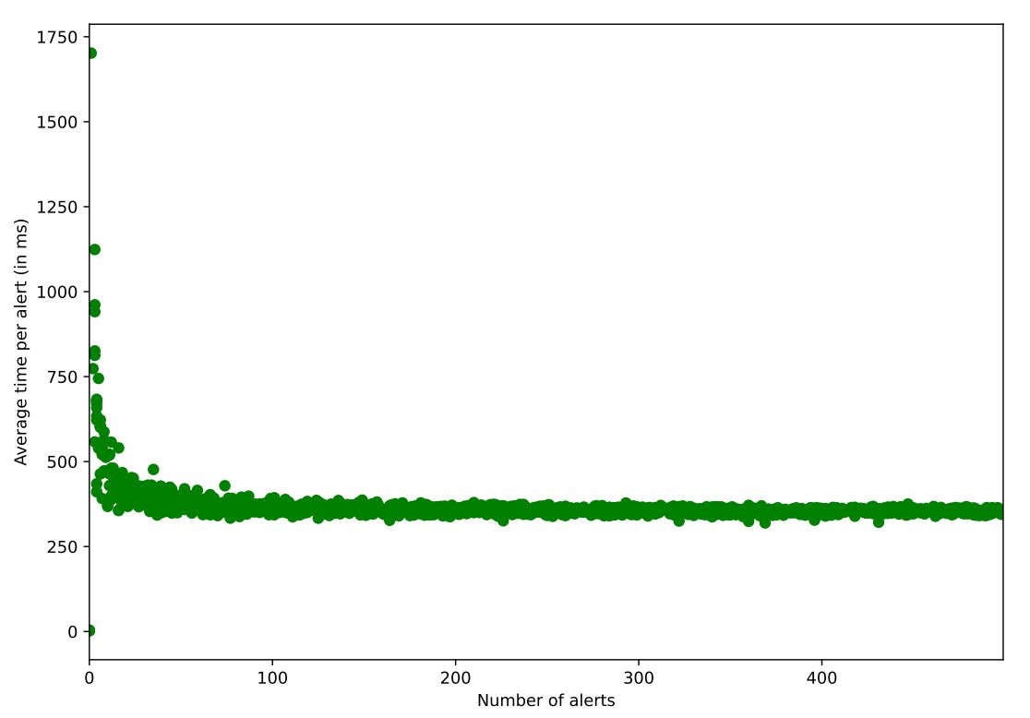
Results
Metrics collected:
Alert responsiveness
Key Results:

Slide 16
Results
Metrics collected:
Alert responsiveness
Key Results:
Zero false alerts
Solution does not slow with volume

Slide 17
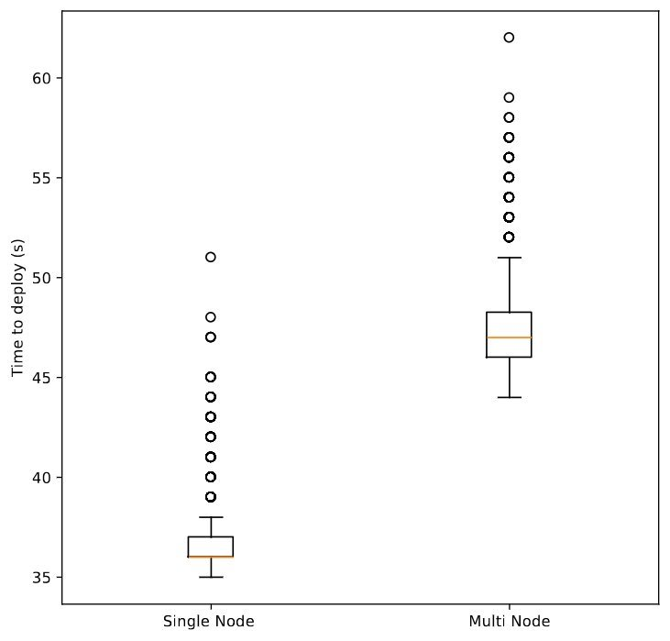
Results
Metrics collected:
Alert responsiveness
Deployment time
Key Results:
Zero false alerts
Solution does not slow with volume

Slide 18
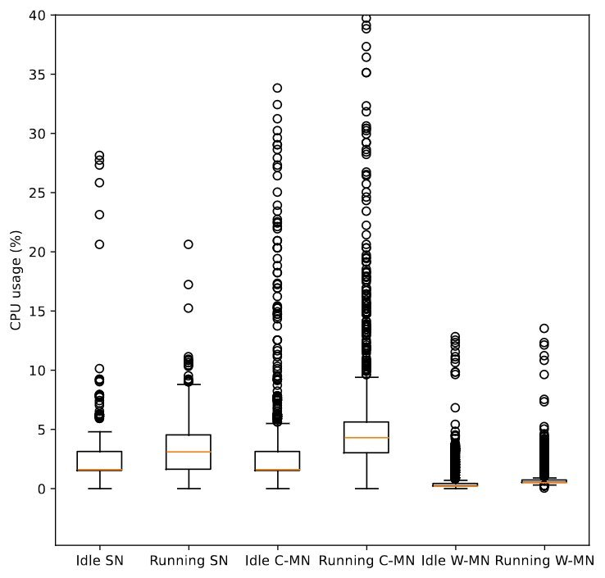
Results
Metrics collected:
Alert responsiveness
Deployment time
CPU and memory usage
Key Results:
Zero false alerts
Solution does not slow with volume
Low resource consumption

Slide 19
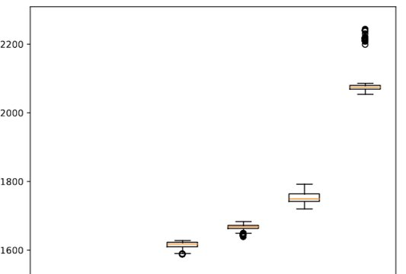
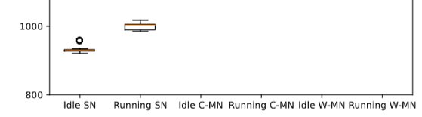
Results
322 MiB
Metrics collected:
Alert responsiveness
Deployment time
CPU and memory usage
Key Results:
Zero false alerts
Solution does not slow with volume
Low resource consumption
51 MiB
69 MiB

Slide 20
Results
Metrics collected:
Alert responsiveness
Deployment time
CPU and memory usage
Key Results:
Zero false alerts
Solution does not slow with volume
Low resource consumption
Main Takeaway: the solution scales well for small clusters

Slide 21
Discussion and Future Work
Strengths:
lightweight, modular, customizable
near real-time alerts with kernel-level granularity
Limitations:
rule-based observation quality depends on coverage
Future directions:
automated rule generation
node quarantine/removal on compromise

Slide 22
Conclusion
Host behavior monitoring is a viable foundation for edge workflow security
Proposed solution is lightweight, accurate, and practical
Current work paves the way for future systems

Slide 23
Thank you for your time!

