Slide 1
Run Builds, Not Risks: Isolation in CI/CD Workflows
Sofia Vaz, Vítor A. Cunha, Rui L. Aguiar
University of Aveiro
Instituto de Telecomunicações
Grants no. 101139120 and no. 101179818
Corresponding author: sofiateixeiravaz@ua.pt

Slide 2
What is CI/CD?
Obviously, Continuous Integration and Continuous Delivery

Slide 3

What is CI/CD?
Obviously, Continuous Integration and Continuous Delivery
Implementing…

Slide 4

What is CI/CD?
Obviously, Continuous Integration and Continuous Delivery
Implementing…
Continuous Testing

Slide 5

What is CI/CD?
Obviously, Continuous Integration and Continuous Delivery
Implementing…
Continuous Building
Continuous Testing

Slide 6
What is CI/CD?
Obviously, Continuous Integration and Continuous Delivery
Implementing…
Continuous Building
Continuous Testing
CI

Slide 7
What is CI/CD?
Obviously, Continuous Integration and Continuous Delivery
Implementing…
Continuous Building
Continuous Testing
CI
CD

Slide 8
What are the positives of CI/CD?

Slide 9
What are the positives of CI/CD?
1- Automated build, test and deploy = rapid iteration

Slide 10
What are the positives of CI/CD?
1- Automated build, test and deploy = rapid iteration
Better developer productivity

Slide 11
What are the positives of CI/CD?
1- Automated build, test and deploy = rapid iteration
Better developer productivity
Critical to many software supply chains!

Slide 12
Where is CI/CD?

Slide 13
Where is CI/CD?
… kind of everywhere?

Slide 14
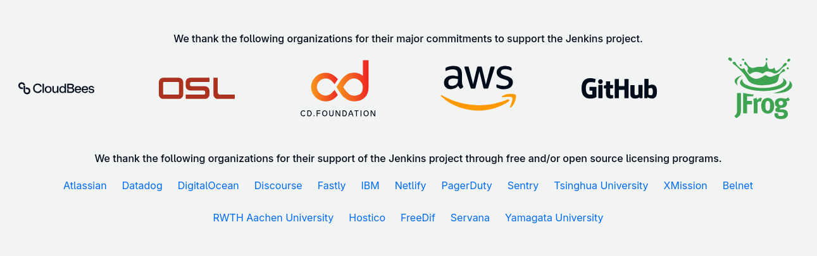
Where is CI/CD?
… kind of everywhere?

Slide 15
Where is CI/CD?
… kind of everywhere?
Currently, the following organizations are officially using Argo CD:
100ms, 127Labs, 3Rein, 42 School, 4data, 7shifts, Adevinta, Adfinis, Adobe, Adventure, Adyen, AirQo, Akuity, Alarm.com, Alauda, Albert Heijn, Alibaba Group, Allianz Direct, AlphaSense, Amadeus IT Group, Ambassador Labs, Ancestry, Andgo Systems, ANSTO - Australian Synchrotron, Ant Group, AppDirect, Arcadia, Arctiq Inc., Artemis Health by Nomi Health, Arturia, ARZ Allgemeines Rechenzentrum GmbH, Augury, Autodesk, Axians ACSP, Axual B.V., Back Market, Bajaj Finserv Health Ltd., Baloise, Batumbu, BCDevExchange DevOps Platform, Beat, Beez Innovation Labs, Bedag Informatik AG, Beleza Na Web, Believable Bots, Bayer AG, BigPanda, BioBox Analytics, BMW Group, Boozt, Bosch, Boticario, Broker Consulting, a.s., Bulder Bank, Cabify, CAM, Camptocamp, Candis, Capital One, Capptain LTD, Car & Classic, CARFAX Europe, CARFAX, Carrefour Group, Casavo, Celonis, CERN, Chainnodes, Chargetrip, Chime, Chronicle Labs, C.H.Robinson , Circle, Cisco ET&I, Close, Cloud Posse, Cloud Scale, CloudScript, CloudGeometry, Cloudmate, Cloudogu, Cobalt, Codefresh, Codility, Cognizant, Collins Aerospace, Commonbond, Compatio.AI, Contlo, Coralogix, Crédit Agricole CIB, CROZ d.o.o., CyberAgent, Cybozu, D2iQ, DaoCloud, Datarisk, Daydream, Deloitte, Dematic, Deutsche Telekom AG, Deutsche Bank AG, Devopsi - Poland Software/DevOps Consulting, Devtron Labs, DigitalEd, DigitalOcean, Divar, Divistant, 1. [DocNetwork, Dott, Doubble, Doximity, EDF Renewables, edX, Elastic, Electronic Arts Inc., Elementor, Elium, END., Energisme, enigmo, Envoy, eSave, Etherflow, Expedia, Factorial, Farfetch, Faro, Fave, Flexport, Flip, Fly Security, Fonoa, Fortra, freee, Freshop, Inc, Future PLC, Flagler Health, G DATA CyberDefense AG, G-Research, Garner, Generali Deutschland AG, Gepardec, Getir, GetYourGuide, Gitpod, Gllue, gloat, GLOBIS, Glovo, GlueOps, GMETRI, Gojek, GoTo Financial, GoTo, Greenpass, Gridfuse, Groww, Grupo MasMovil, Handelsbanken, Hazelcast, Healy, Helio, hetao101, Hetki, hipages, Hiya, Honestbank, Hostinger, Hotjar, IABAI, IBM, Ibotta, Icelandair, IFS, IITS-Consulting, IllumiDesk, Imagine Learning, imaware, Indeed, Index Exchange, Info Support, InsideBoard, Instruqt, Intel, Intuit, IQVIA, Jellysmack, Joblift, JovianX, Kaltura, Kandji, Karrot, KarrotPay, Kasa, Kave Home, Keeeb, KelkooGroup, Keptn, Kinguin, KintoHub, KompiTech GmbH, Kong Inc., KPMG, KubeSphere, Kurly, Kvist, Kyriba, Lattice, LeFigaro, Lely, LexisNexis, Lian Chu Securities, Liatrio, Lightricks, Loom, Lucid Motors, Lytt, LY Corporation, Magic Leap, Majid Al Futtaim, Major League Baseball, Mambu, MariaDB, Mattermost, Max Kelsen, MeDirect, Meican, Meilleurs Agents, Mercedes-Benz Tech Innovation, Mercedes-Benz.io, Metacore Games, Metanet, MindSpore, Mirantis, Mission Lane, mixi Group, Moengage, Mollie, Money Forward, MongoDB, MOO Print, Mozilla, MTN Group, Municipality of The Hague, My Job Glasses, Natura &Co, Netease Cloud Music, Nethopper, New Relic, Nextbasket, Nextdoor, Next Fit Sistemas, Nikkei, Nitro, NYCU, CS IT Center, Objective, OCCMundial, Octadesk, Octopus Deploy, Olfeo, omegaUp, Omni, Oncourse Home Solutions, Open Analytics, openEuler, openGauss, OpenGov, openLooKeng, OpenSaaS Studio, Opensurvey, OpsMx, OpsVerse, Optoro, Orbital Insight, Oscar Health Insurance, Outpost24, p3r, Packlink, PagerDuty, Pandosearch, Patreon, PayIt, PayPay, Paystack, Peloton Interactive, Percona, PGS, Pigment, Pipedrive, Pipefy, Pipekit, Pismo, PITS Globale Datenrettungsdienste, Platform9 Systems, Playground Tech, Polarpoint.io, Pollinate, PostFinance, Preferred Networks, Previder BV, Priceline, Procore, Productboard, Prudential, PT Boer Technology (Btech), PUBG, Puzzle ITC, Pvotal Technologies, Qonto, QuintoAndar, Quipper, RapidAPI, rebuy, Red Hat, Redpill Linpro, Reenigne Cloud, reev.com, Relex Solutions, RightRev, Rijkswaterstaat, 1. Rise, RISK IDENT, Riskified, Robotinfra, Rocket.Chat, Rogo, Rubin Observatory, Saildrone, Salad Technologies, Saloodo! GmbH, Sap Labs, SAP Signavio, Sauce Labs, Schneider Electric, Schwarz IT, SCRM Lidl International Hub, SEEK, SEKAI, Semgrep, Seznam.cz, Shield, Shipfox, Shock Media, SI Analytics, Sidewalk Entertainment, Skit, Skribble, Skyscanner, Smart Pension, Smilee.io, Smilegate Stove, Smood.ch, Snapp, Snyk, Softway Medical, Sophotech, South China Morning Post (SCMP), Speee, Spendesk, Splunk, Spores Labs, Statsig, SternumIOT, Stone Payments, StreamNative, Stuart, Sumo Logic, Sutpc, Swiss Post, Swissblock Technologies, Swisscom, Swissquote, Syncier, Synergy, Syself, T-ROC Global, TableCheck, Tailor Brands, Tamkeen Technologies, TBC Bank, Techcom Securities, Techcombank, Technacy, Telavita, Tesla, TextNow, The Scale Factory, ThousandEyes, Ticketmaster, Tiger Analytics, Tigera, Topicus.Education, Toss, Trendyol, tru.ID, Trusting Social, Twilio Segment, Twilio SendGrid, tZERO, U.S. Veterans Affairs Department, UBIO, UFirstGroup, ungleich.ch, Unifonic Inc, Universidad Mesoamericana, Upsider Inc., Urbantz, Vectra, Veepee, Verkada, Viaduct, VietMoney, Vinted, Virtuo, VISITS Technologies, Viya, Volvo Cars, Voyager Digital, VSHN - The DevOps Company, Wakacje.pl, Walkbase, Webstores, Wehkamp, WeMaintain, WeMo Scooter, Whitehat Berlin by Guido Maria Serra +Fenaroli, Witick, Wolffun Game, WooliesX, Woolworths Group, WSpot, X3M ads, Yieldlab, Youverify, Yubo, Yuno, ZDF, Zimpler, ZipRecruiter, ZOZO

Slide 16
Where can CI/CD go wrong?

Slide 17
Where can CI/CD go wrong?
Where we find the problems
Implementing…
Continuous Building
Continuous Testing
Notes:
Most problems are found by their impact , either on the final product or the build process itself
These problems can be general availability issues, integrity issues, leakage, or general security issues

Slide 18
Where can CI/CD go wrong?
Where we find the problems
Availability issues
Integrity issues
Leakage
Security Problems
Implementing…
Continuous Building
Continuous Testing
Notes:
Most problems are found by their impact , either on the final product or the build process itself
These problems can be general availability issues, integrity issues, leakage, or general security issues

Slide 19
Where can CI/CD go wrong?
Where problems come from
Implementing…
Continuous Building
Continuous Testing
Notes:
However, these issues typically come from de CI part of the process, as they often come from misconfigurations, bad third party inclusions, etc.

Slide 20
Where can CI/CD go wrong?
Where problems come from
Misconfigurations
Bad third party inclusions
Over privileged environments
Weak isolation between pipelines
Implementing…
Continuous Building
Continuous Testing
Notes:
However, these issues typically come from de CI part of the process, as they often come from misconfigurations, bad third party inclusions, etc.

Slide 21
Where can CI/CD go wrong?
Where problems come from
Misconfigurations
Bad third party inclusions
Over privileged environments
Weak isolation between pipelines
Implementing…
Continuous Building
Continuous Testing
Notes:
However, these issues typically come from de CI part of the process, as they often come from misconfigurations, bad third party inclusions, etc.

Slide 22
What can we do?
1 - Isolation

Slide 23
What can we do?
1 - Isolation
(via virtual machines or containers)

Slide 24
What can we do?
1 - Isolation
(via virtual machines or containers)
Often not very isolated!
Notes:
however, isolation methods often rely on shared data and weak isolation methods, which in term makes the solution not particularly strong

Slide 25


What can we do?
1 - Isolation
(via virtual machines or containers)
Often not very isolated!
Also, configured
Notes:
These isolated environments are also an added configuration, which also poses as a problem, because we cannot fix poorly configured workflows with more configuration

Slide 26
What can we do?
1 - Isolation
2- Vulnerability detection
Notes:
there’s also plenty of work which focuses on vulnerability detection in the workflow definition, however….

Slide 27
What can we do?
1 - Isolation
2- Vulnerability detection
More configuration :(
Notes:
This leads to more configuration, which is, once again, part of the problem

Slide 28
What can we do?
1 - Isolation
2- Vulnerability detection
More configuration :(
Limited in scope
Notes:
This leads to more configuration, which is, once again, part of the problem

Slide 29
What can we do?
1 - Isolation
2- Vulnerability detection
More configuration :(
Limited in scope
Not all problems come from vulnerabilities!
Notes:
This leads to more configuration, which is, once again, part of the problem

Slide 30
What can we do?
1 - Isolation
2- Vulnerability detection
3- Provenance tracking
Notes:
there has also been work in provenance tracking, which helps in regards to pointing fingers in regards to who may have broken the build

Slide 31
What can we do?
1 - Isolation
2- Vulnerability detection
3- Provenance tracking
Assume a safe environment
Notes:
however, they assume the correctness of the workflow, or, moreover, that the environment of the workflow is not compromised, which is often not the case because, once again, workflows tend to be configured poorly and executed in overly permissive environments

Slide 32
What can we do?
1 - Isolation
2- Vulnerability detection
3- Provenance tracking
Assume a safe environment
Which is often not the case!
Notes:
however, they assume the correctness of the workflow, or, moreover, that the environment of the workflow is not compromised, which is often not the case because, once again, workflows tend to be configured poorly and executed in overly permissive environments

Slide 33
What can we do?
1 - Isolation
2- Vulnerability detection
3- Provenance tracking
So… what now?

Slide 34
What if we force isolation?
Notes:
well, what if we force isolation?

Slide 35
What if we force isolation?
1- Freedom of execution
Notes:
for starters, we don’t have to verify if the workflow does anything malicious or not, because it is running in a bubble

Slide 36
What if we force isolation?
1- Freedom of execution
Less poisoning
Notes:
additionally, less values will be shared between workflows, as each have their own bubbles -> this means that there is less chance for poisoning or leakage

Slide 37
What if we force isolation?
1- Freedom of execution
Less poisoning
Less ways for an attacker to do damage
Notes:
additionally, less values will be shared between workflows, as each have their own bubbles -> this means that there is less chance for poisoning or leakage

Slide 38
What if we force isolation?
1- Freedom of execution
2- No configuration
Notes:
additionally, by forcing isolation, isolation will not be configured

Slide 39
What if we force isolation?
1- Freedom of execution
2- No configuration
No opting out :)
Notes:
nor an opt-in situation, meaning that the weakest link will, hopefully, be as strong as every other link

Slide 40
What if we force isolation?
1- Freedom of execution
2- No configuration
No opting out :)
No misconfigurations :)
Notes:
nor an opt-in situation, meaning that the weakest link will, hopefully, be as strong as every other link

Slide 41

What if we force isolation?
force security features

Slide 42
But… how?

Slide 43
But how? – Threat Model and Assumptions

Slide 44
But how? – Threat Model and Assumptions
1- The workflow wildcard

Slide 45
But how? – Threat Model and Assumptions
1- The workflow wildcard
Contains trusted and untrusted content, malicious and not

Slide 46
But how? – Threat Model and Assumptions
1- The workflow wildcard
Contains trusted and untrusted content, malicious and not
Attacker can run arbitrary commands

Slide 47
But how? – Threat Model and Assumptions
1- The workflow wildcard
Contains trusted and untrusted content, malicious and not
Attacker can run arbitrary commands
They are bound to the workflow

Slide 48
But how? – Threat Model and Assumptions
1- The workflow wildcard
2- The orchestrator safe harbor

Slide 49
But how? – Threat Model and Assumptions
1- The workflow wildcard
2- The orchestrator safe harbor
Worker OS and isolation process are trusted

Slide 50
But how? – Threat Model and Assumptions
1- The workflow wildcard
2- The orchestrator safe harbor
Worker OS and isolation process are trusted
Network infrastructure and storage are safe

Slide 51
But how? – Threat Model and Assumptions
1- The workflow wildcard
2- The orchestrator safe harbor
3- The adversary’s goals

Slide 52
But how? – Threat Model and Assumptions
1- The workflow wildcard
2- The orchestrator safe harbor
3- The adversary’s goals
Secret exfiltration

Slide 53
But how? – Threat Model and Assumptions
1- The workflow wildcard
2- The orchestrator safe harbor
3- The adversary’s goals
Secret exfiltration
Artifact tampering

Slide 54
But how? – Threat Model and Assumptions
1- The workflow wildcard
2- The orchestrator safe harbor
3- The adversary’s goals
Secret exfiltration
Artifact tampering
Persistent changes to the environment

Slide 55
But how? – Threat Model and Assumptions
1- The workflow wildcard
2- The orchestrator safe harbor
3- The adversary’s goals
Secret exfiltration
Artifact tampering
Persistent changes to the environment
Disruption of other workflows

Slide 56
But… how? – The bubble

Slide 57
But… how? – The bubble
Must be similar to the host machine

Slide 58
But… how? – The bubble
Must be similar to the host machine
Small change between isolated and machine = better adherence

Slide 59
But… how? – The bubble
Must be similar to the host machine
Small change between isolated and machine = better adherence
There may be reason the user wants to use the bare metal machine!

Slide 60
But… how? – The bubble
Must be similar to the host machine
Small change between isolated and machine = better adherence
There may be reason the user wants to use the bare metal machine!
i.e., tools, environment values, etc…

Slide 61
But… how? – The bubble
Must be similar to the host machine
Must be well isolated

Slide 62
But… how? – The bubble
Must be similar to the host machine
Must be well isolated
Answer: Podman container w/ image as a .tar of the machine

Slide 63
Our Setup
1- Jenkins as the orchestrator

Slide 64
Our Setup
1- Jenkins as the orchestrator
2- Two worker machines

Slide 65
Our Setup
1- Jenkins as the orchestrator
2- Two worker machines
Totals: 3 machines

Slide 66
Our Setup
1- Jenkins as the orchestrator
2- Two worker machines
Totals: 3 machines (Openstack)
Ubuntu 24.04, 8 GB of RAM, 64 GB of storage, 4 vCPUs

Slide 67
The Three Modes

Slide 68
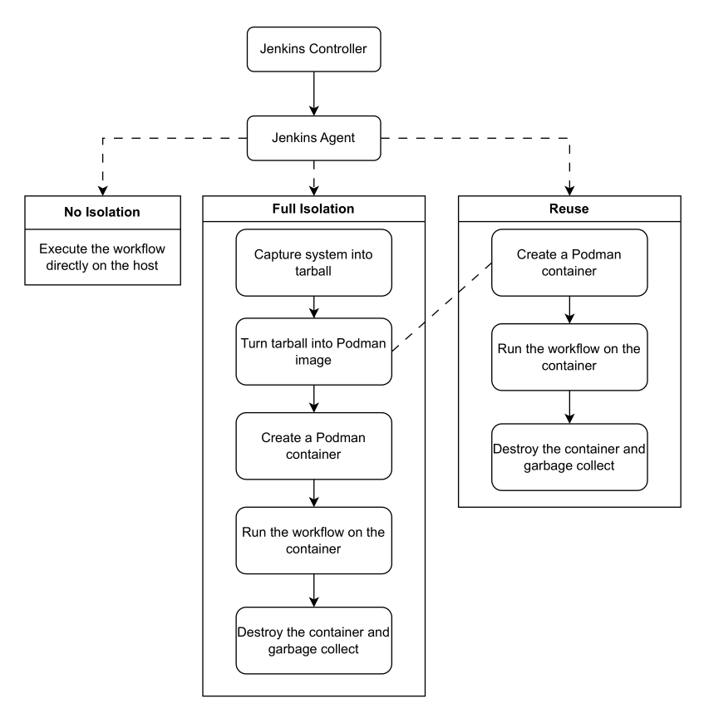
The Three Modes

Slide 69
The Three Modes
Do we have a need to isolate?

Slide 70
The Three Modes
Do we have a need to isolate?
The basis of comparison for other modes

Slide 71
The Three Modes

Slide 72
The Three Modes
A fully isolated mode

Slide 73
The Three Modes
A fully isolated mode
Create, run and destroy

Slide 74
The Three Modes
A fully isolated mode
Create, run and destroy

Slide 75
The Three Modes

Slide 76
The Three Modes
Hopefully faster isolation

Slide 77
The Three Modes
Hopefully faster isolation
Hopefully reuse won’t sacrifice isolation

Slide 78
The Three Modes
Hopefully faster isolation
Hopefully reuse won’t sacrifice isolation

Slide 79
Results

Slide 80
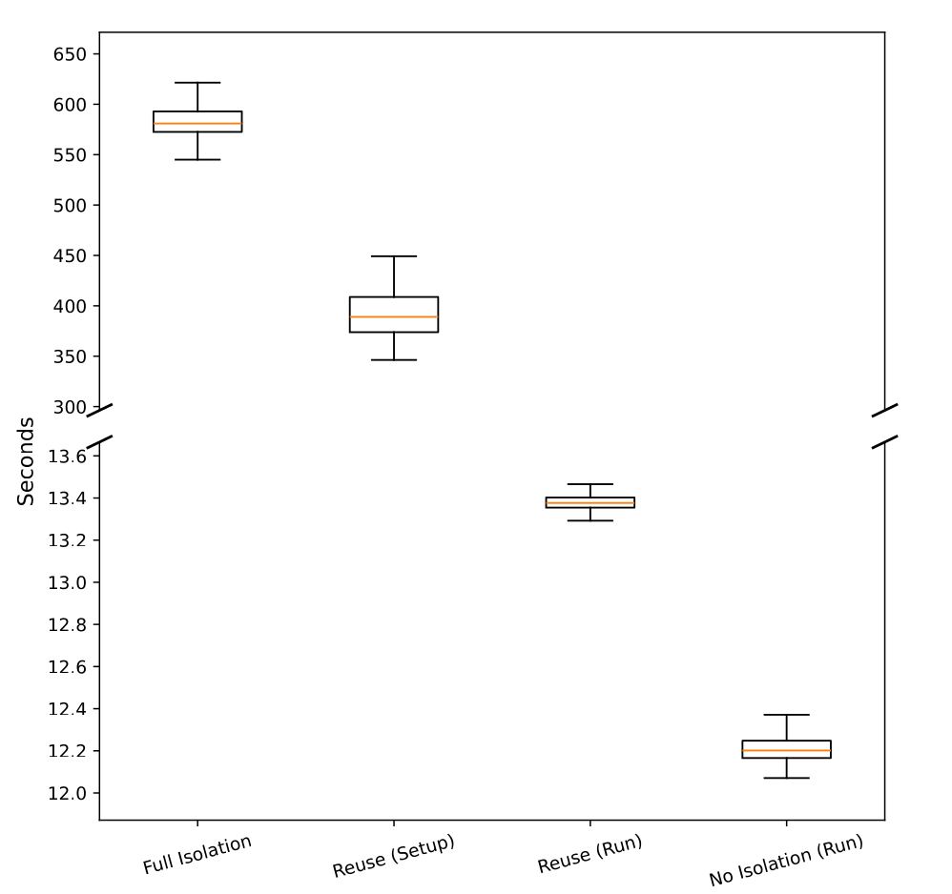
Results – Timing

Slide 81
Results – Timing
No isolation: 12.216 s
Reuse (Run): 13.377 s
Only 1s difference :)

Slide 82
Results – Timing
Reuse (Setup): 390.638 s
Full Isolation: 582.543 s
Full isolated is (a bit)
slower :/

Slide 83
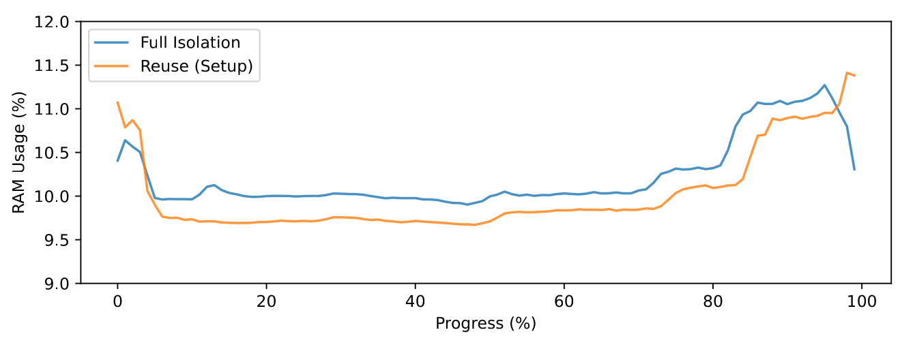
Results – RAM

Slide 84
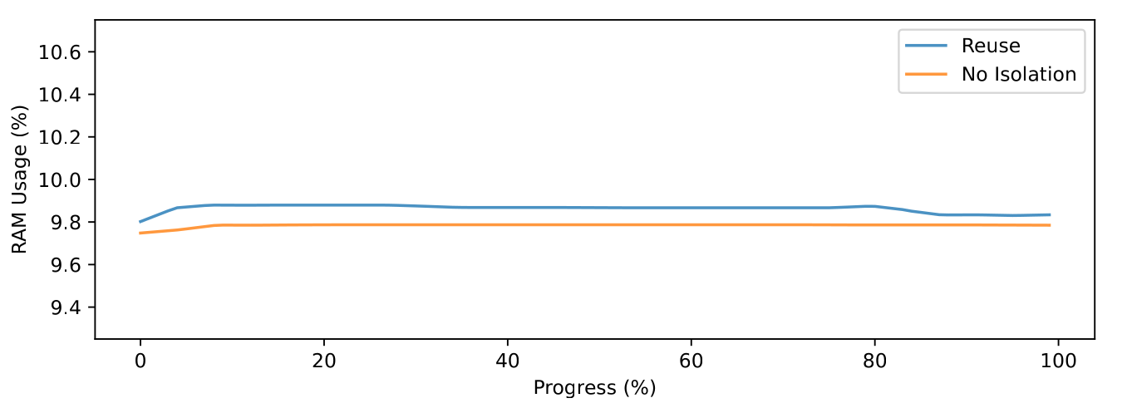
Results – RAM

Slide 85
Results – Isolation
Going back to the Threat Model…

Slide 86
Results – Isolation
Going back to the Threat Model…
The adversary’s goals:
Secret exfiltration
Artifact tampering
Persistent changes to the environment
Disruption of other workflows

Slide 87
Results – Isolation
Going back to the Threat Model…
The adversary’s goals:
Secret exfiltration
Artifact tampering
Persistent changes to the environment
Disruption of other workflows
File reading (OS/WF)

Slide 88
Results – Isolation
Going back to the Threat Model…
The adversary’s goals:
Secret exfiltration
Artifact tampering
Persistent changes to the environment
Disruption of other workflows
File reading (OS/WF)
File writing (WF)

Slide 89
Results – Isolation
Going back to the Threat Model…
The adversary’s goals:
Secret exfiltration
Artifact tampering
Persistent changes to the environment
Disruption of other workflows
File reading (OS/WF)
File writing (WF)
File writing (OS)

Slide 90
Results – Isolation
Going back to the Threat Model…
The adversary’s goals:
Secret exfiltration
Artifact tampering
Persistent changes to the environment
Disruption of other workflows
File reading (OS/WF)
File writing (WF)
File writing (OS)

Slide 91
Results – Isolation
 | Workflow Files | System Files
No Isolation
Reuse Mode
Full Isolation

Slide 92
Results – Isolation
 | Workflow Files | System Files
No Isolation | Read/Write | Read/Write
Reuse Mode
Full Isolation

Slide 93
Results – Isolation
The adversary’s goals:
(+) Secret exfiltration
(+) Artifact tampering
(+) Persistent changes to the environment
(+) Disruption of other workflows
 | Workflow Files | System Files
No Isolation | Read/Write | Read/Write
Reuse Mode
Full Isolation

Slide 94
Results – Isolation
 | Workflow Files | System Files
No Isolation | Read/Write | Read/Write
Reuse Mode | Read | Read
Full Isolation | Read | Read

Slide 95
Results – Isolation
 | Workflow Files | System Files
No Isolation | Read/Write | Read/Write
Reuse Mode | Read * | Read *
Full Isolation | Read * | Read *
Possible to not include these files in the configuration!

Slide 96
Results – Isolation
The adversary’s goals:
(+/-) Secret exfiltration
(-) Artifact tampering
(-) Persistent changes to the environment
(-) Disruption of other workflows
 | Workflow Files | System Files
No Isolation | Read/Write | Read/Write
Reuse Mode | Read * | Read *
Full Isolation | Read * | Read *
Possible to not include these files in the configuration!

Slide 97
What Does This Mean?
1- Full Isolation is slow

Slide 98
What Does This Mean?
1- Full Isolation is slow
Does not show better isolation results in comparison to reuse

Slide 99
What Does This Mean?
1- Full Isolation is slow
Does not show better isolation results in comparison to reuse
Why bother?

Slide 100
What Does This Mean?
1- Full Isolation is slow
2- Reuse mode is similar (timing wise) to no isolation

Slide 101
What Does This Mean?
1- Full Isolation is slow
2- Reuse mode is similar (timing wise) to no isolation
But much better in terms of isolation!

Slide 102
What Does This Mean?
1- Full Isolation is slow
2- Reuse mode is similar (timing wise) to no isolation
But much better in terms of isolation!
Why skip isolation then?

Slide 103
So… What Now?
1- Find best rotation time for image reuse

Slide 104

So… What Now?
1- Find best rotation time for image reuse

Slide 105
So… What Now?
1- Find best rotation time for image reuse
2- More testing

Slide 106
So… What Now?
1- Find best rotation time for image reuse
2- More testing
Better base workflow

Slide 107
So… What Now?
1- Find best rotation time for image reuse
2- More testing
Better base workflow
Better isolation testing

Slide 108
So… What Now?
1- Find best rotation time for image reuse
2- More testing
3- Automation

Slide 109
So… What Now?
1- Find best rotation time for image reuse
2- More testing
3- Automation
Of image generation

Slide 110
So… What Now?
1- Find best rotation time for image reuse
2- More testing
3- Automation
Of image generation
Of workflow isolation

Slide 111
Concluding….
CI/CD has MANY problems

Slide 112
Concluding….
CI/CD has MANY problems
But (forced) isolation can be a solution!

Slide 113
Concluding….
CI/CD has MANY problems
But (forced) isolation can be a solution!
Our approach seems to be a good first step :)

Slide 114
Thank you for your time!
Grants no. 101139120 and no. 101179818
Corresponding author: sofiateixeiravaz@ua.pt

