Slide 1
Stage
Presentations, beautifully simple
Notes:
Welcome. This deck tours the layouts, objects, builds and transitions. Press the Play button, or Cmd/Ctrl+Alt+P.

Slide 2
Everything on one canvas
Text, shapes, images, tables and charts
Smart guides, snapping, rulers and a grid
Themes that re-skin every slide at once
Present with builds, transitions and a presenter view
Notes:
Each bullet appears on click (build by paragraph).

Slide 3
Part one — The objects
Shapes, connectors, charts, tables

Slide 4
Two columns, one idea
Rich text with lists
Fonts, sizes, colours
Columns and autofit
Numbered or lettered lists
Hyperlinks and fields
Speaker notes

Slide 5
Diagrams that stay connected
Build
Idea
Works?
Notes:
Move any box: the arrows follow.

Slide 6
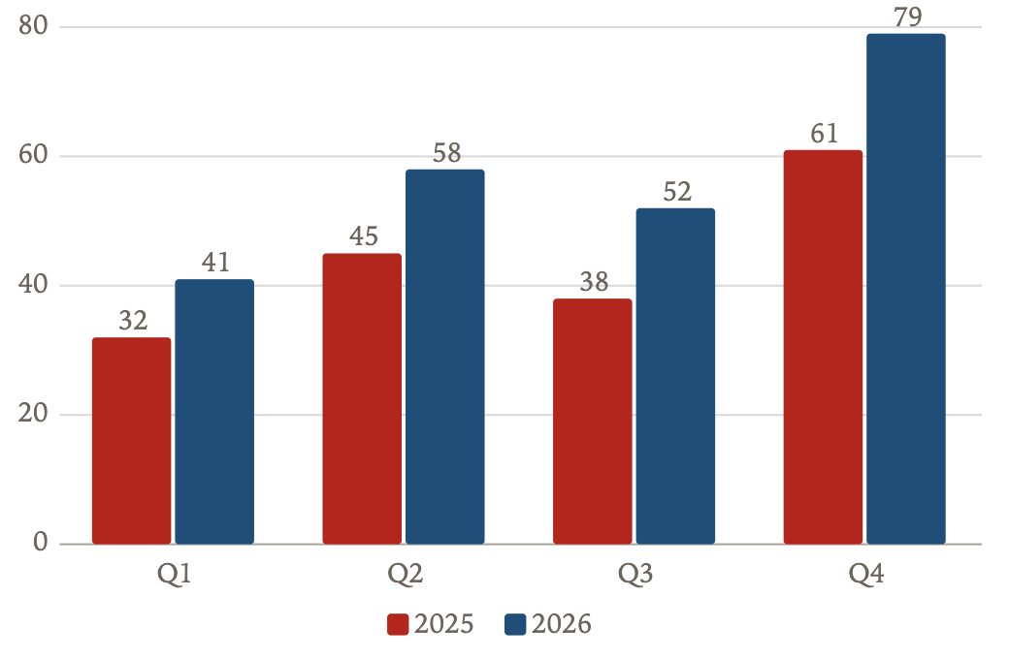
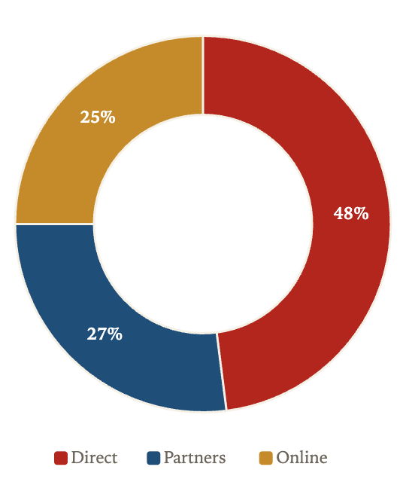
Charts with editable data

Slide 7
Tables
Milestone | Owner | Date | Status
Alpha | Dana | Mar 12 | Done
Beta | Lee | May 02 | In progress
Launch | Priya | Jul 21 | Planned
Review | Sam | Sep 30 | Planned

Slide 8
87%
of the room says it feels native

Slide 9
“Simple is not the absence of detail. It is the right detail, in the right place.”
— Stage sample quote

Slide 10

Photo layout with a built-in scrim

Slide 11
Crop, mask and adjust images
Mask an image to any shape
Brightness, contrast, colour
Drop shadow and reflection

Slide 12
Magic Move
Same name

Slide 13
Same name
Matching names morph
Notes:
Orb, Card and Headline share names with the previous slide.

Slide 14
Builds: in, out and emphasis
Fly in
Spin in
Pulse

Slide 15
Thank you
Switch the theme in Deck ▸ Theme and watch everything re-skin

