Slide 1
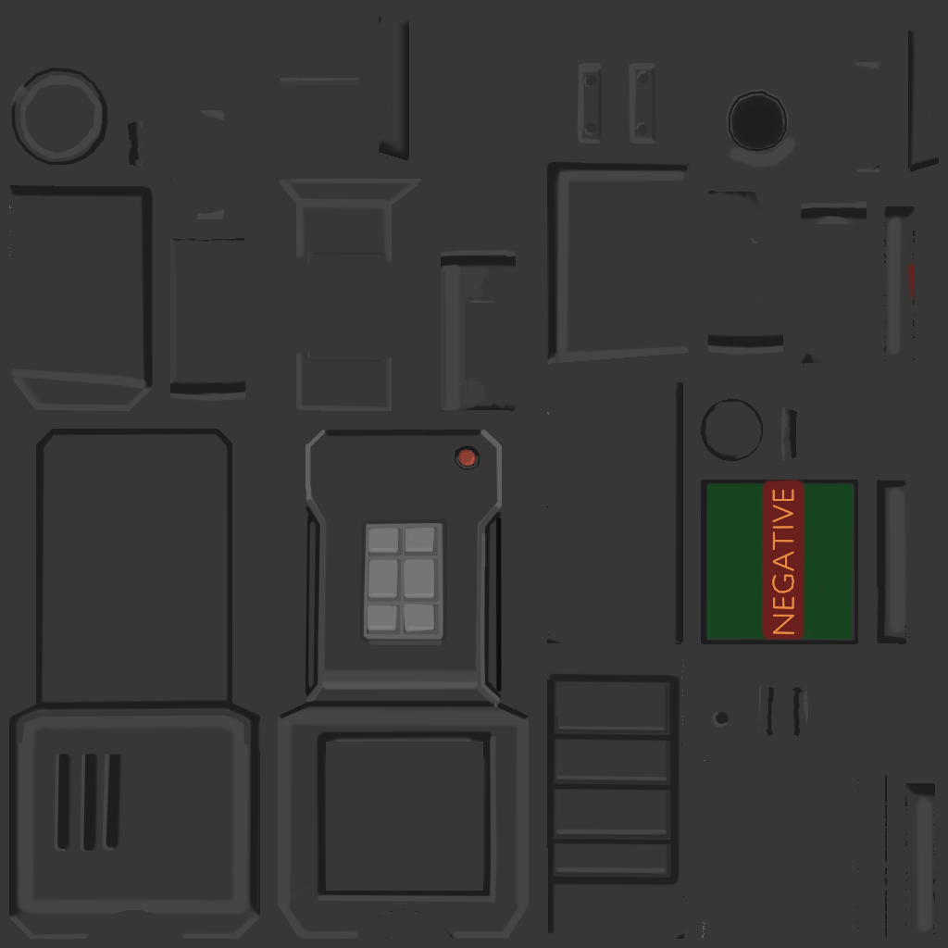
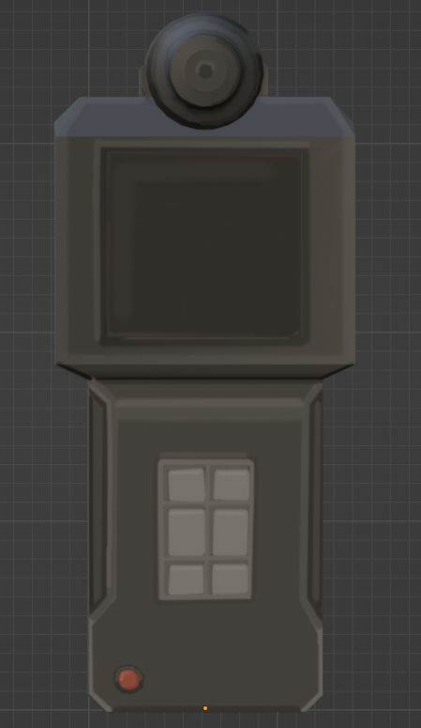
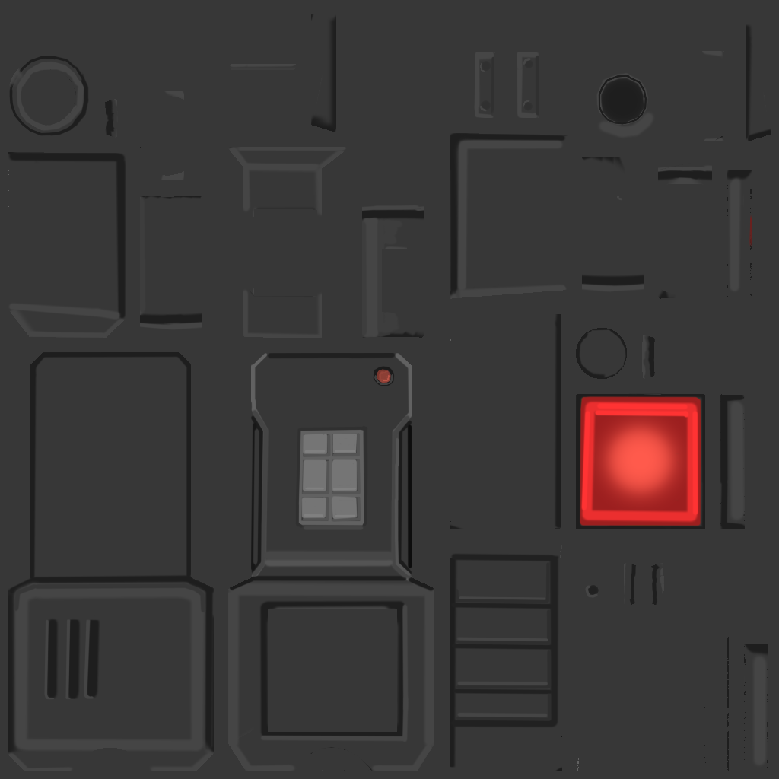










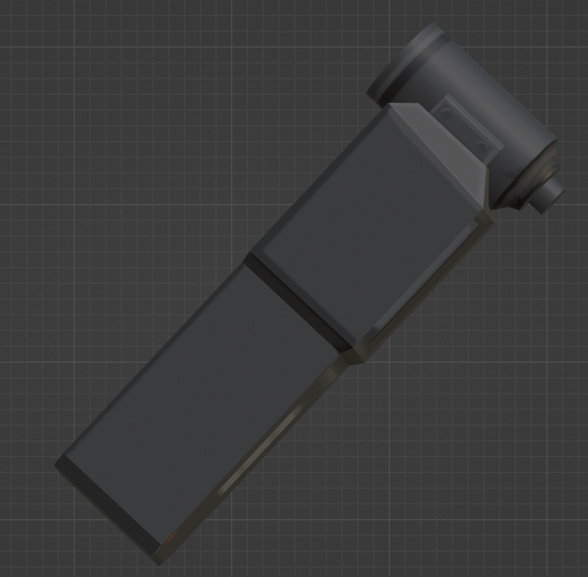
FEDRA
INFECTION SCANNER
Manual: Scanning
How to Use the Cordyceps Infection Scanner
1. Select “Scanning” mode via the pad.
2. Configure the device and choose the detection mode using the button pad.
3. Press the red button to activate the scanner.
4. Point the scanner at the subject's neck.
5. A sound will play, and once it finishes, the screen will light up: green for negative (not infected), red for positive (infected).
2 seconds

Slide 2




FEDRA
INFECTION SCANNER
Manual: Spore Detection
How to Use the Cordyceps Infection Scanner
1. Select “Spore Detection” mode using the button pad.
2. As you approach a spore source, the device will emit a beeping sound.
3. The frequency of the beeps increases as the spore concentration rises.
4. Upon detecting a lethal dose of spores, the device will emit an urgent, alarming beep.

