Slide 1

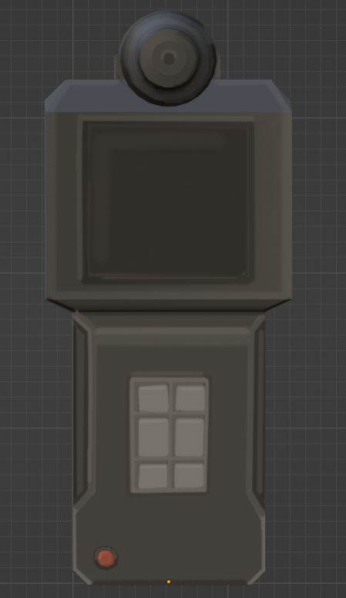
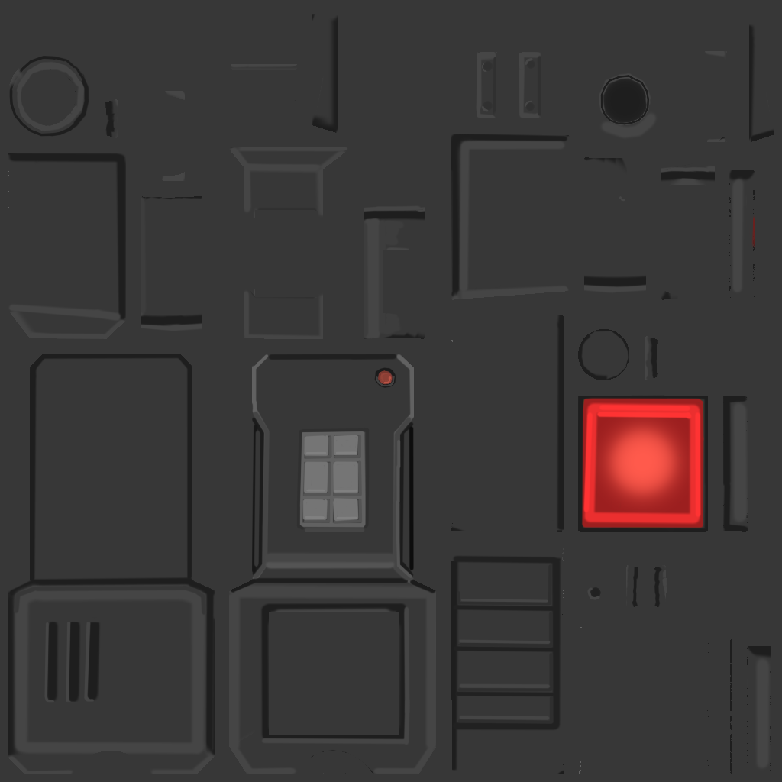






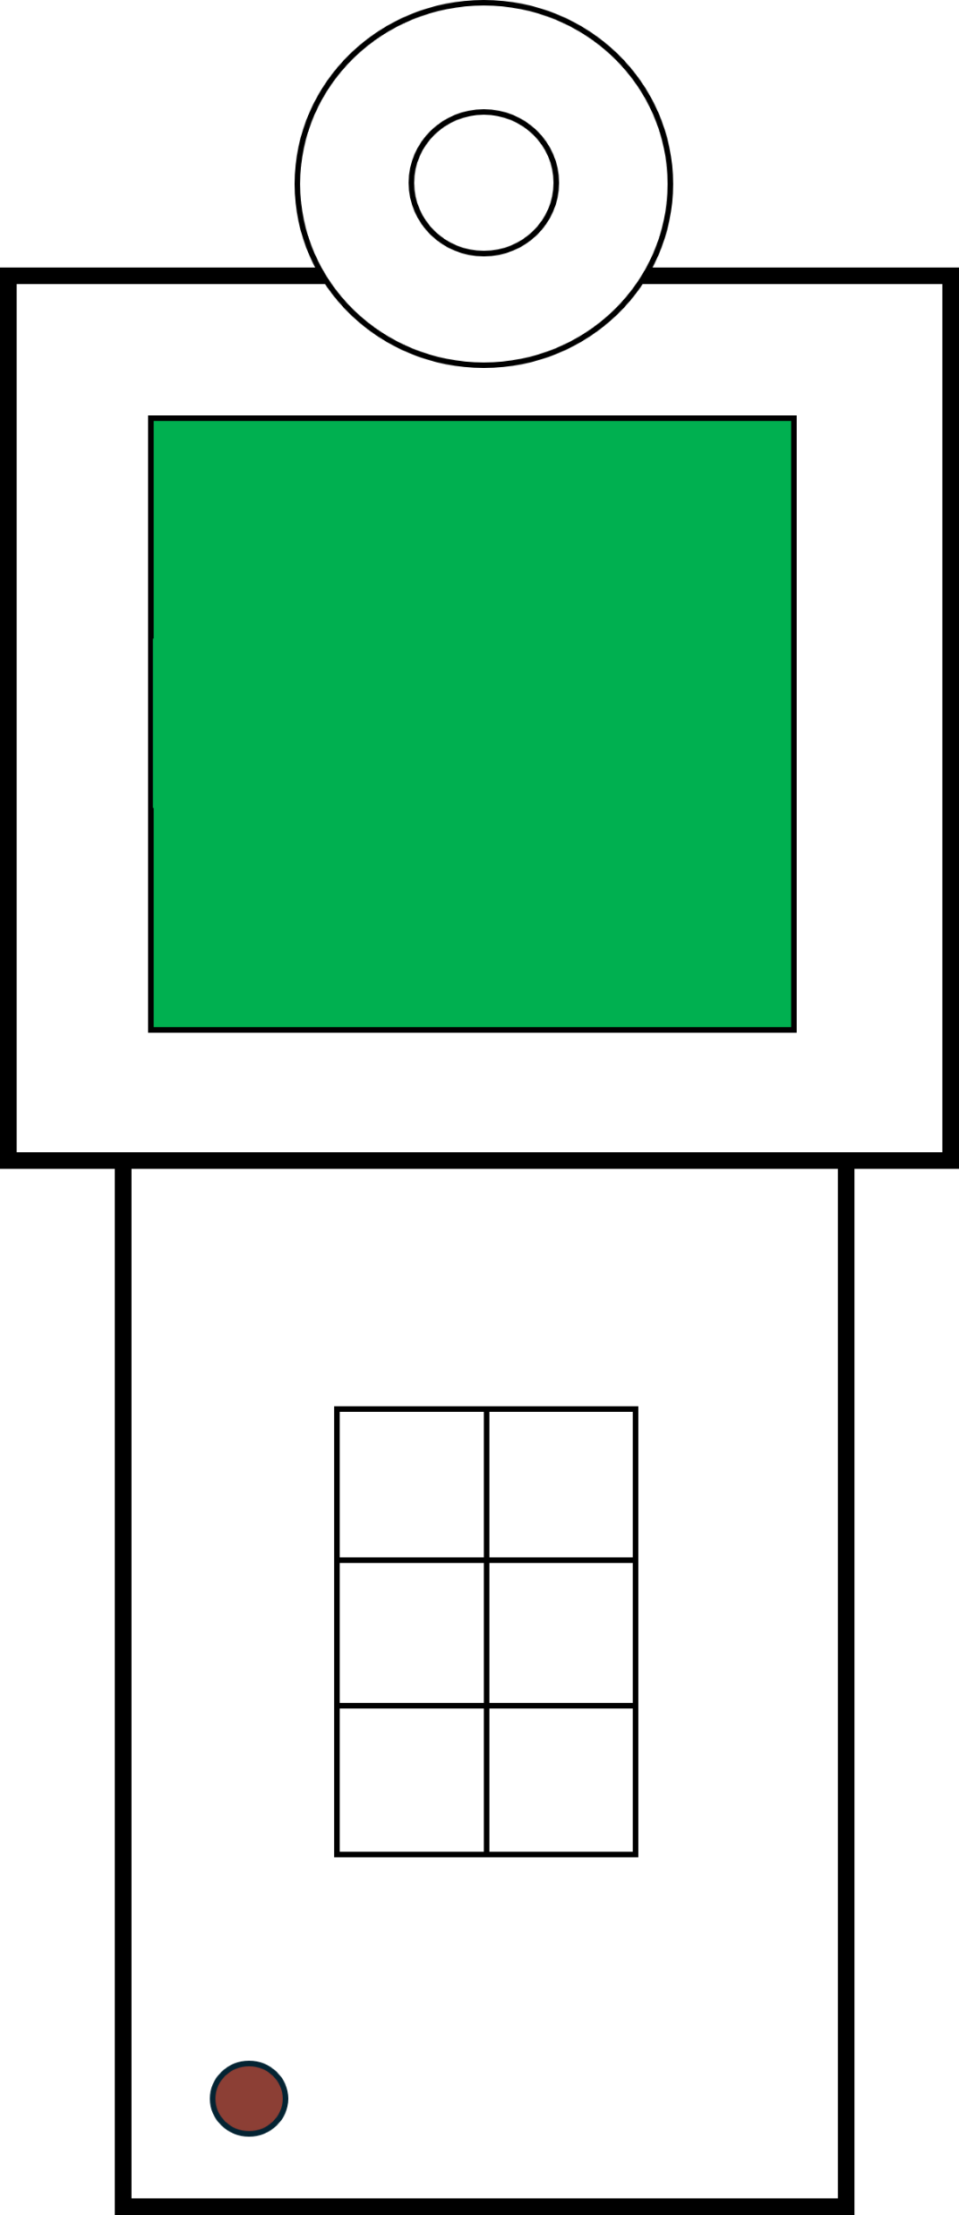
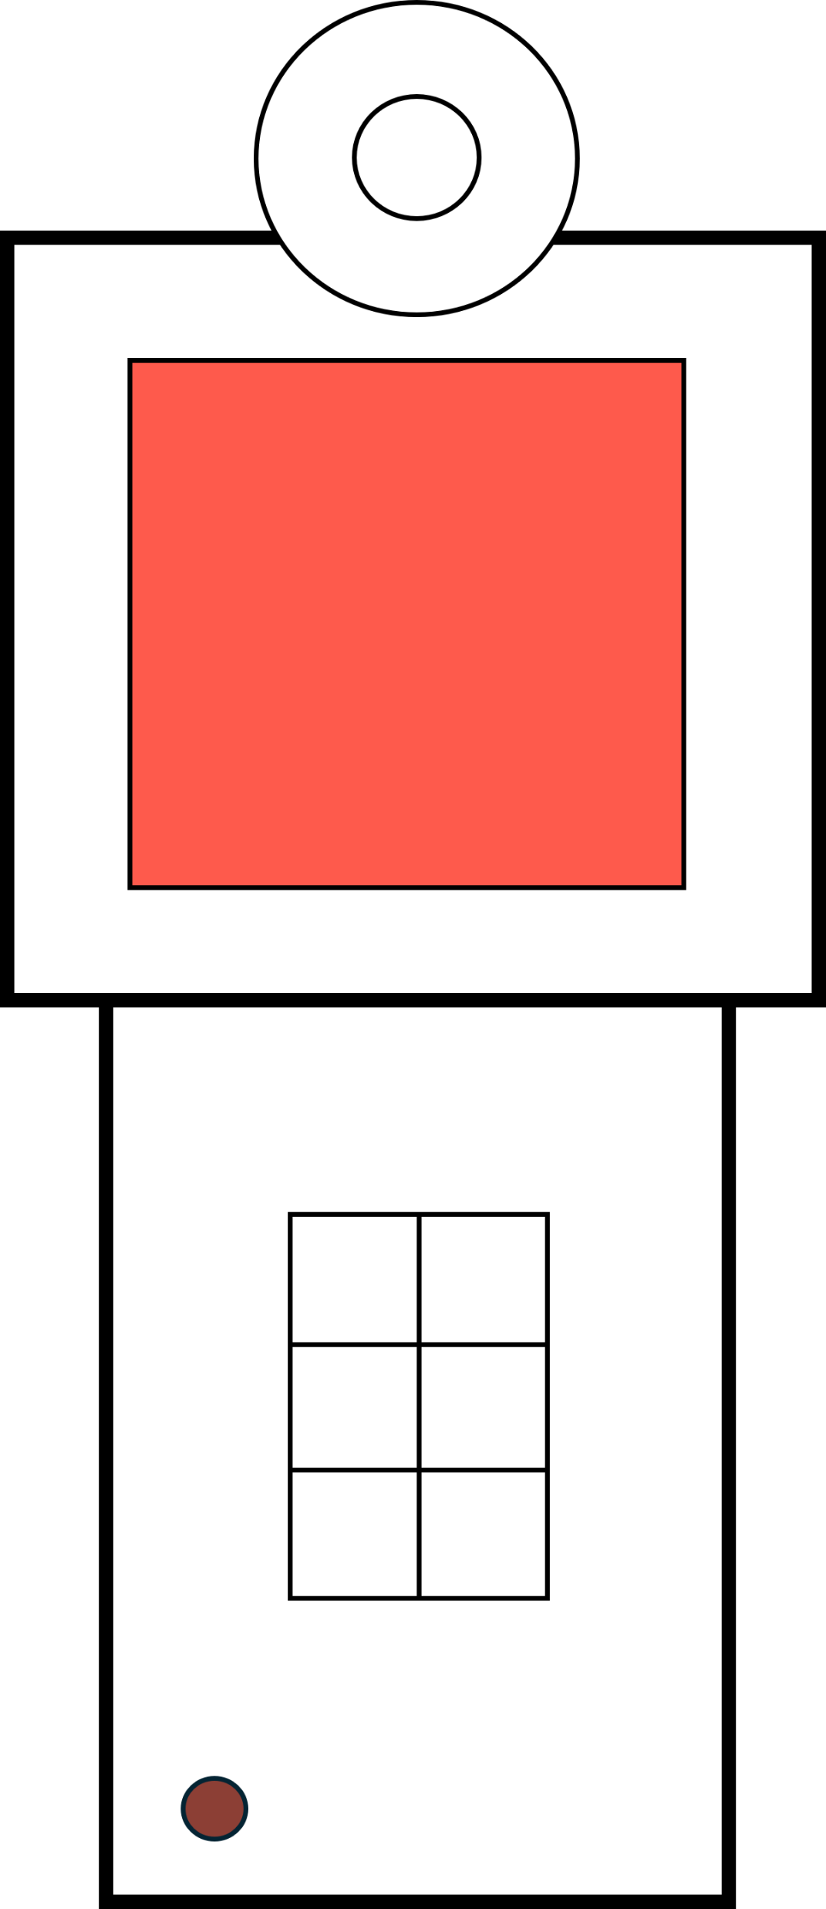


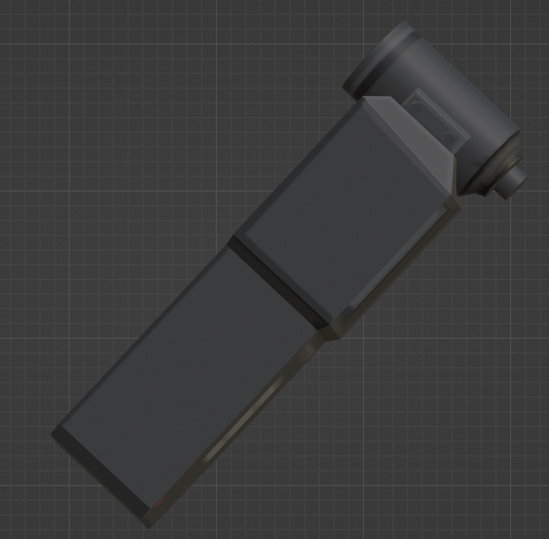
FEDRA
INFECTION SCANNER
Manual
How to Use the Cordyceps Infection Scanner
1. Configure the device and choose the detection mode using the button pad.
2. Press the red button to activate the scanner.
3. Point the scanner at the subject's neck.
4. A sound will play, and once it finishes, the screen will light up: green for negative (not infected), red for positive (infected).
2 seconds

