Slide 1


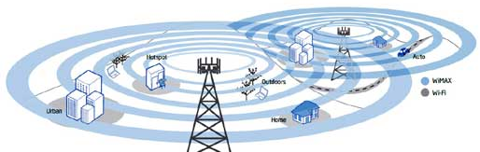
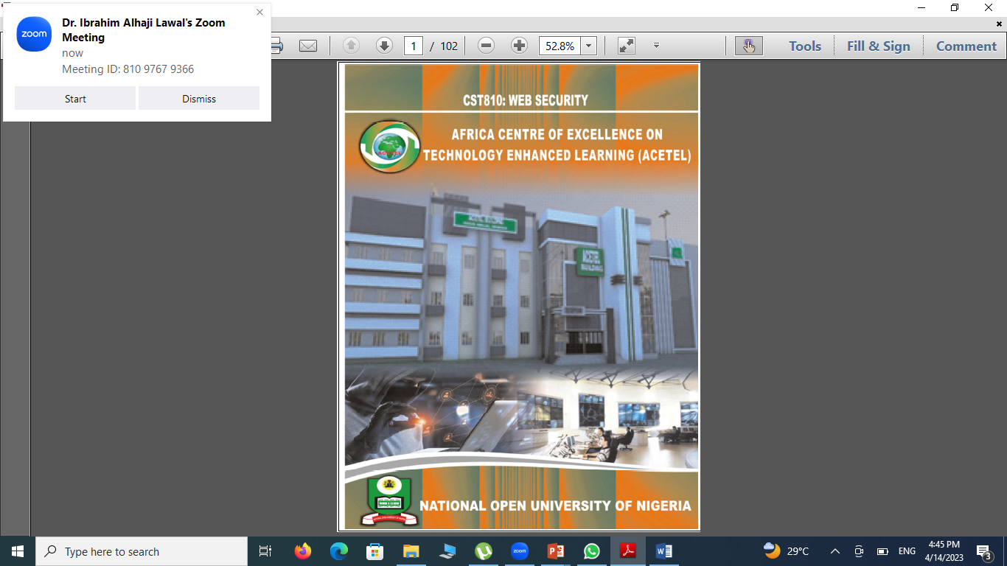
1
2
3
4

Slide 2
Module 1 Fundamental Concepts of web Programming
Unit 1 Introduction of Internet, WWW and N-tier web applications
Unit 2 Web Basics: HTML, CSS, JS, URLs
Unit 3 Web Basics: DOM, Frames, HTTP, Navigation, X-Domain
communication
Module 2 Web application flaws
Unit 1 Injection Flaws
Unit 2 Authentication Flaws
Unit 3 Cookie Flaws
Unit 4 Request Authorization Flaws
Unit 5 HTTP request flows
Unit 6 User Privacy flows

Slide 3
Module 3 Web Vulnerability Exploitation and Web
Security Measures
Unit 1 Network Attacks, HTTPS and its Limitations of HTTPS
Unit 2 Same Origin Policy
Unit 3 Attacks on User Interfaces
Unit 4 Web security measures

Slide 4
Module Introduction
Welcome to a web programming module's Basic Concepts. This module will be completed within 10 hours; it will be supported with videos and exercises which will allow you to learn the most important basic web programming concepts. The module is the first in the course to present the introduction of the web applications Internet, WWW and N-tier. You will learn the Web Basics in this course too: HTML, CSS, Javascript, URLs in a easy way. You'll also learn the basics of the Web: DOM, Frames, HTTP, Browsing, X-Domain Communication.

Slide 5
Module Introduction Cont…
Web programming refers to building a Platform that involves writing, labeling and coding, including Web content, Web client and server scripting, and network protection. The Online programming languages used most commonly include XML, HTML, JavaScript, Perl 5, and PHP. Web programming varies from programming by itself, with interdisciplinary implementation, client and server scripting, and database technology.
Online programming can be split up into server coding and client code. Client-side programming needs to access user data and to provide information. It also needs to make sure that sufficient plugins and security controls are included in a graphical user interface to improve user experience JavaScript is typically used to improve the user interface and the related functionalities on

Slide 6
the client side. It is an excellent forum for the creation and design of client-side Web applications. HTML5 and CSS3 support the bulk of other application frameworks providing client-side features. Server side requires programming mostly related to data recovery, security, and performance. ASP, Lotus Notes, PHP, Java, and MySQL are all applications used here. There are other tools / platforms that support both client and server programming.
In addition to common services such as online chat, file transfer and file sharing, online gaming, and person-to - person voice over Internet Protocol (VoIP) communication via voice and video, the Internet has a wide range of information tools and facilities to support email, notably hypertext documents and World Wide Web ( WWW) networks.

Slide 7
Unit 1: Introduction of Internet, WWW and N-tier Web Applications
Welcome to a web programming module's Basic Concepts. This module will be completed within 10 hours; it will be supported with videos and exercises which will allow you to learn the most important basic web programming concepts. The module is the first in the course to present the introduction of the web applications Internet, WWW and N-tier. You will learn the Web Basics in this course too: HTML, CSS, Javascript, URLs in a easy way. You'll also learn the basics of the Web: DOM, Frames, HTTP, Browsing, X-Domain Communication.

Slide 8
The Internet is the ground-breaking innovation that signals the beginning of a new age of human civilization's Information Era. With millions of computers connected to it, and the number growing exponentially in size about every ten months, mindboggling its potential to affect every facet of life, whether it be communication, education, entertainment, business or government.
Much of the discussion on the Internet today is centered on the World Wide Web. For the last couple of years it has been around but it has been the fastest growing and most popular part of the Net. Inside a browser, the Internet is a Net interface. It incorporates a lot of the different features of the Internet into a single interface used by Web apps.

Slide 9
Introduction of Internet
The Internet is a network of global networks, with a massive multimedia store and exchange of information. It seems to be everywhere and allows many people and devices to connect to it via telephone lines, cables, digital subscriptions or wireless lines. In this section we will explain the importance of the Internet and explore the different ways of connecting to the Web.
In the simplest words, the internet, which is also called the net, consists of a vast number of millions of computers worldwide connected to one another. This network is made up of millions of private, public, academic, business , and government networks, local to global, linked via a wide variety of electronic, cellular, and optical networking technologies such as telephone lines, fiber optic lines, coaxial cables, satellites, and wireless communication.

Slide 10
As time went by several networks linking. By 1971, the ARPANET spanned the western United States (US) with four nodes by the end of 1969, and they had links to Europe by 1973. While the Interconnected Network, or the Internet, was initially confined to military, government, research, and education purposes, it eventually became publicly available. Today, there are hundreds of millions of computers and other devices connected to the Internet worldwide..

Slide 11
Functions of Internet Service Providers (ISPs)
Internet service providers ( ISPs) are corporations (usually private, but publicly owned in some countries) offering basic Internet connectivity and/or access and interconnection for customers (individual users or. businesses wishing to access the Internet). All or any of the following services may be provided by ISPs, depending on their size and business
goals:
1. Public Internet access facilities (dial-in, leased line, cable, ADSL2)
2. Fixed or dynamic IP
3. addresses, with access facilities Accounts by Email
4. Act as a Domain Name Registration Agent
5. Web hosting storage and other facilities (hosting of web pages)

Slide 12
6. Help should issues occur
7. Service Management
8. Additional functionality, including stopping spam.
Both ISPs interconnect to one or more other ISPs to provide access for the public Internet. Smaller ISPs connect to bigger ISPs and bigger ISPs. The charging and peering are two prevalent forms of ISP contact agreement. Charging arrangements provide full Internet connectivity, while peering is restricted to those customers who use ISP only.

Slide 13
World Wide Web (WWW)
The World Wide Web is a source of knowledge which is distributed worldwide and linked together to facilitate easy access. It includes documents called pages which combine the links between text, images, shapes, sound, animation, and hypertext into a rich communication medium.
To many people, The World Wide Web is the internet's most fascinating feature and has driven the internet's development by making it an interactive interface that is easy to use, point-and-click. Users are drawn to the Thanks to their social nature, the Web. The Site project was initiated by CERN (European Particle Physics Laboratory) to create a network to manage the distributed tools needed for scientific research, as it has evolved to include several products for millions of users.

Slide 14
It is used as a market place, art gallery, social media, broadcast channel, library, community centre, school, religious centre, advertising house, publishing house, etc. Most web pages use markup languages including the Hypertext Markup Language (HTML) language. The document author can correctly code sections of the documents to "point" to the information resources. Those specially coded bits, in hypertext, are called links. Users visiting a web page can choose the hyperlink and download or connect to the information resources listed in the "link." Hyperlinks leading to other documents, sounds, images, databases (like library catalogues), email addresses, etc.

Slide 15
Communications Protocols
Such email addresses are set as follows: the username, followed by a "@“ (at) prefix, followed by a domain name (for example, .com.edu.net or.org). Use Easy Mail Transfer Protocol (SMTP) when sending emails to others. When you receive an e-mail you may use the Post Office Protocol (POP, officially POP3) and the Internet Message Access Protocol (IMAP):
• Transmission Control Protocol/Internet Protocol (TCP/IP)
• File Transfer Protocol (FTP)
• Hypertext Transfer Protocol (HTTP)
• Email Protocol.

Slide 16
N-tier Web Applications
The concept of N-tier is broader than merely listing the exact ranges. This concept helps to divide the web application to manage and isolate levels. which could change, re-design, replace and re-write the entire application without breaking. Depending on the technology stack you use, the number of thirds will vary. The following figure demonstrates how N-tier Architecture breaks a web application into different tiers.

Slide 17
Pictorial Representation of N-tier architecture

Slide 18
Unit 2: Web Basics: HTML, CSS, JS, URLs
HTML stands for Mark-up Hypertext Language. It is the language used to create Web pages, which consists of structured codes or "tags" used to describe the information structure on the Web page. Web pages come up in many varieties. They contain static information in its simplest form, which is composed of simple texts. On the other extreme are highly colourful pages which contain elements of animation, sound and interactivity.
HTML codes make it possible for web pages to have many features including bold text, italic text, heading, paragraph breaks, tables, forms etc. Web pages generally reside on the HTTP server.

Slide 19
A user requests a web page from an HTTP (Web) server through a web browser such as Internet Explorer, Mozilla Firefox, Safari, and Chrome and so on, either by clicking on the hypertext or designating a particular URL (Uniform Resource Locator). The server then sends the requested information to the user computer.

Slide 20
Understanding HTML
HTML is a collection of mark-up symbols or codes displayed in a file intended for display on the Web browser page. These markup symbols and codes identify structural elements such as paragraphs, captions, and lists.
HTML may be used to place media (such as graphics, video, and audio) on the Web page and fill-in form description. The browser interprets the markup codes and makes them to the website.
HTML enables platform-independent display of information over the network. Whatever type of computer a Web page is generated on, any browser running on any operating system can display the page. The new version of HTML used today is eXtensible HyperText Mark-up Language (XHTML). XHTML uses HTML tags and attributes, along with the syntax of the eXtensible Mark-up Language (XML).

Slide 21
For any web page they build, web developers may construct their objects and tags, because XHTML is "extensible," which enables developers to have more control about how their web pages look and organize. The only prerequisite is a description of the custom tags and attributes in a document form (DTD).
Also, XHTML pages must comply with a syntax more stringently than standard HTML pages. Though web browsers are very indulgent in and welcome the HTML syntax, XHTML pages must have perfect syntax. This means that the markup language does not contain missing quotes or incorrect capitalization. Although more strict syntax requires more careful design of web pages, this often means web pages appear more homogeneous across various browser platforms..

Slide 22
Web Browser
A Web browser is a software program that interprets the coding language in a graphical form on the World Wide Web, displaying the translation rather than coding. A client represents the internal workings of the site as a user. interface. The browser software, such as Internet Explorer, Google Chrome, Firefox, Mozilla, Safari, etc., interprets HTML codes and shows the user device information in readable format on the web pages.
In a browser no HTML tags appear, browsers function as client programs by contacting the webserver and submitting the request to the user's computations for received information.

Slide 23
HTML Tags
HTML consists of structured "tags" used to describe the web pages‘ information structure. The browser determines the identifier-based information structure, which are marks of HTML Tags embedded in the text.
Two signs (< and >) are labelled with a tag and typically come in pairs. The start tag starts with the name of the tag, and the ending tag ends with a slash followed by the name of the tag. The use of tags enables many features on web pages, including bold text, italic text, heading, paragraph breaks, and numerated or bulleted list. Table 1 outlines a list of elevated HTML tags.

Slide 24
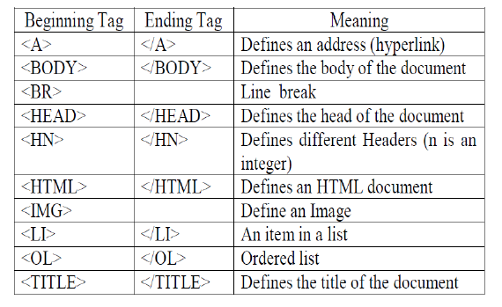
Some common Tags for HTML

Slide 25
Tags are commonly used to designate "mark-up" regions of HTML documents to be interpreted by the Web browser.
Tags are composed of the element name, surrounded by brackets with angles. An end tag also has a slash to distinguish it from the start tag, after the opening angle bracket. For instance, p, which is represented by p element, would be written as: < p > this is my first HTML code < /p > Not all elements need the end tag.
An example of an element that doesn't need an end tag is the <br> element that causes a line break on a browser displaying interpreted HTML codes. HTML attributes are HTML Element Modifiers. They usually appear as namevalue pairs, separated by "=" and are written in an element's start tag after the name of the element: <"tag"' "attribute"'="'value"'> (content to be modified by the tag) </tag>. Where tag names the HTML element, the attribute is the name of the attribute, set to the provided value.

Slide 26
An attribute customizes or modifies HTML elements

