Slide 1
GREENHEX TEAM · NESARI 2026 · NETONE TOPIC 2
NETONE
DYNAMIC
INTELLIGENT ANTENNA
OPTIMIZATION FOR WIRELESS NETWORKS
DETECT
›
ANALYSE
›
OPTIMISE
›
MOVE
›
VERIFY
›
REPEAT
PRESENTERS · GreenHex Inc. Team
GreenHex · NESARI 2026 · NetOne Topic 2

Slide 2
PROBLEM STATEMENT
Coverage that can't keep up with demand
WHY IT MATTERS
?
THE REDEFINED QUESTION
Mobile coverage and capacity shift with subscriber demand through the day. Fixed antenna settings can't track those changes, so parts of the network are over-served while others starve.
How can AI-driven antennas rotate base stations toward peak demand to improve coverage and performance?
Operators need a way to read conditions and know when a configuration change would actually improve service.
GreenHex · NESARI 2026 · NetOne Topic 2
02

Slide 3
WHAT WE SET OUT TO DO
Objectives
01
02
03
04
Detect demand
Diagnose network
Optimise settings
Move the antenna
Find sectors with high or shifting user demand.
Spot coverage and capacity problems early.
Compute recommended antenna angles.
Automatic tilt via a servo-driven model.
05
06
07
08
Verify position
Measure impact
Keep an audit trail
Scale to industry
Confirm the commanded angle with feedback.
Compare performance before and after.
Log recommendations, approvals, outcomes.
A path to real Remote Electrical Tilt gear.
GreenHex · NESARI 2026 · NetOne Topic 2
04

Slide 4
PROPOSED SOLUTION
An AI-assisted optimization loop
The system reads traffic demand and network KPIs, recommends suitable antenna settings, and applies approved adjustments through a controlled hardware or network-management interface.
Monitor
Analyze
Optimize
Apply
Verify
Repeat
↻ continuous — the loop re-runs whenever demand shifts
STARTS IN SIMULATION
BUILT FOR PRODUCTION
Synthetic traffic scenarios plus a physical servo-driven antenna model turn a decision into a visible mechanical response.
Later integrates with NetOne's authorised network-management systems, real measurements, and approved antenna interfaces.
GreenHex · NESARI 2026 · NetOne Topic 2
05

Slide 5
HOW THE PIECES FIT
System Architecture
01
Network data & monitoring
DEMO PATH
Traffic demand · signal quality · throughput · interference · alarms
Python API → Arduino → Servo → Miniature antenna
02
AI optimization engine
Analyse KPIs, recommend settings, estimate the potential improvement
03
Safety & approval layer
Allowed angle limits · authorization · change approval · rollback
INDUSTRIAL PATH
Approved network interface → AISG / RET controller → Antenna actuator
04
Feedback & verification
Confirm position, recheck KPIs, compare, record the outcome, repeat
GreenHex · NESARI 2026 · NetOne Topic 2
08

Slide 6
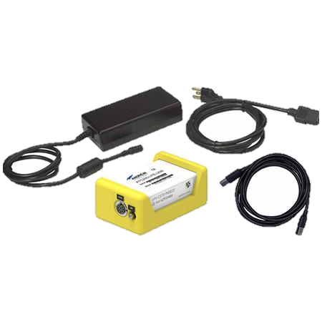
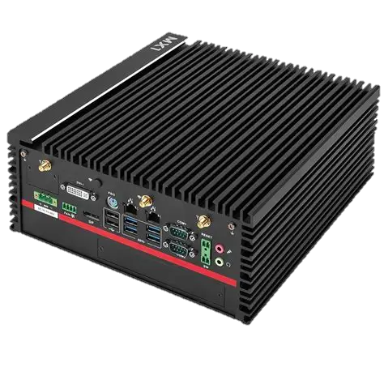
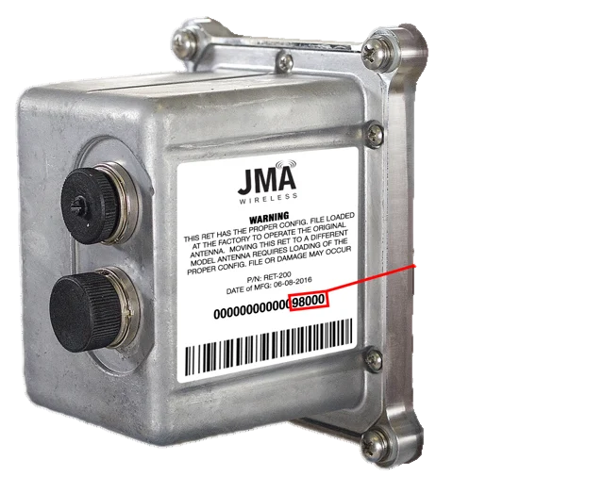
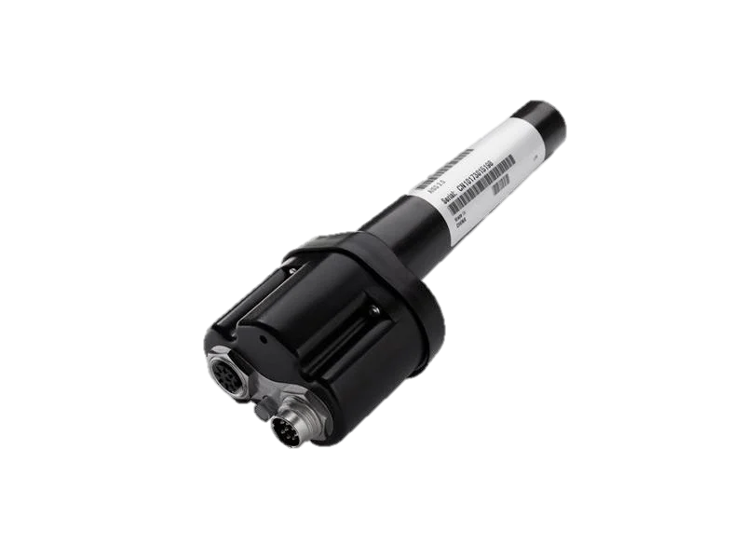
FROM PROTOTYPE TO REAL GEAR
The Proper Industrial Components
Andrew ATM200-A20 Teletilt Actuator
Andrew ATC200-LITE-USB
MiTAC MA1-NX-16GB Fanless Industrial Edge AI Computer
Function: Remotely adjusts electrical downtilt on the antennas.
Price: $553.85 *Listed
Function: Provides a controller interface for supported RET actuators.
Price: $417.20 *Listed
Function: To house the AI model which will be constantly adjusting the actuator.
Price: $1,799.95 *Listed
GreenHex · NESARI 2026 · NetOne Topic 2
09

