Slide 1

Crypto: You’re doing it wrong
Ron Bowes, Leviathan Security Group
Shmoocon 2013

Slide 2

About me
Ron Bowes
@iagox86
ron@skullsecurity.net
Security consultant for Leviathan Security Group
Canadian

Slide 3
Quick agenda
History of crypto attacks
A bunch of examples, with proofs of concept
Bit flipping
Key re-use
Compression attack
Padding oracle
Hash length extension
Bad random numbers
Some proposed solutions

Slide 4
Why am I doing this?
In my opinion, crypto is one of the most important technologies in the modern world, if implemented correctly
Crypto implementation is hard
I decided to teach myself attacks by writing tools
Before I knew it, I had enough to make an interesting talk!

Slide 5
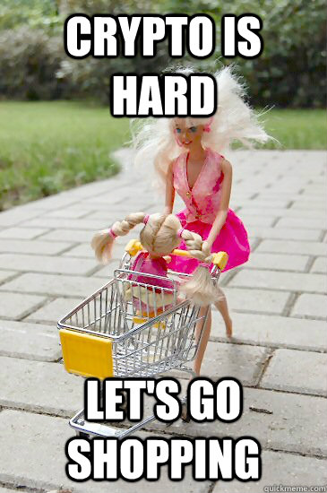
For our purposes…
“Crypto”, in the context of this talk, will cover:
Encryption
Hashing
Random numbers
Anything else I need it to cover

Slide 6

History of Crypto

Slide 7
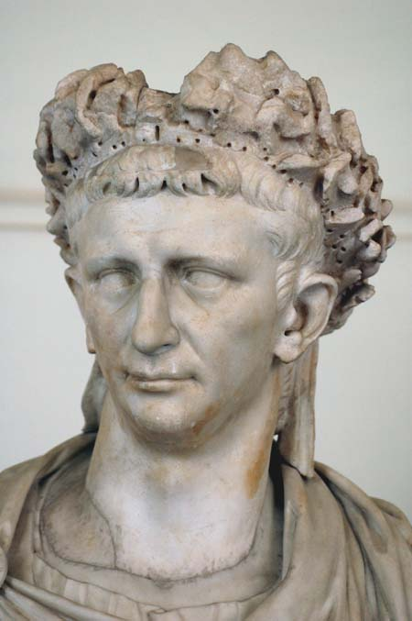
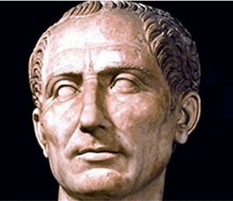
c. 75 BC: Caesar cipher
Shift cipher
25 possible encodings (26, if you count ‘0’)
Trivially bruteforced
J uijol nz gsjfoet bsf uszjoh up ljmm nf!
mpm

Slide 8
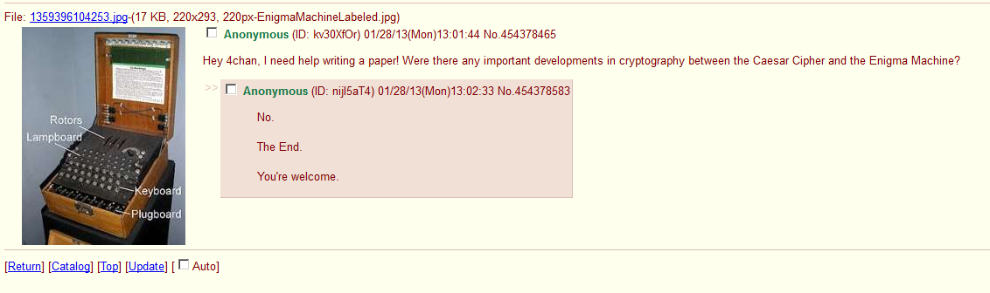
Caesar – World War II: No developments

Slide 9
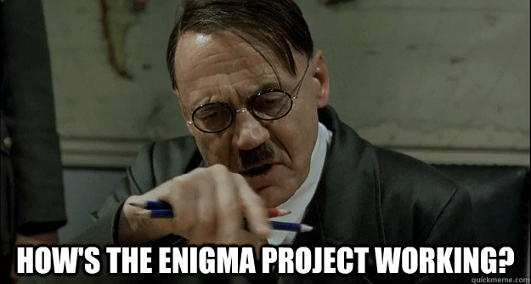
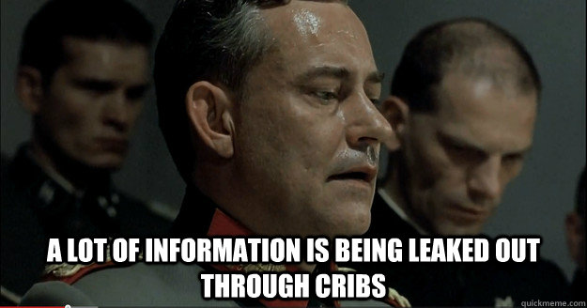

World War II: Enigma Machine
Notes:
Important to talk about: Cribs – large indexes of what each person typically said
Chit-chat in the clear from Enigma operators
‘continuations’ and times
Turned agent – Treasure – sent long messages that were enciphered in both Dockyard Cipher and Enigma – handy
Initially broken because first three characters and next three characters were encrypted the same way
“Gardening” – planting cribs during important events, eg, planting mines in a carefully chosen position such that the message about them would contain a needed word
No letter would ever decrypt to itself
The same rotor wheel couldn’t be used in adjacent positions
Every German operative in Britain was either captured or turned

Slide 10
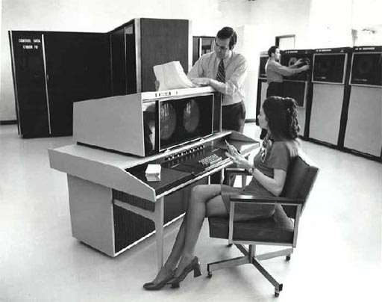
Let’s get more modern

Slide 11



1970s: DES was invented!
A symmetric-key block cipher
Message could be decrypted by the intended recipient and everybody who’s stolen the key
E(“This cereal sucks”)
“Alice”
“Bob”
“Eve” (aka, guy who stole the key)

Slide 12
Still 1970s: Along came DH and RSA
Now the keys could be exchanged with “Eve”, making his/her job slightly more difficult
K_{alice}
K_{bob}
K_{eve}
K_{eve}
“Alice”
“Eve”
“Bob”

Slide 13
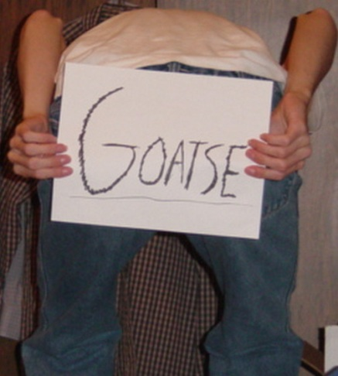
1990s: Certification Authorities
Now you can see if any of 100s of users thinks the “Bob” is actually “Bob”
K_{eve}
Is this K_{bob}?
Sure, whatever
“Eve”
“Alice”
?
“Bob”

Slide 14
Comparing “modern” crypto methods
Relative strength when used properly
Relative strength when used incorrectly
 | Completely broken | Somewhat broken | Probably good
DES (1979) |  | X
RC4 (1987) |  | X
3DES (1998) |  |  | X
AES (1998) |  |  | X
Blowfish |  |  | X
MD4 (1990) |  | X
MD5 (1992) |  | X
SHA1 (1995) |  | X
SHSA2 (2001) |  |  | X
SHA3 (2012) |  |  | X
 | Completely broken | Somewhat broken | Probably good
DES (1979) | X
RC4 (1987) | X
3DES (1998) |  | X
AES (1998) |  | X
Blowfish |  | X
MD4 (1990) |  | X
MD5 (1992) |  | X
SHA1 (1995) |  | X
SHSA2 (2001) |  | X
SHA3 (2012) |  | ???

Slide 15
Important concepts

Slide 16
Encryption
The act of obscuring data using a secret key, such that only the intended recipient – and anybody else who manages to steal the key – can read it

Slide 17
Encryption – Stream cipher

Slide 18
Encryption – Block cipher

Slide 19
Encryption – Public key cryptography

Slide 20
Hashing

Slide 21
Random numbers

Slide 22
Attacks

Slide 23
Public key cryptography

Slide 24
Public-key encryption
Encryption that requires both parties to send their key to a malicious third party before communicating

Slide 25
Public-key encryption with CAs
Encryption that requires one or both parties to trust hundreds of untrustworthy companies

