Slide 1

Crypto: You’re doing it wrong
Ron Bowes, Leviathan Security Group
Shmoocon 2013

Slide 2


About me
Ron Bowes
@iagox86
http://www.skullsecurity.org
ron.bowes@leviathansecurity.com
Security consultant for Leviathan Security Group
Founder/president of SkullSpace, Winnipeg’s hackerspace
Rockclimber
The best way to improve your self confidence is to hang 1000ft in the air – from an anchor you built

Slide 3
Quick agenda
History of crypto attacks
A bunch of examples, with proofs of concept
Key re-use
Hash length extension
Padding oracle
Some proposed solutions

Slide 4
Why am I doing this?
In my opinion, crypto is one of the most important technologies in the modern world, if implemented correctly
Crypto implementation is hard
I decided to teach myself attacks by writing tools
Before I knew it, I had enough to make an interesting talk!

Slide 5
Comparing “modern” crypto methods
Relative strength when used properly
Relative strength when used incorrectly
 | Completely broken | Somewhat broken | Probably good
DES (1979) |  | X
RC4 (1987) |  | X
3DES (1998) |  |  | X
AES (1998) |  |  | X
Blowfish |  |  | X
MD4 (1990) |  | X
MD5 (1992) |  | X
SHA1 (1995) |  | X
SHA2 (2001) |  |  | X
SHA3 (2012) |  |  | X
 | Completely broken | Somewhat broken | Probably good
DES (1979) | X
RC4 (1987) | X
3DES (1998) | X
AES (1998) | X
Blowfish | X
MD4 (1990) | X
MD5 (1992) | X
SHA1 (1995) | X
SHA2 (2001) | X
SHA3 (2012) |  | ???

Slide 6

For our purposes…
“Crypto”, in the context of this talk, will cover:
Encryption
Hashing
Random numbers
Anything else I need it to cover

Slide 7

History of crypto
The somewhat accurate

Slide 8
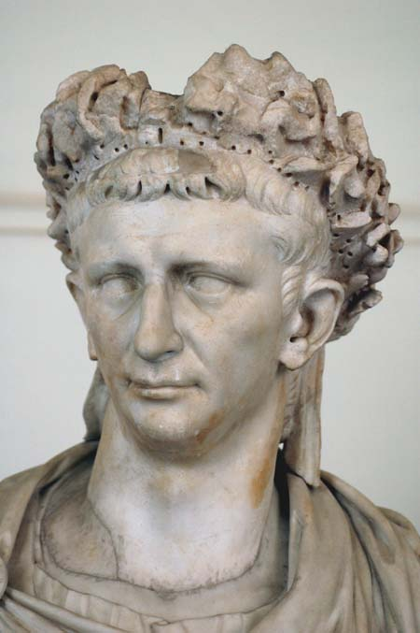
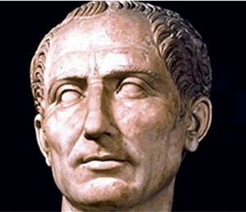
c. 75 BC: Caesar cipher
Shift cipher
25 possible encodings (26, if you count ‘0’)
Trivially bruteforced
J uijol nz gsjfoet bsf uszjoh up ljmm nf!
mpm

Slide 9
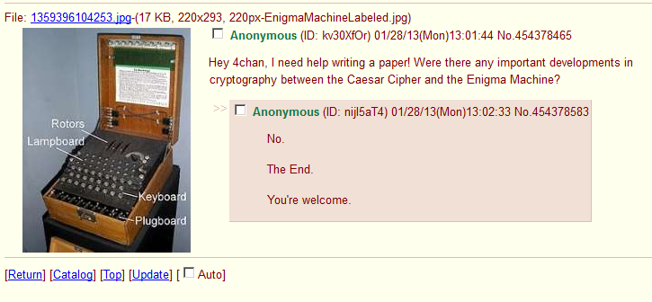
Caesar – World War II: No developments
Not shown: the part where they call OP a “fag” (<3 4chan)
Notes:
“Then they called me a fag”

Slide 10



World War II: Enigma Machine
Notes:
Important to talk about: Cribs – large indexes of what each person typically said
Chit-chat in the clear from Enigma operators
‘continuations’ and times
Turned agent – Treasure – sent long messages that were enciphered in both Dockyard Cipher and Enigma – handy
Initially broken because first three characters and next three characters were encrypted the same way
“Gardening” – planting cribs during important events, eg, planting mines in a carefully chosen position such that the message about them would contain a needed word
No letter would ever decrypt to itself
The same rotor wheel couldn’t be used in adjacent positions
Every German operative in Britain was either captured or turned

Slide 11
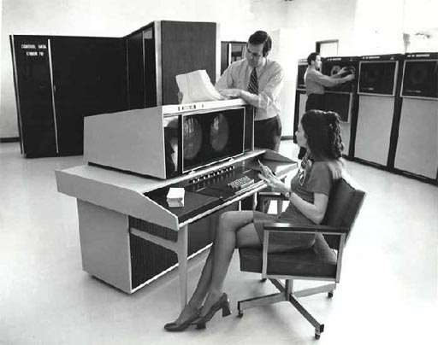
Let’s get more modern

Slide 12



1970s: DES was invented!
A symmetric-key block cipher
Message could be decrypted by the intended recipient and everybody who’s stolen the key
E(“This cereal sucks”)
“Alice”
“Bob”
“Eve” (aka, guy who stole the key)

Slide 13
Still 1970s: Along came DH and RSA
Now both parties have to exchange keys with “Eve” (or each other) before they can communicate
K_{alice}
K_{bob}
K_{eve}
K_{eve}
“Alice”
“Eve”
“Bob”

Slide 14
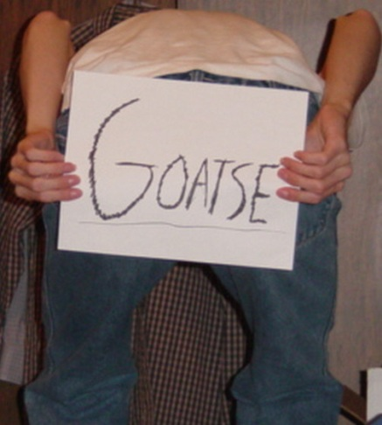
1990s: Certification Authorities
Now you can see if any of 100s of companies thinks the “Bob” is actually “Bob”
K_{eve}
Is this K_{bob}?
Sure, whatever
“Eve”
“Alice”
?
“Bob”

Slide 15

1990s: WEP
While we’re talking about Goatse…
RC4 w/ 24-bit IV
Using RC4 all kinds of wrong led to total compromise

Slide 16
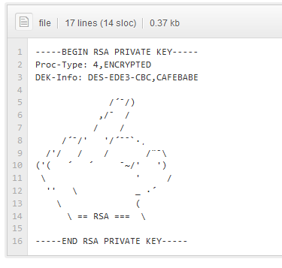
2008: github (and other “Web 2.0” stuff)
A new place for people to post private keys, passwords, and other confidential data

Slide 17
Point?
These days, encryption is rarely broken directly
It’s broken by…
Implementation error (developer mistakes)
Operator error (end-user mistakes)
Document, key, codebook theft/leakage
Stupidity (aka, CAs)
Side-channel attacks
The rest of this talk will be about indirect ways to break state-of-the-art crypto!

Slide 18

Important concepts
Dangerously oversimplified, because this is Shmoocon and most of you probably know this…

Slide 19
Encryption
The act of obscuring data using a secret key, such that only the intended recipient – and anybody else who manages to steal the key – can read it

Slide 20
Encryption: Stream cipher
Each byte is encrypted by “XOR”ing it with a “keystream”
Keystream is typically the output of a random number generator
Meant to simulate a 1-time pad
Plaintext | H | E | L | L | O |  | W | O | R | L | D
Keystream | 3e | 83 | 82 | d1 | 7a | 5a | c5 | b8 | ca | 3c | 1d
Cipher | 76 | c6 | ce | 9d | 35 | 7a | 92 | f7 | 98 | 70 | 59
Keystream (again) | 3e | 83 | 82 | d1 | 7a | 5a | c5 | b8 | ca | 3c | 1d
Plaintext | H | E | L | L | O |  | W | O | R | L | D

Slide 21
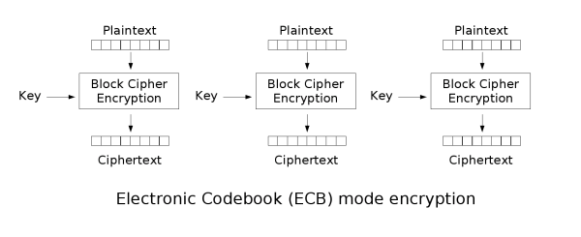
Encryption: Block cipher
Plaintext is broken into 8- or 16-byte blocks, each is encrypted individually
Various “modes of operation” can be used to ensure that the ciphertext isn’t repeated

Slide 22

Encryption: Block cipher modes of operation – ECB
“Electronic codebook” mode encrypts each block individually:
This leads to problems like the famous “ECB Tux” image:

Slide 23
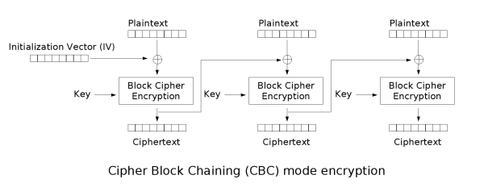
Encryption: Block cipher modes of operation – CBC
“Cipherblock Chaining” feeds the output from each block into the input of the next:
This is much better than CBC, but also has some serious problems
We’ll talk about this in detail when we talk about padding oracles

Slide 24
Initialization vectors: IVs
The ‘input’ into an encryption function
Designed so that the same data encrypted with the same key doesn’t generate the same ciphertext
We’ll see why that’s a problem

Slide 25
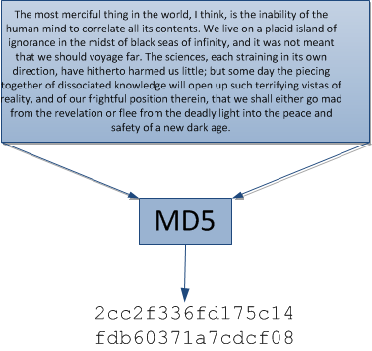
Hashing
Reducing a large amount of data to a small amount
Works similarly to a block cipher, as we’ll see

Slide 26

Attacks
Now, what you all came here for…

Slide 27
Key re-use in stream ciphers
Cut out due to lack of time ☹

Slide 28
Bit-flipping against stream ciphers
First, let’s review stream ciphers…
C = (P ⊕ K)
P = (C ⊕ K) = ((P ⊕ K) ⊕ K)
Text is XORed with keystream, XORed again to get it back
Now the attack…
C = (P ⊕ K)
C’ = (C ⊕ x) = ((P ⊕ K) ⊕ x)
P’ = (C’ ⊕ K) = (((P ⊕ K) ⊕ x) ⊕ K) = (P ⊕ x)

Slide 29

That’s a lot of math!

Slide 30
Bit-flipping example
> Ping 4.2.2.1:
0000 00 ff 7b 92 b7 b8 00 ff 7a 92 b7 b8 08 00 45 00 ..{.....z.....E.
0010 00 3c 2b 59 00 00 80 01 ff 3e 0a 15 00 12 04 02 .<+Y.....>......
0020 02 01 08 00 4d 2d 00 01 00 2e 61 62 63 64 65 66 ....M-....abcdef
0030 67 68 69 6a 6b 6c 6d 6e 6f 70 71 72 73 74 75 76 ghijklmnopqrstuv
0040 77 61 62 63 64 65 66 67 68 69 wabcdefghi
> Note index 0x1e – “04 02 02 01” – the IP address
> RC4(‘THISISMYGOODRC4KEY’, packet):
0000 08 98 56 8E 46 2F 29 58 F4 08 9E C0 D7 6B 76 29 ..V.F/)X.....kv)
0010 FB BD DE F4 71 E7 0F CF 35 81 21 EC 01 E7 17 AC ....q...5.!.....
0020 A5 9F 0E 42 9D 66 D9 38 B4 A5 30 D3 C9 26 3D DE ...B.f.8..0..&=.
0030 E2 18 EE 1D 53 93 BC 54 C4 77 4A 24 8D 6E 10 9E ....S..T.wJ$.n..
0040 88 D4 37 9F 65 64 29 25 7D 8E ..7.ed)%}.
> Index 0x1e is now “17 ac a5 9f”
> 17 ac a5 9f ⊕ 04 02 02 01 ⊕ 08 08 08 08 = 1b a6 af 96:
0000 08 98 56 8E 46 2F 29 58 F4 08 9E C0 D7 6B 76 29 ..V.F/)X.....kv)
0010 FB BD DE F4 71 E7 0F CF 35 81 21 EC 01 E7 1B A6 ....q...5.!.....
0020 AF 96 0E 42 9D 66 D9 38 B4 A5 30 D3 C9 26 3D DE ...B.f.8..0..&=.
0030 E2 18 EE 1D 53 93 BC 54 C4 77 4A 24 8D 6E 10 9E ....S..T.wJ$.n..
0040 88 D4 37 9F 65 64 29 25 7D 8E ..7.ed)%}.
> RC4(‘THISISMYGOODRC4KEY’, updated_packet):
0000 00 FF 7B 92 B7 B8 00 FF 7A 92 B7 B8 08 00 45 00 ..{.....z.....E.
0010 00 3C 2B 59 00 00 80 01 FF 3E 0A 15 00 12 08 08 .<+Y.....>......
0020 08 08 08 00 4D 2D 00 01 00 2E 61 62 63 64 65 66 ....M-....abcdef
0030 67 68 69 6A 6B 6C 6D 6E 6F 70 71 72 73 74 75 76 ghijklmnopqrstuv
0040 77 61 62 63 64 65 66 67 68 69 wabcdefghi
Pcap from pinging 4.2.2.1 (the DST IP field is highlighted)
Encrypt the full packet with IP4 (even the link header, for simplicity)
XOR the DST IP field with the real IP (4.2.2.1) then another IP (8.8.8.8)
Decrypt the packet, note the DST IP is now 8.8.8.8

Slide 31
Why does bit flipping matter?
The plaintext packet can be controlled by modifying the encrypted packet
This works against any algorithm that XORs the plaintext with a keystream
RC4
One-time pads
Block ciphers in OFB, PFB, or CTR mode (we’ll talk more about those later!)

Slide 32
How to prevent bit-flipping attacks
Prepend a HMAC() hash to encrypted data
Proper HMAC(), not H(secret || data)
We’ll see why when we talk about hash-length-extension attacks
To not fail crypto:
Encrypt: Encrypt, then hash
Decrypt: Verify hash, then decrypt

Slide 33

“The Cryptographic Doom Principle”

Slide 34
Key re-use in stream ciphers
In stream ciphers, the same key will generate the same keystream
If you encrypt different data with the same keystream, you’re gonna have a bad time
(I’m looking at you, WEP)
That’s why the initialization vector – IV – was invented

Slide 35
Key re-use in stream – example
> ping = [Ping 4.2.2.1]
> enc_packet = RC4(‘THISISMYGOODRC4KEY’, ping):
0000 08 98 56 8E 46 2F 29 58 F4 08 9E C0 D7 6B 76 29 ..V.F/)X.....kv)
0010 FB BD DE F4 71 E7 0F CF 35 81 21 EC 01 E7 17 AC ....q...5.!.....
0020 A5 9F 0E 42 9D 66 D9 38 B4 A5 30 D3 C9 26 3D DE ...B.f.8..0..&=.
0030 E2 18 EE 1D 53 93 BC 54 C4 77 4A 24 8D 6E 10 9E ....S..T.wJ$.n..
0040 88 D4 37 9F 65 64 29 25 7D 8E ..7.ed)%}.
> keystream = [Ping 4.2.2.1] ⊕ RC4(‘THISISMYGOODRC4KEY’, [Ping 4.2.2.1]):
0000 08 67 2D 1C F1 97 29 A7 8E 9A 29 78 DF 6B 33 29 .g-...)...)x.k3)
0010 FB 81 F5 AD 71 E7 8F CE CA BF 2B F9 01 F5 13 AE ....q.....+.....
0020 A7 9E 06 42 D0 4B D9 39 B4 8B 51 B1 AA 42 58 B8 ...B.K.9..Q..BX.
0030 85 70 87 77 38 FF D1 3A AB 07 3B 56 FE 1A 65 E8 .p.w8..:..;V..e.
0040 FF B5 55 FC 01 01 4F 42 15 E7 ..U...OB..
> telnet = [Telnet www.skullsecurity.org “PASS: ???”
> secret = RC4(‘THISISMYGOODRC4KEY’, telnet):
0000 08 98 56 8E 46 2F 29 58 F4 08 9E C0 D7 6B 76 29 ..V.F/)X.....kv)
0010 FB BE 8B 1B 31 E7 0F C8 2B D9 21 EC 01 E7 DD 72 ....1...+.!....r
0020 66 06 CA C8 D7 9B A7 E6 5E C1 A5 F6 D7 A0 08 A0 f.......^.......
0030 BA 87 41 38 38 FF 81 7B F8 54 01 76 93 63 16 8D ..A88..{.T.v.c..
0040 9C C7 30 88 71 60 3C 31 62 88 CE 0A F1 ..0.q`<1b....
> result = (secret ⊕ keystream)
0000 00 FF 7B 92 B7 B8 00 FF 7A 92 B7 B8 08 00 45 00 ..{.....z.....E.
0010 00 3F 7E B6 40 00 80 06 E1 66 0A 15 00 12 CE DC .?~.@....f......
0020 C1 98 CC 8A 07 D0 7E DF EA 4A F4 47 7D E2 50 18 ......~..J.G}.P.
0030 3F F7 C6 4F 00 00 50 41 53 53 3A 20 6D 79 73 65 ?..O..PASS:.myse
0040 63 72 65 74 70 61 73 73 77 6F cretpasswo
Encrypt something that’s well known to the attacker
XOR the ciphertext with the known plaintext
Encrypt something unknown using the same key
XOR the secret with the keystream we derived

Slide 36
Key re-use in stream: What’s happening?
By encrypting known data, we can derive the keystream
We can then use that keystream to decrypt anything else encrypted with that key

Slide 37
Key re-use in stream: How to prevent?
Use different and random initialization vectors (IVs) when encrypting data
If possible, use a different key (not always possible)

Slide 38
Key re-use in block ciphers

Slide 39
Key re-use in block ciphers
Using the same key/IV to encrypt two messages = fail
This affects:
DES (all modes)
3DES (all modes)
AES (all modes)
RC2
RC4
RC5
And… well, everything else I’ve tested

Slide 40
Key re-use in block ciphers: When does this work?
This attack works if:
Any normal cipher is used (block or stream)
Note that there are better ways to attack stream ciphers
The attacker controls at least [blocksize] bytes of the plaintext, preferably at the beginning
Note that only bytes after the attacker-controlled text can be decrypted
The same key and IV are used each time the encryption happens
Note that some ciphers – like ECB – don’t have IVs, so this attack cannot be prevented

Slide 41
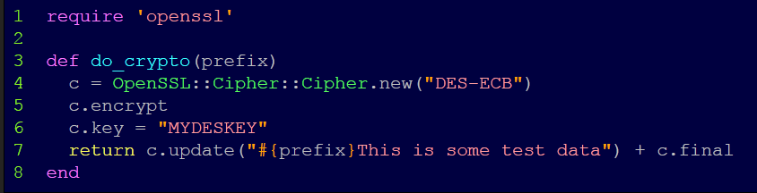
Key re-use in block ciphers – the setup
Here’s our “oracle”:
Note that we’re using “DES-ECB” – this attack will work, as-is, with every block and stream cipher in almost every “mode”
ECB is somewhat special because it can’t be fixed
We’ll talk about ECB, CBC, etc. when we talk about padding oracles

Slide 42
Key re-use in block ciphers: example [1]
Here’s the output from do_crypto(“A” * 16):
P₁ | 'A' | 'A' | 'A' | 'A' | 'A' | 'A' | 'A' | 'A'
C₁ | \x74 | \x31 | \xe1 | \xf0 | \xc6 | \x1b | \x35 | \x11
P₂ | 'A' | 'A' | 'A' | 'A' | 'A' | 'A' | 'A' | 'A'
C₂ | \x74 | \x31 | \xe1 | \xf0 | \xc6 | \x1b | \x35 | \x11
P₃ | 'T' | 'h' | 'i' | 's' | ' ' | 'i' | 's' | ' '
C₃ | \x35 | \x13 | \x7b | \x27 | \xb6 | \xf5 | \xda | \x9c
P₄ | 's' | 'o' | 'm' | 'e' | ' ' | 't' | 'e' | 's'
C₄ | \xb1 | \x0e | \xdf | \x42 | \x93 | \xe8 | \x17 | \x42
P₅ | 't' | ' ' | 'd' | 'a' | 't' | 'a' | \x02 | \x02
C₅ | \xe0 | \x6f | \xcf | \xc0 | \xcf | \xfe | \x87 | \x66
Two blocks of just “A”s (note that the ciphertext is the same)
The rest of the string encrypted as-is

Slide 43
Key re-use in block ciphers: example [2]
Here’s the output from do_crypto(“A” * 7):
P₁ | 'A' | 'A' | 'A' | 'A' | 'A' | 'A' | 'A' | 'T'
C₁ | \xea | \xca | \x59 | \x30 | \x3d | \x8b | \xe6 | \x0f
P₂ | 'h' | 'i' | 's' | ' ' | 'i' | 's' | ' ' | 's'
C₂ | \xf2 | \xaa | \xb1 | \xfb | \x54 | \xb4 | \xb5 | \x87
P₃ | 'o' | 'm' | 'e' | ' ' | 't' | 'e' | 's' | 't'
C₃ | \x34 | \x87 | \x06 | \x80 | \x9a | \xcc | \xad | \x43
P₄ | ' ' | 'd' | 'a' | 't' | 'a' | \x03 | \x03 | \x03
C₄ | \xd3 | \x71 | \x2a | \xf5 | \x79 | \x10 | \x25 | \xea
P₁ | 'A' | 'A' | 'A' | 'A' | 'A' | 'A' | 'A' | 'T'
C₁ | \xea | \xca | \x59 | \x30 | \x3d | \x8b | \xe6 | \x0f
← GOAL
Stuff
That
We
Don’t
Care
About
…
…
…
…

Slide 44
Key re-use in block ciphers: example [3]
Goal:
P₁ | 'A' | 'A' | 'A' | 'A' | 'A' | 'A' | 'A' | 'T'
C₁ | \xea | \xca | \x59 | \x30 | \x3d | \x8b | \xe6 | \x0f
← We’re trying to find a match for this
Note: I’m only showing the first block or two
It’s pretty trivial to guess a single byte…
[‘A’..’Z’ + ‘a’..’z’] do |c| do_crypto(‘AAAAAAA’ + c); end
P₁ | 'A' | 'A' | 'A' | 'A' | 'A' | 'A' | 'A' | 'S'
C₁ | \x1c | \x32 | \x22 | \x39 | \xb7 | \x99 | \x73 | \x42
P₂ | 'T' | 'h' | 'i' | 's' | ' ' | 'i' | 's' | ' '
C₂ | \x35 | \x13 | \x7b | \x27 | \xb6 | \xf5 | \xda | \x9c
← Nope
P₁ | 'A' | 'A' | 'A' | 'A' | 'A' | 'A' | 'A' | 'T'
C₁ | \xea | \xca | \x59 | \x30 | \x3d | \x8b | \xe6 | \x0f
← Oh hai!
P₁ | 'A' | 'A' | 'A' | 'A' | 'A' | 'A' | 'A' | 'U'
C₁ | \x5a | \x3c | \x17 | \x25 | \xc8 | \x0f | \x68 | \x3f
← Nope

Slide 45
Key re-use in block ciphers: example [4]
Here’s the output from do_crypto(“A” * 6):
P₁ | 'A' | 'A' | 'A' | 'A' | 'A' | 'A' | 'T' | 'h'
C₁ | \xcb | \x7a | \x74 | \xd0 | \x38 | \x45 | \xbf | \x21
P₂ | 'i' | 's' | ' ' | 'i' | 's' | ' ' | 's' | 'o'
C₂ | \xf9 | \x8e | \xcd | \xdf | \x49 | \xf0 | \x86 | \xcb
P₃ | 'm' | 'e' | ' ' | 't' | 'e' | 's' | 't' | ' '
C₃ | \x70 | \x8c | \xc0 | \x1d | \xe5 | \xf2 | \xdc | \x01
P₄ | 'd' | 'a' | 't' | 'a' | \x04 | \x04 | \x04 | \x04
C₄ | \xb4 | \x74 | \xfc | \x99 | \xd9 | \xbe | \xd2 | \x70
P₁ | 'A' | 'A' | 'A' | 'A' | 'A' | 'A' | 'T' | 'h'
C₁ | \xcb | \x7a | \x74 | \xd0 | \x38 | \x45 | \xbf | \x21
← GOAL
Stuff
That
We
Don’t
Care
About
…
…
…
…

Slide 46
Key re-use in block ciphers: example [5]
P₁ | 'A' | 'A' | 'A' | 'A' | 'A' | 'A' | 'T' | 'h'
C₁ | \xcb | \x7a | \x74 | \xd0 | \x38 | \x45 | \xbf | \x21
← We’re trying to find a match for this
Once again, we’re guessing a single byte:
[‘A’..’Z’ + ‘a’..’z’] do |c| do_crypto(‘AAAAAAT’ + c); end
Note: I’m only showing the first block or two
P₁ | 'A' | 'A' | 'A' | 'A' | 'A' | 'A' | 'T' | 'g'
C₁ | \xbb | \x48 | \x96 | \xa3 | \xb9 | \xb5 | \xc4 | \x32
P₂ | 'T' | 'h' | 'i' | 's' | ' ' | 'i' | 's' | ' '
C₂ | \x35 | \x13 | \x7b | \x27 | \xb6 | \xf5 | \xda | \x9c
← Nope
P₁ | 'A' | 'A' | 'A' | 'A' | 'A' | 'A' | 'T' | 'h'
C₁ | \xcb | \x7a | \x74 | \xd0 | \x38 | \x45 | \xbf | \x21
← Oh hai!
P₁ | 'A' | 'A' | 'A' | 'A' | 'A' | 'A' | 'T' | 'i'
C₁ | \x79 | \xc2 | \x04 | \x11 | \x64 | \xd0 | \xae | \xc2
← Nope

Slide 47
Key re-use in block ciphers: What’s going on?
We continue likewise till we’ve decrypted the entire packet
What’s going on?
We’re forcing the first unknown byte to be on a block boundary, then guessing it
We can guess any character in 256 guesses, as long as we know all the characters before it

Slide 48

Key re-use in block ciphers: A tool!
I wrote a tool called “Prephixer” to implement this attack
https://www.github.com/iagox86/prephixer
Let’s do a demo!

Slide 49
Preventing key re-use in block ciphers
Use different and random initialization vectors (IVs) when encrypting data
If possible, use a different key (not always possible)
If you’re using ECB mode…. WHY ARE YOU USING ECB MODE!?

Slide 50
Hash length extension attacks

Slide 51
Hash length extension attacks
This is why I became interested in crypto attacks
The basic idea: most hash algorithms (before SHA3) can “pick up where they left off”
What’s that mean for security?
Let’s find out!

Slide 52
Hash length extension: the setup
This is an attack where the following happens:
Server calculates:
Then later, to validate that attacker_data is valid:
The “Bad” operations are in red
verifier = H(secret || attacker_data)
if(H(secret || new_attacker_data) != verifer)
throw error()
else
trusted_operation(attacker_data)

Slide 53
How hashing works…
Example hash:
SHA1(“The most merciful thing in the world, I think, is the inability of the human mind to correlate all its contents. We live on a placid island of ignorance in the midst of black seas of infinity, and it was not meant that we should voyage far. The sciences, each straining in its own direction, have hitherto harmed us little; but some day the piecing together of dissociated knowledge will open up such terrifying vistas of reality, and of our frightful position therein, that we shall either go mad from the revelation or flee from the deadly light into the peace and safety of a new dark age.”) = ed8873c107d882b7b6fcbbc19a272d614cf9e7ee

Slide 54
How hashing works
First, it’s broken up into blocks…
“The most merciful thing in the world, I think, is the inability “
“of the human mind to correlate all its contents. We live on a pl”
“acid island of ignorance in the midst of black seas of infinity,”
“ and it was not meant that we should voyage far. The sciences, e”
“ach straining in its own direction, have hitherto harmed us litt”
“le; but some day the piecing together of dissociated knowledge w”
“ill open up such terrifying vistas of reality, and of our fright”
“ful position therein, that we shall either go mad from the revel”
“ation or flee from the deadly light into the peace and safety of”
“ a new dark age.”

Slide 55
How hashing works
Padding is added to the last block
“The most merciful thing in the world, I think, is the inability “
“of the human mind to correlate all its contents. We live on a pl”
“acid island of ignorance in the midst of black seas of infinity,”
“ and it was not meant that we should voyage far. The sciences, e”
“ach straining in its own direction, have hitherto harmed us litt”
“le; but some day the piecing together of dissociated knowledge w”
“ill open up such terrifying vistas of reality, and of our fright”
“ful position therein, that we shall either go mad from the revel”
“ation or flee from the deadly light into the peace and safety of”
“ a new dark age.\x80\x00\x00\x00............\x00\x00\x00\x12\x80”
The padding is equal to a 1-bit followed by a bunch of zero bits (“\x80\x00\x00…”)
The last eight bytes are equal to the length of the string (0x250 bytes) in bits (0x1280 bits)
Dropped a bunch of “\x00” to conserve space

Slide 56
How hashing works
Each block is hashed individually, and its output is fed into the next block
The output of the last block is our hash!
“The most merciful thing in the world, I think, is the inability “
3be731c7 5880ab49 5d90c0cd df295189 b3c91449
“of the human mind to correlate all its contents. We live on a pl”
58ec922f bdee6eec 699db098 a378f875 2b29d697
“acid island of ignorance in the midst of black seas of infinity,“
c55bc6a3 b26d5dd0 96166093 5d73c256 7f357a83
“ation or flee from the deadly light into the peace and safety of“
845b75f7 403a1814 30ee1c70 8a229eab c88c00d9
“a new dark age.\x80\0\0\0\0\0.........\0\0\0\0\0\0\0\0\0\x12\x80“
ed8873c1 07d882b7 b6fcbbc1 9a272d61 4cf9e7ee

Slide 57

Hash extension: We’re almost there!
What if we add another block, after the padding?
What good is that?
“ation or flee from the deadly light into the peace and safety of“
845b75f7 403a1814 30ee1c70 8a229eab c88c00d9
“a new dark age.\x80\0\0\0\0\0.........\0\0\0\0\0\0\0\0\0\x12\x80“
ed8873c1 07d882b7 b6fcbbc1 9a272d61 4cf9e7ee
“Hello? Yes, this is dog.“ (+ implicit padding)
37a780c2 e1f8a3e9 f99a7561 f12c9945 f0d82b12

Slide 58
Hash extension: And here we are!
We just calculated the checksum for
(original_text || padding || “Hello? Yes, this is dog.”)
Knowing only:
The output of the original hash function:
ed8873c1 07d882b7 b6fcbbc1 9a272d61 4cf9e7ee
And the text we wanted to add!
“||” is the “concatenate” operator in crypto. @mak_kolybabi yells at me if I don’t use it.

Slide 59
Hash extension: Applying it
Let’s say you have an API that requires a shared secret
message = SHA1(shared_secret || commands) + commands
And let’s say commands is a URL-like list of commands.. For example:
commands = “set_firstname=ron&set_lastname=bowes”
or, commands = “deletemyaccount=1”
Etc.

Slide 60
Hash extension: Applying it
Let’s use this API to change my firstname to “ron”:
message = SHA1(“secretkey” + “set_firstname=ron”) + “set_firstname=ron”
message = “\x5e\x8a\x88\x6a\x5f\x9c\xa9\x77\x42\x1a\xe0\x67\xcc\x56\x55\xb7\xf3\x47\x97\x4dset_firstname=ron”
“\x5e\x8a\x88\x6a\x5f\x9c\xa9\x77\x42\x1a\xe0\x67\xcc\x56\x55\xb7\xf3\x47\x97\x4dset_firstname=ron”
“Ron”
“Flickr”
“Eve”

Slide 61
Hash extension: Applying it
Now, Eve has a message and its associated hash. What can he use it for?
Remember: SHA1(“secretkey” || “set_firstname=ron”) is calculated like this:
“secretkeyset_firstname=ron\x80\0\0\0\0\0\0\0\0\0\0...\0\0\0\0\0\xd8
5e8a886a 5f9ca977 421ae067 cc5655b7 f347974d

Slide 62
Hash extension: Applying it
Eve can calculate the following message, given just the output (in blue):
Let’s look at how both the evil client and the legit server calculates that hash
“?????????set_firstname=ron\x80\0\0\0\0\0\0\0\0\0\0...\0\0\0\0\0\xd0
5e8a886a 5f9ca977 421ae067 cc5655b7 f347974d
“&deletemyaccount=1“ (+ implicit padding)
b841c517 5bbce26b 353bcfe3 d47acefa b1ce26a1

Slide 63
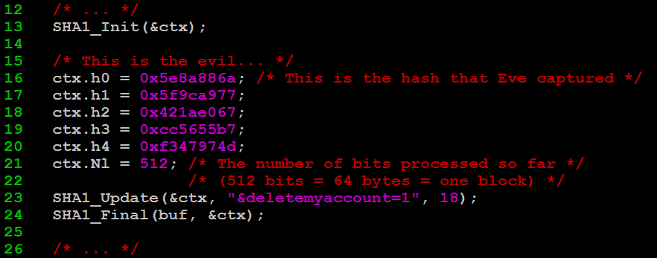

Hash extension: evil client
Eve writes the following program:

Slide 64
Hash extension: Evil client -> legit server
Eve then sends the following to the server:
“\xb8\x41\xc5\x17\x5b\xbc\xe2\x6b\x35\x3b” +
“\xcf\xe3\xd4\x7a\xce\xfa\xb1\xce\x26\xa1” +
“set_firstname=ron” +
“\x80" + ("\x00" * 36) + "\xd0” +
“&deletemyaccount=1"
The extended hash
The original data
The original padding
The new data

Slide 65
Hash extension: Legit server
The legit server prepends the secret key to the data Eve sent, and calculates:
This can easily be proven in Ruby’s irb:
Digest::SHA1.hexdigest("secretkeyset_firstname=ron\x80" + ("\x00" * 36) + "\xd0&deletemyaccount=1")
=> "b841c5175bbce26b353bcfe3d47acefab1ce26a1"
secretkeyset_firstname=ron\x80\0\0\0\0\0\0\0\0\0\0...\0\0\0\0\0\xd0
5e8a886a 5f9ca977 421ae067 cc5655b7 f347974d
“&deletemyaccount=1“ (+ implicit padding)
b841c517 5bbce26b 353bcfe3 d47acefa b1ce26a1

Slide 66
Hash extension: A tool!
It’s amazingly difficult to write these attacks by hand
I never fail to mess up the number of zeroes, or forget to convert the length to bits, or screw up endianness
Luckily, you don’t have to! I wrote hash_extender to take care of that
hash_extender supports the following hashes:
MD4, MD5, RIPEMD160, SHA, SHA1, SHA256, SHA512, Whirlpool
The following hash types are more difficult to extend, because the state is truncated before being used:
SHA224, SHA384
And, the following hash type is impossible to extend, by design, although time will tell:
SHA3

Slide 67
hash_extender in action
./hash_extender --data="set_firstname=ron" --append="&deletemyaccount=1" --signature="5e8a886a5f9ca977421ae067cc5655b7f347974d" --format=sha1 --secret=9 --out-data-format=cstr
Type: sha1
Secret length: 9
New signature: b841c5175bbce26b353bcfe3d47acefab1ce26a1
New string: set\x5ffirstname\x3dron\x80\x00\x00\x00\x00\x00\x00\x00\x00\x00\x00\x00\x00\x00\x00\x00\x00\x00\x00\x00\x00\x00\x00\x00\x00\x00\x00\x00\x00\x00\x00\x00\x00\x00\x00\x00\x00\xd0\x26deletemyaccount\x3d1

Slide 68
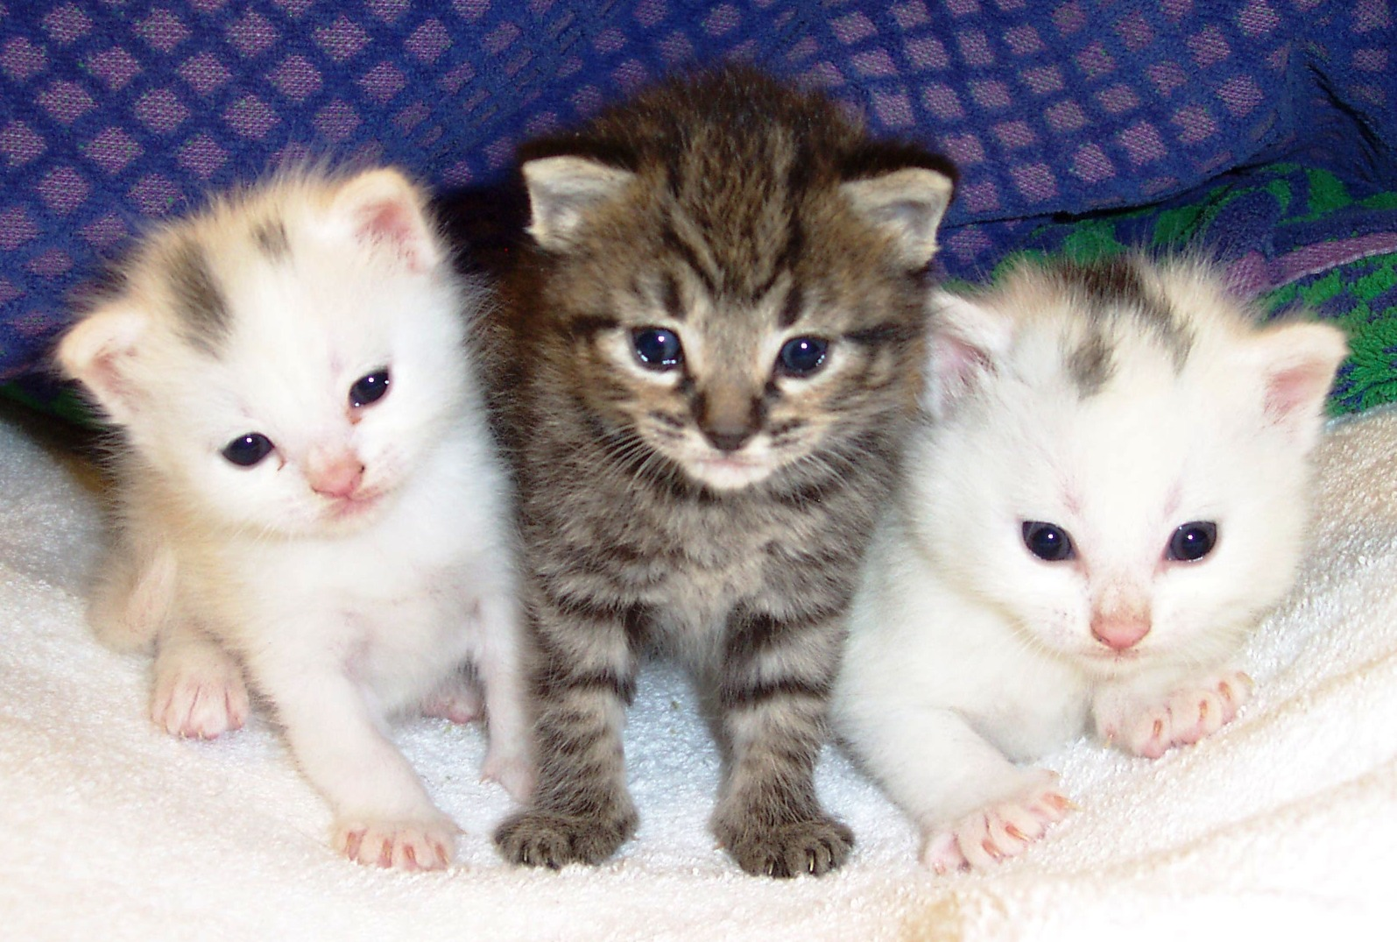
That was a lot of material…
So let’s look at some cats then do a demo

Slide 69
Hash extension: summary
If an attacker has access to a hash in the form of:
H(secret + “knowndata”)
He can trivially calculate:
H(secret + “knowndata” + padding + anything)

Slide 70
Hash extension: Defense
HMAC.
Next topic.

Slide 71

Padding oracles

Slide 72
Padding oracles
Hash extension attacks are fairly simple to understand – you just have to realize that hashes can “pick up where they left off”
Padding oracles, on the other hand, require a bit more of a leap
That being said, let’s do it!

Slide 73
Padding oracles: Overview
Not to be confused with the Oracle database…
This isn’t an attack against any particular algorithm, but against cipher-block chaining (CBC)
Invented by Serge Vaudenay in the early 2000s, also called the “Vaudenay attack”
A padding oracle attack occurs when an attacker has encrypted and unknown data that he can ask a server to secretly decrypt
The data is a block cipher (DES, AES, etc) in CBC mode
The server doesn’t give indication as to what the plaintext data is
The returns a boolean value indicating whether the decryption succeeded (which is based on the padding)

Slide 74
Padding oracles: Padding
We already talked about padding on hashes, but this is different
Block ciphers require the data to be padded such that it’s a multiple of the blocksize
If the data is already a multiple, an empty block is added
It doesn’t matter what the padding is, just that it’s predictable
Let’s look at the most common…

Slide 75
Padding oracles: Padding
Typically, PKCS #7 is used, which says…
The value of the padding = the number of bytes of padding
Eg (assume block size = 8):
H | e | l | l | o | \x03 | \x03 | \x03
H | e | l | l | o |  | W | o | r | l | d | \x05 | \x05 | \x05 | \x05 | \x05
P | a | s | s | w | o | r | d | \x08 | \x08 | \x08 | \x08 | \x08 | \x08 | \x08 | \x08
Block 1
Block 2

Slide 76
Padding oracles: CBC mode encryption
Now that we’ve looked at padding, let’s look at how the blocks fit together
We already talked about electronic codebook (ECB) and cipher-block chaining (CBC)
The “padding oracle attack” is actually an attack against CBC
Let’s see why…

Slide 77
Padding oracles: CBC mode encryption
Let’s take a minute to review cipher-block chaining encryption
For any given block of plaintext, P_{n}, the corresponding ciphertext, C_{n}, can be calculated as:
C_{n} = E(P_{n} ⊕ C_{n-1})

Slide 78
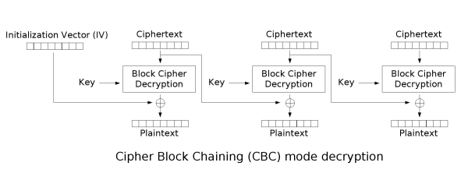
Padding oracles: CBC mode decryption
Now let’s look at decryption:
For any given block of ciphertext, C_{n}, we can calculate the corresponding plaintext, P_{n}, as:
P_{n} = D(C_{n}) ⊕ C_{n-1}

Slide 79
Padding oracles
So, we have two formulas:
C_{n} = E(P_{n} ⊕ C_{n-1})
P_{n} = D(C_{n}) ⊕ C_{n-1}
We can verify these make sense by encrypting and decrypting a block:
P_{n} = D(E(P_{n} ⊕ C_{n-1})) ⊕ C_{n-1}
P_{n} = P_{n} ⊕C_{n-1} ⊕ C_{n-1}
P_{n} = P_{n}
Decrypt the encrypted data
Two XORs cancel out
Success!

Slide 80
Padding oracles
Encryption steps…
Add padding
Remove/verify padding
Encrypt each block
Decrypt each block
Send
Receive
Sender
Receiver

Slide 81
Padding oracles
Let’s use an example to learn this…
P = “Hello World”
P₁ = “Hello Wo”
P₂ = “rld”
Split into blocks
P₁ = “Hello Wo”
P₂ = “rld\5\5\5\5\5”
Add padding
⊕
C₁ = “8aec483e43027f22”
C₂ = “287ca837fb65e219”
Encrypt
C = “8aec483e43027f22287ca837fb65e219”
Put the blocks back together

Slide 82

Padding oracles
Now, the attacker has the following encrypted string:
C₁ = “8aec483e43027f22”
C₂ = “287ca837fb65e219”

Slide 83
Padding oracles
As an attacker, we take each block individually. Let’s start with C₂:
We prepend our own block to it, initialized to whatever we want (let’s call it C’):
C₂ = “287ca837fb65e219”
C’ = “0000000000000000”
C₂ = “287ca837fb65e219”
= “0000000000000000287ca837fb65e219”

Slide 84
Padding oracles
The host will decrypt C₂ first:
Recall our decryption formula:
C_{n-1} is C’, in this case, since we prepended C’ to the encrypted string, so we wind up with:
C₂ = “287ca837fb65e219”
P_{n} = D(C_{n}) ⊕ C_{n-1}
“0000000000000000287ca837fb65e219”
P’₂ = D(C₂) ⊕ C’

Slide 85
Padding oracles
“0000000000000000287ca837fb65e219”
This is how the oracle attempts to decrypt the second block
Let’s look at where C₂ originally came from…
P’₂ = D(C₂) ⊕ C’
C_{n} = E(P_{n} ⊕ C_{n-1})
Recall our encryption formula from earlier
C₂ = E(P₂ ⊕ C₁)
C₂, in particular, was encrypted after being XORed with C₁
P’₂ = D(E(P₂ ⊕ C₁)) ⊕ C’
In the formula for P’₂ (above), expand C₂ to its original value
P’₂ = P₂ ⊕ C₁ ⊕ C’
E(D(X)), like before, becomes X – this is the value that the oracle calculates on behalf of the attacker

Slide 86
Padding oracles
P’₂ = P₂ ⊕ C₁ ⊕ C’
The server calculated this value, where…
P’₂ = The value the server calculates (mostly a garbage string)
P₂ = The original plaintext value (our goal)
C₁ = The previous ciphertext block (known to us)
C’ = The ciphertext block chosen by the attacker (“0000000000000000”)
So now we have an equation with two unknowns – P₂ and P’₂…
Or do we?

Slide 87
Padding oracles
P’₂ = P₂ ⊕ C₁ ⊕ C’
We actually do know something about P’₂!
Recall the last step of decryption…
We know whether or not the padding is correct on the final (garbage) string!
In fact, we can change the last byte C’ to all 256 possible values, and the server will tell us when the padding is right
Remove/verify padding

Slide 88
Padding oracles
P’₂ = P₂ ⊕ C₁ ⊕ C’
When the padding is right, we know something about P’₂, namely, it ends with:
\x01
\x02\x02
\x03\x03\x03
…etc.
Let’s assume it’s \x01 (the others are rare and can easily be eliminated
Remember, P’₂ is mostly a garbage string, still, the result of decrypting a good block and XORing it with a bad block

Slide 89
Padding oracles
Let’s take another look at that formula:
When the padding is right, we know the last bytes of all but one:
P’₂[N] – 0x01
C₁ [N] – The last byte of the previous block (we know it)
C’ [N] – The last byte of the block that we created
Now it’s easy to determine the last byte of P₂ – just re-arrange the formula!
P’₂[N] = P₂[N] ⊕ C₁[N] ⊕ C’[N]
P₂[N] = P’₂[N] ⊕ C₁[N] ⊕ C’[N]

Slide 90
Padding oracles
So, to summarize:
Choose a new block, which we call C’, and prepend it to the block you’re trying to decrypt:
Change the last byte of C’ until you stop getting a padding error:
Plug it into the formula:
And solve!
C’ = “0000000000000000”
C₂ = “287ca837fb65e219”
C’ = “0000000000000026”
C₂ = “287ca837fb65e219”
P₂[N] = P’₂[N] ⊕ C₁[N] ⊕ C’ [N]
P₂[N] = 0x01 ⊕ 0x22 ⊕ 0x26
P₂[N] = 0x05
Recall:
P₂ = “rld\5\5\5\5\5”

Slide 91
Padding oracles
By having the server tell us when the last byte of the decrypt block is right, we can trivially decrypt and encrypt it using only the XOR operation
The last byte can be set to \x02, and the second-last byte can be guessed using the same formula
The last and second-last bytes can be set to \x03\x03, and the third-last byte can be guessed using the same formula
…and so on, until the whole block is decrypted

Slide 92

Introducing: Poracle
Like all these attacks, I wrote a tool
This one’s called “Poracle”

Slide 93
Padding oracles: Prevention
How do you prevent padding oracles?
HMAC!
By prepending an HMAC hash to the encrypted data – and validating it before the decryption is performed – you can check if anybody has tampered with the hash!
You can also prevent this by using a block cipher mode of operation other than cipher-block chaining – eg, counter mode, output feedback, plaintext feedback, etc.

Slide 94

Almost there!

Slide 95


Solutions
Because people get mad at me for just pointing out problems…

Slide 96
Solution #1: don’t give attackers encrypted data
This isn’t always possible
When you can, give an index, a session, or something like that, rather than letting an attacker store state

Slide 97

Or, to put it another way…

Slide 98
Solution #2: When you give them encrypted data, validate it
“The cryptographic doom principle”
Calculate a HMAC and send it with the encrypted data
Validate the HMAC before attempting to decrypt
Alternatively, use encryption in “EAX mode” – a NIST standard for authenticated encryption
Coming soon: CAESAR
CAESAR: Competition for Authenticated Encryption: Security, Applicability, and Robustness

Slide 99
“The cryptographic doom principle”

Slide 100

Solution #3: Never encrypt data with the same key and IV
Almost every cipher fails if you use the same key and IV
Change keys when it makes sense, and change IVs every time

Slide 101
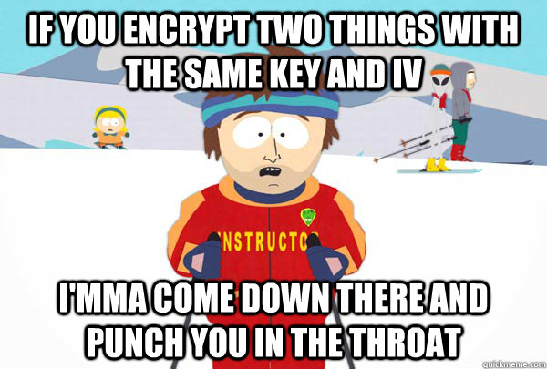
One last ski instructor, then we’re done!

Slide 102
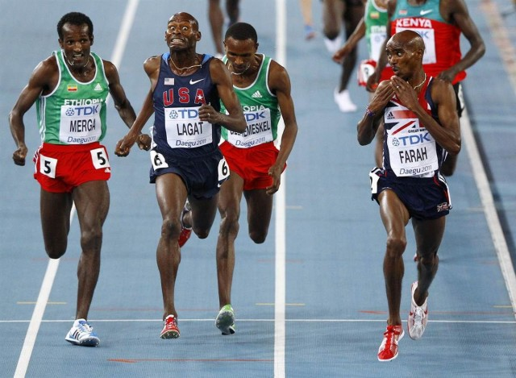
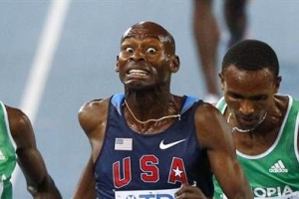
That’s all!

Slide 103
Links + Contact info
Me:
Ron Bowes <ron.bowes@leviathansecurity.com>
@iagox86
http://www.skullsecurity.org
http://www.leviathansecurity.com
Tools released:
https://www.github.com/iagox86/prephixer
https://www.github.com/iagox86/poracle
https://www.github.com/iagox86/hash_extender
https://www.github.com/iagox86/unzipher
This talk will be on https://www.github.com/iagox86 as well

