Slide 1
Machine Learning

Slide 2
Feature Space
Initial Features: 546
NaNs greater than 80%
Encrypted & Duplicated Features
There are total of 27,494 records and 281 features in the Heart Transplant Dataset.
Select Last Five Years
There are total of 15,282 records and 281 features in the Heart Transplant Dataset.
Remove Features associated with Device Description & Medication Descriptions, including unknown features with no descriptive information.
There are total of 15,282 records and 278 features in the Heart Transplant Dataset.
Removed any Features referring to After Transplantation
Multiple Label features Identified
Total: 15,282 Rows & columns: 218 Features
Convert Integers into Category Descriptions using a data dictionary from Excel

Slide 3
Feature Engineering
Some examples of newly engineered features are created from the dataset to provide additional insights and relationships between donor and candidate variables to reduce dimensionality.
Age_Difference:
The difference between the donor's age (AgeCalc_DON) and the candidate's age (Age_CAN).
BMI_Difference:
The difference in Body Mass Index (BMI) between the donor (BMI_DON) and the candidate (BMI_CAN).
Creatinine_Difference:
The difference in creatinine levels between the donor (Creatinine_DON) and the candidate (Creatinine_CAN).
Hemodynamics_CAN_Addition:
The sum of hemodynamic measurements for the candidate, including cardiac output (Hemodynamics_CO_CAN), pulmonary artery diastolic pressure (Hemodynamics_PA_DIA_CAN), mean pulmonary artery pressure (Hemodynamics_PA_MN_CAN), pulmonary capillary wedge pressure (Hemodynamics_PCW_CAN), and systolic blood pressure (Hemodynamics_SYS_CAN).
Cancer_DON_Combined:
Combine the columns (ExtracanialCancer_DON, IntracanialCancer_DON, HistoryCancer_DON, SkinCancer_DON, and Cancer_DON )into a single category indicating whether there is any kind of cancer,
Final Total: 14,856 rows & 111 columns
Note: Hypothesis testing using Chi-square statistic and calculating Cramer's V to build consensus for the categorical variables while consolidating categorical variables.

Slide 4
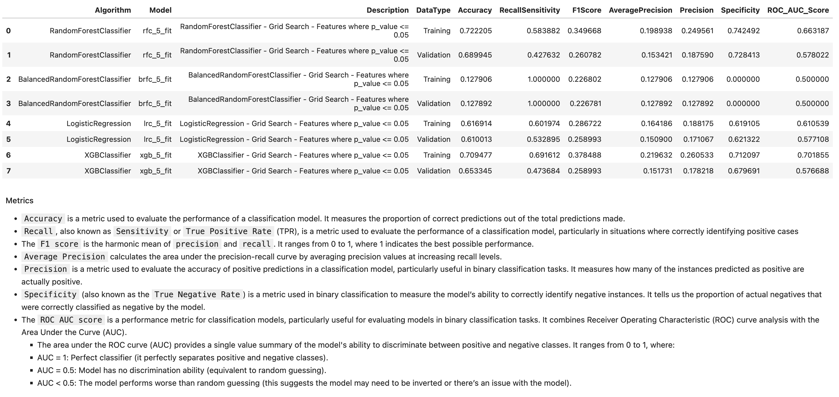
Machine Learning:
Feature Selection:
SelectKBest with f_classif function
p_value < 0.05
Grid Search 5 Fold CV

Slide 5
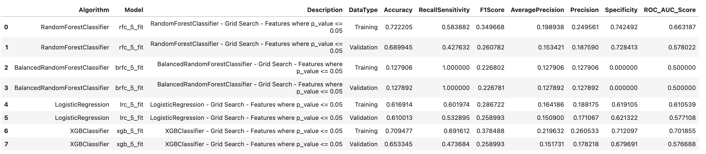
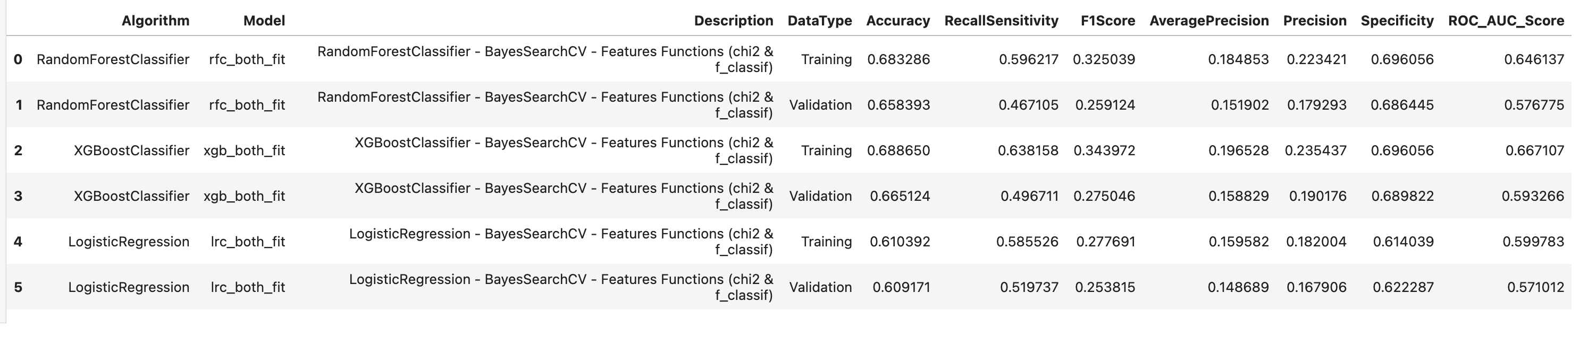

Slide 6
