Slide 1

United Network for Organ Sharing (UNOS)
Erik Pak

Slide 2
Data Description
Files
THORACIC_DATA.DAT
THORACIC_DATA.htm
THORACIC_FOLLOWUP_DATA.DAT
THORACIC_FOLLOWUP_DATA.htm
THORACIC_FORMATS_FLATFILE.DAT
THORACIC_FORMATS_FLATFILE.htm
optn-star-files-data-dictionary.xlsx
Type of Features
Categorical (nominal & ordinal)
Continuous variables
Data from 1984 to 2021
Donors & Recipients in a single row
Types of Transplant
Lung Transplant:
68,079 rows
Heart & Lung Transplant:
3,495 rows
Heart Transplant:
128,215 rows

Slide 3
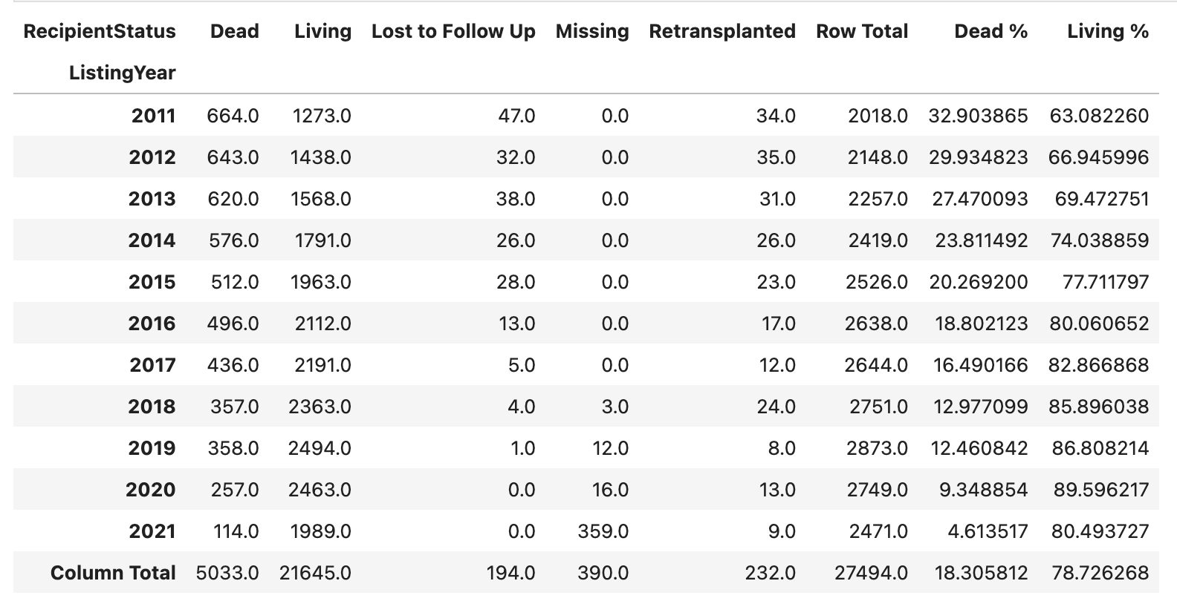
Heart Transplant Data
Selection criteria:
WL_ORG == ‘HR’
LISTYR > 2010
AGE_GROUP == ‘A’
Remove feature containing greater than 80% Nulls
After Selection
New Number of columns: 317
Total number of rows: 27,494

Slide 4
Additional Data Cleaning
Remove Features
Correlation
Remove features
INHALED_NO and INHALED_NO_TCR @ 1.000
Impute missing data
Examine distribution
Mean: Normal distribution
Median: Skew distribution
Categorical
New category ‘U’: Unknown
Total of 27,494 records and 281 features

Slide 5
Data Wrangling
Remove & Consolidate & Engineer Additional Features
Age/Creatinine/ for Donor & Candidate
Difference/Addition/Ratio/Mean
Consolidate Categories
Cancer for Donor/Life Support for Candidate
Engineer new binary feature
Remove Cancer Site/Extracanial/Intracranial/History/Skin
Candidate with any life support into a new single binary feature.
Hemodynamics & Inotropic and Vasodilator & etc.
Chi2/Cramer's V score statistics test for categorical features to determine the association between categories before consolidating features
Consolidate features that contain prior Heart transplantation & remove any measurements taken after the surgery
Numeric Categories (Nominal/Ordinal)
Transform features into description using Data Dictionary excel from optn-star-files-data-dictionary.xlsx

Slide 6
Additional Data Cleaning Cont…
Additional Data wrangling
Remove Unwanted Features
PrimaryPaymentSource/WorkIncome/TransplantState/ResidencyState/etc.
OtherMedsText1/OtherMedsText2/OtherMedsText3/VentricularDeviceType/etc.
BMI/PreviousTransplantAnyOrgan & PreviousTransplantSameOrgan
Categorizing features
PanelReactiveAntibody
CPRA values typically range from 0% to 100%
Remove After & Labels
FollowUpFunctionalStatus/AcuteRejectionEpisode/StrokePostTransplant/etc.
Consolidate Categories
Diagnosis Codes/Prior Cardiac Surgery Type
Consolidate different types Codes
Reduce the number of categories
Remove Unknown Features
DAYS_STAT1A/DAYS_STATA4/DAYS_STATA3/etc.
Note: Hypothesis testing using Chi-square statistic and calculating Cramer's V to build consensus for the categorical variables while consolidating categorical variables

Slide 7
Feature Engineering
Discretization
The process of converting continuous data into discrete values or intervals.
Weight/Height/Distance/Age
New Features
Age Difference between Donor & Candidate
Gender Difference
Mean between HemodynamicsRegistration & HemodynamicsTransplant
Total of 16,126 records and 205 features
Note: Gaussian Mixture Model information criteria (AIC and BIC) to determine the optimal number of components for Discretization.

