Slide 1

United Network for Organ Sharing (UNOS)
Discretization
Erik Pak

Slide 2
Data Engineering
Remove & Consolidate & Engineer Additional Features
Age/Creatinine/ for Donor & Candidate
Difference/Addition/Interaction/Mean
Consolidate Numeric features
Hemodynamics: refers to the study of blood flow
Registration & Transplant
Hemodynamics_SYS_CAN: Systolic blood pressure. (mmHg)
Hemodynamics_PA_DIA_CAN: Pulmonary artery diastolic pressure. (mmHg)
Hemodynamics_PA_MN_CAN: Pulmonary artery mean pressure. (mmHg)
Hemodynamics_PCW_CAN: Pulmonary capillary wedge pressure. (mmHg)
Hemodynamics_CO_CAN: Cardiac output. (L/min)
Combine & Interaction SYS/PA_DIA/PA_MIN/PWC
Correlation above positive .8
Any Life Support into a new single ordinal feature.
Total Count for all ‘Yes’
Age/Weight/Height
New feature: difference

Slide 3
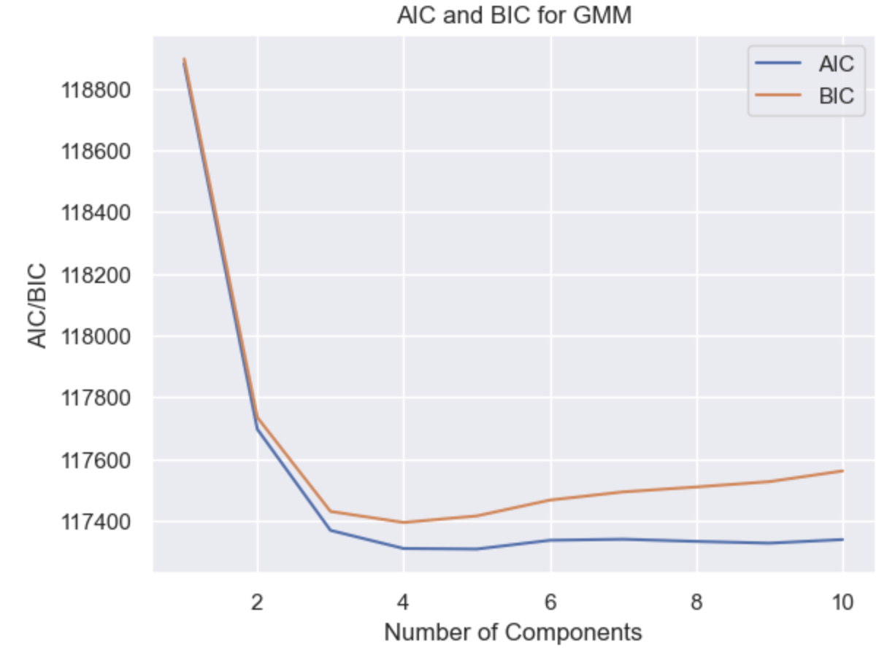
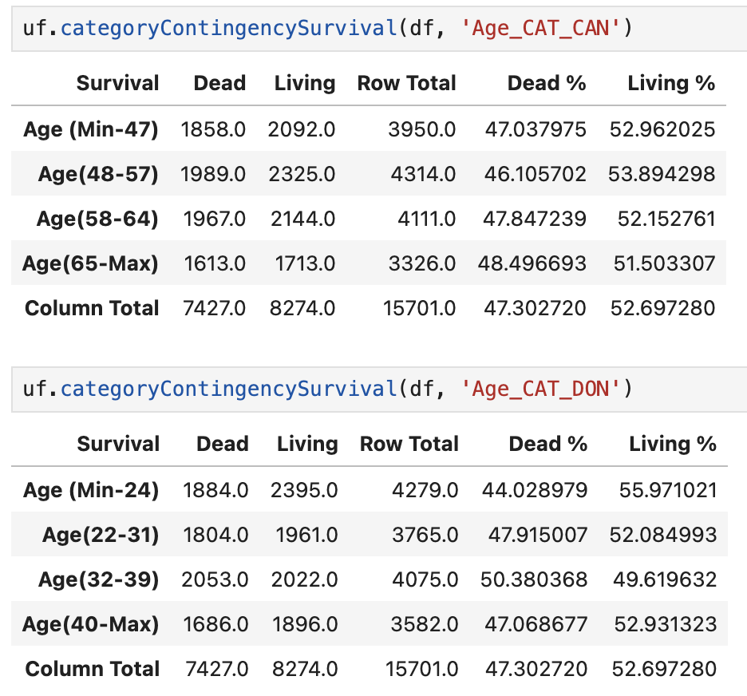
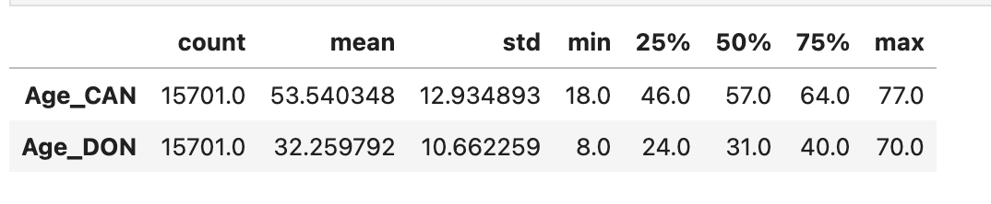
Data Discretization
Gaussian Mixture Model (GMM) with different numbers of
components (clusters) and use information criteria (AIC and BIC) to determine the optimal number of. components.

Slide 4
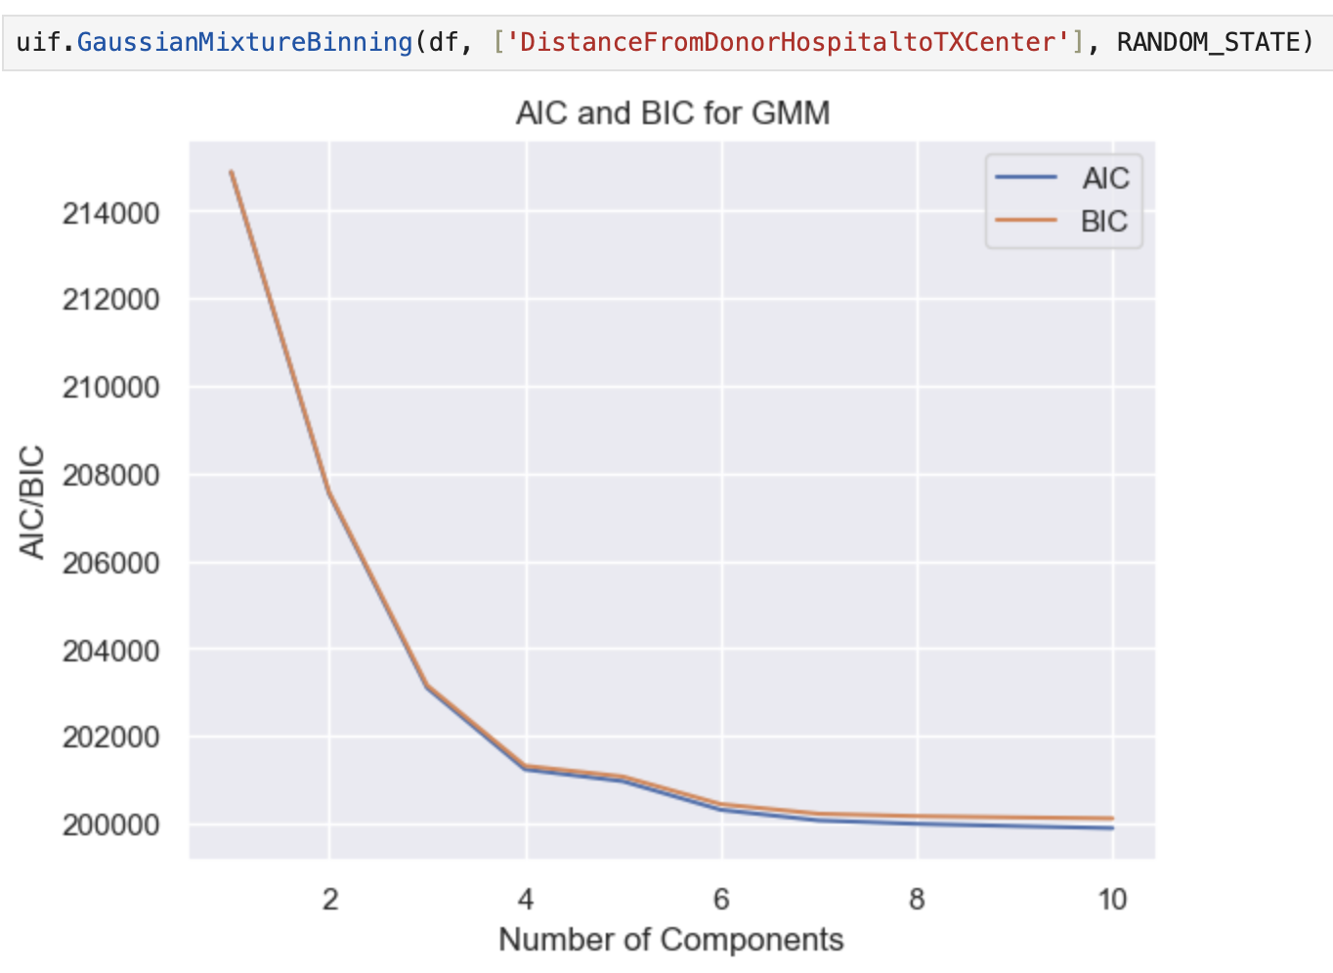
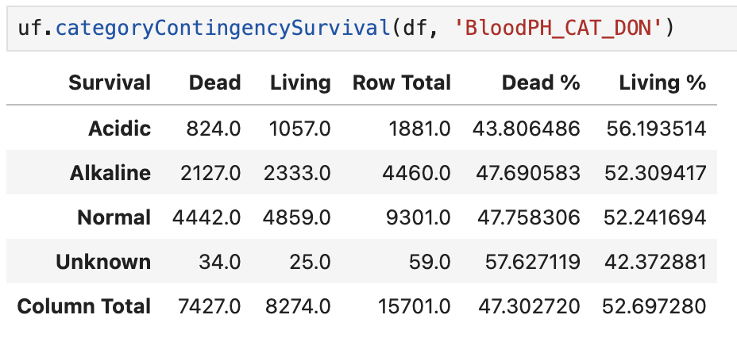
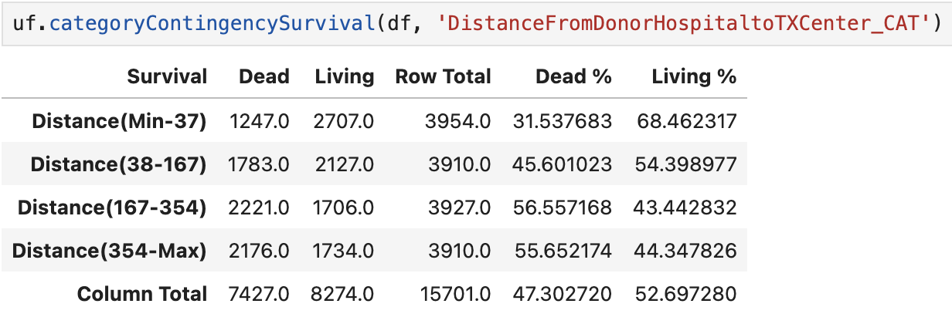
Data Discretization Cont…
Blood PH
The normal blood pH range is indeed between 7.35 and 7.45. This slightly alkaline range is crucial for the proper functioning of enzymes and other biochemical reactions in the body.
A blood pH below 7.35 is considered acidic, and it can lead to a condition called acidosis. Acidosis can disrupt cellular functions and impair organ systems, particularly the cardiovascular and respiratory systems.
A blood pH above 7.45 is considered alkaline, and it can lead to a condition called alkalosis. Alkalosis can cause symptoms such as muscle twitching, hand tremors, and confusion.
DistanceFromDonorHospitaltoTXCenter

Slide 5
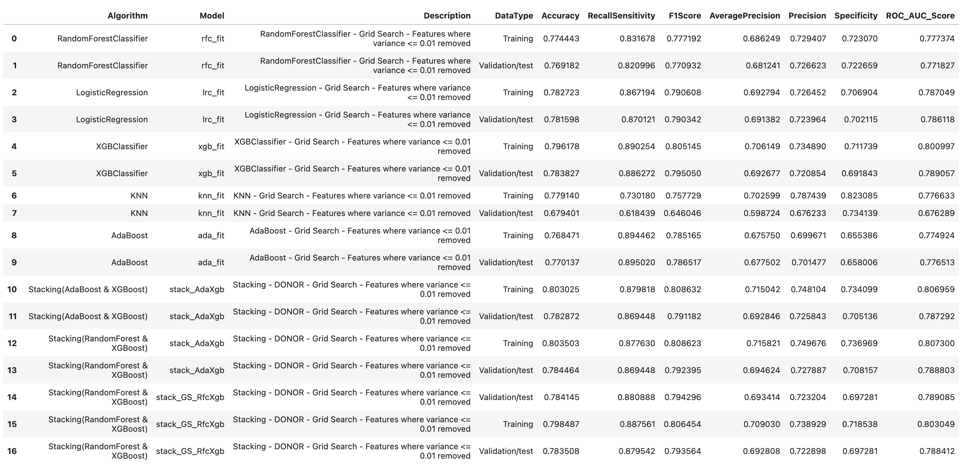
ML: Candidate & Donor Features

Slide 6
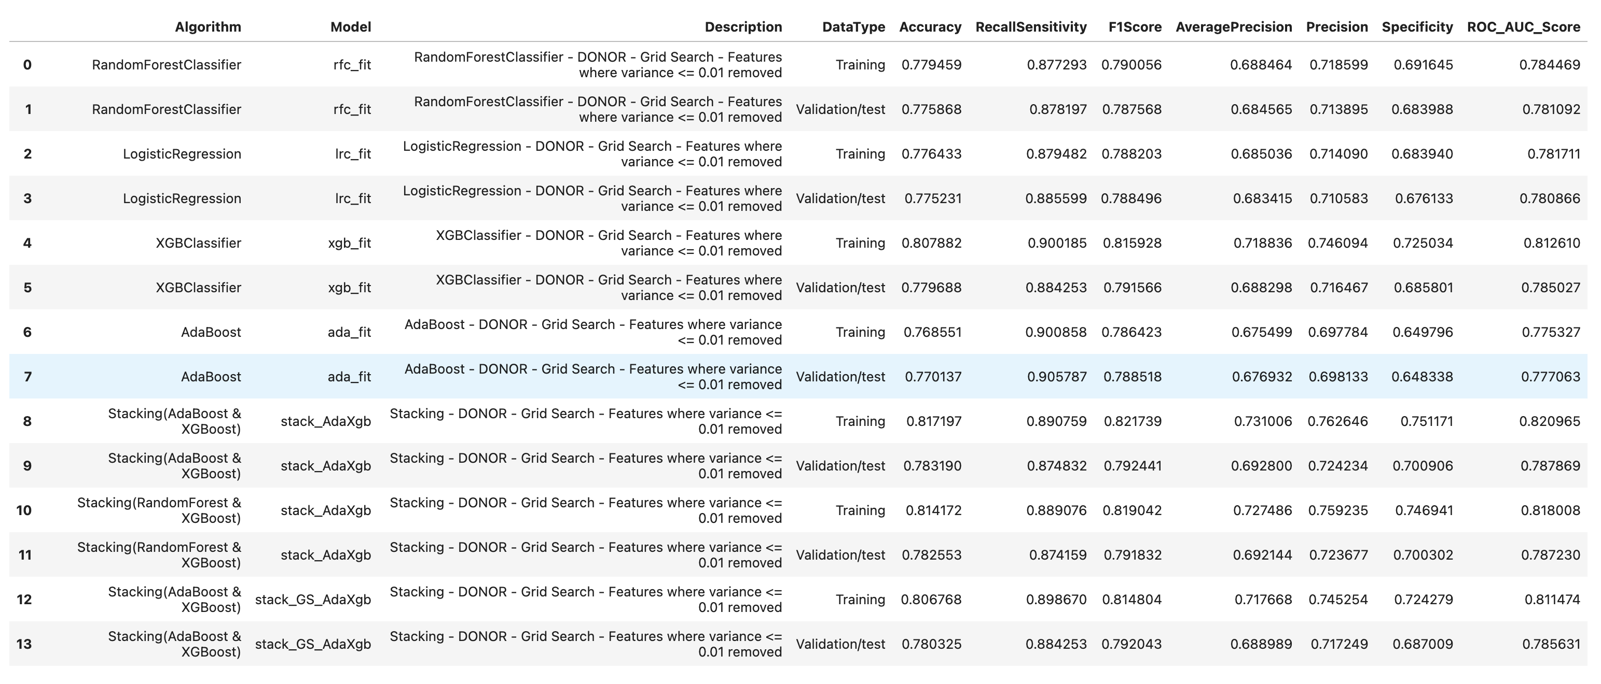
ML: Candidate & 11 Features for Both

Slide 7
Questions?

