Slide 1

United Network for Organ Sharing (UNOS)
Erik Pak

Slide 2
Overall Data Description
Number of features: 546 & Number of rows: 200,217
Type of Features
Categorical (nominal & ordinal)
Continuous variables
Data from 1984 to 2021
Donors & Recipients in a single row
Types of Transplant
Lung Transplant:
68,079 rows
Heart & Lung Transplant:
3,495 rows
Heart Transplant:
128,215 rows

Slide 3
Heart Transplant Data
Selection criteria:
WL_ORG == ‘HR’
LISTYR > 2001
AGE_GROUP == ‘A’
Remove feature containing greater than 80% Nulls
After Selection
New Number of columns: 317
Total number of rows: 27,494

Slide 4
Additional Data Cleaning
Remove Features
Encrypted Features
WL_ID_CODE: ENCRYPTED REGISTRATION IDENTIFIER
Correlation
Remove features
INHALED_NO and INHALED_NO_TCR @ 1.000
Impute missing data
Examine distribution
Mean: Normal distribution
Median: Skew distribution
Categorical
New category ‘U’: Unknown
Total of 27,494 records and 281 features

Slide 5
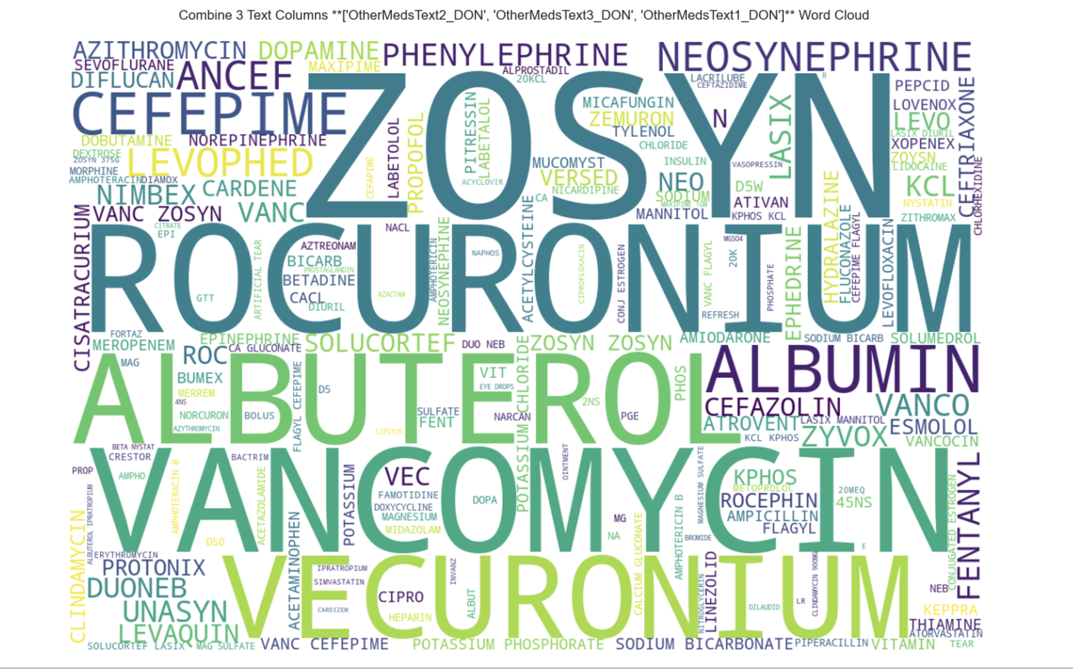
Donor's most frequently used medications.
ZOSYN (piperacillin and tazobactam for injection, USP) is an injectable antibacterial combination product consisting of the semisynthetic antibiotic piperacillin sodium and the β‑lactamase inhibitor tazobactam sodium for intravenous administration. Piperacillin sodium is derived from D(-)-α-aminobenzyl-penicillin.
Rocuronium is a non-depolarizing neuromuscular blocker widely used to produce muscle relaxation to help facilitate surgery and ventilation of the lungs in elective and emergent situations.
Vancomycin is a tricyclic glycopeptide antibiotic originally derived from the organism Streptococcus orientalis. Vancomycin is used to treat and prevent various bacterial infections caused by gram-positive bacteria, including methicillin-resistant Staphylococcus aureus (MRSA).
Vecuronium is a nondepolarizing agent that achieves skeletal muscle paralysis by competing with acetylcholine for cholinergic receptor sites and binding with the nicotinic cholinergic receptor at the postjunctional membrane of the motor endplate
Albuterol is used to prevent and treat difficulty breathing, wheezing, shortness of breath, coughing, and chest tightness caused by lung diseases such as asthma and chronic obstructive pulmonary disease (COPD; a group of diseases that affect the lungs and airways).

Slide 6
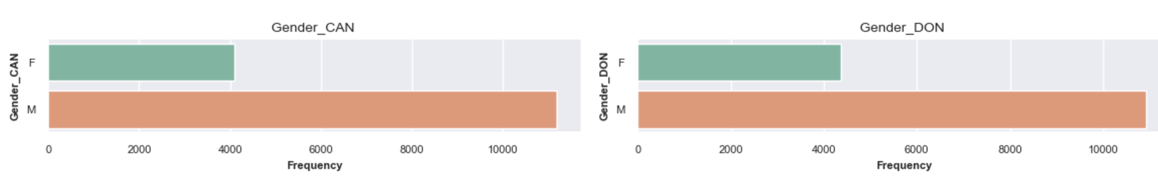
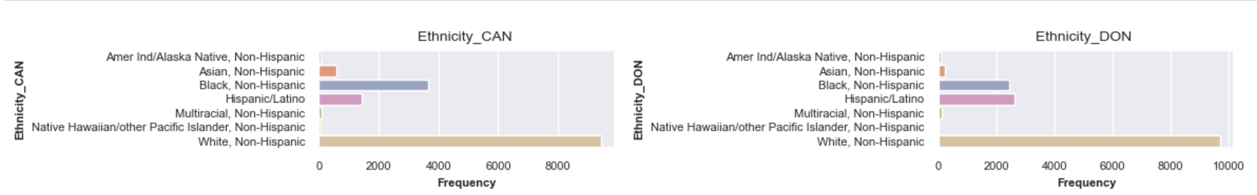
Univariate Plots for Gender & Ethnicity
CAN: Candidate
DON: Donor
The gender distribution in Gender_CAN and Gender_DON is similar, with about 70% males and 30% females. This indicates a consistent demographic pattern across candidates and donors, suggesting that males have a higher frequency of heart transplants in the UNOS dataset.
Ethnicity_CAN is predominantly White and non-Hispanic, followed by Black, non-Hispanic, and Hispanic/Latino, with smaller proportions of other ethnicities. In contrast, Ethnicity_DON shows higher proportions of Hispanic/Latino and Black, non-Hispanic individuals, while other ethnicities are less represented, highlighting demographic differences between recipients and donors.

Slide 7
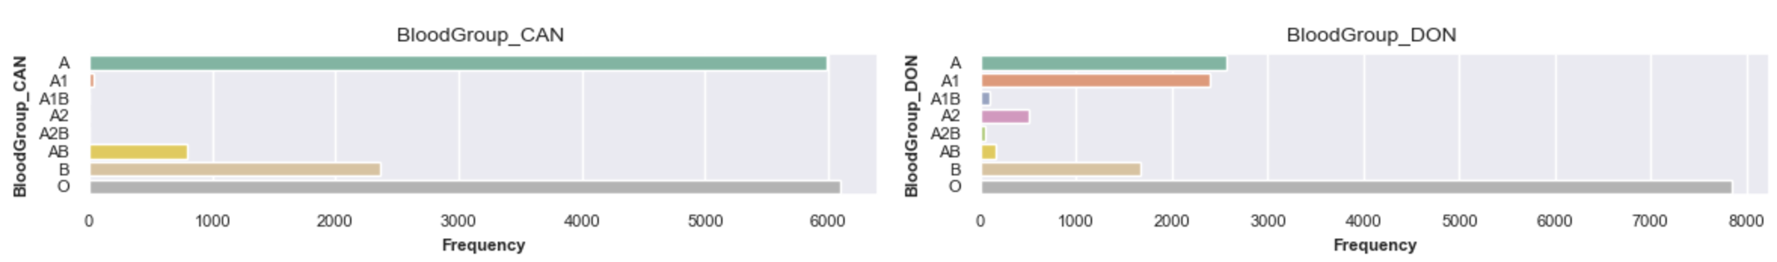
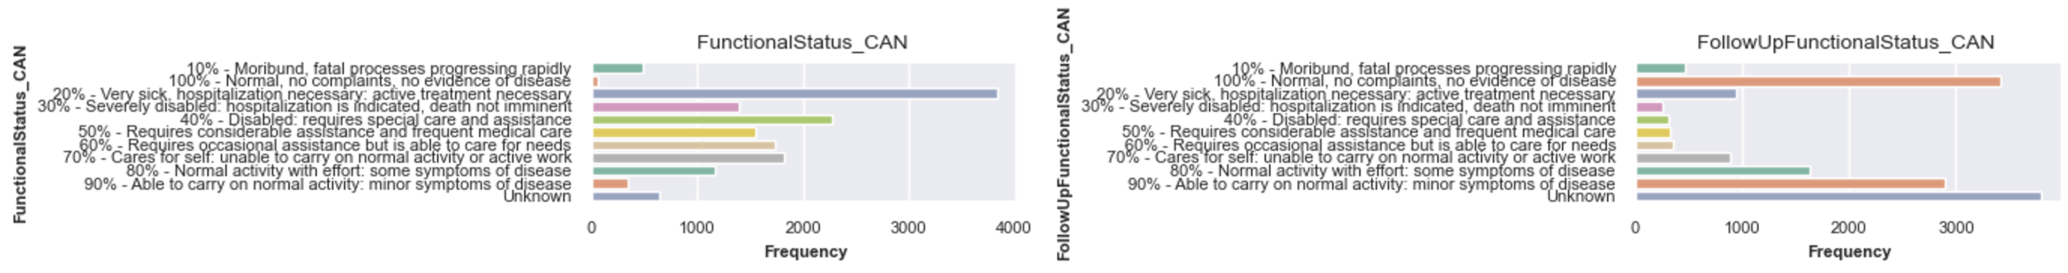
Blood Type & Functional Status
CAN: Candidate
DON: Donor
A1, A2, A1B, and A2B are subtypes of the ABO blood group system. A1 and A2 are subtypes of blood group A, while A1B and A2B are subtypes of blood group AB. The distinction lies in the density of A antigens on red blood cells, with A1 and A1B having more antigens than A2 and A2B. These subtypes can be clinically relevant, especially in transfusions, as individuals with the A2 or A2B subtype may produce anti-A1 antibodies.
Blood group O is the most prevalent in both datasets, but it is more dominant in BloodGroup_DON. Blood group A is the second most common in both, but its proportion is significantly higher in BloodGroup_CAN.
FunctionalStatus_CAN indicates a higher prevalence of severe health conditions than FollowUpFunctionalStatus_CAN, where many individuals are in better health or have unknown status.

Slide 8
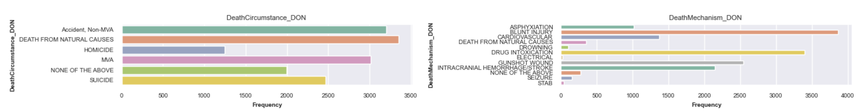
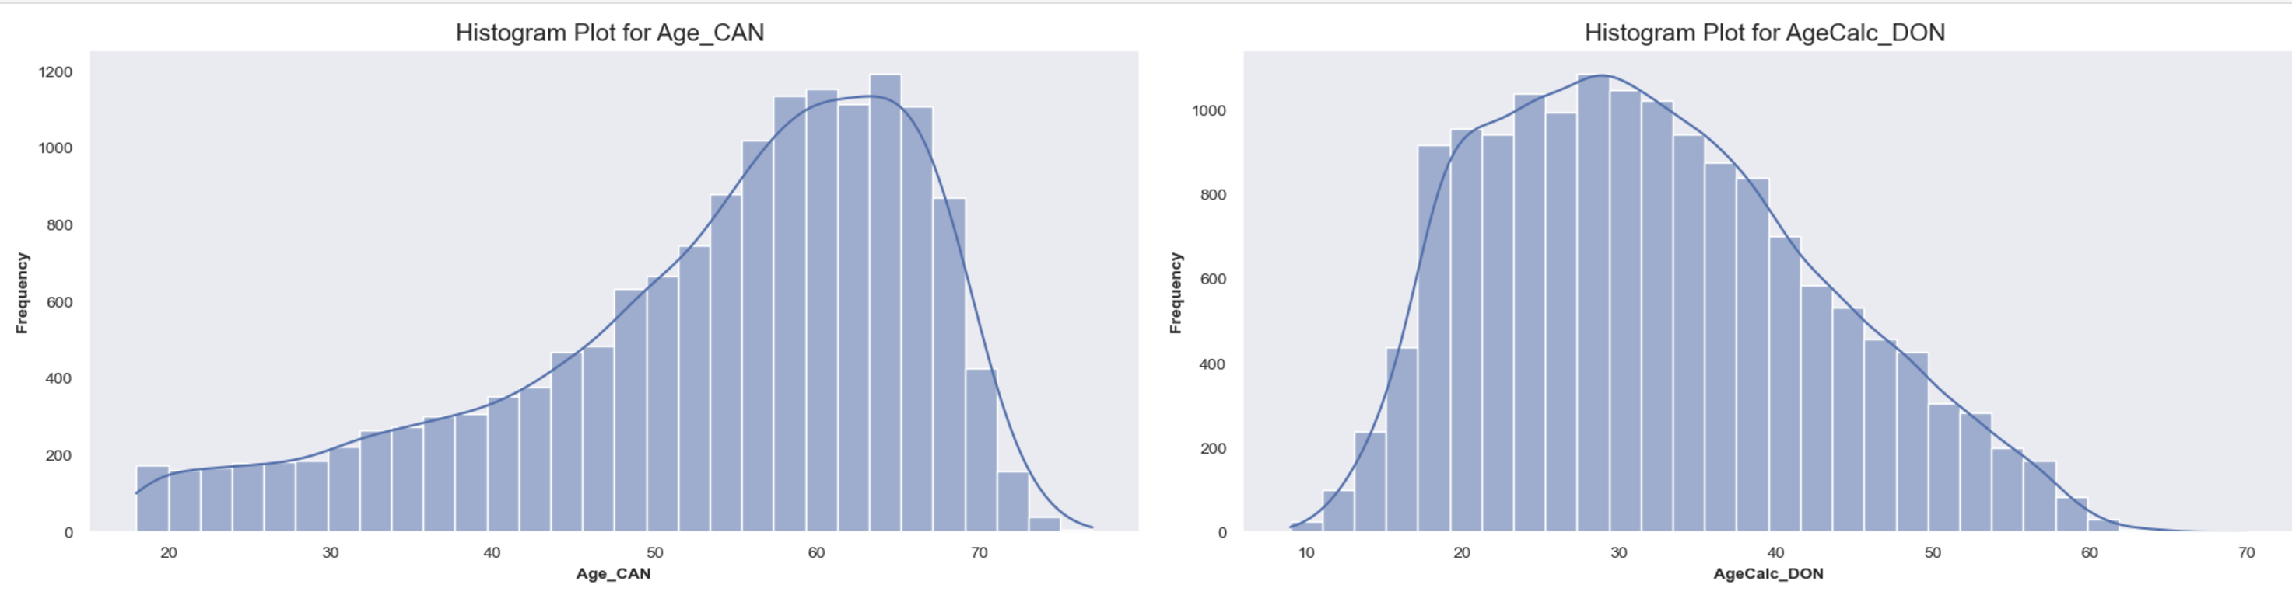
Death Circumstance/Mechanism & Age
CAN: Candidate
DON: Donor
The most common death circumstances are natural causes, non-motor vehicle accidents, and motor vehicle accidents, with natural causes being the most frequent. In terms of death mechanisms, blunt injury and drug intoxication are the leading causes, followed by gunshot wounds and intracranial hemorrhage/stroke.
The histogram indicates that the Age_CAN group is generally older than the AgeCalc_DON group, which has a younger age distribution.

Slide 9
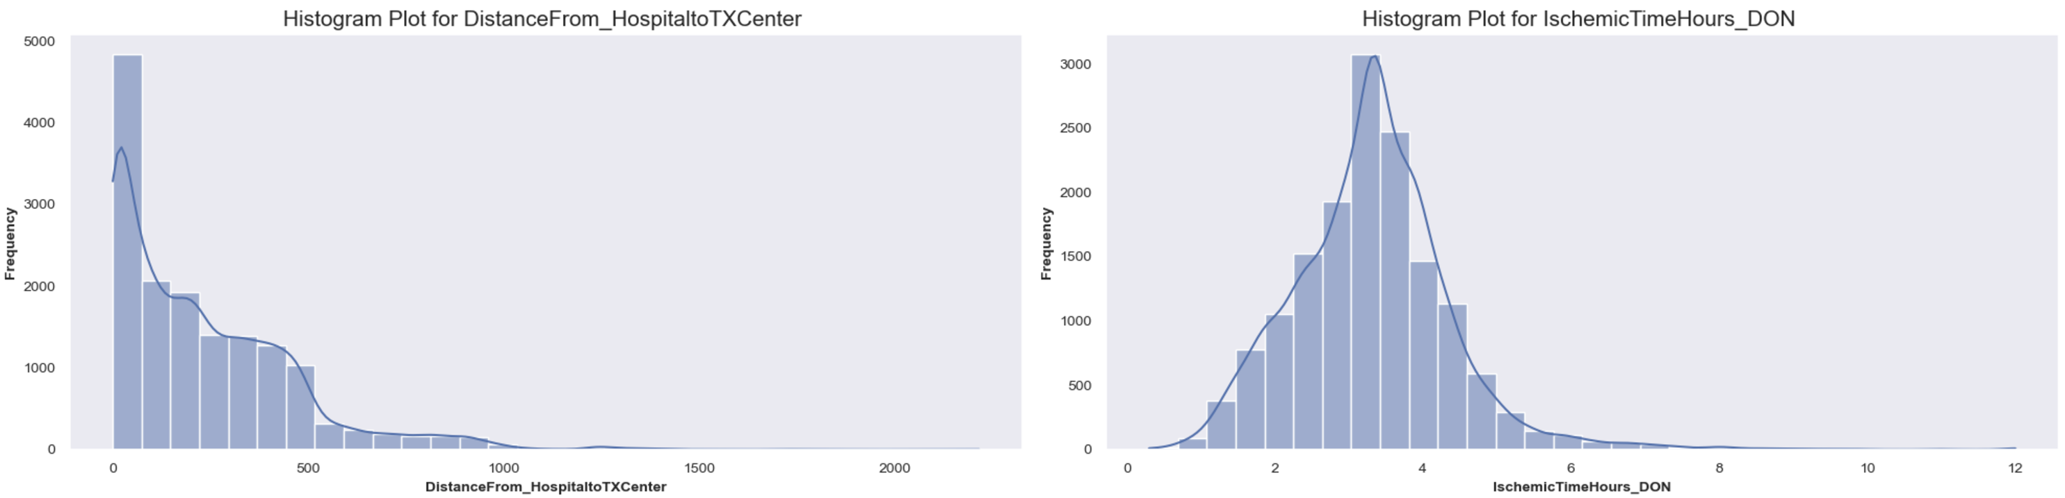
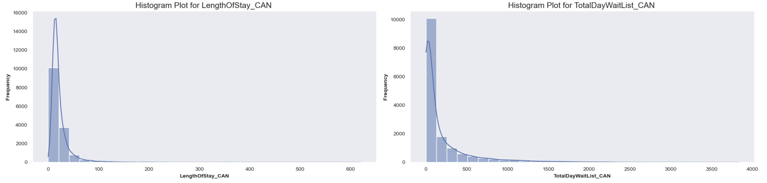
Patient’s Experience
CAN: Candidate
DON: Donor
DistanceFrom_HospitaltoTXCenter: The average distance from the hospital to the transplant center is roughly 200 miles, ranging from 0 to over 2,000, indicating significant distance variability.
IschemicTimeHours_DON: The average ischemic time is around 3 hours, with most values falling between 2 and 4 hours and a maximum of 12 hours.
LengthOfStay_CAN: The average length of stay is around 20 days, with a wide range from 0 to over 600 days, suggesting some patients have extended hospital stays.
TotalDayWaitList_CAN: The average number of days on the waitlist is around 200, with a significant standard deviation indicating that some patients wait much longer than others, up to a maximum of over 3,000 days.
These plots provide an overview of the dataset's variability and central tendencies, highlighting patients' diverse experiences in terms of distance traveled, ischemic time, hospital stay, and waitlist duration.
Note: Ischemic time is the amount of time an organ or tissue is deprived of blood supply

Slide 10
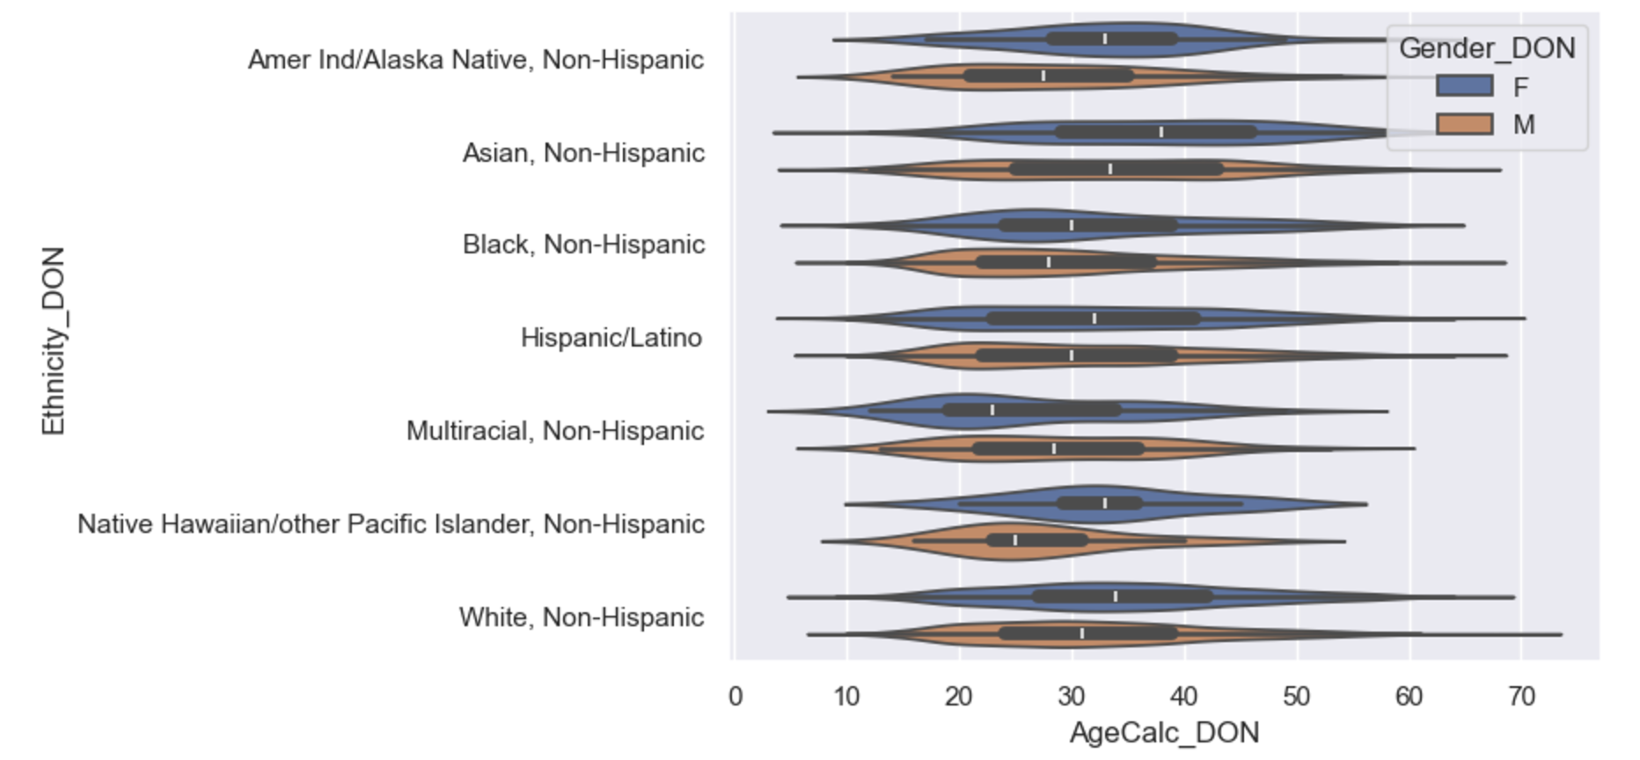
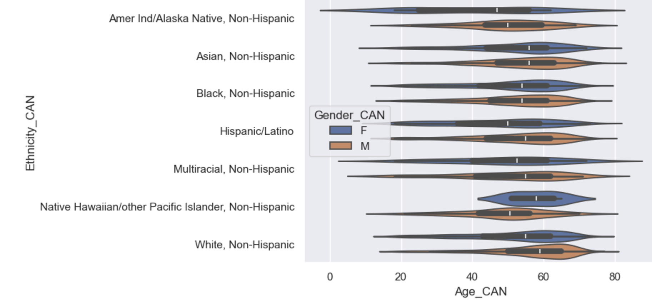
Multivariate Plots: Ethnicity & Age & Gender
CAN: Candidate
DON: Donor
An analysis of donor demographics across various ethnicities uncovers notable gender and age disparities in organ donation patterns. The data reveals that female donors, on average, are older than their male counterparts across all ethnic groups, highlighting a consistent gender-based difference in donation age. Among female donors, those identified as multiracial and non-Hispanic exhibit the lowest average age. This intriguing finding suggests that younger women from mixed ethnic backgrounds may be more likely to become organ donors than other demographic groups in the UNOS dataset.
An analysis of candidate demographics across various ethnicities in the UNOS dataset reveals notable gender and age disparities in organ recipient patterns. The data shows that male recipients are generally older than female recipients across all ethnic groups, indicating a consistent gender-based age difference. Among female recipients, those identified as Native Hawaiian/Other Pacific Islanders and non-Hispanic have the highest average age, suggesting that older women from these backgrounds are more likely to become organ recipients compared to other demographic groups.

Slide 11
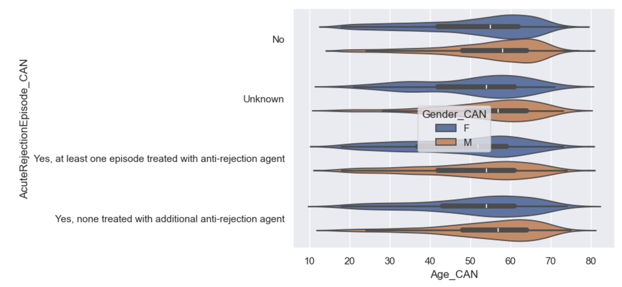
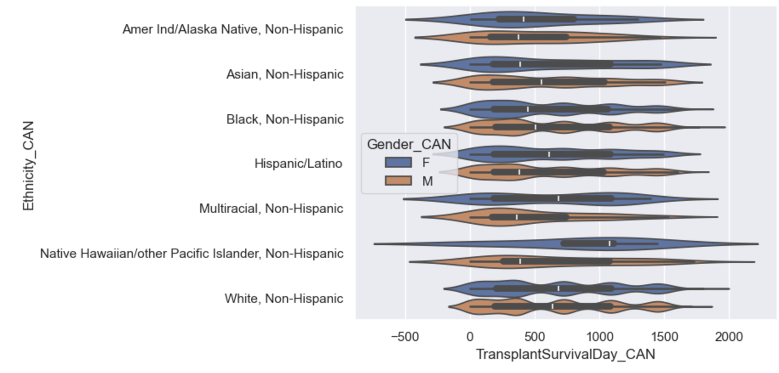
Multivariate Plots: Ethnicity & Age & Gender
CAN: Candidate
DON: Donor
An analysis of AcuteRejectionEpisode_CAN data reveals a gender disparity in heart transplant rejection rates, with males demonstrating a higher propensity for acute rejection episodes in their 60s compared to females in their late 50s. This trend suggests that gender may be a factor in post-transplant outcomes.
An analysis of the TransplantSurvivalDay_CAN data reveals a gender disparity in heart transplant survival, with females showing a higher mean survival duration across most ethnic groups. Exceptions to this trend include Asian, non-Hispanic, Black, and non-Hispanic populations, where males exhibit comparable or slightly better survival outcomes. Interestingly, a higher density of data points for Asian, Non-Hispanic, Black, Non-Hispanic, Hispanic/Latino, and White, Non-Hispanic groups is observed below the 500-day mark, indicating shorter survival times for a significant portion of these populations. This pattern highlights potential disparities that warrant further investigation into the interplay of gender, ethnicity, and other contributing factors in transplant outcomes.

Slide 12
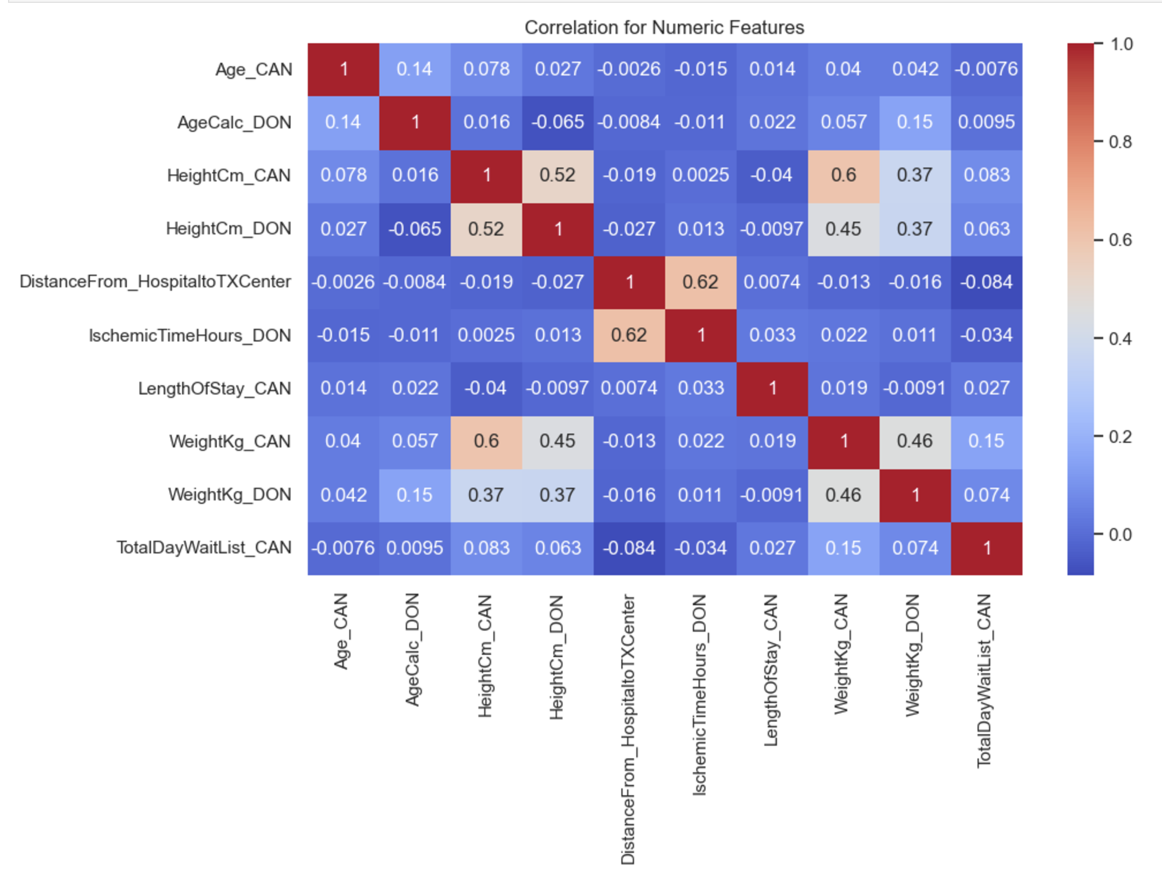
Correlation Heatmap
CAN: Candidate
DON: Donor
HeightCm_CAN and HeightCm_DON: A positive correlation (0.524) indicates that the heights recorded in CAN and DON datasets are related.
DistanceFrom_HospitaltoTXCenter and IschemicTimeHours_DON: A positive correlation (0.617) suggests that longer distances from the hospital to the transplant center are associated with longer ischemic times.
HeightCm_CAN and WeightKg_CAN: There is a moderate positive correlation (0.599), indicating that taller individuals tend to weigh more.
HeightCm_DON and WeightKg_CAN: There is a positive correlation (0.446), showing a similar trend in the DON dataset.
WeightKg_CAN and WeightKg_DON: There is a positive correlation (0.456), suggesting consistency in weight measurements between the two datasets.
The Heatmap highlights moderately strong correlations between height and weight, distance, and ischemic time. Most other variables show weak or negligible correlations.

Slide 13
Data Wrangling
Remove & Consolidate & Engineer Additional Features
Age/Creatinine/ for Donor & Candidate
Difference/Addition/Ratio/Mean
Consolidate Categories
Cancer for Donor/Life Support for Candidate
Engineer new binary feature
Remove Cancer Site/Extracanial/Intracranial/History/Skin
Candidate with any life support into a new single binary feature.
Hemodynamics & Inotropic and Vasodilator & etc.
Chi2/Cramer's V score statistics test for categorical features to determine the association between categories before consolidating features
Consolidate features that contain prior Heart transplantation & remove any measurements taken after the surgery
Numeric Categories (Nominal/Ordinal)
Transform features into description using Data Dictionary excel from optn-star-files-data-dictionary.xlsx

Slide 14
Additional Data Cleaning Cont…
Additional Data wrangling
Remove Unwanted Features
PrimaryPaymentSource/WorkIncome/TransplantState/ResidencyState/etc.
OtherMedsText1/OtherMedsText2/OtherMedsText3/VentricularDeviceType/etc.
BMI/PreviousTransplantAnyOrgan & PreviousTransplantSameOrgan
Categorizing features
PanelReactiveAntibody
CPRA values typically range from 0% to 100%
Remove After & Labels
FollowUpFunctionalStatus/AcuteRejectionEpisode/StrokePostTransplant/etc.
Consolidate Categories
Diagnosis Codes/Prior Cardiac Surgery Type
Consolidate different types Codes
Reduce the number of categories
Remove Unknown Features & NaNs
DAYS_STAT1A/DAYS_STATA4/DAYS_STATA3/etc.
Total of 14,856 records and 113 features
Note: Hypothesis testing using Chi-square statistic and calculating Cramer's V to build consensus for the categorical variables while consolidating categorical variables

Slide 15
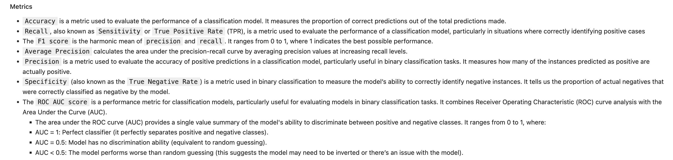
Machine Learning
Random Forest/Balanced Random Forest/Logistic Regression/XGBoost
Techniques employed
Grid Search
Cross-Validation (CV)
Bayesian Optimization
Label: GraftFailed_CAN
Binary Feature

Slide 16
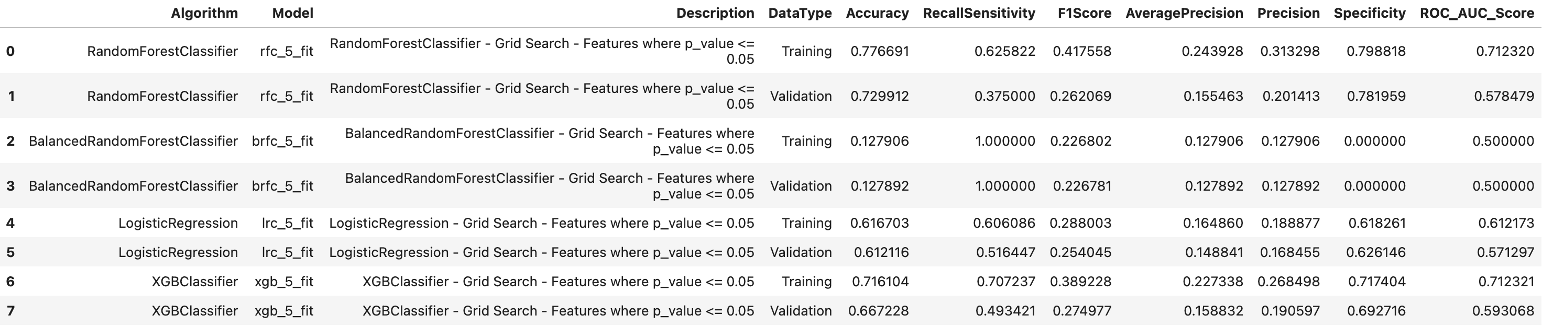
Machine Learning
Random Forest/Balanced Random Forest/Logistic Regression/XGBoost
Four machine learning models were evaluated on a dataset using features selected by SelectKBest (p-values ≤ 0.05) with Grid Search:
RandomForestClassifier: Highest accuracy but significant recall drop in validation.
BalancedRandomForestClassifier: Perfect recall but extremely low accuracy and specificity, indicating failure to learn.
LogisticRegression: Consistent moderate performance across training and validation.
XGBClassifier: Second-highest accuracy with balanced performance across metrics.
While RandomForestClassifier achieved the highest accuracy, XGBClassifier demonstrated the most robust and balanced performance, suggesting it's the most reliable model for this dataset and feature selection. A total of 44 features were selected.

Slide 17
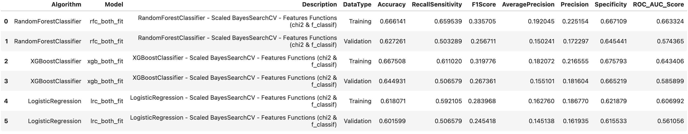
Machine Learning
Random Forest/Logistic Regression/XGBoost
Three machine learning models were evaluated on a dataset using features selected by SelectKBest using f_classif for numeric features and chi2 function for categorical features where p_value > 0.05 with Bayesian Optimization:
The performance metrics of the models using Scaled BayesSearchCV and feature selection (chi2 & f_classif) highlight varying levels of effectiveness. The RandomForestClassifier achieves moderate performance, with a training accuracy of 0.666 and validation accuracy of 0.627. However, its recall, F1 score, and ROC AUC score decrease significantly during validation, indicating overfitting and a challenge in maintaining accuracy on new data. Despite identifying true positives effectively during training, its generalization ability is limited.
The XGBoostClassifier slightly outperforms the RandomForestClassifier, achieving a validation accuracy of 0.645 and maintaining a more balanced recall, F1 score, and ROC AUC across training and validation datasets. Although its performance also drops from training to validation, the decline is less pronounced, indicating better generalization capabilities. This makes it more reliable for datasets with feature selection.
The LogisticRegression model lags behind the other two models, with the lowest validation accuracy (0.602) and weak performance across all metrics, including recall, F1 score, and ROC AUC. Its limited ability to distinguish between classes and its sharp decline in performance on new data make it less suitable for this dataset. Among the models, XGBoostClassifier demonstrates the most balanced and consistent performance, making it the preferred choice for this dataset.

Slide 18
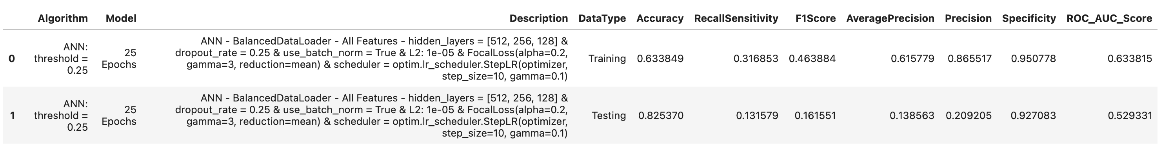
Machine Learning
Artificial Neural Network(ANN)
PyTorch
The WeightedRandomSampler in PyTorch utility was used to handle imbalanced datasets
Encode and MinMax Scale dataset
Batch size = 32 & Hidden Layers = [512, 256, 128] & Dropout Rate = 0.25 & Batch Normalization & L2 Regularization & criterion = FocalLoss() & classification threshold value of 0.25
(network): Sequential( (0): Linear(in_features=204, out_features=512, bias=True) (1): BatchNorm1d(512, eps=1e-05, momentum=0.1, affine=True, track_running_stats=True) (2): ReLU() (3): Dropout(p=0.25, inplace=False) (4): Linear(in_features=512, out_features=256, bias=True) (5): BatchNorm1d(256, eps=1e-05, momentum=0.1, affine=True, track_running_stats=True) (6): ReLU() (7): Dropout(p=0.25, inplace=False) (8): Linear(in_features=256, out_features=128, bias=True) (9): BatchNorm1d(128, eps=1e-05, momentum=0.1, affine=True, track_running_stats=True) (10): ReLU() (11): Dropout(p=0.25, inplace=False) (12): Linear(in_features=128, out_features=1, bias=True) (13): Sigmoid() ) )

Slide 19
Recurring Important Features
Important Features
Random Forest/XGBoost
From the algorithms above, the discovery of import features for classification models:
TotalBilirubin_Addition
TotalDayWaitList_CAN
HeightCm_Difference
Creatinine_Difference
DistanceFrom_HospitaltoTXCenter
IschemicTimeHours_DON
Transfusion_CAN_Y
Diabetes_CAN_Yes
MismatchLevel_LOCUS
PriorCardiacSurgery_CAN_Y
Note: The above features consistently play a significant role across various classification models, although not in a specific order of importance. This recurring theme suggests these features are crucial for the model's predictive performance. Their consistent presence across different algorithms highlights their relevance in capturing the underlying patterns within the dataset, making them essential for achieving accurate classification results.

Slide 20
Survival Analysis
Survival Analysis
RandomSurvivalForest/ GradientBoostingSurvivalAnalysis/CoxPHSurvivalAnalysis
Currently, the focus is on analyzing survival data using three advanced algorithms: Random Survival Forests (RSF), Gradient Boosting Survival Analysis, and Cox Proportional Hazards (CoxPH) Survival Analysis for TransplantStatus_CAN & TransplantSurvivalDay_CAN.
Random Survival Forests (RSF): This ensemble method extends traditional random forests to handle right-censored survival data. RSF builds multiple survival trees using bootstrapped samples and random feature selection at each node, which enhances model robustness and reduces overfitting. The main output is an ensemble cumulative hazard function, providing a non-parametric estimation of survival probabilities without assuming proportional hazards.
Gradient Boosting Survival Analysis: This approach applies the principles of gradient boosting to survival data, focusing on minimizing prediction errors through iterative improvements. It is beneficial for handling complex datasets with non-linear relationships and interactions among variables. Gradient boosting offers flexibility in model tuning and can effectively manage high-dimensional data.
Cox Proportional Hazards Model (CoxPH): A semi-parametric model commonly used in survival analysis, CoxPH assesses the impact of covariates on the hazard rate while assuming proportional hazards over time. It provides interpretable coefficients that indicate the relative risk associated with each predictor, making it a valuable tool for understanding the influence of variables on survival outcomes.
These algorithms offer complementary strengths for survival analysis, allowing for a comprehensive evaluation of time-to-event data by leveraging both parametric and non-parametric methods.

Slide 21
Future Work
Feature Engineering:
Feature engineering leverages the insights from important features to refine existing ones or create new ones. By enhancing feature quality and introducing meaningful variables, models can capture deeper patterns, improve predictive accuracy, and generalize better.
SHAP/Permutation Importance to identify high-impact features
Clustering:
Cluster Candidates & Donors
Clustering Candidates and Donors involves segmenting individuals based on their similarities across key characteristics to derive insights that can improve decision-making in organ transplantation.
By grouping candidates and donors, healthcare providers can identify patterns and trends, optimize matching processes, and enhance fairness and efficiency in organ allocation.
Linear Regression:
Predicting the Length of Stay at the hospital following a heart transplantation is a crucial task for optimizing healthcare resource allocation and improving patient outcomes.
Techniques such as regression analysis, tree-based models, or neural networks can be applied to achieve accurate forecasts.

Slide 22
References:
Heart Transplant Outcome Prediction using UNOS Data
Predictive Abilities of Machine Learning Techniques May Be Limited by Dataset Characteristics
Personalized Donor-Recipient Matching for Organ Transplantation
Thoracic organ transplantation
What Predicts Long-Term Survival After Heart Transplantation?
Temporal shift and predictive performance of machine learning for heart transplant outcomes

