Slide 1
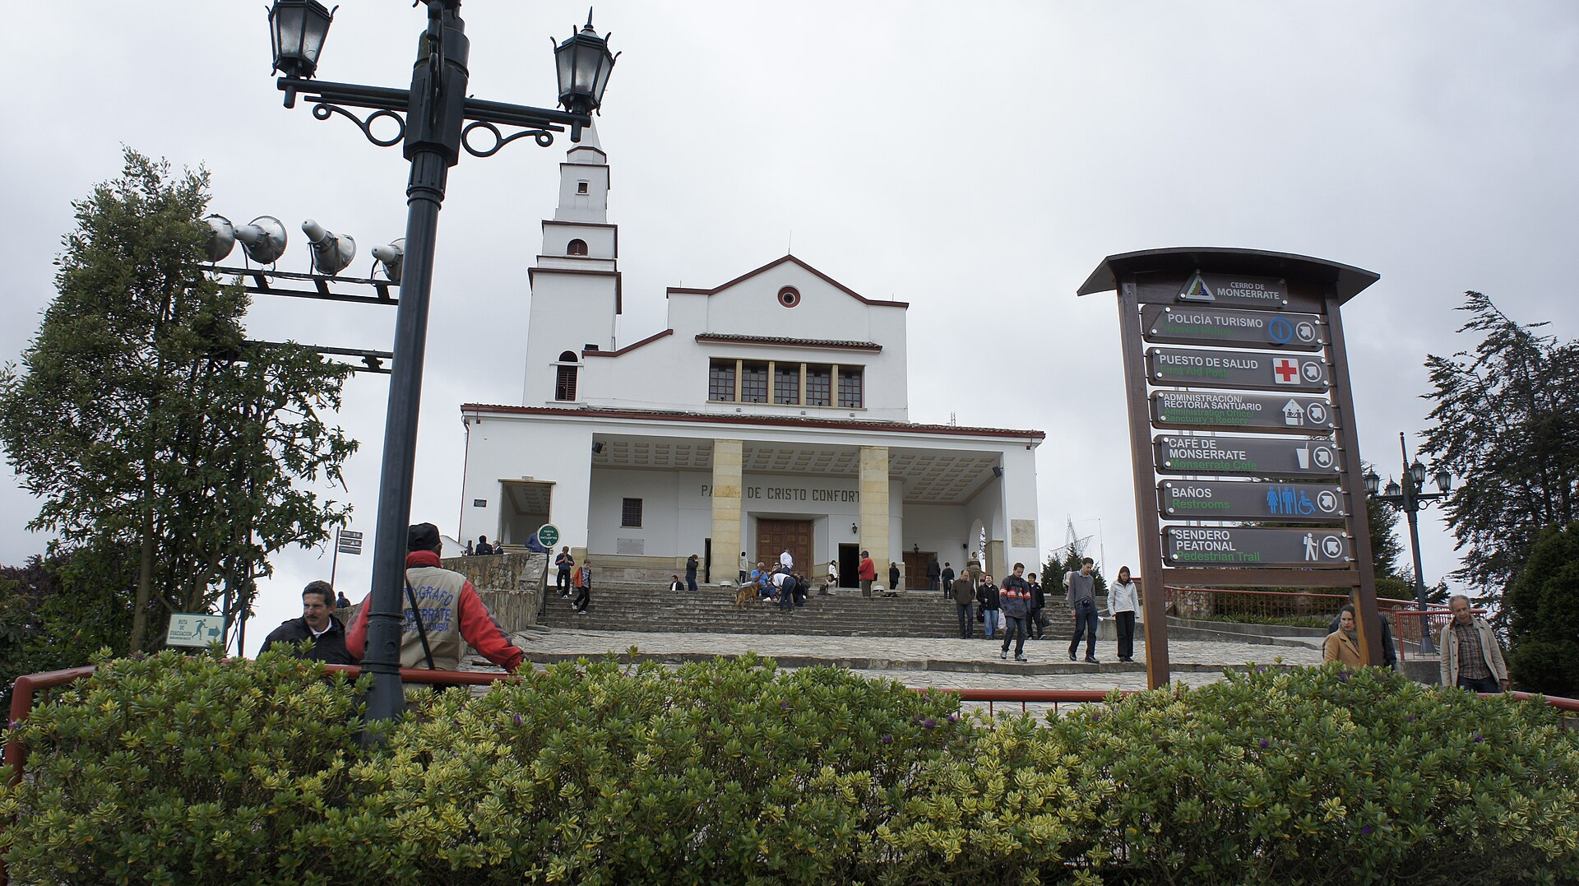
SENA · ENGLISH PRESENTATION
MONSERRATE
Bogotá from the Sky
A tourist site where nature, culture, religion, and city life meet.
Jhon Steven Alvarez Ruiz
GA2-240202501-AA2-EV02
BOGOTÁ FROM THE SKY

Slide 2
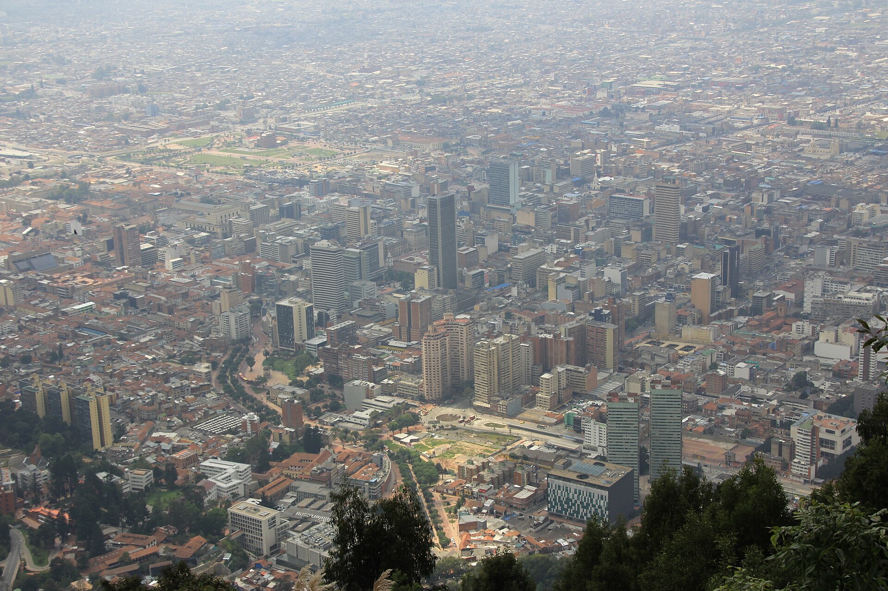
01 · WHERE IS IT?
Location and Access
EASTERN HILLS
Santa Fe · Bogotá · Colombia
3,152 m
ABOVE SEA LEVEL
CABLE CAR
FUNICULAR
WALKING TRAIL
Near Bogotá’s historic city center
A VIEW OVER THE CAPITAL
GA2-240202501-AA2-EV02 · JHON STEVEN ALVAREZ RUIZ
02 / 08

Slide 3
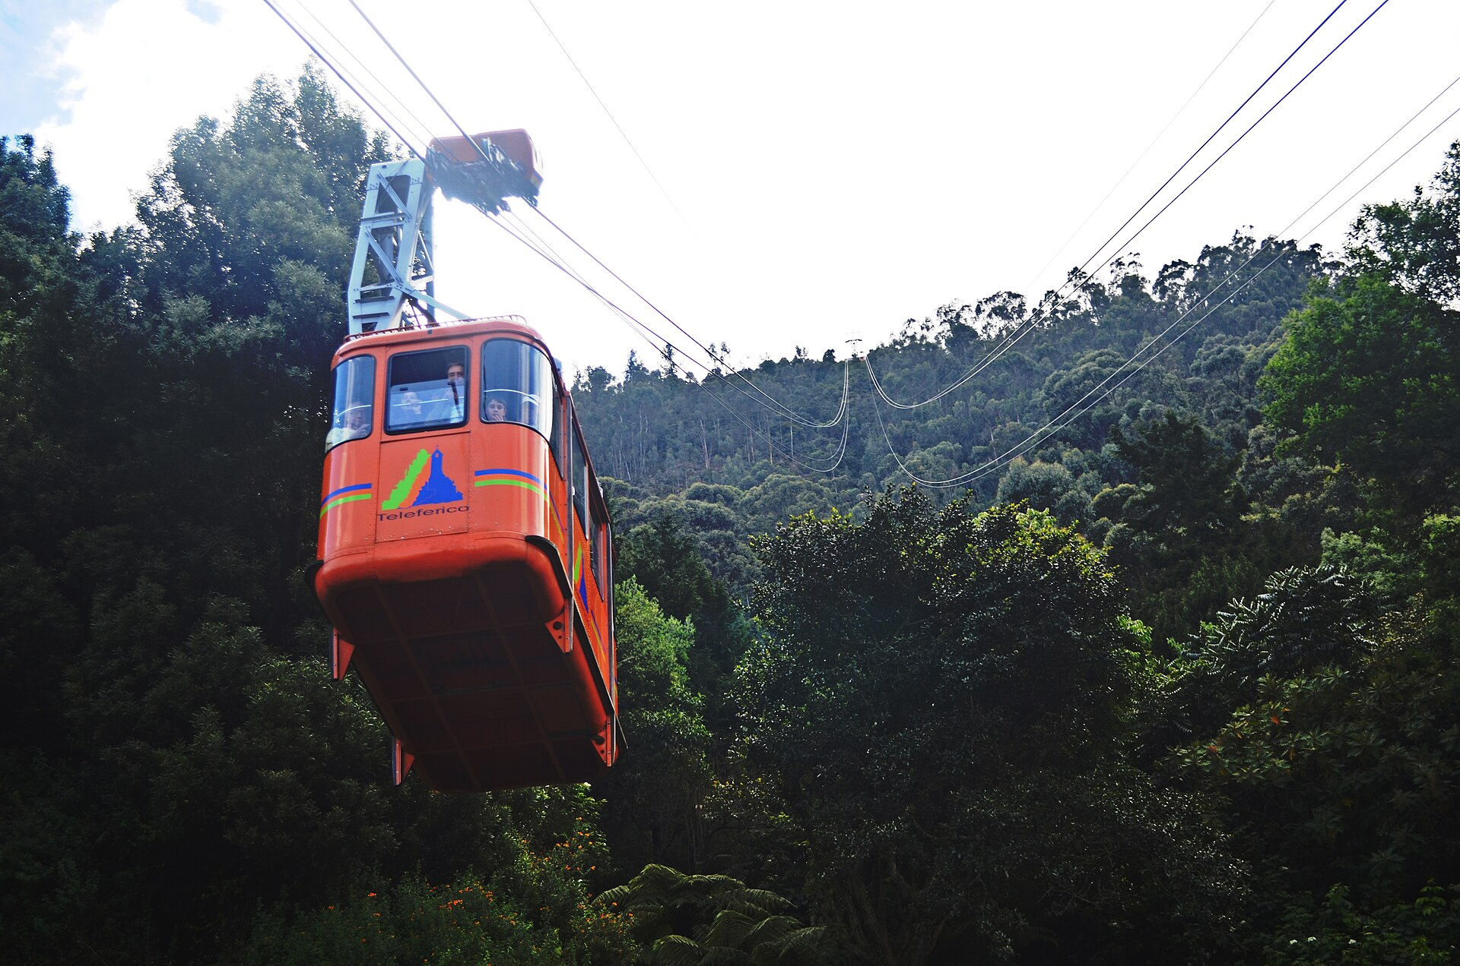
02 · WHAT CAN VISITORS FIND?
Main Elements
01
Basilica of the Fallen Lord
02
Way of the Cross
03
Panoramic viewpoints
04
Cable car and funicular
05
High Andean forest
06
Restaurants and local food
RELIGIOUS · CULTURAL · URBAN · NATURAL
GA2-240202501-AA2-EV02 · JHON STEVEN ALVAREZ RUIZ
03 / 08

Slide 4
03 · WHAT IS IT LIKE?
Description of the Place
HIGH · GREEN · STEEP
the mountain
COOL · CHANGEABLE
the weather
WIDE · IMPRESSIVE
the city view
CALM · RESPECTFUL
inside the basilica
NATURE · CULTURE · RELIGION · CITY
GA2-240202501-AA2-EV02 · JHON STEVEN ALVAREZ RUIZ
04 / 08

Slide 5
04 · WHAT CAN PEOPLE DO?
Activities
01
Take panoramic photographs
02
Visit the sanctuary
03
Ride the cable car or funicular
04
Hike 2.35 km and 1,605 steps
05
Try Colombian food and coffee
06
Observe birds on the Paramuno Trail
GA2-240202501-AA2-EV02 · JHON STEVEN ALVAREZ RUIZ
05 / 08

Slide 6
05 · A PERSONAL POINT OF VIEW
My Opinion
“
In my opinion, Monserrate is one of Bogotá’s most complete attractions.
My favorite feature: the panoramic view
Nature + City + Tradition
For families, friends, and tourists
GA2-240202501-AA2-EV02 · JHON STEVEN ALVAREZ RUIZ
06 / 08

Slide 7
06 · BEFORE YOU GO
Recommendations
01
Check the official opening hours
02
Wear comfortable shoes
03
Bring water, sunscreen, and a rain jacket
04
Walk slowly because of the altitude
05
Use official routes and follow instructions
06
Keep the place clean and respect worshipers
CHECK OFFICIAL HOURS BEFORE YOU GO
GA2-240202501-AA2-EV02 · JHON STEVEN ALVAREZ RUIZ
07 / 08

Slide 8
CONCLUSION
MONSERRATE
connects Bogotá with nature, culture, and tradition.
THANK YOU FOR WATCHING
Jhon Steven Alvarez Ruiz
FACTS AND VISITOR INFORMATION
IMAGE CREDITS · CC BY-SA 3.0
Visit Bogotá · Cerro de Monserrate · IDRD
Jimmy Gómez N · Javadumper · diego_cue / Wikimedia Commons
GA2-240202501-AA2-EV02
08 / 08

