Slide 1
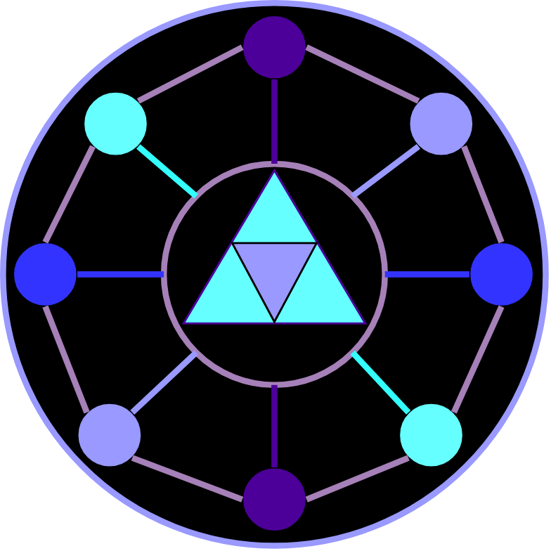
Nightwatcher Solution Overview
Some quick overview about this solution
01 November 2026 A.D
21 Jomada Al Oula 1448 H.D
ELEMIAGUARD

Slide 2
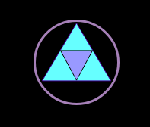
Topics to be covered
ELEMIAGUARD
Overview of Work
Our Modules
The Architectural Layers
Application & Modules Division
Services Workflow in Terms of Layers
Important Notes
More Information

Slide 3
Overview of Work
ELEMIAGUARD
Elemia GUARD Nightwatcher is a web application that provides the manager of one or more GUARD appliances all the information needed to monitor these appliances.
The main work of Nightwatcher is to monitor the status and the data of every GUARD solution instance.
It takes the information coming from a GUARD instance, reformatting it, and displays it in real-time frontend interface.

Slide 4
Our Modules
ELEMIAGUARD
The program is consisting mainly of six modules:
1- Telemetry: The part that is responsible for showing the data and instances in the frontend.
2- System Status Manager: Displays the status of the program employed and monitored by Nightwatcher.
3- Event & Alert Engine: Displays the info, warnings and errors coming from Nightwatcher itself.
4- History Data Engine: Responsible for putting and extracting the information about past numbers captured before using Nightwatcher.
5- API & Interfaces Orchestrator: Orchestrates between the data coming from the services/programs.
6- Identity & Access Control: Manages all the authentication and authorization of the Nightwatcher application (like Login, and some telemetry restrictions).

Slide 5
The Architectural Layers
ELEMIAGUARD
The architectural layer of any web application are as the following in a top-down manner:-
Presentation layer: The frontend webpage and the backend server that receives the HTTP request.
Application Layer: The backend server sees which application will proceed with this request.
Business Logic Layer: The usual work of an application
Data Access Layer: When the application interacts with a database or any read-write file or external application.
Infrastructure Layer: The operating system that works in the background to deploy this server.
One of the reasons of introducing these layers is mainly for web application problems troubleshooting.
Presentation Layer
Application Layer
Business Logic Layer
Data Access Layer
Infrastructure Layer

Slide 6
Application & Modules Division
ELEMIAGUARD
As a convention, every module is divided into some services.
Service
Module
Application
Service
Module
Service
Service

Slide 7
Additional Notes
ELEMIAGUARD
The module is the logical part of the piece of work. In other words, dividing the application into some parts and working on every part individually.
The service is the applied piece of code in order to make something achievable for a program.
A composition relationship between the service and modules is existing where the module is composing some services as illustrated in the previous slide.
The team leader is responsible for creating the services during the development of every module.

Slide 8
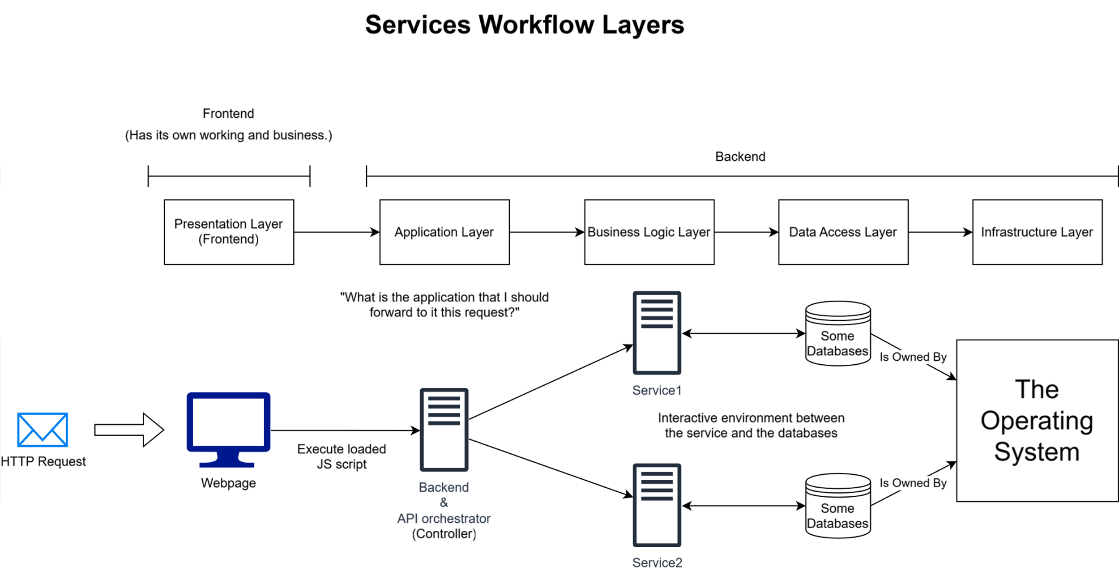
Services Workflow in Terms of Layers
ELEMIAGUARD
A Draw IO image that illustrates this workflow (taken from the file itself.)

Slide 9
Important Notes
ELEMIAGUARD
You are free to use any technology you want, whether when we are talking about Application, Presentation, Business, Infrastructure or Data Access layers.
But, the technology of exchanging the data between the telemetry and backend is fixed which is WebSocket.
All the services can be inside only one server.
The distribution between the orchestrators and services are the responsibilities of the team leader.

Slide 10
More Information?
ELEMIAGUARD
The presentation is made for not confusing someone about the direct roadmap of the development process, not to show all the requirements and the whole diagrams until the end.
You can locate other info from the Draw IO file sent with the other materials of the project.
The Important diagrams inside the file to be seen:-
The Class Model
The Frontend Webpages external form
The GitHub directory mapping

Slide 11
Thank You!
We hope you happy development process ☺.
ELEMIAGUARD

