Slide 1
Serverless Hands-on
Cutting the Edge in 2 Hours

Slide 2
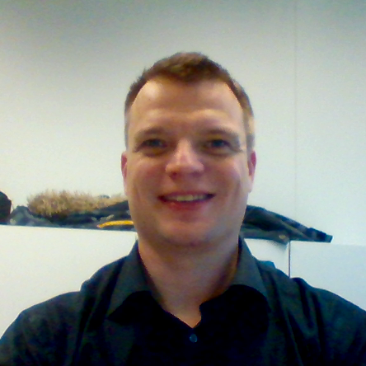
ILKKA ANTTONEN / ACCENTURE
Senior Technology Architect
Emerging Technologies Nordic Lead
Helsinki Liquid Studio CTO
Nordics Serverless Lead
Mail: ilkka.anttonen@accenture.com
Blog: http://sirile.github.io
Twitter: IlkkaAnttonen

Slide 3
AGENDA
10.00 Introductions and start the set-up of prerequisites
10.05 Presentation: Serverless – What and Why
10.10 Hands-on assignment introduction
10.15 Tooling set-up and self-paced work
10.40 Coffee break (possible to work through)
11.00 Check-point and second part
11.35 Wrap-up
11.40 Lunch

Slide 4
Set-up the Prerequisites
https://github.com/SirIle/tad2017

Slide 5
Presentation: Serverless
What and Why

Slide 6
The What (of Serverless)
Name is confusing - it’s both a philosophy and a framework
Virtual Machines => Containers => Functions (or Nanoservices?)
OS + Middleware + Service => Middleware + Service => Service
Everyone is jumping aboard
AWS has Lambdas
Google has Cloud Functions
Azure has Functions
Different events can trigger (http, batch, S3, messages, ..)
Currently there are limitations like maximum running time
DevOps is finally catching up (especially Serverless-framework)

Slide 7
The Why (of Serverless)
Who (really) wants to care about servers and instances?
SLAs are handled by “someone else”
“Unlimited” scaling
You only pay for function/service invocations (the CPU-time they take), not even for server time let alone server instances
Extremely well suited for Microservices architecture

Slide 8
High Level Architecture Example

Slide 9
Hands-on Assignment Introduction

Slide 10
Capabilities implemented during the exercise
EcmaScript 2017 supported by Babel
Offline development capability
WebPack based compressed and minified executable
Mocha and Chai based tests
Linting using ESLint and AirBnB rules
JSBeautify configured to create AirBnB linting compatible format
Fast feedback cycle is the key to developer happiness!

Slide 11
Work Time!
If you get stuck, ask Joonas, Klaus or Ilkka

Slide 12
Check-Point and Second Part
https://github.com/SirIle/tad2017/tree/second-part
(switch to “second-part” branch)

Slide 13
Wrap Up
From zero to production capable in a few hours

Slide 14
Thanks for Participating!

